Slide 1

CEOS Disaster Risk Management Flood Pilot Status and Plans
Presented at the CEOS Disasters Working Group Meeting #5 in Bonn, Germany
Co-Lead Stu Frye (stuart.frye@nasa.gov)
Co-Lead Bob Kuligowski (bob.kuligowski@noaa.gov)
NASA DisWG Rep David Green (david.s.green@nasa.gov)
6-8 September 2016

Slide 2
Outline
Flood Pilot overview
Status of data acquisition and exploitation
Pilot status report:
  Objective A: Global component status
  Objective B: Regional component status
    Caribbean/Central America
    Southern Africa
    Southeast Asia
    Special event: Mississippi River (US)
  Objective C: Capacity Building
Issues and Risk Management

Slide 3
CEOS DRM Flood Pilot Overview
Goal: demonstrate effective application of EO to the full cycle of flood management at all scales by:
  Objective A: Integrating information from existing NRT global flood monitoring / modeling systems into a Global Flood Dashboard;
  Objective B: Delivering EO-based flood mitigation, warning, and response products and services through regional end-to-end pilots in:
    Caribbean/Central America (focus on Haiti)
    Southern Africa (inc. Namibia, South Africa, Zambia, Zimbabwe, Mozambique, and Malawi);
    Southeast Asia (focus on lower Mekong Basin and Java)
  Objective C: Encouraging at least base-level in-country capacity to access EO and integrate it into their operational systems and flood management practices
3

Slide 4
Data Acquisition Status
Detailed EO Requirements for each Pilot approved at 2013 Plenary; acquisition allocations approved at 2014 Plenary
Individual requests from each Pilot coordinated by co-leads and detailed on consolidated request form
Data distribution co-ordinated by co-leads (the lack of standardized data distribution makes it very labor-intensive)
Mission / Instrument | Repeat or Revisit | Swath Width | Spatial Resolution | Agency | Image Counts
 |  |  |  |  | Annual Quota | Since 3/2016 WGDisasters Meeting | Cumulative Total
Optical - Coarse Resolution (>100 m)
Terra / MODIS | 1 day | 2230 km | 250, 500, 1000 m | NASA
Aqua / MODIS | 1 day | 2230 km | 250, 500, 1000 m | NASA
NPP / VIIRS | 1 day | 3000 km | 375, 750 m | NASA
Optical - Moderate Resolution (10 to 100 m)
Sentinel-2A / MSI | 10 days | 290 km | 10, 20, 60 m | ESA |  | 0 | 0
EO-1 / ALI | 204 days | 185 km | 10, 30 m | NASA | 300 | 11 | 81
Landsat-8 / OLI | 16 days | 185 km | 15, 30 m | USGS |  | 8 | 78
Optical - High Resolution (<10 m)
SPOT (archive only) | 26 days | 60 km | 1.5 and 6 m | CNES |  | 0 | 0
Pleiades | 26 days | 20 km | 50 cm and 2 m | CNES | 50 | 9-12* | 9-12*
L-Band SAR
ALOS-2 / PALSAR-2 | 14 days | 25 to 350 km | 10 to 100 m | JAXA | 100 | 0 | 40
C-Band SAR
Sentinel-1A / SAR | 12 days | 80, 250, 400 km | 9, 20, 50 m | ESA |  | 5 | 52
Sentinel-1B / SAR | 12 days | 80, 250, 400 km | 9, 20, 50 m | ESA |  | 0 | 0
Radarsat-2 / SAR-C | 1-6 days | 50 to 500 km | 8 to 100 m | CSA | 500 (3 yr) | 6 | 123
X-Band SAR
Cosmo Sky-Med / SAR-2000 | 5 days | 10 to 200 km | 1 to 100 m | ASI | 300 | 4 | 107
*includes a set of 4 stripes over Jakarta corresponding to 7-9 individual images
4

Slide 5
Data Acquisition Status
The CEOS Flood Pilot team requested International Disaster Charter data for six events since March:
  Argentina (activation on 7 April)
  Seychelles (19 April)
  Sri Lanka (17 May)
  Bangladesh (25 May)
  Louisiana (14 August)
  India (26 August)
Charter data for the first four events above were already freely available (e.g., NOAA, EUMETSAT, USGS, ESA); Charter data from Louisiana and India is still pending receipt except two images from Venezuela were delivered over Louisiana
  Wide-swath Multispectral Camera (WMC) onboard the Venezuelan Remote Sensing Satellite-1 (VRSS-1) from 17:19:42 to 17:20:09 UTC (camera 1) and from 17:19:48 to 17:20:15 UTC (camera 2) 28 August 2016 including four spectral bands (red, green, blue, and near-IR)

Slide 6
How Data Are Being Exploited
Geographic Area | Product | Value Added Partner
Haiti | Flood extent maps, flood risk maps, landslide maps, flash flood guidance / threat maps, integrated risk assessment platform | SERTIT, CIMA, INGV, Altamira, CIMH, RASOR FP7, NOAA/HRC
Other Caribbean islands, Central America | Flood damage maps, change detection products, co-registered map overlays | CATHALAC, CIMH, NASA/GSFC, RCCP (Costa Rica)
Namibia | Flood extent maps, flood warning products, co-registered map overlays | Namibia Hydrology Dept, Namibian Water Authority, NASA
Zambezi basin | Flood extent maps, flood forecast models, flood hazard maps, flood depth forecasts | Lippmann Institute (HAZARD, WATCHFUL), Deltares, RSS
Mekong | Flood extent maps, flood risk maps, flash flood guidance / threat maps | Mekong River Commission, ADPC, NASA, NOAA, HRC, USGS, Univ. of South Carolina, Texas A&M , IMWI
Java (Bandung, Jakarta, Cilacap) | Flood risk maps, subsidence maps tied to flood risk, tsunami risk maps (Cilacap only), flood extent maps | SERTIT, Deltares, CIMA, Altamira, INGV, RASOR FP7
Products used by: national end users, civil protection agencies, World Bank, Red Cross, World Food Program, River Commissions (Kavango, Zambezi, Mekong)
6

Slide 7
Outline
Flood Pilot overview
Status of data acquisition and exploitation
Pilot status report:
  Objective A: Global component status
  Objective B: Regional component status
    Caribbean/Central America
    Southern Africa
    Southeast Asia
  Objective C: Capacity Building
Issues and Risk Management

Slide 8
Objective A: Global Component Status
2014 Milestone: initial pilot Global Flood Dashboard website with linkages to major global projects and systems and archive flood products
2015 Milestone: functional linkages between the Global Flood Dashboard and the three regional flood component areas; indication of regions of interest based on reports of flooding; showcase at WCDRR
  Status: 75% complete—telecon with B. Koetz (ESA) to discuss concept of using GeoOpenSocial API to allow regional users to post and access products that could be hosted at Hydro-TEP or on Amazon Cloud. ESA is currently considering it and will provide a response in September.

Slide 9
Objective A: Global Component Status
2016-17 Milestone: draft a plan for longer-term sustainability; provide functional linkages to additional user-selected polygons of interest beyond the three regional Pilot areas.
  Status: In concert with GeoDARMA, reach out to UN World Bank, International Red Cross, and other potential partners to implement the Flood Pilot monitoring capabilities on a more permanent basis, possibly in other regional settings

Slide 10
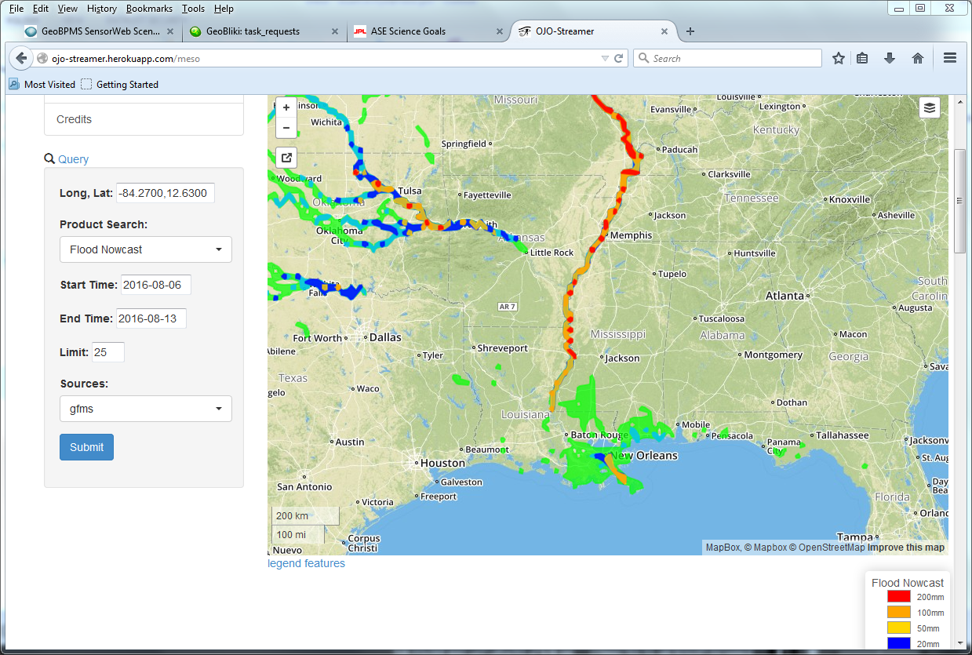
Global Component Highlight
GFMS flood products (above from August LA flooding) converted to GIS layers and distributed via ojo-streamer client
  C. Vaughan of FEMA: “This is absolutely the direction we want to head (API based).”
Also provided data for a levee break in China (June) and flooding in Sri Lanka (May), Myanmar (June), Mexico (June), WV (July), Louisiana (August) and India (August)

Slide 11
Outline
Flood Pilot overview
Status of data acquisition and exploitation
Pilot status report:
  Objective A: Global component status
  Objective B: Regional component status
    Caribbean/Central America
    Southern Africa
    Southeast Asia
  Objective C: Capacity Building
Issues and Risk Management

Slide 12
Objective B: Caribbean/Central American Component Status (1/7)
2014 Milestones:
  Flood dashboard based on Namibia pilot adapted to Caribbean and Central American users
    Status: Prototype Flood Dashboard completed: http://matsu-flashflood.opensciencedatacloud.org/
  Flood monitoring (i.e., targeted EO data acquisitions)
    Status: Targeted EO acquisitions in 2014 for Guatemala, Panama, Trinidad, Haiti, and Belize
  Contributions of data to KAL Haiti data base
    Status: Completed

Slide 13
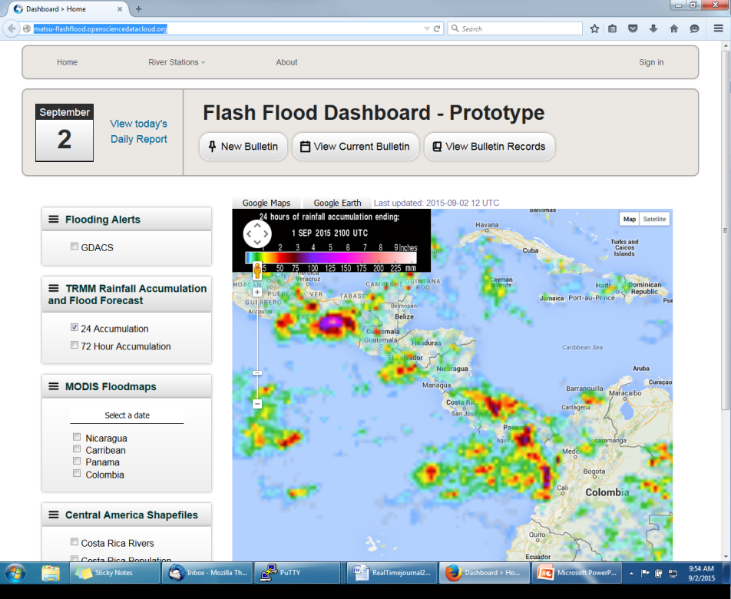
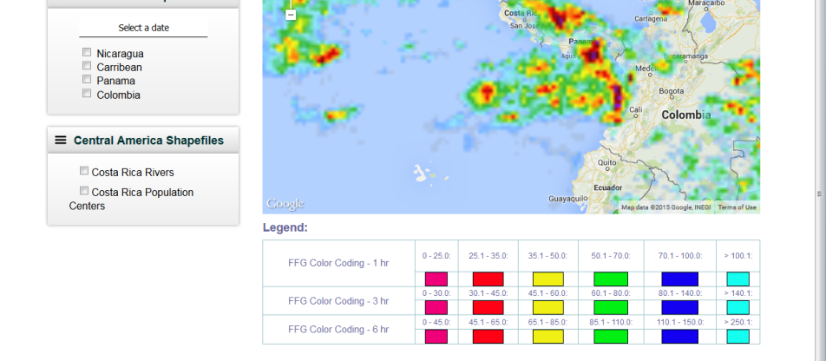
Objective B: Caribbean/Central American Component Status (2/7)
http://matsu-flashflood.opensciencedatacloud.org/

Slide 14
Objective B: Caribbean/Central American Component Status (3/7)
2015 Milestones:
  Flood monitoring during 2015 season
    Status:
      Panama (June); EO-1 / MODIS / Landsat flood maps for CATHLAC
      Dominica (August—TS Erika): COSMO-Sky-Med, Radarsat-2, and EO-1 data
      Bahamas (October—H Joaquin); EO-1 images, GPM rainfall, GFMS flood predictions, flood maps from multiple sensors
  RASOR risk management platform operational for flood risk and landslide risk analysis in Haiti
    Status: No significant new work since subsidence mapping reported in March
  10-year flood archive based on Deltares Flood Monitoring Programme
    Status: work is on-hold due to funding constraints.

Slide 15
Objective B: Caribbean/Central American Component Status (4/7)
2016-17 Milestones:
  Flood monitoring during 2016 season
    Status: Provided optical imagery (EO-1 and MODIS) and GFMS for Mexico (TS Danielle—June) and Belize (H Earl—August)
  Draft a plan for longer-term sustainability
    Status: Intent is to transition much of this work into AmeriGEOSS, but details need to be worked out
Overall Status: 50% complete.

Slide 16
Objective B: Caribbean/Central American Component Status (5/7)
Other Planned Activities / Accomplishments
  Collection of background Radarsat-2 pre-event imagery at known look angles and modes for the entire region (CSA-Giguere)
    Status: Completed; 8 complete sets of background images collected over all of Central America and the Caribbean
      Working with the Landslide Pilot to identify opportunities for them to use these datasets
  Damage assessment studies to analyze satellite-derived inputs as compared to ground-based manual techniques (CIMH-Farrell)
    Status: Analysis in Saint Vincent and the Grenadines (using Radarsat and EO-1), and in Dominica (using Radarsat and COSMO-SkyMed) has been hampered by lack of pre-event Radarsat and COSMO-SkyMed imagery with same characteristics as post-event imagery. Currently looking at the effects of Hurricane Earl in Belize using pre- and post-event Radarsat-2 data.

Slide 17
Objective B: Caribbean/Central American Component Status (6/7)
Other Planned Activites / Accomplishments (cont.)
  Open GeoSocial API for publishing / visualizing flood modeling and monitoring products installed at DAI in Costa Rica
    Part of the disasters component of the Climatic Information Platform for Central America and the Dominican Republic under the Regional Climate Change Program (RCCP) funded by USAID; software installation supported by a grant from SICA/CEPREDENAC.
    Training workshop conducted in early May in Costa Rica
    System operational since May: http://centroclima.org/powered-by-nasa/ (example on next slide)

Slide 18
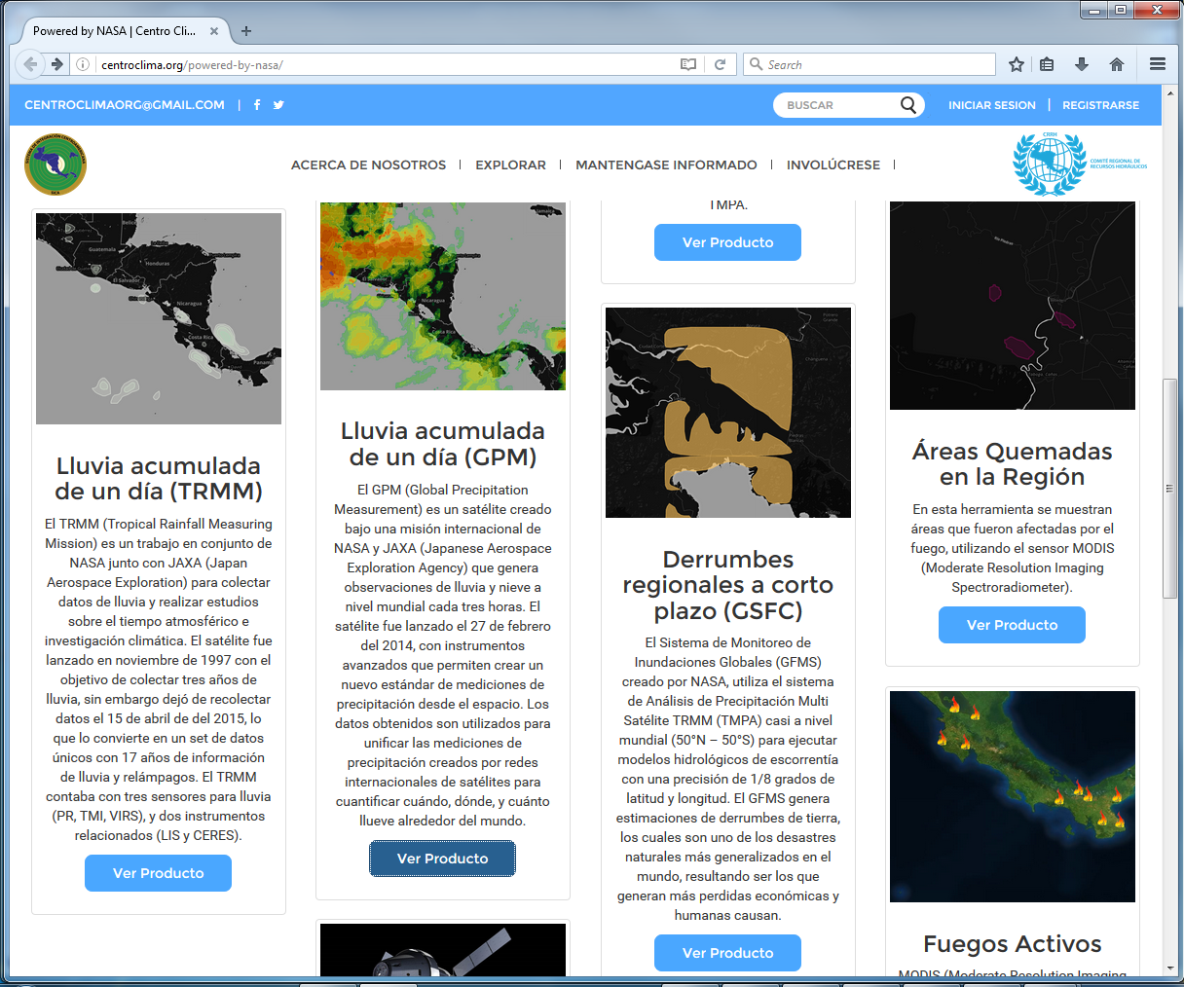
Objective B: Caribbean/Central American Component Status (7/7)

Slide 19
Outline
Flood Pilot overview
Status of data acquisition and exploitation
Pilot status report:
  Objective A: Global component status
  Objective B: Regional component status
    Caribbean/Central America
    Southern Africa
    Southeast Asia
  Objective C: Capacity Building
Issues and Risk Management

Slide 20
Objective B: S. Africa Component Status (1/6)
2014 Milestones:
  Flood monitoring during early 2014
    Status: Acquisitions from NASA and CSA under previous agreement within GEO task
  Updates to flood dashboard
    Status: Upgraded Flood Dashboard completed: http://matsu-namibiaflood.opensciencedatacloud.org/
2015 Milestones:
  Flood monitoring during early 2015
    Status: Radarsat-2 images provided for Namibia during flooding on 24 Feb; three Archive Radarsat-2 images of Malawi (early January—ordered in March) provided to LIST for Flood Hazard Mapping that were Disaster Charter acquisitions
  10-year flood archive over region based on Deltares Flood Monitoring Programme
    Status: on hold due to funding constraints
Status: 75% complete.

Slide 21
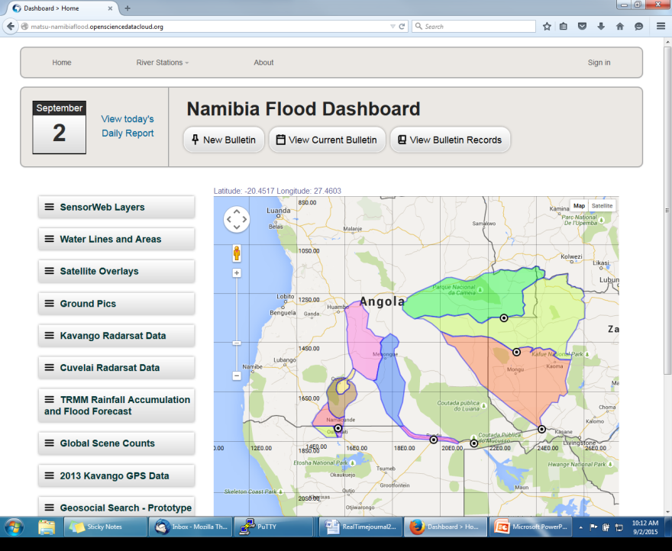
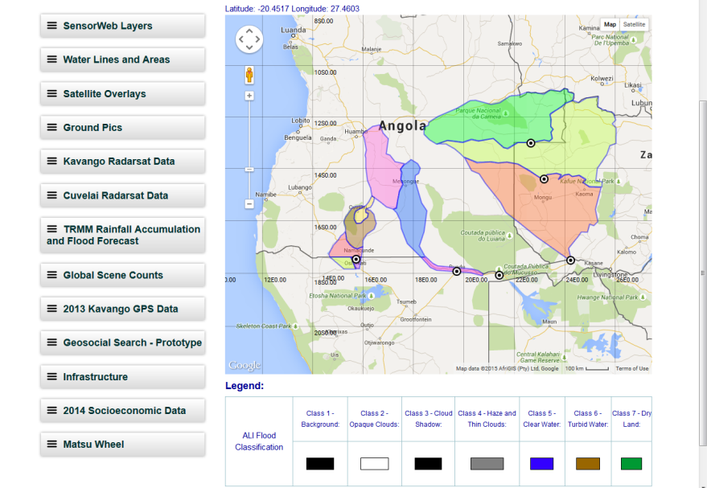
Objective B: S Africa Component Status (2/6)
http://matsu-namibiaflood.opensciencedatacloud.org/

Slide 22
Objective B: S. Africa Component Status (3/6)
2016-17 Milestones:
  Flood monitoring during 2016 season
    Status: Quiet flood season thus far, so no support provided
  Draft a plan for longer-term sustainability
    Status: Intent is to transition much of this work into AfriGEOSS but details need to be worked out
Status: 75% complete.

Slide 23
Objective B: S Africa Component Status (4/6)
Other Planned Activities
  Improvements to flood model by computing river width and deriving more realistic and complete stream networks derived from Landsat-8 (UCLA-Schumann; results in next slide)
    Status: Validating the improved flood model outputs with MODIS flood maps from the Dartmouth Flood Observatory
  Using a flood modeling study of the Lower Zambezi to define areas for high-resolution LiDAR acquisitions over the floodplains to construct higher-resolution DEMs for flood modeling / forecasting (UCLA-Schumann)
    Status: LiDAR image acquisition is targeted for funding by the World Bank this year
  Implementation of regional CREST flood model in Namibia, Kenya, and South Africa (U of Oklahoma-Hong/Flaming)
    Status: SERVIR grant secured and set to begin September 2016 to transition from CREST to EF5 flood model.

Slide 24
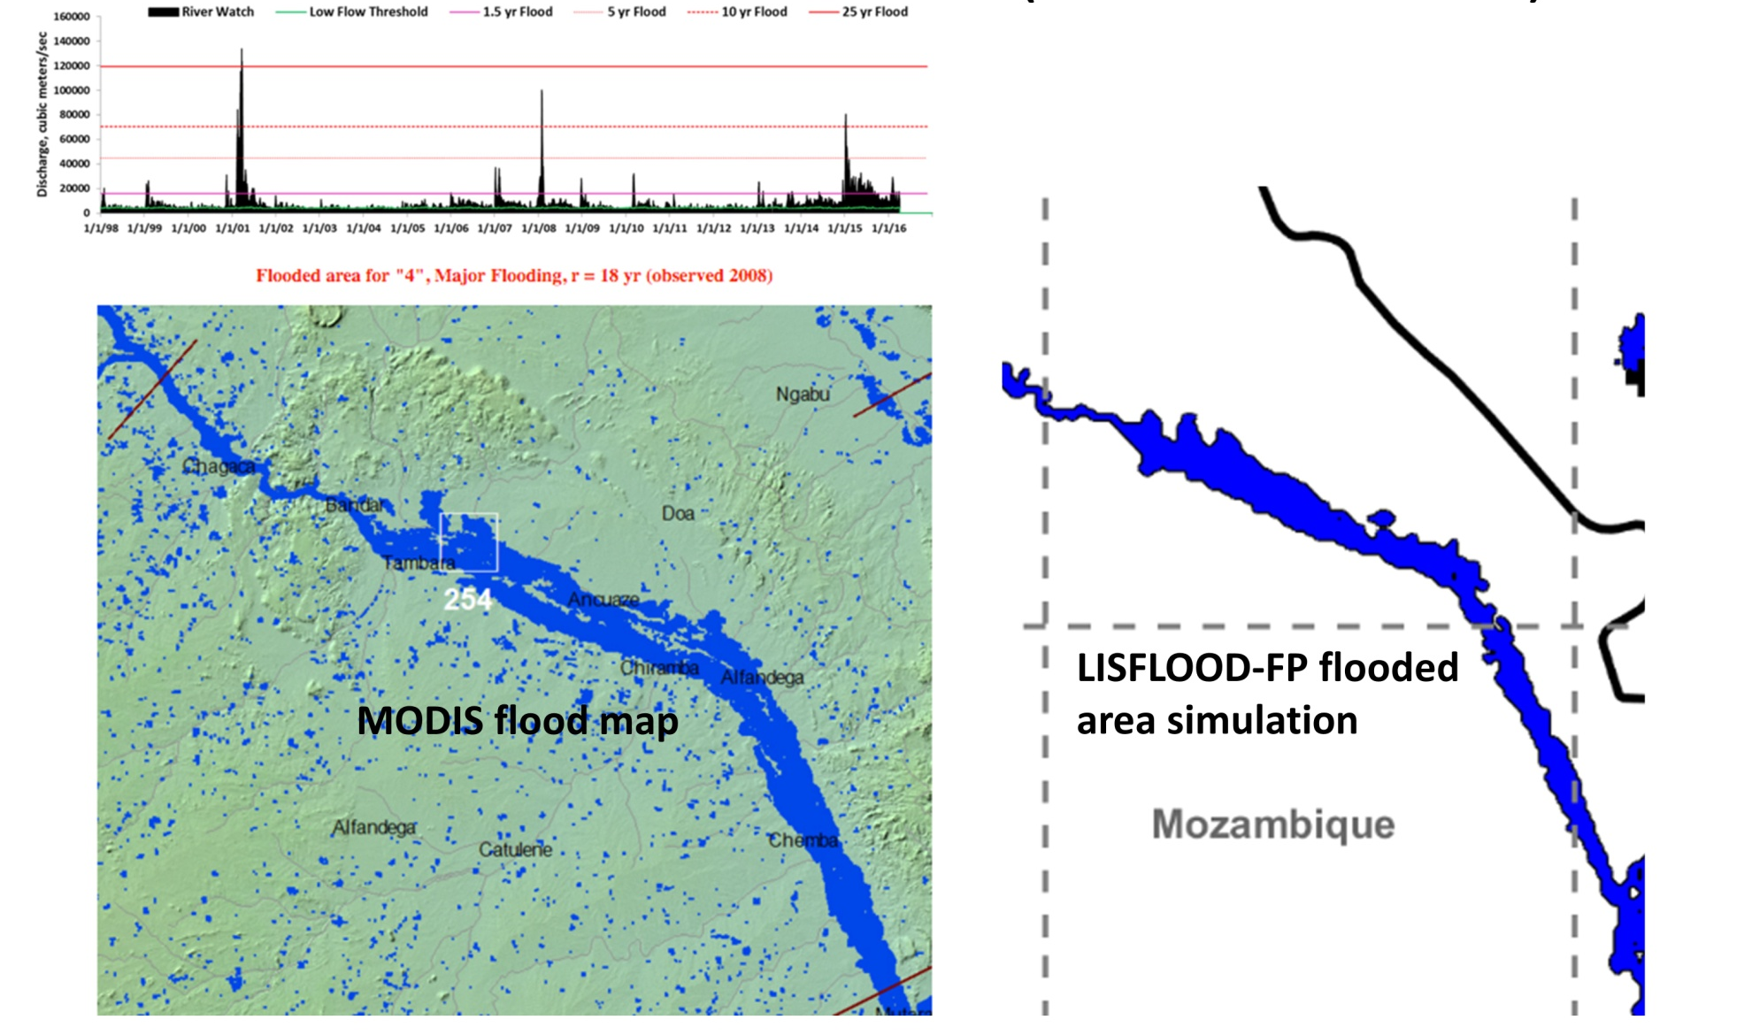
Southern Africa Component Status (5/6)
Validation of Africa-wide flood model by comparing simulations to Dartmouth Flood Observatory MODIS flood maps (Credit: G. Schumann, UCLA)

Slide 25
Objective B: S Africa Component Status (6/6)
Other Planned Activities
  Framework for evaluating flood model forecasts in the Zambezi basin using satellite-derived flood extent maps (LIST-Matgen)
    Status: In progress; results can also be used to evaluate and modify model calibration parameters and thus improve accuracy

Slide 26
Outline
Flood Pilot overview
Status of data acquisition and exploitation
Pilot status report:
  Objective A: Global component status
  Objective B: Regional component status
    Caribbean/Central America
    Southern Africa
    Southeast Asia
  Objective C: Capacity Building
Issues and Risk Management

Slide 27
Objective B: SE Asia Component Status (1/9)
2014 Milestones:
  User consultations on new pilot products
    Status: Open GeoSocial API flood forecasting and event mapping software installed at ICIMOD in 2015.
      New SERVIR funding secured to install new flood products at ADPC (e.g., J. Bolten’s NDVI differential product for the Mekong)
      SERVIR grant for OpenGeoSocial API installation was not funded but hoping to leverage the above work
  Test TRMM/GPM-based Global Flood Modeling System (GFMS) 1km resolution flood modeling product over the Lower Mekong Basin (contingent on river gauge data being obtained)
    Status: On hold—unable to obtain gauge data for this application. SERVIR project may provide a way forward.
  Flood Dashboard development based on Namibia pilot example adapted to SE Asia users;
    Status: Completed http://matsu-seasia.opensciencedatacloud.org/; may be replaced by OpenSocial API hosted by ADPC

Slide 28
Objective B: SE Asia Component Status (2/9)
2015 Milestones:
  Operational test bed for RASOR risk management system for test sites in Java
    Status: RASOR team analyzed future flood risk in Bandung based on subsidence mapping from comparing ALOS and CSK data (next two slides). Phase 2 proposal by RASOR team to fund extensions of 2007-11 / 2013-15 risk mapping work is currently under review by the EC. RASOR also used Pleaides data to generate more accurate maps of urban landscape for damage potential assessment (third slide after)
  Integration of flood dashboard
    Status: Current Dashboard may be replaced by OpenSocial API hosted by ADPC
  Initial services for Mekong River Commission
    Status: See above

Slide 29
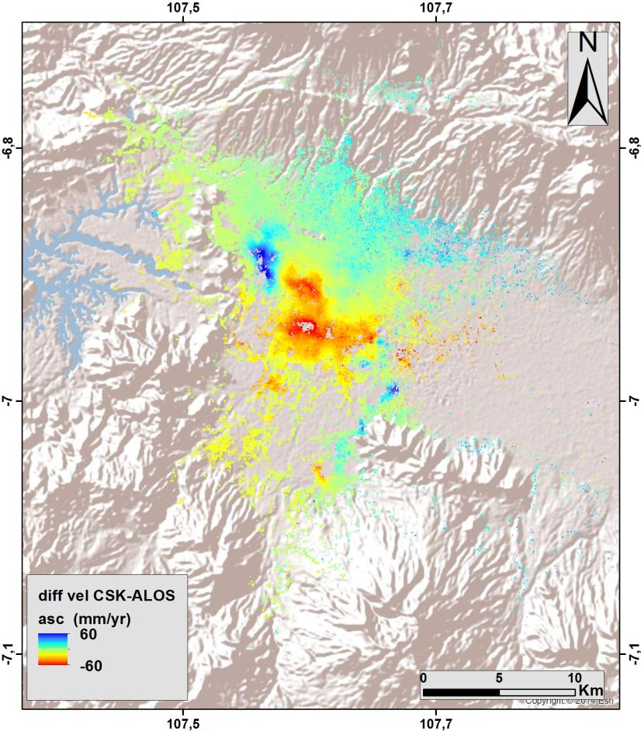
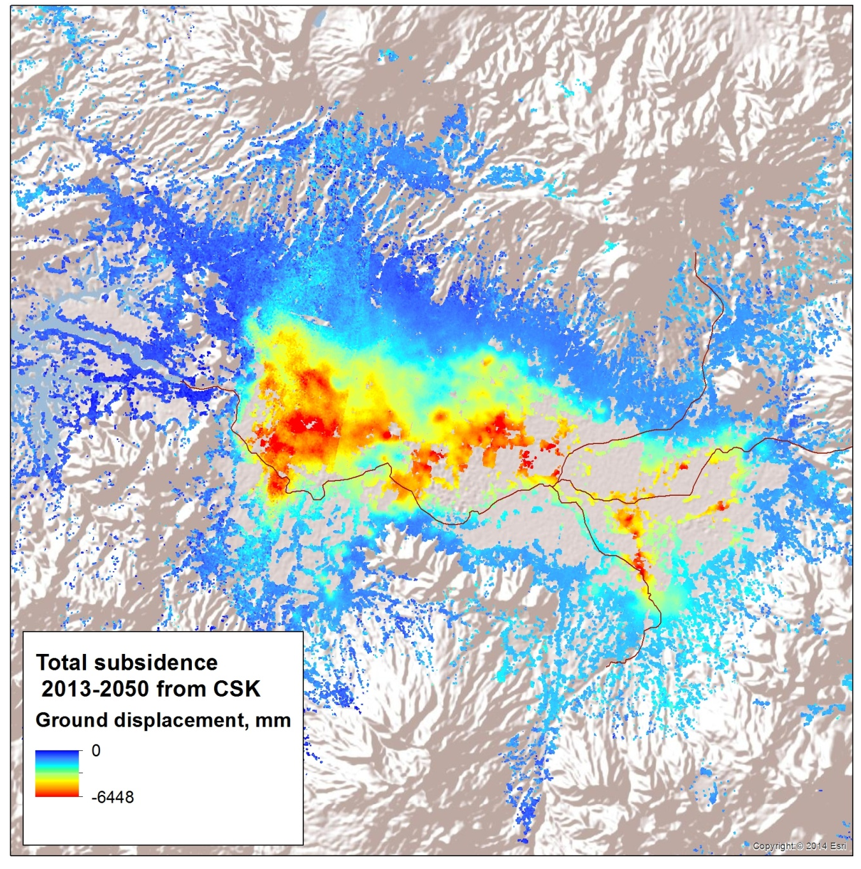
Objective B: SE Asia Component Status (3/9)
Estimated rate of change in subsidence in Bandung from comparing subsidence rates computed from ALOS in 2007-11 and CSK in 2013-15.
Predicted total subsidence by 2015 based on extrapolation of the changes in subsidence rates

Slide 30
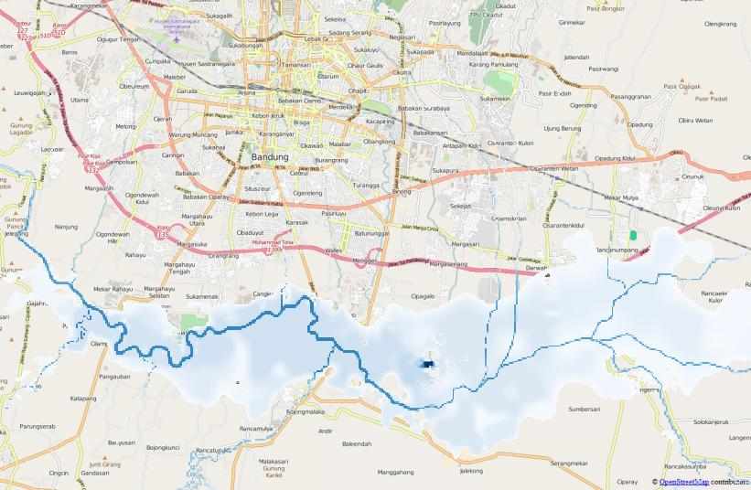
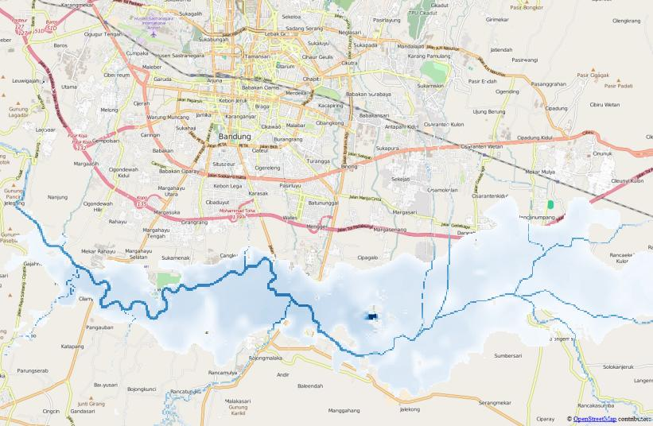
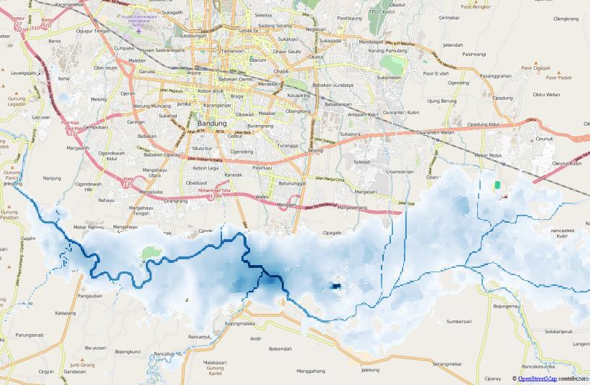
Objective B: SE Asia Component Status (4/9)
Inundation depths calculated for subsidence scenarios in 2014, 2020 and 2050 based on rainfall from the Dec 2014 flood
2014
0 - 1 m
1 - 2 m
2 - 3 m
3 - 4 m
4 - 5 m
5 - 6 m
6 - 7 m
7 - 8 m
8 - 9 m
9 - 10 m
> 10 m
2020
2050
Notes:
The RASOR flood models were employed to simulate the 2014 floods and to analyze how the inundation depths would increase if the subsidence projections for 2020 and 2050 become reality. In each case, the TRMM historical rainfall from December 2014 was used as input. Flood impact was computed using EO based exposure data and vulnerability functions available via the RASOR platform.

Slide 31
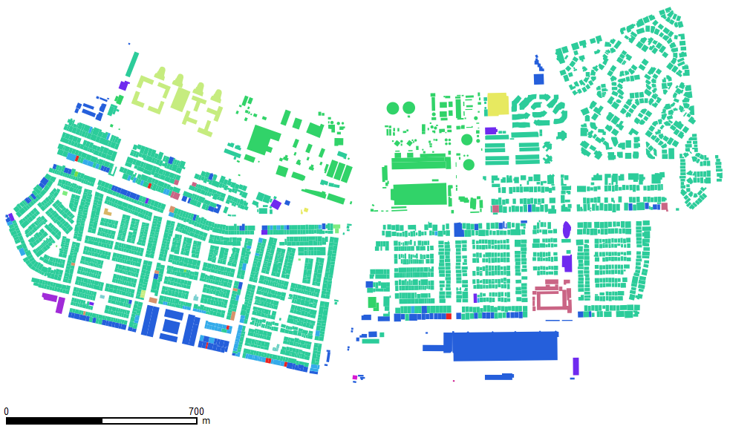
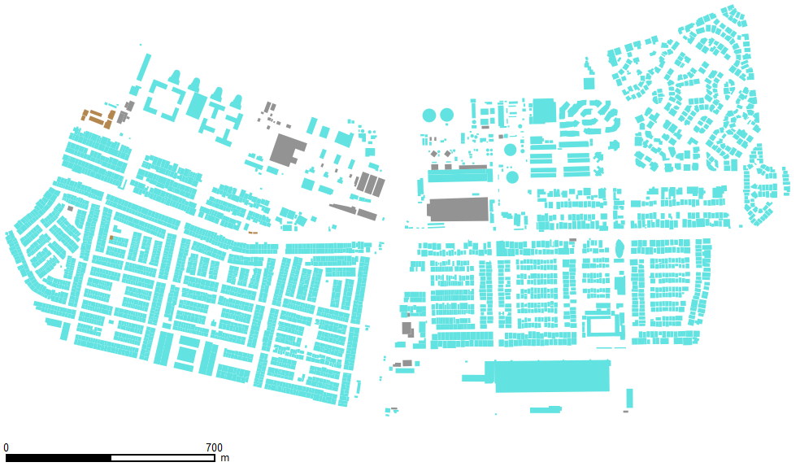
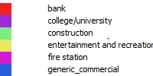



Objective B: SE Asia Component Status (5/9)
Comparison of land overlay of buildings and usage in Jakarta from Pleiades (left) with Open Street Map (right) (Courtesy H. Yesou, SERTIT)
Notes:
The RASOR flood models were employed to simulate the 2014 floods and to analyze how the inundation depths would increase if the subsidence projections for 2020 and 2050 become reality. In each case, the TRMM historical rainfall from December 2014 was used as input. Flood impact was computed using EO based exposure data and vulnerability functions available via the RASOR platform.

Slide 32
Objective B: SE Asia Component Status (6/9)
2015 Milestones (cont.):
  10-year flood archive over region based on Deltares Flood Monitoring Programme
    Status: Deltares has ceased collaboration with this Pilot region.
  1st new TRMM/GPM and other flood monitoring products
    Status: iMERG products now served under Open GeoSocial API; GFMS flood products being served from another API instance (http://ojo-streamer.herokuapp.com/)
2016-17 Milestones:
  Flood monitoring during 2016 season
    Status: Provided optical imagery for flooding in Sri Lanka (May) and Myanmar (June) and India (August)
  Draft a plan for longer-term sustainability
    Status: Intent is to build this capacity into ADPC via the SERVIR Applied Science Grant but details need to be worked out
Status: 80% complete.

Slide 33
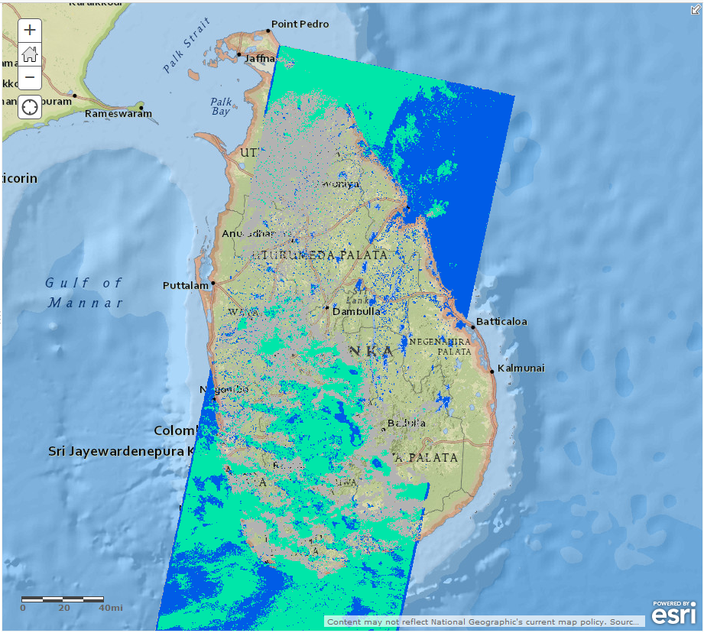
Objective B: SE Asia Component Status (7/9)
Flood coverage map for Sri Lanka on 18 May 2016 derived from Landsat-8 OLI

Slide 34
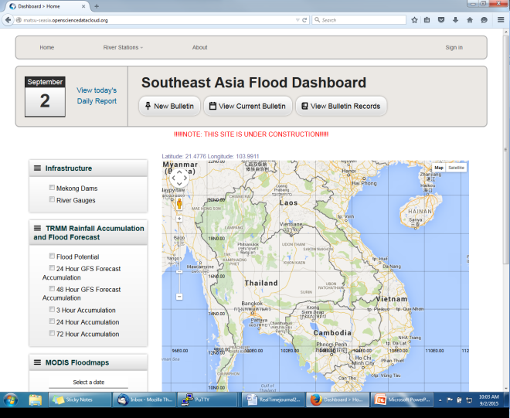
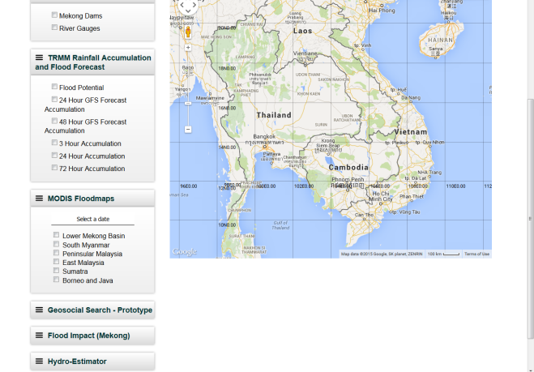
Objective B: SE Asia Component Status (8/9)
http://matsu-seasia.opensciencedatacloud.org/

Slide 35
Objective B: SE Asia Component Status (9/9)
Other Planned Activites
  Indonesia and Java risk assessments and subsidence calculations (Deltares-Villars)
    Status: on hold due to funding constraints.
Other Activities:
  Interaction with the World Bank in December 2015 as part of the RO meeting revealed types of flood products that would be useful to their needs assessments and ongoing recovery support.
  Provided demonstration of the Open GeoSocial API interface on the ojo-streamer client to World Bank GFDRR and Humanitarian Open Street Map Team (HOT) personnel July 2016.

Slide 36
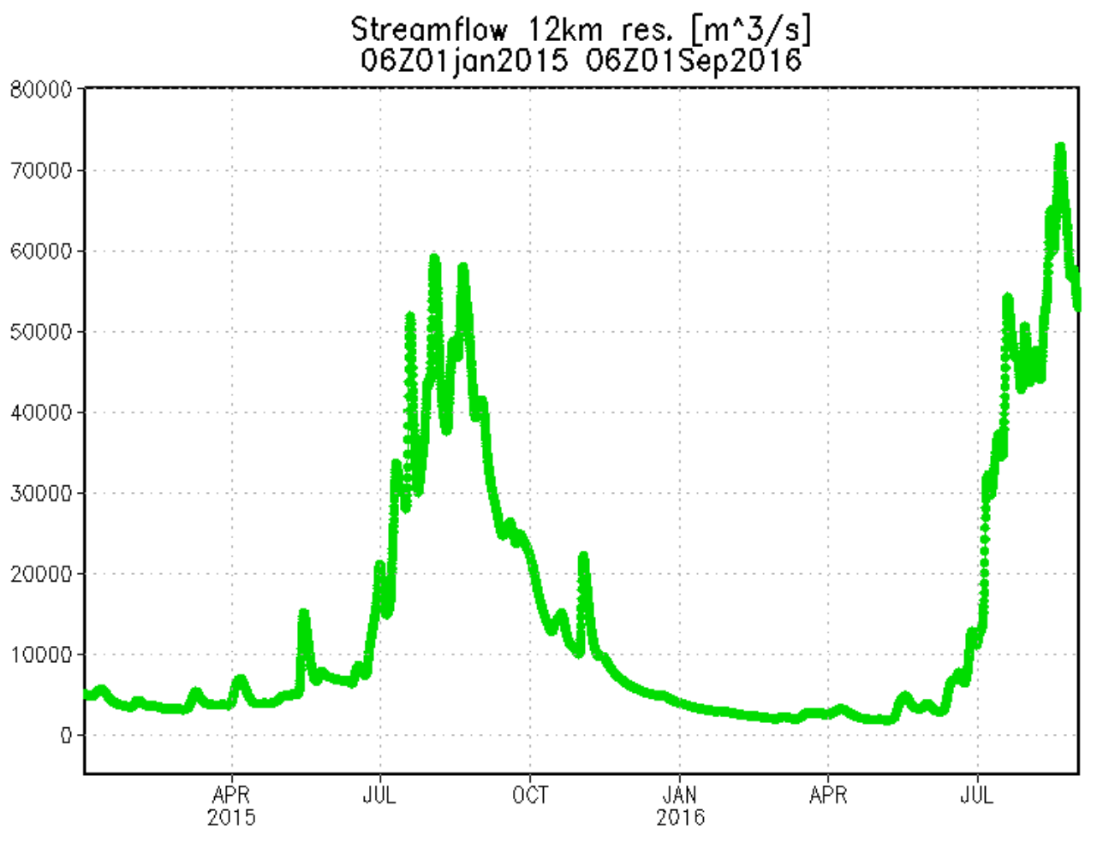
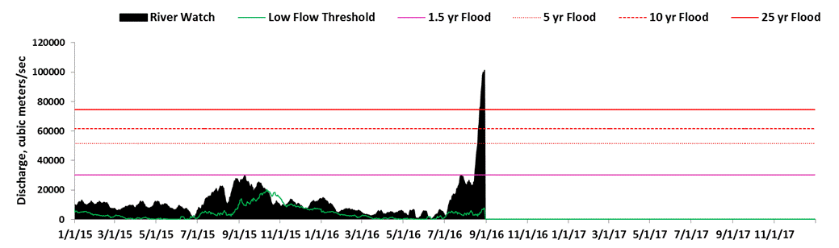
Ganges River Flooding August 2016
(Comparison of GFMS and Other Information)
Flood Threshold
GFMS Streamflow at 25.30N, 86.56E, location of River Watch Site # 195
25.30N, 86.56E, River Watch Site # 195 U. of Colorado)

Slide 37
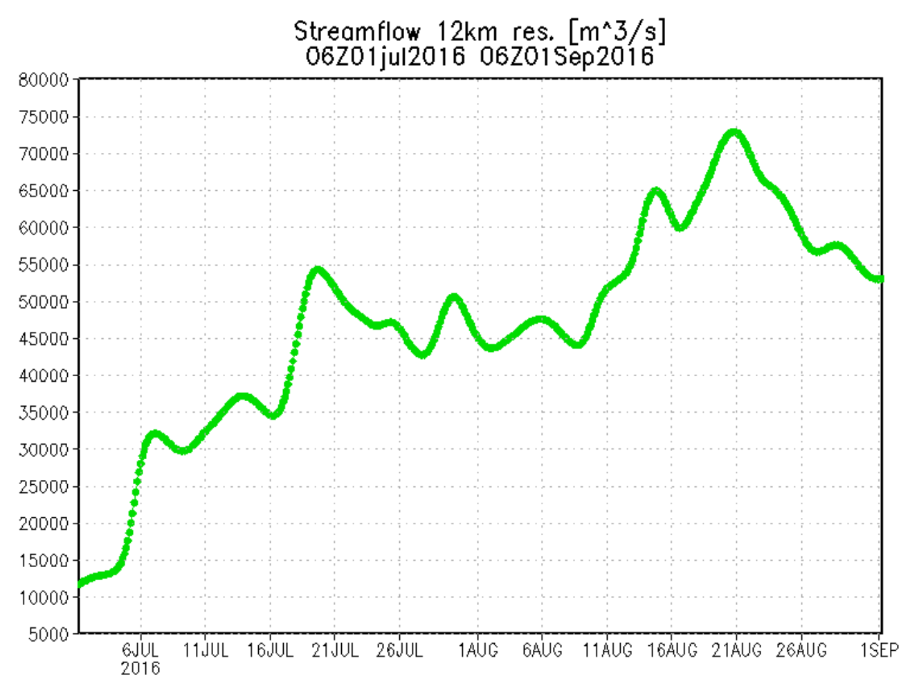
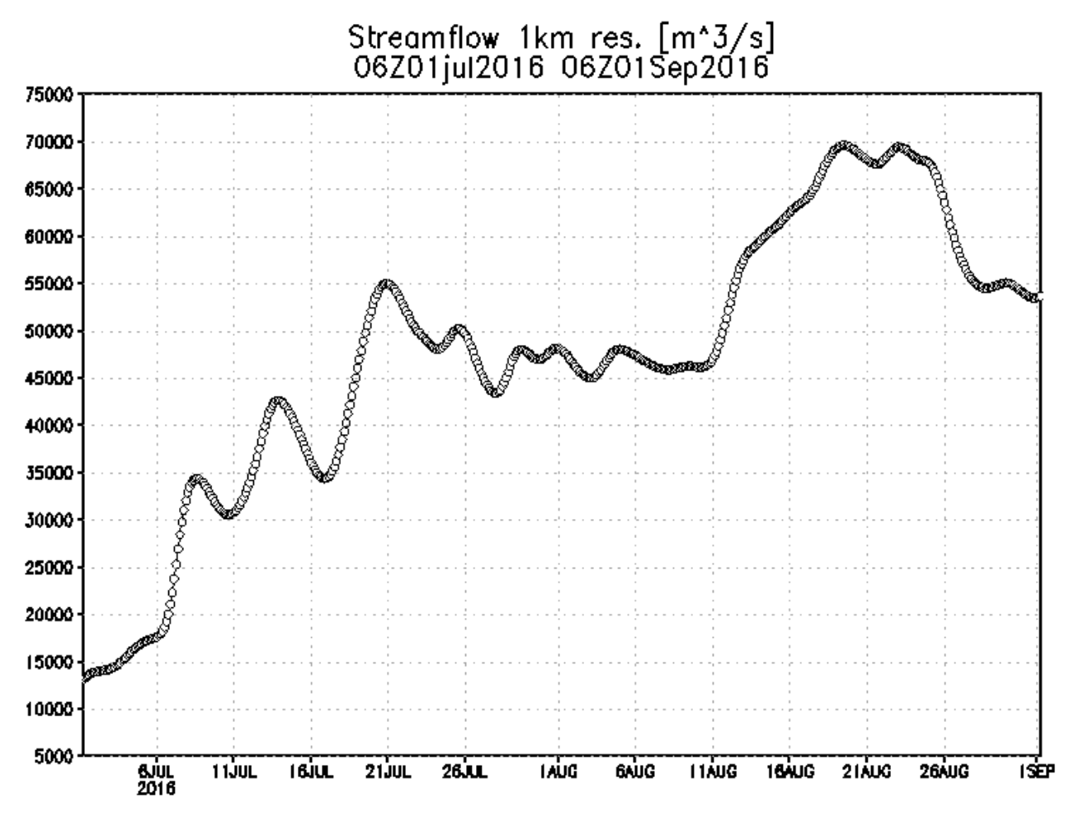
GFMS 12 km Streamflow
GFMS 1 km Streamflow

Slide 38
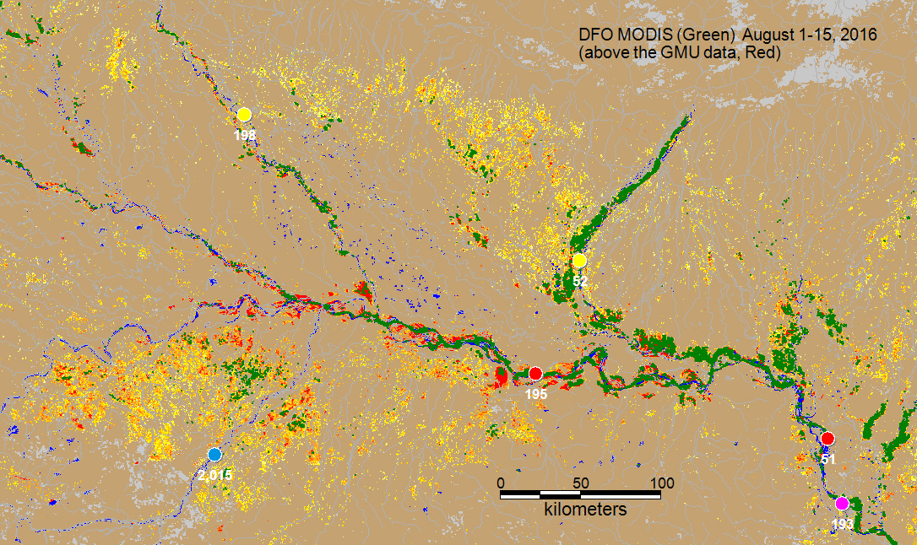
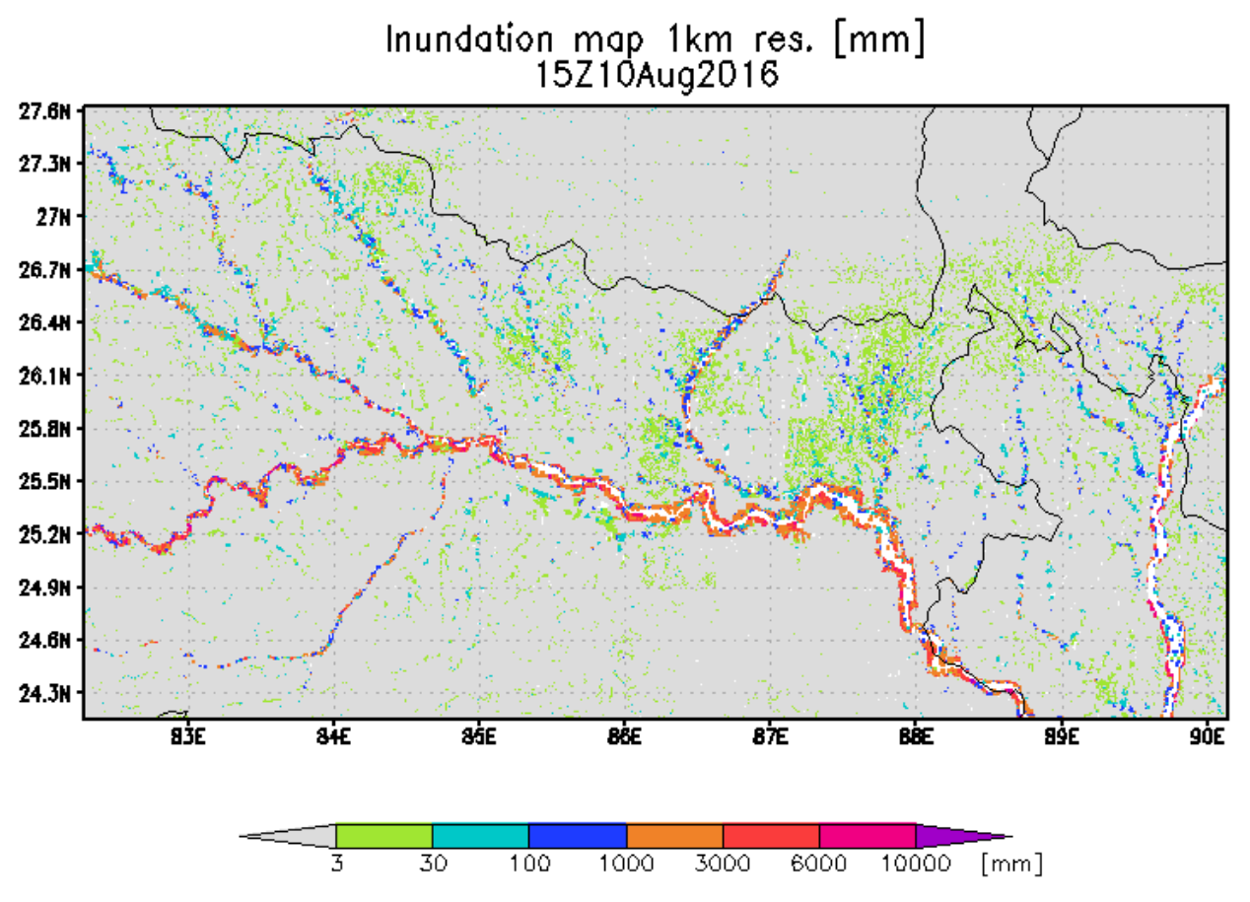
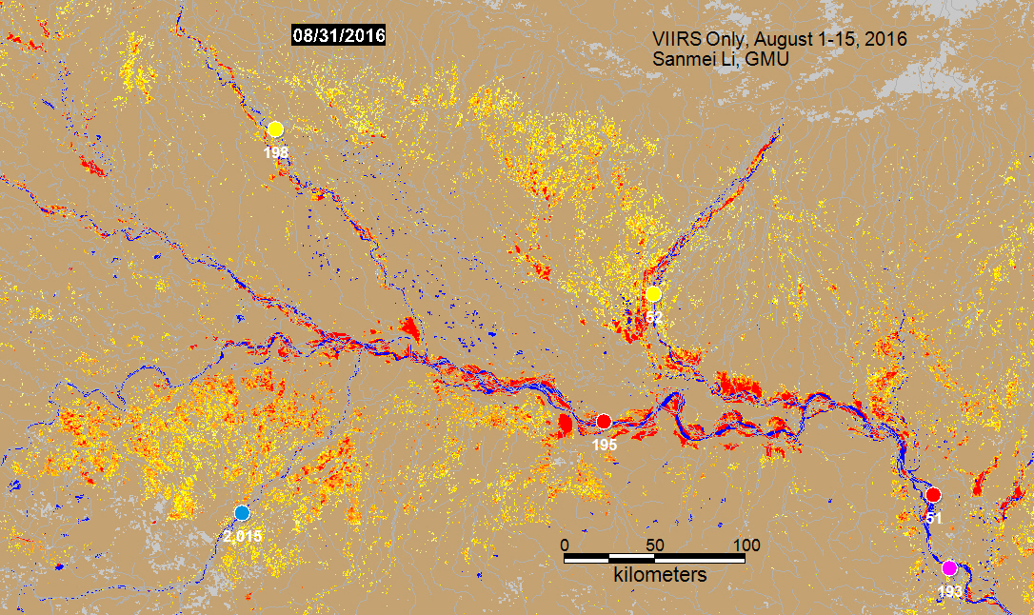
Inundation Estimates
GFMS

Slide 39
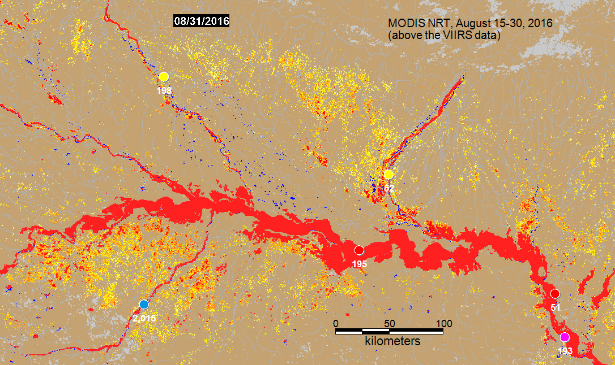
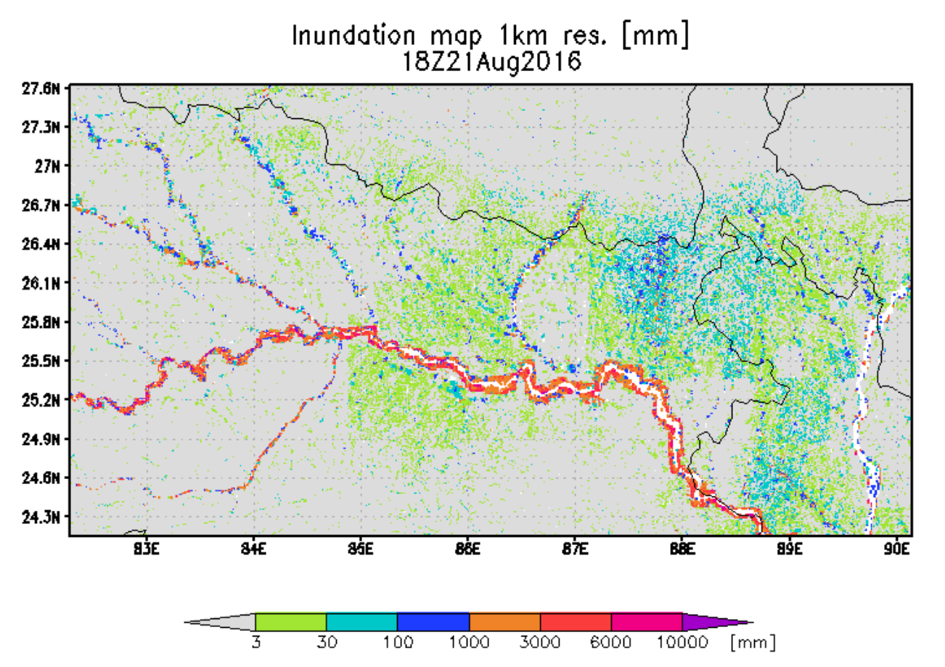
GFMS

Slide 40
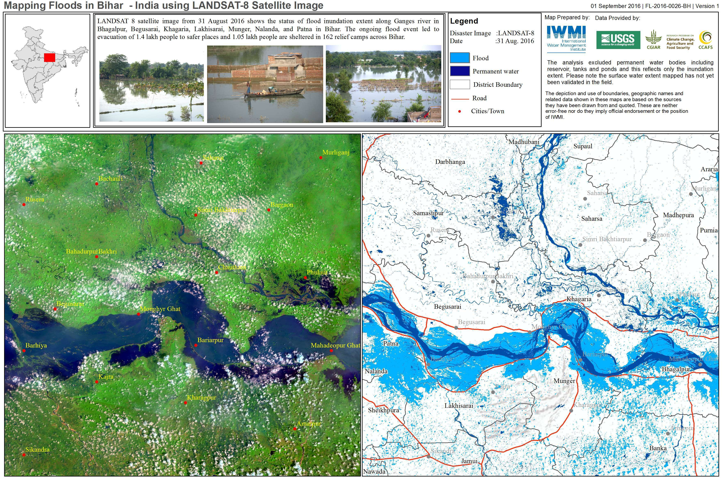
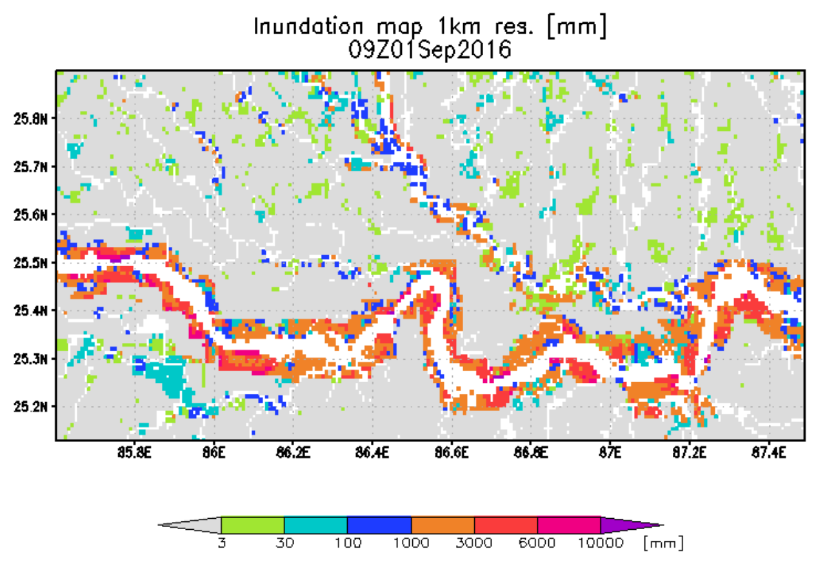
GFMS

Slide 41
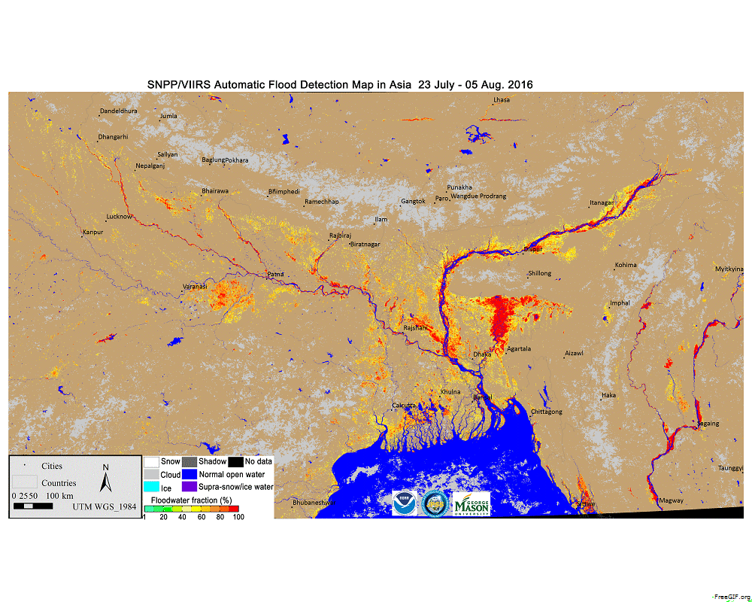

Slide 42
Outline
Flood Pilot overview
Status of data acquisition and exploitation
Pilot status report:
  Objective A: Global component status
  Objective B: Regional component status
    Caribbean/Central America
    Southern Africa
    Southeast Asia
  Objective C: Capacity Building
Issues and Risk Management

Slide 43
Objective C: Capacity Building Status (1/2)
Caribbean/Central American Component:
  Implemented previously mentioned Open GeoSocial API Flood Monitoring software suite
    Training workshop by NASA GSFC personnel (supported by SERVIR and USAID) in Costa Rica held in May
    Now creating products in real time and delivering to regional partners
  Working through AmeriGEOSS to extend this capability to other portions of the Americas (Chile, Colombia, and Mexico)
    2-day disaster training course on disasters (including floods) for AmeriGEOSS participants conducted in Bogata in June
Southern Africa Component:
  Nothing to report since March WGDisasters meeting

Slide 44
Objective C: Capacity Building Status (2/2)
Southeast Asia Component:
  SERVIR funding (J. Bolten) for new ADPC flood products, including ADPC-produced NDVI differences in the Mekong as a new product
  Provided demonstration of the Open GeoSocial API interface on the ojo-streamer client to ADPC in April and to the Sri Lanka head disaster manager in July

Slide 45
Outline
Flood Pilot overview
Status of data acquisition and exploitation
Pilot status report:
  Objective A: Global component status
  Objective B: Regional component status
    Caribbean/Central America
    Southern Africa
    Southeast Asia
    Special Event: Mississippi River (US)
  Objective C: Capacity Building
Issues and Risk Management

Slide 46
Issues and Risk Management Approach
Data ordering and distribution among participating CEOS agencies are at the labor intensive for pilot members due to manual processes and variations across agencies for tasking and data delivery requirements — this is a challenge for both current Flood Pilot operations and longer-term sustainability
46

Slide 47
Data Use: Recent (since March) Publications / Conference Presentations
Publications
Schumann G. J-P., Frye S., Wells G., Adler R., Brakenridge R., Bolten J., Murray J., Slayback D., Green D., Wu H., Kirschbaum D., Howard T., Flamig Z., Clark R., Chini M., Matgen.P., Stough T., B. Jones, 2016: Unlocking the Full Potential of Earth Observation during the 2016 Texas Flood Disaster. Water Resources Research, 52(5), 3288-3293.
Schumann, G. J-P and K. M. Andreadis (2016). A method to assess localized impact of better floodplain topography on flood risk prediction, Advances in Meteorology, 6408319.
Wu, H. and Adler, R., “Evaluation of Quantitative Precipitation Estimations (QPE) and Hydrological Modeling at the Iowa Flood Studies Focal Basins.”, 2016 Journal of Hydrometeorology, in review.
Conference presentations (oral unless otherwise noted)
Jones, B., and S. Frye, 2016: International Charter / CEOS Flood Pilot. NASA Flood Response Workshop.
Kuligowski, R. J., and S. Frye, 2016: The CEOS Working Group on Disasters Flood Thematic Pilot (poster). NASA Flood Response Workshop.
Rudari, R., S. Frye, and B. Kuligowski, 2016: CEOS Disaster Risk Management Flood Pilot. 2016 Understanding Risk Forum.
Tolomei, C., S. Salvi, A. Lugari, J. Beckers, M. Huber, G. Pezzo, and L. Rossi, 2016: Multitemporal InSAR data to develop natural hazard scenarios for the Bandung area (Western Java, Indonesia). ESA Living Planet Symposium 2016.
47

Slide 48
Questions / Discussion

