Slide 1
Status Report on Volcano Pilot Project
Mike Poland (USGS)
Simona Zoffoli (ASI)
WG Disasters #6
Vancouver, WA, USA
6 -8 September, 2016

Slide 2
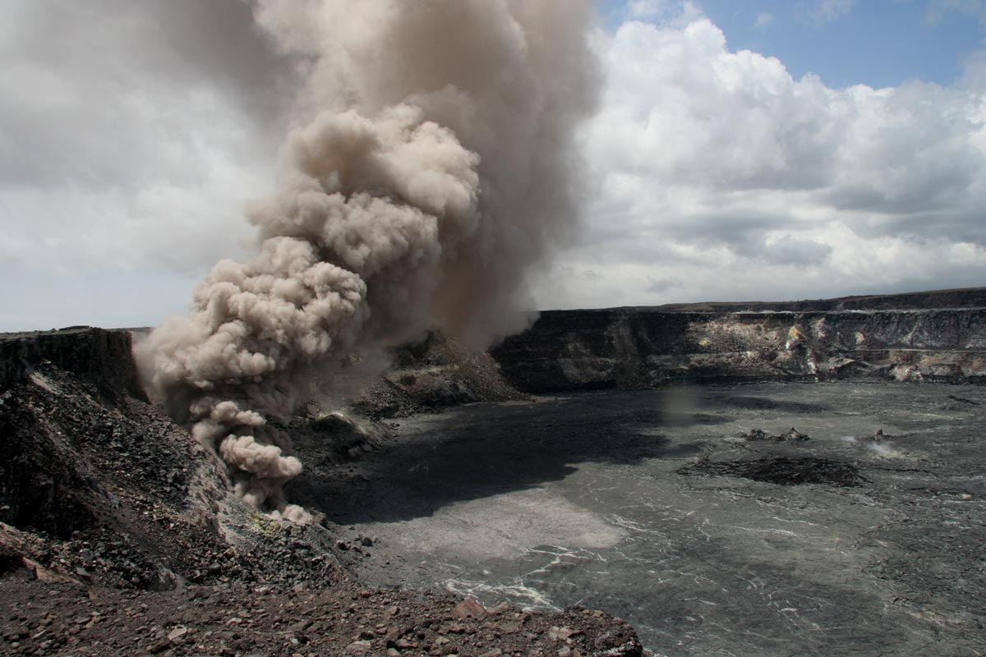
Overview
Motivation and objectives
Data usage
New results
Capacity building
Sustainability

Slide 3
Pilot Team
Juliet Biggs, David Arnold, James Hickey (University of Bristol)
Susi Ebmeier (University of Leeds)
Matt Pritchard, Francisco Delgado (Cornell University)
Christelle Wauthier (Penn State University)
Falk Amelung (University of Miami)
Fabrizio Ferrucci (Open University)
Mike Pavolonis (NOAA)
Rick Wessels (USGS)
Eugenio Sansosti (IREA-CNR)

Slide 4
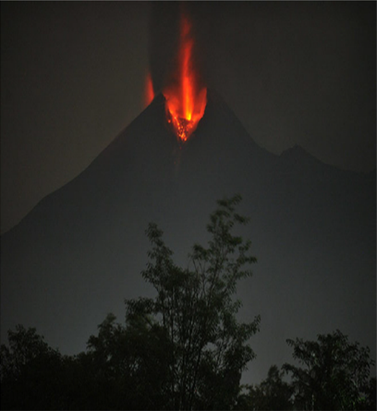
WHY?
Volcano Pilot
Over 300,000 people have been killed by volcanoes since the 1600s.
Hundreds of millions live within 20 km of an active volcano today.
In 2010, the Eyjafjallajökull eruption brought losses of $200m/day, and 100,000 cancelled flights.
Merapi, Indonesia, erupting in 2010. From Pallister and others, 2013

Slide 5
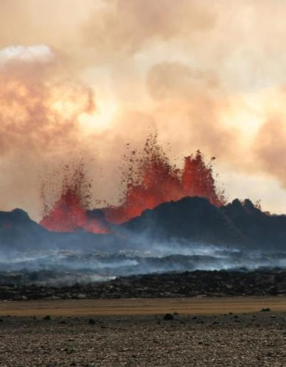
WHAT IS MISSING?
Volcano Pilot
Large monitoring gaps exist at many hazardous volcanoes around the world
Current EO data collection is not usually coordinated for volcano monitoring
Need systematic observations before, during, and after volcanic events
Bardarbunga, Iceland, erupting in 2014.
Photo credit: M Parks

Slide 6
Pilot objectives
Objective A – Regional Demonstration
Demonstrate the feasibility of global volcano monitoring of Holocene volcanoes by undertaking regional monitoring of volcanic arcs in Latin America, stretching from Mexico to southern Chile, and including the Lesser Antilles, using satellite EO data to track deformation as well as gas, ash, and thermal emissions.
Objective B – Geohazard Supersites and Natural Laboratories
Multi-disciplinary, multi-platform monitoring of a few volcanoes that represent a diverse cross section of eruptive activity and unrest.
Objective C – Significant Global Event
Specific studies in case of a major eruption with significant regional or global impact, providing data for a comprehensive analysis of all aspects of the eruption cycle, including local (e.g., mass flows on the volcanic slopes), regional (e.g., ash emissions that may be hazardous to aircrafts), and global (e.g., volatile and aerosol emissions that may influence climate) impacts.

Slide 7
Objective B: Supersites
Work continues on approved volcano Supersites:
  Hawai‘i
  Iceland
  Italy
  Ecuador
  New Zealand
Critical for hazards assessment and mitigation efforts and highly valued by local agencies
Volcano supersites provide opportunities for scientific innovation due to the availability of high spatial and temporal resolution datasets

Slide 8
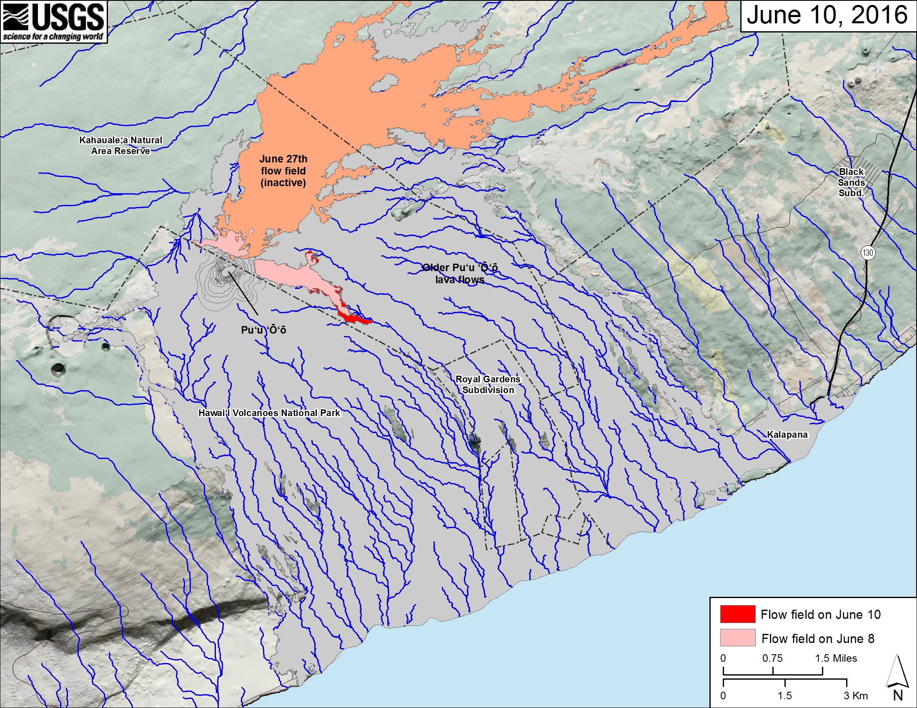
Objective B: Hawaiʻi

Slide 9
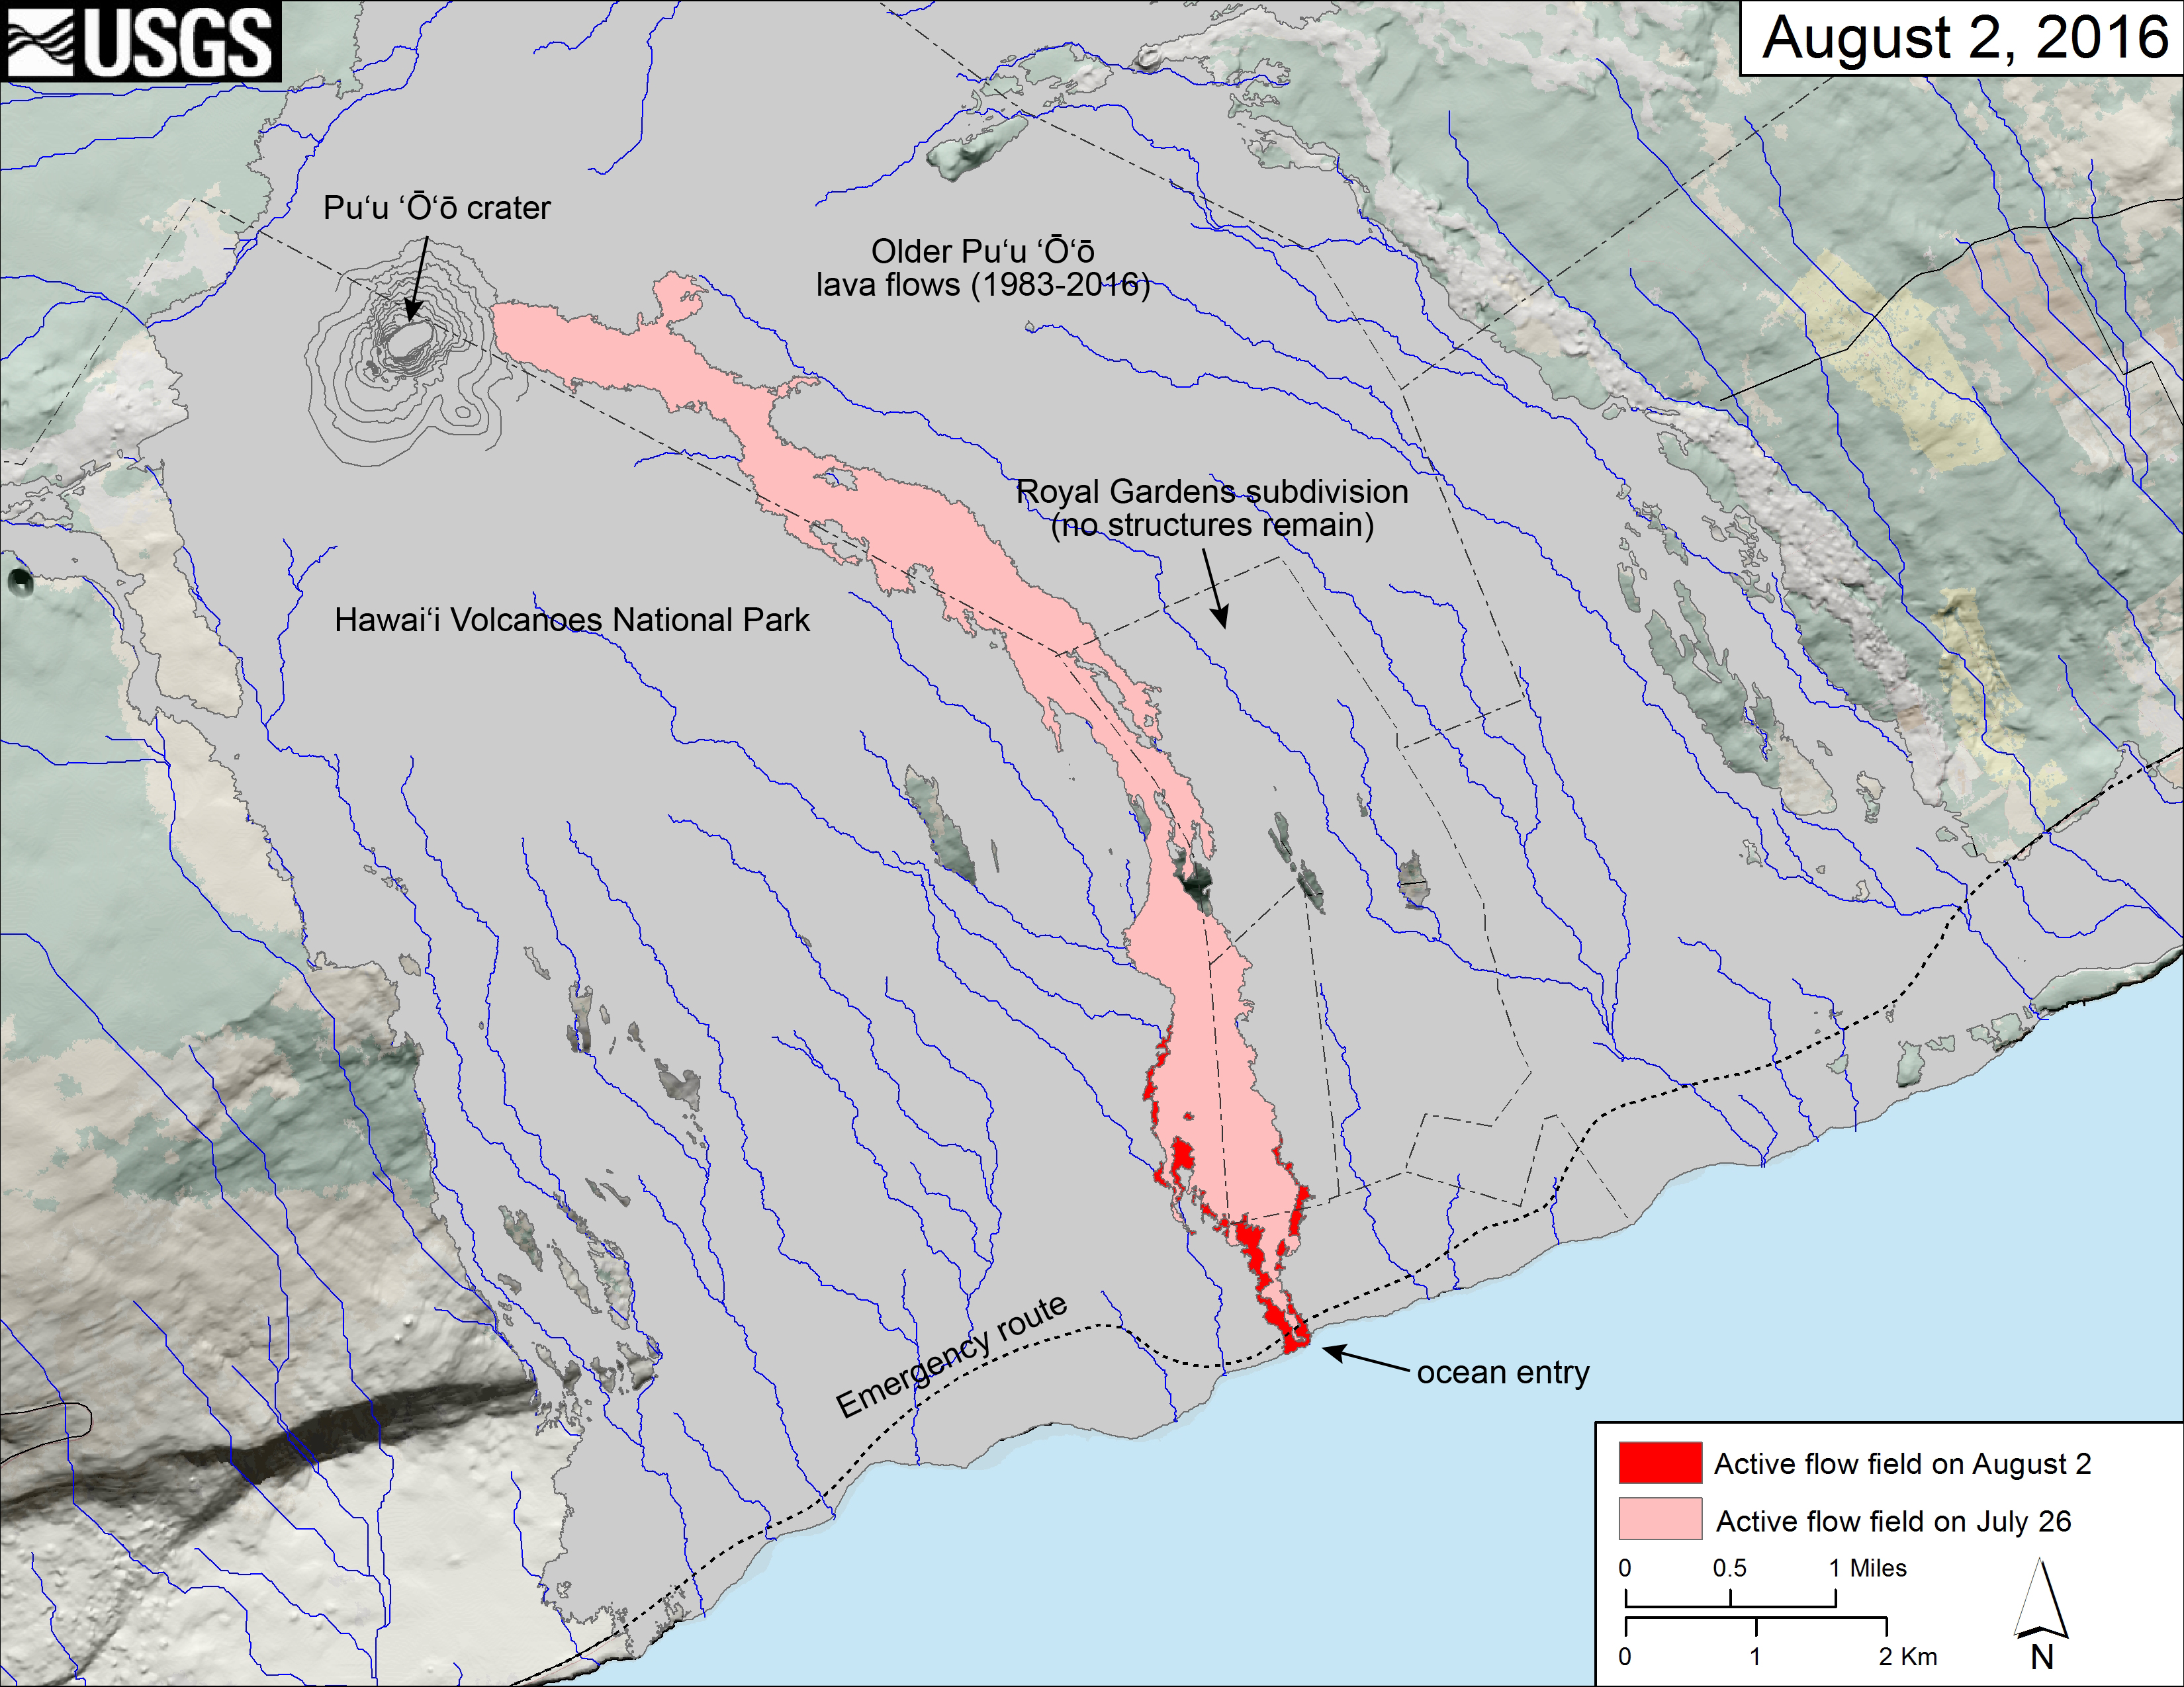
Objective B: Hawaiʻi

Slide 10
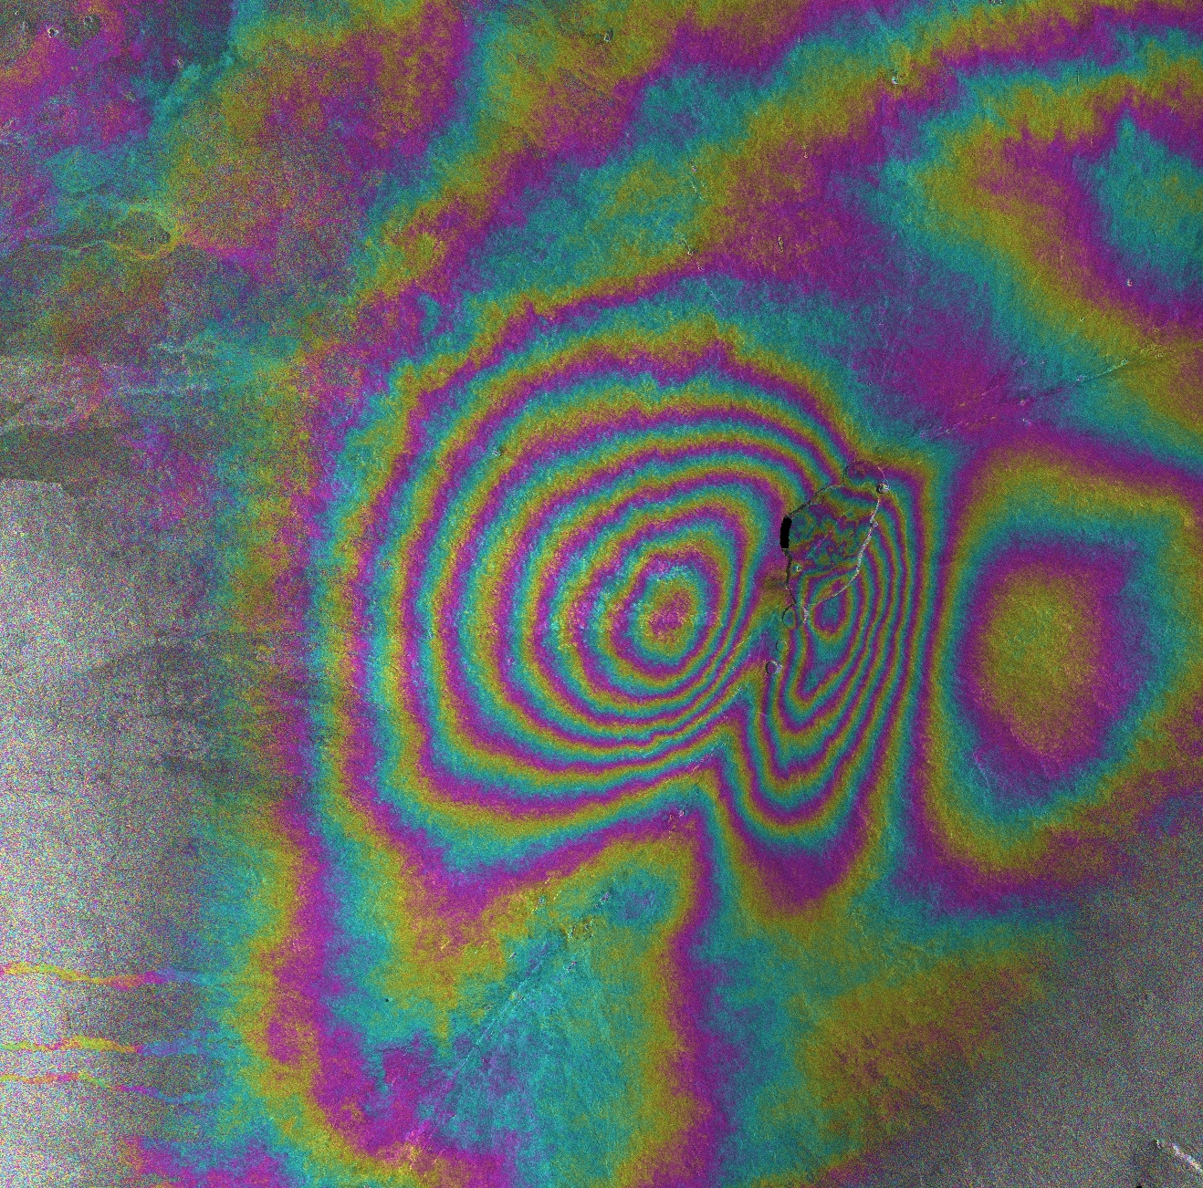

Objective B: Hawaiʻi
Inflation of Mauna Loa volcano, Hawaiʻi
Cosmo-SkyMed
August 22, 2014 – August 27, 2016

Slide 11
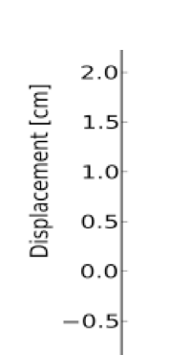
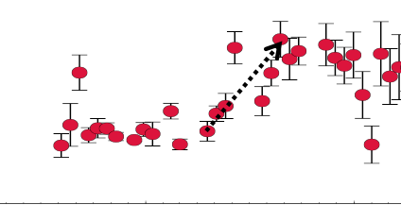
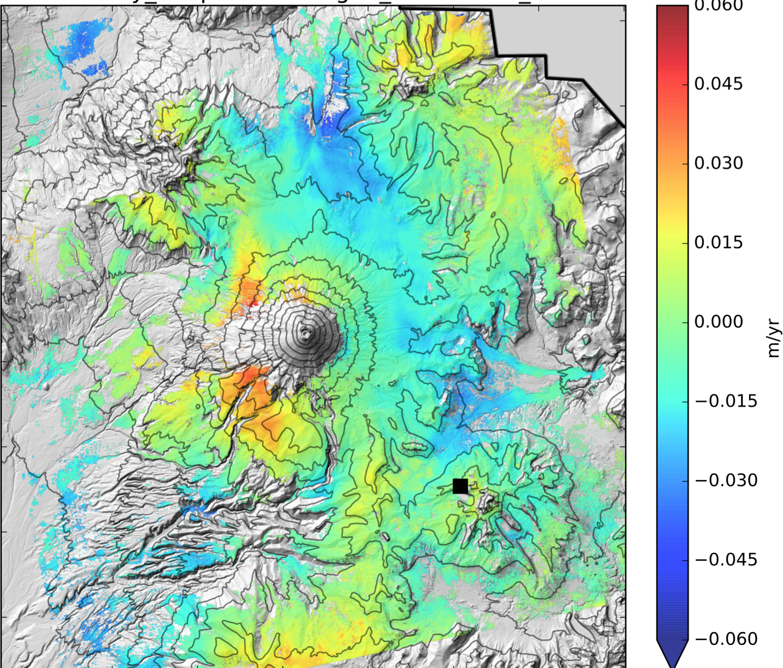
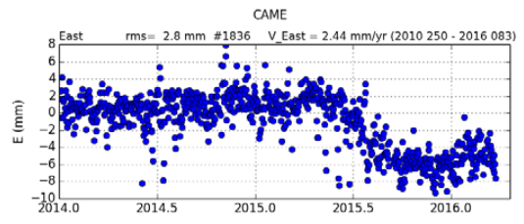
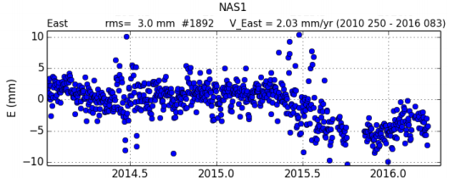
Objective B: Cotopaxi
Eruption
InSAR
Mean LOS Velocity
April – July 2015
LOS
GPS
CAME
NAS1
InSAR shows ~1.5 cm LOS decrease from April to August 2015, correlating with GPS

Slide 12
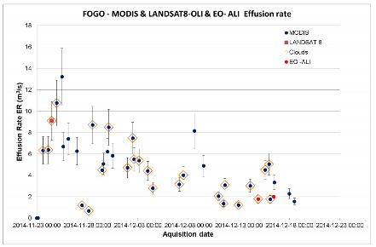
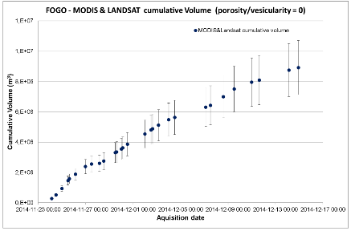
Objective C: Large event
Proposal has been submitted to ensure rapid access to data if a large volcanic event occurs
Fogo eruption serves as a demonstration
courtesy Fabrizzio Ferucci, Open University

Slide 13
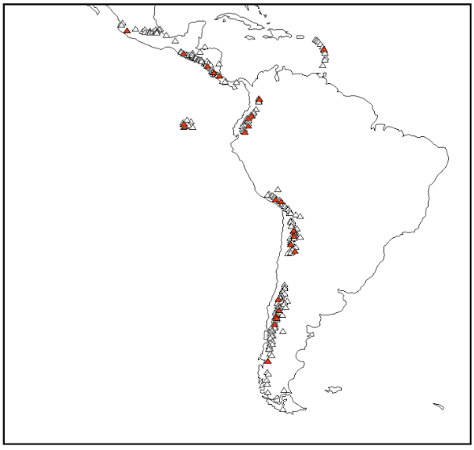
Objective A: Regional demonstration
Demonstrate how EO data can be used to cost-effectively monitor all 315 volcanoes in the region that erupted in the last 10,000 years
Identify volcanoes that may became active in the near future
Track new and ongoing eruptive activity
Why Latin America?
Diversity of environments
Abundant volcanic activity
Benefits to local users
64% of volcanoes in the region have no ground monitoring of any type
Notes:
Triangles are all volcanoes in Latin America. Red triangles are target volcanoes from the CEOS pilot plan. Black boxes and text show regions for planned quarterly monitoring with C-Band (Sentinel-1) and L-Band (ALOS 2) InSAR. Grey text shows the local end users (monitoring agency).

Slide 14
Objective A Efforts by Partner
Topic/region | Value Added Partner
Northern Andes and Lesser Antilles SAR | University of Bristol
Southern and Austral Andes SAR | Cornell University
Galápagos SAR | IREA/CNR
Mexico SAR | University of Miami
Central America SAR | Pennsylvania State University
Detection of ash plumes and thermal anomalies | NOAA
Development and testing of EO-based methodology for improved monitoring of surface deformation | All
Capacity-building and training activities in countries that do not currently have access to abundant EO data and/or the ability to process and interpret such data | All
Collect feedback from users | All

Slide 15
SAR Data Usage
Mission | Ordered / Allocated | Noteworthy results
RADARSAT-2 | 243 / 270 | Córdon Caulle, Pacaya
COSMO-SkyMed | 491 / 600 | Fernandina, Wolf
TSX | 164 / 400 | Chiles–Cerro Negro
ALOS-2 | 98 / 200 | Arc-wide studies
TDX (CoSSC exp.) | 22/150 | Montserrat
*Sentinel-1A data have not been included, since those data are distributed at no cost and with no restrictions.

Slide 16
Results: Santiaguito

Slide 17
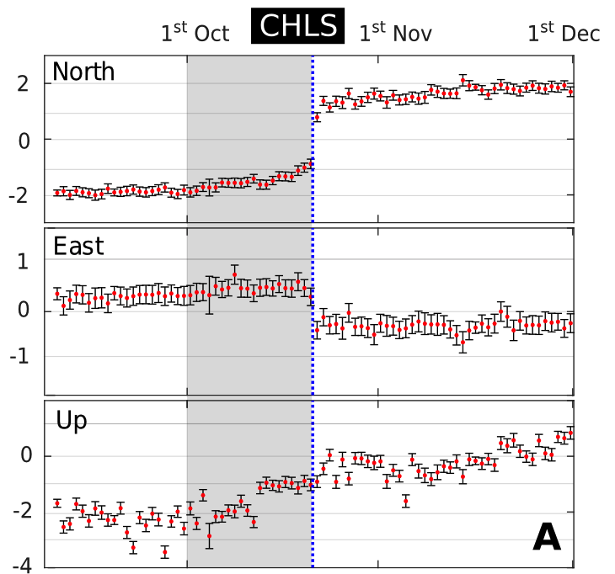
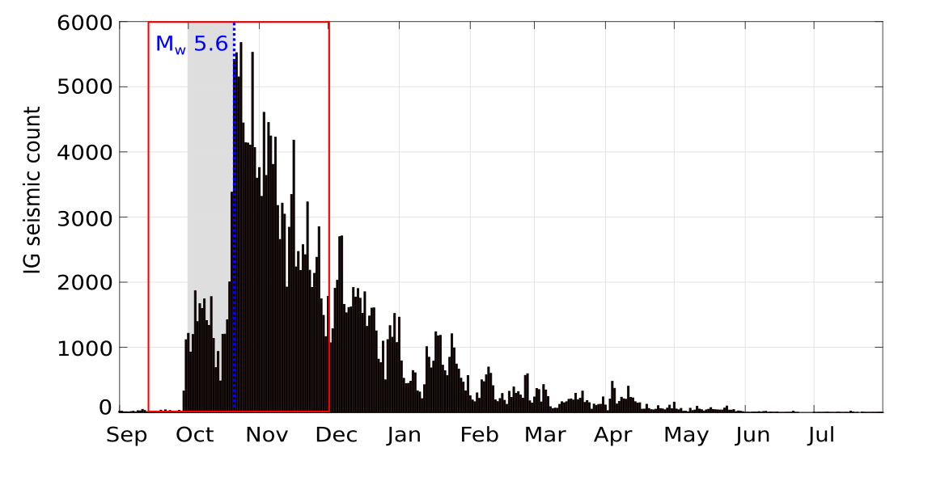
Results: Chiles – Cerro Negro

Slide 18
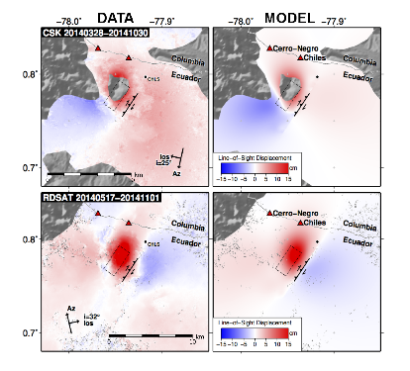
Results: Chiles – Cerro Negro
Cerro Negro
Chiles
Ground deformation – is it magma or “just” the earthquake?
TerraSAR-X
18th Oct- 27th Nov 2014

Slide 19
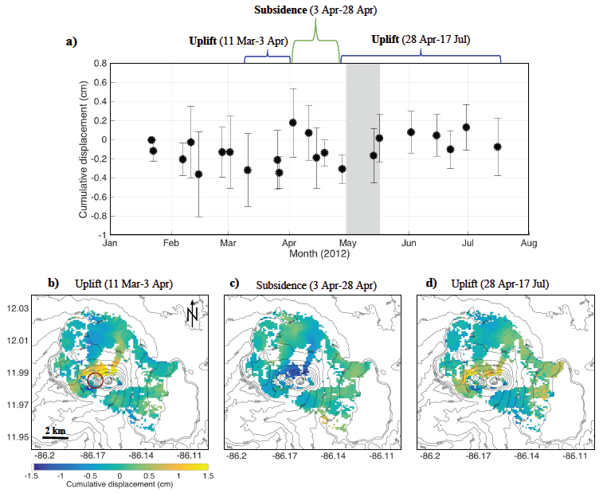
Results: Masaya (2012 explosions)
(data from Cosmo-SkyMed)

Slide 20
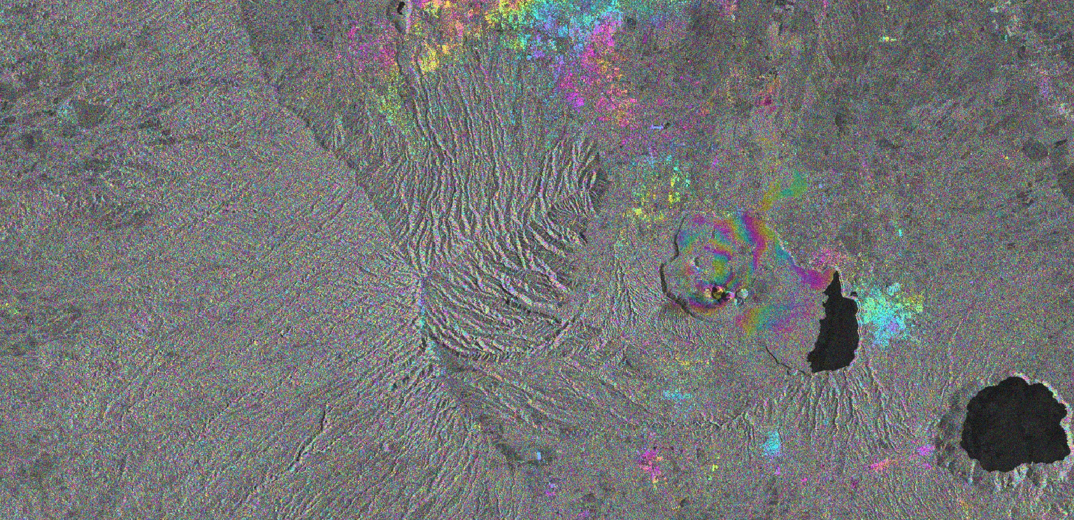
Results: Masaya (2015–2016)
0
1.55 cm
November 4, 2015 – May 14, 2016
Sentinel-1a, ascending track
Modeled source depth: 1.5 km

Slide 21
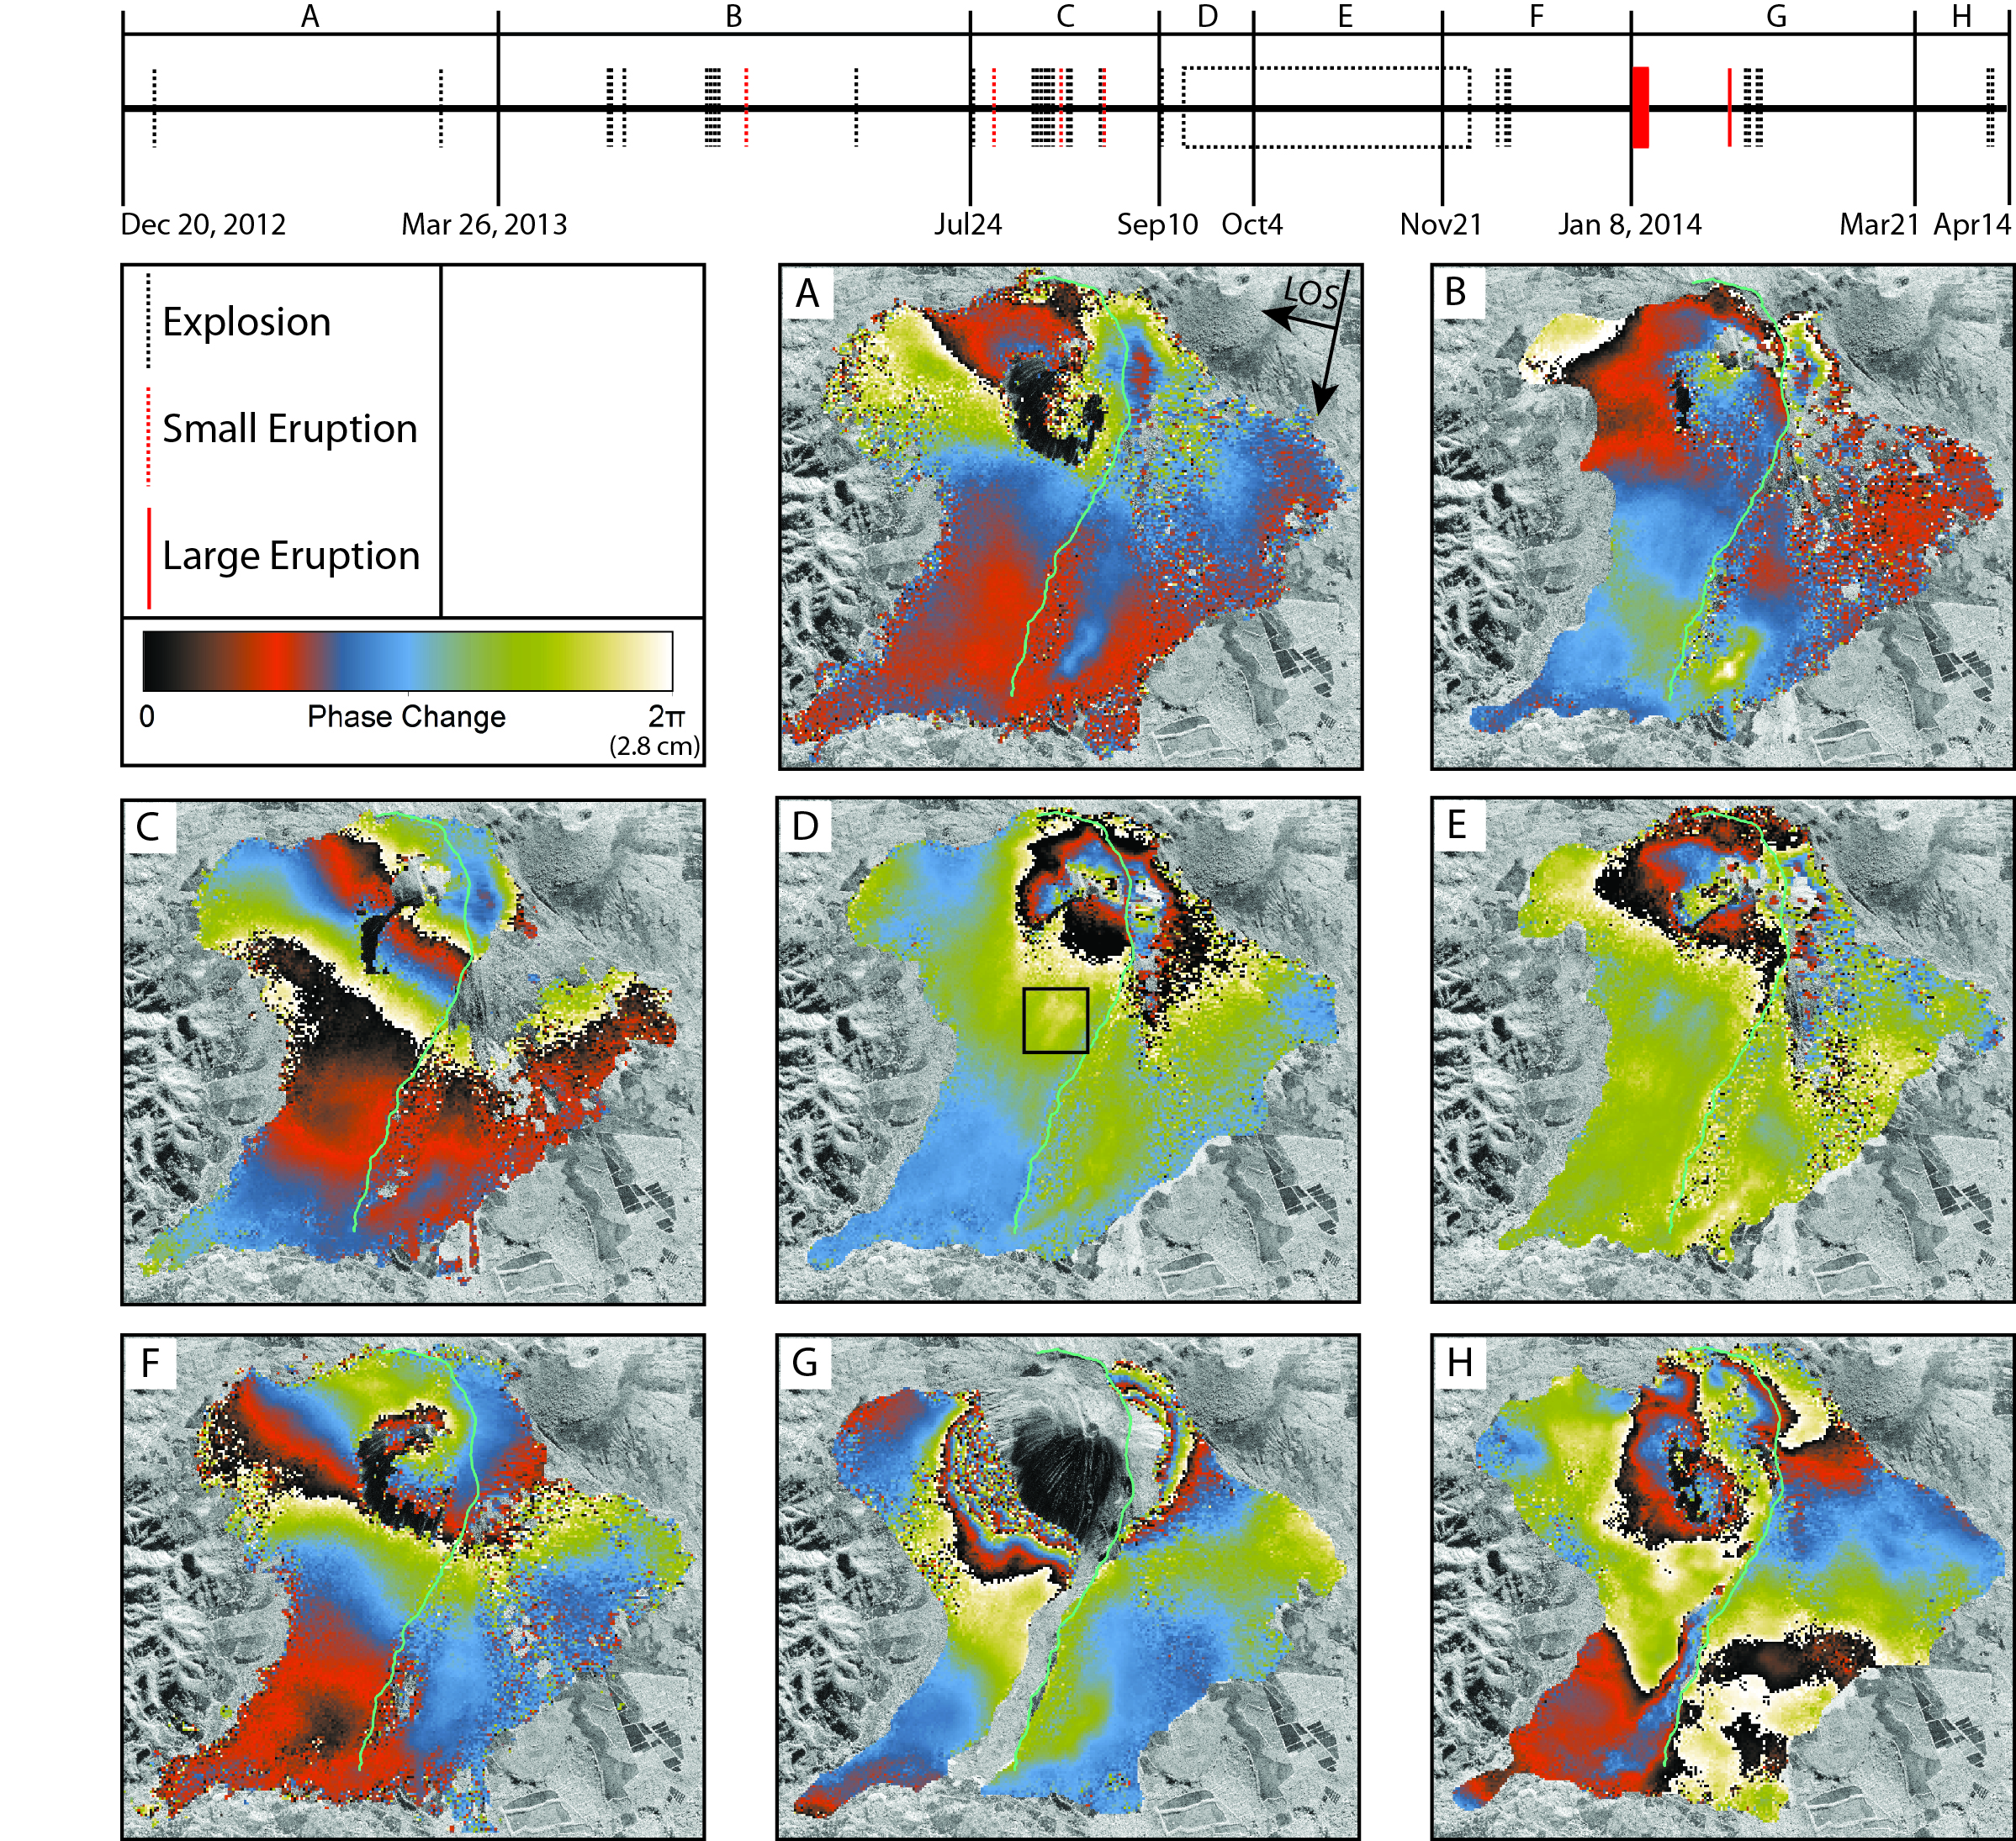
Results: Pacaya
Complex deformation of Pacaya, Guatelama, revealed by RADARSAT-2

Slide 22
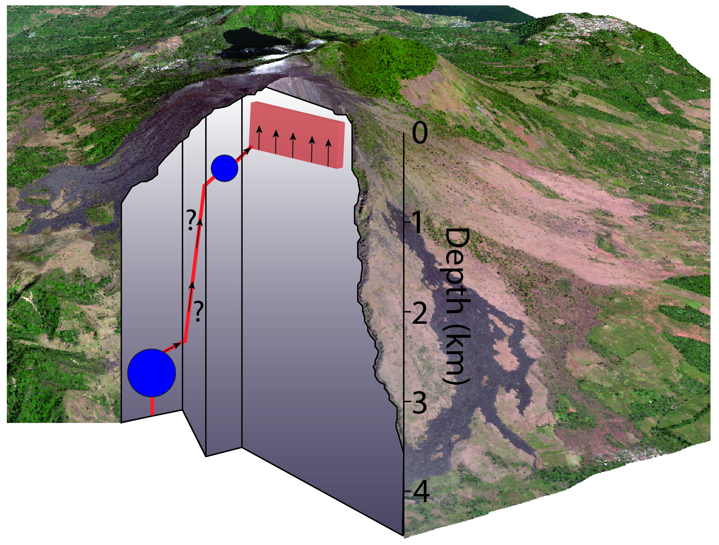
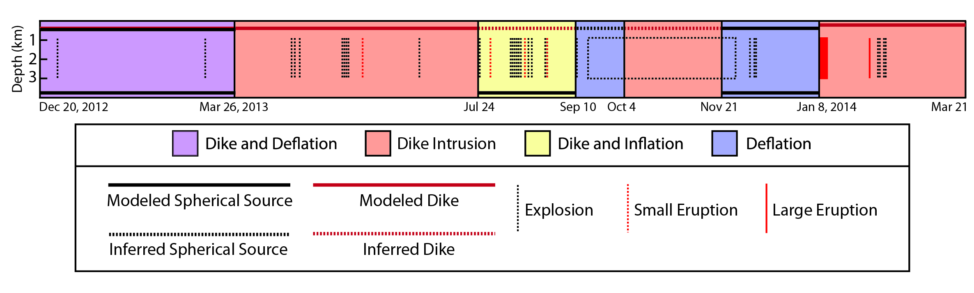
Results: Pacaya
Modeling of InSAR reveals the magmatic plumbing system at Pacaya

Slide 23
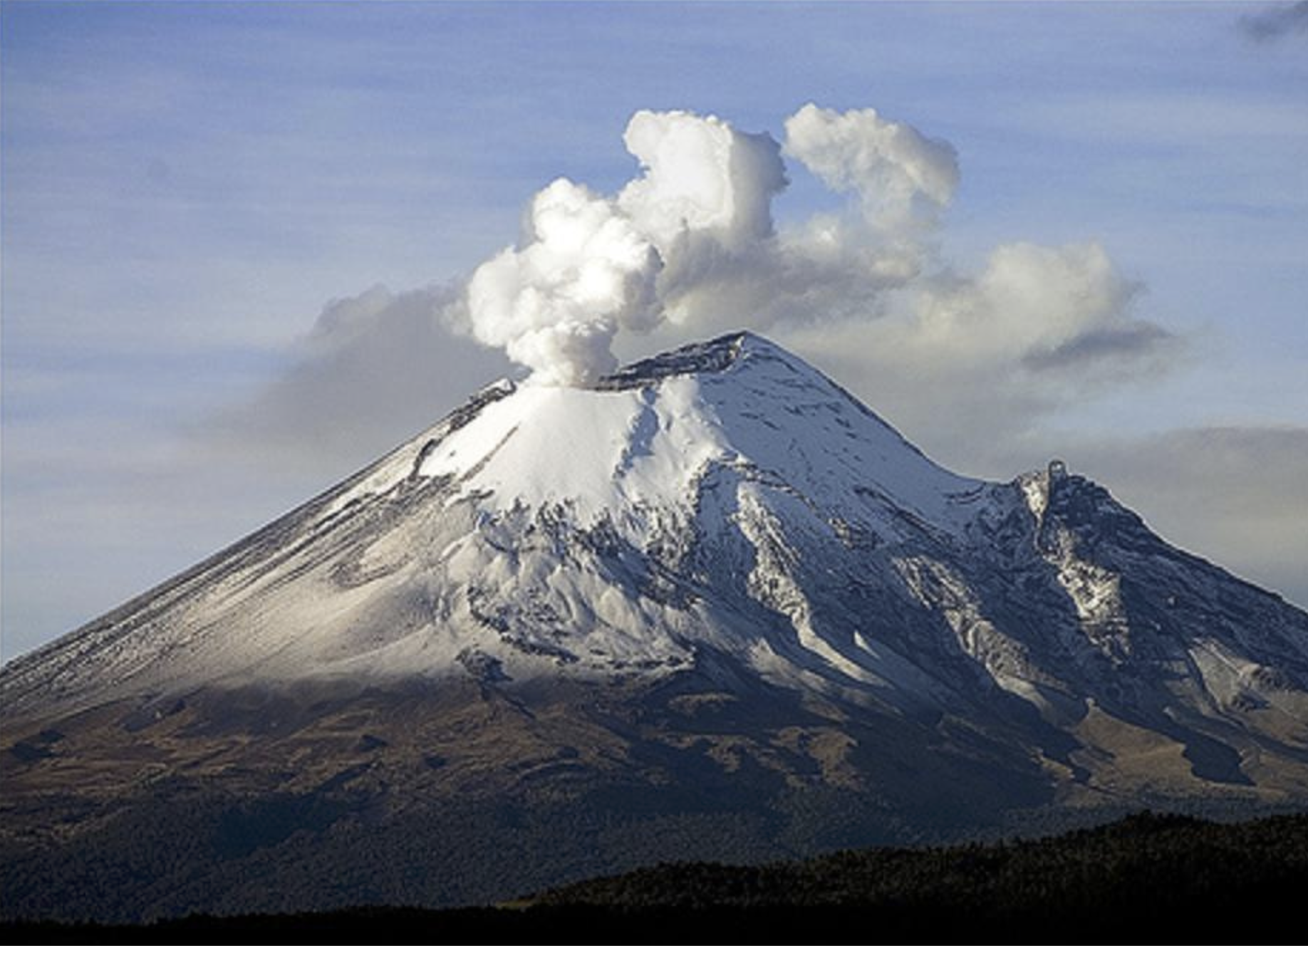
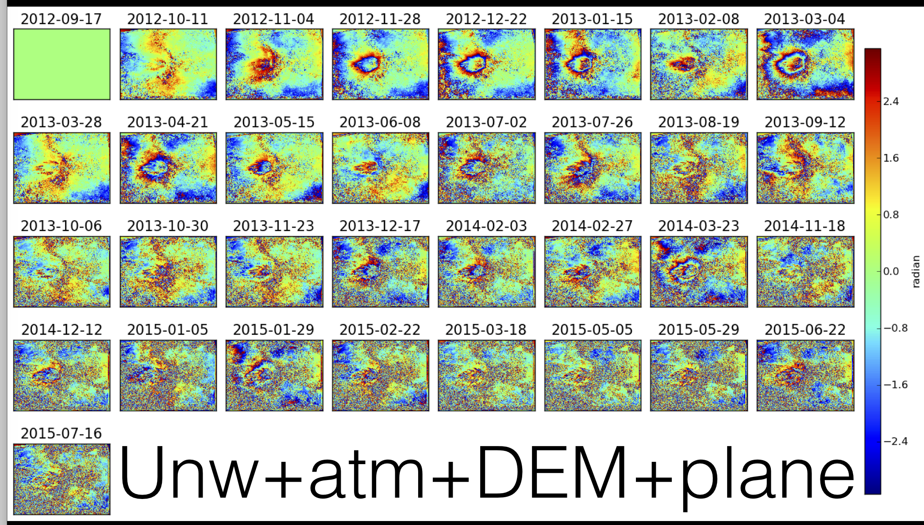
Results: Popocatepetl
Radarsat-2 displacement time-series
Next steps:
combine with TSX in collaboration with Thomas Walter, GFZ
use GPS zenith delays to assess troposphere
explore TSX over Colima

Slide 24
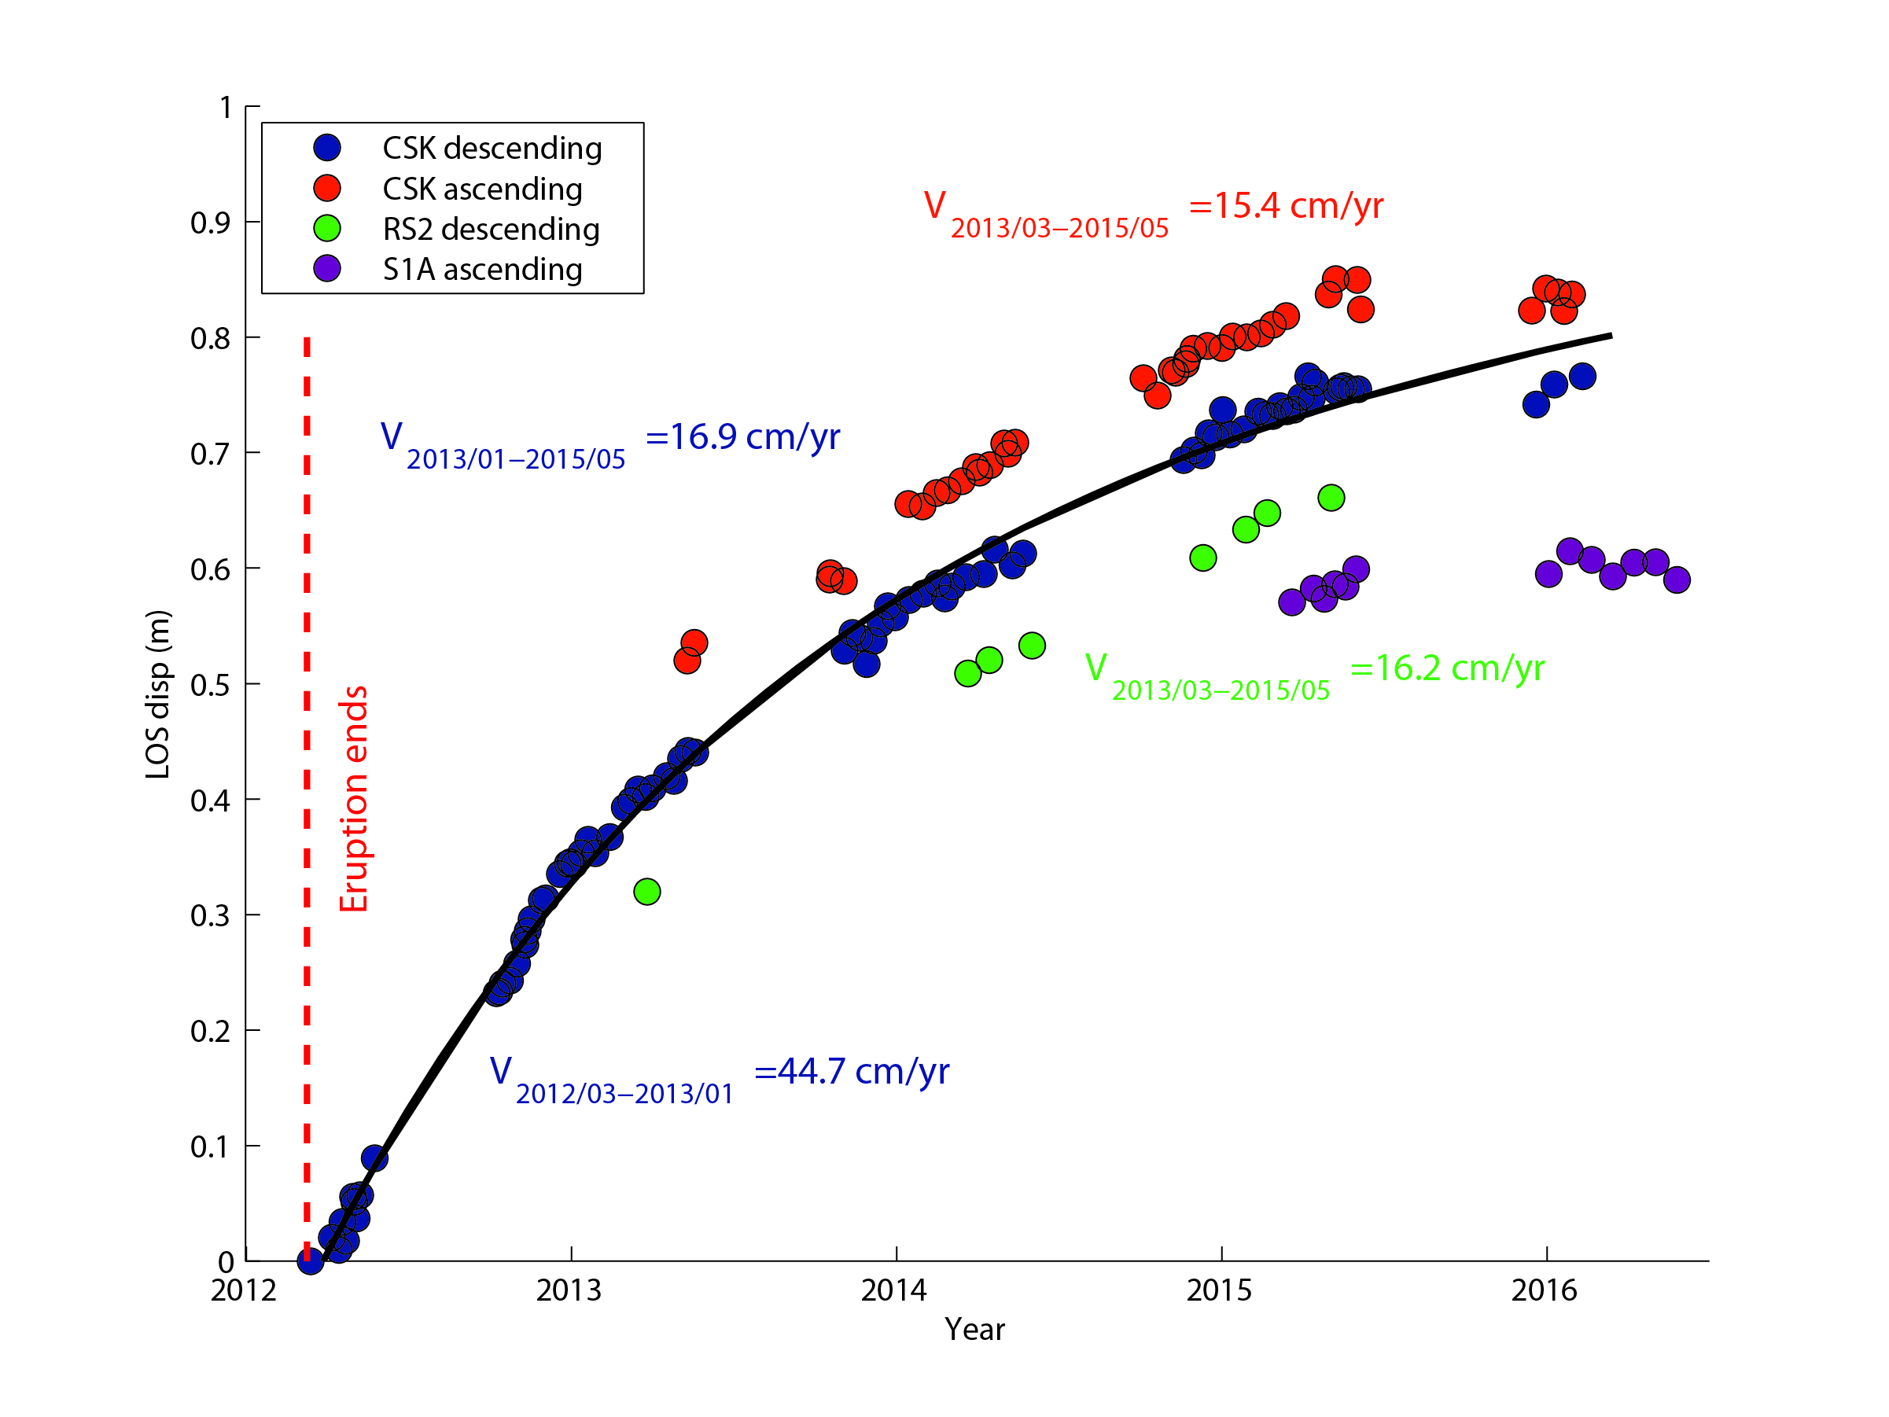
Results: Cordón Caulle
OVDAS installed 3 continuous GPS stations in response to interferograms showing inflation of Cordón Caulle

Slide 25
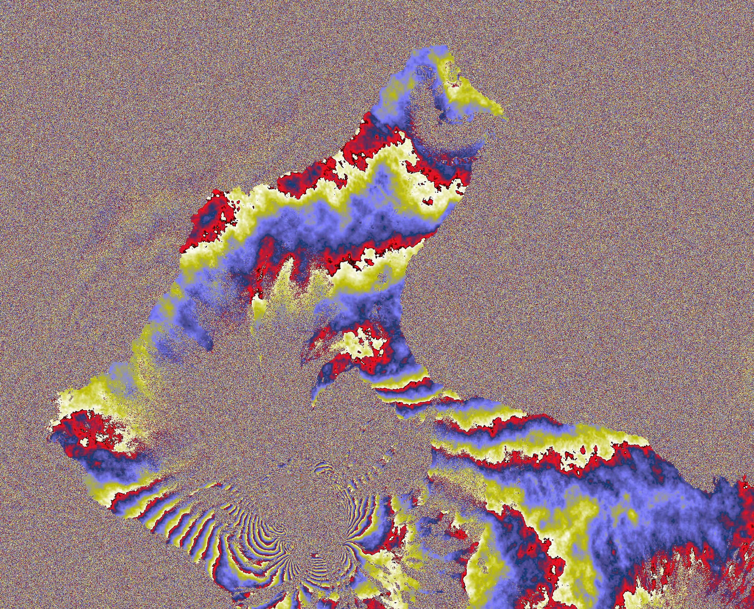
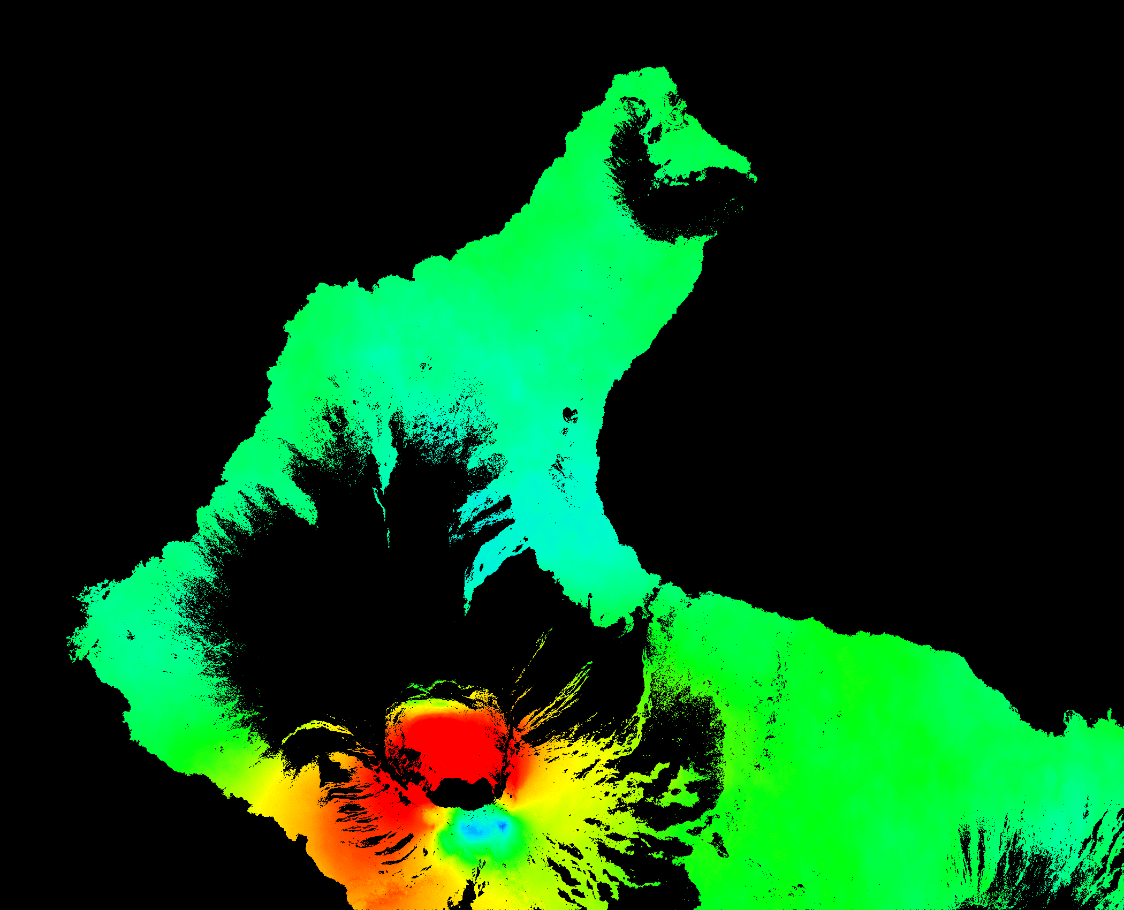
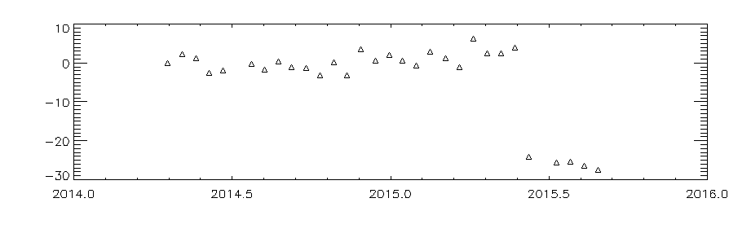
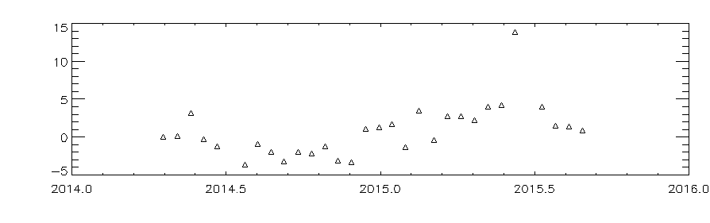
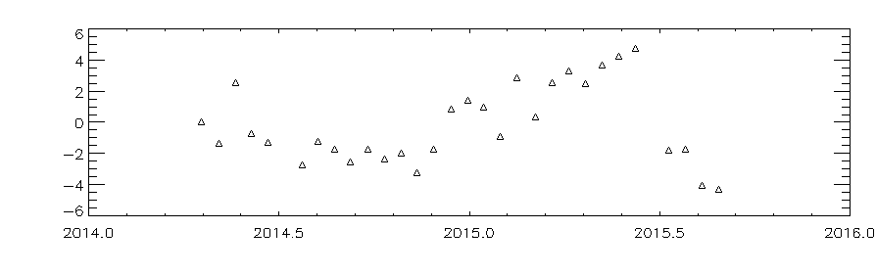
Results: Wolf
Eruption of Wolf volcano, Galápagos, May 25 – July 11, 2015

Slide 26
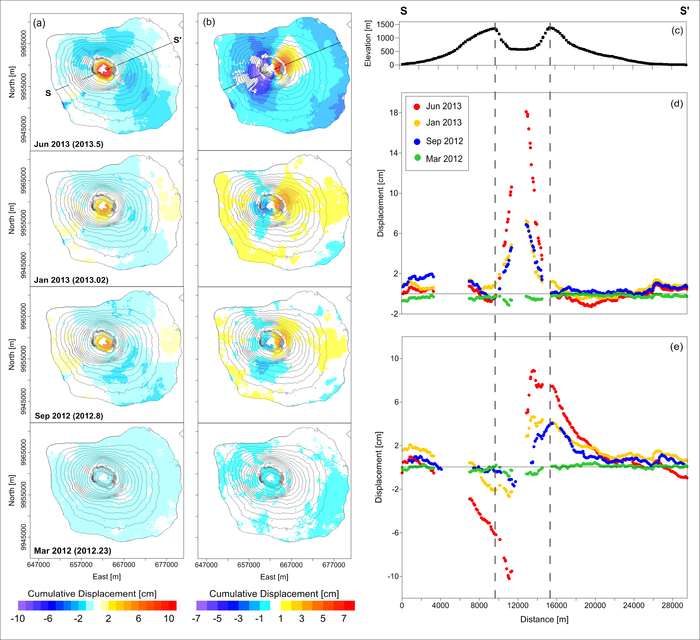
Results: Fernandina
Deformation of Fernandina volcano, Galápagos, in space and time

Slide 27
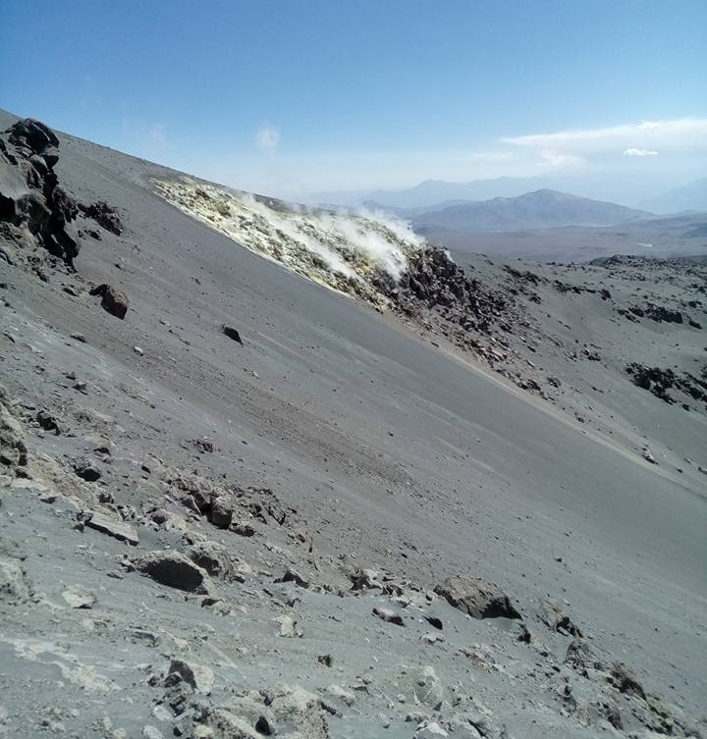
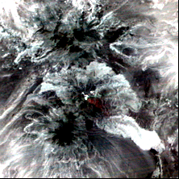
Results: Request from Peru
On August 31, 2016, OVS (Peru) sent a request to Matt Pritchard for thermal satellite imagery and InSAR covering fumaroles on the flank of Sabancaya volcano.

Slide 28
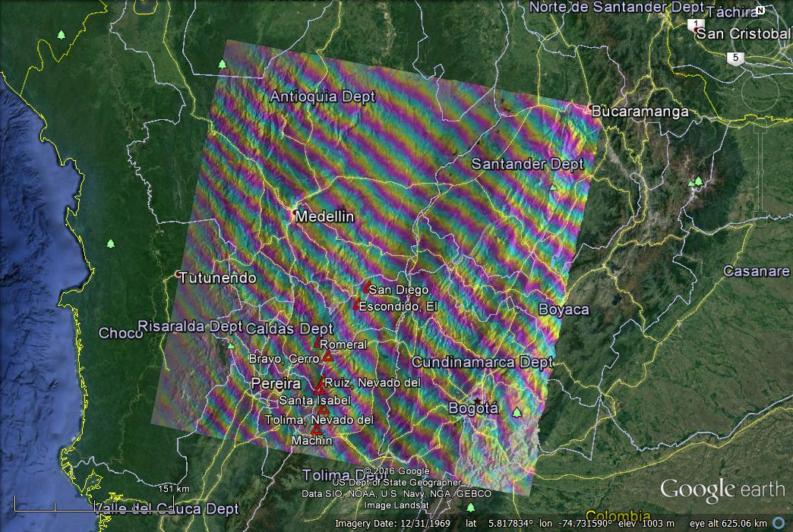
Results: ALOS2 broad-scale InSAR
July 28, 2015 – January 12, 2016

Slide 29
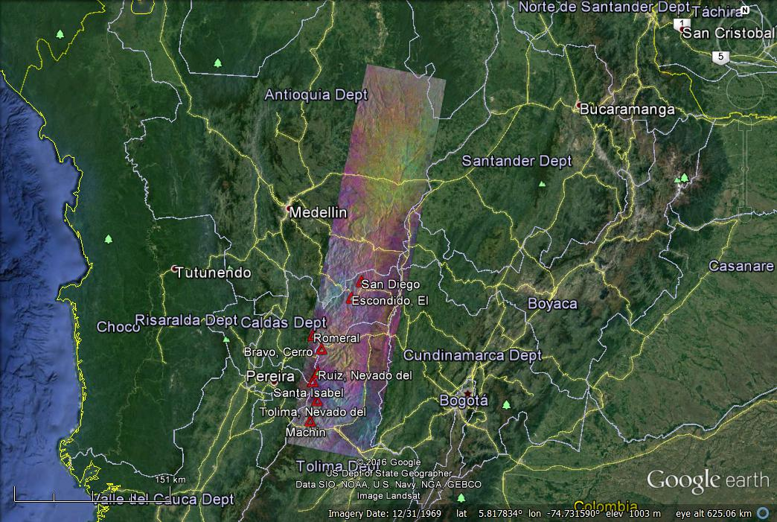
Results: ALOS2 broad-scale InSAR
July 28, 2015 – January 12, 2016

Slide 30
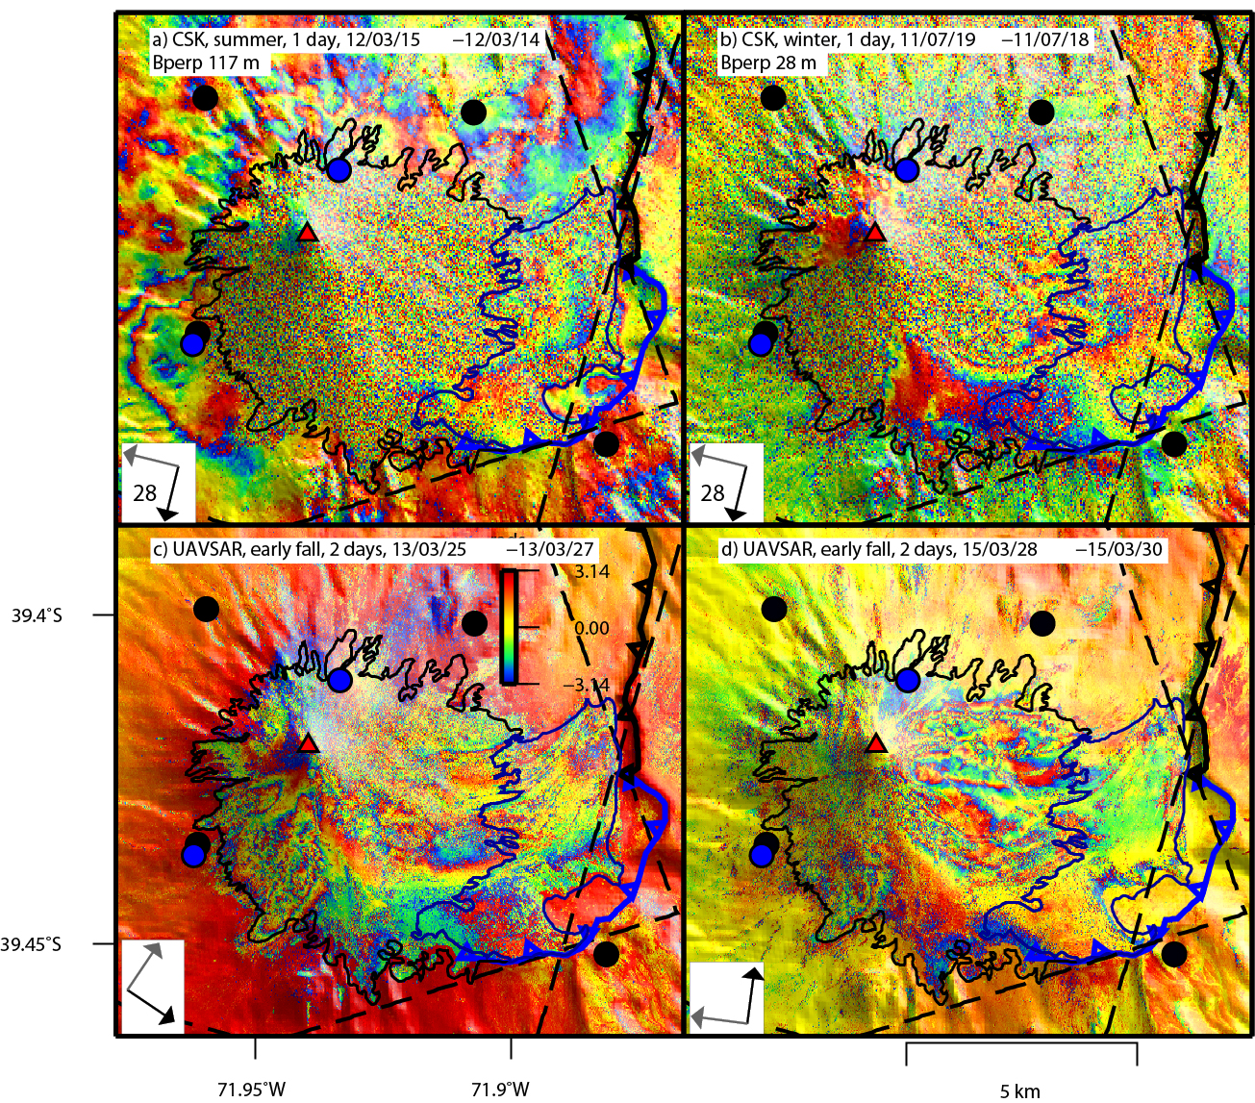
Results: Lessons learned
Villarica, Chile
The volcano is capped by a glacier. Even 1-2-day interferograms (X- and L-band) are not very coherent, implying that InSAR will not be useful for studying shallow magma dynamics.

Slide 31
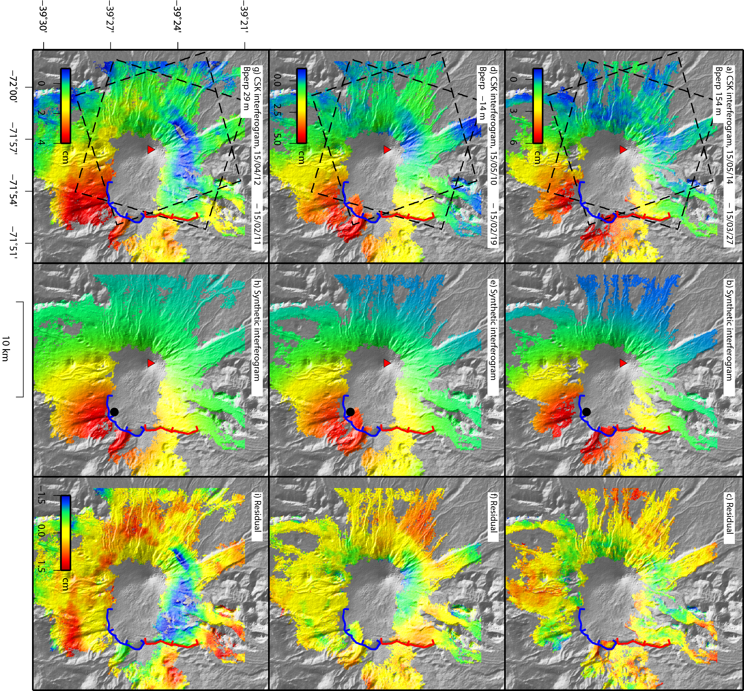
Results: Lessons learned
Villarica, Chile
Deformation may not be centered on the volcano. This means that extremely high resolution SAR scenes (like TSX Spotlight) of a volcano’s summit might “miss” volcano-wide deformation.

Slide 32
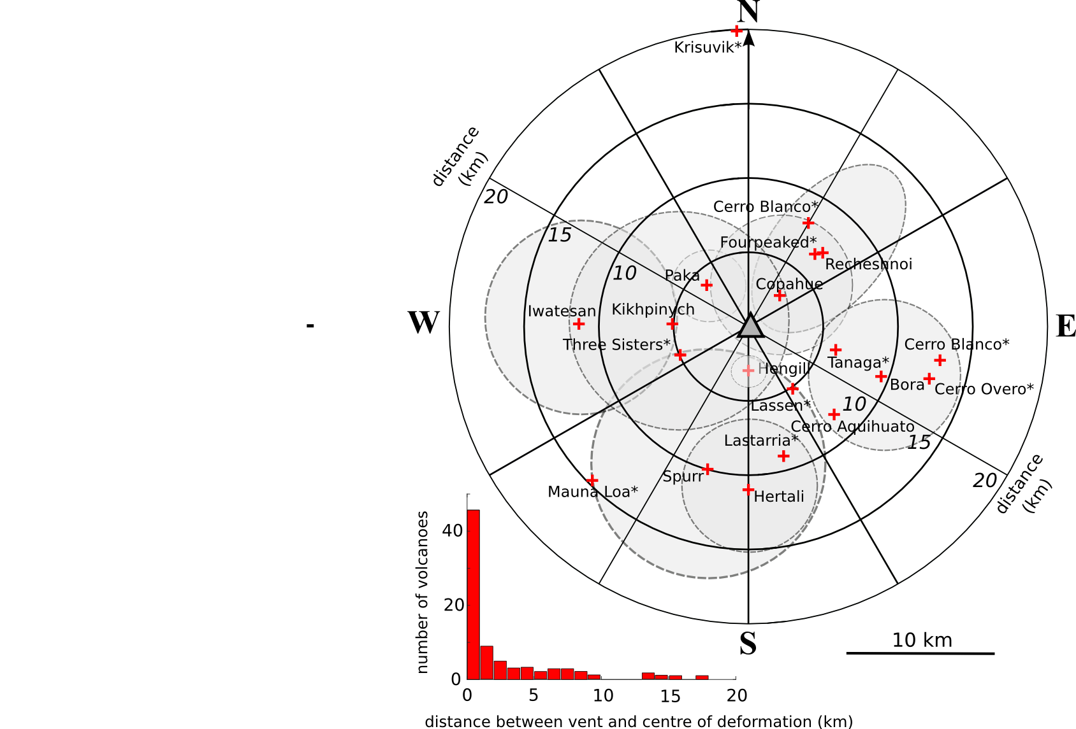
Results: Lessons learned
43 examples of deformation > 5 km from volcano associated with unrest
Eight observations of distal deformation associated with volcanic eruptions
Ten distal deformation signals associated with major earthquakes, ~25 have an unclear relationship with eruptive centres

Slide 33
Results: Lessons learned
Is there an ability to exploit the massive archive of CSK data (hundreds of scenes, in some cases) available over some volcanoes?
  Villarica
  Santiaguito
  Masaya
  Tungarahua
What are the spatial-temporal characteristics of deformation?
How frequently are acquisitions needed?

Slide 34
Results: Publications
Arnold, D. W. D., J. Biggs, G. Wadge, S. K. Ebmeier, H. M. Odbert, and M. P. Poland (2016), Dome growth, collapse, and valley fill at Soufrière Hills Volcano, Montserrat, from 1995 to 2013: Contributions from satellite radar measurements of topographic change, Geosphere, doi:10.1130/GES01291.1.
Delgado F., M. E. Pritchard, S. Ebmeier, P. Gonzalez, L. Lara (submitted), Recent unrest (2002-2015) imaged by space geodesy at the highest risk Chilean volcanoes: Villarrica, Llaima, and Calbuco (southern Andes), Journal of Volcanology and Geothermal Research.
Delgado, F., M. E. Pritchard, D. Basualto, J. Lazo, L. Córdova, and L. Lara (in press), Rapid re-inflation following the 2011-2012 rhyodacite eruption at Cordón Caulle volcano (Southern Andes) imaged by InSAR: evidence for magma chamber refill, Geophysical Research Letters.
Ebmeier, S. K., J. R. Elliott, J. M. Nocquet, J. Biggs, P. Mothes, P. Jarrín, M. Yépez, S. Aguaiza, P. Lundgren, and S. V. Samsonov (2016), Shallow earthquake inhibits unrest near Chiles–Cerro Negro volcanoes, Ecuador–Colombian border, Earth and Planetary Science Letters, v. 450, 283–291.
Stephens, K.J., S.K. Ebmeier, N.L. Young, and J. Biggs (submitted), Transient deformation associated with explosive eruption measured at Masaya volcano (Nicaragua) using Interferometric Synthetic Aperture Radar, Journal of Volcanology and Geothermal Research.
Wnuk, K. C., and C. Wauthier (submitted), Temporal evolution of magma sources and surface deformation at Pacaya Volcano, Guatemala revealed by InSAR, Journal of Volcanology and Geothermal Research.

Slide 35
Capacity Building
STREVA workshop in Pasto, Colombia: “Interpreting and modelling volcano InSAR” (will involve scientists from Colombia and Ecuador) – September, 2016
Cities on Volcanoes 9 workshop in Puerto Varas, Chile: “Interferometric Synthetic Aperture Radar (InSAR) Processing” – November 2016
IAVCEI workshop in Portland, OR, USA: “Volcano remote sensing” – August 2017

Slide 36
Sustainability: Questions
What elements of the pilot have proven to be successful, especially with regard to user interest and involvement? Are there specific elements that will be "missed" if stopped now? Which ones and why?
InSAR results, both crisis and non-crisis
Information about ash plumes
On-site training (Colombia, Ecuador, Peru, Chile, etc.)
All these elements would be “missed” because they provide both indications of potentially active volcanoes and situational awareness during eruptions

Slide 37
Sustainability: Questions
Are there elements of the pilot that are likely to be supported (possibly financially) from outside CEOS and the pilot going forward beyond 2017? If yes, what organizations might be willing to contribute to a sustainability plan?
A number of database projects (including the Powell Center) will continue beyond 2017
Outreach will continue via efforts like STREVA
USGS (Volcano Disaster Assistance Program) is a logical partner in sustainability

Slide 38
Sustainability: Questions
In considering successes that should go forward, do these involve a transition from research to operations? Are there data issues involved?
Operational effort MUST involve dedicated scientific personnel to coordinate work (FTE)
Data availability (mostly SAR, but also some thermal/optical) must be assured

Slide 39
Sustainability: Questions
Do you consider that data for the sustainable elements should come from CEOS, or from commercial providers, or some mix?
Data must come from a mix, but can be coordinated and supported by CEOS

Slide 40
Sustainability: Questions
Who are the key partners for achieving sustainability?
Academic institutions (can provide training as well as data processing/interpretation)
Operational institutions (e.g., USGS, NOAA)
Space Agencies
CEOS

Slide 41
Sustainability: Questions
Who are the main clients and users of the sustainable services?
Volcano Observatories
VAACs
Academic Institutions
Operational Institutions (e.g., USGS, NOAA)

Slide 42
Sustainability: Questions
What if any is the role for CEOS in the sustainable service?
Facilitating access to satellite data for use in hazards assessment/mitigation and disaster response (beyond the International Charter)

Slide 43
Sustainability: Questions
What are the largest threats to sustainability, and what are the consequences of not achieving a sustainable service as proposed?
Threats
Data availability
Need trained scientists to work on data, communicate with VOs, interface with space agencies
Consequences
Business as usual (VOs don’t get needed insights)

Slide 44
Sustainability: Questions
Does sustainability imply a simple continuation, or does it involve scaling something developed in the pilot to a global level, or other larger level? What is involved? Can you provide a description/vision of this larger system and what it entails from a cost perspective (using elements from the pilot as a the starting point for costing)?
Many possibilities, from regional to global, depending on the level of support

Slide 45
Sustainability: Paths forward
Tier 0 [Pre-pilot]
No coordinated global volcano observing strategy
Limited, ad hoc data availability from commercial satellites (ALOS2, CSK, DLR, RSAT2)

Slide 46
Sustainability: Paths forward
Tier 1a [no cost, just data]: continued regional activities
Quotas of satellite data from commercial satellites (write proposals, manage quotas, write reports)
Coordinated approach—teams of academics work with VOs
Best effort response to crises
Tier 1b [no cost, just data]: continued global activities
Larger quotas from commercial satellites (write proposals, manage quotas, write reports)
Coordinated approach—teams of academics for each region work directly with VOs
*Best effort response to crises

Slide 47
Sustainability: Paths forward
Tier 2a [some new funds]: expanded regional activities
Quotas of satellite data available from commercial satellites
Partial FTE to support project management: proposals, quotas, reports, telecons, communicate with space agencies and VOs
Coordinated approach—teams of academics work with VOs
Best effort response to crises
Tier 2b [no cost, just data]: expanded global activities
Larger quotas from commercial satellites
Partial FTE (larger fraction than with option a) to support project management: proposals, quotas, reports, telecons, communicate with space agencies and VOs
Coordinated approach—teams of academics for each region work directly with VOs
Best effort response to crises

Slide 48
Sustainability: Paths forward
Tier 3 [new funds]: scalable to regional or global
Large quotas of satellite data available from commercial satellites
One or more FTE's:
  Project management by a scientifically trained person: write proposals, manage quotas, write reports, communicate with space agencies and VOs, participate in telecons
  Routine, near real time data processing—interpretation and processing strategy needs continuous scientific input (not just an advisory board); who will do the work, who has the oversight, and how this will be funded needs to be worked out
Coordinated approach—teams of academics work directly with supported FTES and with VOs
Routine response to all crises (but how to decide what constitutes a crisis?)

Slide 49
Coming Up…
Prepare a Journal of Applied Volcanology article describing the results of our work, focusing on the value to end users
Develop broader space-based EO strategy using insights from pilot
Powell Center (2017–2019)
  15–20 volcano remote sensing experts
  Global in scope
  USGS sponsored
  Use existing databases to understand the best satellite indicators of potential eruptions
  Provide feedback to space agencies

Slide 50
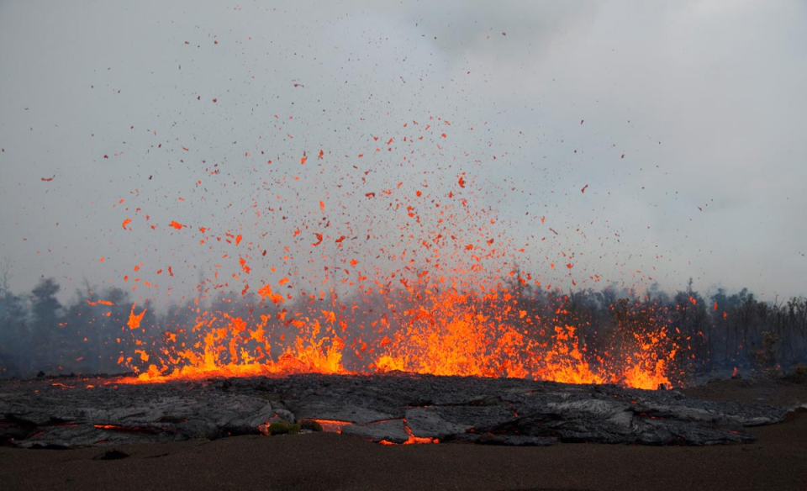
Thank you

