Slide 1
EO Contribution to Recovery Activities - A case study on the experience of the Great East Japan Earthquake -
Michio Ito (Mr.)
ito.michio@jaxa.jp
Space Applications and Operation Center
JAXA

Slide 2
Purpose of the presentation
To share the experience of the recovery process among CEOS partners to find the best approach on the use of EO for recovery activities
To find the best EO contribution to recovery activities through the experience of the Great East Japan Earthquake

Slide 3
The Great East Japan Earthquake (2011)
The M9.0 earthquake attacked at 70km east off the coast of Sendai, at 14:46 JST on March 11, 2011. The maximum seismic intensity was 7 and it was the largest earthquake ever recorded in Japan. About 30 minutes after the earthquake, very high tsunami, more than 10m in some areas, attacked the cities and towns along the east coast of Tohoku district.
By the earthquake and the tsunami,15,883 people died, 6,144 injured, 2,676 were missing (as of 12 Sep. 2012) and 470,000 people evacuated.
More than one million buildings were damaged (129,225 units totally collapsed, 254,204 half collapsed and 691,766 partially damaged).
The Fukushima Daiichi nuclear power plant lost its control and the residents within 20km radius of the power plant evacuated.
WB estimated the economic cost damage to be US$235billion, making it the costliest natural disaster in world history.
Some cities lost most of their people, facilities and houses as well as local governance functions
About one year after the disaster, Government of Japan established “Reconstruction Agency” as a “control tower” to accelerate recovery activity expects to complete reconstruction in no more than 10 years.
As of March 2016, 5 years from the disaster, reconstruction is still under way.

Slide 4
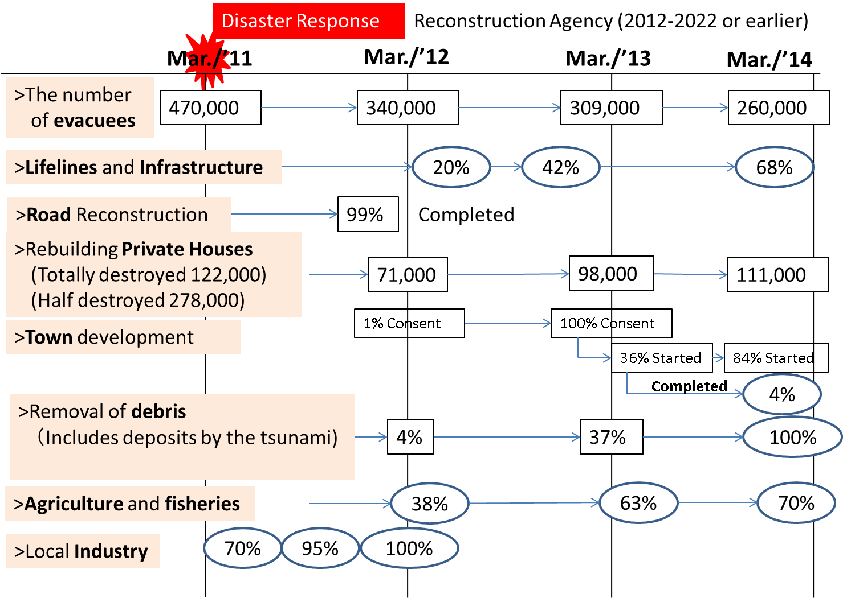
Recovery and Reconstruction Progress after the Disaster
( As of March 2016)
The data are from the HP of Reconstruction Agency
http://www.reconstruction.go.jp/
Present
term-limited)
Mar./’16
171,000
88%
126,000
43% relocation
99% started
46%
74%

Slide 5
Catastrophe of the Cities by the Great East Japan Earthquake
Some cities and towns lost almost of the lives, buildings and facilities in their areas as well as their governance functions.
City | Population (as of 2011) | Number of houses | Number of Killed+missing | Number of Destroyed Houses | Killed/City population | Destroyed/ houses in the city | Survival of City Governance
Rikuzentakata | 23,300 | 7767 | 446 | 3341 | 8.3% | 43% | NO
Yamada-cho | 18,617 | 6596 | 815 | 3184 | 4.4% | 48.3% | NO
Sendai | 1,045,986 | 464640 | 730 | 82560 | 0.1% | 17.8% | Yes
Ishinomaki | 160,826 | 57796 | 3892 | 24019 | 2.4% | 41.6% | NO
Kesen-numa | 73,489 | 25399 | 1404 | 10941 | 1.9% | 43.1% | NO
Higashi-matsushima | 42,903 | 13984 | 1138 | 10903 | 2.7% | 78% | NO
Onagawa-town | 10,051 | 4441 | 980 | 3934 | 9.8% | 89.2% | NO
Minamisanriku | 17,429 | 5288 | 902 | 3299 | 5.2% | 62.4% | NO

Slide 6
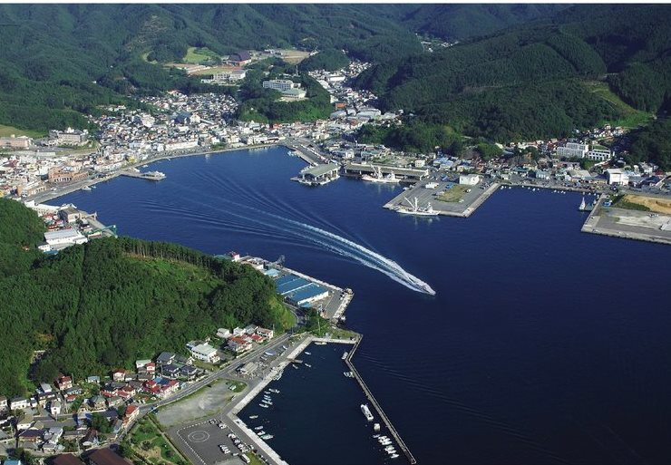
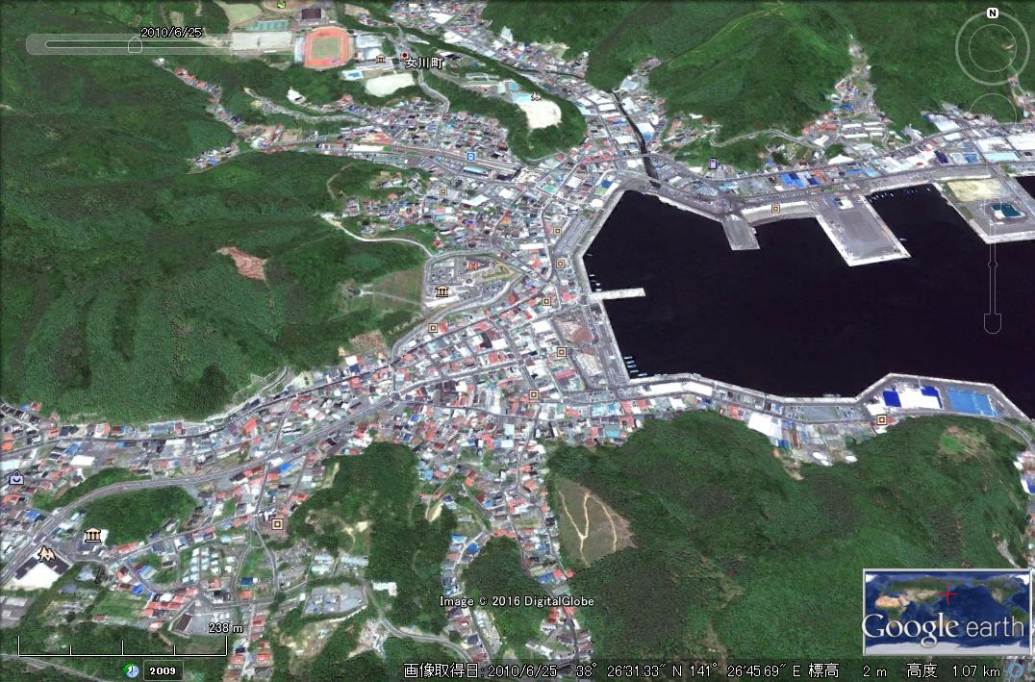
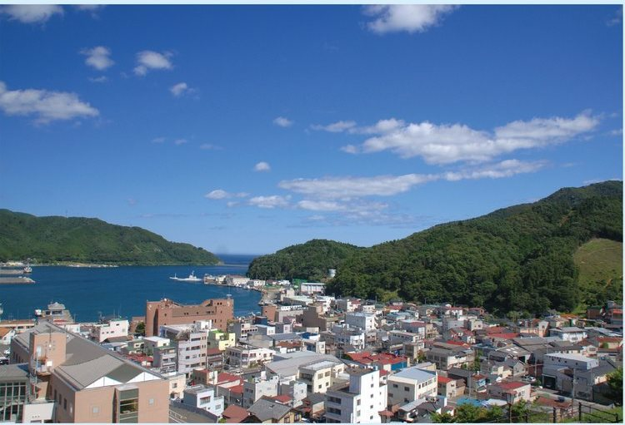
[Onagawa-town] March/2010 Before Disaster
Population ----- 10,051 (as of 2010)
Number of houses ------ 4441 units
Total town area ----- 65.8km²
Residential area ------ 3.6km²

Slide 7
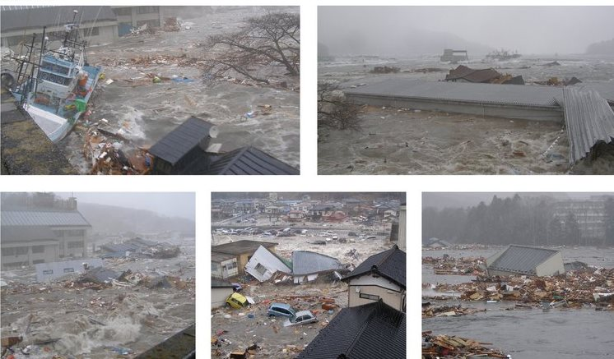
[Onagawa-town] March/11/2011 Tsunami Attacked
Earthquake
March/11, 14:46
Tsunami attack
March/11, 15:35
The maximum tsunami height 14.8m
The maximum tsunami run-up height 34.7m

Slide 8
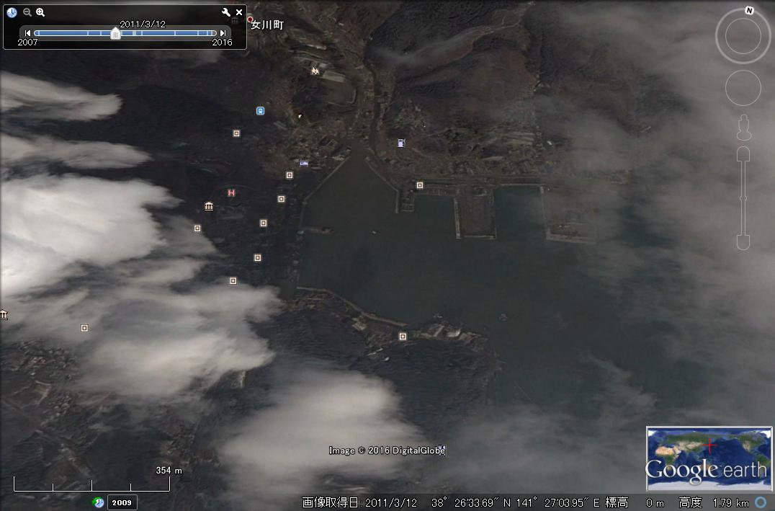
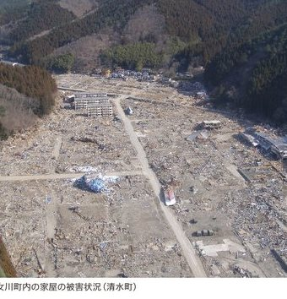
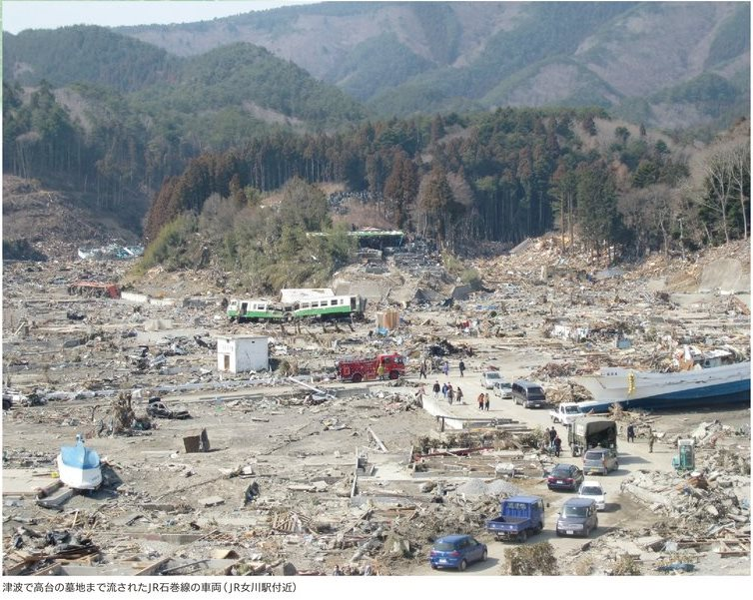
[Onagawa-town] March/12/2011 Catastrophe
March/12/2011 Google earth
©Digital Globe
Missing and Killed :
980 (9.8% of population)
Number of destroyed houses :
3934 units
(89.7% of total houses )
Inundated area :
3.2km²
(87.7% of residence area)

Slide 9
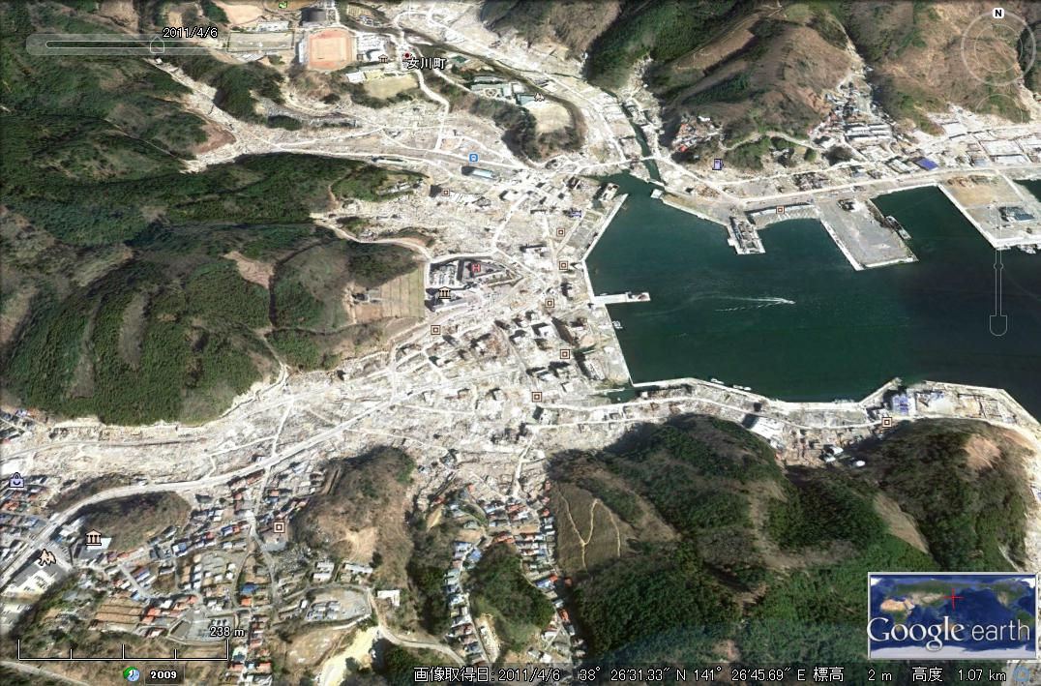
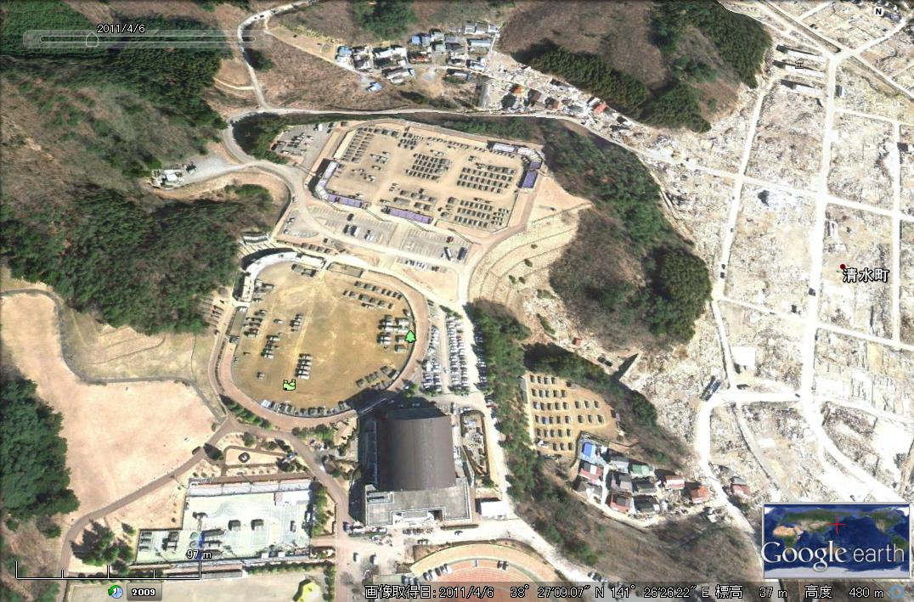
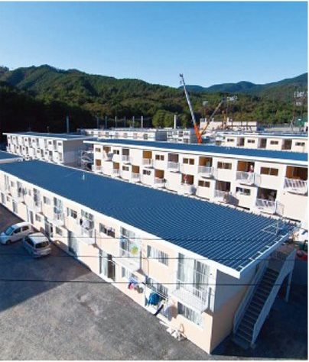
[Onagawa-town] April/06/2011 Temporary houses for evacuees
April/06/2011 Google earth
©Digital Globe
Temporary houses for evacuees had been constructed from April to July 2011 on top of the hills.
There still left a lot of debris in the devastated area.

Slide 10
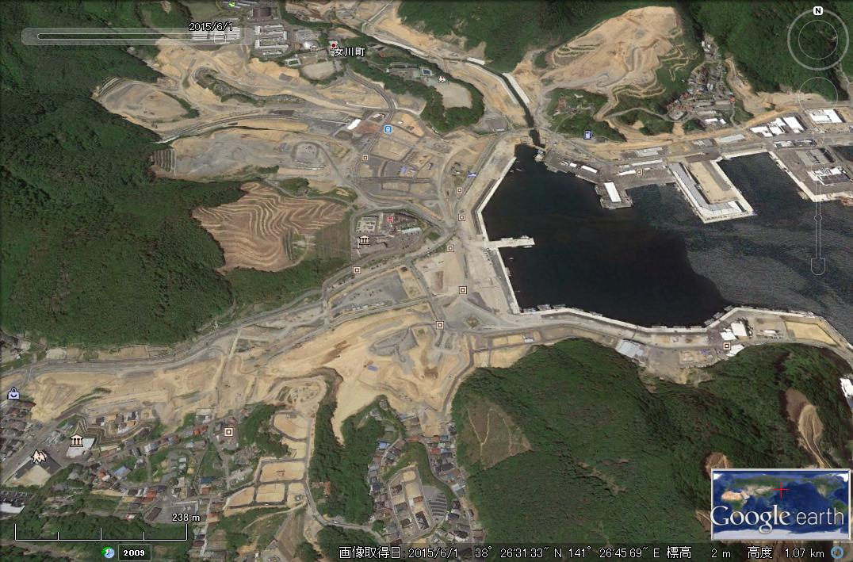
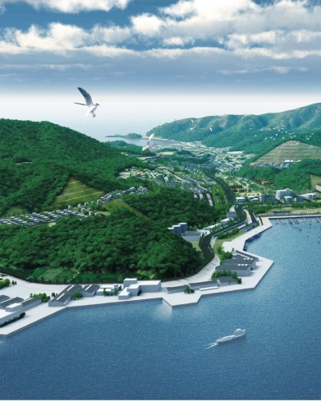
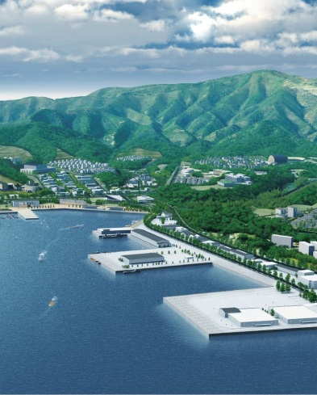
[Onagawa-town] At Present Resilient Town Development
June/01/2015 Google earth
©Digital Globe
Under construction toward town development.
Onagawa-town Reconstruction Plan
‘11-’12 : Recovery Phase
‘13-’15 : Infrastructure development phase
‘16-’18 : Full-scale reconstruction phase

Slide 11
Contribution of EO to Recovery Activities
a day – a week
days - months
weeks - years
Emergency Response
Temporary Recovery for Survivability
Full-scale recovery/reconstruction for resilience and sustainability
Damage identification
Damage monitoring
Search and rescue
Evacuation
Temporary villages for evacuees
Logistics and lifelines for survivability
Damage and loss assessment for economic support
Recovery/reconstruction planning
Resilient town development
Rebuilding permanent houses/facilities
Agriculture, fishery and industrial reconstruction
Recovery of social, economical activities
Disaster Response Activities
Damage Identification
GI for search and rescue
Hazard Map Safety Map
Hazard/Safety Map for recovery planning
Products
Specific products by requests
Recovery Monitoring
Periodic Observation for process control and records
Emergency Observation
Observation under specific request
Periodic Monitoring
EO by satellites
Earth Observation and GIS products

Slide 12
Summary and Conclusions
Japan’s progress in recovery from the Great East Japan Earthquake was summarized.
Recovery of Onagawa-town, which had been devastated and wiped out all the life foundation by the disaster, is now in progress toward a resilient town against disaster.
From the experience of the Japanese recovery progress, recovery phase can be categorized “temporary recovery” and “full-scale recovery (reconstruction)” phase.
Temporary recovery” phase requires geographic information to find safe and easy accessible/supportable location at its early stage.
“Full-scale recovery” phase requires geographic information to develop “recovery plan” as well as the periodic observation for process control and the records of the progress.
“Recovery plan” with the goal and the milestones of the recovery/reconstruction process is important to identify “recovery ” .
Both emergency EO and recovery monitoring are important to contribute to the recovery activities.

Slide 13
ALOS-2 Observation, 2016 Kumamoto Earthquake

Slide 14
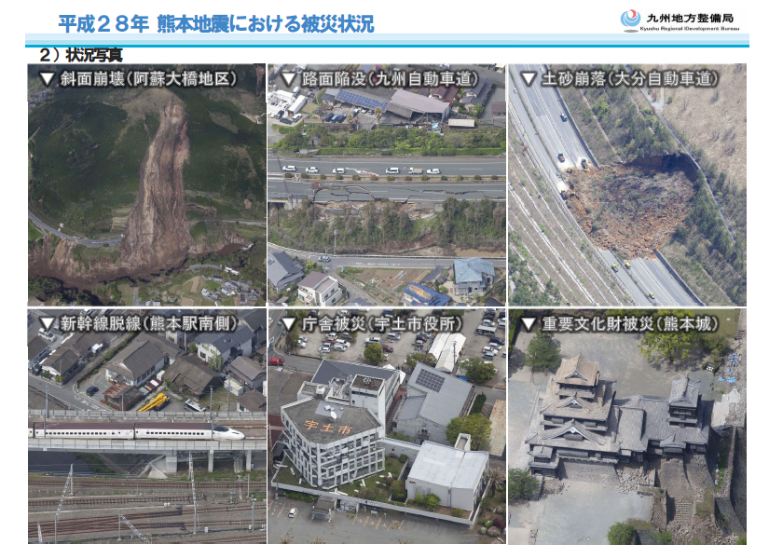
“2016 Kumamoto Earthquake” in Japan
April 14, 2016, 21:26 The Foreshock attacked Kumamoto prefecture. Mw=6.3, maximum seismic intensity=7 was almost the same scale as that of the Hanshin Awaji Great Earthquake in 1995.
April 16,2016, 01:25 The main shock attacked Kumamoto Prefecture. Mw=7.3, max. seismic intensity=7 was greater than the foreshock. It killed more than 20 people and damaged more than 40,000 houses.
More than 130 landslides were observed by aircrafts/satellites earth observation.

Slide 15
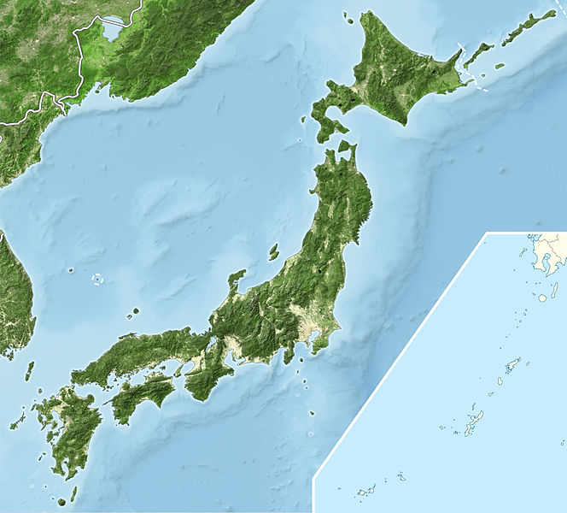
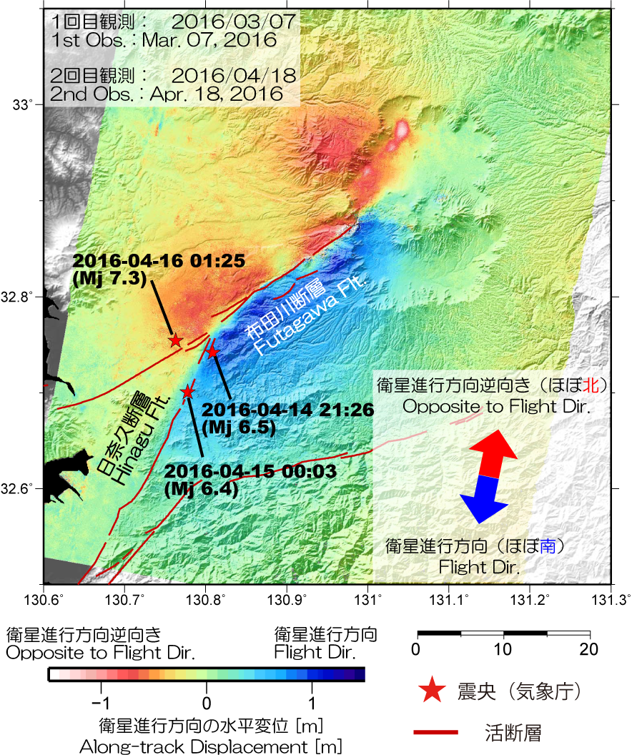
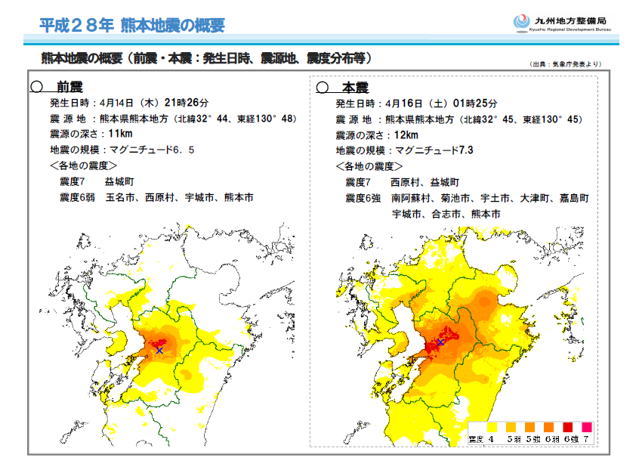
“2016 Kumamoto Earthquake” in Japan
InSAR Analysis using ALOS-2/PALSAR-2 EO data identified two active faults as causes of the earthquakes in Kumamoto Prefecture.
Kumamoto Prefecture in Kyushu
Epicenter
Active fault
source: http://www.gsi.go.jp/BOUSAI/H27-kumamoto-earthquake-index.html#3
©GSI（Geospatial Information Authority of Japan), data provided by JAXA

Slide 16
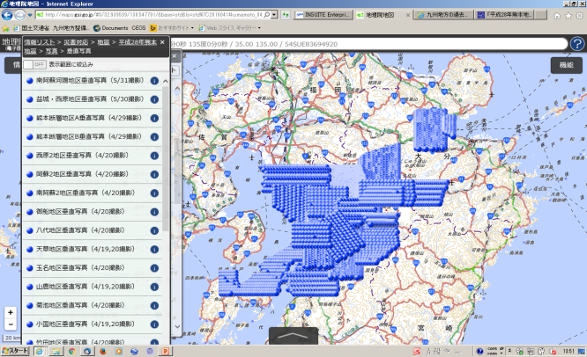
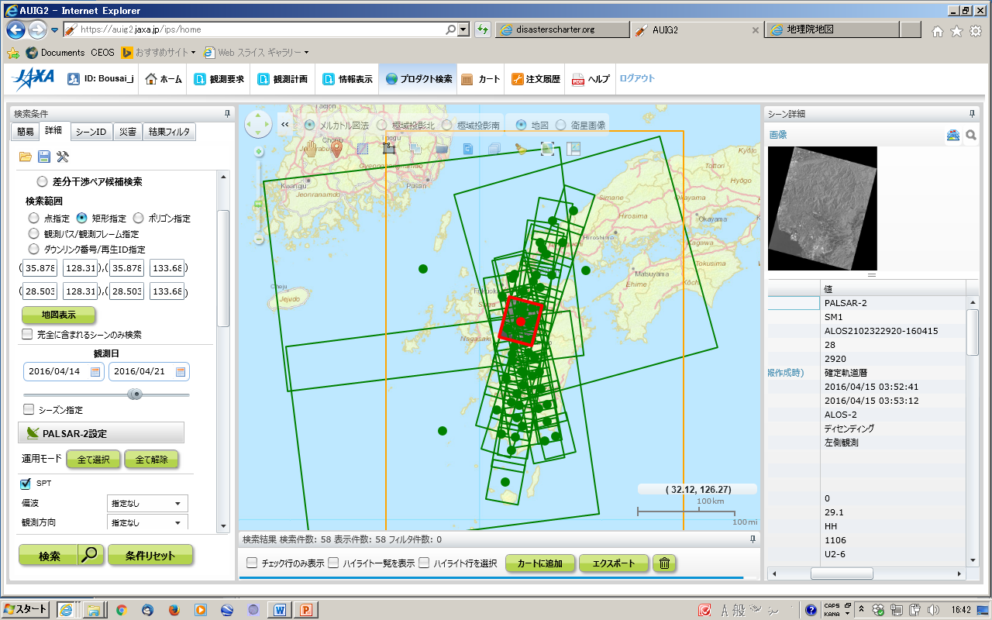
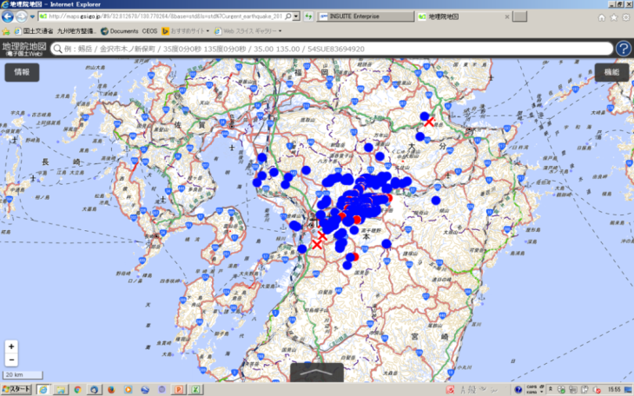
Aircrafts observation plots
(14/April – 31/May)
http://maps.gsi.go.jp
©GSI,Japan
Satellites observed area
(15/April – 20/April)
http://maps.gsi.go.jp
Identified landslides by aircrafts/satellites observation
http://maps.gsi.go.jp
©GSI,Japan

