Slide 1

Status of the GSNL initiative
Stefano Salvi
Chair of the Supersites Advisory Committee
CEOS WG Disasters, Bonn, March 2016

Slide 2

The Geohazards Supersites
& Natural Laboratories
A voluntary partnership aiming to demonstrate in specific areas of the world (the Supersites) the advantages of global collaboration on geohazard research to provide visible benefits for local Risk Prevention and Response activities.
Specific goals:
Promote scientific advancements in geohazard research through easier data access and international collaboration
Promote a more direct uptake of scientific results in local prevention and response activities for seismic and volcanic risks
Promote knowledge transfer on geohazard research

Slide 3
Active Supersites
Hawaiian volcanoes – USGS
Icelandic volcanoes – Univ. of Iceland & IMO
Etna volcano – INGV - Catania
Campi Flegrei volcano – INGV - Naples
Western North Anatolian Fault – KOERI - Istanbul
Taupo Volcano – GNS Science - Lower Hutt
Tungurahua and Cotopaxi volcanoes – IGEPN - Quito
Gorkha Earthquake Event Supersite (April 25, 2015)

Slide 4
Supersites proposals
Greek Supersite – Coordinator: ITSAK, Athens: reviewed in November by three experts, revised proposal to be received in April. Some issues still pending.
South East Asia Natural Laboratory. It is going to be reduced to a Supersite proposal, then after 2 years the NL might be re-evaluated. To be received in April.
San Andreas fault Supersite – Initial draft by USGS. Should be re-submitted using new template.

Slide 5
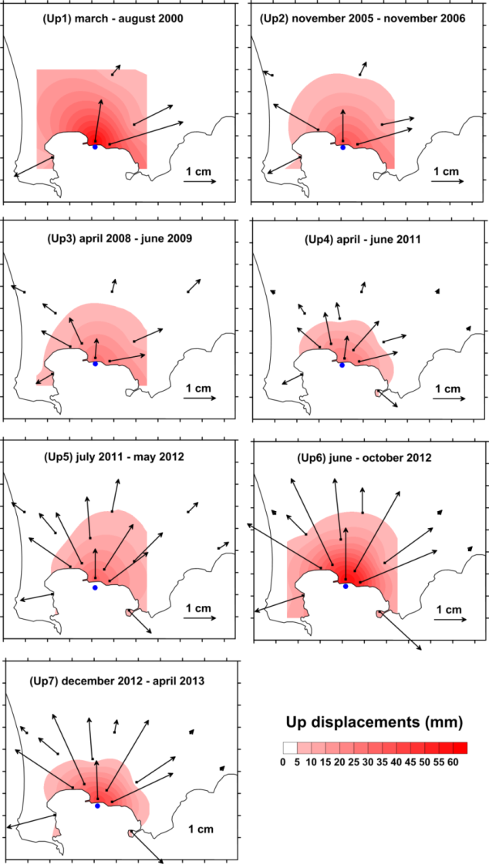
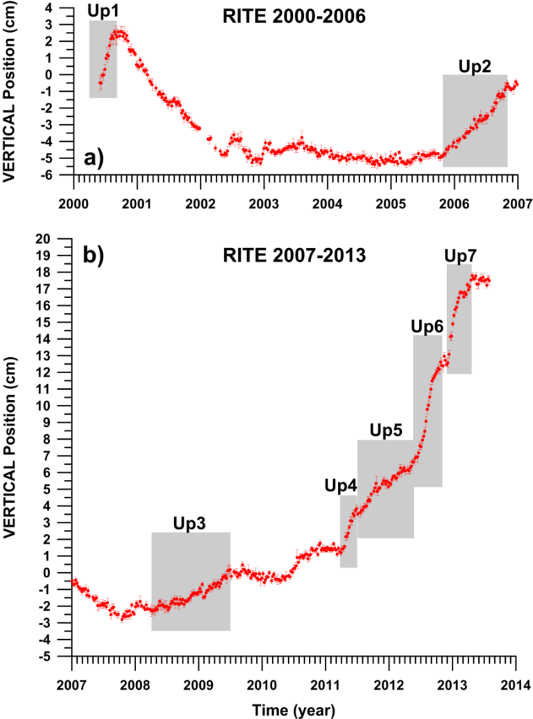
Supersites results: unrest at Campi Flegrei
Deformation pattern from cGPS data (2000-2013)
P. De Martino et al., 2014
Notes:
Seven main uplift episodes were detected, and during each uplift period, the recurrent horizontal displacement pattern, radial from the “caldera center”, suggests no significant change in deformation source geometry and location occurs
Figure left: GPS weekly time series of Vertical component for station RITE: a) 2000-2006 time span; b) 2007-2013 time span. The gray box indicate the selected seven uplift periods (Up1, 20 Up2…..,Up7).
Figure right: The vectors show the magnitude and direction of displacement of each continuous GPS station during the selected 7 uplift periods in Figure left. For each period have shown the position of the source obtained by means joint inversion of horizontal and vertical displacements, and uplift map.

Slide 6
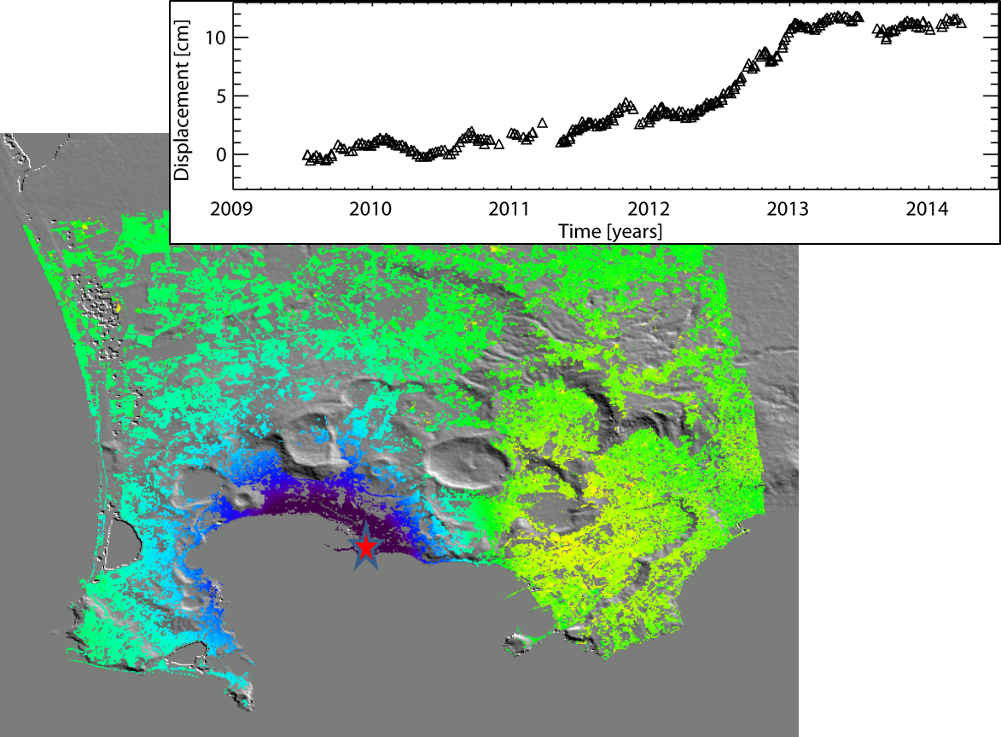
Supersites results: unrest at Campi Flegrei
> 3
298 Images
921 Interferograms
Multi-look factor in both directions (10x10)
DEM SRTM
[cm/year]
< -3
CSK Ascending Mean Velocity Map (2009-2014)
Credits: IREA-CNR, MED-SUV Project

Slide 7
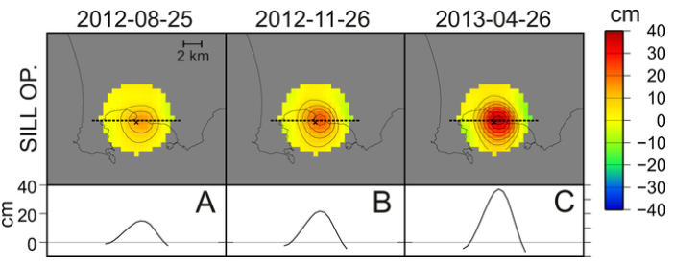
Supersites results: unrest at Campi Flegrei
Magma migration in a sill-like source at 3100 m depth,
for a volume of 0.004 km³
D’Auria et al., 2015. Scientific reports, 5

Slide 8
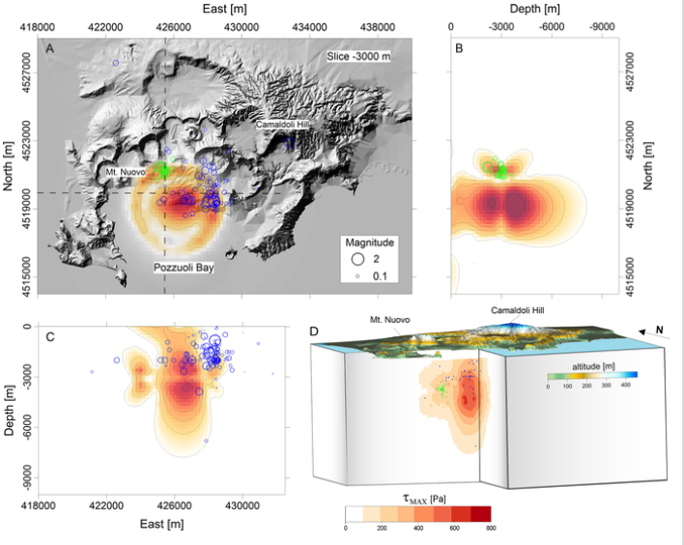
Supersites results: unrest at Campi Flegrei
Model validated by seismic data
D’Auria et al., 2015. Scientific reports, 5

Slide 9
Campi Flegrei deformation monitoring
Main decision making agency: Dept. of Civil Protection (DPC)
Main scientific institution in charge: INGV
Collaborating scientists: IREA-CNR
InSAR and GPS data are cross-validated and used to constrain source models (together with other in situ data).
The 11 cm uplift recorded in the April 2012—January 2013 period ( cm with a peak of 3 cm/month) led DPC to raise the alert level of the volcano from “background” to “attention”.

Slide 10
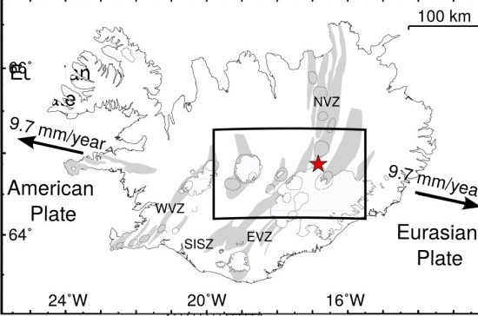
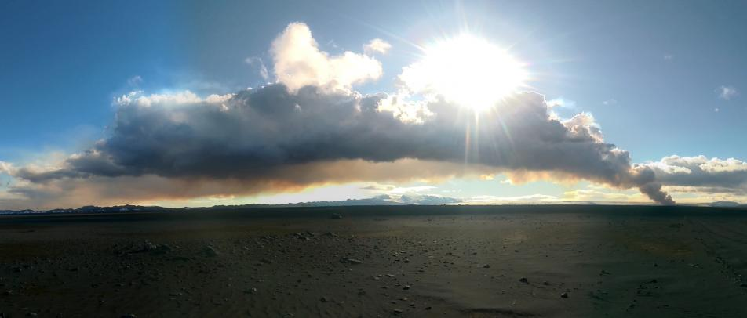
Supersites results: the Bardabunga eruption
Eruption starts August 16, 2014 under a 800 m - thick ice cap. Worst scenario was magma/water interaction, causing strong explosions, 10-km high volcanic ash/gas plume, subglacial floods.

Slide 11
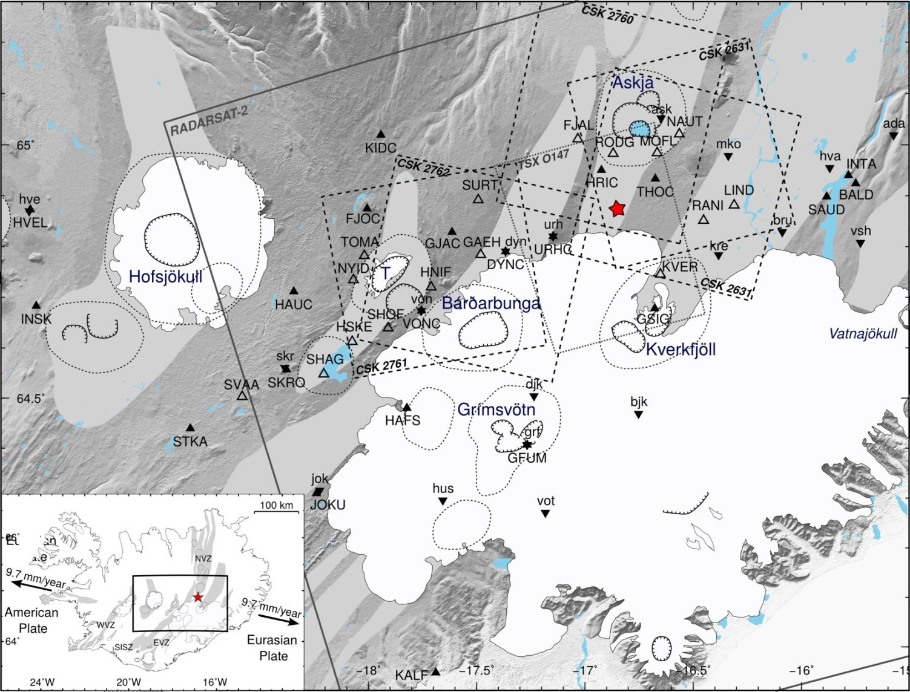
Supersites results: the Bardabunga eruption
Very good EO data coverage through the Supersite

Slide 12
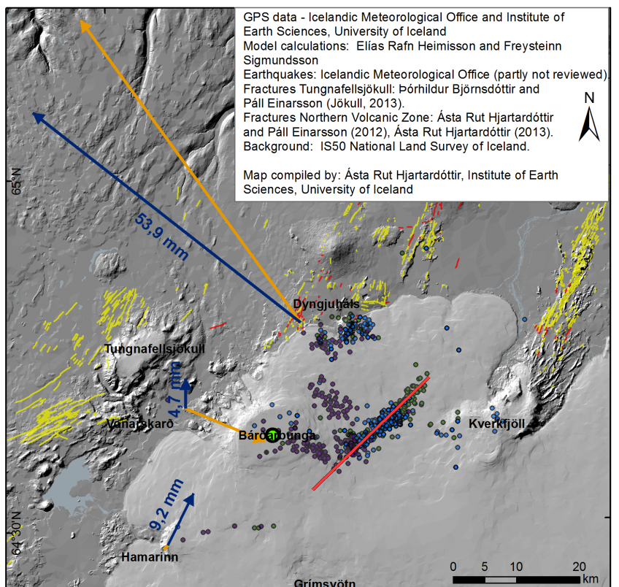
Supersites results: the Bardabunga eruption
August 20th: seismicity starts to migrate north

Slide 13
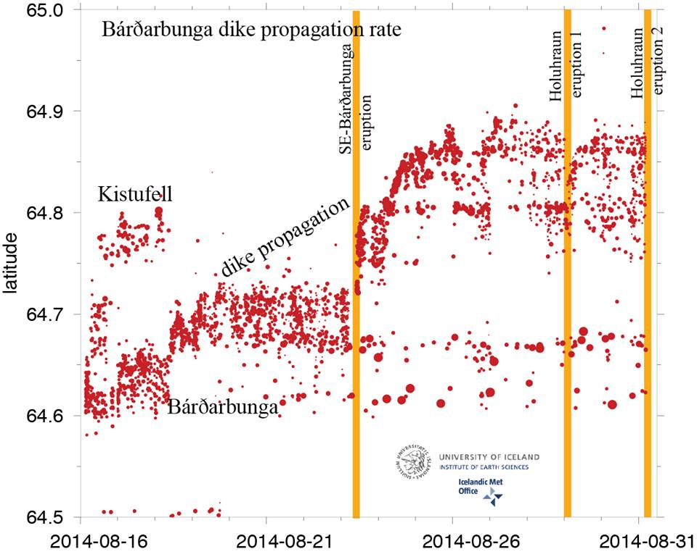
Supersites results: the Bardabunga eruption
Magma migrates 40 km to the north, outside of the ice cap
Bryndís Brandsdóttir, Univ. of Iceland

Slide 14
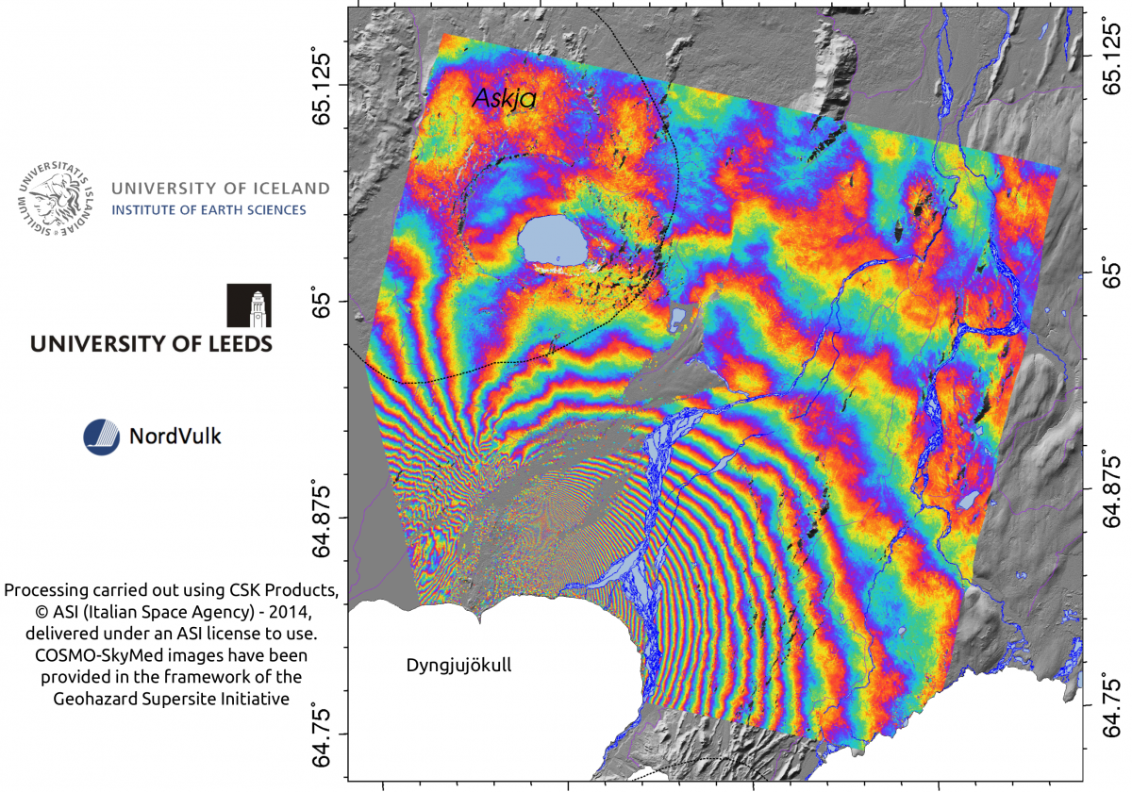
Supersites results: the Bardabunga eruption
CSK interferograms used to model the dyke evolution
University of Leeds

Slide 15
Bardabunga eruption monitoring
Main decision making agency: Iceland Police, Dept. of Civil Protection
Main scientific institutions in charge: University of Iceland, Iceland Meteorological Office
Collaborating scientists: University of Leeds, NordVulk
The EO data allowed to model the magma migration outside of the ice cap, providing invaluable information for the situational awareness.
Constant monitoring was ensured through international collaboration.
Scientific results were used to take decisions, and were disseminated on the Univ. of Iceland website.

Slide 16
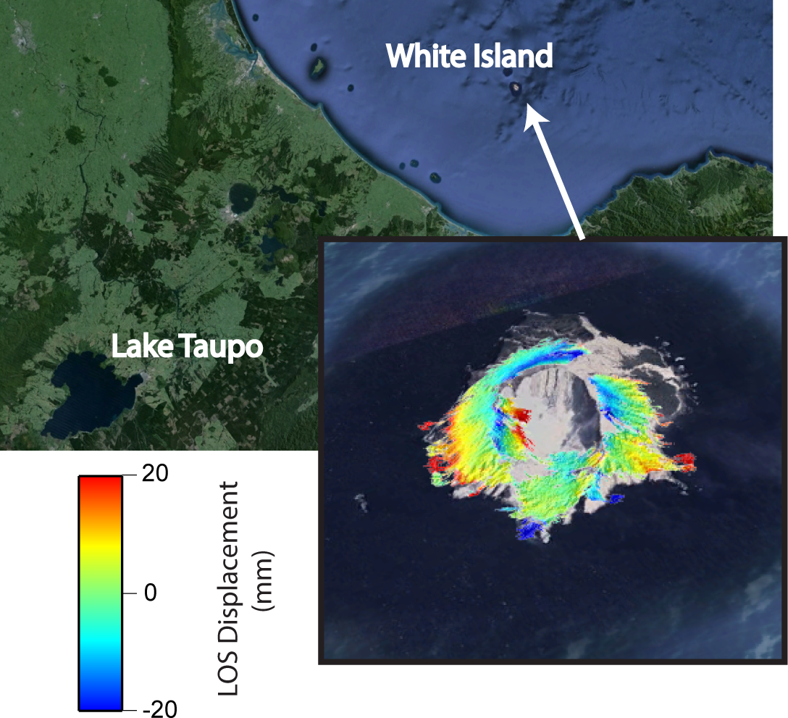
Supersites results: White Island monitoring
Preliminary TSK interferogram

Slide 17
New Zealand volcano monitoring
Main decision making agency: Civil Defense Emergency Management Groups (CDEM) at national and local scale
Main scientific institutions in charge: GNS Science
Collaborating scientists:
Supersite started to receive data few months ago. No results yet.

Slide 18
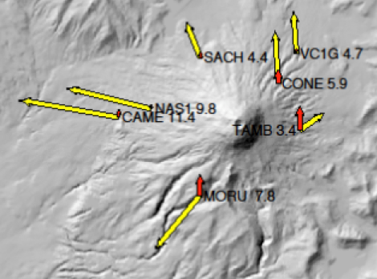
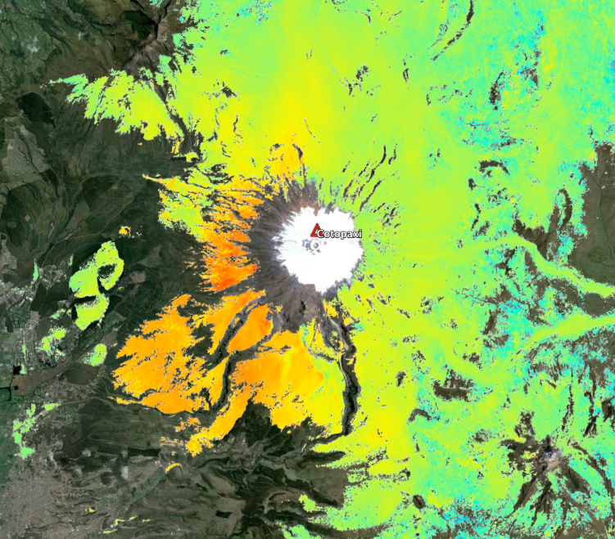
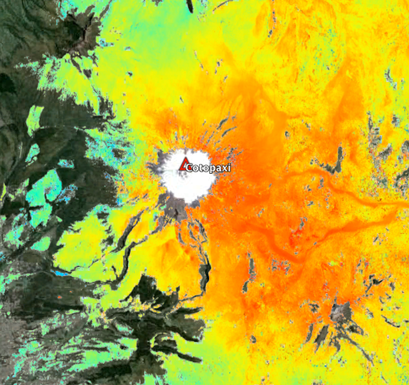

Supersites results: Cotopaxi unrest
Initial 2015 CSK data analysis seems to show inflation (longer time-series required)
Results by F. Amelung
Ascending
Descending
MORU
MORU
Cerro Quilindana
5 km

Slide 19
Ecuador volcano monitoring
Main decision making agency: National Office of Civil Defense
Main scientific institutions in charge: Instituto Geofisico, Escuela Politecnica Nacional
Collaborating scientists: University of Miami
Monitoring of unrest at Cotopaxi is under way.

Slide 20
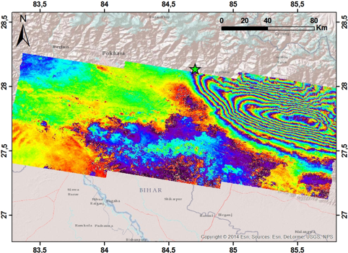
Supersites results: Gorkha event ss
Sentinel 1 interferogram
(3 scenes)
C. Tolomei, INGV
Paper in preparation

Slide 21
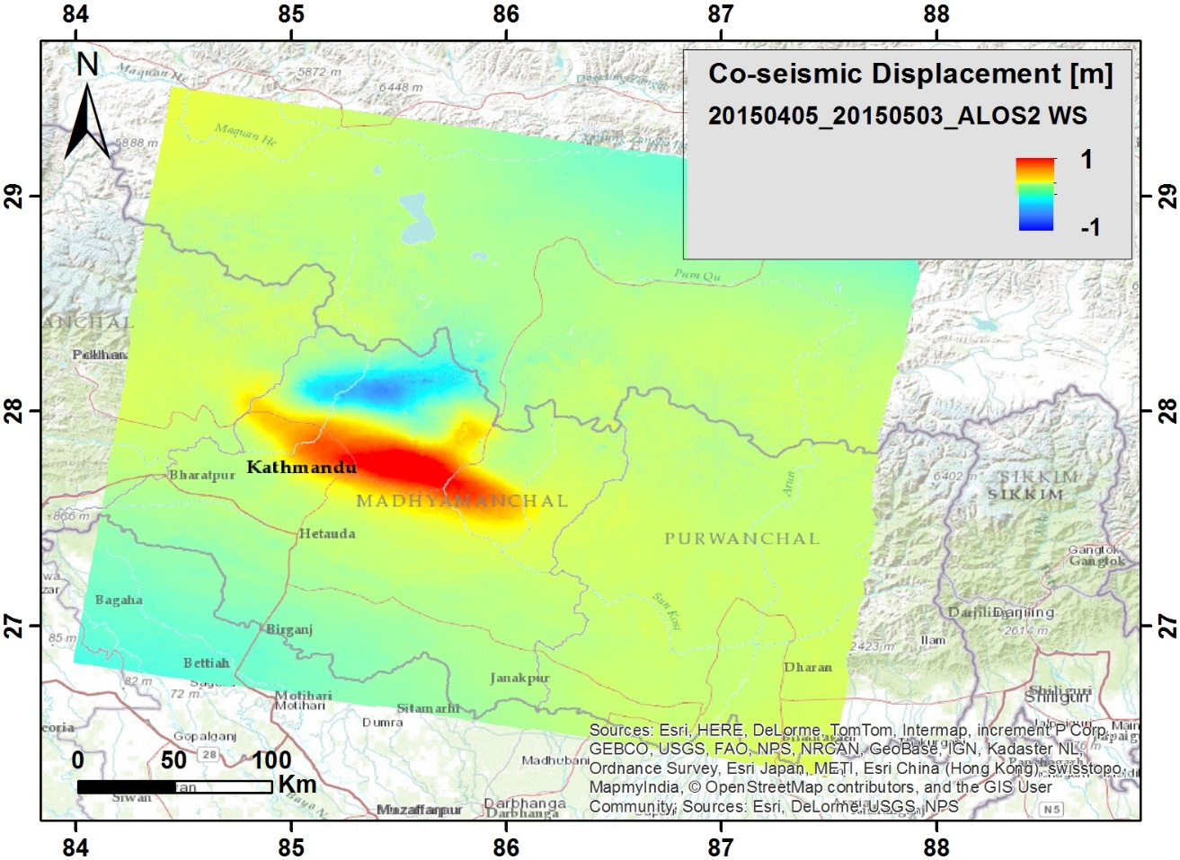
Supersites results: Gorkha event ss
ALOS 2 WS
interferogram
(1 scene, 50 Gb)
C. Tolomei, INGV
Paper in preparation

Slide 22
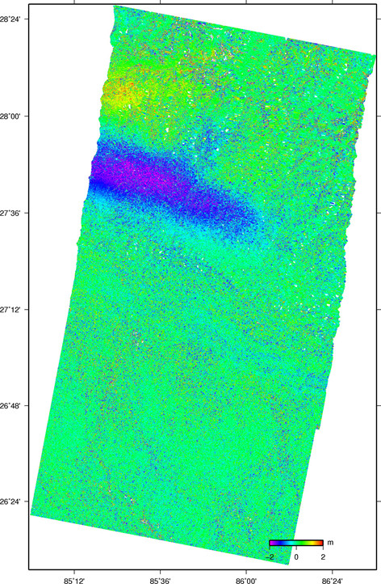
Supersites results: Gorkha event ss
Radarsat 2
interferogram
(2 scenes)
S. Samsonov

Slide 23
Supersites results: Gorkha event ss
Results based on Radarsat 2 data
Diao et al (2015)

Slide 24
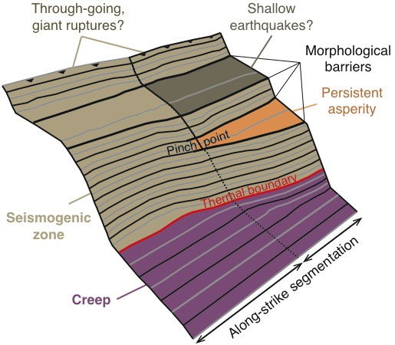
Supersites results: Gorkha event ss
Using EO and geological data the precise shape of the fault surface could be mapped.
It appears that the upward propagation of the 2015 eq. rupture was inhibited by asperities possibly caused by changes of dip.
Possible implications for seismic hazard (future rupture of upper fault).
Qiu et al, 2016, Geology

Slide 25
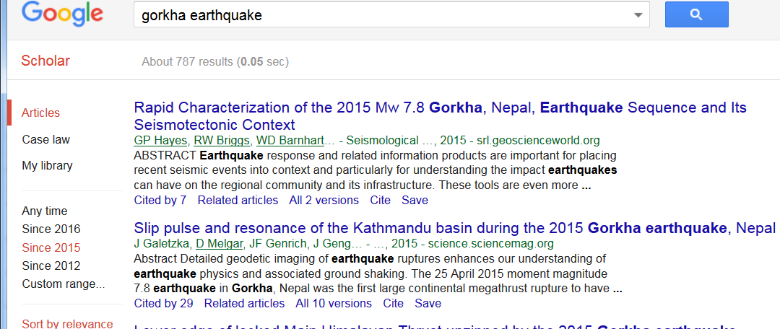
Users for the Gorkha earthquake results
Main decision making agency: National Disaster Management Authority (NDMA), National Emergency Operation Center (NEOC)
Main scientific institutions in charge: National Society for Earthquake Technology (NSET), academic institutions
Published science: a lot!

Slide 26
Status of EO data access
There is a nearly routine data flow for all Permanent Supersites, some data were not requested probably because other sensors were used.
GSNL EO data can now be easily accessed through various infrastructures: SSARA/UNAVCO, SS-Portal/DLR, Data Gateway/ASI, GEP&VA/ESA.

Slide 27
Status of in situ data access
Most of the older Supersites have now developed a data sharing infrastructure: Hawaii, Iceland, Etna, Campi Flegrei.
For other Supersites we request to put in place an initial infrastructure within the two-year term. They can build their own web platform or use other infrastructures (e.g. UNAVCO or EPOS web services).

Slide 28
Issues with data access
CSA does not provide a web interface to access Radarsat data. US scientists place Radarsat data on the SSARA/UNAVCO platform. Could we use also the GEP&VA/ESA for data sharing?
Will CNES provide a web interface for GSNL data sharing?
For some “old” Supersites (Marmara) the in situ data are still not easily accessible (ftp access or email requests).
For some in situ data types (e.g. gravity, geochemical data) the access is not provided or is not straightforward.

Slide 29
Status of scientific product sharing
GSNL 2.0 rules require scientists to provide their scientific results in digital format (Supersite review procedures)
Precondition #1: a data (product) policy. A schematic DP is being drafted and will be approved by SAC in April. It could be adapted to comply to local restrictions (e.g. Indonesia).
Precondition #2: a proper attribution of IP and a licensing policy. Open data licenses will be proposed, possibly with limitations for commercial use (e.g. CC BY-NC-SA 4.0).
Product sharing issues: agree on standard metadata, provide proper management (also for DOI attribution) and infrastructure for web access.

Slide 30
A Virtual Research Environment for GSNL
The Supersite community is now involved in a project called EVER-EST which has been funded by the EC under a Research Infrastructure call.
The project is led by ESA and will end in October 2018.
EVER-EST will build a Virtual Research Environment, providing a variety of services to the Supersite community, to improve the way scientists interact on each Supersite.
Three more communities will be using this infrastructure, marine environment, hydromet hazards, land use and security.
The VRE will help researchers to share or access data, disseminate or access scientific products, maintain long term archives for the Supersite, provide and share common tools for data processing/modeling, document scientific work, cross compare scientific results, manage IPRs (DOI attribution, licensing), facilitate remote collaboration, etc.

Slide 31
The new Supersite evaluation procedure
The new procedure has been approved in November and is now enforced for all new proposals.
It has introduced new requirements to ensure that the Supersites are more efficient in providing data and promoting scientific advancements, that their scientific products can reach the decision makers and support DRM activities, and that the entire initiative is aligned with the GEO Flagship concept.
We also request formal commitments from the in situ data providers.

Slide 32
GSNL as a GEO Flagship
First document, describing the initiative and proposing the Flagship status, has been integrated into the 2016 work programme.
GEO Flagship should develop and implement pilot or pre-operational services.
Most Supersites already provide services to their respective end-users, and experiment methods to improve these services integrating EO data into their value-adding chain
GSNL is a global network of “projects” with the objective to promote better science and practices adapted to local needs for DRR, so there is strong benefit from the exchange of scientific knowledge, technology, practices for supporting DRM agencies.
Better coordination with other initiatives is required.

Slide 33
Status of the South East Asia Natural Laboratory
The DCT was concerned about the large data requests in the NL proposal. The Agencies requested that the concept be demonstrated on a smaller area with a more focused approach.
At a meeting in Indonesia in February 2016 it was agreed that the Indonesians will submit a proposal for a Supersite, including probably 5-8 volcanoes with different activity type, eruption frequencies, and ground monitoring conditions, to test a variety of situations.
The proposal will be jointly coordinated by the Institute of Technology of Bandung (ITB, a University), and the Centre for Volcanology and GeoHazard Monitoring (CVGHM).
CVGHM is a monitoring agency, a research institute, but also a decision maker during emergencies, issuing evacuation orders.
The University of Manila was also present but a Supersite proposal from the Philippines requires an internal process to build the partnership.
Notes:
Krakatoa tsunami in 1883 killed 35 to 120k.

Slide 34
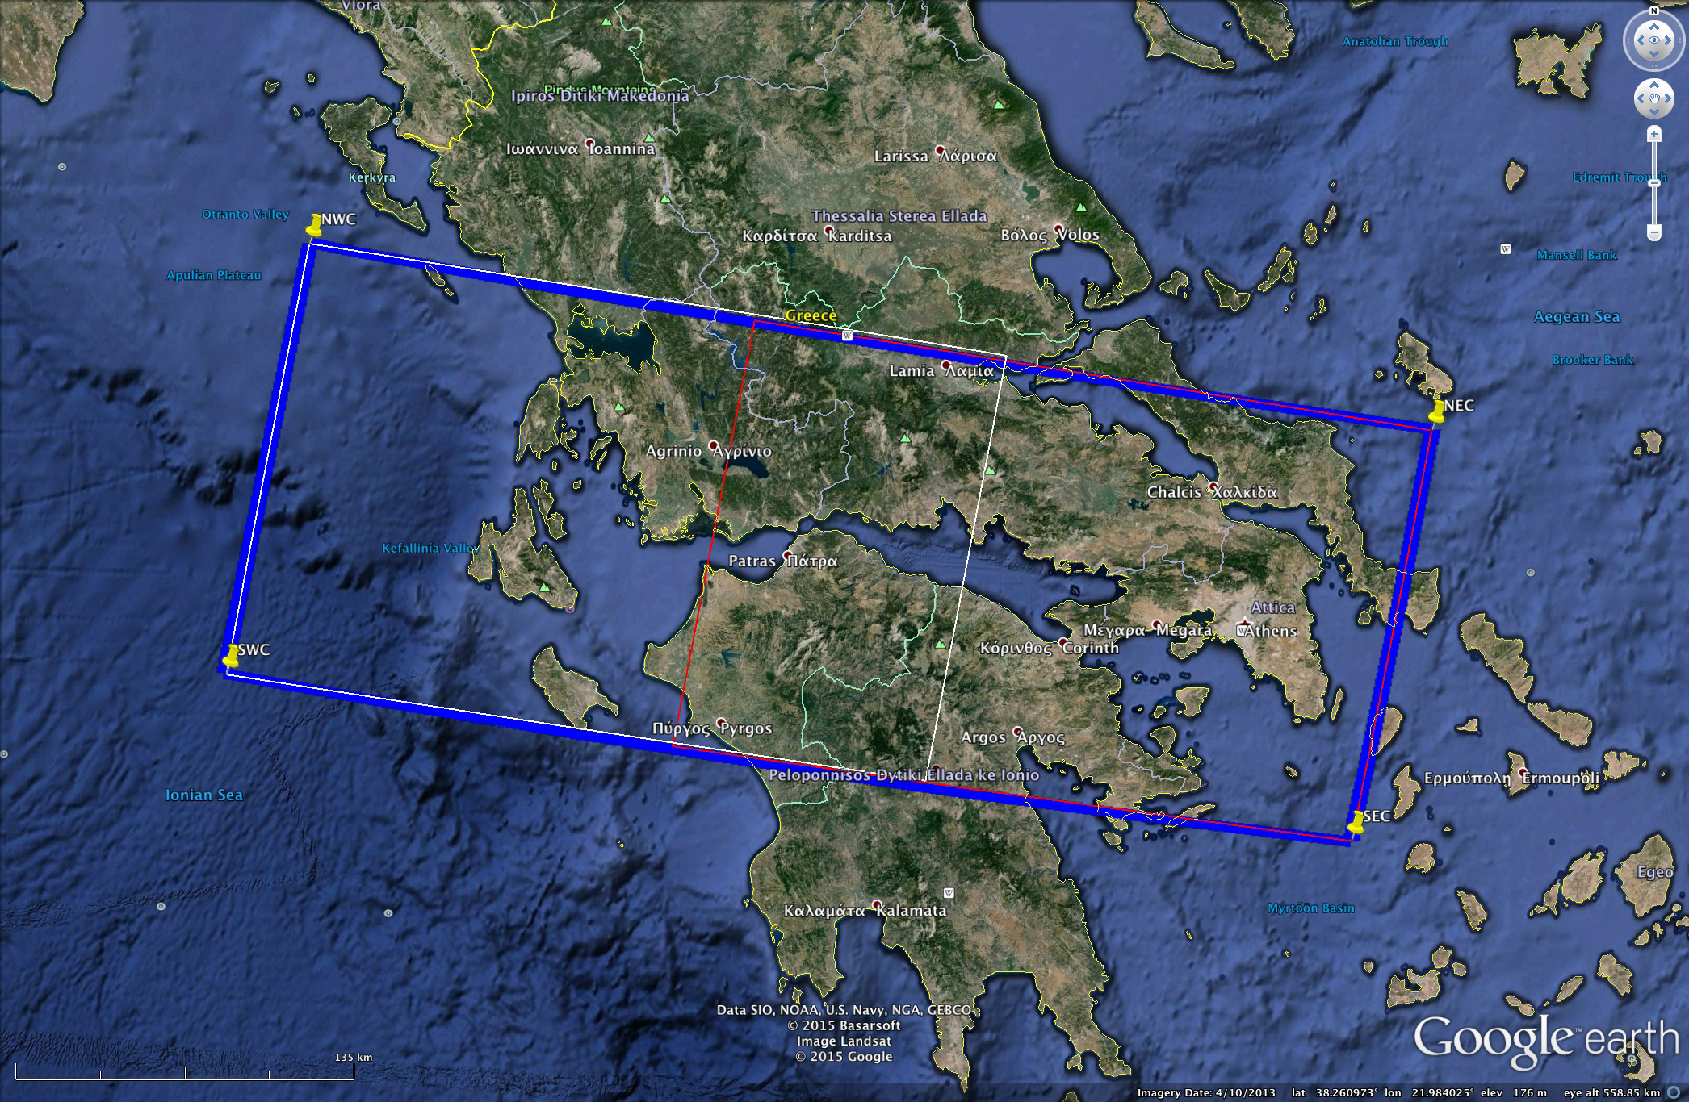
Status of the Greek Supersite proposal
Notes:
Krakatoa tsunami in 1883 killed 35 to 120k.

Slide 35
Objectives of Greek Supersite
Long term monitoring of the area for mapping the crustal deformation and stress-strain regime, including time-varying patterns.
Perform updated seismicity relocations for the areas of interest, using calibrated crustal/upper models.
Exploitation of the available datasets (existing and new) to obtain reliable empirical estimates of source, path and site effects for seismic motions in the Supersite area
Efficient fusion of the acquired earth and space observations in order to better monitor and understand the hazard sources.
Exploitation of ground and satellite information to assess the risk in the Supersite area and achieve Disaster Risk Reduction and Resilience.

Slide 36
The partnership of the Greek Supersite
Coordinator: Institute of Engineering Seismology & Earthquake Engineering – ITSAK, part of the Earthquake Planning and Protection Organisation (EPPO). EPPO is a government agency in charge of Prevention, Mitigation, and Emergency activities
Core team: five more Universities in Athens, Patras and Thessaloniki

Slide 37
In situ data for the Greek Supersite
Mostly broadband and short period seismic data and GPS data

Slide 38
EO data requested by the Greek Supersite
Sentinel-1 will be used for wide area monitoring
COSMO-SkyMed will be used for “Periodical monitoring in order to maintain a good coherence over preselected active tectonically areas (active faults in urban or rural areas). “ (~100 images)
Same for TerraSAR X. (~100 images)
Same for Radarsat 2. (~50 images)
An undefined number of ALOS 2 images
An undefined number of optical scenes (SPOT and Pleiades)
EMS products will be requested by EPPO and used in case of emergency.

Slide 39
Side issues
What is the status of RSAT2 for Ecuador Supersite?
Can Tandem X DEM be made available for GSNL?
UNAVCO is available to maintain Supersite data into SSARA, but to justify resources a formal request could be needed.
A clear procedure should be defined for SPOT/Pleiades image requests
Can Radarsat 2 Supersite data be hosted on the GEP?

