Slide 1


JAXA A/I M4/18
Recovery Observation
- Sentinel Asia -
Michio Ito (Mr.)
Satellite Applications and Operation Center (SAOC)
Japan Aerospace Exploration Agency (JAXA)
ito.michio@jaxa.jp

Slide 2
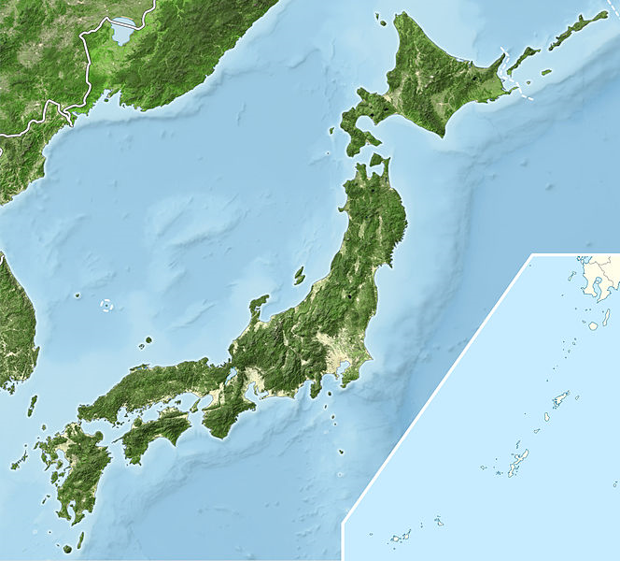
JAPAN
Area :
App. 380,000 sq.km
Population :
App. 128,000,000
Islands :
App. 6,850
GDP :
US$6,000billion
app. 1000km
The Great East Japan Earthquake
(11/03/2011) Earthquake + Tsunami
Casualties & the missing : 24,700
Damaged Buildings : 1,100,000
Economic Damage : US$235billion
Hanshin-Awaji Great Earthquake
(17/01/1995) Earthquake + Fire
Casualties & Missing : 50,000
Damaged Buildings : 640,000
Economic Damage : US$100billion

Slide 3
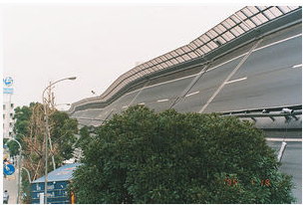
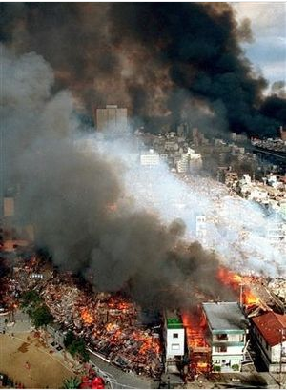
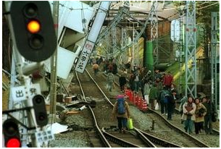
The Hanshin-Awaji Great Earthquake(1995)
5:46AM(JST), 17 January 1995, M7.3, North of Awajishima Island, Hyogo Prefecture, 16km depth epicenter
Death: 6434, Injured: 43792, Missing: 3, Number of evacuated people: 316678
Totally Collapsed Buildings: 104,906、Half Collapsed Buildings 144,274、Partially damaged buildings: 390,506
Fire damaged :8969 families
Road damage :7245 points、Bridge damage 330 points、Railway damage 774points、Landslides 347
Estimated economic cost damage: a order of US$100billion

Slide 4
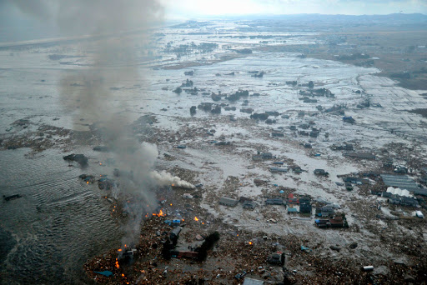
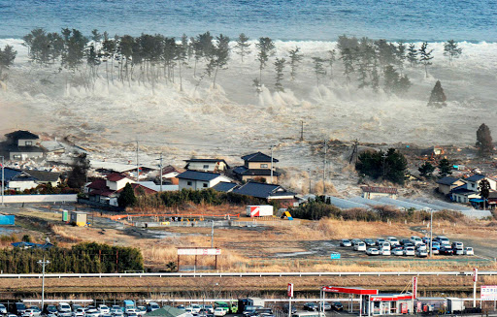
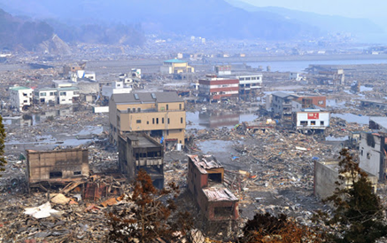
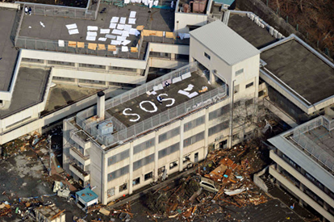
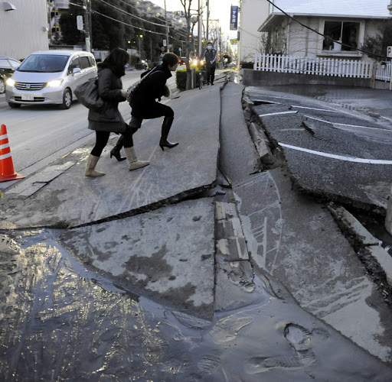
The Great East Japan Earthquake (2011)
14:46 JST 11 March 2011. M9.0 70km east of Oshika Peninsula, 30km depth epicenter.
Death:15,883, Injured: 6,144, missing: 2,676 (As of 12 Sep. 2012)
Totally collapsed building:129,225, half collapsd:254,204 partially damaged 691,766
Level 7 melt dawn of Fukushima Daiichi nuclear power plant and Residents within 20km radius of the nuclear power plant evacuated.
The WB estimated economic cost damage was US$235billion, making it the costliest natural disaster in world history.

Slide 5
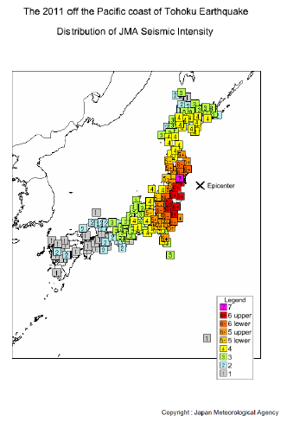
1000km
http://www.jma.go.jp/jma/en/Activities/intsummary.pdf

Slide 6
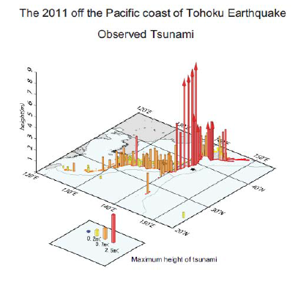
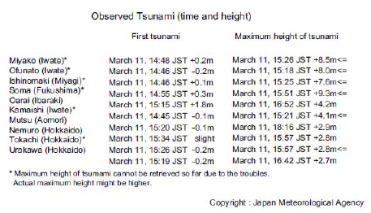
http://www.jma.go.jp/jma/en/2011_Earthquake/2011_Earthquake_Tsunami.pdf

Slide 7
10-year recovery plan of Miyagi Prefecture, Japan
2011-2013 restoration phase
Restore infrastructure and livelihood
2014-2017 regeneration phase
Regenerate economic and social activities
2018-2020 Development phase
Develop and revitalize more resilient health, social and economic structure

Slide 8
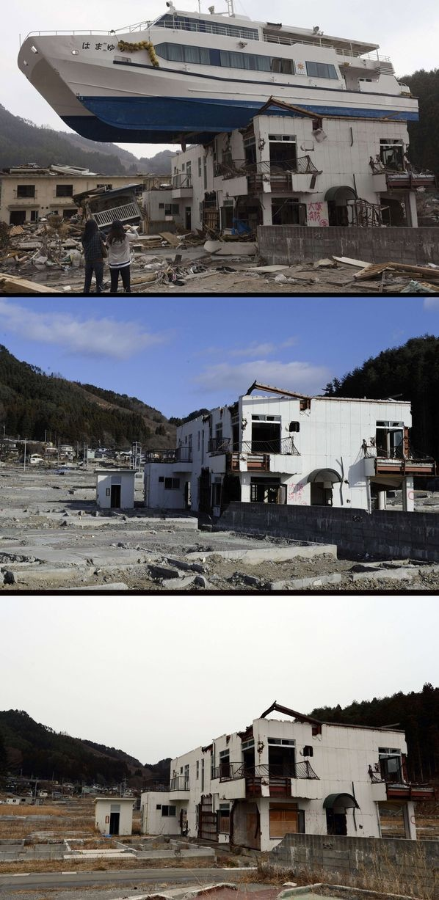
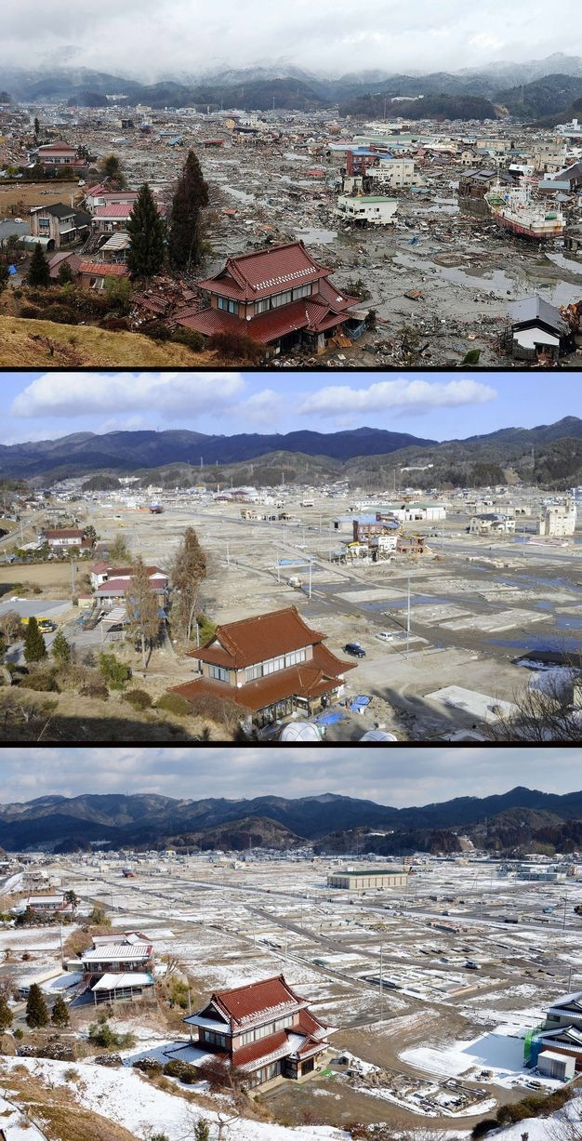
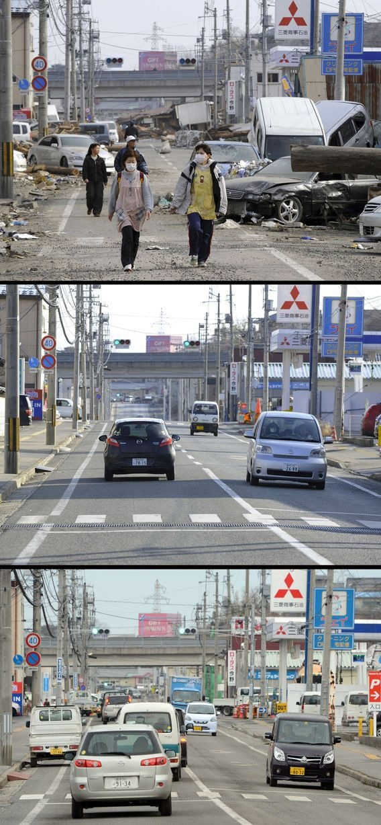
2011.3
2012.3
2013.3
http://dailynewsagency.com/2013/03/08/japan-two-years-post-tsunami-3n9/

Slide 9
What is recovery from the damage?
Restoration of the facilities and infrastructures
Redevelop and revitalize the health, social, economic, natural and environmental fabric
Building more resilient cities and communities
How can Sentinel Asia support recovery operation from space?
Periodic satellite monitoring of long term restoration process of the damaged city or the area
- Open Street Map such as Google Earth can be harnessed
(No need to be supported by Sentinel Asia)
Provide geographic information of disaster affected area for redevelopment and revitalization (Sentinel Asia Applicable)
(Continued)

Slide 10
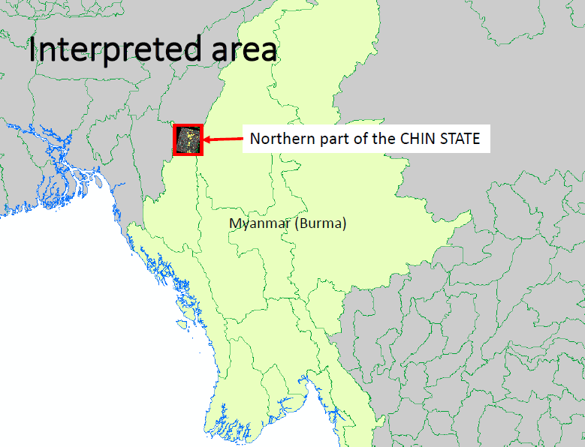
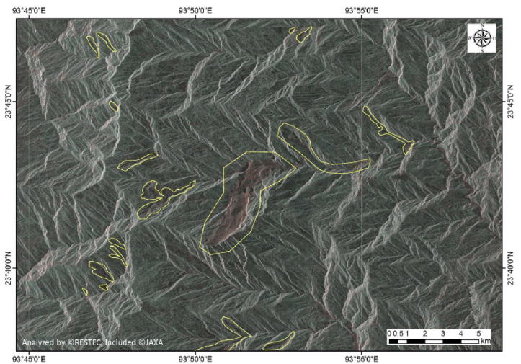
To provide geographic hazard information to support recovery planning and/or hazard mapping
- Archived data of emergency observation can be used
(Sentinel Asia Applicable)
Ministry of Social Welfare, relief and Resettlement of the Republic of the Union of Myanmar is developing resettlement hazard map using the provided information
Sentinel Asia observed landslides in Myanmar in August 2015
(example)
ALOS-2 PALSAR-2 observation detected 52 landslides in Chin state

Slide 11
Sentinel Asia Emergency Observation Strategy
days
days
days
months and years
Response
Recovery
Disaster
Preparedness
Precaution
everyday
Sentinel Asia Step3 Evolution extend the emergency observation period from “just after disaster” to “precaution to response”.
Sentinel Asia Satellites
Emergency Observation Period
Sentinel Asia supports full cycle of disaster management

Slide 12
Thank you very much for your kind attention !

