Slide 1
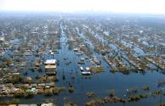
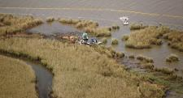
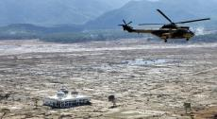
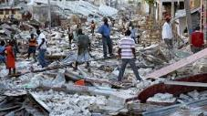
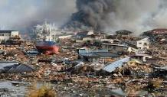
Recovery Observatory: status and next steps
Catherine Proy, CNES
Steven Hosford, CNES
Patrice Benarroche, CNES
Andrew Eddy, Athena Global
Hurricane Katrina
2005
Deepwater Horizon
2009
Indonesian Tsunami
2004
Haiti Earthquake
2010
Tohoku Tsunami
2011

Slide 2
Presentation Outline
Status of RO and report on December working session (30 min)
Initiation of recovery monitoring demonstration (Malawi) (30 min)
EO data licensing for disasters – progress and next steps (20 min)
Recovery input for UR Istanbul event (20 min)
Sustainability and next steps (10mn)

Slide 3
Oversight Team (ROOT) Membership
Space agencies from CEOS Disaster working group:
CNES (Catherine Proy (Co-Chair), Patrice Benarroche and Steven Hosford)
ASI (Simona Zoffoli)
DLR (Jens Danzeglocke)
ESA (Ivan Petiteville and Philippe Bally)
JAXA (Chu Ishida and Nobuyoshi Fujimoto)
NASA (David Green and Stuart Frye)
USGS (Brenda Jones)
DRM Stakeholders:
World Bank/GFDRR (Joe Leitmann (Co-Chair), Keiko Saito and Tahir Akbar)
UNDP (Chiara Mellucci)
UNOSAT (Olivier Vandamme and Einar Bjorgo)
European Commission (Francoise Villette and Peter Spruyt)
Other partners:
CURBE (University of Cambridge, Emily So)
COPE (University of Copenhagen, Nathan Clarke)
Secretariat support provided by Athena Global (Andrew Eddy)
Membership is open to all CEOS agencies with an interest in the RO.
Associate Membership is open to donors and DRM stakeholders, and value-adding partners.

Slide 4
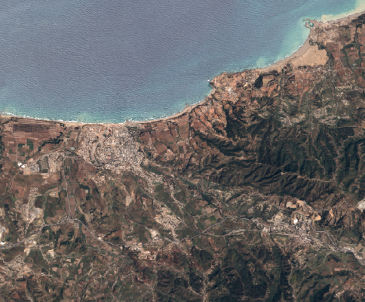
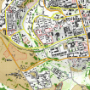

What will the Recovery Observatory consist of?
Collection of images and maps at several scales
For 3 to 5 years after a major disaster
(duration to match recovery framework)
Overview area
Mid-scale products from Sentinel data at 10m resolution
Change in landcover, open spaces
Vegetation loss or re-growth
Agriculture
Update frequency:
every 10 days to 6 months
Overview
AOI
Urban
zoom 1
Urban zooms
Large scale products from very high resolution data
Buildings
Infrastructure
Camps
Update frequency:
every 2 to 4 months
Urban
zoom 2

Slide 5
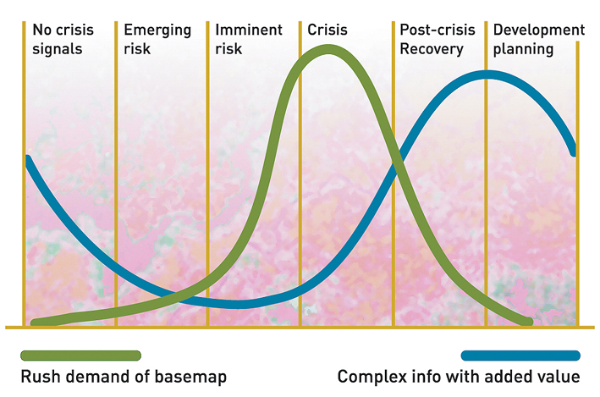
Geo-Information in Response & Recovery
Recovery Observatory added value
Highest current use during crisis – need to develop methodologies and products for recovery planning and monitoring
Demand for geo-information
Slide adapted from UNOSAT Luca dell’Oro
Notes:
The availability and sharing of timely and relevant information is critical for assisting humanitarian operations.
As shown here in the graph in the immediate aftermath of an event there is a peak in the demand of data and information including maps.

Slide 6
Recovery – Inventory of potential Recovery indicators and products
Baseline mapping | Monitoring
Buildings, shelters | Buildings footprint mapping Building attributes (roof type, height indication, collapsed or partially collapsed) Indicate density of damaged buildings Urban blocks with indication of damage | Building removal and construction Change in urban land use, morphology and density Indicate type of dwelling reconstruction
Camps | Location of spontaneous and organized gathering areas Location of temporary dwellings Land use, open spaces | Camp removal and installation Tent removal and installation New land use / open spaces
Transport | Accurate transport network mapping with detailed metadata (type, damage level) Accessibility analysis Proximity analysis Traffic activity analysis | Rebuilt transport facilities New transport facilities Removal of transport facilities Accessibility analysis Proximity analysis Traffic activity analysis
Infrastructures | Mapping of utilities and services infrastructures (administration, education, healthcare, power - water - sanitation facilities…) with detailed metadata (type, level of damage) | Recovered infrastructures Infrastructure removal and construction
Environment | Landcover, open spaces Affected landcover (e.g. burn scar with fire damage severity…) | Change in landcover, open spaces Indicate loss of vegetation Vegetation re-growth
Topography | Risk analysis (vulnerability to flood, to water run-off risk, to soil erosion…) | Risk analysis
Notes:
RED – mainly eo-based
Blue – requires significant external input

Slide 7
RO Status Overview
  Recovery Observatory ready for triggering since 1 January, 2015
  Collaboration attempted on Cyclone Pam (Vanuatu, March/April 2015 – see Lessons Learned Report), highlighting contradictions between Rapid Assessment and Recovery support;
  CNES-commissioned study on RO product definition and image requirements presented to DRM stakeholders;
  Finalization of the RO data infrastructure
  Working session held with DRM stakeholders (GFDRR, WB, UNDP) in Washington December 2015;
  Demonstration to begin March 2016 (Malawi);
  Triggering of the RO after a major event or as follow-on to demonstration work in Malawi (in 2016);
  Evaluation at RO + 6 months;
  Lessons learned and sustainability strategy after evaluation of 1st RO
Notes:
Preliminary demonstration will be used to confirm product definition and better evaluate needs of data for the future recovery activation

Slide 8
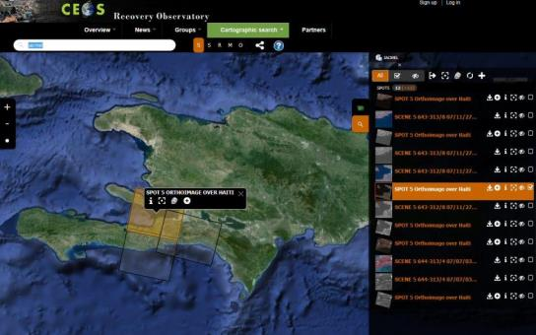
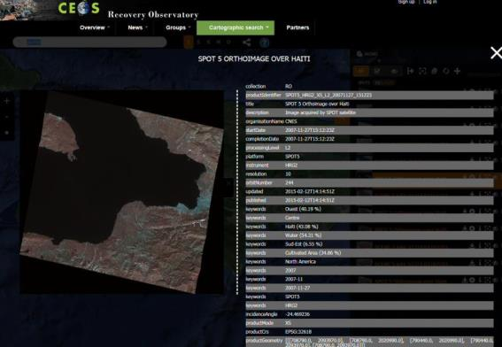
Recovery Observatory Infrastructure
Notes:
As of summer 2015, the RO IT infrastructure is essentially complete. Current portal:
supports geographic and temporal search functions
display raw and georeferenced images (SPOT and Pléiades available)
offers simple registration process
allows networks of users to define community of practice and share resources available for browsing and download, and eventually upload as well once RO is established
Guest login available for demonstration/beta trial
Work continuing
to increase number of data formats supported : CSK, ALOS-2, TSX, RSAT-2, Sentinel-1 & 2, Landsat-8 to be completed
vector and raster product archiving (as opposed to data archiving)

Slide 9
Recovery Observatory Infrastructure
First instance available for Haiti in the final version https://kalideos.kalimsat.eu/drupal/
Data/Map products/Document selection and metadata display
Data display at full resolution
When logged in : data download and posting of edits or results
Collaborative approach to involve all participants (discussion groups)
DEVELOPMENT STATUS :
Insertion of Ground Control Points, Vector/Shapefiles, Landsat-8, Spot6/7 in addition to SPOT 5 and Pléiades
Next steps: Insertion of product maps (pdf and jpeg), Sentinel 1&2, Alos-2, CosmoSkyMed, TerraSar-X, Worldview…
Notes:
Malawi instanciation

Slide 10
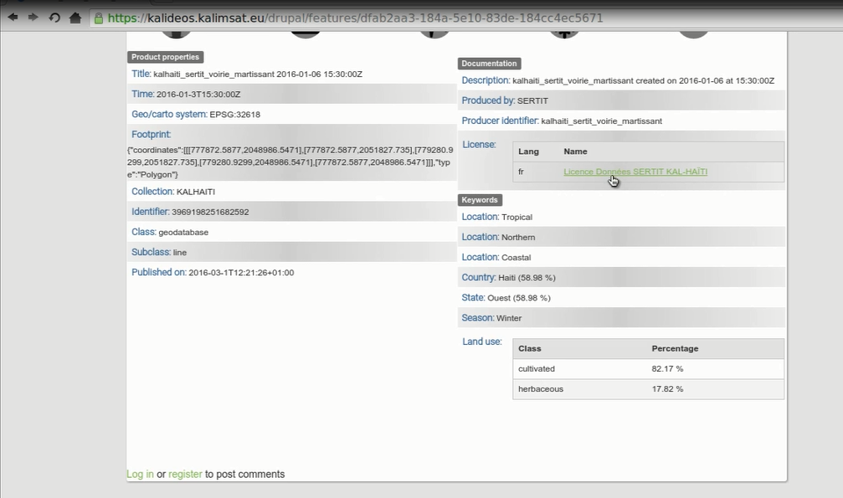
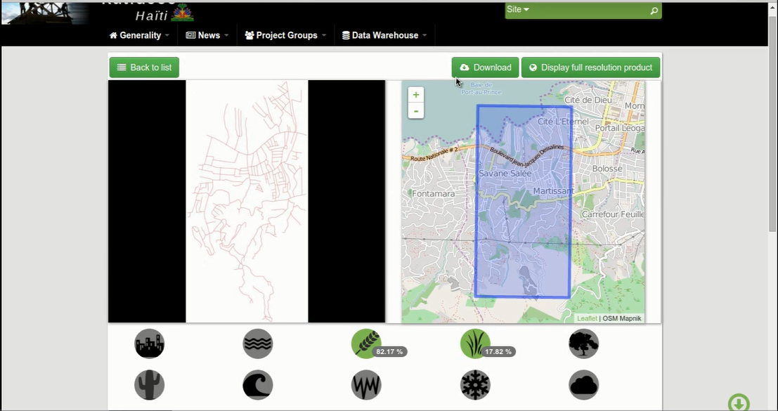
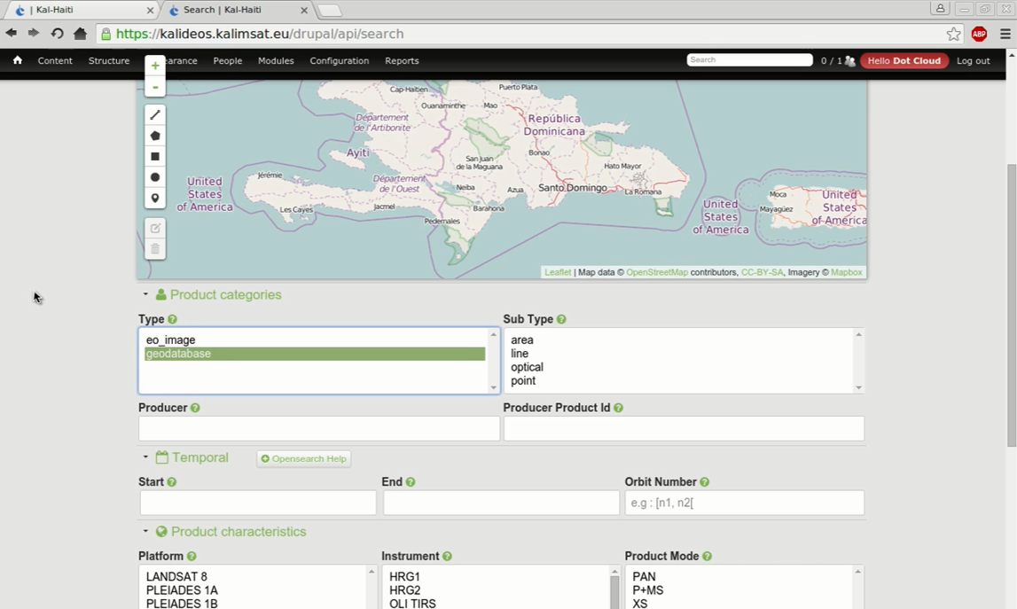
Multi-criteria data search interface

Slide 11
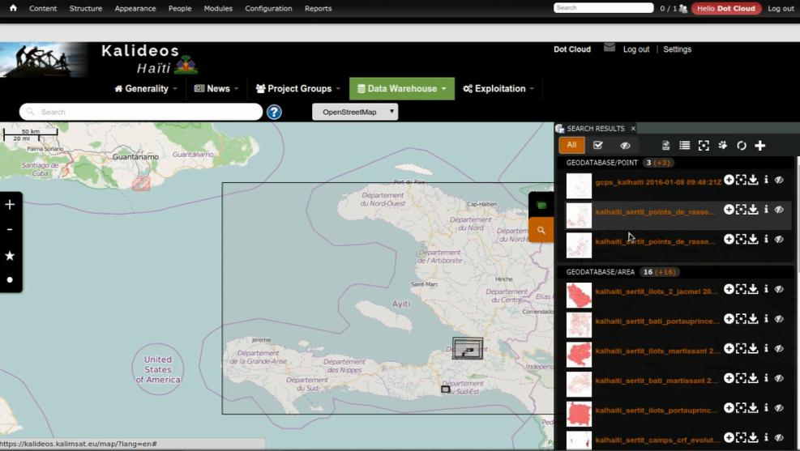
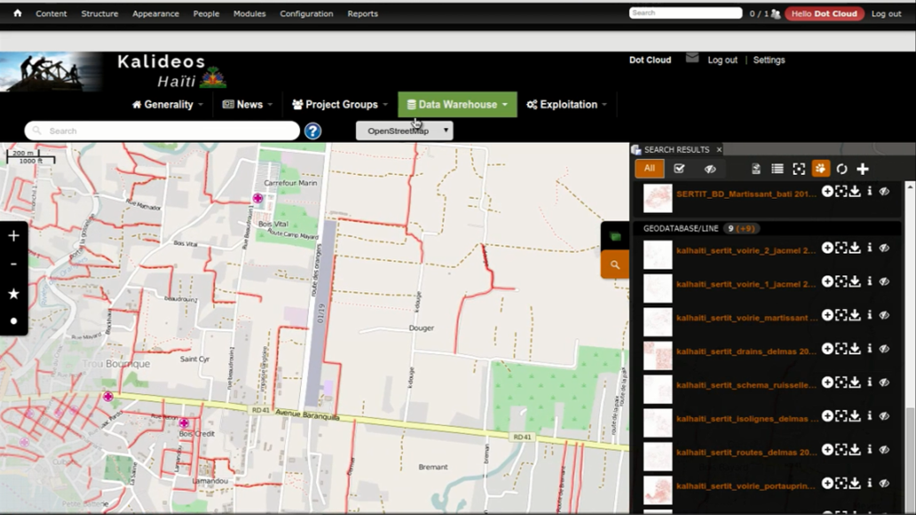
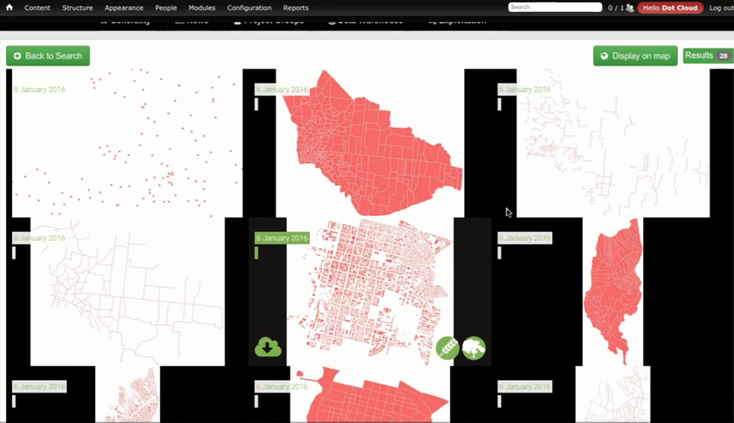
Selection and display of vector data

Slide 12
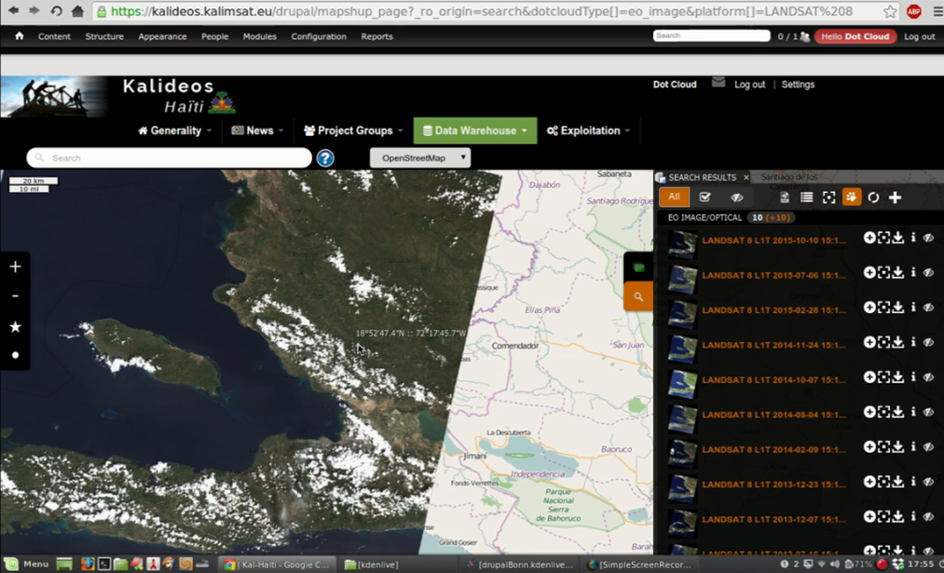
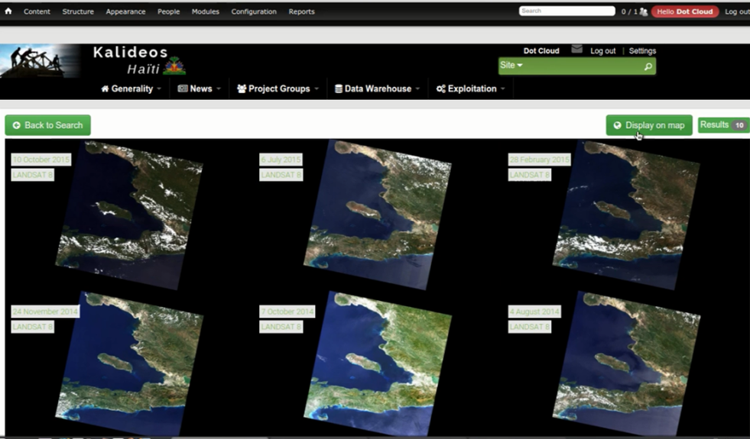
Selection and display of Landsat-8 images

Slide 13
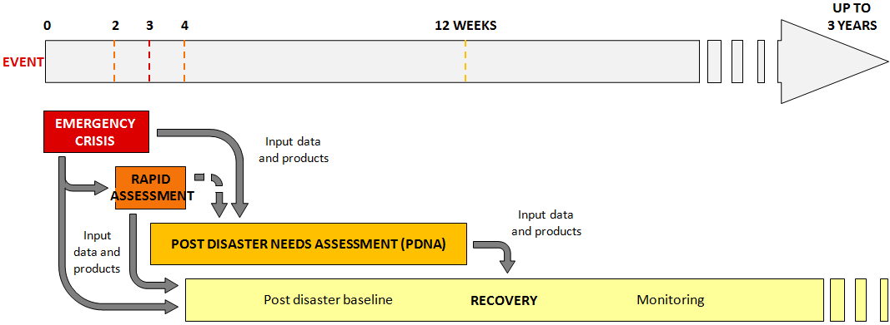
Timeline and RO Role
6-8 WEEKS
4
Crisis Response
Recovery Observatory
The RO should focus on long-term planning and monitoring, as rapid assessment and PDNAs are completed in weeks and require very timely contributions; the ROOT has passed on this interest in satellite contributions to the Charter and Copernicus;
Notes:
THIS SLIDE REQUIRES UPDATING

Slide 14
High-level Conclusions from ROOT working session Dec 2015
Some useful applications have already been developed but are not well-known to the User community;
Perception that satellite work is principally useful for rapid assessments, and lack of understanding of how satellites can contribute over long-term; the RO should correct this perception;
There is a general lack of awareness in DRM community of what is possible and how to obtain data and products; need for :
  Improved ‘showcasing’ of results for uptake within the users;
  Inclusion of resources for value-adding in recovery planning activities.
GFDRR to inform ROOT of future PDNAs, and to begin a “demonstrator” with ROOT in near future
Notes:
Participants: GFDRR, World Bank, UNDP, CSA, CNES, NASA, USGS, (JAXA on phone)

Slide 15
Presentation Outline
Status of RO and report on December working session (30 min)
Initiation of recovery monitoring demonstration (Malawi) (30 min)
EO data licensing for disasters – progress and next steps (20 min)
Recovery input for UR Istanbul event (20 min)
Sustainability and next steps (10mn)

Slide 16
Path to Malawi Demonstrator
Agreement in Washington at working session to explore possible “demonstrator” that would showcase EO-based products and demonstrate savings or improved results from satellites
Several possible pilot locations discussed, including Malawi, Mozambique, India, Vanuatu, Dominica, Niger, and others
WB/GFDRR sent project level documents for analysis of potential EO-contribution
Short list of India, Mozambique and Malawi established
Discussion with GFDRR led to selection of Malawi as first possible demonstrator
Discussions engaged with local and DC-based Bank personnel to confirm Malawi government interest

Slide 17
Malawi activities
Assessment of Recovery Observatory activities in the scope of 2015 Malawi flood recovery.
Strategy built from exisiting images:
  Lansdat and Sentinel for large area issues
  Spot 6/7 and Pleiades for smaller areas and stereo pairs
Activities identified are extracted from Malawi National Disaster Recovery Framework document (NDRF) in order to address final user needs as closely as possible
WB team determined five possible districts for collaboration; ROOT team to select areas of interest from these districts and propose themes for monitoring; monitoring plan on 2 areas to be established in conjunction with Government of Malawi in March; review scheduled for late June or early September

Slide 18
Malawi activities
NDRF topics | EO product | Explanation
Transportation, performance management of facilitation of movement of people and goods | Linear communication paths survey such as: Length of roads rehabilitated in km Length of bridges constructed in meters Length of canals rehabilitated in km | Measure length of reconstruction.
DRM: Develop Disaster Contingency Plans Dykes/dams reconstruction Education, Health, Trade: Relocate assets to safer grounds | 3D flood forecast (extension of potential flood areas) and related applications such as: Safe rebuilding Contingency plans, etc. | Depending on stereoscopic images available, it is possible to construct a Digital Elevation Model of some areas.
Housing, performance management of safer house practices | Building survey New building inventory Rebuilt building inventory Suppressed building inventory | Count number of houses built, indication of the quality of the rebuilt houses (resilient construction) has to be provided from in-situ observers.
Agriculture, environment and Food security, performance management of: Resilience to climate change Restored arable lands | Evolution of areas planted in km² | This product can be generated for larger areas, even at district scale. Nature of plants may be assessed in this product if information is provided from in-situ observers.
Performance management of relocation of displaced people | Displaced people camp follow-up | Measure area of camps.

Slide 19
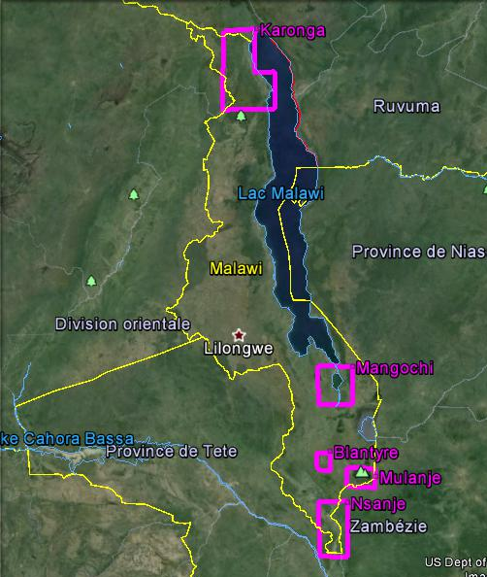
Malawi activities
Malawi preliminary assessment from 5 districts chosen by DoDMA / WB:
Karonga,
Mangochi,
Blantyre,
Mulanje,
Nsanje.
Purple squares show proposed Earth Observation AoI as explained in following slides.

Slide 20
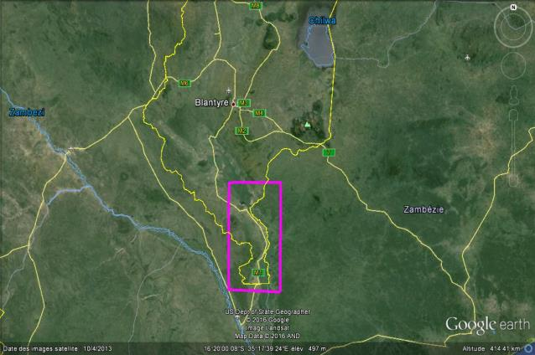
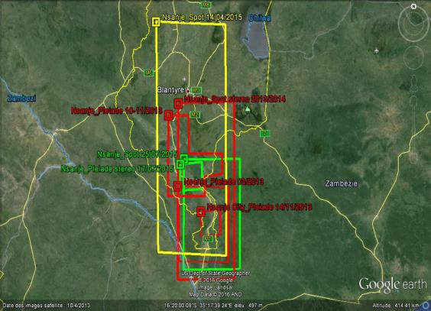
Malawi activities
The district of Nsanje is clearly the most affected by the flood event of 2015.
Farmlands around Bangula present an intensive structure, which is convenient for mapping purposes.
Activities from NDRF to be monitored in Nsanje District
Construct and reshape 154 km damaged rural feeder roads and 8 bridges
Rehabilitate Irrigation schemes
Relocation of 10 primary schools and 4 market centres to upper areas (Makhanga, Bangula, Tengani & sankhulani) including all associated market social amenities
Rehabilitation of flood retention structures Flood Management and Catchment Development - feasibility Study for Ruo
NB: Landsat and Sentinel images not shown as they cover whole district.

Slide 21
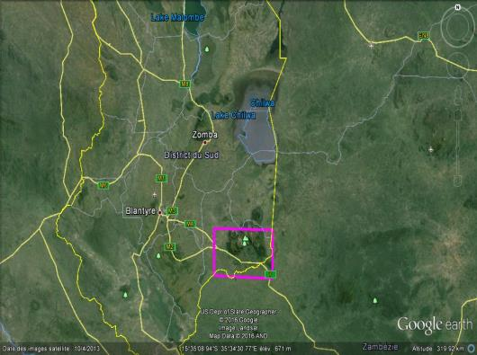
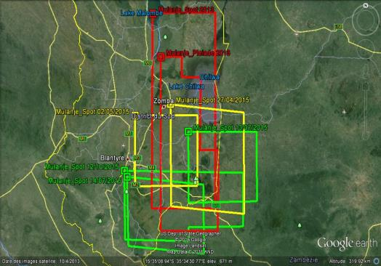
Malawi activities
The district of Mulanje has priorities in most of the sector needs. The proposed AOI is centered over the main populated area, and over the most important farmlands of the region. The very pronounced topography due to the Mulanje Mountain increases the risk of runoff, flood and soil erosion.
Activities from NDRF to be monitored in Mulanje District
Redirect Ruo river to its original course at Sonjeka
Provide river bank embankments on Muloza river at Limbuli
Reconstruct entirely destroyed weir of Msikita scheme and Rehabilitation of damaged 300 m canals of Kuzinja and Gibsani scheme
NB: Landsat and Sentinel images not shown as they cover whole district.

Slide 22
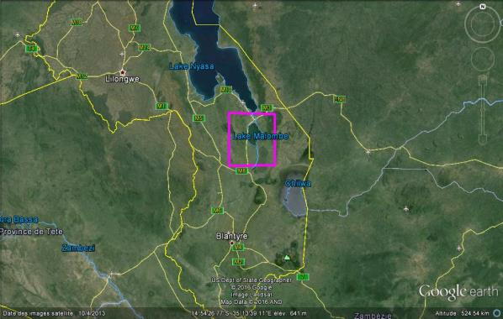
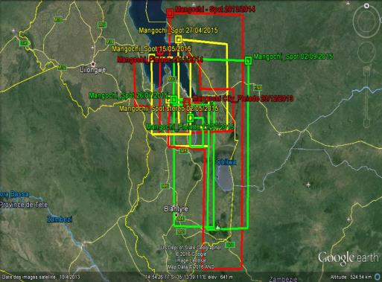
Malawi activities
The district of Mangochi has mainly priorities for agriculture, education and environment. This district appears to be the less important.
.
Activities from NDRF to be monitored in Mangochi District
Reconstruct 6850 houses under the recovery using safer construction guidelines
Plant and manage 25000 trees along river banks of all rivers which affected with floods.
NB: Landsat and Sentinel images not shown as they cover whole district.

Slide 23
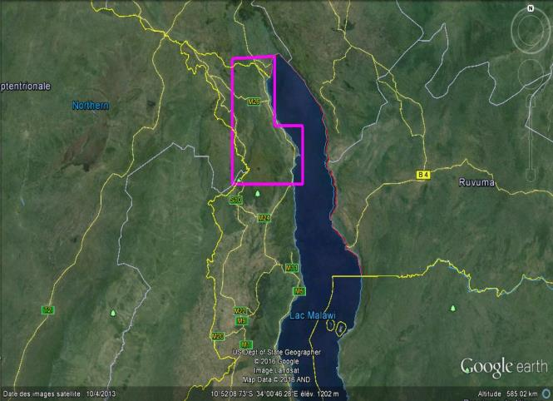
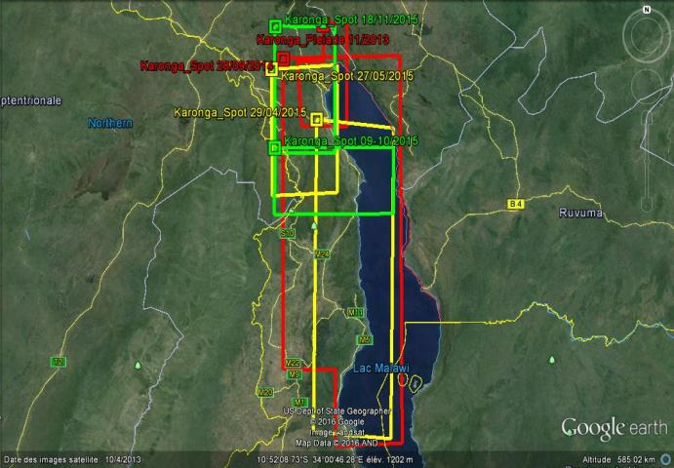
Malawi activities
The district of Karonga was marginally affected during the flood event that occurred in early 2015.
Activities from NDRF to be monitored in Karonga District
Rehabilitate Fargo and Ngelenge dykes
Afforestate 80 ha of land in the disaster prone areas
NB: Landsat and Sentinel images not shown as they cover whole district.

Slide 24
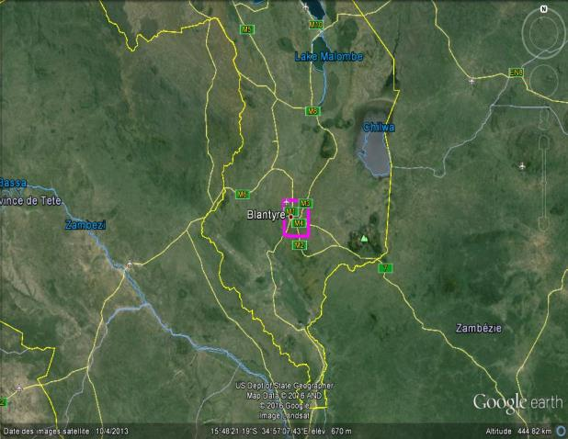
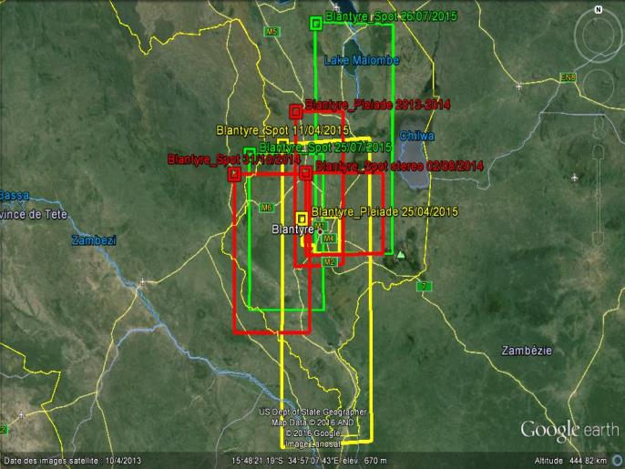
Malawi activities
The district of Blantyre was heavily affected by the flood event of early 2015. The most important damages and recovery efforts are related to health, housing and industry sectors.
Activities from NDRF to be monitored in Blentyre District
Under assessment
NB: Landsat and Sentinel images not shown as they cover whole district.

Slide 25
Malawi activities
CEOS has proposed additional products that can address large area issues or activities common to several districts affected by the disaster.
Zomba Rehabilitate 20 bridges and 44 km of roads
Balaka Promote climate-smart agriculture on 4395 hectares of land, monitor planting evolution
Ntcheu Raise and plant 4,000,0000 tree seedlings in four river catchment areas
Global Monitor crop production through evolution of area actually cultivated
Global Disaster contingency plans
Global Reconstruction of resilient houses, health centers, schools, protection centers, nursery schools, etc.
Global Various training provided to inhabitants and/or local authorities

Slide 26
Next steps
Tentative schedule
March 2016: choice of AOIs by Malawi
Decision to set up a Malawi RO portal taken in February – to be implemented by May
June: first products completed and review of results with Malawi local users
Next CEOS Disasters WG:
CEOS to consider Malawi as candidate for multi-year RO activity depending on pilot phase outcome, considering especially the technical success of monitoring activities and the engagement of the national end user.

Slide 27
Presentation Outline
Status of RO and report on December working session (30 min)
Initiation of recovery monitoring demonstration (Malawi) (30 min)
EO data licensing for disasters – progress and next steps (20 min)
Recovery input for UR Istanbul event (20 min)
Sustainability and next steps (10mn)

Slide 28
EO data licensing for disasters – overview report from COPE
ROOT supported University of Copenhagen study on data licensing for disasters
Licensing conditions for several systems analysed with view to identifying common points and differences:
  First Analysis: Identify common (and conflicting) terms and conditions
    Permitted Uses
    Ownership and Attribution
    Categorization of Data
    Registration and Reporting
  Licenses: TerraSAR-X/ TanDEM-X, Pleiades, COSMOS-SkyMed, Alos-2, NextView

Slide 29
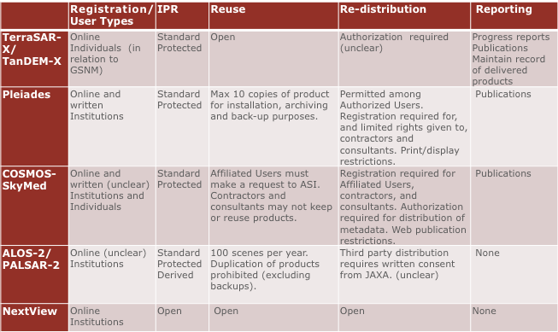
COPE Report summary

Slide 30
Next steps
COPE Report:
  Obtain an overview from data providers of the restrictions on data and information based on international and national policies and legislation.
  Estimate the long-term impact that access and use conditions will have on end users once the RO has finished.
  Examine the license conditions of EO contributions to the RO from commercial providers.
ROOT:
  Create CEOS Task Team on EO Data Licensing for disasters?
  Objective: identify principle hurdles to data dissemination; proposed harmonized approach for easier access by users.

Slide 31
Presentation Outline
Status of RO and report on December working session (30 min)
Initiation of recovery monitoring demonstration (Malawi) (30 min)
EO data licensing for disasters – progress and next steps (20 min)
Recovery input for UR Istanbul event (20 min)
Sustainability and next steps (10mn)

Slide 32
UR Istanbul Event
CEOS side event 18 May 9:00- 11:30: Satellite data for enhanced risk management and reduction
Significant progress made in collaboration with World Bank and Government of Malawi on recovery monitoring – need to showcase this activity at UR2016:
  Institutional collaboration framework a success;
  Technical feasibility demonstration status;
  Vision for scalability and other applications.
ROOT Chair proposes to present Malawi collaboration as a showcase and participate in panel discussion on how to improve application of satellite data to risk management.

Slide 33
Presentation Outline
Status of RO and report on December working session (30 min)
Initiation of recovery monitoring demonstration (Malawi) (30 min)
EO data licensing for disasters – progress and next steps (20 min)
Recovery input for UR Istanbul event (20 min)
Sustainability and next steps (10mn)

Slide 34
RO Lifecycle
Preparation
Institutional relationships
Triggering
Charter and EMS activation monitoring
Establishment
Product definition and development
Scenario building
Summary Event Report
Decision by ROOT to trigger
Upload of Charter and EMS crisis data and products
Operations
Preliminary Data Acquisition Plan
Link to national end user
Development of RO activity grid
Research and training & capacity development
Liaison and development of links with end users
Promotion and Outreach
Reporting
Evaluation (+ 6 months) and lessons learned
Initial reporting
IT maintenance
Legacy planning
Recovery demonstrator
Protocols for RO operations
Infrastructure
Value-adding coordination
baseline products
RO database feeding
Notes:
Before activation (now)
Development/characterization of product list with UNDP, WB (and others) in coordination with UNOSAT (and others)
Update of existing scenarios including estimates of volume of data to be tasked and processed
Preparation of data processing (ortho-rectification and atmospheric corrections) with involved CEOS agencies
Preparation of value-adding strategy (who? how? in kind contributions? funds?)
License for RO data use (CNES for SPOT and Pleiades, others?)
Pre-triggering RO activities (strategy for PDNAs and for 1st RO; others? which agencies would host and operate)
Link between the RO and the CEOS WEB pages
Development of IT and data ingestion process
Triggering preparation:
Rapid report on situation to support triggering
Interface with stakeholders for product needs, coordination with other initiatives…
Preliminary definition of acquisition plan (V0)
Analyze of possible implementation of IT (deployment, hosting, project management and operations)
After activation (3 to 6 months)
Implementation of the RO when triggered
First operations: upload of Charter data and result, PDNA or for RO, baseline first products for recovery planning and monitoring
Coordination activities:
Interface with stakeholders for precise definition of needs and identification of national entities to involve
Interface with the national institutions for product needs, coordination with other initiatives…
Definition of the acquisition plan (v1) and initial liaison with agencies
Establishment of formal institutional relationship with national entities (definition of role and responsibilities, identification of funding sources if available)
Elaboration of the RO activity grid (applications……)
Reporting to CEOS on development of RO and recommendations on issues to address
Building of research and training activities
On-going operations (1 to 3 years)
Coordination activities:
Liaison and development of institutional relationships, new relationship building
Promotion and outreach (including long term promotion of RO within country)
Development of lessons learned and replication of RO model (in other countries)
Value-adding coordination and new product development; new value added partners
Regular Report of technical results to national institutions
Support to national users (technical and policy), including new service development
Coordination and animation of new research activities around RO concept
Management of the activity (applications) grid in coordination with the project manager
Formal report to CEOS on RO (annual)
Project Management activities
Management of the acquisition plan and tasking with CEOS agencies
Management of RO content (data, product, news, documents)
Management of data processing
Technical reporting
Development of long-term plan for RO after initial set-up (1-3 years)
Maintenance of the RO IT (corrections, evolutions)
VA generation
Preparation of closure
Evaluation
Legacy strategies

Slide 35
RO Lifecycle
Preparation
Institutional relationships
Product definition and development
Recovery demonstrator
Infrastructure
Scenario building
Notes:
Before activation (now)
Development/characterization of product list with UNDP, WB (and others) in coordination with UNOSAT (and others)
Update of existing scenarios including estimates of volume of data to be tasked and processed
Preparation of data processing (ortho-rectification and atmospheric corrections) with involved CEOS agencies
Preparation of value-adding strategy (who? how? in kind contributions? funds?)
License for RO data use (CNES for SPOT and Pleiades, others?)
Pre-triggering RO activities (strategy for PDNAs and for 1st RO; others? which agencies would host and operate)
Link between the RO and the CEOS WEB pages
Development of IT and data ingestion process

Slide 36
Next Steps and Outstanding Issues
Next Steps :
Triggering of the RO after a major event or as follow-on to demonstration work in Malawi (in 2016);
Evaluation at RO + 6 months;
Lessons learned and sustainability strategy after evaluation of 1st RO
Issues
Resources for demonstration activities and level of effort
Decision to trigger RO (new event versus development of demonstration activities)
Resources for RO (especially value-adding resources)

Slide 37
Conclusions
Significant progress has been made on the Recovery Observatory in the past six months
A solid understanding of the scope of the RO activities has been reached with the DRM community, and has sharpened the focus of RO activity
Awareness is being built within the Recovery community and this will contribute to address certain outstanding issues, including to some extend resources for value-adding
Further involvement and commitment from other CEOS agencies not currently engaged would be useful and welcome

Slide 38
Thank you!
catherine.proy@cnes.fr
patrice.benarroche@cnes.fr
steven.hosford@cnes.fr
andrew.eddy@athenaglobal.com

