Slide 1

Committee on Earth Observation Satellites
Follow-on on
GEO DARMA:
status and
concept phase
Ivan Petiteville, ESA
8 – 10 March 2016

Slide 2
Expectation After Sendai
Raising awareness of Decision Makers & Key Stakeholders on the need to use all data sources for taking appropriate DRR and resilience measures, in all phases (not only during crisis)
Need for sustained end-to-end solutions with involvement of ALL relevant actors from data / information providers down to final end users.
Expect an increase in coming years of the number of countries using space‐based observations for better-informed decision making.
Notes:
DARMA = Data Access for Risk Management.
The Japanese Daruma or Darma, a traditional handmade Japanese wishing doll (referred to as a "GOAL DOLL") that keeps people focused on achieving their goals.

Slide 3
Expectation After Sendai
So much to be done to address the priorities of the Sendai framework → a single initiative will not suffice.
Expect several “remote sensing-related”
    initiatives & projects to start in coming months.
Good communication between various initiatives is desirable to avoid overlaps and duplication of efforts.

Slide 4
GEO-DARMA Goal
GEO-DARMA Concept still to be consolidated
Goal:
Enhance use of EO data for better-informed Disaster Risk Reduction and Resilience decision making
How:
Series of end-to-end projects addressing priorities of the “Sendai Framework for Disaster Risk Reduction 2015-2030”.
International Cooperation. Engagement of all stakeholders (end users, data & risk information providers, internat./national agencies, donor institutions, scientists,…)
Notes:
DARMA = Data Access for Risk Management.
The Japanese Daruma or Darma, a traditional handmade Japanese wishing doll (referred to as a "GOAL DOLL") that keeps people focused on achieving their goals.

Slide 5
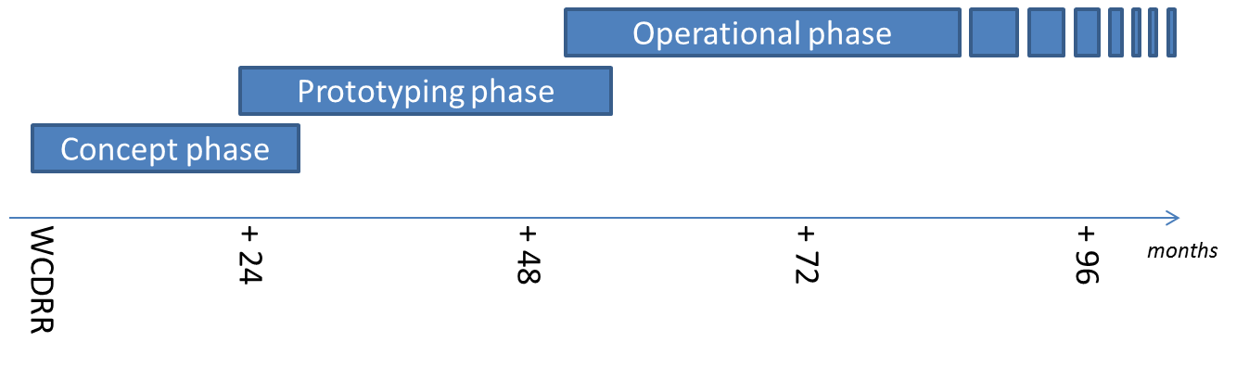
GEO-DARMA Partnership
Intention: build an international partnership with key stakeholders to define a strategy addressing high priorities of Sendai framework with resources available, on a best effort basis, adopting a phased approach
if extra resources and funding
identified

Slide 6
GEO-DARMA Concept Phase
Data providers not fully aware of DRR priorities & user needs
Support from knowledgeable bodies needed for ….
.. independent assessment of DRR priorities for 2015-2030:
At regional level, 2 or 3 independent and authoritative regional institutions such as World Bank, GFDRR, UNESCAP, UNISDR, UNDP, UNOOSA, RCMRD, others, … (start with few regions e.g. South-East Asia, South America, Latin America & Caribbean, Southern Africa)
Identification of hazards affecting most of the countries in the region (e.g. highest human and economic losses) or of transboundary risks that require regional and multi-country involvement.
Identification of 1st set of countries within the region that are ready to actively participate in projects at the very beginning.

Slide 7
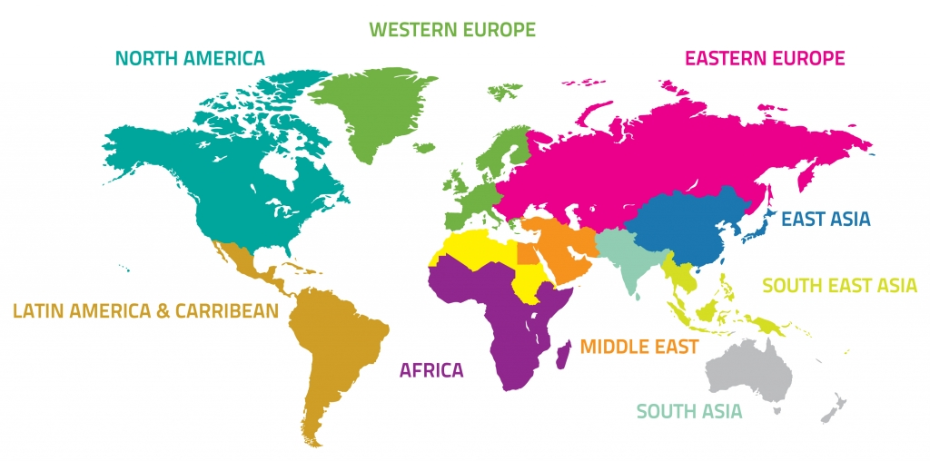

GEO-DARMA – Just an Example !
Identification of users needs and DRR priorities per region
For each region:
Types of hazards,
DRR Issues to be solved,
Initial countries

Slide 8
GEO-DARMA Prototype Phase
1. Realistic assessment of recommendations from Regional Institutions, given resources from the potential actors (e.g. data providers, value-added information providers, ..)
2. Define and implement possible prototype projects at country level to address recommended priorities;
close iterations with end users;
maximum reuse of existing initiatives / activities incl. operational, research, capacity building, …
3. Progressive extension to neighboring countries where applicable.
4. If “successful” prototype projects and if strong request from end users to continue → Assess transition to operation with identification of donors for future operational phase

Slide 9
GEO-DARMA – Just an Example !
Prototype projects – progressive extension to neighbouring countries

Slide 10
GEO-DARMA Governance
Propose to adopt governance structure similar to GFOI incl. Steering Group (high level persons representing International Organisations, Institutional Donors, end-User Communities, Scientific communities, National Disaster Management Agencies, National Resource Management Agencies, …)
Partnership to be built progressively according to needs / activities:
Controlled growth to avoid large unmanageable heterogeneous group with diverging objectives.
1st group: initial partners to serve needs of Concept Phase → mainly international / regional active Stakeholders that can contribute to the consolidation of GEO-DARMA proposal and execution of Concept phase (mainly to generate recommendations)
2nd group: 1st group + national countries + practitioners … to define and execute series of projects in response to recommendations. Progressive growth of 2nd group when prototype solutions are progressively applied to neighboring countries.

Slide 11
GEO-DARMA Status &
Issues (1/2)
GEO-DARMA proposal endorsed by GEO Plenary (Nov. 2016) but dormant since Plenary.
Currently CEOS is the only official contributor (and PoC):
UNESCAP, UNISDR-America already contacted before GEO Plenary
At both the GEO Plenary and UNISDR S&T conference, CEOS has proposed UNOOSA to coordinate both the Regional Institutions and the Capacity Building activities. No follow-on reaction from UNOOSA.
No real support from GEO Secretariat to attract other potential contributors though World Bank’ interest has been mentioned by GEO SEC. Missing full-time Disaster expert at GEO Secretariat .

Slide 12
GEO-DARMA Status &
Issues (2/2)
To foster the kick-off of GEO-DARMA, ESA’s intention is to get some contractual support to help the POC (Ivan Petiteville):
  Statement of Work has been drafted
  Roughly 2 to 3 months before the contract can be placed.
Given the potential growth of GEO-DARMA with several new pilot projects in the coming years, support from WGDisasters members is sought via the creation of a GEO-DARMA subgroup within WGDisasters.
GEO-DARMA could be an excellent opportunity to start follow-on activities, based on the current pilots projects.

