Slide 1
Status Report on the Seismic Hazards Pilot
Philippe Bally (ESA)
Stefano Salvi (INGV)
Theodora Papadopoulou (ARGANS c/ ESA)
WG Disasters #5
Bonn, Germany
8-10 March, 2016

Slide 2
Outline
Seismic Hazards pilot - Status
Results from pilot work to date
  1. EO data access for pilot users
  2. EO processing
  3. Awareness - Promotion of results
  4. Observations strategy
Issues and risks identified

Slide 3
Seismic Hazards pilot - Status

Slide 4
Seismic Hazards pilot - Status
As of today:
A Collaboration of ESA, NASA, ASI, CNES, DLR, JAXA, and other partners: INGV, NOA, UNAVCO, COMET+, University of Miami, EU Centre, ISTerre/IPGP, BGS and CNR IRPI.
20 users: CNR IREA shall be fully on-board in the next days.
The GEP is available since March 2015: supports both EO data access and EO data processing.
Continued collaboration of pilot group with Sentinel-1 mission Project Manager to optimize coverage of the tectonic mask during ramp up phase.
Validation of InSAR based velocity measurements is completed over California. Turkey and Japan in progress.
Major seismic events during this period (2015-2016): Nepal, Greece and Chile.

Slide 5
Seismic Hazards pilot - Objectives
Support the generation of globally self-consistent strain rate estimates and the mapping of active faults at the global scale by providing EO InSAR and optical data and processing capacities to existing initiatives, such as the iGSRM
[role of EO: wide extent satellite observations]
Support and continue the GSNL
[role of EO: multiple observations focused on supersites]
Develop and demonstrate advanced science products for rapid earthquake response.
[role of EO: observation of earthquakes with M>5.8]

Slide 6
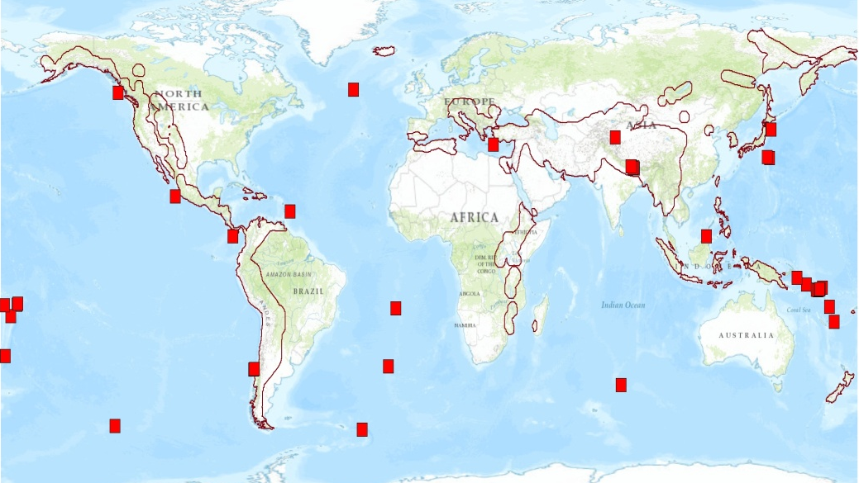
Overview of activities (1)
Objective A:
Validation of InSAR based velocity measurements over California is complete (since September 2015).
Regional analysis of Sentinel-1 data in Turkey is on-going.
Next steps:
  Complete Japan validation if a data source can be identified (ex. ALOS-1).
  Complete validation of interseismic strain measurements using TerraSAR-X at the following sites:
    1) North Anatolian Fault
    2) Septentrional Fault in Haiti/D.R.
    3) Chaman Fault in Afghanistan/Pakistan
Notes:
There are already GSNL sciense users using the GEP (INGV, NOA).

Slide 7
Overview of activities (2)
Objective B:
The pilot continued to support the Gorkha earthquake Event Supersite.
Gorkha earthquake COSMO-SkyMed data recently made available through the GEP, via a connection with the ASI Data Gateway (only for authorised users who have signed the ASI license form).
No other Event Supersites have been established in the period.
The CEOS has continued to support the active Permanent Supersites, see S. Salvi presentation.
Historical GSNL COSMO-SkyMed data will be accessed through the GEP.
Objective C:
  ALOS 2 data obtained through the Seismic pilot for the Gorkha Event Supersite (since JAXA does not support GSNL), ongoing work is focusing on post-seismic deformation (a paper on the earthquake is in review).
  Analysis of the Greece earthquake in November 2015.
  Analysis of the Chile earthquake in September 2015.
Notes:
There are already GSNL sciense users using the GEP (INGV, NOA).

Slide 8
  Results from pilot work in the period September 2015- February 2016
  1. EO data access for pilot users

Slide 9
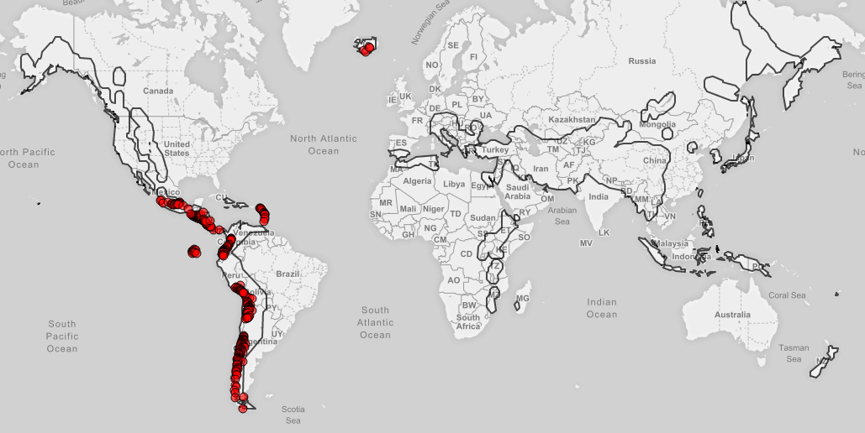
CEOS priority areas on GEP
CEOS priority areas masks are available on the GEP GeoBrowser:
─ Seismic Pilot
Volcano Pilot

Slide 10
EO data access for Pilot users
Following the arrangement made by ESA with ASI, DLR and JAXA to support data dissemination through the Geohazards Exploitation Platform (GEP):
-First COSMO-SkyMed data for the Nepal Event Supersite are available for GSNL users (Obj. B) that have signed the ASI license form. All COSMO-SkyMed data for GSNL, Volcano and Seismic pilot shall be accessed through the GEP (ASI: currently updating Hardware).
-TerraSAR-X data are currently catalogued on the platform. Users shall be re-directed to the DLR portal for downloading. Access granted after registration.
-ALOS-2 data for Seismic and Volcano pilot users are available on the GEP.
-For a fair portion of the tectonic mask, dense ESA archive data (ERS, ENVISAT) are available (70+ terabytes) and work is on going to fully cover the area; Copernicus Sentinel-1 data are available through the Scihub https://scihub.esa.int/

Slide 11
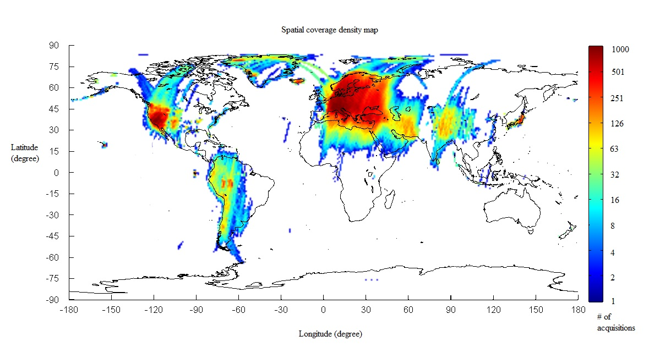
Available ERS, Envisat &
Copernicus Sentinel-1A SAR & Sentinel-2 data
Sentinel-1 made available (in raw as well as SLC format) starting with CEOS Pilot targets and with the goal to gradually provide global coverage.
Sentinel-2 are gradually available on the platform since early March.
ERS & Envisat SAR data:
Current ENVISAT ASAR IM Level-0 Data
Current ERS SAR IM Level-0 Data
(70+ terabytes)
ERS & ENVISAT Level-0 data available as of February ’16.
Notes:
A pltaform for EO processing rather than data distribution or dissemination. Agreement with CEO Spartners for access and accounting of specific data collections (CDEOS Pilots and Geohazard Supersites).

Slide 12
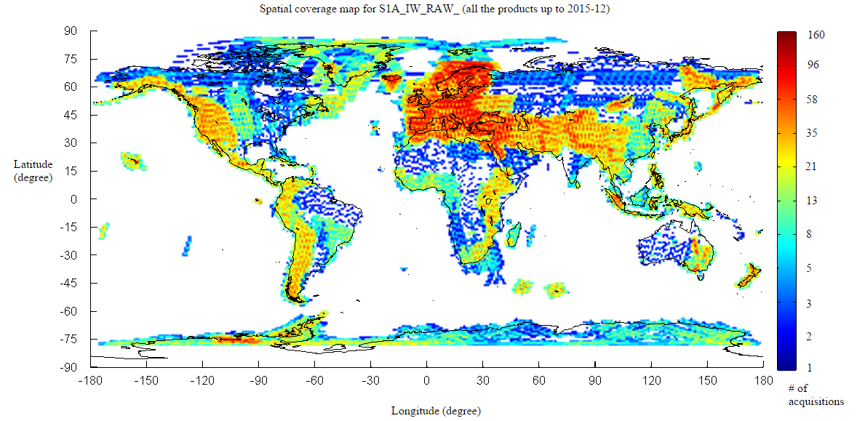
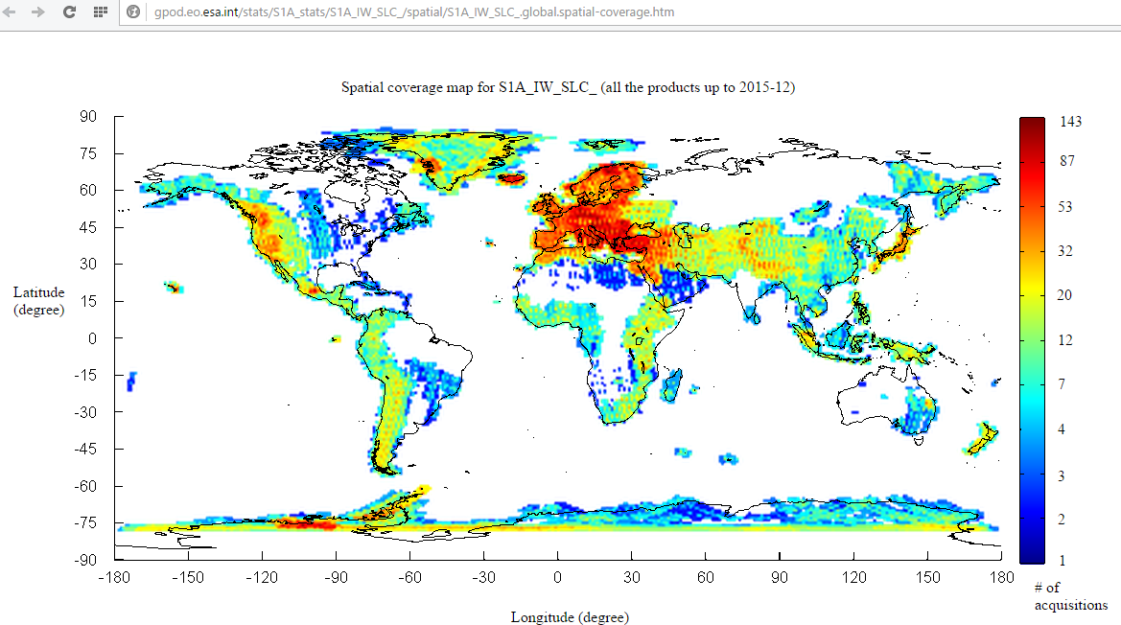
Available Copernicus Sentinel-1A SAR data
S-1 RAW data available as of December 2015
Since November 2015, Sentinel-1 products contain Restituted orbit files.
S-1 SLC data available as of December 2015

Slide 13
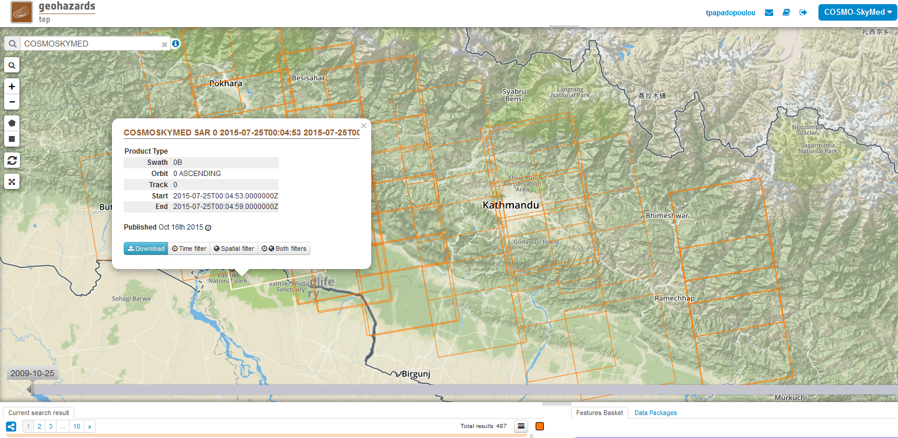
GEP supporting the GSNL
COSMO-SkyMed data collections over Nepal available through the GEP (only for authorized users having signed the ASI license form).

Slide 14
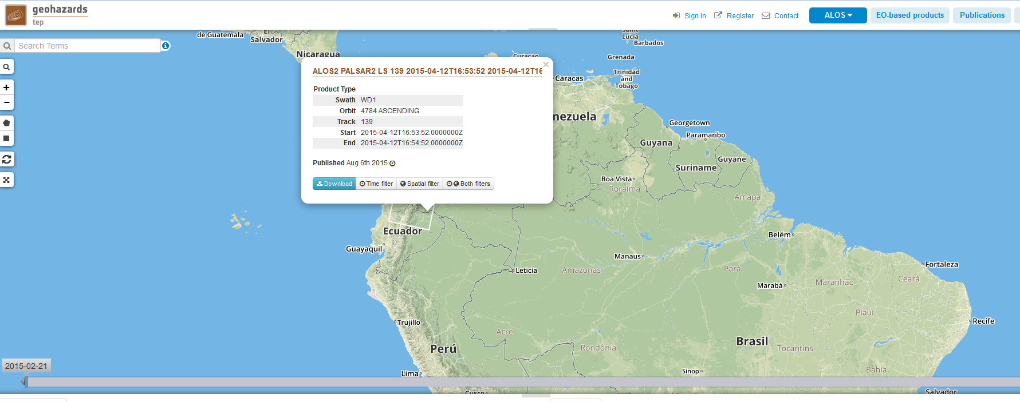
GEP supporting the Volcano pilot
ALOS-2 images over Chile and Ecuador volcanoes are available through the GEP. The ALOS-2 collections for the Volcano pilot will reach up to 11 terabytes.

Slide 15
Yearly Quota 2015
Agency | ASI | CNES Pleiades | CSA | DLR | ESA | JAXA ALOS-2 | NASA | USGS Landsat-8
Number of Images | 300 | 50 | 2 | on request | * | 100 | - | -
*ESA: large dataset through the GEP (ERS & ENVISAT 70+ Tera and Copernicus Sentinel-1 & Sentinel-2 gradually)
DLR (TerraSAR-X): quota shall be provided, if requested
CNES (Spot): no quota provided
Freely available sources: no quota (e.g. USGS L8).
DLR: Provided 65 images after a request for the Lefkada earthquake. Data acquisitions are on-going.
JAXA: The 2015 and 2016 quota (200 images) can be ordered until March 2017.

Slide 16
ALOS-2 & Cosmo-SkyMed quota:
AOI’s defined
Overview of ALOS-2 data (prepared by Erwan Pathier)
Requested images:
Seismic Pilot-Objective C, Total 27 (up to 37) for the Gorkha Earthquake
Seismic Pilot-Objective A, Total 67 (can be down to 57 if excluding Taiwan): Turkey (38 products), Nepal interseismic (10 products), Central Andean Subduction (9 products), Taiwan (10 products)
Total 100 for Y2015
The data request plan for Y2016 shall be discussed at the meeting.
Overview of COSMO-SkyMed data (prepared by Barry Parsons)
Areas proposed: China (Haiyuan) and Iran (Shahdad).
2 scenes per area every 16 days would use ~90 scenes out of this allocation.
Further targets on creeping faults can be defined or as agreed in FRINGE it is possible to leave a significant amount of the allocation for earthquake response and postseismic studies.
A provisional order for COSMO-SkyMed was submitted to ASI for coverage over two creeping faults in China (Haiyuan) and Iran (Shahdad).
Total 300 for Y2015

Slide 17
Data requests & access
Objective A
-33 ALOS-2 images (2015 quota) were ordered for Turkey, Andes and Nepal. Soon to be available on GEP.
-Cosmo-SkyMed images over China and Iran were requested (according to the latest update from the users).
-TerraSAR-X request for Obj. A to be forwarded to DLR.
Objective C
Support for the Gorkha earthquake
-25 ALOS-2 post-seismic images are available.
Greece
- 65 TerraSAR-X scenes (strimap) for post-seismic analysis over Lefkada are being acquired starting on 01-12-2015.
- Co-seismic Radarsat-2 data received.
60 COSMO-SkyMed stripmap scenes, including co- and post-seismic coverage, have been requested.
SPOT data request still pending

Slide 18
  Results from pilot work in the period September 2015- February 2016
  2. EO processing

Slide 19
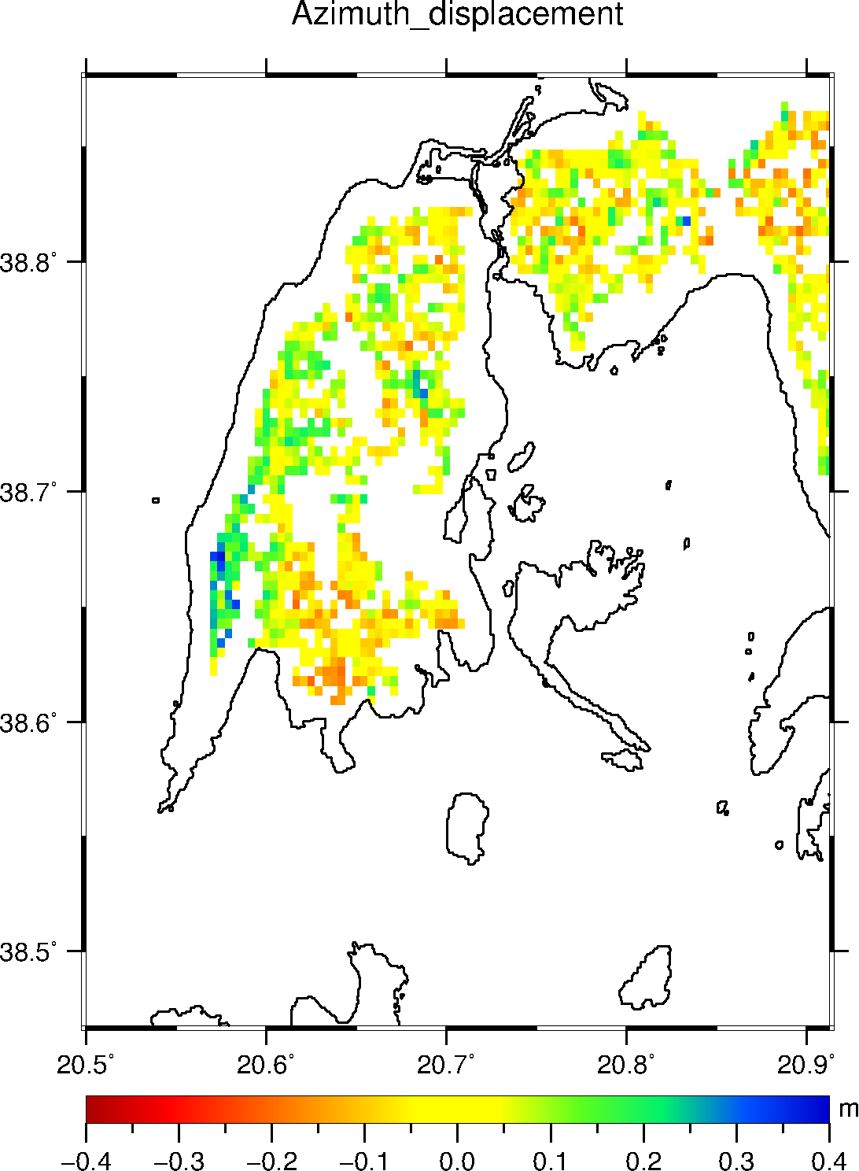
INGV : Azimuth displacement for the 2015 Lefkada earthquake
Offset tracking analysis of COSMO-SkyMed stripmap coseismic pair.
20-30 cm southward motion along the western shore of the island.

Slide 20
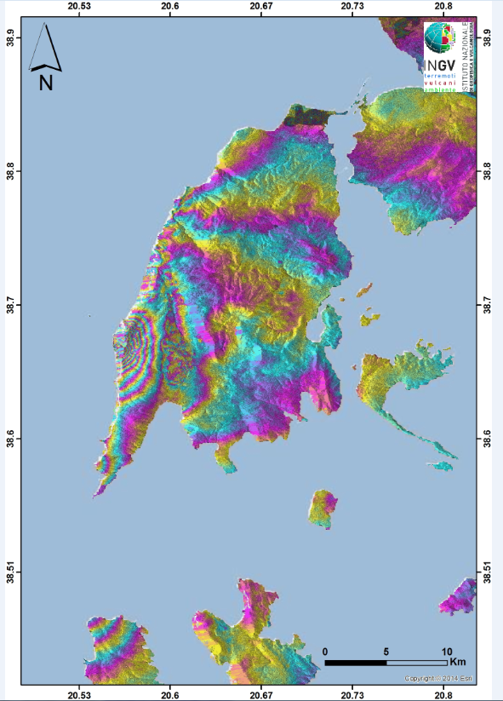
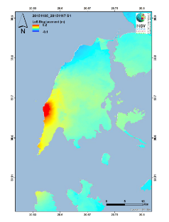
INGV & NOA: Sentinel-1 Displacement
Sentinel-1 ascending data: Interferogram and Displacement

Slide 21
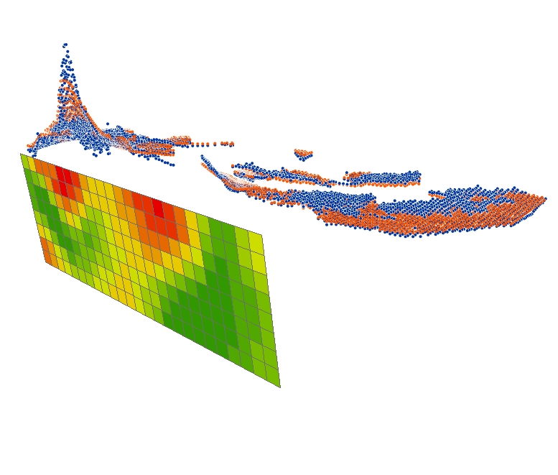
INGV & NOA: Initial fault model for the
2015 Lefkada earthquake
INGV and NOA have inverted COSMO-SkyMed, Radarsat-2, and S-1 data to constrain a source model for the earthquake.
Blue points: observed displacement, red points: modeled displacements.

Slide 22
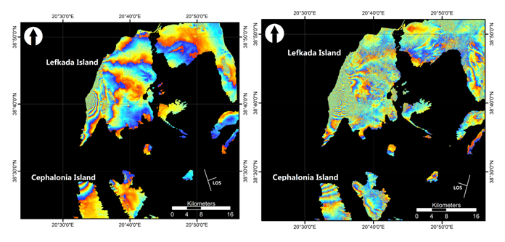
NOA: Co-seismic deformation in Lefkada (1)
Study of the surface deformation caused by the November 2015 seismic event.
Sentinel-1A differential interferograms of the ascending pair (left) and descending (right)
H. Kontoes, NOA: Sentinel -1 data

Slide 23
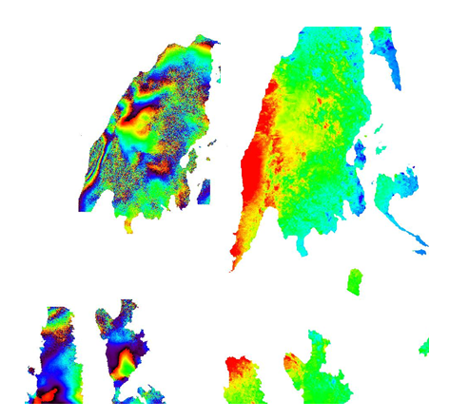
NOA: Co-seismic deformation in Lefkada (2)
Study of the surface deformation caused by the November 2015 seismic event.
Wrapped (left) and unwrapped (right) preliminary interferograms using Radarsat-2 data for the Lefkada earthquake. Maximum LOS uplift of about 17cm is observed.
H. Kontoes, NOA: Radarsat-2 data

Slide 24
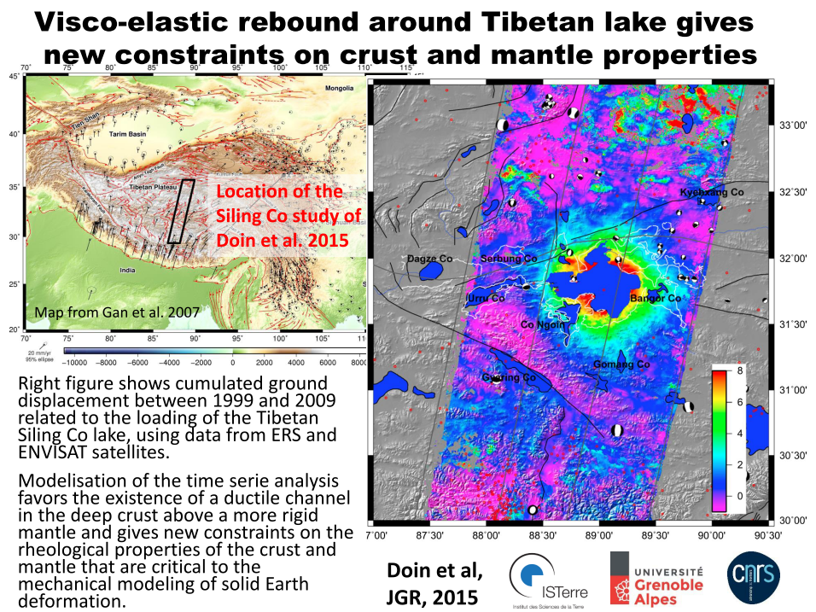
ISTerre: InSAR Deformation measurements using ERS and Envisat
ERS and ENVISAT data used NSBAS chain applied
Marie-Pierre Doin, ISTerre

Slide 25
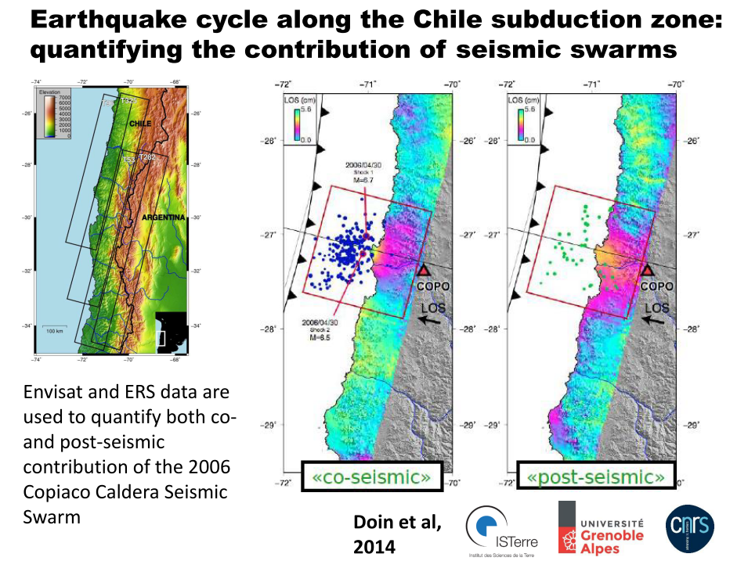
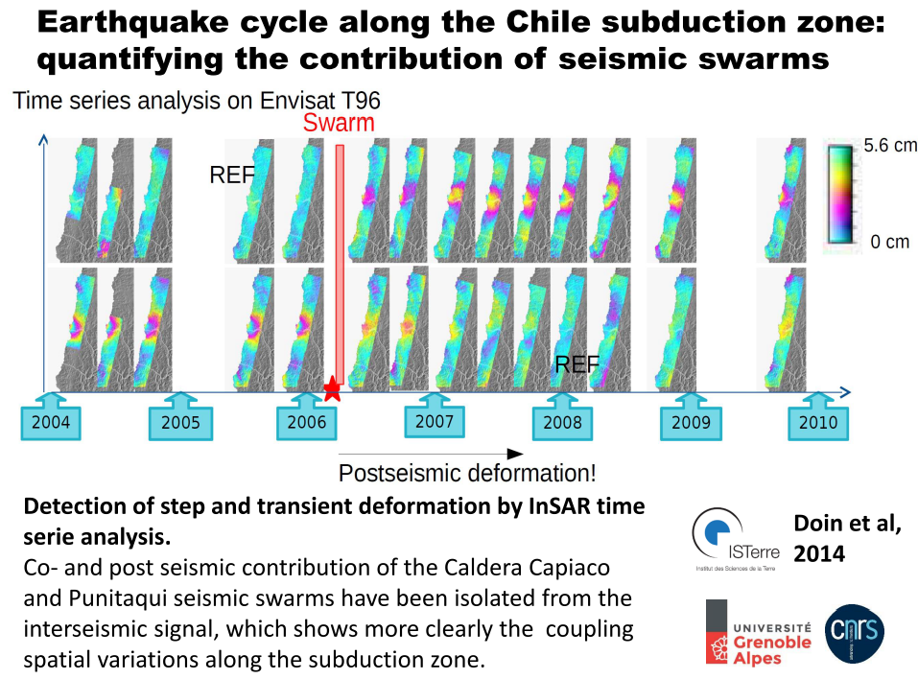
ISTerre: Chile seismic swarms
Marie-Pierre Doin, ISTerre

Slide 26
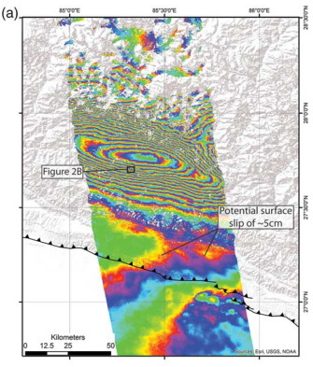
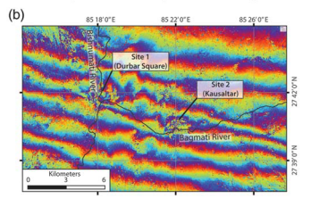
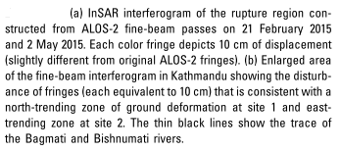
JPL NASA: ALOS-2 fine-beam interferograms over Kathmandu
Eric J. Fielding, JPL NASA

Slide 27
Helping pilot users with on demand cloud processing

Slide 28
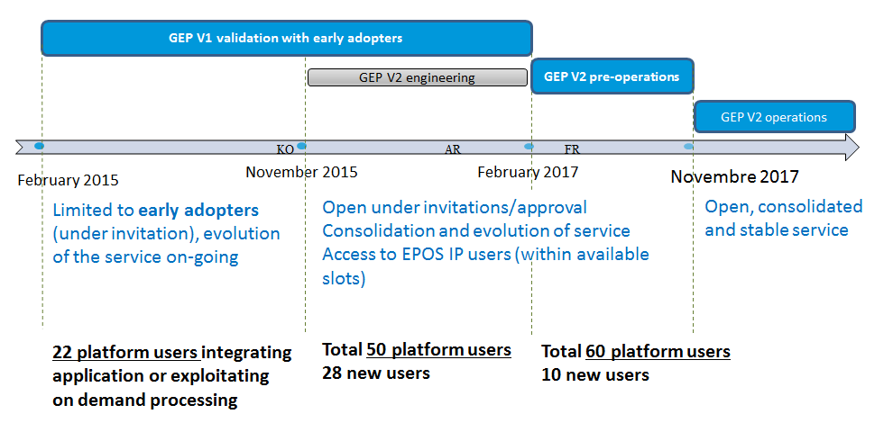
GEP Roadmap

Slide 29
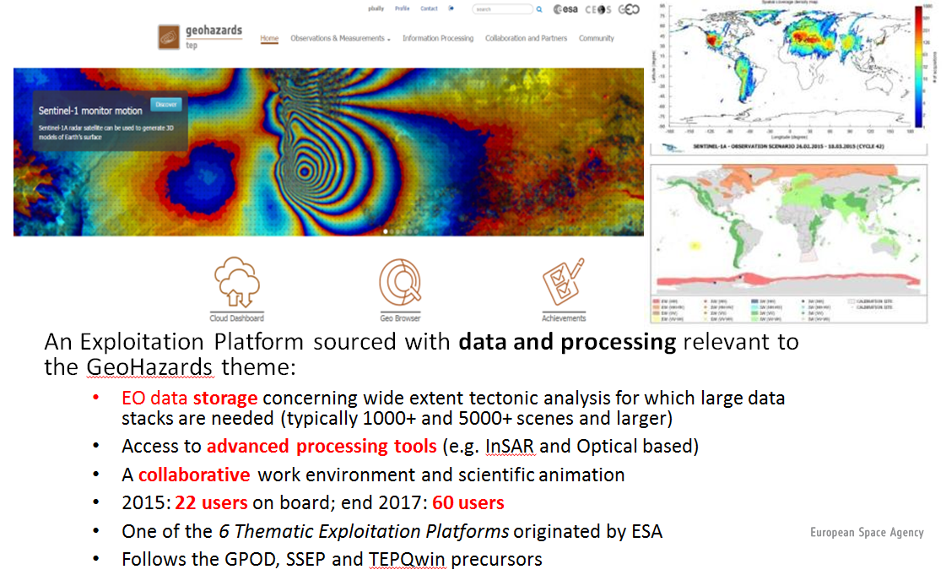
GEP: an innovative response
The GEP KO meeting took place in October 2015.

Slide 30
Examples of Early Adopters,
Validation Phase started in March 2015
User organisation | Areas
Ecole Normale Supérieure de Paris (France) | Etna, Italy and Corinth Rift, Greece
DLR IMF (Germany) | European tectonic mask
Altamira Information (Spain) | Test sites on landslides and earthquakes
ISTerre / Institut de Physique du Globe de Paris (France) | Subduction zones of Latin America, the NAFZ and Tibet.
INGV Roma (Italy) | Alto Tiberina Fault and Fogo Cape Verde
INGV Roma (Italy) | Marmara, East sector of NAFS
INGV Roma (Italy) | Haiti and West Java
ETH (Switzerland) | Large surface deformations caused by landslides in Bhutan Himalaya
NOA (Greece) | Geohazard sites in Greece
SATIM (Poland) | Silesia & Warsaw (Poland)
Obs. Physique du Globe de Clermont-Ferrand (France) | Piton de la Fournaise in La Réunion, Cordon del Azufre / Lastarria in Chile–Argentina
INGV Catania (Italy) | Etna & Campi Flegrei / Vesuvius
British Geological Survey (UK) | Urban areas of Great Britain
University of Leeds (UK) | Active deformation in the Alpine-Himalayan belt
ESA | Over calibration sites: Rain forest, Germany (DLR targets), Australia Milan, Chicago, Sao Paulo
ESA(Progressive Systems SLR) | Greater Cairo, South Rayan dune field, Middle Egypt province and Aswan province
CNR IREA (Italy) | Tests on Italian volcanoes and Hawaiian and Japanese volcanic and seismic areas
Universita De L’ Aquila (Italy) | Abruzzo region: L’ Aquila and Teramo for post-seismic ground displacements
University College of London (UK) | UK landslides
ICTP (Italy) | Morocco seismic activity
Volcanoes
Earthquakes
Landslides
PoC for applications: geohazards-tep@esa.int

Slide 31
Processing tasks on the platform from CEOS pilot users
37 processing jobs launched in September
  36 ISTerre (30 NSBAS, 5 GAMMA, 1 InSAR SBAS)
  1 NOA (StaMPS)
18 processing jobs launched in October
  5 INGV (InSAR SBAS)
  13 ISTerre (11 NSBAS, 2 ROI_PAC)
18 processing jobs launched in November
  6 INGV (InSAR SBAS)
  3 ISTerre (NSBAS)
  4 NOA (StaMPS)
18 processing jobs launched in December
  1 ISTerre (NSBAS)

Slide 32
Next processing activities on (and out of) the platform from CEOS pilot users
  NOA: Maria Kaskara performed time series analysis (Persistent Scatterer processing) on SAR data over Istanbul, Turkey (2009-2010).
  INGV: Christiano Tolomei processed ENVISAT images over the areas of Iran (Tabriz and Bandar Abbas) and Italy (Gargano Promontory) . ERS multi-frame processing to be launched shortly over Central and South Italy.
  ISTerre: activities consisted in processing the ERS over Iran which on GEP is provided as 3 frames (100x100km). ISTerre confirms the usefulness of testing/using the NSBAS installation once logged on the VM via SSH connexion (expert mode), as well as the link to the Geobrowser, allowing to trigger the NSBAS processing as-a-Service from there.
  ISTerre future activities include:
  Tibet: launch their own NSBAS work environment from the Cloud dashboard in January to start over their next activities, over East Tibet, with the need to process long tracks and better systematize the "data results" repatriation workflow.
  Turkey: next activities over Turkey will be starting in Spring 2016.

Slide 33
  Results from pilot work in the period September 2015- February 2016
  3. Awareness – Promotion of results

Slide 34
Awareness – Promotion of results
CEOS Pilot users can promote their results through:
CEOS website (http://ceos.org/ )
GSNL portal (http://www.earthobservations.org/gsnl.php )
Geohazards Exploitation Platform ( https://geohazards-tep.eo.esa.int/ ).

Slide 35
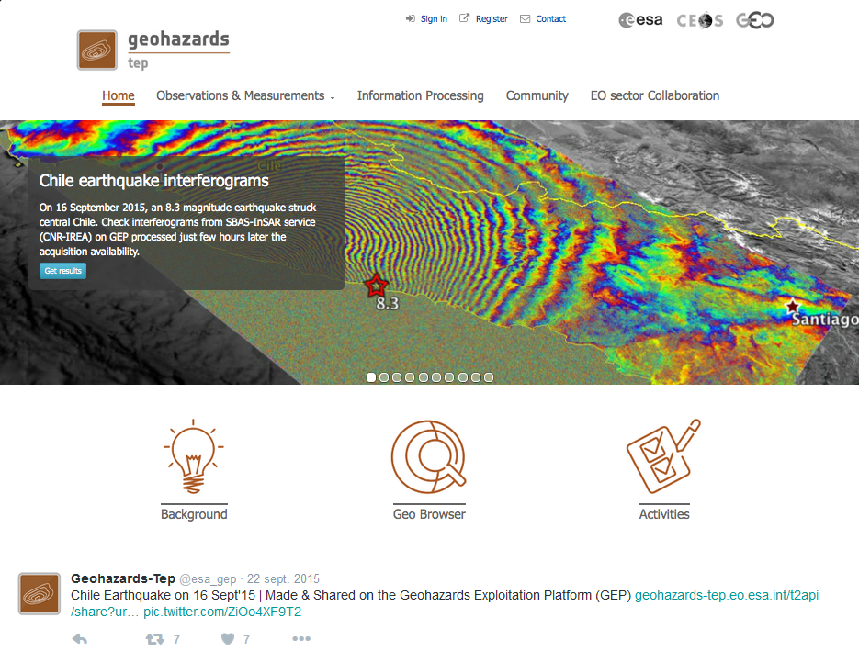
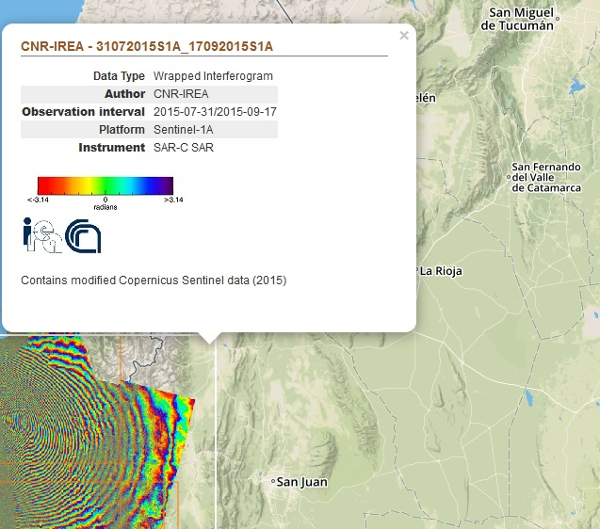
Example of promotion of results on the GEP from CNR IREA
Sentinel-1 interferograms over Chile using the SBAS-InSAR processor.
The processing was run on ESA’s Grid Processing On Demand (G-POD) where the algorithm is currently integrated. The integration of the SBAS-InSAR service on the GEP is still on-going.
Notes:
Processing NOT performed on the GEP.

Slide 36
Publications
Grandin et al. (2015), "Rupture process of the Mw=7.9 2015 Gorkha earthquake (Nepal): insights into Himalayan megathrust segmentation" submitted (IPGP, Obj. C)
Doin, M. - P., Twardzik, C., Ducret, G., Lasserre, C., Guillaso, S., & Sun Jianbao. (2015). InSAR measurement of the deformation around Siling Co Lake: Inferences on the lower crust viscosity in central Tibet, J. Geophys. Res.-Solid Earth, 120, 5290–5310, doi:10.1002/2014JB011768. (ISTerre, Obj. A)
Papadopoulos et al. (2016), The Mw6,5 earthquake of 17 November 2015 in Lefkada Island and the seismotectonics in the Cephalonia Transform Fault (Ionian Sea, Greece), Geophysical Research Abstracts, Vol. 18, EGU2016-9041-1, 2016 (accepted, NOA, Obj. C)
Melgar D. et al., Slip segmentation and slow rupture to the trench during the 2015, Mw8,3 Illapel, Chile earthquake, doi: 10.1002/2015GL067369 (JPL, under Obj. C)
Angster et al. (2015), Field Reconnaissance after the 25 April 2015 M 7,8 Gorkha Earthquake, Seismological Research Letters, Vol. 8, No. 6 (JPL, under Obj. C)

Slide 37
  Results from pilot work in the period September 2015- February 2016
  4. Observations strategy

Slide 38
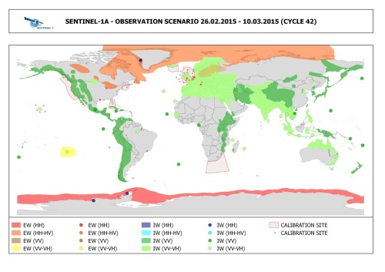
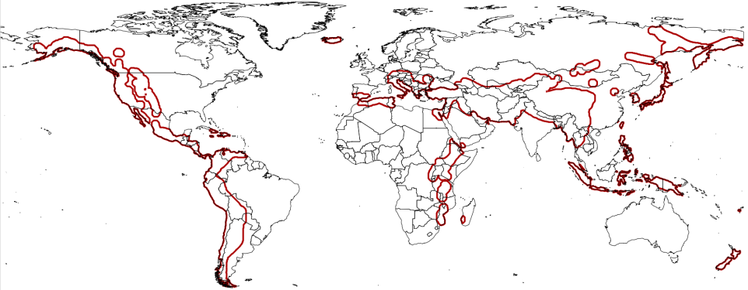
Observations strategy
Continues exchanges between Seismic Hazards pilot lead and Sentinel-1 mission Project Manager in order to cover the entire tectonic mask.
Study of the examination of the gaps of existing acquisition plans over megacities in areas of high seismic risk: Most sites are at least partially covered by SAR sensor and are:
-sites with high repeat coverage using Sentinel-1 and ALOS-2
-sites with rare coverage using ascending or descending acquisitions from Radarsat-2, TerraSAR X, and COSMO-SkyMed.
https://sites.google.com/a/ingv.it/satellite-monitoring-of-geohazard-prone-megacities---satgeomeg/home

Slide 39
Issues and risks identified

Slide 40
Issues & risks identified
Organizing data supply to users has been time-consuming.
User base consists essentially of EO and geophysical science users. End users need a scientific support to take decisions based on pilot results.
Difficult to get detailed user feedback about the value of satellite data and how they exploited products.
Accounting of data accessed can be difficult due to lack of user feedback.

Slide 41
Thank you!

Slide 42
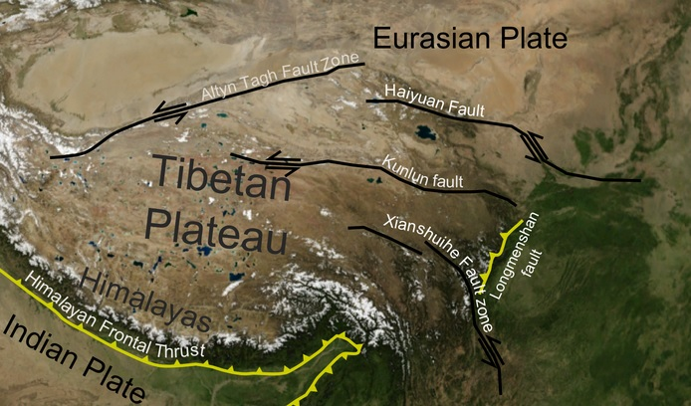
Haiyuan fault
Notes:
For clarification

Slide 43
Current status of GEP
  What the Geohazard Exploitation Platform provides:
  a geobrowser able to search & map data collections from platform repository and from repositories of CEOS partners contributing data from outside the platform
  Allows using Cloud appliances (on demand processing) and have the test data available (as if on an external drive)
  Allows use of a Developer Sandbox to develop and integrate new scientific applications and subsequently exploit them against larger sets of data & computing resources
  Allows the users to consume via the geobrowser Web Processing Services exposed by the user’s processing appliance as a Platform as a Service (PaaS) model.
  Exploits third party Web Processing Services such as G-POD services.
  Exposes appliances with SBAS, GAMMA DInSAR, GAMMA L0, GAMMA, ROI-PAC, StaMPS, Doris , GMTSAR, PF-ASAR, Basic SSEP Toolbox, MATLAB and IDL, NEST v5.1, NEST Generic Toolbox, NEST Coreg, NEST InSAR
  Processors currently under integration: Sentinel-1 Toolbox, DIAPASON, NSBAS, S-1 INSAR QL Processor (DLR), SBAS hybrid, SBAS x S-1, pi-rate
Notes:
Bvlue: proceoors able to proces S1
For the Sentinel-1 TBX the TOPS InSAR capability comes with the new version (20 March 2015).

