Slide 1
Status Report on Volcano Pilot Project
Mike Poland (USGS)
Simona Zoffoli (ASI)
WG Disasters #5
Bonn, Germany
8 -10 March, 2017

Slide 2
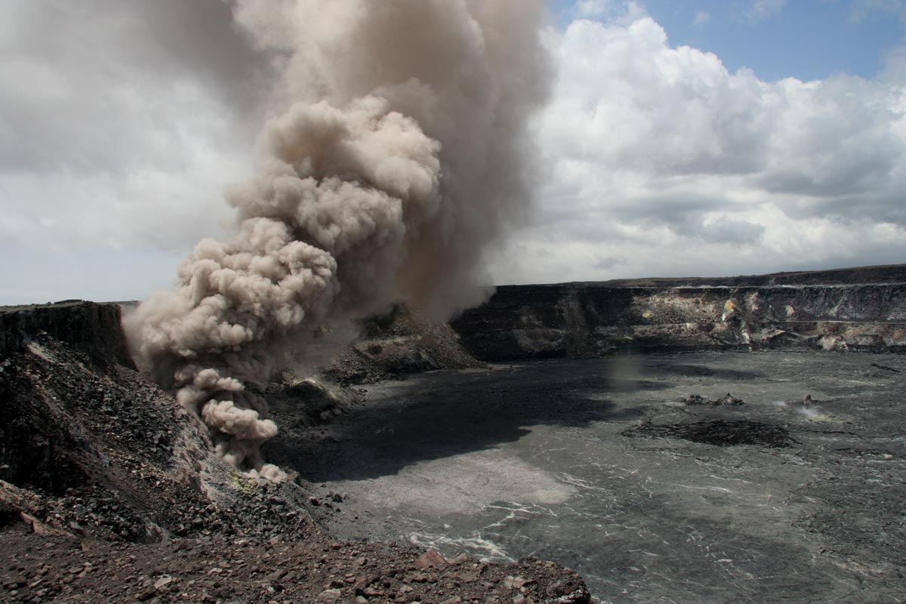
Overview
Motivation and objectives
Data usage
New results
Interfacing with end users
Milestones
Issues

Slide 3
Pilot Team
Juliet Biggs, David Arnold, James Hickey, Susi Ebmeier (University of Bristol)
Matt Pritchard, Francisco Delgado (Cornell University)
Christelle Wauthier, Kendall Wnuk (Penn State University)
Falk Amelung (University of Miami)
Fabrizio Ferrucci (Open University)
Mike Pavolonis (NOAA)
Rick Wessels (USGS)
Eugenio Sansosti (IREA-CNR)

Slide 4
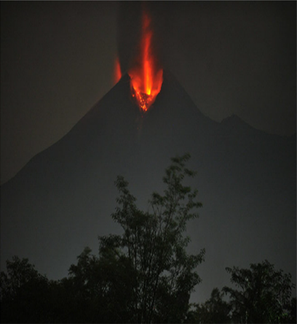
WHY?
Volcano Pilot
Over 300,000 people have been killed by volcanoes since the 1600s.
Hundreds of millions live within 20 km of an active volcano today.
In 2010, the Eyjafjallajökull eruption brought losses of $200m/day, and 100,000 cancelled flights.
Merapi, Indonesia, erupting in 2010. From Pallister and others, 2013

Slide 5
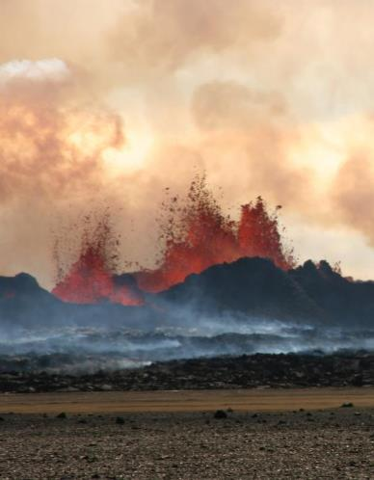
WHAT IS MISSING?
Volcano Pilot
Large monitoring gaps exist at many hazardous volcanoes around the world
Current EO data collection is not usually coordinated for volcano monitoring
Need systematic observations before, during, and after volcanic events
Bardarbunga, Iceland, erupting in 2014.
Photo credit: M Parks

Slide 6
Pilot objectives
Objective A – Regional Demonstration
Demonstrate the feasibility of global volcano monitoring of Holocene volcanoes by undertaking regional monitoring of volcanic arcs in Latin America, stretching from Mexico to southern Chile, and including the Lesser Antilles, using satellite EO data to track deformation as well as gas, ash, and thermal emissions.
Objective B – Geohazard Supersites and Natural Laboratories
Multi-disciplinary, multi-platform monitoring of a few volcanoes that represent a diverse cross section of eruptive activity and unrest.
Objective C – Significant Global Event
Specific studies in case of a major eruption with significant regional or global impact, providing data for a comprehensive analysis of all aspects of the eruption cycle, including local (e.g., mass flows on the volcanic slopes), regional (e.g., ash emissions that may be hazardous to aircrafts), and global (e.g., volatile and aerosol emissions that may influence climate) impacts.

Slide 7
Objective B: Supersites
Work continues on approved volcano Supersites:
  Hawai‘i
  Iceland
  Italy
  Ecuador
  New Zealand
Critical for hazards assessment and mitigation efforts and highly valued by local agencies
Volcano supersites provide opportunities for scientific innovation due to the availability of high spatial and temporal resolution datasets

Slide 8
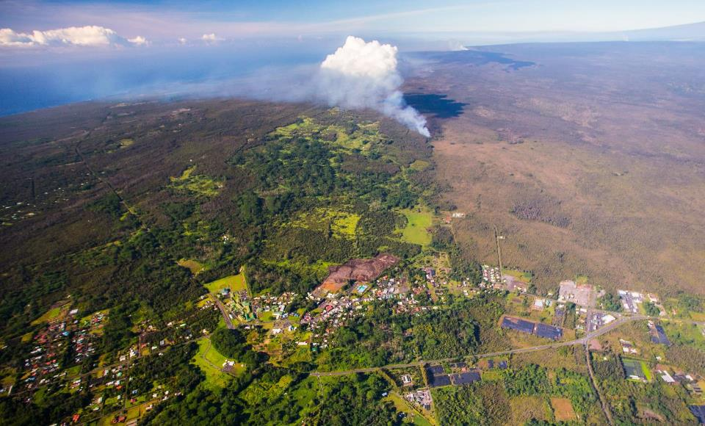
Objective B: Supersites (hazards)

Slide 9

Objective B: Supersites (science)
Chen et al., 2014

Slide 10
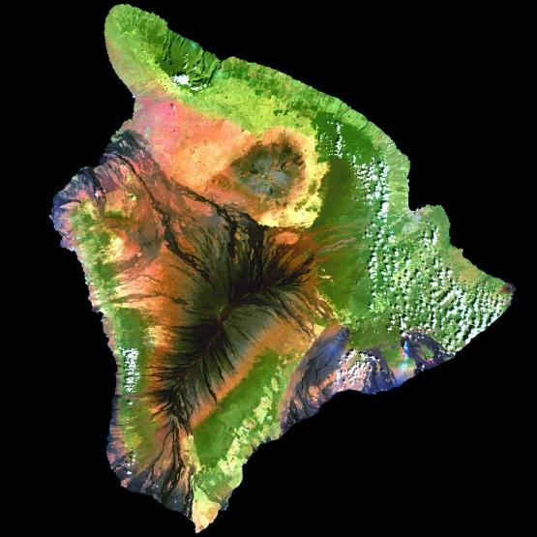
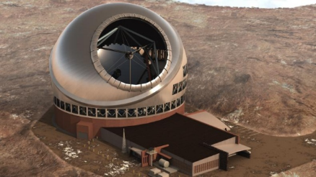
Objective B: Supersites (both!)
Mauna Kea
Home to several world-class telescopes

Slide 11
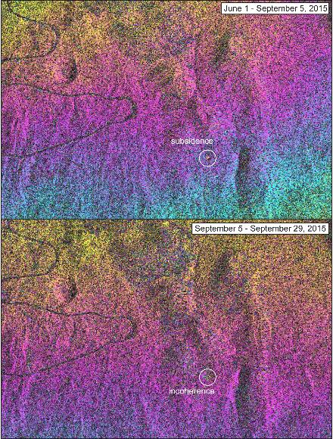
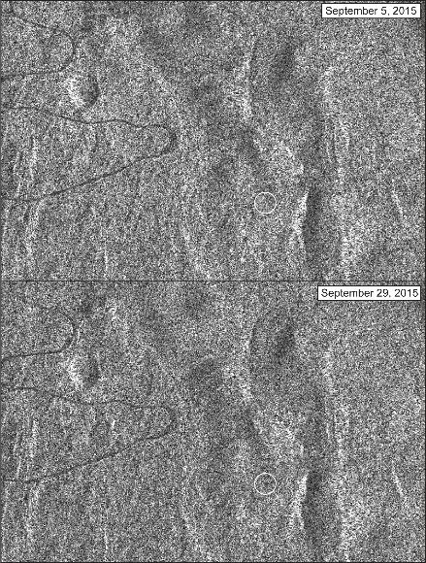
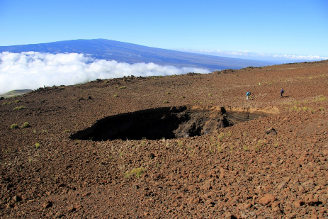
Objective B: Supersites (both!)

Slide 12
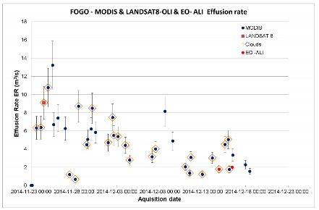
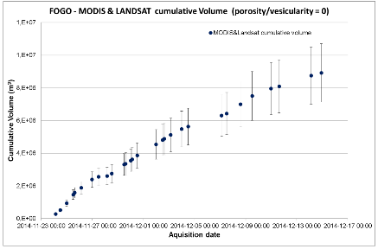
Objective C: Large event
Proposal has been submitted to ensure rapid access to data if a large volcanic event occurs
Fogo eruption serves as a demonstration
courtesy Fabrizzio Ferucci, Open University

Slide 13
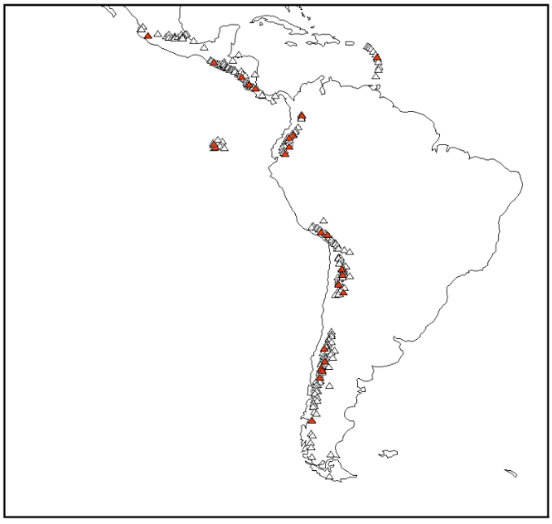
Objective A: Regional demonstration
Demonstrate how EO data can be used to cost-effectively monitor all 315 volcanoes in the region that erupted in the last 10,000 years
Identify volcanoes that may became active in the near future
Track new and ongoing eruptive activity
Why Latin America?
Diversity of environments
Abundant volcanic activity
Benefits to local users
64% of volcanoes in the region have no ground monitoring of any type
Notes:
Triangles are all volcanoes in Latin America. Red triangles are target volcanoes from the CEOS pilot plan. Black boxes and text show regions for planned quarterly monitoring with C-Band (Sentinel-1) and L-Band (ALOS 2) InSAR. Grey text shows the local end users (monitoring agency).

Slide 14
Objective A Efforts by Partner
Topic/region | Value Added Partner
Northern Andes and Lesser Antilles SAR | University of Bristol
Southern and Austral Andes SAR | Cornell University
Galápagos SAR | IREA/CNR
Mexico SAR | University of Miami
Central America SAR | Penn State, University of Bristol
Detection of ash plumes and thermal anomalies | NOAA
Development and testing of EO-based methodology for improved monitoring of surface deformation | All
Capacity-building and training activities in countries that do not currently have access to abundant EO data and/or the ability to process and interpret such data | All
Collect feedback from users | All

Slide 15
SAR Data Usage
Mission | Ordered / Allocated | Noteworthy results
RADARSAT-2 | 235 / 270 | Cordon Caulle, Pacaya, Villarica
COSMO-SkyMed | 381 / 600 | Cordon Caulle, Chiles – Cerro Negro, Villarica
TSX | 135 / 400 | Chiles – Cerro Negro, Ubinas
ALOS-2 | 84 / 200 | Momotombo, Santiaguito
TDX (CoSSC exp.) | 14/150 | Reventador, Soufriére Hills Volcano
*Sentinel-1A data have not been included, since those data are distributed at no cost and with no restrictions.

Slide 16
Utility of data
How have satellite data been useful?
Monitored volcanoes with no ground networks and motivated installation of new sensors (Cordon Caulle)
Provided data for determining alert levels (Chiles-CN)
Complemented ground-based data and contributed to situational awareness during a crisis (Calbuco, Momotombo)
Filled “gaps” at volcanoes that have some ground-based monitoring (Tungarahua, Pacaya, Santiaguito)
Provide otherwise inaccessible data (Reventador, SHV)
Research (Ubinas)

Slide 17
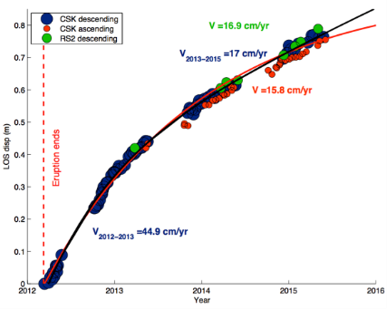
Results: Cordón Caulle
Rapid uplift following end of 2011-2012 eruption
Uplift is aseismic (no associated earthquakes)
OVDAS wants to deploy a GPS based, but had to postpone due to the Villarrica and Calbuco eruptions in 2015
Recognition of uplift motivated NOAA to increase detection sensitivity for ash and thermal anomalies
Uplift 2013/03-2015/06: ˜16 cm/yr uplift
Uplift 2012/03-20012/12: ˜45 cm cm/yr

Slide 18
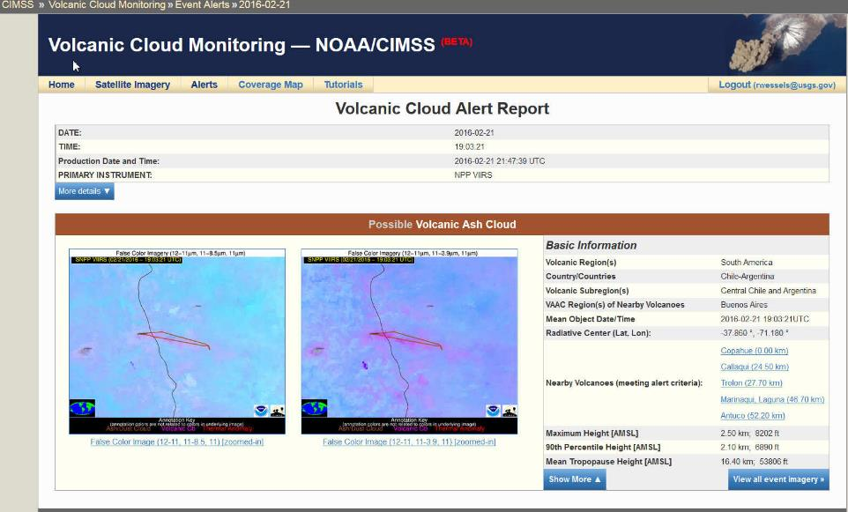
Results: automated alerts
courtesy Mike Pavolonis, NOAA

Slide 19
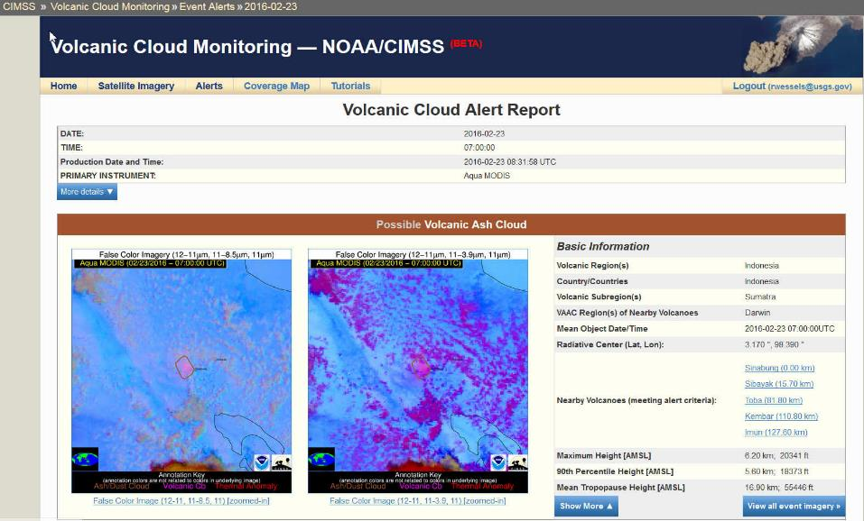
Results: automated alerts
courtesy Mike Pavolonis, NOAA

Slide 20
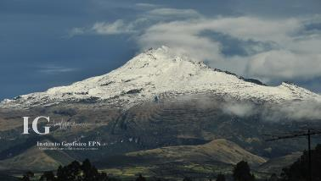


Results: Chiles – Cerro Negro
Seismic unrest 2013-2014
3000 events
2000 events
1000 events
Oct 2013
February 2014
May 2014
Oct 2014

Slide 21
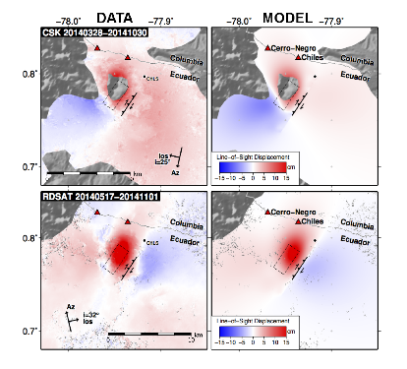
Results: Chiles – Cerro Negro
Cerro Negro
Chiles
Ground deformation – is it magma or “just” the earthquake?
TerraSAR-X
18th Oct- 27th Nov 2014

Slide 22
Results: Chiles – Cerro Negro
Modeling of InSAR data indicate it was “just” the EQ!
Regular CSK and TSX acquisitions were processed as part of the CEOS pilot, and interferograms were provided to the Instituto Geofisico (Ecuador) and Servicio Geologico (Colombia) every ~6 days.
Interferograms, with GPS and decrease in seismic events, were “in helping us arrive to the decision to lower the alert level from orange to yellow.” (P. Mothes, IG)

Slide 23
Results: Calbuco
Feedback from Buenos Aires VAAC manager on May 3, 2015:
“I thank you and congratulate you for the excellent work in making available of all images and products that allow us to significantly improve the tasks of detecting and tracking volcanic eruptions and clouds and ash, since we only have GOES13 and some polar satellites images.”
In the wake of the explosive eruption of Calbuco, the Buenos Aires VAAC used the products to help brief aviation stakeholders

Slide 24
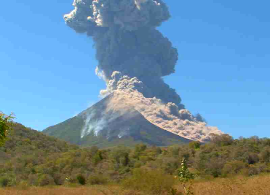
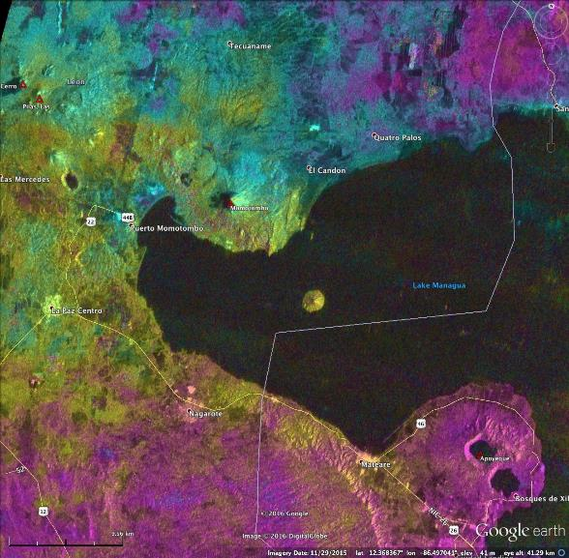
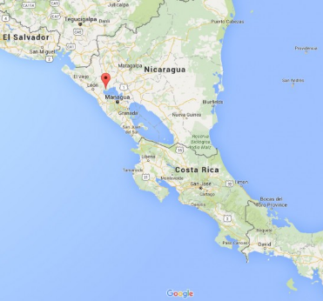
Results: Momotombo
ALOS-2
2015-11-24 to 2016-01-05

Slide 25
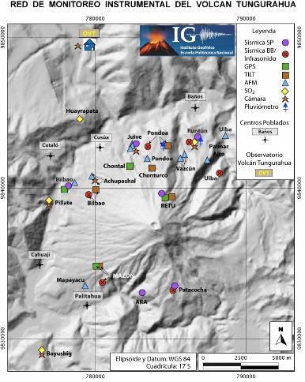
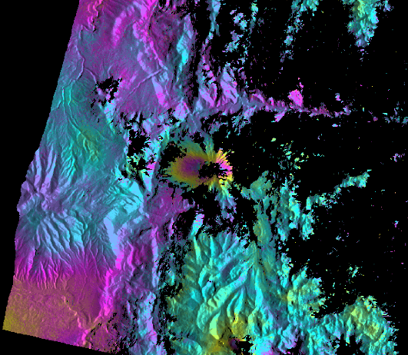
Results: Tungaraua
RSAT2
April 15 – May 9, 2011
Outcome of CEOS pilot investigation:
IG installs new ground sensors in monitoring gap

Slide 26
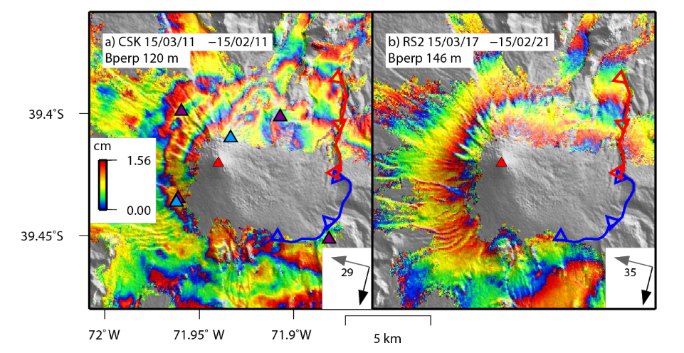
Results: VIllarica
Most dangerous volcano in the southern Andes, experienced a small eruption in March 2015. No clear evidence of co-eruptive deformation from InSAR, GPS (purple triangles), or tilt (blue triangles).

Slide 27
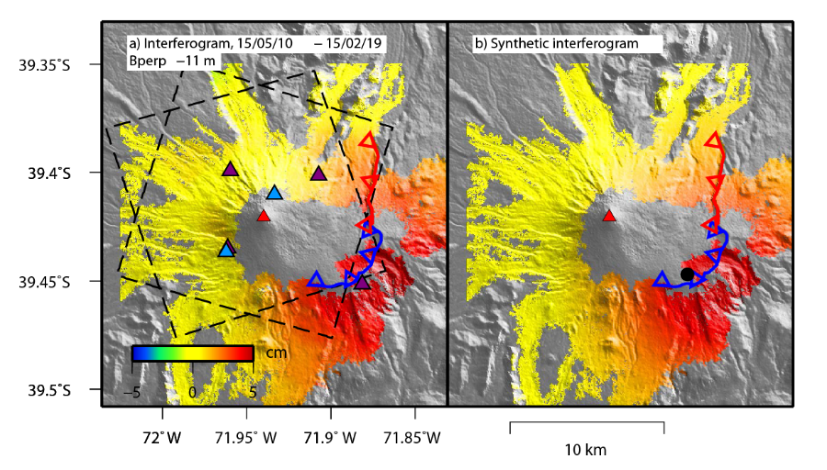
Results: VIllarica
One GPS station (purple triangle) suggested deformation in May 2015. This result was corroborated by InSAR (CSK), and resulted in an increase in the volcano’s alert level.

Slide 28
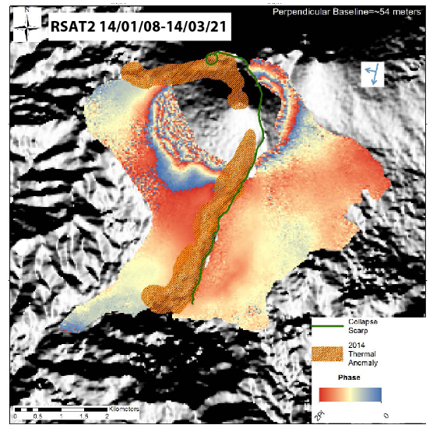
Results: Pacaya
Interferogram spanning the 2014 eruption shows deformation that is likely magmatic in origin on the NE flank, while deformation on the SW flank resembles that from other time periods and is probably related to flank instability.

Slide 29
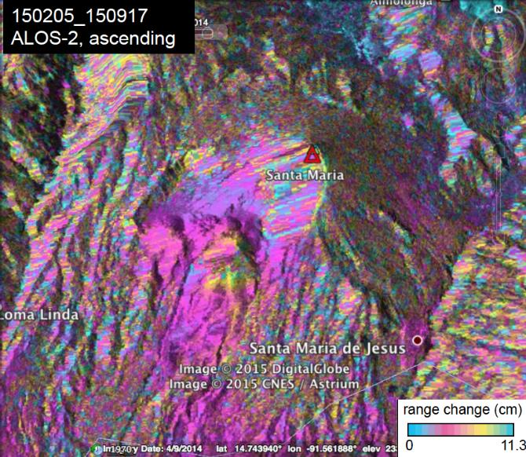
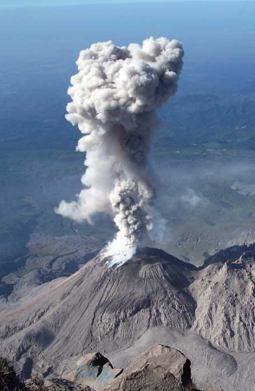
Results: Santiaguito

Slide 30
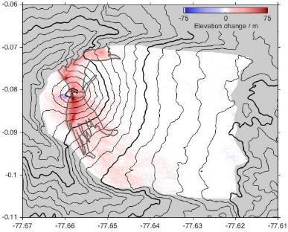
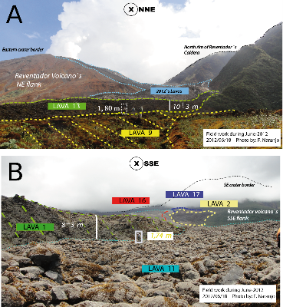
Results: Reventador
IG monitors lava effusion rate using field measurements and photos from overflights (irregular sampling and dependent on clear weather)
Thickness of new lava flows between 2011 and 2014 from TDX CoSSCs
InSAR data provide independent measure of effusion rates. Recent data from CoSSCs have imaged activity that was unknown to IG
Interferograms provide the only source of deformation measurement, important for assessing whether magma is accumulating

Slide 31
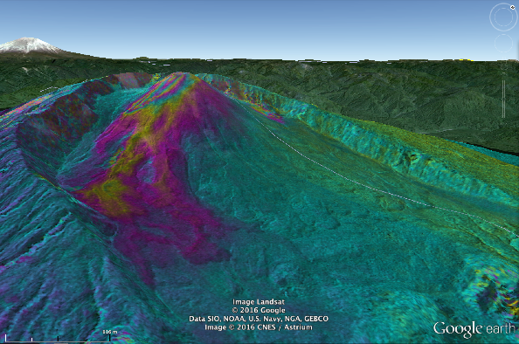
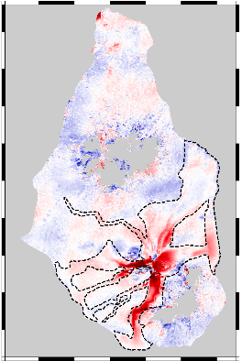

Results: TDX for Topography
2 km
Topographic fringes from a TanDEM-X image pair showing thickness of new lava flows at Volcán Reventador, Ecuador. One complete color cycle corresponds to 25 m of new lava. Images like these supplement limited ground based measurements and allow volcano observatories to see how the rate of eruption is changing over time.
Thickness of volcanic deposits on Montserrat measured by TanDEM-X. These results can be used to update DEMs and improve hazard maps and geophysical models

Slide 32
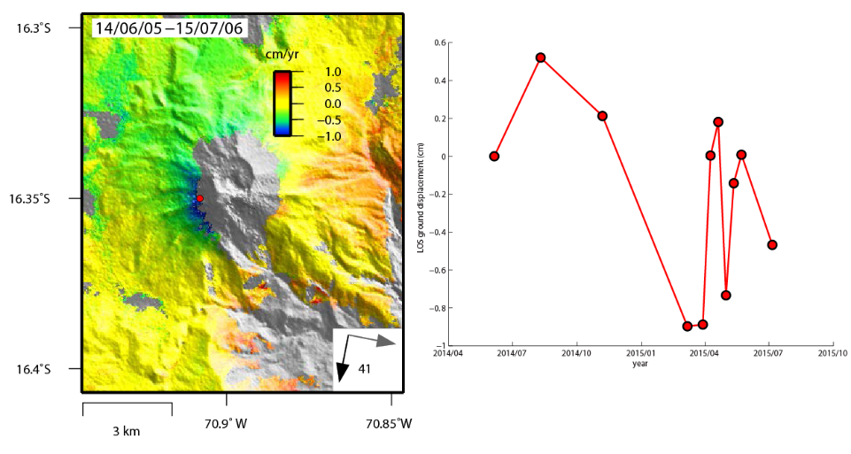
Results: Ubinas
TSX
Most active and dangerous volcano in Peru and in a state of continuous unrest since 2013, with several small eruptions. But no evidence of deformation!

Slide 33
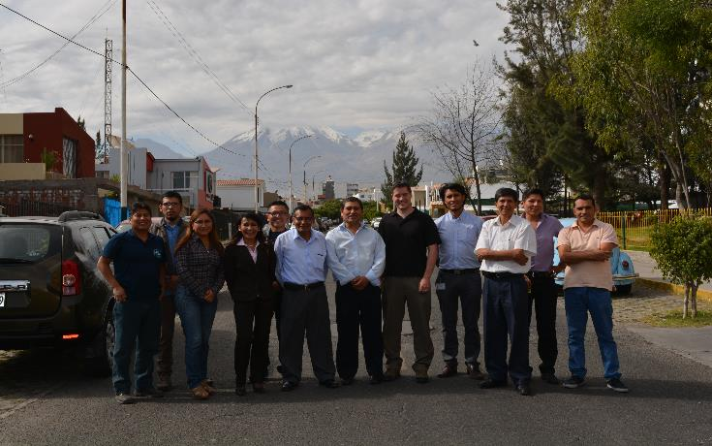
Users—who are they?
End-users are scientists in volcano observatories or VAACs who interface with local government officials

Slide 34
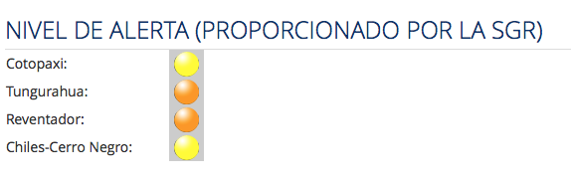
Users – who are they?
[HAZARD] Volcano observatories are the experts that are governmentally mandated to monitor volcanic hazards and usually set alert levels.
[RISK] The authorities (local or national governmental bodies) have the final decision on response (e.g. evacuation) and have the responsibility to advise the local communities etc.
[ALERTS] In practice, response and communication is directly linked to the alert level. Thus when a volcano observatory changes the alert level, a pre-defined response is triggered and in almost all cases, the recommendations of the volcano observatories are followed.
http://www.igepn.edu.ec/red-de-observatorios-vulcanologicos-rovig
If the CEOS pilot were to communicate directly with the local decision makers and communities, it would potentially undermine the authority of the observatories and bypass the alert system. The technical information would likely be either not used or misunderstood.

Slide 35
User feedback
1.Name of your organization and brief statement of mandate.
2.What satellite data were provided to you as part of the CEOS volcano pilot project? How was the data used? (For example, images used in staff meetings, discussions of volcano alert levels, strategies for deploying ground sensors used in making figures for internal or external distribution, etc.)?
3. Were the data useful? If so, please describe in a few lines what level of products was most useful:
(For example, raw data, interferograms, google earth files, a written summary of the significance of the data, etc.).
If not, how could we improve on the use of satellite data for your needs? For example, by sending data in a more timely manner or in a different format.
4. Looking to the future, would your organization like increase the use satellite of observations and what do you think is needed to make that happen?

Slide 36
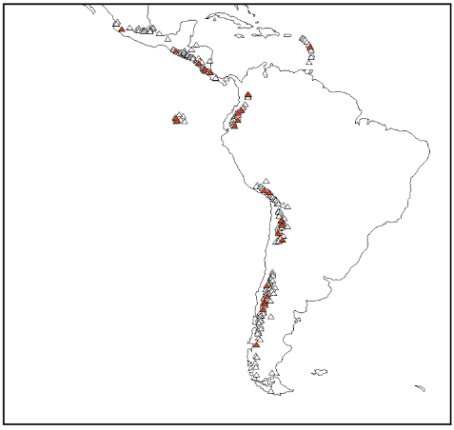
User Feedback
Interviews conducted with users in:
  Guatemala
  Costa Rica
  Columbia
  Ecuador
  Peru
  Chile

Slide 37
User Feedback
What do end users want?
Data provided as Google Earth and/or ArcGIS files, and some interpretation of imagery
More frequent data (in terms of volume and latency between tasking, acquisition, processing, and interpretation) for use in regular reports
Graduate-level training for students (short courses are valuable, but will not train remote sensing experts)
Peru provides a good example of how remote sensing data are used and what is needed in the future.

Slide 38
Upcoming milestones
2016
Achieve monitoring of Latin American volcanoes
Continue to provide products and collect feedback from end users
Evaluate results from site-specific studies
Prepare a Journal of Applied Volcanology article describing the results of our work, focusing on the value to end users
2017
Develop broader space-based EO strategy using insights from pilot

Slide 39
Strategy for volcano EO
SAR observations of Holocene volcanoes
  ALOS-2 and Sentinel-1 can provide broad “routine” wide-area coverage (based on environment)
  High spatial- and temporal-resolution sensors (CSK, TSX) focus on specific targets of concern/interest
  Flexible sensors (RSAT-2) for challenging problems
Visible and thermal monitoring is already somewhat mature (for example, MODVOLC, NOAA system)
Coordinate systems for alerting one another (already done in some cases with visible/thermal systems)
Dedicated FTE, capacity building, data acquisition

Slide 40
Strategy for interfacing with users
Proximity
  (What is the current status of the volcano?)
Integrity
  (What is the status of ground-based monitoring? How will EO products be used?)
Comprehensibility
  (Products versus data; ability to process/interpret data)
Materiality
  (What is needed at the volcano? What features are of greatest interest?)

Slide 41
Issues
ACQUISITION
  Consistent acquisition strategy for volcanoes (background TSX program?)
COMMUNICATION
  Improve dialogue to avoid conflicts in data acquisition
INTEGRATION
  SAR versus visible/thermal wavelengths, better use of Geohazards Exploitation Platform
EXPANSION
  Resources for expanding to global monitoring will be extreme (student case-study projects do not constitute a sustainable capability—PhD students have other demands on their time!)

Slide 42
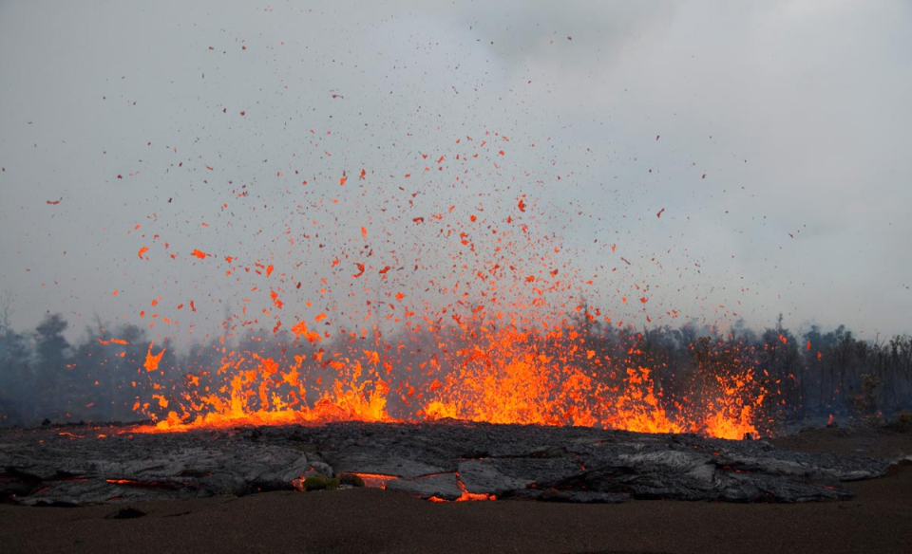
Thank you

