Slide 1

CEOS Disaster Risk Management Flood Pilot Status and Plans
Presented at the CEOS Disasters Working Group Meeting #5 in Bonn, Germany
Co-Lead Stu Frye (stuart.frye@nasa.gov)
Co-Lead Bob Kuligowski (bob.kuligowski@noaa.gov)
NASA DisWG Rep David Green (david.s.green@nasa.gov)
8-10 March 2016

Slide 2
Outline
Flood Pilot overview
Status of data acquisition and exploitation
Pilot status report:
  Objective A: Global component status
  Objective B: Regional component status
    Caribbean/Central America
    Southern Africa
    Southeast Asia
    Special event: Mississippi River (US)
  Objective C: Capacity Building
Issues and Risk Management

Slide 3
CEOS DRM Flood Pilot Overview
Goal: demonstrate effective application of EO to the full cycle of flood management at all scales by:
  Objective A: Integrating information from existing NRT global flood monitoring / modeling systems into a Global Flood Dashboard;
  Objective B: Delivering EO-based flood mitigation, warning, and response products and services through regional end-to-end pilots in:
    Caribbean/Central America (focus on Haiti)
    Southern Africa (inc. Namibia, South Africa, Zambia, Zimbabwe, Mozambique, and Malawi);
    Southeast Asia (focus on lower Mekong Basin and Java)
  Objective C: Encouraging at least base-level in-country capacity to access EO and integrate it into their operational systems and flood management practices
3

Slide 4
Data Acquisition Status
Detailed EO Requirements for each Pilot approved at 2013 Plenary; acquisition allocations approved at 2014 Plenary
Individual requests from each Pilot coordinated by co-leads and detailed on consolidated request form
Mission / Instrument | Repeat or Revisit | Swath | Resolution | Agency | Image Counts
 |  |  |  |  | Annual Quota | Since 9/2015 WGDisasters meeting | Total for 2015 + Jan-Feb 2016
Optical - Coarse Resolution (>100 m)
Terra / MODIS | 1 day | 2230 km | 250, 500, 1000 m | NASA
Aqua / MODIS | 1 day | 2230 km | 250, 500, 1000 m | NASA
NPP / VIIRS | 1 day | 3000 km | 375, 750 m | NASA
Optical - Moderate Resolution (10 to 100 m)
Sentinel-2A / MSI | 10 days | 290 km | 10, 20 m | ESA | ? | N/A | N/A
EO-1 / ALI | 204 days | 185 km | 10, 30 m | NASA | 300 | 28 | 70
Landsat-8 / OLI | 16 days | 183 km | 15, 30 m | USGS | 730 | 28 | 70
Terra / ASTER | 16 days | 60 km | 15, 30, 90 m | NASA
Optical - High Resolution (<10 m)
SPOT (archive only) | 26 days | 60 km | 1.5 and 6 m | CNES |  | 0 | 0
Pleiades | 26 days | 20 km | 50 cm and 2 m | CNES | 50 | 0 | 0
C-Band SAR
Sentinel-1A / SAR | 12 days | 80, 250, 400 km | 9, 20, 50 m | ESA |  | 15 | 47
Radarsat-2 / SAR-C | 1-6 days | 8-500 km | 0.8 to 100 m | CSA | 500 (3 yr) | 116 | 117
ALOS-2 / PALSAR-2 | 14 days | 25 to 490 km | 10 to 100 m | JAXA | 100 | 40 | 40
X-Band SAR
Cosmo Sky-Med / SAR-2000 | 5 days | 10-200 km | 1 to 100 m | ASI | 300 | 103* | 103*
* 50 of the CSK images were archive images that counted toward the 2014 quota
4

Slide 5
Data Acquisition Status
The International Disaster Charter has granted the CEOS Flood Pilot team access to Charter data:
  Future events: requests must be submitted within 14 days of the activation notice (i.e., the beginning of the period)
  Past events: permission has also been granted for five 2015 events: Malawi (Jan); Vietnam (July); Myanmar (August), and India (December); and one in 2016 (Mississippi River in January)
To date, the Flood Pilot has been able to obtain images from
  ALOS-2 (JAXA)
  RISAT-1, ResourceSat-1,2, and Cartosat 1-2 (ISRO)
  KOMPSAT-2 (KARI)
  Kanopus-V 1 and Resurs-P (ROSCOSMOS)
  UK-DMC2 (DMC International Imaging)
This is a significant step forward and the CEOS DRM Flood Pilot team wishes to thank the International Disaster Charter for their cooperation and Brenda Jones for all her help!

Slide 6
How Data Are Being Exploited
Geographic Area | Product | Value Added Partner
Haiti | Flood extent maps, flood risk maps, landslide maps, flash flood guidance / threat maps, integrated risk assessment platform | SERTIT, CIMA, INGV, Altamira, CIMH, RASOR FP7, NOAA/HRC
Other Caribbean islands, Central America | Flood damage maps, change detection products, co-registered map overlays | CATHALAC, CIMH, NASA/GSFC
Namibia | Flood extent maps, flood warning products, co-registered map overlays | Namibia Hydrology Dept, Namibian Water Authority, NASA
Zambezi basin | Flood extent maps, flood forecast models, flood hazard maps, flood depth forecasts | Lippmann Institute (PAPARAZZI, HAZARD, WATCHFUL), DELTARES, RSS
Mekong | Flood extent maps, flood risk maps, flash flood guidance / threat maps | Mekong River Commission, NASA, NOAA/HRC, USGS, University of South Carolina, Texas A&M
Java (Bandung, Jakarta, Cilacap) | Flood risk maps, subsidence maps tied to flood risk, tsunami risk maps (Cilacap only), flood extent maps | SERTIT, Deltares, CIMA, Altamira, INGV, RASOR FP7
Products used by: national end users, civil protection agencies, World Bank, Red Cross, World Food Program, River Commissions (Kavango, Zambezi, Mekong)
6

Slide 7
Outline
Flood Pilot overview
Status of data acquisition and exploitation
Pilot status report:
  Objective A: Global component status
  Objective B: Regional component status
    Caribbean/Central America
    Southern Africa
    Southeast Asia
    Special event: Mississippi River (US)
  Objective C: Capacity Building
Issues and Risk Management

Slide 8
Objective A: Global Component Status
2014 Milestone: initial pilot Global Flood Dashboard website with linkages to major global projects and systems and archive flood products
2015 Milestone: functional linkages between the Global Flood Dashboard and the three regional flood component areas; indication of regions of interest based on reports of flooding; showcase at WCDRR
2016 Milestone: draft a plan for longer-term sustainability; provide functional linkages to additional user-selected polygons of interest beyond the three regional Pilot areas.
Status: 75% complete—decided to initially host the site on the Matsu cloud using a copy of the Southern Africa Flood Dashboard as a platform, retrieving data anywhere requested by the user. Completion expected by mid-March 2016. Will share requirements and prototype implementations with ESA afterward.

Slide 9
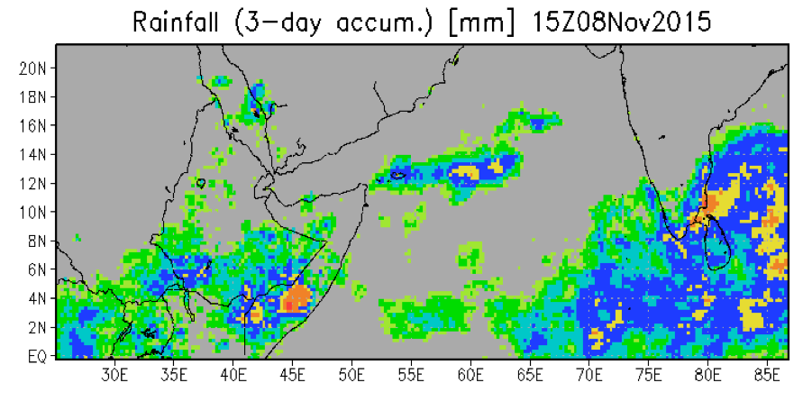
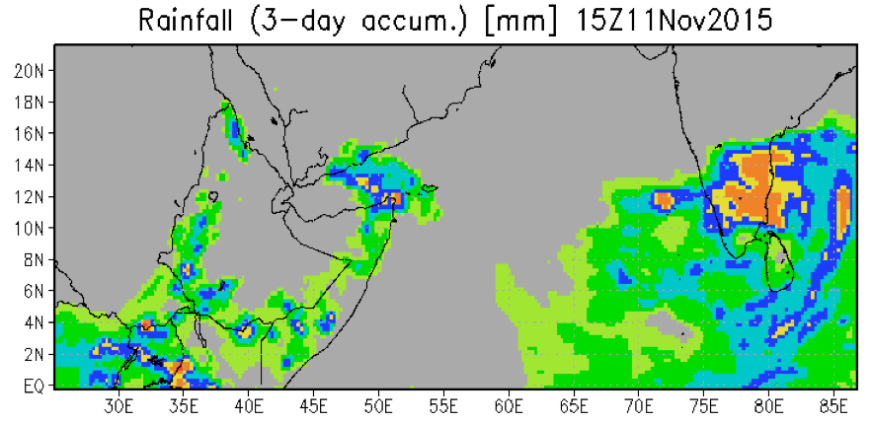

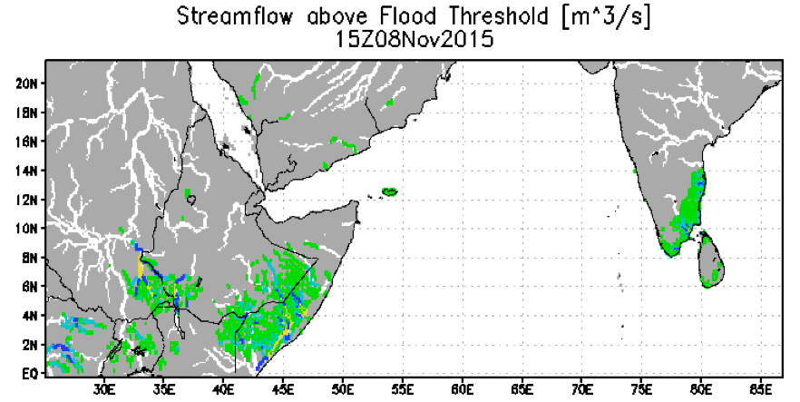
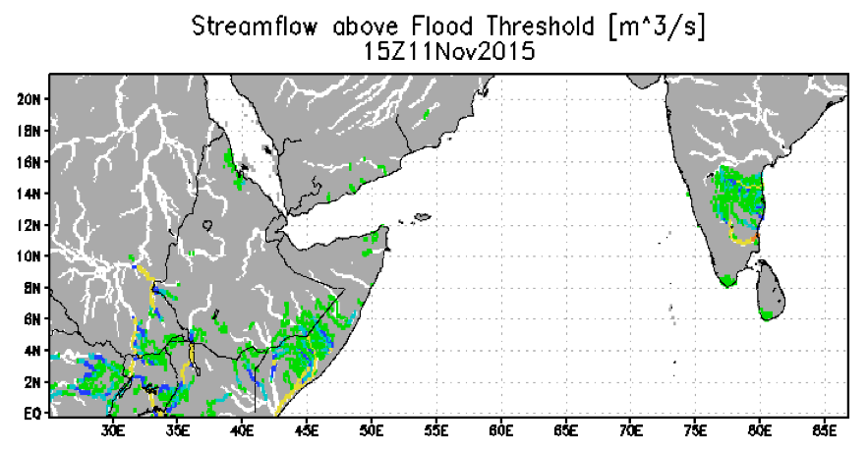

Global Component Highlight: Somalia Floods
(used by UN Office for the Coordination of Humanitarian Affairs)
OBSERVED rainfall 6-8 November
FORECAST rainfall 9-11 November
FORECAST Streamflow above threshold 11 November
Streamflow above threshold 8 November
Figure courtesy B. Adler / H. Wu, U. of Maryland

Slide 10
Outline
Flood Pilot overview
Status of data acquisition and exploitation
Pilot status report:
  Objective A: Global component status
  Objective B: Regional component status
    Caribbean/Central America
    Southern Africa
    Southeast Asia
    Special event: Mississippi River (US)
  Objective C: Capacity Building
Issues and Risk Management

Slide 11
Objective B: Caribbean/Central American Component Status (1/6)
2014 Milestones:
  Flood dashboard based on Namibia pilot adapted to Caribbean and Central American users
    Status: Prototype Flood Dashboard completed: http://matsu-flashflood.opensciencedatacloud.org/
  Flood monitoring (i.e., targeted EO data acquisitions)
    Status: Targeted EO acquisitions in 2014 for Guatemala, Panama, Trinidad, Haiti, and Belize
  Contributions of data to KAL Haiti data base
    Status: Completed

Slide 12
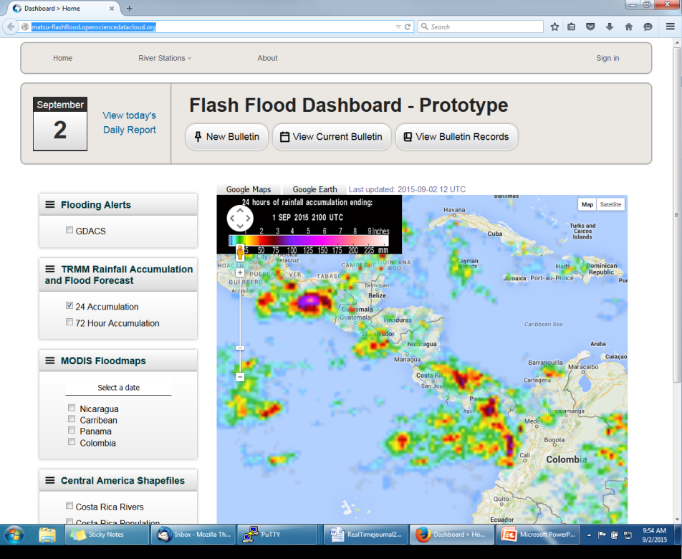
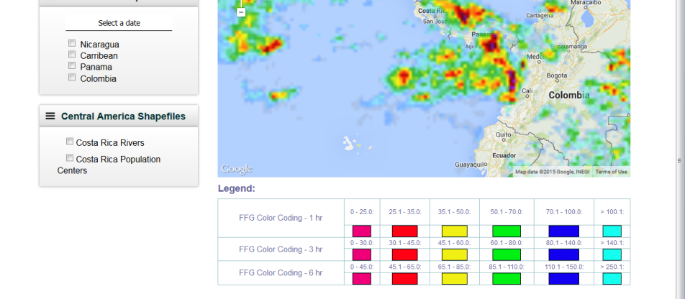
Objective B: Caribbean/Central American Component Status (2/6)
http://matsu-flashflood.opensciencedatacloud.org/

Slide 13
Objective B: Caribbean/Central American Component Status (3/6)
2015 Milestones:
  Flood monitoring during 2015 season
    Status:
      Panama (June); EO-1 / MODIS / Landsat flood maps for CATHLAC
      Dominica (August—TS Erika): COSMO-Sky-Med, Radarsat-2, and EO-1 data
      Bahamas (October—H Joaquin); EO-1 images, GPM rainfall, GFMS flood predictions, flood maps from multiple sensors
  RASOR risk management platform operational for flood risk and landslide risk analysis in Haiti
    Status: Subsidence analysis for 2014 has been performed using RADARSAT-2 imagery (see next slide)
  10-year flood archive based on Deltares Flood Monitoring Programme
    Status: Deltares has ceased collaboration with this Pilot region as per Hessen Winsemius.

Slide 14
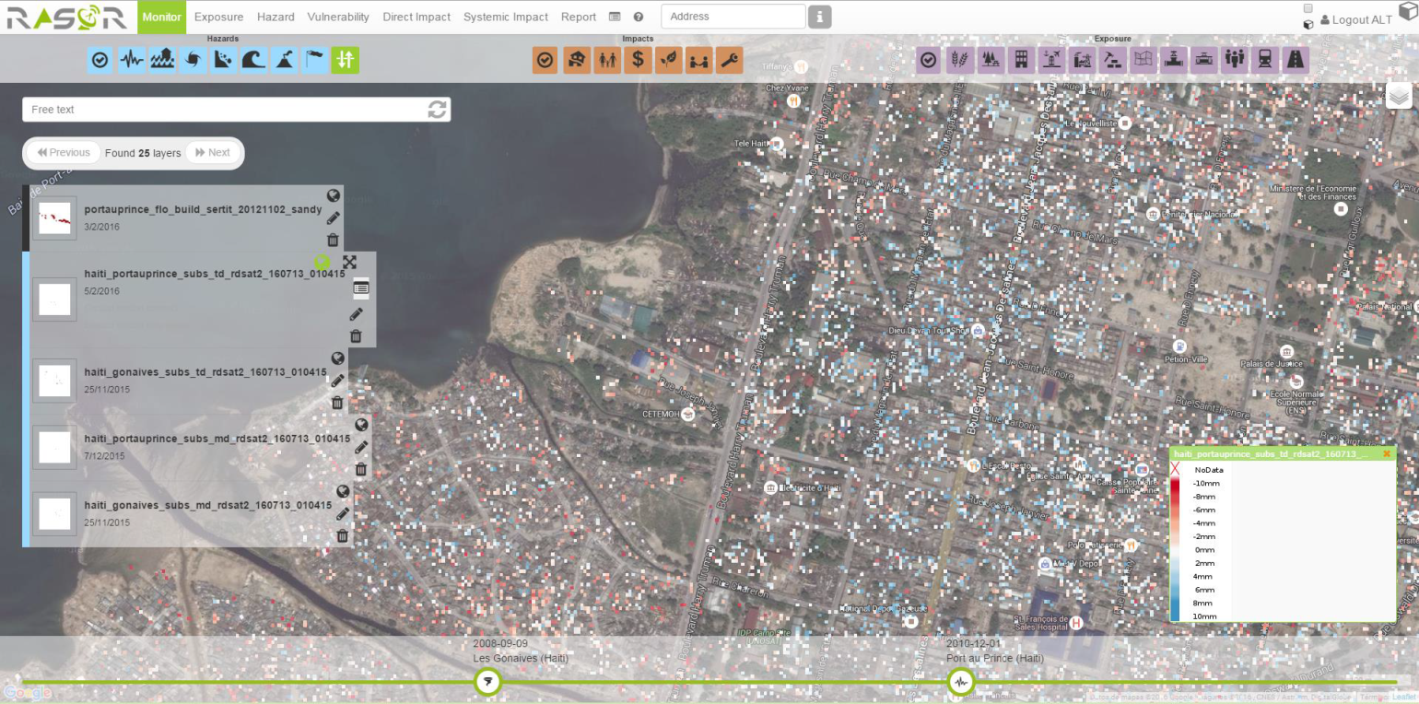
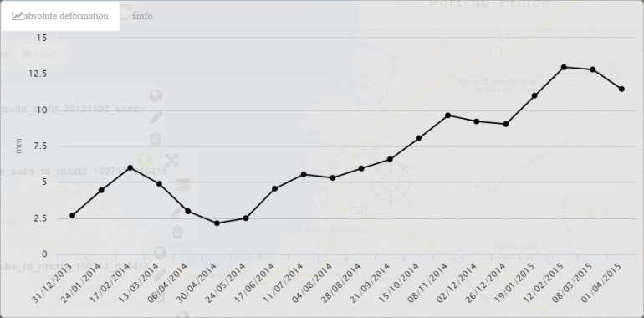
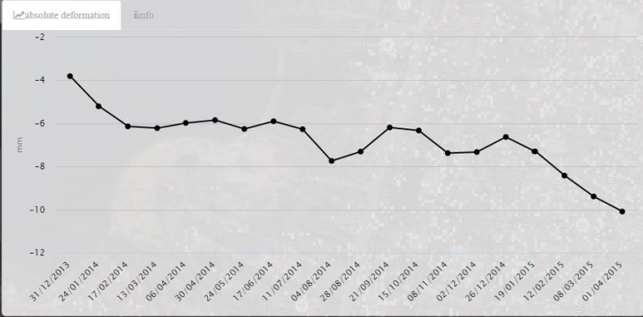
Objective B: Caribbean/Central American Component Highlight
Map of Port-au-Prince with elevation changes determined by RASOR team (red=decrease; blue=increase) based on ~1 year of RADARSAT-2 images. This can in turn be related to changes in flood risk. (Credit: F. Kuodogbo, Altamira)

Slide 15
Objective B: Caribbean/Central American Component Status (4/6)
2016 Milestones:
  Flood monitoring during 2016 season
  Draft a plan for longer-term sustainability
Overall Status: 50% complete.

Slide 16
Objective B: Caribbean/Central American Component Status (5/6)
Other Planned Activites
  Collection of background Radarsat-2 pre-event imagery at known look angles and modes for the entire region (CSA-Giguere)
    Status: 5 complete sets of background images collected over all of Central America and the Caribbean
    Attempts to use these images for the October 2015 Guatemala landslide with varying degrees of success
  Damage assessment studies to analyze satellite-derived inputs as compared to ground-based manual techniques (CIMH-Farrell)
    Status: Case studies performed in Saint Vincent and the Grenadines using Radarsat and EO-1, and in Dominica using Radarsat and COSMO-SkyMed. Collaboration with MDA Corporation to highlight regions of change that were then compared to ground surveys. Lack of pre-event COSMO -SkyMed data made comparisons over Dominica more difficult. CIMH has limited (skill) capacity to process the SAR data but are working to improve their knowledge base.

Slide 17
Objective B: Caribbean/Central American Component Status (6/6)
Other Planned Activites (cont.)
  Open GeoSocial API for publishing / visualizing flood modeling and monitoring products installed Feb 2016 as part of the disasters component of the Climatic Information Platform for Central America and the Dominican Republic under the Regional Climate Change Program (RCCP) funded by USAID. The software suite is being hosted by DAI in Costa Rica under a grant from SICA/CEPREDENAC. Training workshop planned in March / early April in Costa Rica.

Slide 18
Outline
Flood Pilot overview
Status of data acquisition and exploitation
Pilot status report:
  Objective A: Global component status
  Objective B: Regional component status
    Caribbean/Central America
    Southern Africa
    Southeast Asia
    Special event: Mississippi River (US)
  Objective C: Capacity Building
Issues and Risk Management

Slide 19
Objective B: S. Africa Component Status (1/5)
2014 Milestones:
  Flood monitoring during early 2014
    Status: Acquisitions from NASA and CSA under previous agreement within GEO task
  Updates to flood dashboard
    Status: Upgraded Flood Dashboard completed: http://matsu-namibiaflood.opensciencedatacloud.org/
2015 Milestones:
  Flood monitoring during early 2015
    Status: Radarsat-2 images provided for Namibia during flooding on 24 Feb; three Archive Radarsat-2 images of Malawi (early January—ordered in March) provided to LIST for Flood Hazard Mapping that were Disaster Charter acquisitions
  10-year flood archive over region based on Deltares Flood Monitoring Programme
    Status: DELTARES ceased collaboration with this Pilot region.
Status: 75% complete.

Slide 20
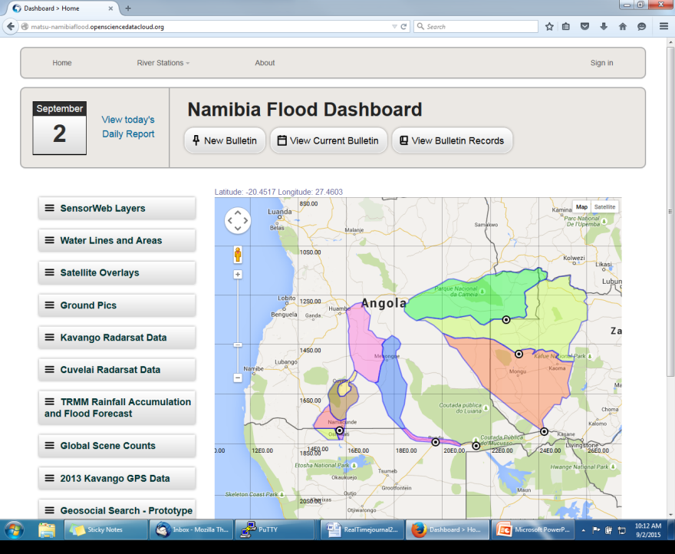
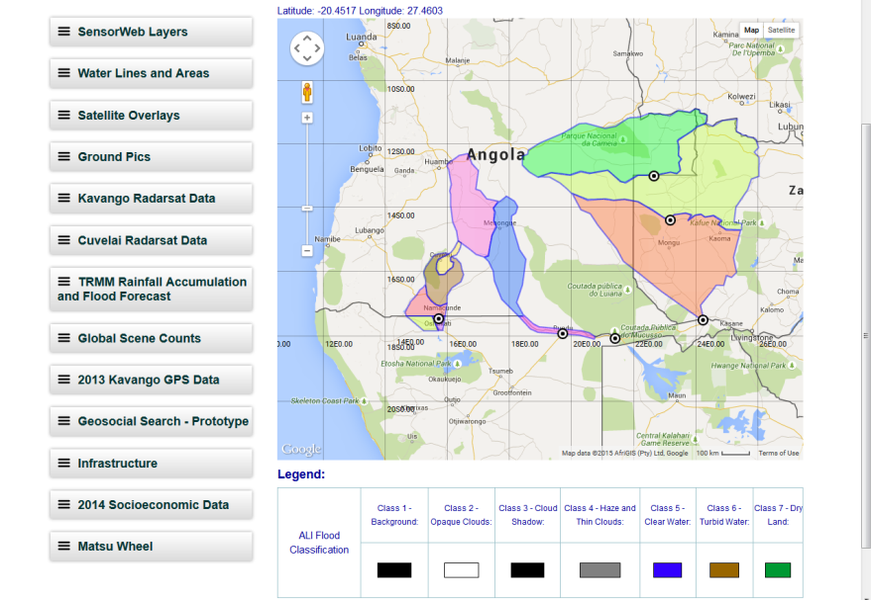
Objective B: S Africa Component Status (2/5)
http://matsu-namibiaflood.opensciencedatacloud.org/

Slide 21
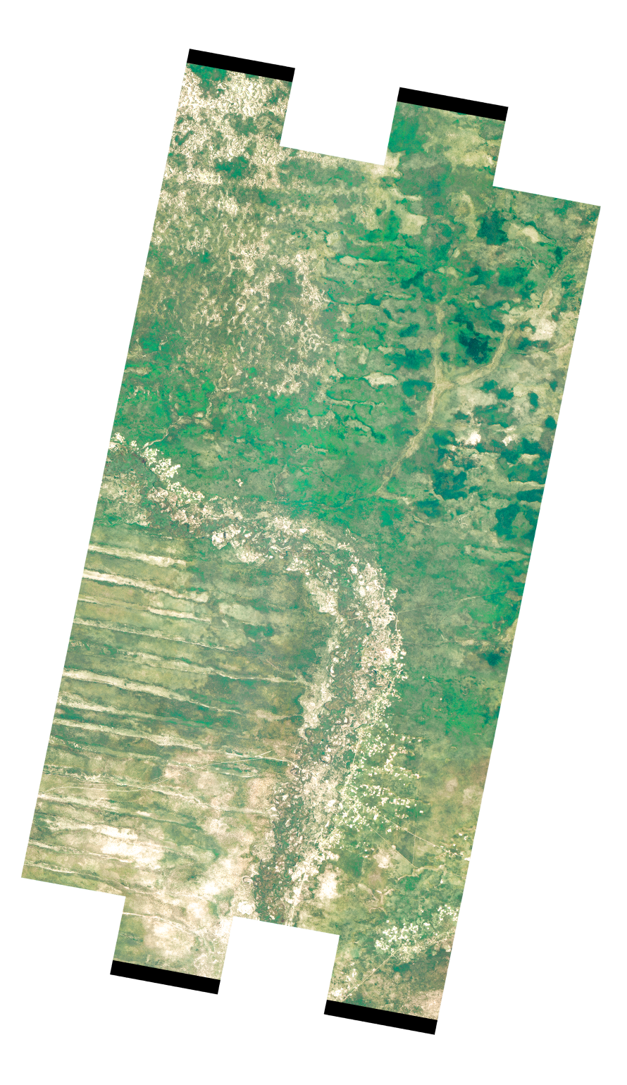
Objective B: S. Africa Component Status (3/5)
2016 Milestones:
  Flood monitoring during 2016 season
    Not strictly flood monitoring, but provided EO-1 and Radarsat-2 images to the Namibia Ministry of Agriculture, Water, and Forestry to identify possible diversion of water from the Kwando River in Namibia (not confirmed by available imagery at this point)
  Draft a plan for longer-term sustainability
Status: 75% complete.
Zambia
Angola
Namibia

Slide 22
Objective B: S Africa Component Status (4/5)
Other Planned Activities
  Improvements to flood model by computing river width and deriving more realistic and complete stream networks derived from Landsat-8 (RSS-Schumann)
    Status: In progress; results on next slide show that differences in flood extent can be large (flood depth differences still need to be assessed).
  Using a flood modeling study of the Lower Zambezi to define areas for high-resolution LiDAR acquisitions over the floodplains to construct higher-resolution DEMs for flood modeling / forecasting (RSS-Schumann; results in slide after next slide)
    Status: LiDAR image acquisition is targeted for funding by the World Bank this year
  Implementation of regional CREST flood model in Namibia, Kenya, and South Africa (U of Oklahoma-Hong/Flaming)
    Status: Proposal for Step-2 SERVIR ROSES call in preparation to enhance flood image processing and flood / landslide monitoring at ADPC in Bangkok (SERVIR hub). ADPC will be listed as self-funded Co-Is.

Slide 23
Southern Africa Component Highlight
Difference in flooded area using a 2-D flood model LISFLOOD-FP, conditioned on the gauged flow of the 2007 event.
Pink outline: Simulation based on HydroSHEDS stream network & river widths.
Blue area: : Simulation based on Landsat-derived stream networks & river widths.
Especially in the delta region, differences in flood extent are significant and more realistic using the Landsat river dimensions. Flood depths are also very different but these still need to be assessed.
(Credit: G. Schumann)

Slide 24
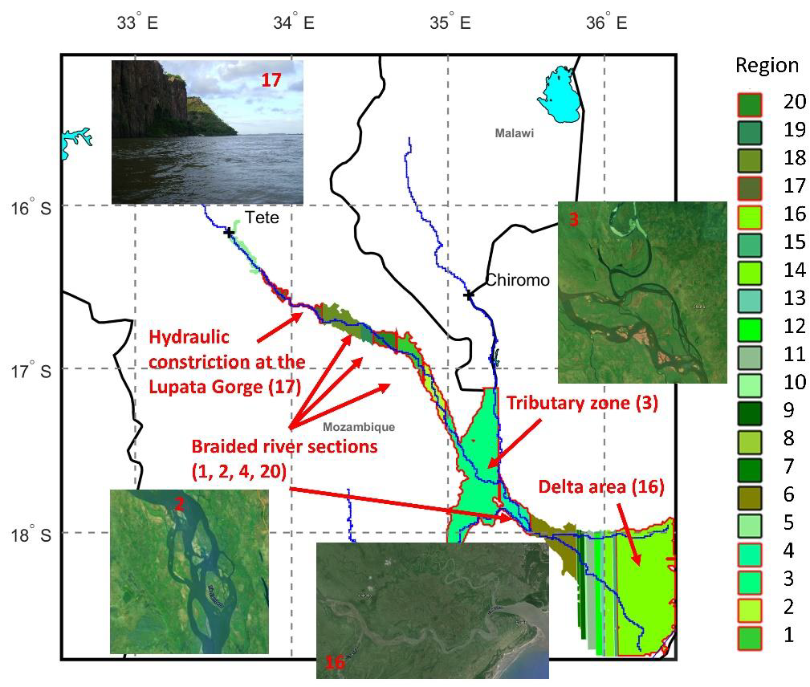
Southern Africa Component Highlight
Map of individual sub-reaches and their floodplains (colors are random). Sub-reaches of hydraulic complexity are depicted with a red outline and annotated. Note that the flooded area shown for each sub-reach is based on a 1:10,000 year flow return flood simulation. Photos are taken from Google Earth. (Credit: G. Schumann)

Slide 25
Objective B: S Africa Component Status (5/5)
Other Planned Activities
  Framework for evaluating flood model forecasts in the Zambezi basin using satellite-derived flood extent maps (LIST-Matgen)
    Status: In progress; results can also be used to evaluate and modify model calibration parameters and thus improve accuracy

Slide 26
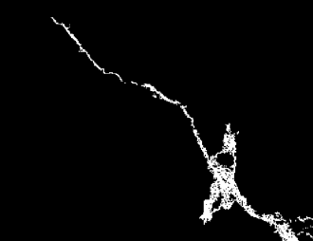
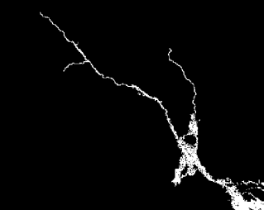
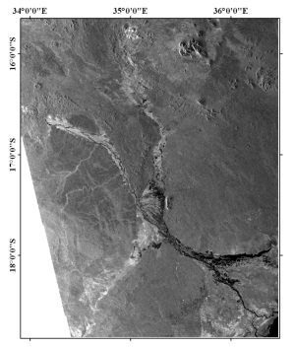
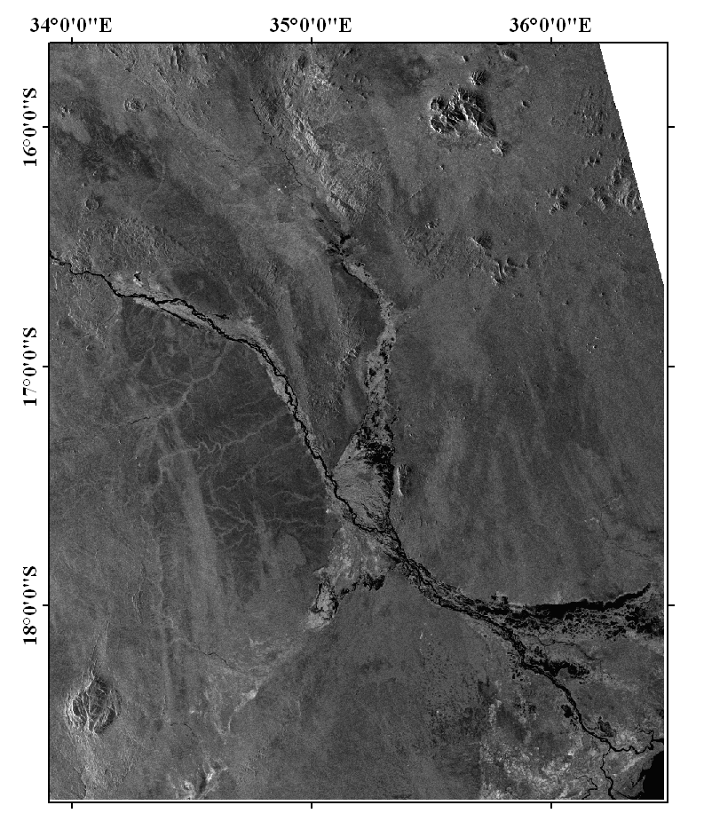
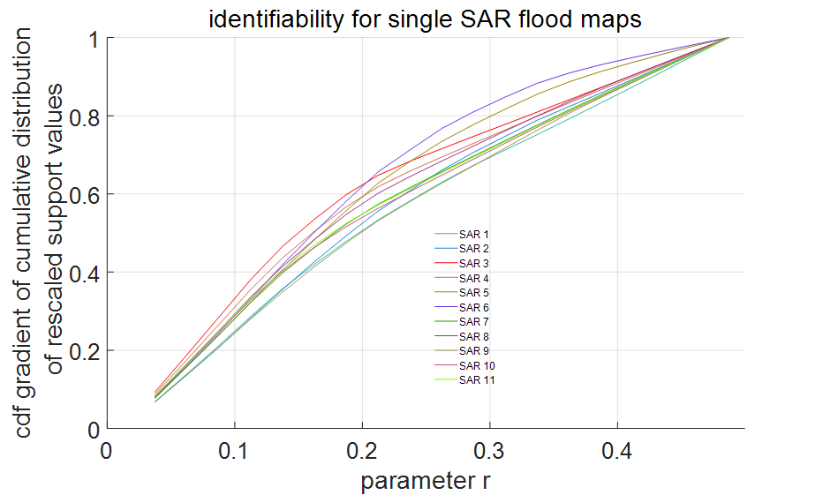
Southern Africa Component Highlight
Improving flood model predictions using collections of SAR-derived flood extent maps
Objectives:
New methodology using a repository of satellite flood images to make improvements to the estimation of hydraulic model parameters.
Correct parameterisation ensures a more robust model that can make better predictions of flooding.
Regular calibration is essential to the future performance of these flood models.
The methodology compares many model simulations of the Zambezi and Shire rivers in flood ….
LISFLOOD February 5 2008
LISFLOOD February 8 2008
… against the SAR satellite observations & makes a judgement which model is best at reproducing the observations
ENVISAT February 5 2008
ENVISAT February 8 2008
If there are multiple satellite data available, the methodology uses ‘identifiability’ to find the satellite images with the best information for calibration
(Credit: P. Matzgen)

Slide 27
Outline
Flood Pilot overview
Status of data acquisition and exploitation
Pilot status report:
  Objective A: Global component status
  Objective B: Regional component status
    Caribbean/Central America
    Southern Africa
    Southeast Asia
    Special event: Mississippi River (US)
  Objective C: Capacity Building
Issues and Risk Management

Slide 28
Outline
Flood Pilot overview
Status of data acquisition and exploitation
Pilot status report:
  Objective A: Global component status
  Objective B: Regional component status
    Caribbean/Central America
    Southern Africa
    Southeast Asia
    Special event: Mississippi River (US)
  Objective C: Capacity Building
Issues and Risk Management

Slide 29
Objective B: SE Asia Component Status (1/5)
2014 Milestones:
  User consultations on new pilot products
    Status: Flood forecasting and event mapping software installed at ICOMOD in 2015. Currently working out the details on defining and installing software at ADPC for a combination of Flood Pilot products and theirs.
  Test TRMM/GPM-based Global Flood Modeling System (GFMS) 1km resolution flood modeling product over the Lower Mekong Basin (contingent on river gauge data being obtained)
    Status: On hold—unable to obtain gauge data for this application
  Flood Dashboard development based on Namibia pilot example adapted to SE Asia users;
    Status: Completed http://matsu-seasia.opensciencedatacloud.org/

Slide 30
Objective B: SE Asia Component Status (2/5)
2015 Milestones:
  Operational test bed for RASOR risk management system for test sites in Java
    Status: Phase 2 proposal being prepared by RASOR team to fund extensions of 2007-11 / 2013-15 risk mapping work
  Integration of flood dashboard
    Status: Funding to automate updates to http://matsu-seasia.opensciencedatacloud.org/ ceased so not all data being served are current; if SERVIR Step-2 proposal is awarded, data will be served through OpenGeoSocial API, including ADPC’s own products.
  Initial services for Mekong River Commission
    Status: ADPC to host Open GeoSocial API Flood Monitoring software suite; full proposal for Step-2 SERVIR grant funding is being developed

Slide 31
Objective B: SE Asia Component Status (3/5)
2015 Milestones (cont.):
  10-year flood archive over region based on Deltares Flood Monitoring Programme
    Status: DELTARES has recently re-engaged with the Pilot to produce products with Charter data and in collaborating with the ADPC flood record (access via OpenSocial API pending SERVIR grant funding).
  1st new TRMM/GPM and other flood monitoring products
    Status: iMERG products now served under Open GeoSocial API
    GFMS flood products being served from another API instance (http://ojo-streamer.herokuapp.com/)
2016 Milestones:
  Flood monitoring during 2016 season
  Draft a plan for longer-term sustainability
Status: 80% complete.

Slide 32
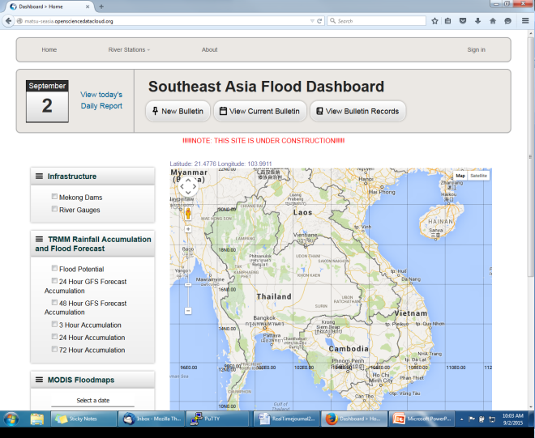
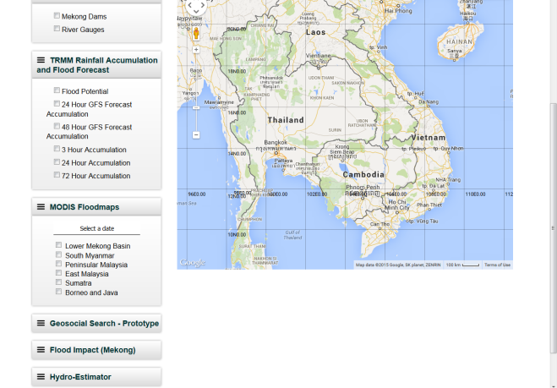
Objective B: SE Asia Component Status (4/5)
http://matsu-seasia.opensciencedatacloud.org/

Slide 33
Objective B: SE Asia Component Status (5/5)
Other Planned Activites
  Indonesia and Java risk assessments and subsidence calculations (Deltares-Villars)
    Status: DELTARES has recently re-engaged with the Pilot and are part of the RASOR team working in Indonesia / Java.
Other Activities:
  Interaction with the World Bank in December 2015 as part of the RO meeting revealed types of flood products that would be useful to their needs assessments and ongoing recovery support.

Slide 34
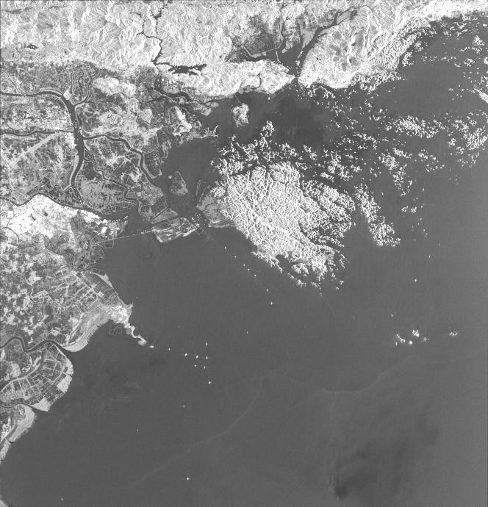
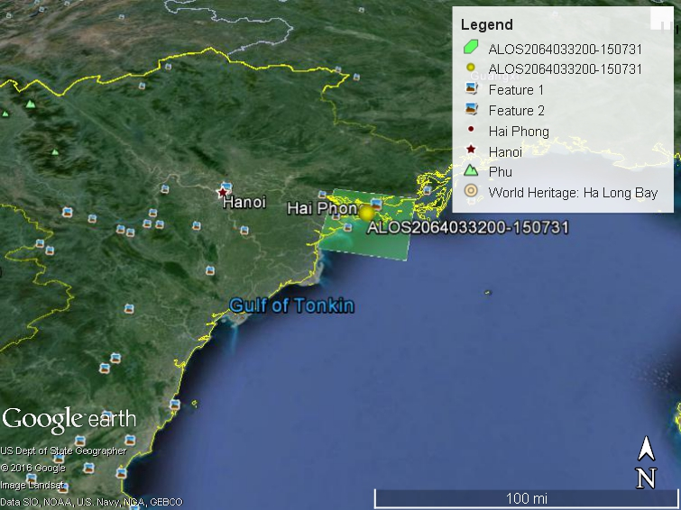
Objective B: SE Asia Component Highlight
HV-polarized ALOS-2 Charter image from Vietnam flooding, 0445 UTC 31 July 2015

Slide 35
Outline
Flood Pilot overview
Status of data acquisition and exploitation
Pilot status report:
  Objective A: Global component status
  Objective B: Regional component status
    Caribbean/Central America
    Southern Africa
    Southeast Asia
    Special event: Mississippi River (US)
  Objective C: Capacity Building
Issues and Risk Management

Slide 36
Mississippi River Special Event (1/3)
Data provided: In addition to flood forecast products accessed via data pull from e.g., the U. of Maryland Global Flood Monitoring System and Dartmouth Flood Observatory, NASA provided ALOS-2 flood maps provided to FEMA for the Mississippi River. Feedback from FEMA was very positive.

Slide 37
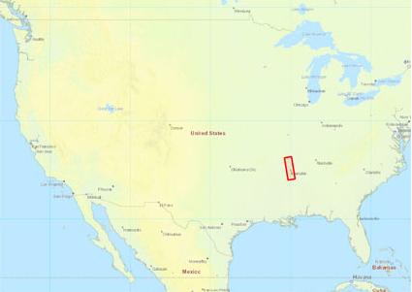
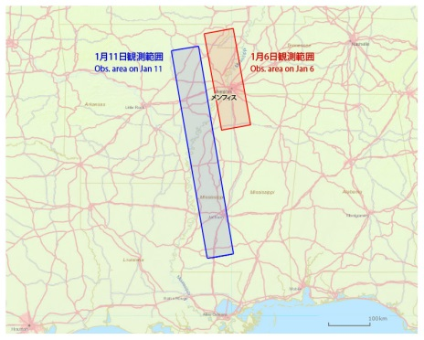
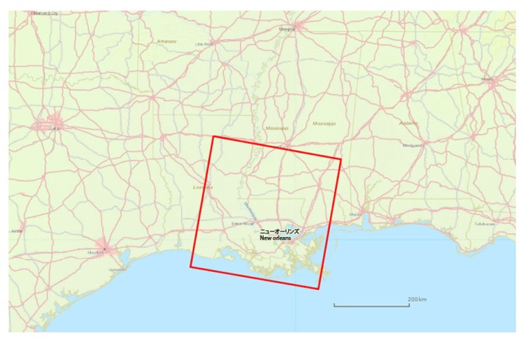
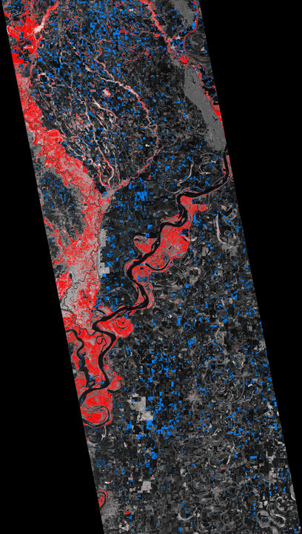
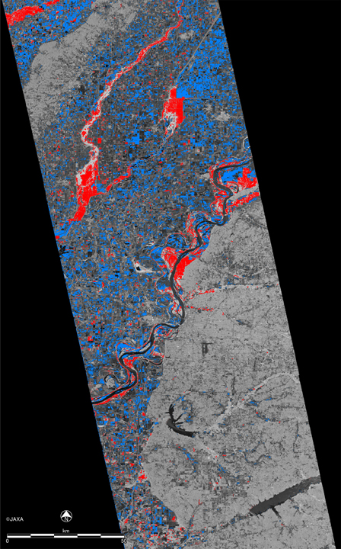
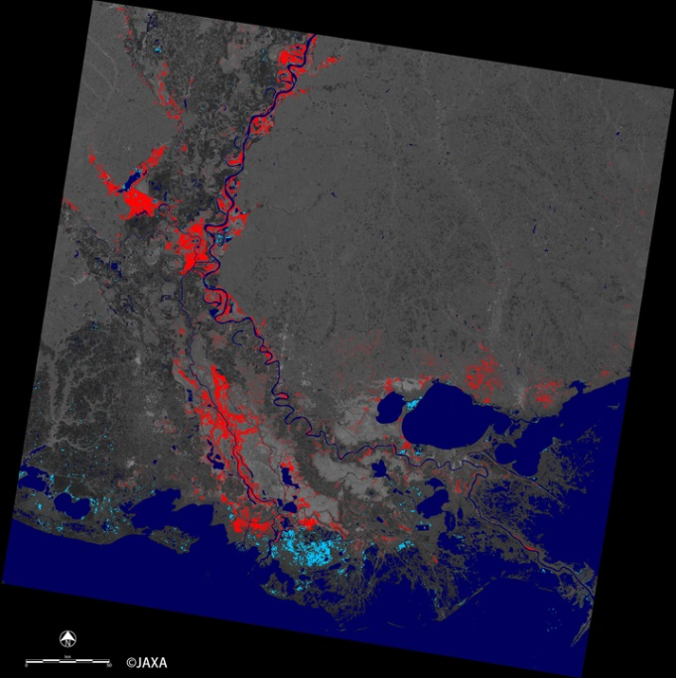
Mississippi River Special Event (2/3)
ALOS-2, 16 Jan 2016
ALOS-2, 1 Jan 2016
ALOS-2, 11 Jan 2016

Slide 38
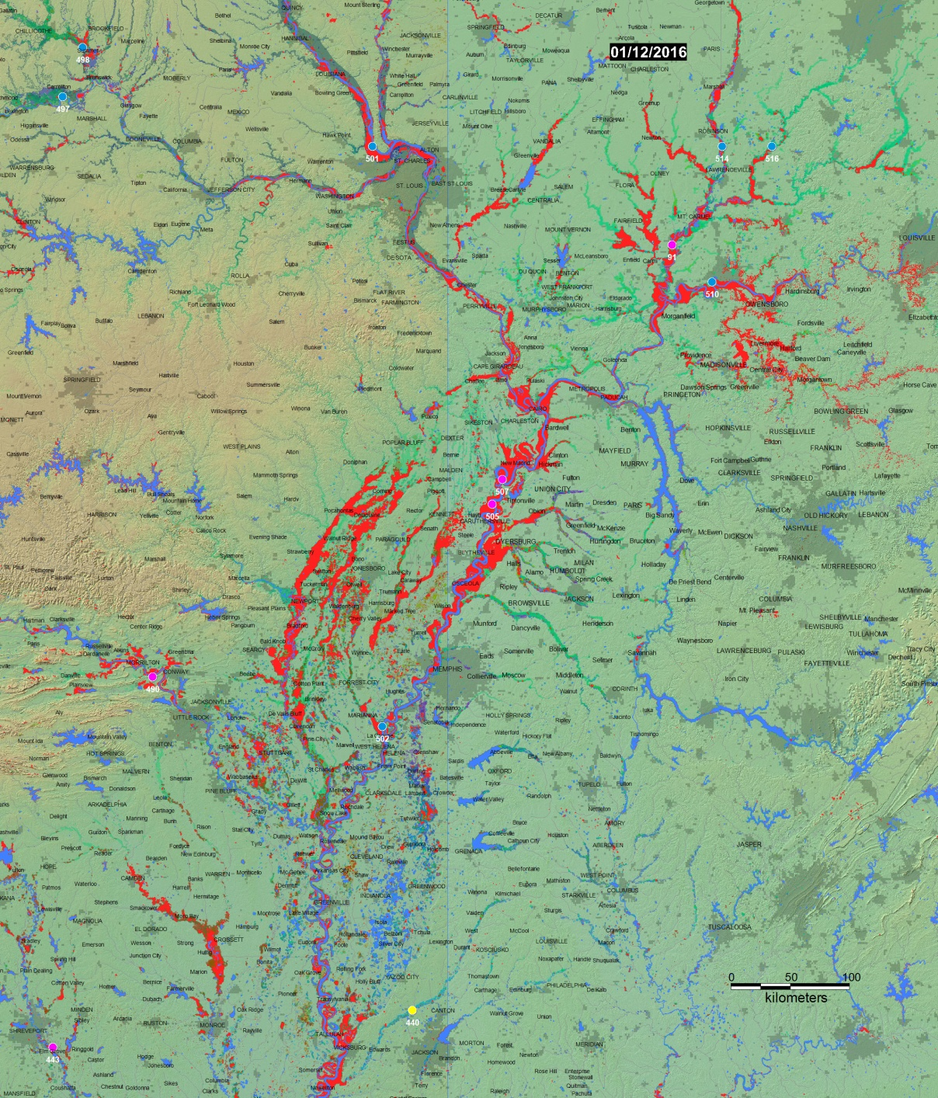
Mississippi River Special Event (3/3)
Dartmouth Flood Observatory map comparing the flood extent on 12 January 2016 (red) with previous floods (other colors) based on MODIS data
(Credit: Bob Brakenridge)

Slide 39
Outline
Flood Pilot overview
Status of data acquisition and exploitation
Pilot status report:
  Objective A: Global component status
  Objective B: Regional component status
    Caribbean/Central America
    Southern Africa
    Southeast Asia
    Special Event: Mississippi River (US)
  Objective C: Capacity Building
Issues and Risk Management

Slide 40
Objective C: Capacity Building Status (1/2)
Caribbean/Central American Component:
  Coordinated inclusion of Open GeoSocial API Flood Monitoring software suite as disasters component within the Climatic Information Platform for Central America and the Dominican Republic as part of the USAID Regional Climate Change Program (RCCP)
    Training workshop by NASA GSFC personnel (supported by SERVIR and USAID) in Costa Rica
    Awaiting Step 1 Go-Ahead for SEVIR grant funding.
  Approval of AmeriGEOSS initiative by GEO; working on Terms of Reference for a Disasters group within the Americas (Chile, Colombia, Costa Rica, and Mexico) that would need to interact with the CEOS Regional component in the Caribbean and Central America. Splinter session at Latin American Remote Sensing (LARS) Conference 30 March-1 April in Santiago, Chile.
Southern Africa Component:
  TIGER workshop in Addis Abbaba 1-2 February; 100 participants and 72 h of training on EO for water resources management
  New TIGER training kit is being used in “Training of Trainers” with Cap-Net UNDP (119 experts trained so far)

Slide 41
Objective C: Capacity Building Status (2/2)
Southeast Asia Component:
  ADPC installation of API pending SERVIR grant funding.

Slide 42
Outline
Flood Pilot overview
Status of data acquisition and exploitation
Pilot status report:
  Objective A: Global component status
  Objective B: Regional component status
    Caribbean/Central America
    Southern Africa
    Southeast Asia
    Special Event: Mississippi River (US)
  Objective C: Capacity Building
Issues and Risk Management

Slide 43
Issues and Risk Management Approach
Data access:
  Update: previously discussed agreement with the International Charter has greatly alleviated the previously raised data access issues. Thanks again to the International Charter for their cooperation and to Brenda Jones for all her help!
43

Slide 44
Data Use: Recent Publications / Conference Presentations
Frye S., Wells G., Adler R., Brakenridge R., Bolten J., Murray J., Slayback D., Green D., Wu, H., Kirschbaum D., Howard T., Flamig Z., Clark R., Chini M., Matgen.P., Stough T., “User-Driven Workflow for Modeling, Monitoring, Product Development, and Flood Map Delivery Using Satellites for Daily Coverage Over Texas May-June 2015”, Poster presentation at the American Geophysical Union 2015 annual meeting, December 2015 San Francisco, CA
Schumann G. J-P., Frye S., Wells G., Adler R., Brakenridge R., Bolten J., Murray J., Slayback D., Green D., Wu H., Kirschbaum D., Howard T., Flamig Z., Clark R., Chini M., Matgen.P., Stough T., B. Jones, “Unlocking the Full Potential of Earth Observation during the 2016 Texas Flood Disaster”, Water Resources Research, in review.
Schumann, G. J-P and K. M. Andreadis (2016). A method to assess localized impact of better floodplain topography on flood risk prediction, Advances in Meteorology, in review.
Wu, H. and Adler, R., “Evaluation of Quantitative Precipitation Estimations (QPE) and Hydrological Modeling at the Iowa Flood Studies Focal Basins.”, 2016 Journal of Hydrometeorology, in review.
Presentation by Chu Ishida on the Flood Pilot at Asian Water Cycle Symposium last week
Special Issue in Remote Sensing on “Earth Observation for Water Resource Management in Africa”
44

Slide 45
Questions / Discussion

