Slide 1

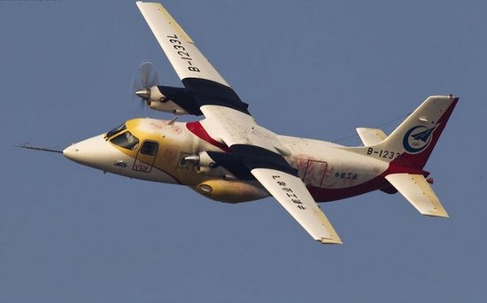
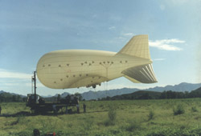
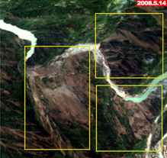

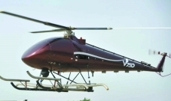

How will China’s ArcSer system support landslide monitoring?
CEOS Working Group on Disaster Meeting #5
Ziyang Li
zyli@aoe.ac.cn
Key Laboratory of Quantitative Remote Sensing Information Technology, Academy of Opto-Electronics (AOE), Chinese Academy of Sciences (CAS)
8 March, 2016 DLR, Bonn, Germany

Slide 2
Outline
1 An overview of the ArcSer system
2 How to improve the ArcSer – a prospect
3 Supporting projects

Slide 3
2. An overview of the ArcSer system
Overview
  ArcSer was introduced in detail at the CEOS WGDisaters Meeting #4 held in Frascati Italy in 2015, by Prof. Chuanrong Li , AOE of CAS.
What is ArcSer?
  Aerospace Application Coordination System for Emergency Response and Data Sharing
What is it for?
  An universal mechanism and system to coordinate the spatial resources to implement disaster reduction
Who operates it?
  AOE, as EO sharing service center for emergency response, is responsible for ArcSer’s operation.
  AOE plays a key role in EO technology for disaster reduction in China.

Slide 4
2. An overview of the ArcSer system
Framework & Workflow
Severe Disaster
especially earthquake
Coordinate civil aerospace resources to acquire remote sensing data for disaster area
Acquire aerospace remote sensing data and collects the data together
Distribute the data to disaster reduction application agencies a.s.a.p.
Notes:
When great natural catastrophe occurs in China, ArcSer acquires EO data of disaster area and distributes to the end users very quickly.

Slide 5
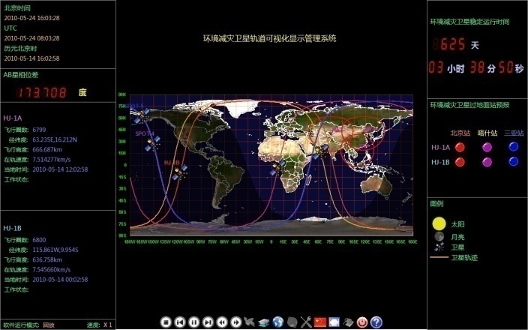
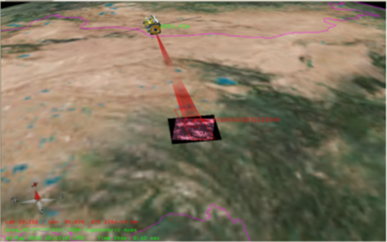
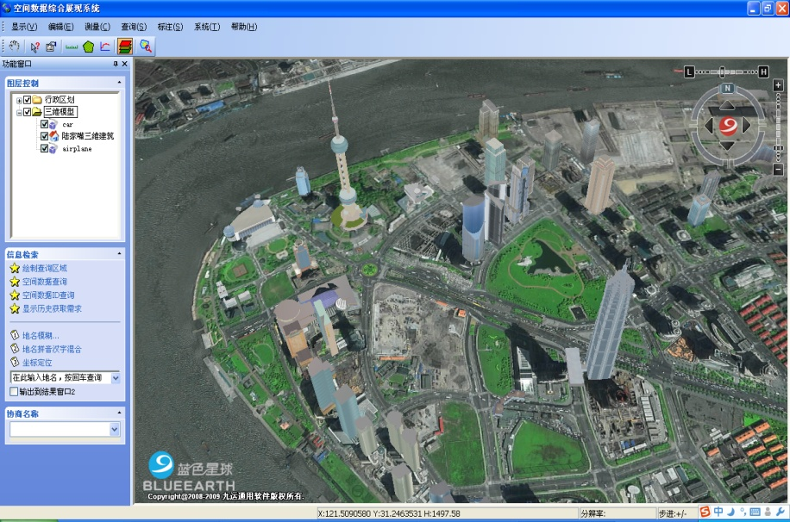
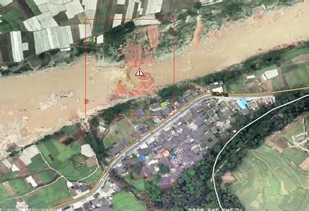
2. An overview of the ArcSer system
Characteristics
Unified
  Unified coordination mechanism of EO data sharing for emergency response.
  Adopt universal standards for aerospace data acquisition and exchange.
Extensive and Timely
  Capable to coordinate and dispatch all civil satellite and aerial resources.
  Plan space and aerial tasks uniformly based on EO data requirements.
Consultation supportive
  Disaster experts, space technology engineers, government officers, end users etc., can consult together on how to acquire EO data.
Visual
  Display tasks implementing state, disaster information, related base data, and EO data of disaster area.

Slide 6
Outline
1 An overview of the ArcSer system
2 How to improve the ArcSer – a prospect
3 Supporting projects

Slide 7
2. How to improve the ArcSer – a prospect
2.1 Two cases of landslides needed to monitor
2.2 Current situation of the ArcSer for landslide monitoring
2.3 Ways to improve the ArcSer to support landslide monitoring

Slide 8
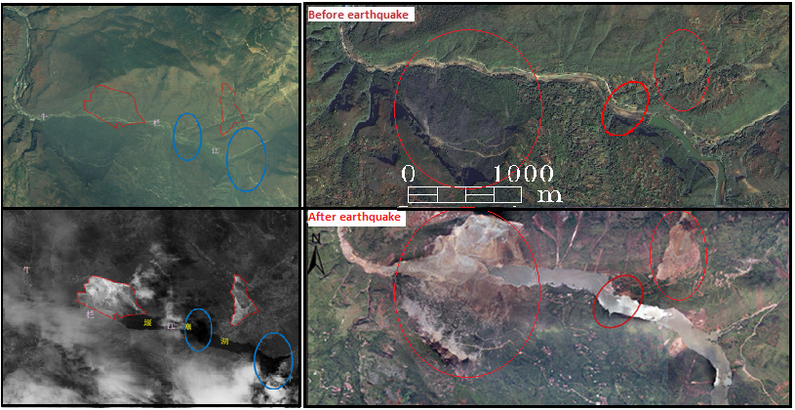
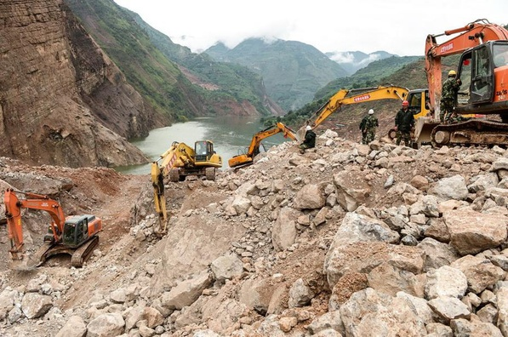
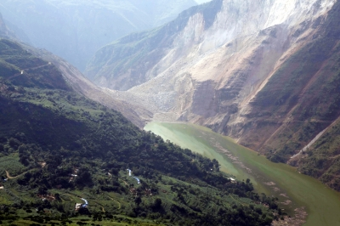
2.1 Two cases of landslides needed to monitor
Case 1: Seismic-triggered landslides
Pre-earthquake
Location
  Riverside in Ludian, Yunnan, China
Time
  2014-08-03, after 16:30
Trigger factor
  Ms 6.5 Earthquake in Ludian
Landslide & barrier dam
  Landslide size: > 1km * 1km
  Height of barrier: ~120 m
Barrier lake size
  Rising of water level: 58 m
  Water storage: > 50 million m³
At risk
  40,000 people in 10+ towns
  30 k㎡ cropland
Post-earthquake
Landslide
barrier
barrier
lake
inundated
power station

Slide 9
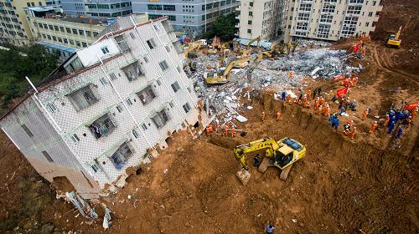
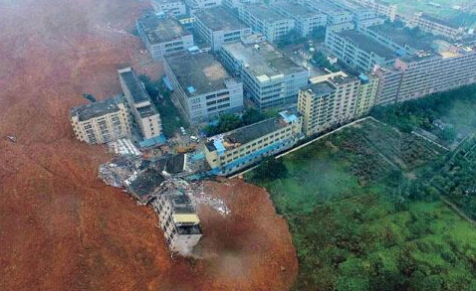
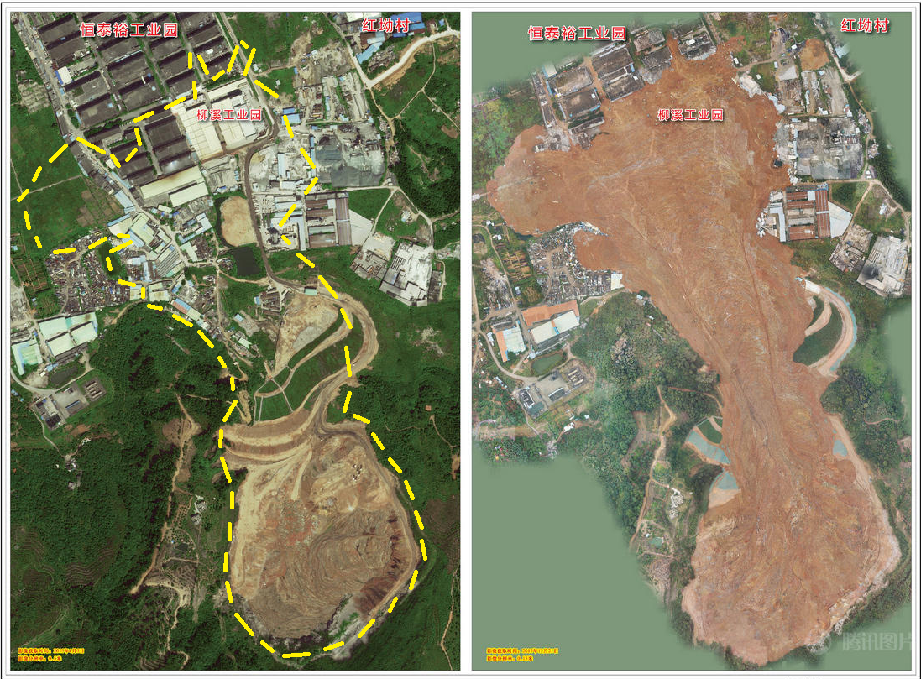
2.1 Two cases of landslides needed to monitor
Case 2: Human-activity-triggered landslide
Location
  Urban area in Shenzhen, China
Time: 2015-12-20 11:40
Trigger factor
  Excessive stacking of waste soil
Slide size
  Depth: tens of meters
  Area: ≈ 0.3-0.5km * 1.2km, 380,000 ㎡
  Volume: 4,000,000 m³
Losses
  33 buildings buried/damaged
  69 dead, 8 missing
waste soil
sweeping like
sea waves
Pre-slide
Post-slide
Notes:
12月21日上午10点，国家测绘地理信息局制作出灾前0.5米山体滑坡影像图、标注滑坡位置的地形图，并将这些图提供给国务院应急办、国土资源部等部门使用。
下午3点，航空摄影拍摄完成，获取到事发地现场0.15米影像，
并于当晚8点赶制完成滑坡前后影像对比图，迅速将前后影像对比图提供给国务院应急办，为研判灾情、科学救灾提供地理信息数据支持。

Slide 10
2. How to improve the ArcSer – a prospect
2.1 Two cases of landslides needed to monitor
2.2 Current situation of the ArcSer for landslide monitoring
2.3 Ways to improve the ArcSer to support landslide monitoring

Slide 11
2. How to improve the ArcSer – a prospect
2.2 Current situation of the ArcSer for landslide monitoring
Lack of feedback from users
  ArcSer distributed all available EO data to users but got few feedback
  ArcSer did not know much about user’s data and service requirements
Lack of aerial remote sensing data
  ArcSer mainly coordinated and dispatched satellite resources
  ArcSer has a mechanism to coordinate aerial resources, but they are scarce and difficult to get in time when great natural catastrophe occurred.
Lack of hazard information product
  ArcSer is mainly engaged in acquiring, managing and distributing EO data to users for emergency response.
  ArcSer now provides no hazard information product derived from EO data.

Slide 12
2. How to improve the ArcSer – a prospect
2.1 Two cases of landslides needed to monitor
2.2 Current situation of the ArcSer for landslide monitoring
2.3 Ways to improve the ArcSer to support landslide monitoring

Slide 13

2. How to improve the ArcSer – a prospect
2.3 Ways to improve the ArcSer to support landslide monitoring
Find ArcSer’s end-users & potential participants of Landslide Pilot
Integrate aerial remote sensing resources
Produce hazard/landslide information product
Unified
workflow
Universal standards
Planning & Programming
Consultation
support
Coordination
command
Satellite
observation
Aerostat
observation
UAV
observation
Mobile device
info collection
Observation
resources
Data synthesis &
Integrated analysis
Information
analysis
EO
data
landslide
information product
Other
thematic product
Data
services

Slide 14





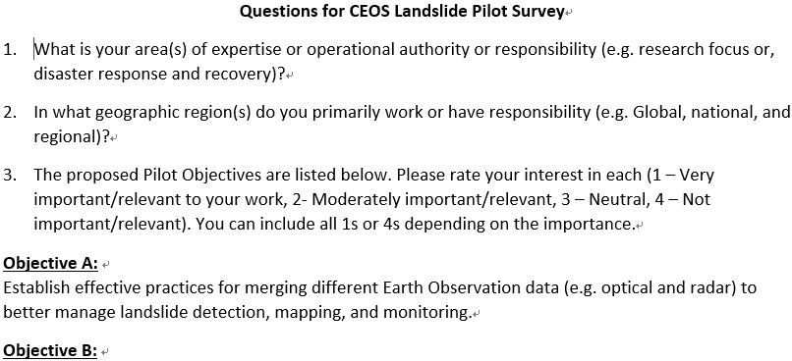
2. How to improve the ArcSer – a prospect
Find ArcSer’s end-users & potential participants of Landslide Pilot
ArcSer’s
command and control center
Institute of Mountain Hazards
and Environment (IMDE), CAS
Institute of Water Resources and Hydropower Research
National Disaster Reduction Center of China (NDRCC)
…
Academy of Opto-Electronics (AOE), Chinese Academy of Sciences (CAS)
China Eartqhuake Networks Center
Institute of Crustal Dynamics (ICD),
China Earthquake Administration (CEA)
Landslide Pilot Survey Questionnaire:
We distributed the questionnaire to our Chinese partners, received 8 responses from 5 institutions, and found 10 potential participants of the Landslide Pilot.

Slide 15

2. How to improve the ArcSer – a prospect
Find ArcSer’s end-users & potential participants of Landslide Pilot
Number
  10 people
Roles
  Researcher
  Disaster Response Coordinator
  User
Research
  Image analysis for landslide detection
  Seismic landslides risk assessment
  Hydro-meteorological related hazards
  ...
Disaster response
  EO data coordination and sharing
  Earthquake disaster emergency and relieve
  Post-disaster impact assessment
  …
Research area foci:
  China
  Southwest China
  South Asia
EO data requirements
  High-res optical images for landslide mapping and risk assessment
  Optical and radar images for landslide process understanding
  InSAR data for landslide monitoring
  Images of staring camera in stationary orbit
  …

Slide 16
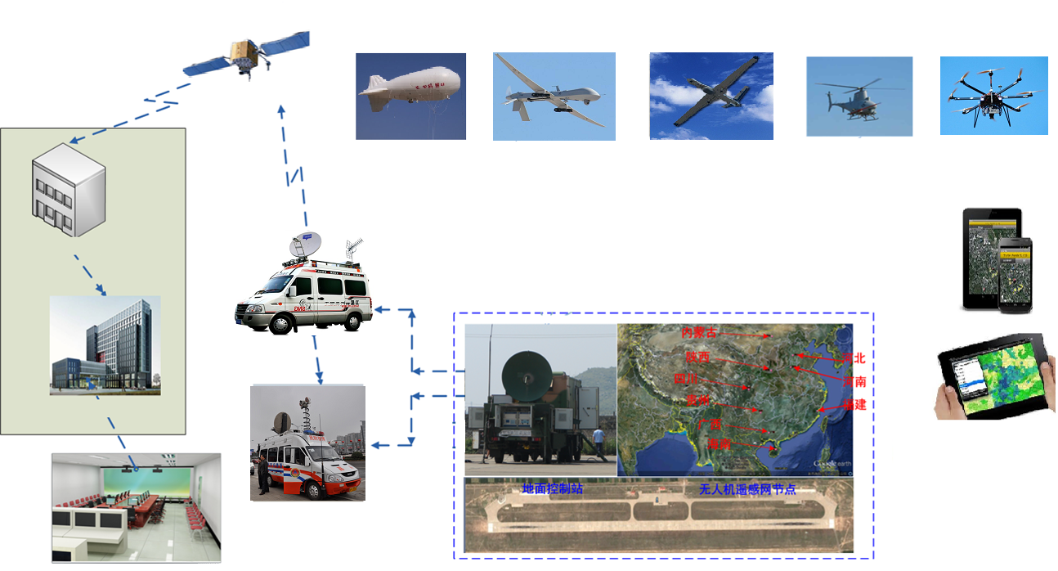
2. How to improve the ArcSer – a prospect
Integrate aerial remote sensing resources
Aerial remote sensing resources, especially from aerostat and UAV platform, will provide technology support for optimizing aerial resources to further improve the emergency response (and landslide monitoring) capabilities.
Relay / communication satellite
Airship/ balloon
Large UAV
Medium UAV
Small UAV
Mini UAV
Communication vehicle
Ground station
Command center
Mobile devices
Command Unit
Command Hall
Notes:
At present, AOE leads a UAV remote sensing network project.
It will provide technology support for optimizing UAV resources to further improve the emergency response capabilities.

Slide 17
2. How to improve the ArcSer – a prospect
Produce hazard/landslide information product
Like the Copernicus Emergency Management Service (EMS) Rapid Mapping service, the hazard maps can be produced by visual-interpretation of EO data.
By developing and integrating some landslide monitoring algorithms, landslide information (e.g., delineation, dynamic changes, forecast) products can be automatically produced and distributed to users.
Hazard maps of the Copernicus EMS Rapid Mapping service
Notes:
At present, AOE leads a UAV remote sensing network project.
It will provide technology support for optimizing UAV resources to further improve the emergency response capabilities.

Slide 18
Outline
1 An overview of the ArcSer system
2 How to improve the ArcSer – a prospect
3 Supporting projects

Slide 19
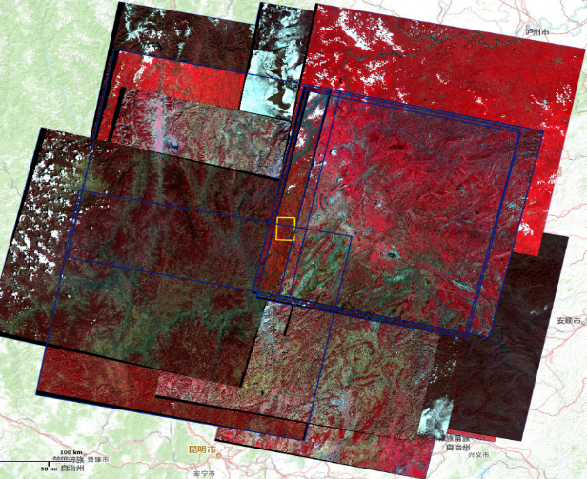
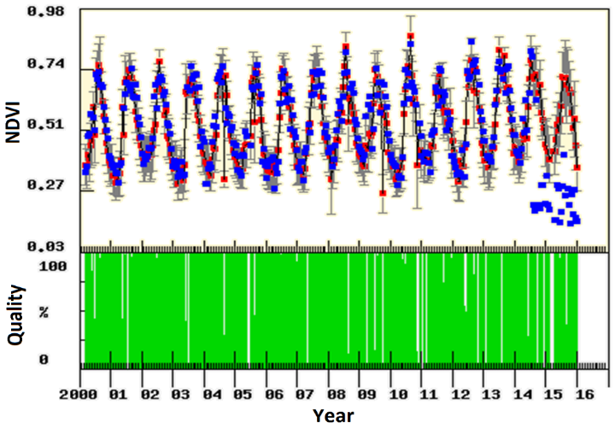
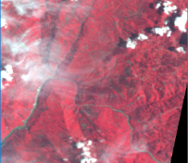
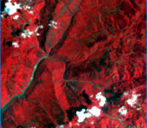
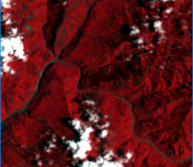
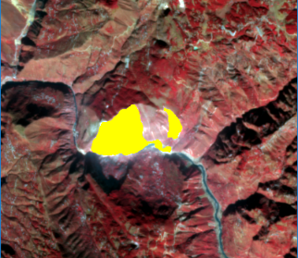
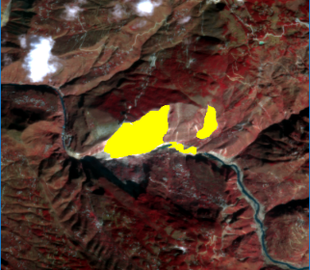
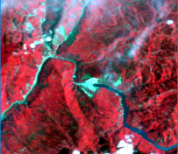
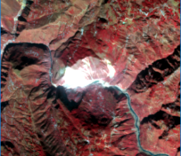
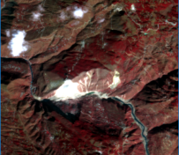
3. Supporting projects
Present
  We have obtained funding from AOE since 2016: a Startup Project for research on landslide monitoring using remote sensing big data.
Now developing algorithm for monitoring spatial-temporal dynamics of landslides using multi-source remote sensing image time series.
Multi-source
images
Time series
analysis
…
High-freq
images
time series
Landslide
dynamic monitoring
…

Slide 20
3. Supporting projects
Future
  We are now applying for a Natural Science Fund Project from China NSFC (Natural Sciences Foundation Committee) for research on landslide monitoring using multi-source satellite image time series.
  We are also applying for a Major Special Project on Earth Observation from China’s MOST (Ministry of Science and Technology) for Integrated ground-air-space based remote sensing technology and systems for cooperative emergency monitoring.
  We will get continuous funding to engage in improving the ArcSer system to support landslide monitoring and contributing to the CEOS Landslide Piot.

Slide 21

CEOS Working Group on Disaster Meeting #5
Thank you !
Lucky dolls of Chinese New Year

