Slide 1
Meeting objectives Background presentation for WG Disasters#5, Bonn, March 2016 Stephane Chalifoux, WGD Chair Andrew Eddy, WGD Secretary

Slide 2
Objectives of the three-day meeting
1. Review of thematic pilots, the Recovery Observatory and the GEO-DARMA initiatives, including assessing current and future data provision, and issues.
2. Evaluation of pilot success/results – deliverable for 2017 (feedback from users of the products).
3. Gather issues needed discussion at SIT-31: Main decisions and urgent needs from the international community that could be addressed by CEOS Agencies.
4. Gather activity needed to be approved at SIT-31: GSNL update.
5. Gather information on Partnership to be shared with the CEOS community at SIT-31 (best way to manage and implement CEOS partnerships): UNDP, WB/GFDRR, etc.

Slide 3
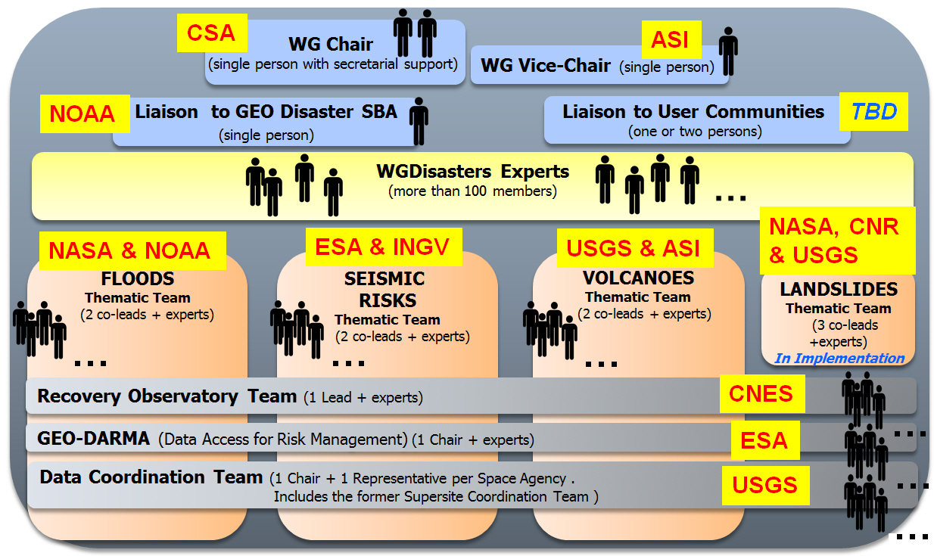
WG Disasters Organisation: Teams & Functions

Slide 4
2016 Understanding Risk (UR) Forum – Istanbul, Turkey
Side event: Satellite data for enhanced risk management and reduction - innovative technologies and future applications
The Committee on Earth Observation Satellites (CEOS) recently initiated three thematic pilots on floods, seismic hazards and volcanoes, and is currently planning a fourth on landslides. These activities aim to showcase innovations in the application of satellite data to full-cycle disaster risk management (DRM), with a strong focus on Disaster Risk Reduction (DRR) activities. The event aims to show how users can overcome the challenges associated to accessing and exploiting satellite data to support hazard mapping and risk assessment. The DRM pilots are providing first demonstrations of this with local and regional levels disaster risk reduction activities that are scalable and can be adapted to different geographical and capacity contexts. CEOS Agencies are supporting the Disaster Recovery Observatory which will collect satellite imagery, generate monitoring products and provide an informatics platform for recovery partners to collaborate in the reconstruction effort. The GEO-DARMA (Data Access for Risk Management) initiative (included in GEO Work Programme 2016), will facilitate the sustained provision of EO-based risk information products and services to decision-makers. The session will highlight success stories from the past 18 months and open the discussion on how to fast track successful satellite data use for widespread uptake within the DRR community.

Slide 5
Organizer name and contact information:
Main contact: Stephane Chalifoux, Canadian Space Agency
Event facilitator names and contact information:
Stephane Chalifoux, Canadian Space Agency
Andrew Eddy, Athena Global, Recovery Observatory
Speaker names:
Theodora Papadopoulou, Seismic Hazards Pilot
Stéphane Chalifoux, Canadian Space Agency, CEOS Disasters WG Chair, GEO-DARMA (Data Access for Risk Management)
Catherine Proy, CNES, Recovery Observatory
Sang-Ho Yun, JPL-NASA, Damage Proxy Map (DPM), GEO Event Supersite - M7.8 Gorkha, Nepal Earthquake
Fabrizio Ferrucci, The Open University, Volcano Hazards Pilot
Stefano Salvi, Istituto Nazionale di Geofisica e Vulcanologia, GEO Geohazard Supersites and Natural Laboratories (GSNL)

