Slide 1
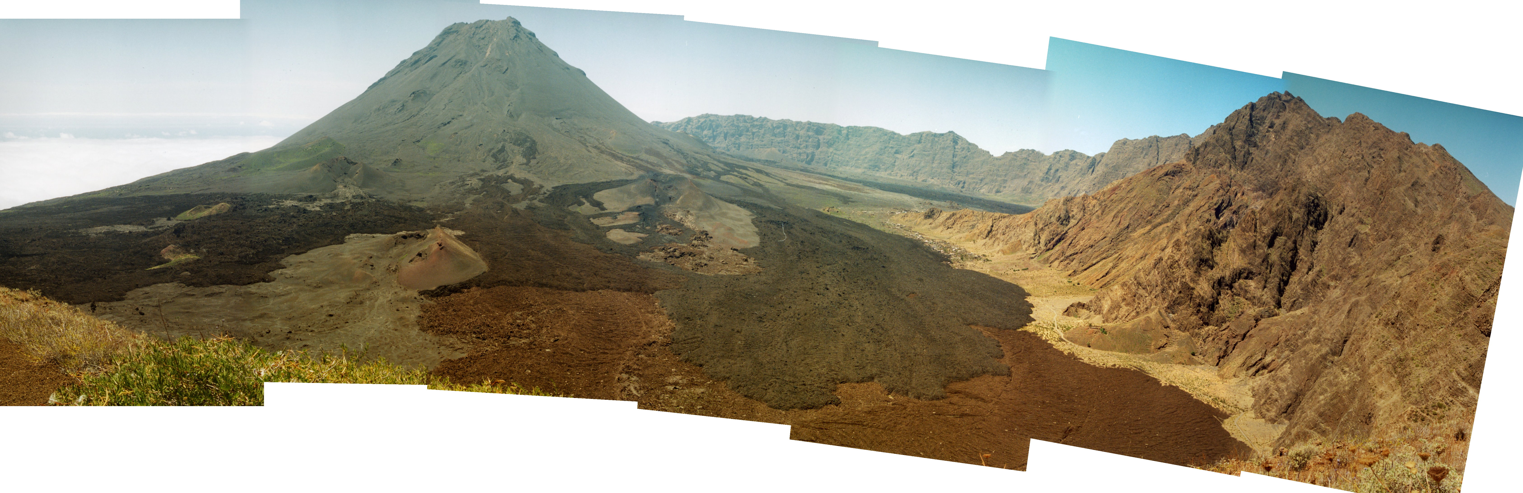

Pico do Fogo, Cape Verde, 2014-2015
Photo by S. Day (2015)
Specific stakeholder’s request
Continuous estimate of mass flows to forecast flow limiting lengths
Methods and Technologies
Quantitative estimate based on deterministic physical models.
Unsupervised merge of data borne by multispectral payloads from Very-high-temporal to High-spatial resolution
Inherited from ESA’s GlobVolcano and EC FP7 project

Slide 2
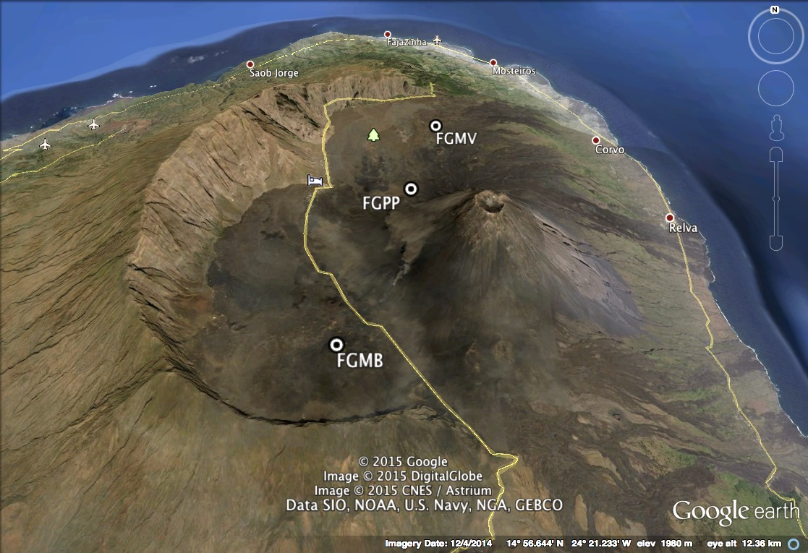
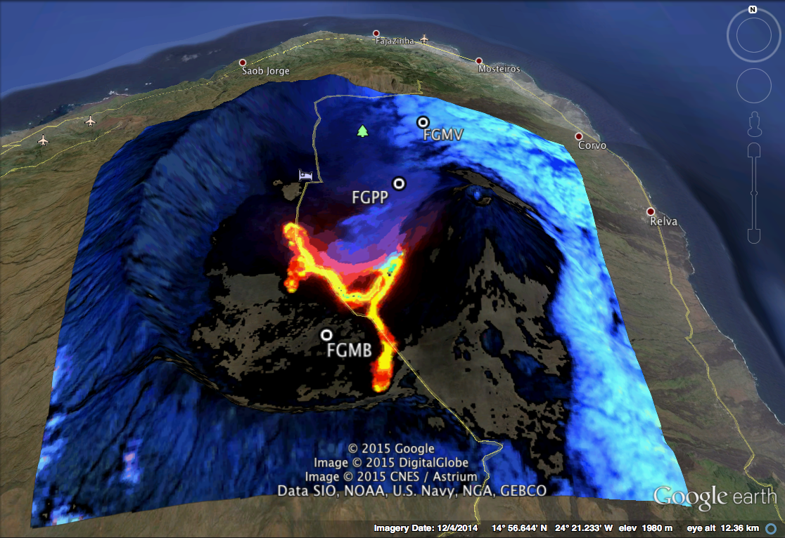
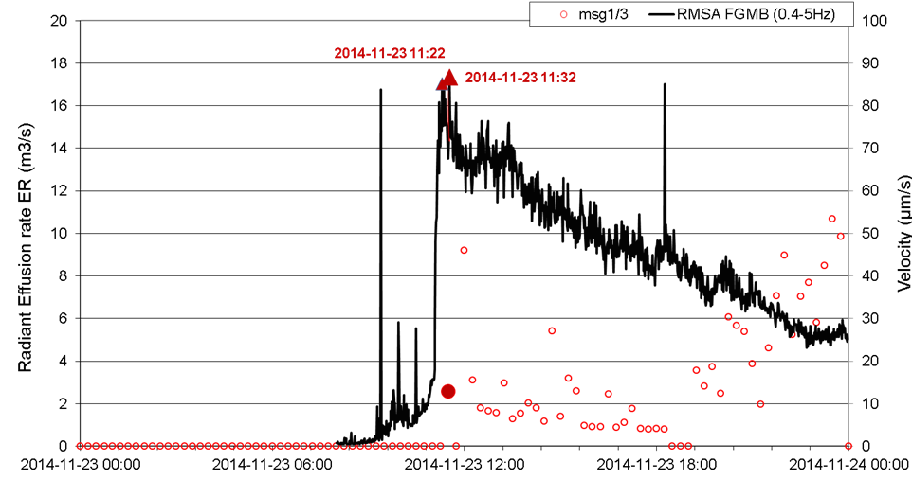















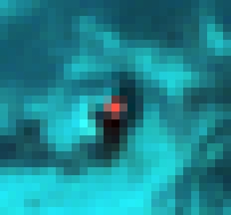
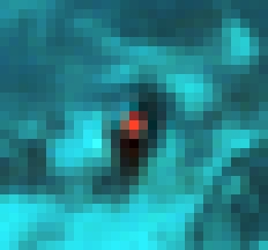
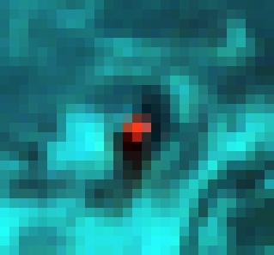

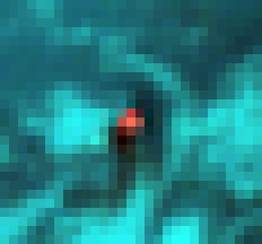

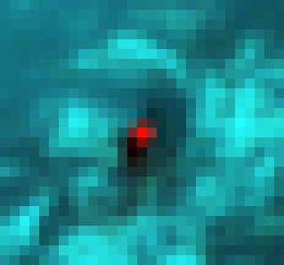
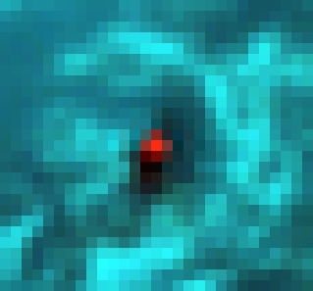
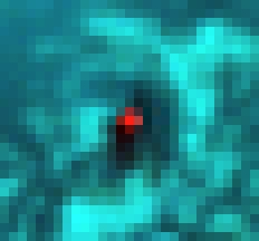




Variable Resolution Datasets
High-temporal resolution (≈3700 images): Radiant Fluxes by SEVIRI onboard MSG-3 and MSG-1, every 15 minutes, night and day
Moderate resolution (157 scenes, 1x1 km²): Radiant flux monitoring by MODIS onboard TERRA and AQUA, nightscenes
High Spatial resolution (8 exploitable scenes, 30x30 m²): Radiant flux monitoring by EO 1-ALI and Landsat 8-OLI, daytime scenes
Very-High Spatial resolution (2+1 scenes): characterization of the source (NIR, 2.8x2.8 m²)
Ground-based: RSAM (1-min integration)
11:00
11:15
11:30
11:45
12:00
12:15
12:30
12:45
13:00
13:15
15:15
15:30
15:45
16:00
16:15
16:30
16:45
17:00
17:15
17:30
17:45
18:00
18:15
10:00
10:15
10:30
10:45
18:30

Slide 3
Multiple spatial resolutions
SEVIRI - 11,400,000 m² (Fogo, Cape Verde)
> 46,000,000 m² (Bardarbunga, Iceland)
MODIS
1,000,000 m²
OLI, ALI
900 m²
Pleiades
8 m²
•
Radiant flux Q_{r} ➔ Effusion rate E_{r}
Simple cooling bar model, neglecting convection and conduction losses
E_{R} = Q_{R} [ρ_{lava} (Cp_{lava} ΔT_{stop}+C_{L} Δφ) ]⁻¹ m³/s
with ρ_{lava} density
Cp_{lava} specific heat capacity
Δφ mass fraction of crystals grown
C_{L} latent heat of crystallization
Limiting Flow Length - Alert Thresholds for Fogo
  E_{R} > 20 m³/s by Gratz Number, or
  30 < E_{R}< 40 m³/s by flow Front Strength

Slide 4
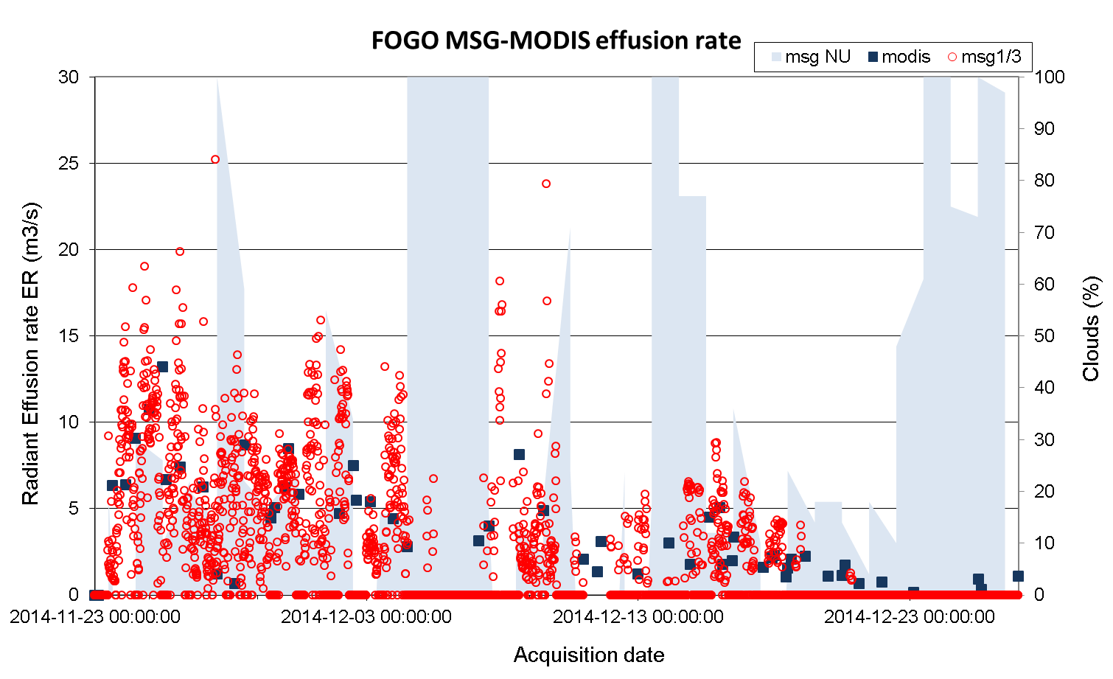
Fogo, November 23rd to December 27th, 2014

Slide 5
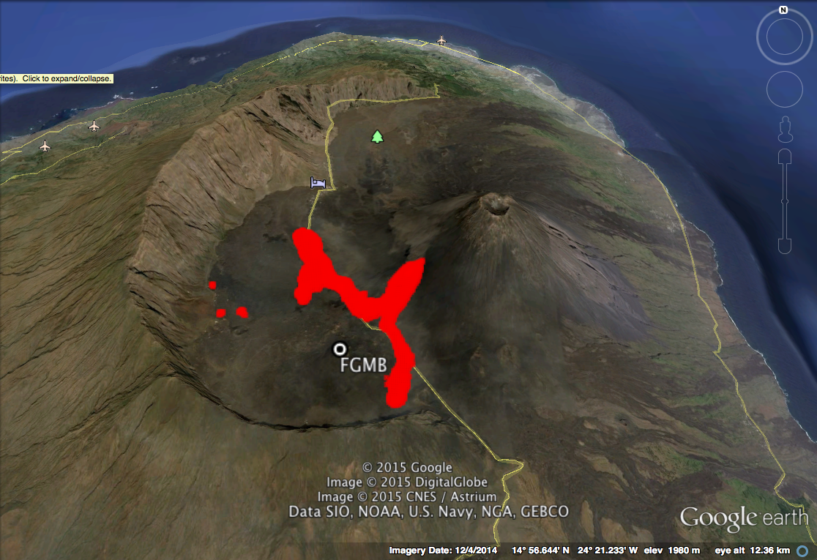

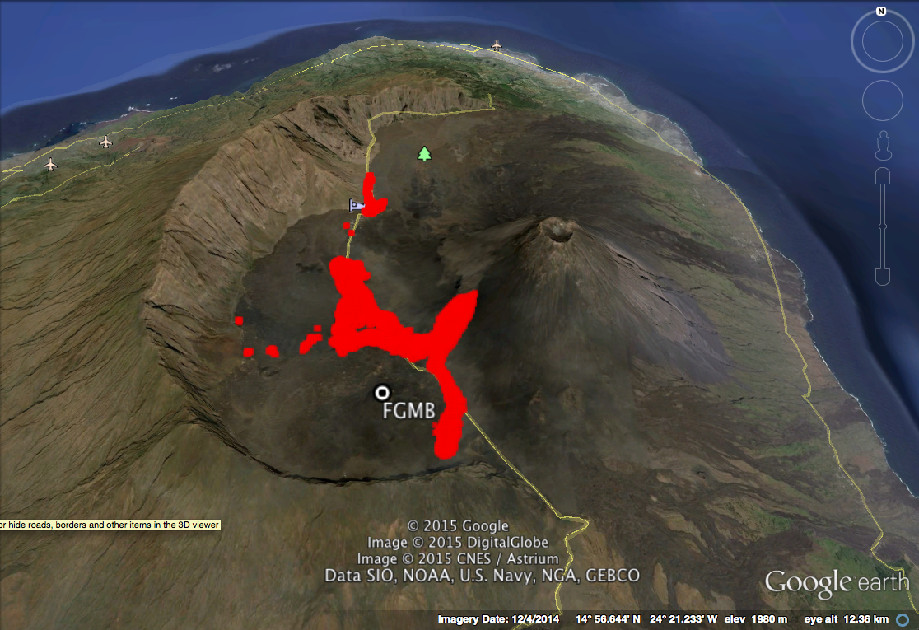



Fogo, December 10th to December 27th, 2014
  Flow length: with ~30% combined vesicles and rubble porosity both equations predicted a ~ 5 km limiting length of the Portela - Bangeira flow
  By December 6th the flows were unlikely to escape Cha das Caldeiras.
  This was confirmed by December 14th onwards by Hi-Res ALI

Slide 6
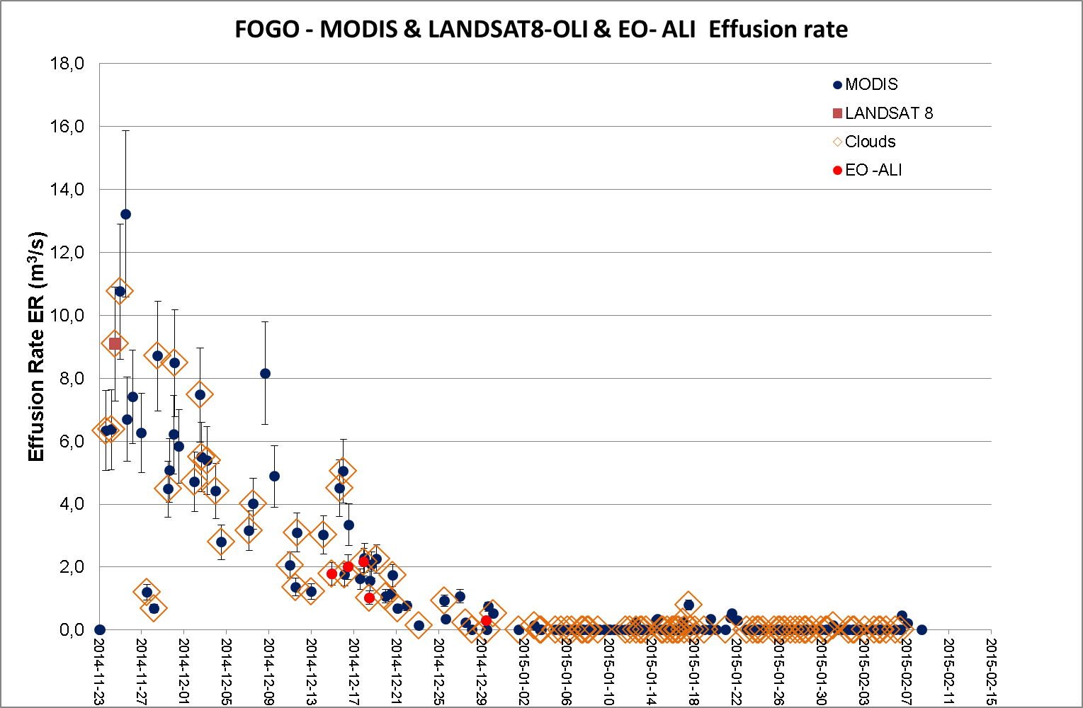
Until 08-02-2015, by High- and Moderate-Spatial Resolution

Slide 7
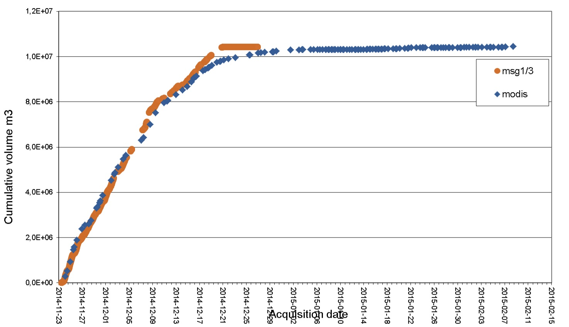
Cumulative volumes (Φ=0) until February 8, 2015

Slide 8
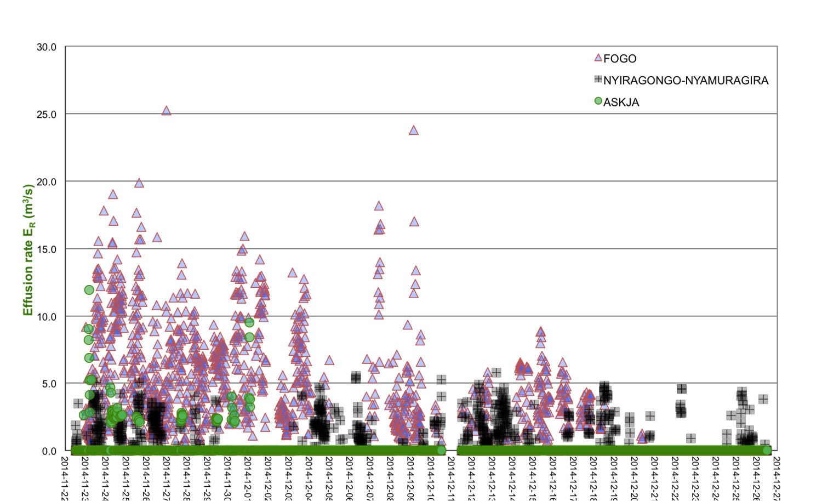
Anywhere: All-in-one 2014 by 15-minute MSG (full disk)

Slide 9
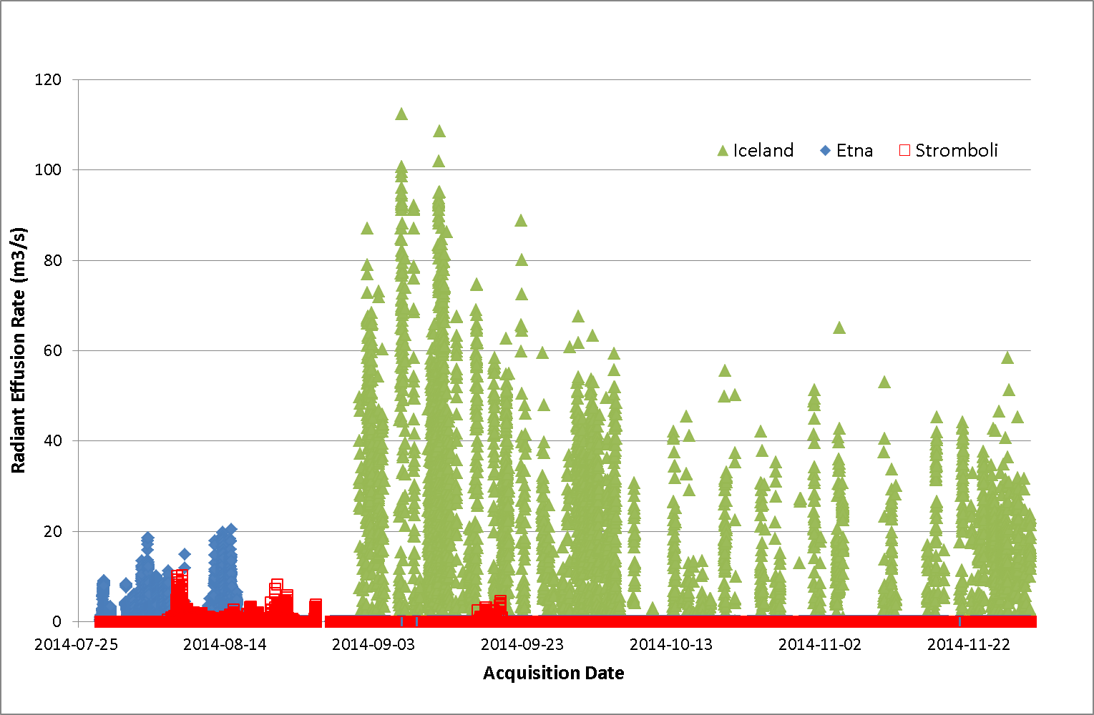
Anywhere: All-in-one 2014 by 5-minute MSG Rapid Scan
ETNA (05/07) ➔ 19/09/2014
STROMBOLI 06/08 ➔ 19/09/2014 HOLUHRAUN 31/08 ➔ (02/03/2015)

Slide 10
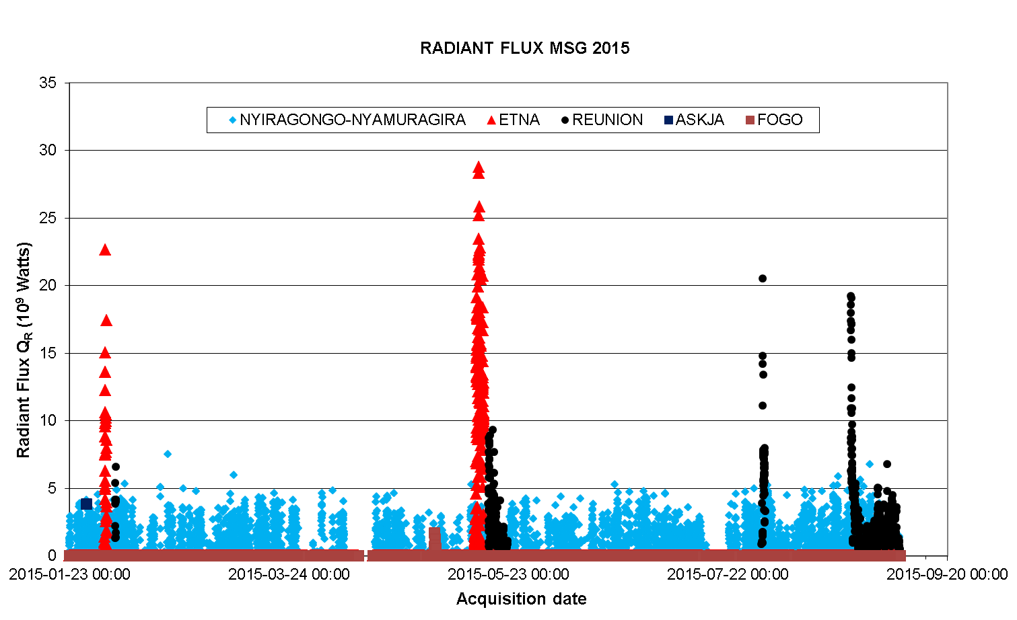
Anywhere: All-in-one 2015 by 15-minute MSG (full disk)

Slide 11
Piton de la Fournaise, Réunion Island - ongoing

Slide 12
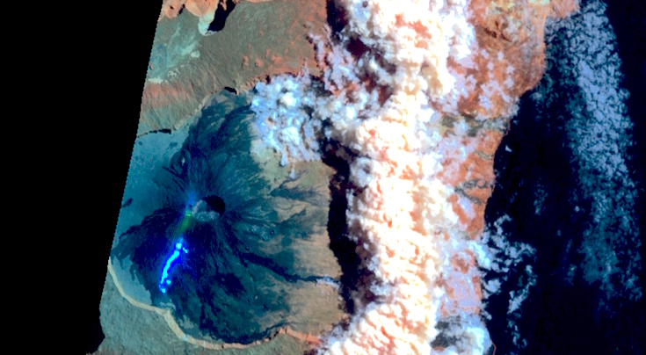
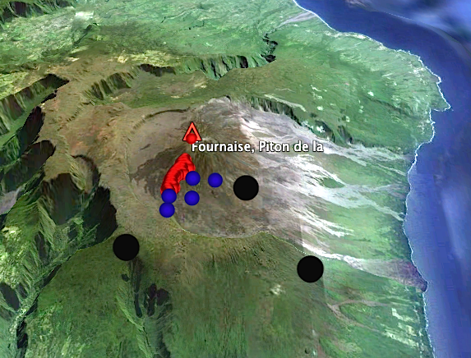
Piton de la Fournaise, Réunion Isl. (EO1-ALI , Sep. 2, 2015)
EO1 - ALI
Terra-MODIS
MSG3-SEVIRI

Slide 13
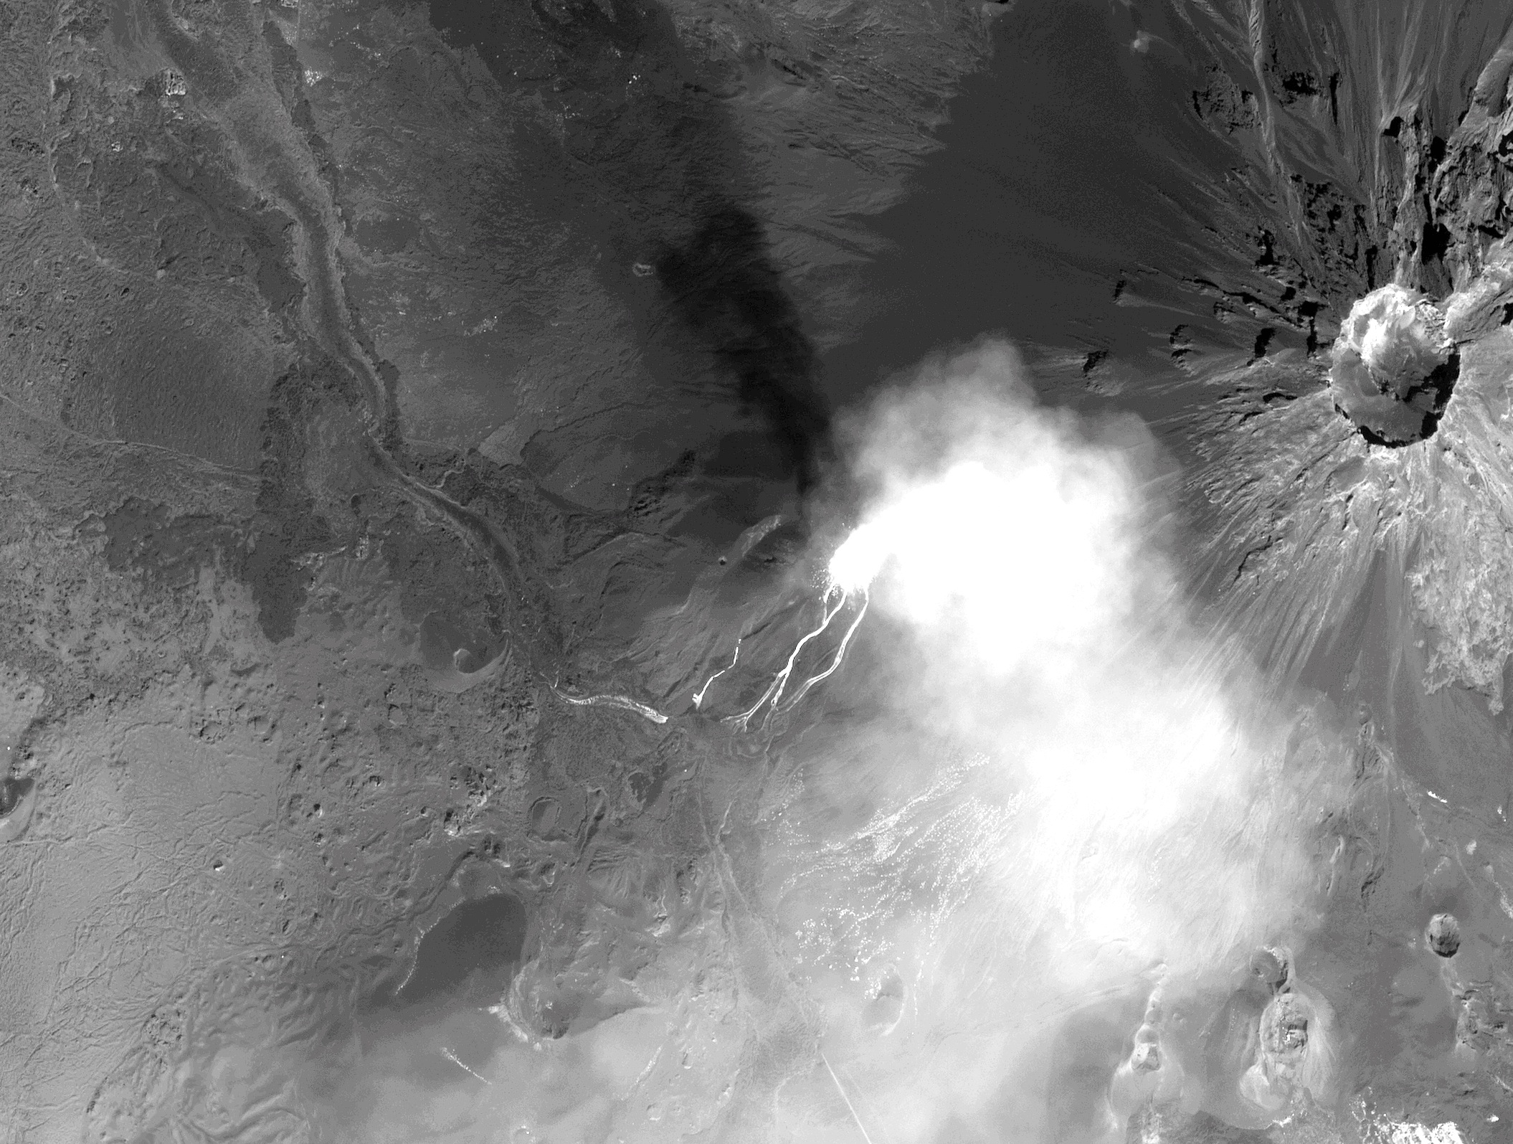
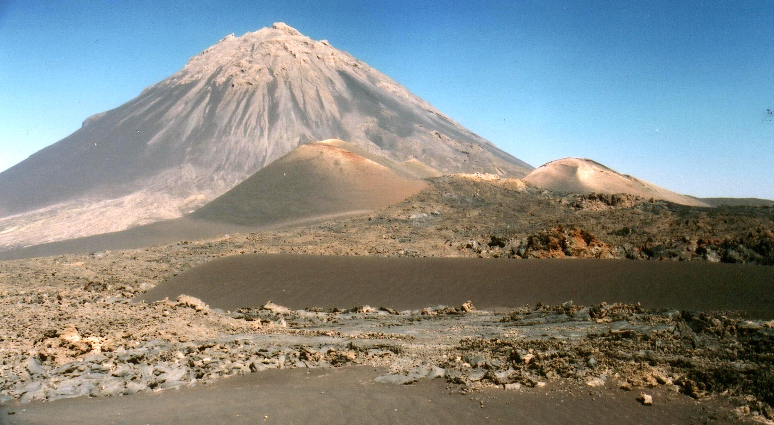
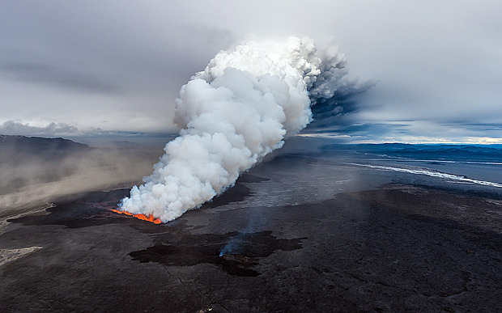
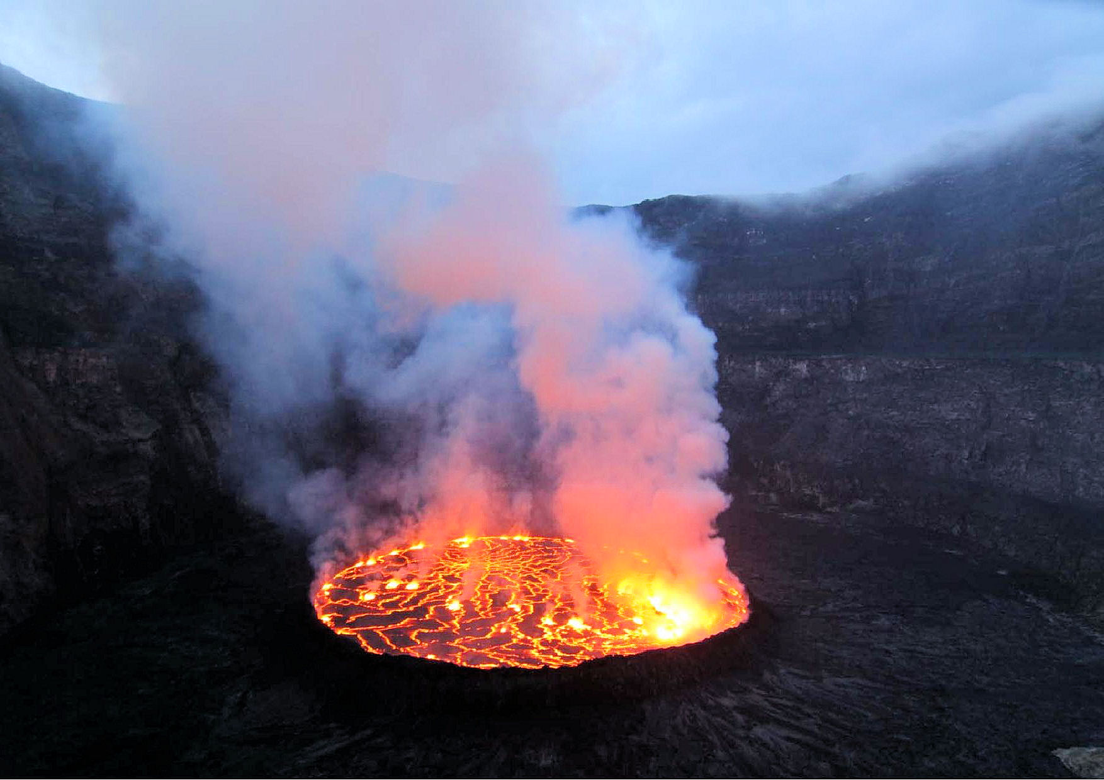

MS HR was better suited than VHR to the technical needs that arose on Fogo
Precise questions can be answered precisely
In crisis management, temporal resolution is ways more critical than spatial resolution
Response without monitoring ?
Volcano Pilot, area of focus “C”

