Slide 1


Development of LiDAR Technology for Disaster Mitigation
CEOS Working Group on Disaster Meeting #4
Presented by Chuanrong Li
Key Laboratory of Quantitative Remote Sensing Information Technology, Academy of Opto-Electronics (AOE), Chinese Academy of Sciences (CAS)
September, 2015 Frascati, Italy

Slide 2
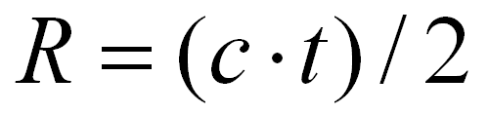
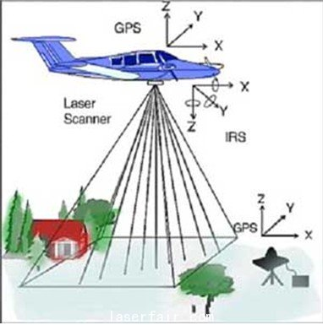
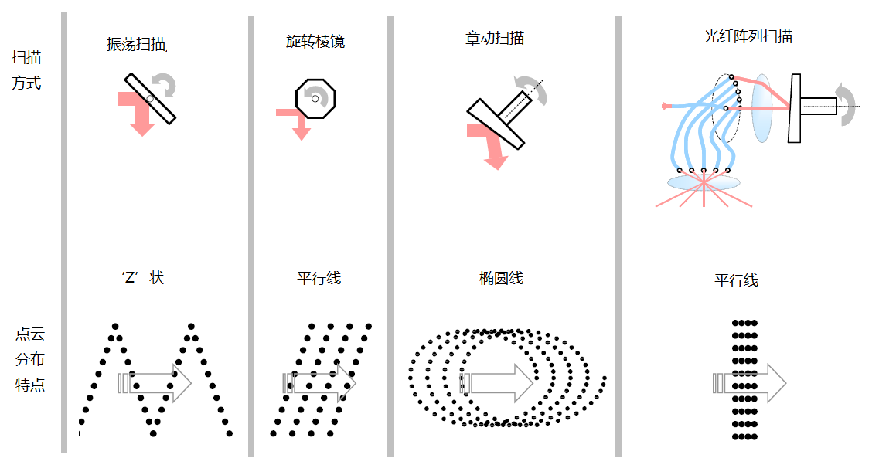
LiDAR Technology--Distance Measurement
LiDAR is the production of the combination between traditional Radar technology and modern laser technology. LiDAR was born in 1961, the next year after the invention of laser technology. Starting with simple distance measurement technology, a series of LiDAR have been developed for different application areas.
When laser pulse from laser device hits the target, a part of optical wave would reflect to LiDAR receiver. According to the theory of Laser distance measurement, the distance from target to LiDAR is calculated as
According to laser device position from GPS and laser emission direction from INS, each coordinate (X,Y,Z) of ground luminous spot can be precisely calculated.
Imaging theory of airborne LiDAR
Scanning modes of LiDAR

Slide 3
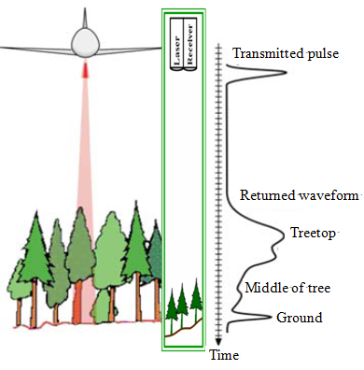
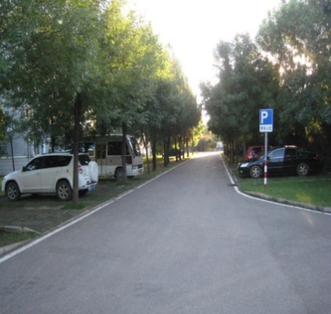
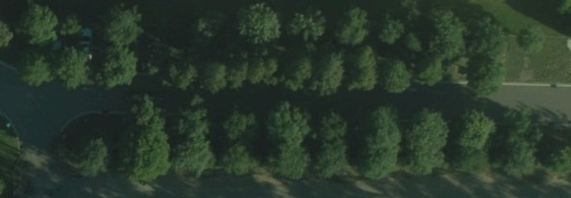
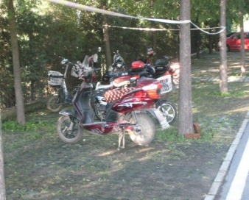
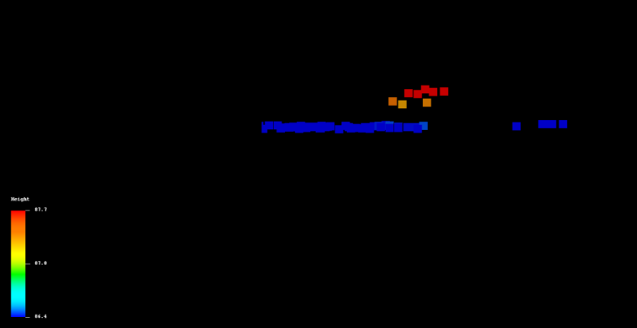
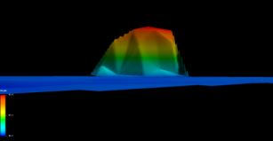
Characteristics of LiDAR
Active Remote Sensing
24-hour：actively emit laser signal and detect target information without the influences of shadow and solar altitude angle.
Direct Measuring: rapidly and directly achieve three-dimensional(3D) space information of wide-area ground target
Penetrable：partially penetrate plant cover ; thus can be used for forestry detection in forest and mountain region, provide search service for targets under plant cover.
Concealed cars
Laser of ability to penetrate to forest

Slide 4
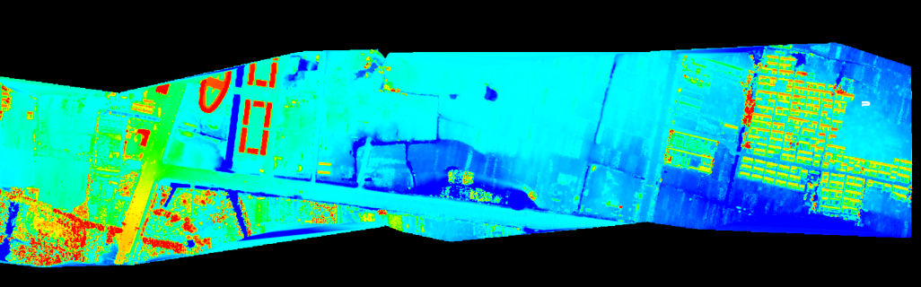
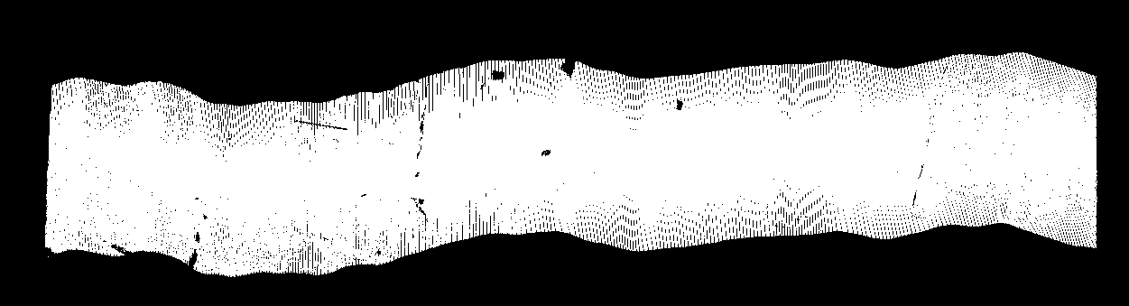
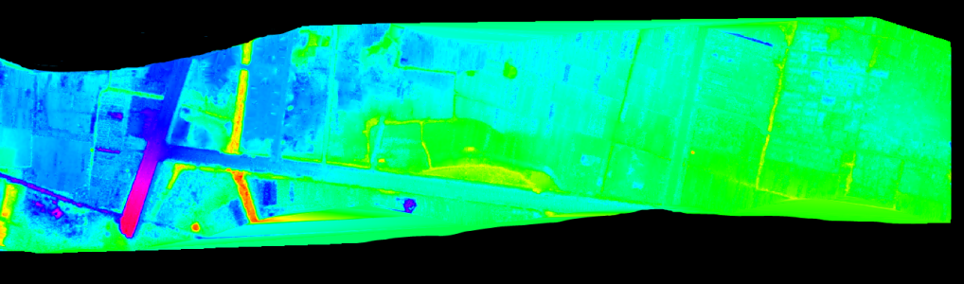
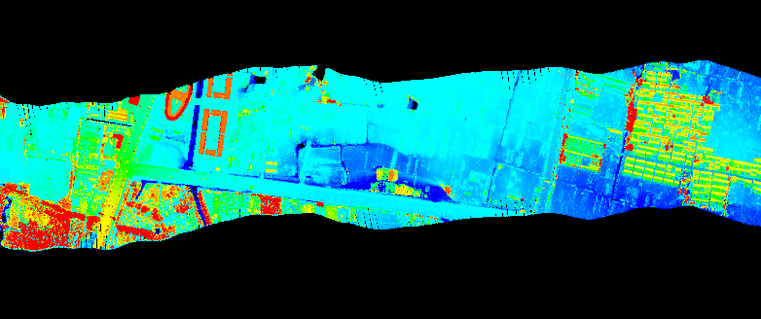
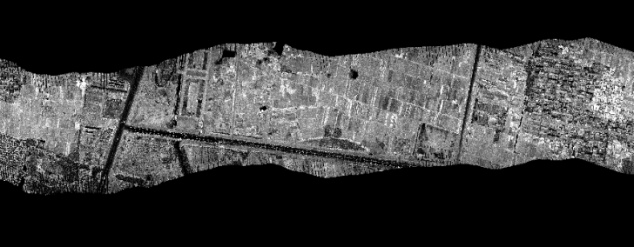
Development of LiDAR Technology(Ⅰ) -Imaging
DSM
LiDAR Point Cloud
DEM
LiDAR Point Cloud colorized by Elevation
Intensity Image

Slide 5
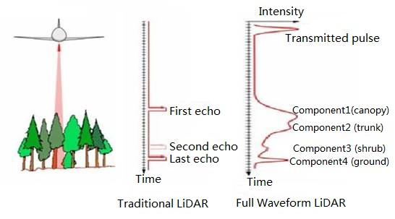
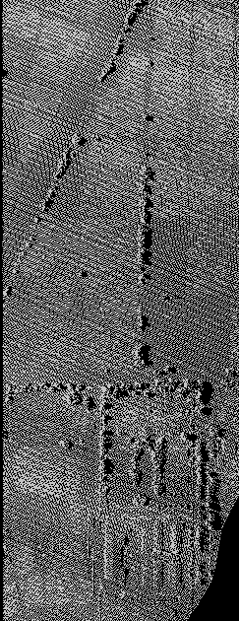
Development of LiDAR Technology(II) -Full Waveform
Full waveform LiDAR record
More Information
More Precise for feature recognition
Distance
Intensity
Extract Multiple features including:
Distance
Intensity
Width of Echo Waveform
Backscattering cross section
Components number of a waveform
…
Width
Backscattering
cross section
Original Point Cloud data
Extracted features

Slide 6
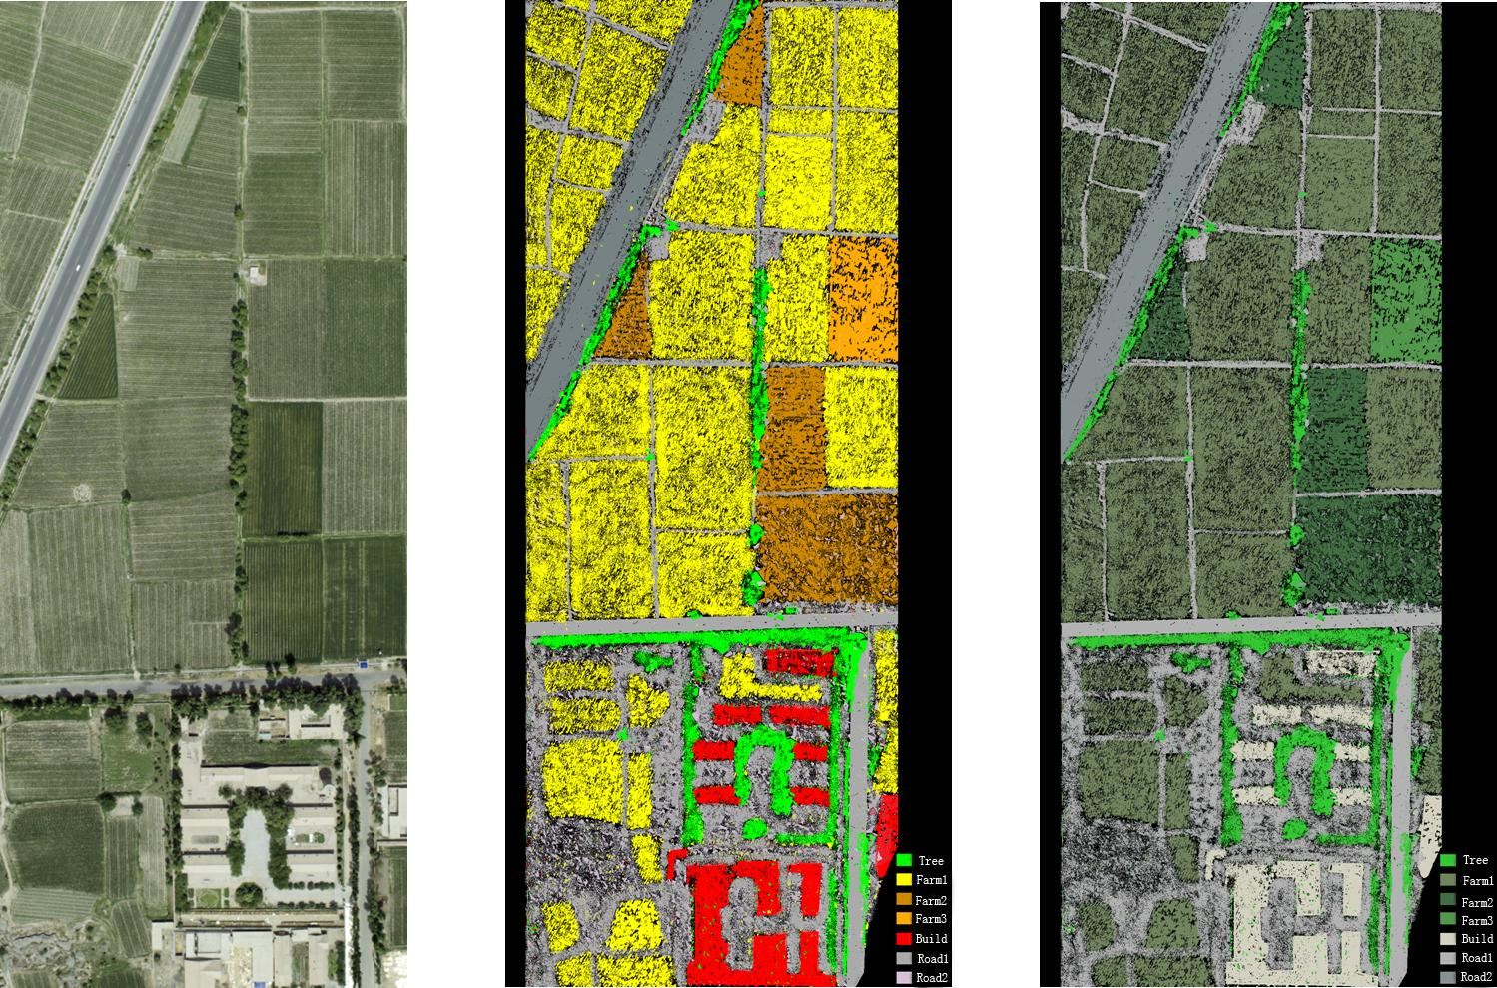
Development of LiDAR Technology(II) -Full Waveform
Application: Fine classification based on point cloud data
Remote Sensing Image
Point Cloud Data (colored by classification results)

Slide 7
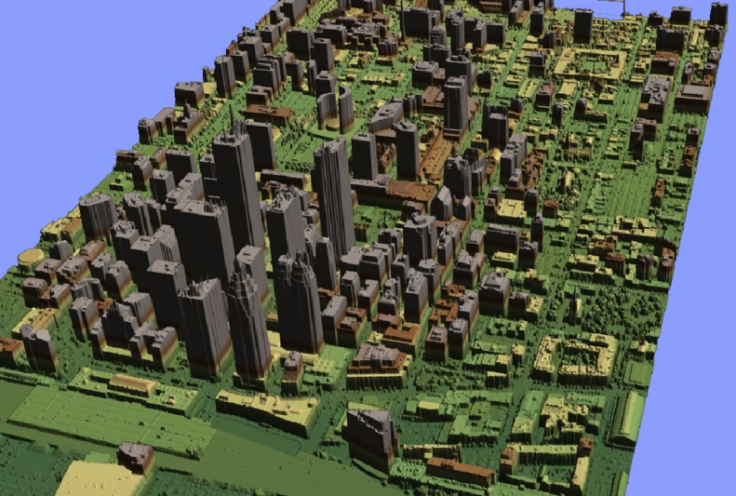
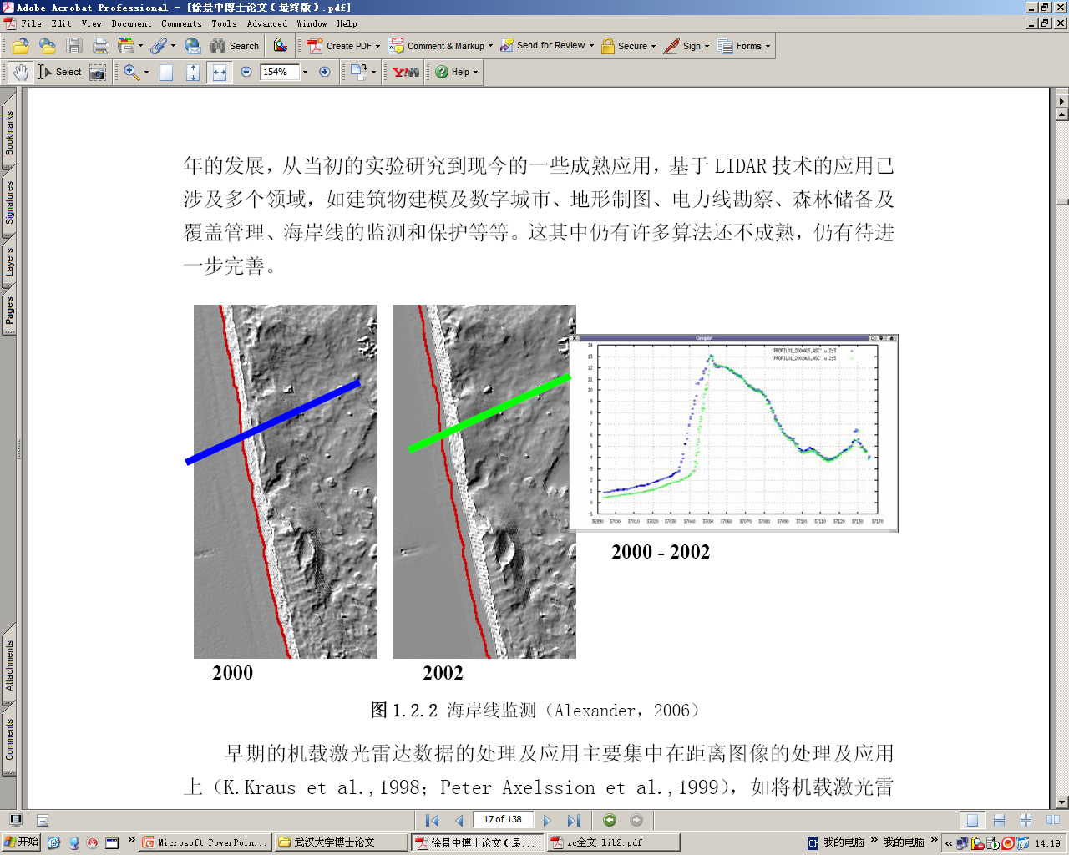
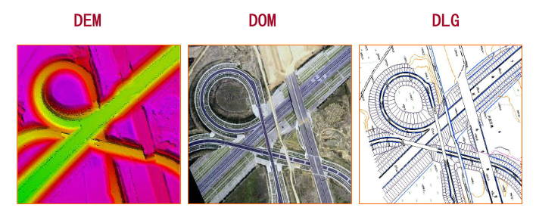
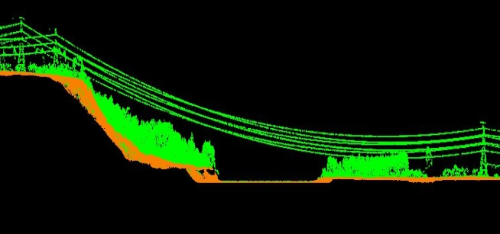
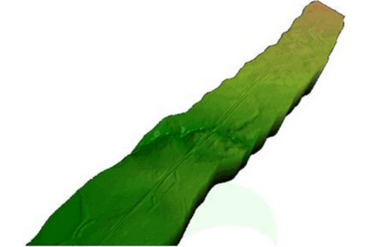
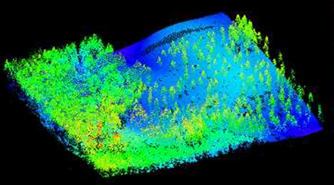
Currently Primary Application of LiDAR
Three-Dimension City Modeling
Coastline Detection
Driveway Prospecting
Measurement of power lines
Selection Optimization of oil and gas pipelines
Forestry deposit quantity evaluation

Slide 8
Application for Disaster Mitigation
Advantages of LiDAR Application
Precisely 3D measurement for the structure and shape of the observed object
24-hour observation and high-speed information extraction
The detection of full procedure of geological disaster
Damage assessment of infrastructure
Detection and evaluation of post-disaster reconstruction
Emergency response for disaster zone
Providing in-situ information for on site rescuing decision

Slide 9
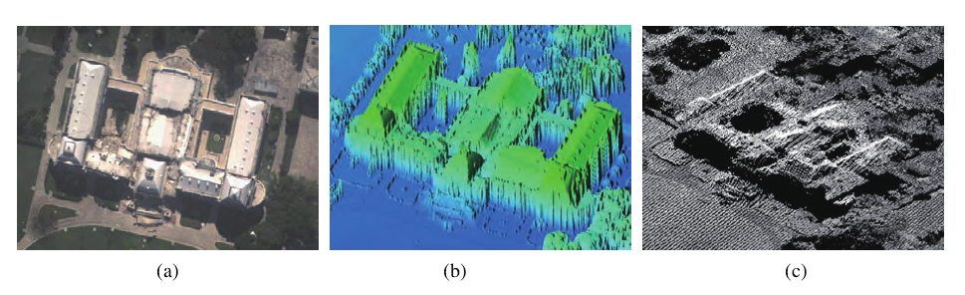
Application for Disaster Mitigation
Seismic Hazard
The 2010 Haiti earthquake was a catastrophic magnitude 7.0Mw earthquake, which caused major damage in capital Port-au-Prince and most region of Haiti and about 220,000 casualties. The scientists from University of Rochester utilized “Piper PA-31 Navajo”airplane equipped with LiDAR to collect 3D Port-au-Prince images.
Haiti Earthquake“National Palace”
(a)Post-seismic high-Resolution(HR) aerial image(b) Post-seismic LiDAR image(c)Transformation between pre-seismic and post-seismic(bright area)

Slide 10
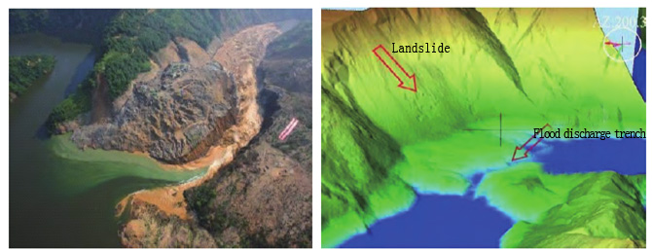
Disaster Mitigation Application
Secondary Disaster Barrier Lake
The 2008 Great WenChuan Earthquake, measured at 8.0Ms on Monday, May 12 in Sichuan province and killed about over 69,000 people, caused massive landslides in TangJiaShan. Two adjacent landslides with megalith and clay filled in river channel to form giant barrier lake. The scientists from Wuhan University collected LiDAR point-cloud data in TangJiaShan barrier lake and achieved high-definition digital elevation image to qualitatively and quantitatively analyze water level, water retention capacity, spill way, and
neighbor landslides of TangJiaShan barrier lake.
(a)Optical image (b)LiDAR Data
Figure of Local Topography of TangJiaShan barrier lake(Including landslide and spill way)

Slide 11
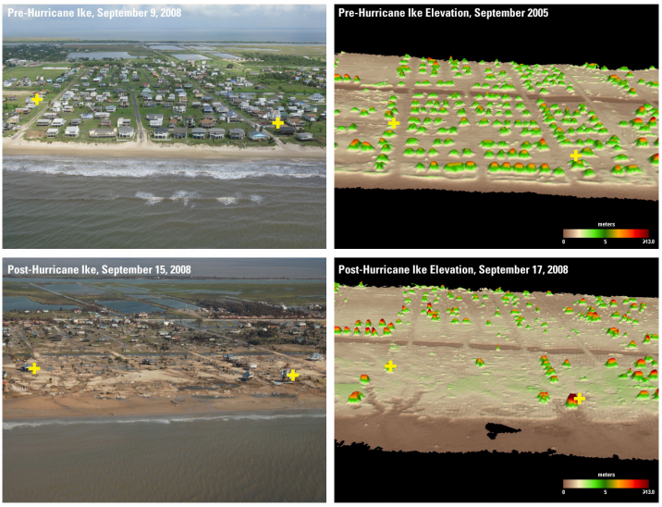
Application for Disaster Mitigation
Hurricane Hazard
Huuricane“Ike” was a powerful tropical cyclone that swept through portions of coastal area of Texas in US and resulted in ten billions of US dollars in property damage and about a hundred casualties in September 2008. The researchers utilized the USGS Experimental Advanced Airborne Research LiDAR (EAARL) system to achieve LiDAR data by twin-engine “Cessna 310”airplane.
（a） Before hurricane Image
（b） Before hurricane Elevation
（c）After hurricane Image
（d） After hurricane Elevation

Slide 12
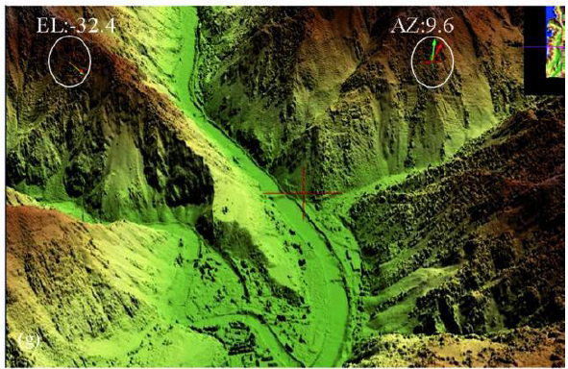
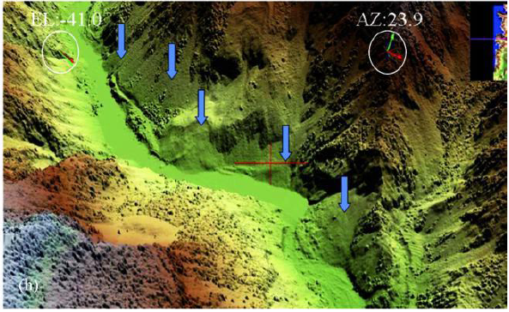
Application for Disaster Mitigation
Landslide/ Mud-rock Flow Hazard
After Great SiChuan Earthquake, measured at 8.0Ms, the digital elevation model were achieved by LiDAR. The relative elevation accuracy could be reached by 30cm. The landslide zone can be easily recognized, and there are too many landslides in a few hundred meters in hardest-hit area.
(a) 3D Topographic Map nearby YingXiu Town
(b) Landslide Interpretation
nearby DuWen Driveway

Slide 13
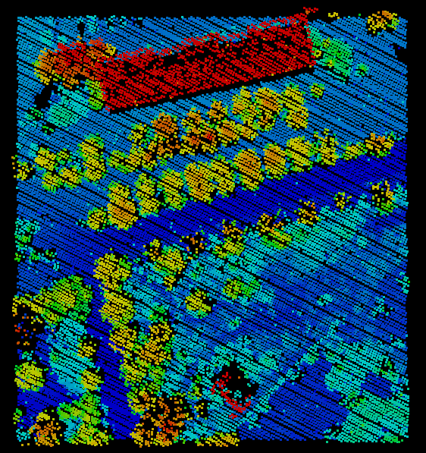
Development of LiDAR Technology(III) -- High-Spatial resolution Image
Challenging to LiDAR Imaging
Image of sparse discrete point can not clearly display the details, such as nature tone and texture of surface features
Remote Sensing Image
Point Cloud Data
(colored by elevation)

Slide 14
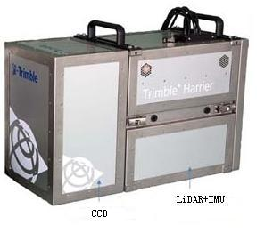
Development of LiDAR Technology(III) -- High-Spatial resolution Image
Solution One: Sharing Same Plateform
With Same platform
Optical Image
LiDAR Data
Orthographic Image
DEM
3D Image
Complicated process flow
Image
Point Cloud Data
(colored by elevation)
Difficulty to match between LiDAR dot and image pixel
Hard to work in real time way

Slide 15
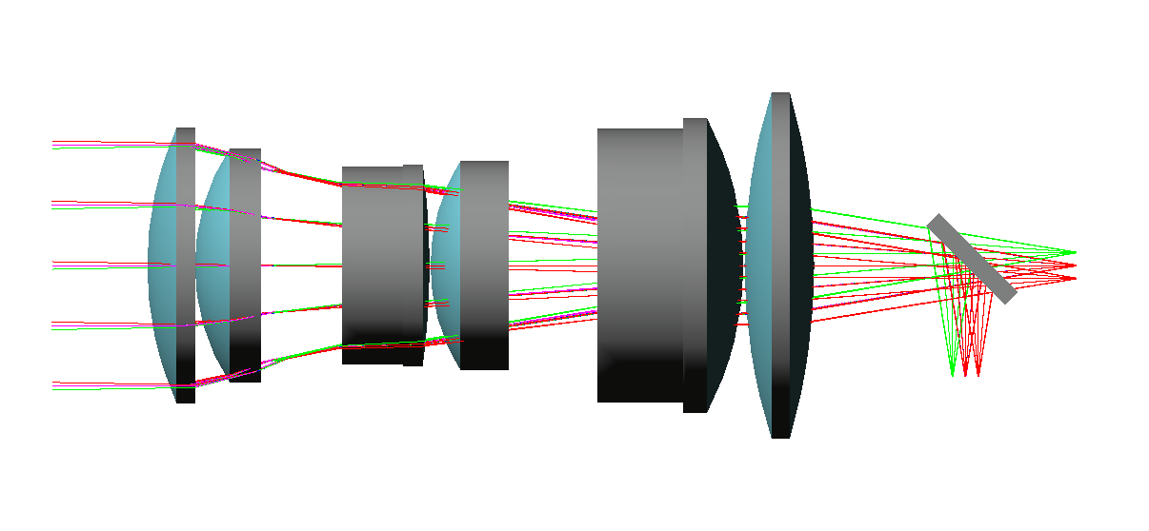
Development of LiDAR Technology(III) -- High-Spatial resolution Image
Solution Two(AOE Solution): Sharing Same Front Optical System
spectrum separation filter
laser detector
CCD detector
Key Point：
Adopt common-path push-broom approach
Precisely match two types of data at front-end device of signal acquisition for real-time 3D imaging

Slide 16
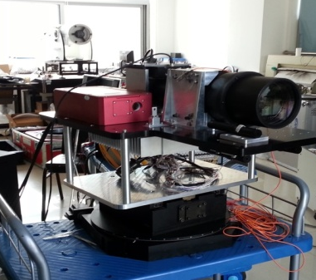
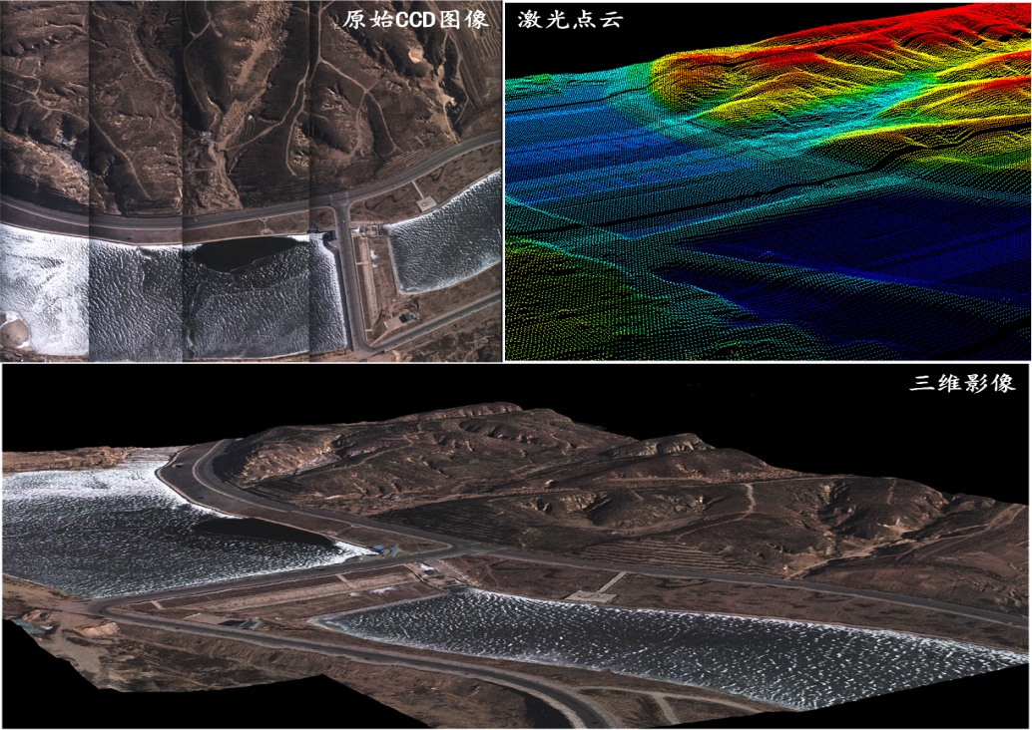
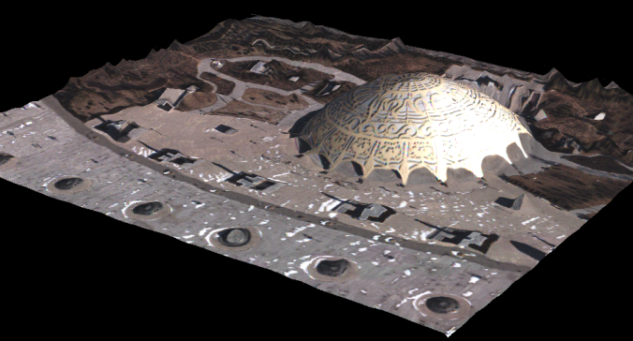
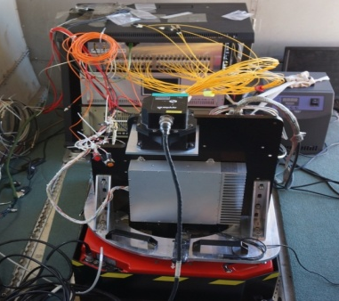
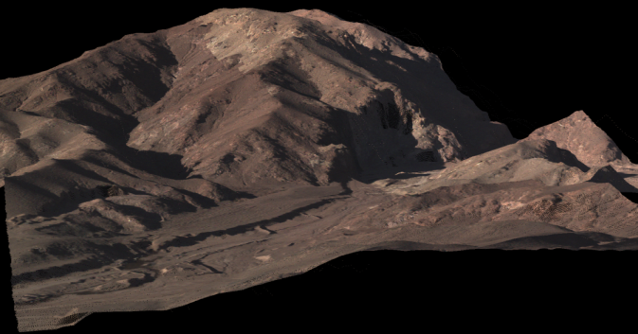
Experiment Achievement -- AOE Opto-LiDAR Imaging System
A prototype of flight was successfully developed since 2009. The experiments of the ground surface and flight were positively performed, and it was first time to real-time achieve 3D image in common-path way
Original CCD image
LiDAR point data
Bronze square of Ordos
Equipment ground test
Reservoir of Ordos
Wula mountain of Bayannaoer
Equipment installation
（Y-12 aircraft ）
Flight elevation：2km
Resolution ratio of 3D image：0.05m
Accuracy degree of relative elevation：0.3m
Experiment plot ：Ordos in Inner Mongolia
Flight time： December 2013
Flight hour：4 hours
Quantity of achievement data：210G

Slide 17
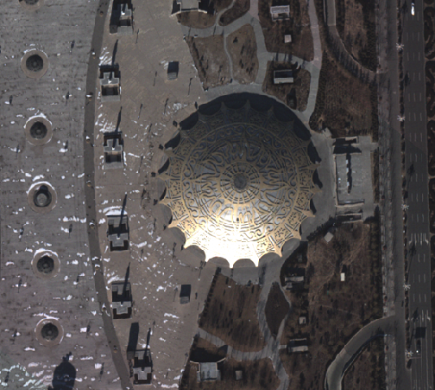
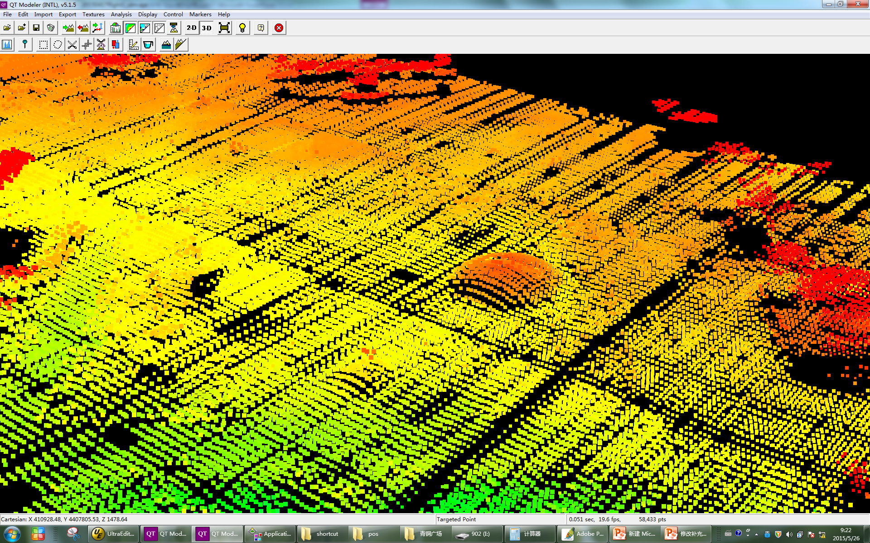

Experiment Achievement -- AOE Opto-LiDAR Imaging System
Breaking through the limitation of achievement real-time elevation information from traditional optical imaging detection, support the demand for rapid response of disaster Mitigation
HR optical two-dimension(2D) imaging
High-accuracy laser 3D measurement
Real-time image technology of common aperture optical stereo
（410919.6,448092.2,1439.1）
16m
86m
Notes:
17

Slide 18
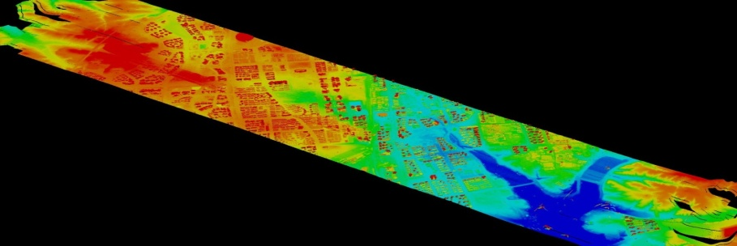
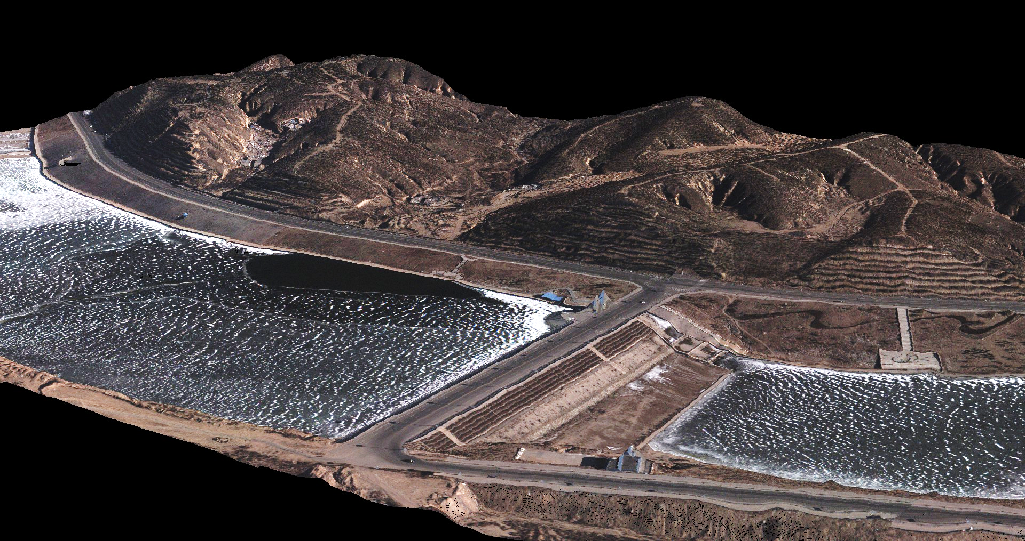
Experiment Achievement -- AOE Opto-LiDAR Imaging System
A prototype of Flight——Real-time 3D imaging
Point cloud of detection area
（414686.0,4404965.3,1392.2）
3.6m
15.5m
Water reservoir in Ordos
Notes:
18

Slide 19
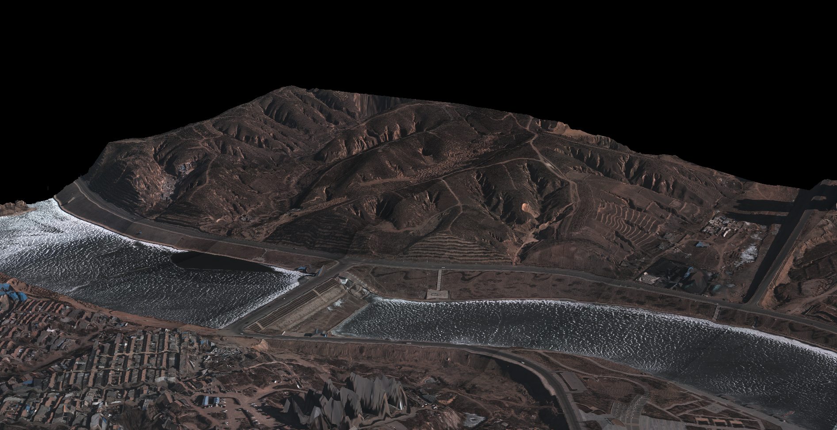
Experiment Achievement -- AOE Opto-LiDAR Imaging System
A prototype of Flight——Real-time 3D imaging
18.3m
20.8m
（415221.8,4405198.3,1405.2）
Water reservoir in Ordos
Notes:
19

Slide 20
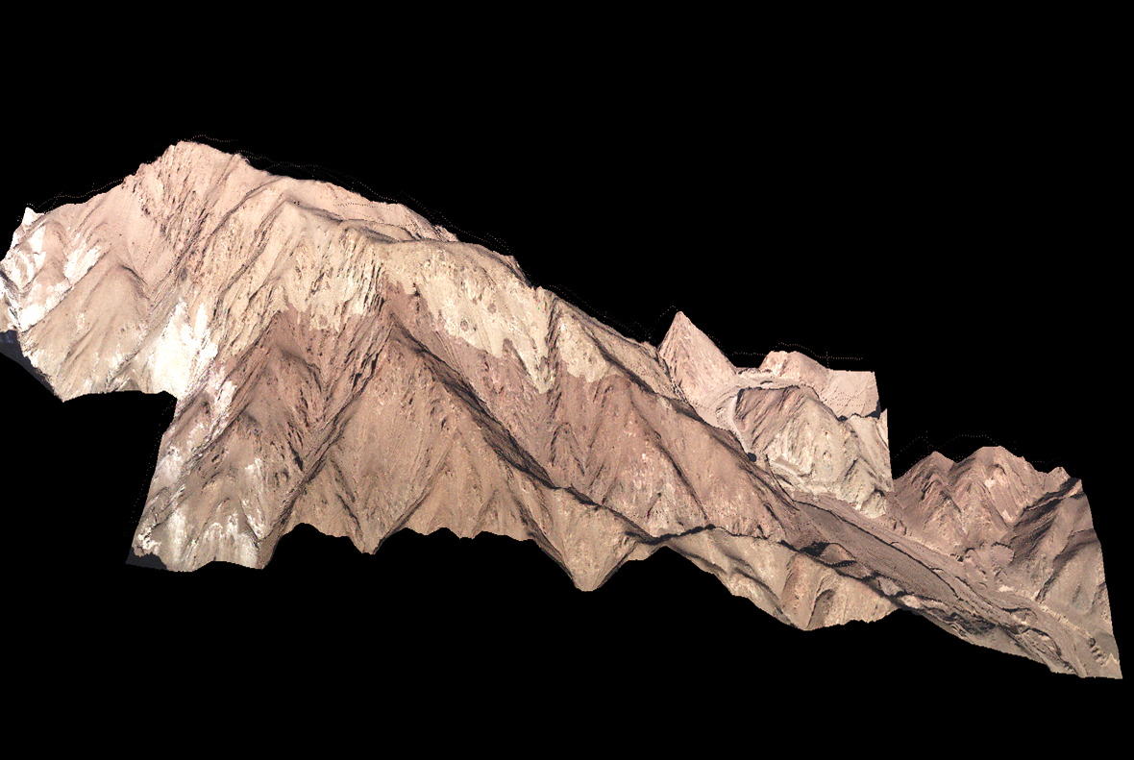
Experiment Achievement -- AOE Opto-LiDAR Imaging System
A prototype of Flight——Real-time 3D imaging
（371527.2,4532154.3,1493.8）
坡度30°
（337284.4,,4531989.1,1324.2）
WuLa mountain in inner Mongolia
Notes:
20

Slide 21
Development of LiDAR Technology(IV) – AOE Mini LiDAR
  Emergency response, arrive on the scene immediately
  Flexibly and simply operate, low demand for field, and steadily worked
  Collect field data, rapidly process data and transfer data to command center for making decision and judgment
  Trace trend in development of disaster and assist command center to implement constant operation
  Participate in post-disaster reconstruction and provide relative geographic information
Mini UAV
  Difficulty in Getting into Disaster Zone
  Real-time & Emergency Response
Requirement
  Platform of mini UAV
+
LiDAR payload of miniaturization, light-weighting and low-power consumption

Slide 22
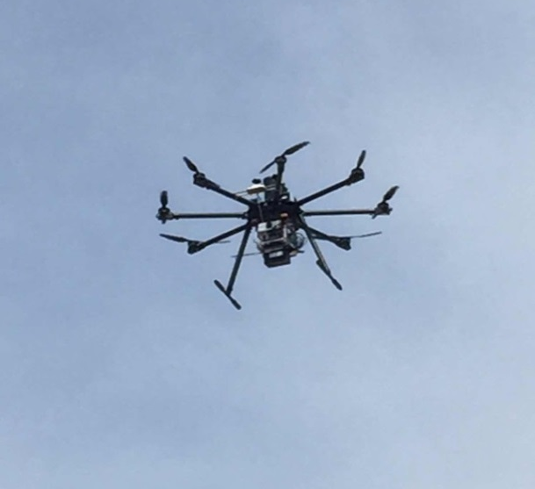
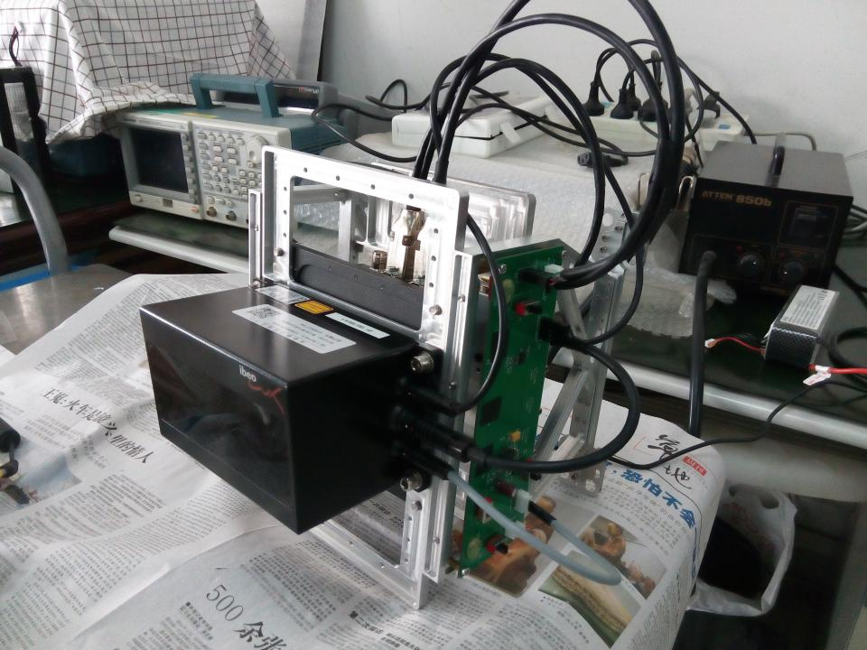
Development of LiDAR Technology(IV) -- AOE Mini LiDAR
Mini UAV LiDAR System
Light-weight structure design;
high-accuracy mini LiDAR system integrated into light-small INS, GPS aerial, and mini memory cell;
system weight under 5KG;
Meet the demand for common mini UAV equipment
Wavelength ：905nm
Operating distance ：200m
Effective field angular ：110°
Range resolution ：4cm
Range accuracy ：0.1m
Number of echoes：3
Positioning accuracy: 1cm± 1ppm
Volume: 360mmX220mmX265mm

Slide 23
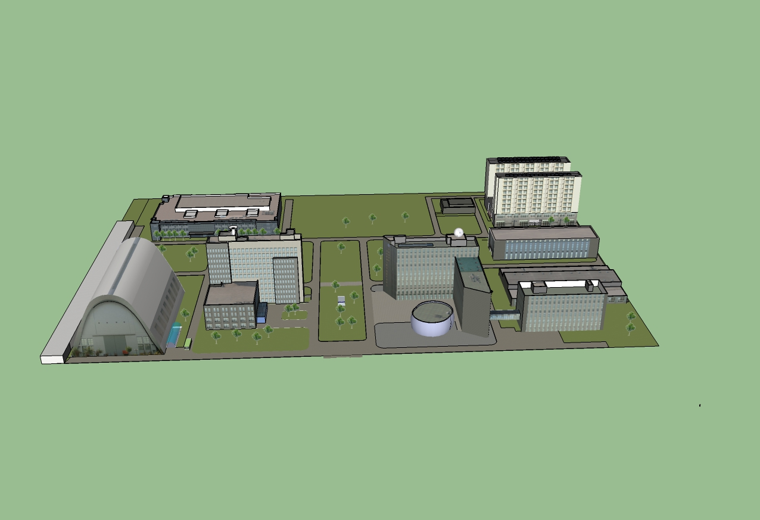
Experiment Achievement -- AOE Mini LiDAR
Airborne data
Vehicle data
LiDAR Point Cloud
Three-dimensional model

Slide 24
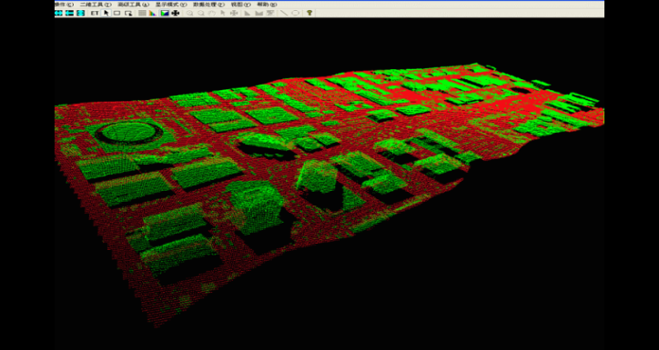
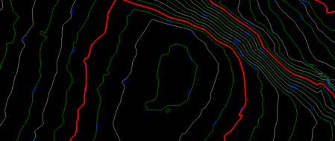
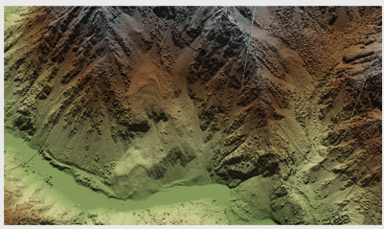
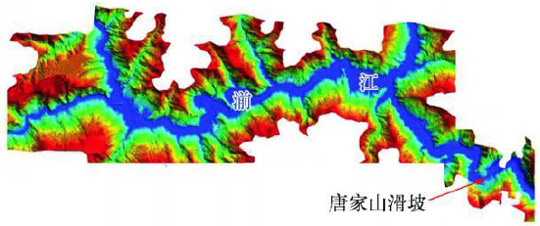
Development of LiDAR Technology(IV) -- AOE Mini LiDAR
Above-mentioned system loaded in mini UAV can be mobile, flexible, and high-speed to analyze landslide, dredge barrier lake, judge the situation, and formulate emergency plan
Point Cloud
  Contour line
  Contour line
Achieve DEM data in disaster zone
Build contour line
Analyze landslides
Analyze water level of barrier lake
Landslide
DEM in disaster zone
Landslide

Slide 25
Way Forward(Ⅰ) —— New Element to Arcser
As aerospace infrastructures plays a key role in disaster emergency, “Aerospace Application Coordination System for Emergency Response and Data Sharing (ArcSer)” is established by support of Chinese National Science-Technology Support Plan Projects
Coordinate civil aerospace resources to acquire remote sensing data of disaster area
Do aerospace remote sensing data acquisition and collects the data together
Distribute the data to disaster reduction application agencies as soon as possible

Slide 26
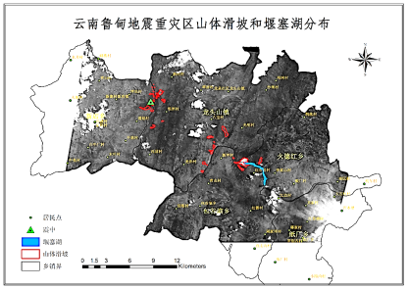




Way Forward(Ⅰ) —— New Element to Arcser
Inter-Ministerial Coordination Mechanism
Once great natural catastrophe occurs in China, ArcSer starts working.
ArcSer Platform
Civil Aerospace Resources Coordination
Data Sharing for Disaster Reduction
It has started three times:
  YuShu Earthquake(2010.4 )
  LuShan Earthquake(2013.4 )
  Ludian Earthquake(2014.8 )
Disaster relief on site
Disaster assessment
Technical support
Local Government
Ministries
Institutes & Organizations

Slide 27

Way Forward(Ⅰ) —— New Element to Arcser
Inter-Ministerial Coordination Mechanism
Common aperture LiDAR system
ArcSer Platform
Civil Aerospace Resources Coordination
Data Sharing for Disaster Reduction
Mini LiDAR
Disaster relief on site
Disaster assessment
Technical support
Local Government
Ministries
Institutes & Organizations

Slide 28




Way Forward(Ⅱ) —— International Cooperation
AOE is willing to offer its contribution to international society of disaster mitigation.
We have the ability to provide end - to - end reliable service to the user by using LiDAR technology.
Provide specific system solutions based on user requirement
Develop ready to use LIDAR remote sensing system on-demand
Undertake LiDAR data acquisition service and satisfy application need

Slide 29
Way Forward(Ⅲ) —— Space-borne LiDAR
Technical Challenge:
  Power issue
  LiDAR technology
  Effect of atmosphere
  …..
We believe that space-borne LiDAR system is assured of a place in global earth observation systems in the near future.

Slide 30

Thank you !

