Slide 1
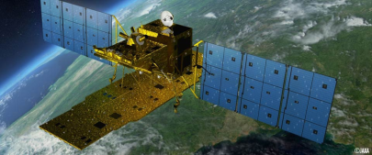
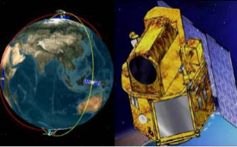


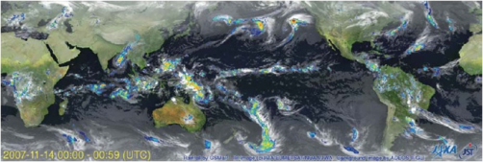



























Sentinel Asia Step 3
Evolution
Michio Ito (Mr.)
Representative of Sentinel Asia Secretariat
Space Applications and Operation Center (SAOC)
Japan Aerospace Exploration Agency (JAXA)
ito.michio@jaxa.jp

Slide 2
Contents
What is Sentinel Asia ?
Sentinel Asia Evolution
CEOS and SA cooperation

Slide 3
1. What is sentinel asia ?

Slide 4
Began its Activities in 2006 as an initiative of APRSAF
Member Status
(As of September 1, 2015)
Disaster Reduction
Community
Space Community
APRSAF
SENTINEL ASIA
ADRC
Member Countries
(30 member countries)
Satellite Image
83 organizations from 25 countries & regions and 15 international organizations
In total: 98* organizations
Promotion of Utilization
Disaster Information
Capacity Building
Utilization (User)
*Three members are increased from last meeting
Joint Project Team (JPT)
International Community
UNESCAP, UNOOSA
ASEAN, AIT and
International Disaster Charter
etc.
International Cooperation

Slide 5

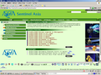
1. Emergency Observation
Requesting Organization (RO)
Emergency Observation
Request
IDC
ADRC Members
JPT Members
Analyzed Products
Data Provider
Node (DPN)
ADRC
Emergency Observation
Request
Emergency Observation
Request
Disaster
Occurrence
JAXA
ISRO
GISTDA
KARI
NARL
Feedback
Disaster Information
Digital Camera Images
Archive Images
Analyzable Data
Images by Emergency
Observation
Support
Satellite Images
& Disaster Information
JAXA
Asia Branch
(Bangkok)
Data Analysis
Node (DAN)
Sentinel Asia
Step 2 System
Analyzed Products
http://sentinel.tksc.jaxa.jp/
AIT, ADRC
CRISP, CAIAG
LAPAN, SD/Sri Lanka
MONRE, ICIMOD
Sri Lanka MoDM, CEA
NCRST, BPPT, MO, etc.
Support
Own Data
Disaster Management Agencies
in Asia

Slide 6
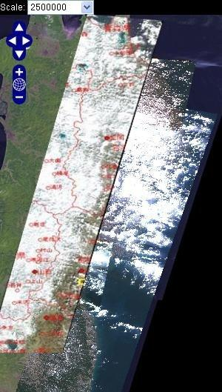
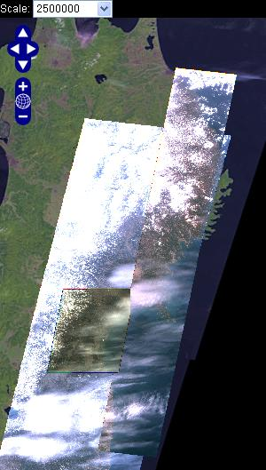
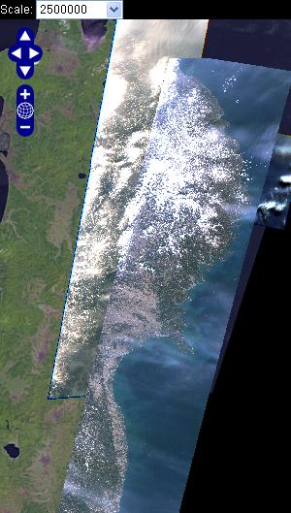
Great East Japan Earthquake observed by Sentinel Asia Constellation
12 March 2011
13 March
14 March
ALOS
THEOS
FORMOSAT-2
CARTOSAT-2

Slide 7
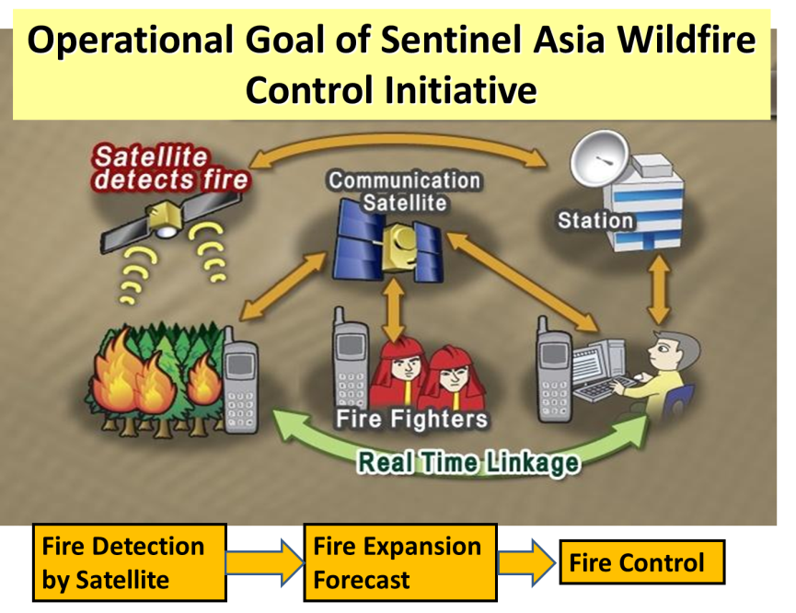
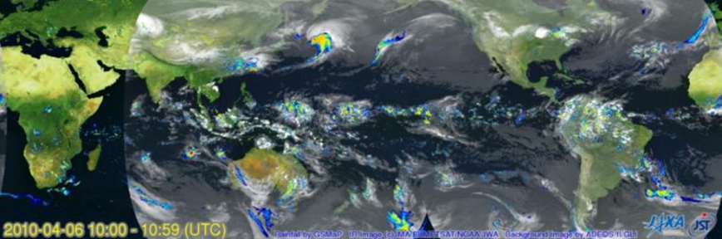
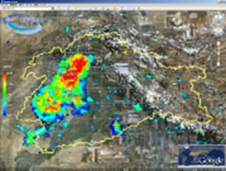
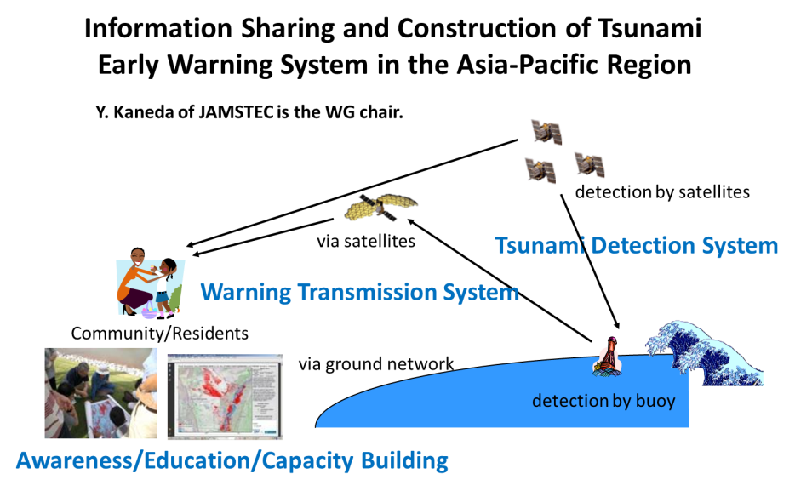
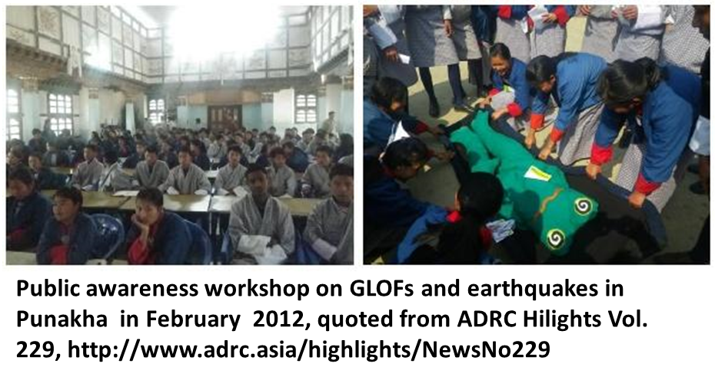
2. Working Groups
Wild Fire WG
Flood WG
Precipitation
Flood Prediction
GLOF WG
Tsunami WG

Slide 8
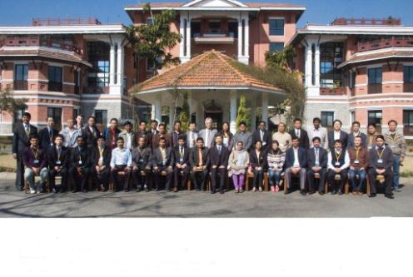
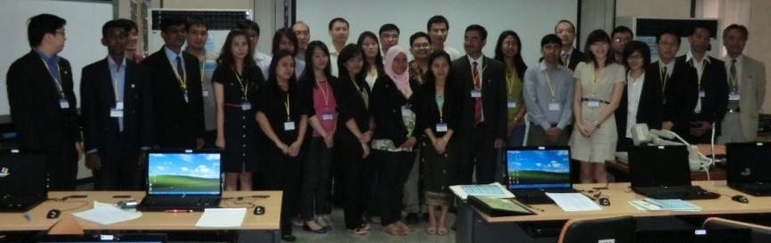
3. Capacity Building and Human Network
A good human network is the foundation of the project
The 7th Sentinel Asia System Operation Training by JAXA,
hosted by ICIMOD
in February-March 2011
The 8th Sentinel Asia System
Operation Training by JAXA,
hosted by AIT
in February 2012

Slide 9
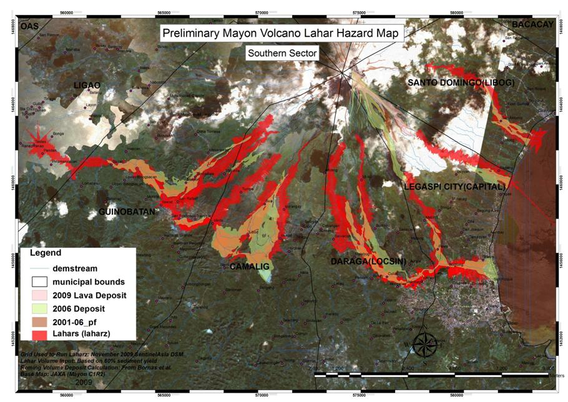
Mayon Volcanic activity in Philippines from 14 December 2009
4. Success Story Project
Response Phase
Recovery Phase
Mitigation/
Preparedness Phase
hazard maps were prepared with cooperation of JAXA and PHIVOLCS
20 Dec.: the lava was confirmed
DPN/ DAN
25 Dec.: Observation by Camera
PHIVOLCS made lava deposit map by the eruption using these ALOS imagery and others
Disaster Management Agencies
the maps were used to understand the situation and make decision by NDCC
*1: Philippine Institute of Volcanology and Seismology
*2: National Disaster Coordinating
9
9
9
Notes:
This is a hazard map.
Hazard maps were prepared with cooperation of JAXA and PHIVOLCS.
this is a activity of Mitigation/ Preparedness Phase.

Slide 10
2. Sentinel Asia step 3 evolution

Slide 11
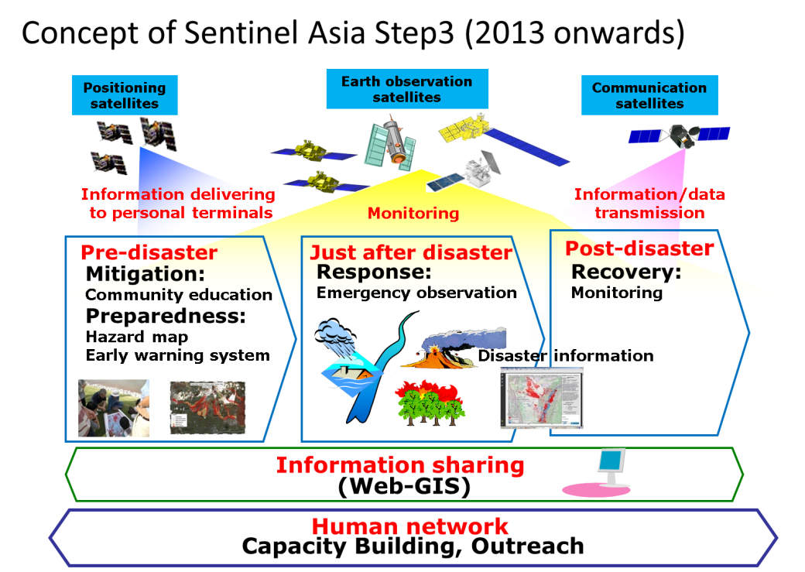
Sentinel Asia Step 3
Cover whole disaster cycles
Quick observation and delivery of the information and products
Comprehensive utilization of space applications
Strategy for the evolution to the Sentinel Asia Step 3
Strategic management
End user oriented activities
Cooperated promotion

Slide 12
1. Strengthen collaboration between space/GIS organizations and disaster management organizations
Space/GIS organization (examples)
Disaster management organization (examples)
GISTDA (Thailand)
SPARROSO (Bangladesh)
ISRO (India)
LAPAN (Indonesia)
JAXA (Japan)
BPPT (Indonesia)
KARI (Korea)
ICIMOD (Nepal)
ANGKASA (Malaysia)
SUPARCO (Pakistan)
PAGASA (Philippines)
CRISP (Singapore)
AIT (Thailand)
---------
NCDM (Cambodia)
NDRCC (China)
NDMO (Fiji)
NDMA (India)
BNPB(Indonesia)
RRD (Myanmar)
NDMO (Lao PDR)
NSSP (Armenia)
MARD (Vietnam)
DMC (Sri Lanka)
MHCA (Bhutan)
DDPM (Thailand)
MDMR (Bangladesh)
---------
Cooperation
Periodic meetings
Quasi-real time information exchange during disaster response activities
Information sharing through WEB-portal
WG activities
Success story projects
Disaster management organizations of JPT members and ADRC member countries

Slide 13
Less than 24 hours
About a week
①Disaster
or Symptom
②Subsequent disaster
In situ activities
(Rescue, Evacuation, etc.)
Preparedness for subsequent disaster
In situ disaster management organization (government, local government)
EOR
Communicate to confirm the situation
Provide quick analysis products
Communicate to confirm the status/obs. request
ADRC & Secretariat office
Observation request
Input info.
Observation request
DPN & WG (disaster kind oriented)
Observed data
Observed data
Sentinel Asia server
Down load
Up load
Up load
Down load
Up load
Quick analysis by DAN( P-DAN leads )
Value enhance
Analysis

Slide 14
2. Collaborative WGs with space/RS experts and disaster management experts and development
WGs
GLOF & Landslides
Flood and Heavy Rain Disasters
Earthquake and Volcanic Disasters
Forest Fire
Tsunami
Preparedness and Emergency Response
Purpose of the WGs
Research analysis method for in situ disaster response
Research for optimization of cooperative satellite observation and analysis
Review/assess observation products for PDCA
Study and suggest success story project

Slide 15
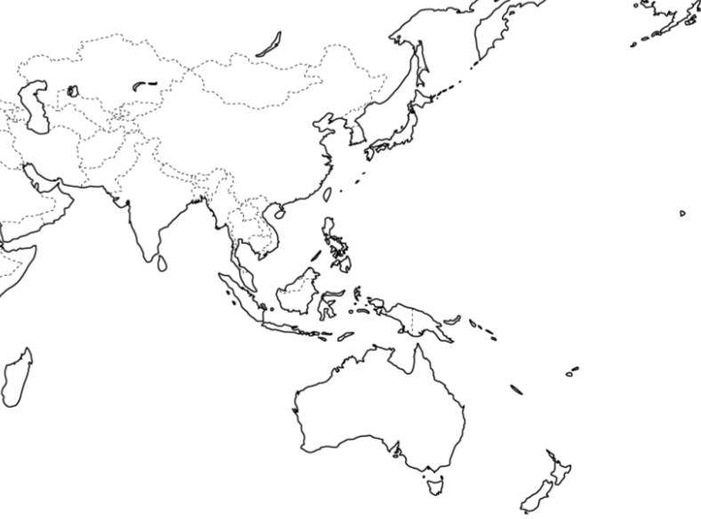
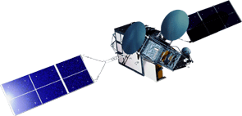

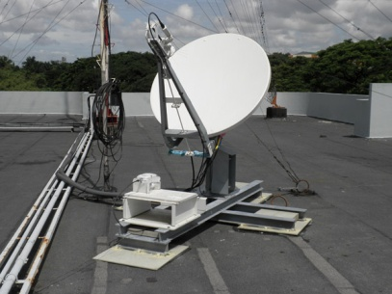
3. Improvement of Accessibility to Information
153Mbps (down link) Data Transmission
to Regional Servers by WINDS
WINDS
Kazakhstan RS (with WINDS)
Mongolia RS (with WINDS)
Kyrgyz RS
(with WINDS)
Japan
Central Server
Nepal RS (with WINDS)
Vietnam RS (with WINDS)
Bangladesh RS
(with WINDS)
Taiwan RS
Philippines RS (with WINDS)
Thailand RS (with WINDS)
Sri Lanka RS (with WINDS)
Malaysia RS (with WINDS)
Indonesia RS (with WINDS)
Fiji RS (with WINDS)
RS: Regional Server

Slide 16
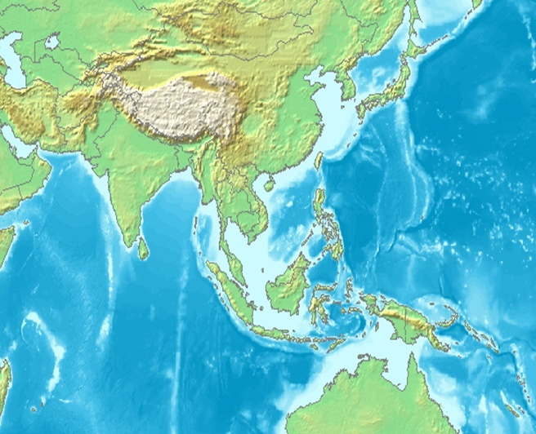
4. Harmonized observation (DPN) and P-DAN conducted analysis (DAN) for rapid observation and response to EOR
NCSRT
CAIAG
KARI
JAXA
ADRC
Chiba University
Chubu University
Hiroshima Institute of Technology
ICIMOD
CEA
Yamaguchi University
Sichuan University
NARL
ISRO
Chinese University of
Hong Kong
CSRSR/NCU
University of the Philippines
GIC/AIT
Manila Observatory
MONRE
ADB
SD
GISTDA
PHIVOLCS
MoDM
ANGKASA
IWMI
SD
CRISP
LAPAN
BPPT
SOPAC

Slide 17
5. Maximize utilzation of SAR satellites and ALOS-2 observation to contribute to the emergency response
SAR observation is a strong tool for emergency response
Capability of all weather, day and night time observation enables certain and rapid monitoring to support emergency response
Disital intensity mapping as well as polarimetric analysis can identify disaster situation – flood, landslides, natural dams etc., - to contribute to emregency response
SAR Interferometry can support long time monitoring of disaster risks – land movements, volcanic activities, etc. – to contribute to disaster risk reduction.
ALOS-2 enables quasi-realtime diaster monitoring
In addition to the SAR performance, 14 days recurrent period and the variety of the observation mode of ALOS-2 enables disaster monitoring of the target aria almost evry day.
L-Band SAR can identify land movements and landslides in mountanious area with high reliability.
ALOS-2 disaster monitoring with the support of other SAR satellites will realize substantial contribution to in situ humanitarian support

Slide 18
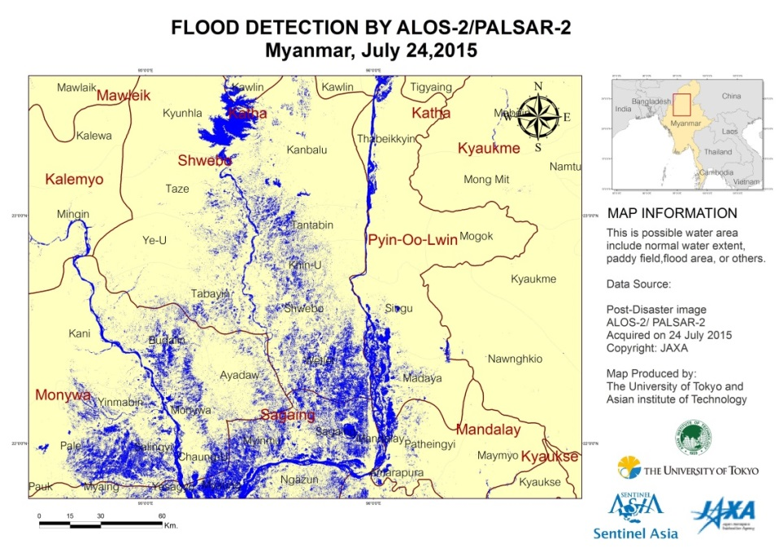
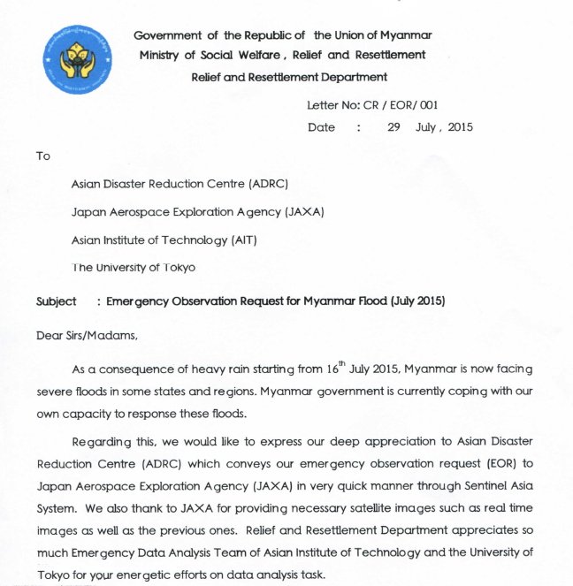
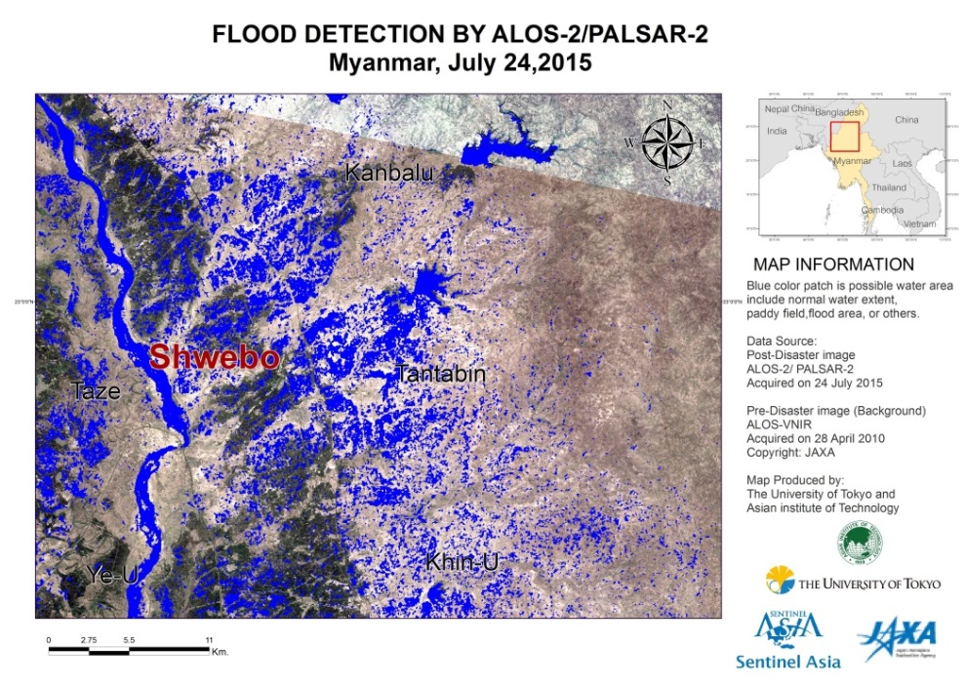
Sentinel Asia Triggered for Myanmar Flood 2015 July
SA promptly coordinated with Disaster Authorities and data products was shared among the
authorities and used for listing flooded villages(incl. potential), also for response actions etc.
- Jul 22 Emergency Obs. Request received .
Sentinel Asia triggered.
- Jul 23 ALOS-2 observed the AOI.
L1 product transferred.
Data Analysis Nodes analized the data.
Quick analysis result was released.
- Jul 24 Archived data was uploaded.
- Jul 27 Additional Obs request received.
- Jul 28 ALOS-2 observed the 2nd AOI.
- Jul 29 L1 product transferred.
Letter from Relief&Resettle
ment Dept. Myanmar,
Jul 29, 2015

Slide 19
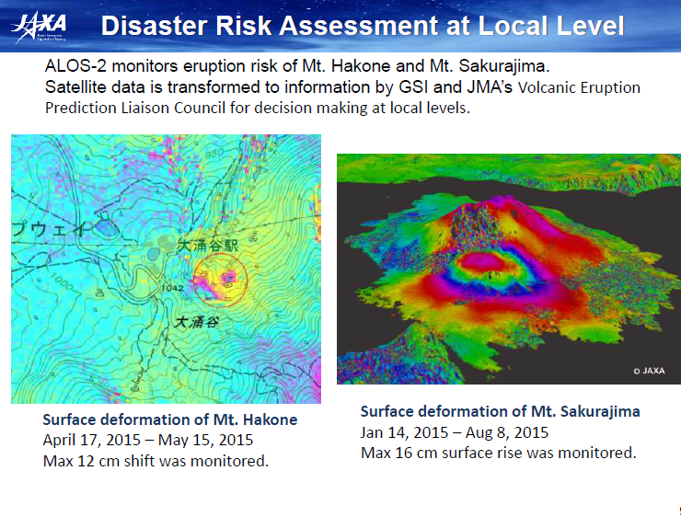

Slide 20
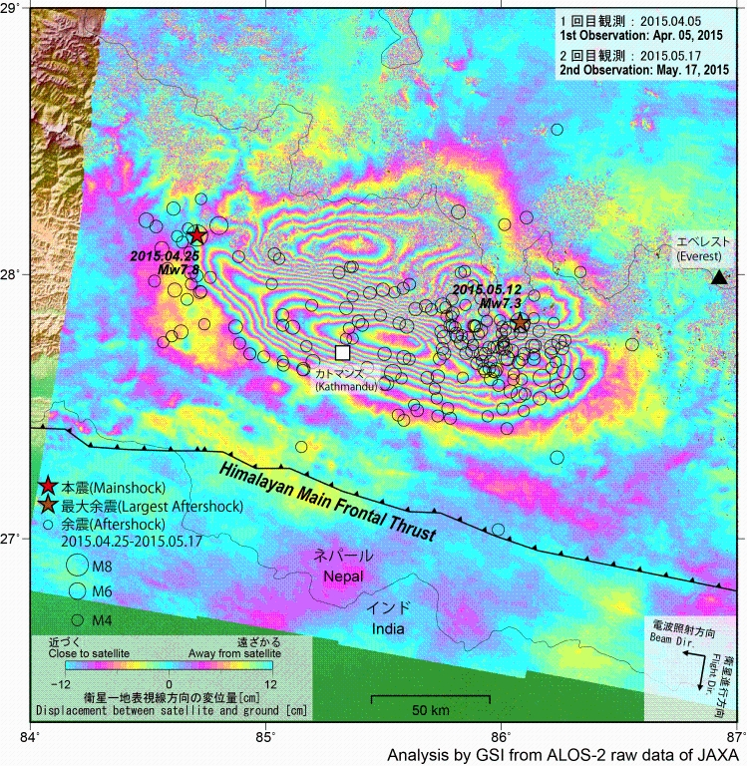
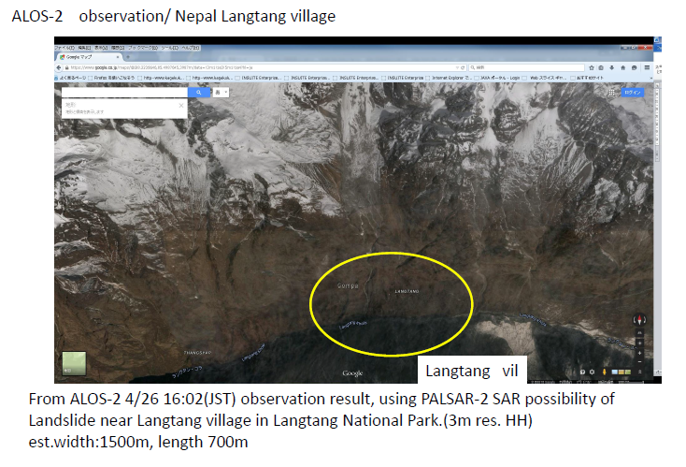
Analysed land deformation by the earthquakes in Nepal from 25/Apr. to 17/May (ALOS-2 InSAR)
Detetion of landslides at Langtang village bay ALOS-2 PALSAR observation

Slide 22
CEOS and SEntinel asia cooperation

Slide 23
Sentinal Asia is a Asia-Pacific gateway for space technology to contribute to substantial disaster risk and damage reduction with the collaboration of disaster management organizations and space/GIS organizations of Asia-Pacifi countries.
Cooperative operation of SAR satellites with the support of optical satellites and their archives can contribute to emergency respone to reduce disaster losses, such as in situ emegency rescue and humanitarian support
Sentinel Asia secretariat hopes CEOS to support its activities by participating in DPN and/or DAN

Slide 24



