Slide 1


A New System of Earth Observation Data Sharing for Emergency Response
CEOS Working Group on Disaster Meeting #4
Presented by Chuanrong Li
Key Laboratory of Quantitative Remote Sensing Information Technology, Academy of Opto-Electronics (AOE), Chinese Academy of Sciences (CAS)
September, 2015 Frascati, Italy

Slide 2

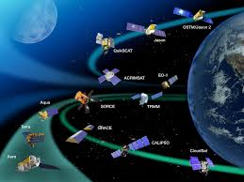

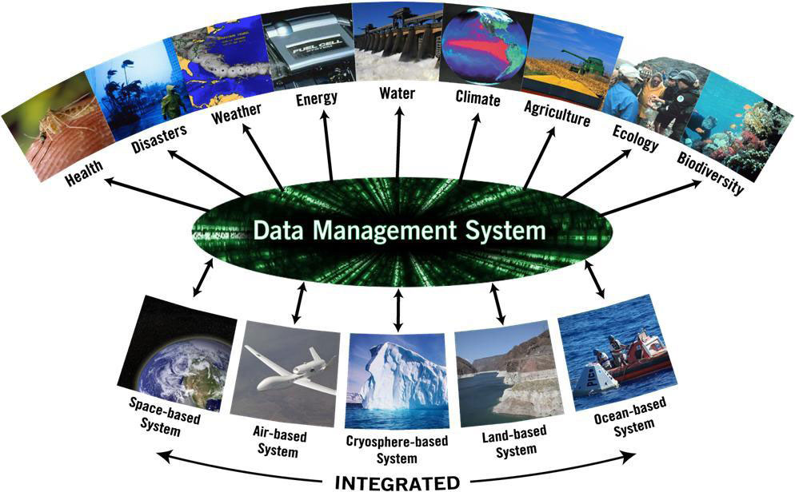


1.Background
International Charter
CEOS-WGDisasters
Copernicus/GMES
UN-SPIDER
Sentinel-Asia
Many related international organizations have made their great efforts to reduce disaster losses through EO technology and obtained remarkable benefits

Slide 3
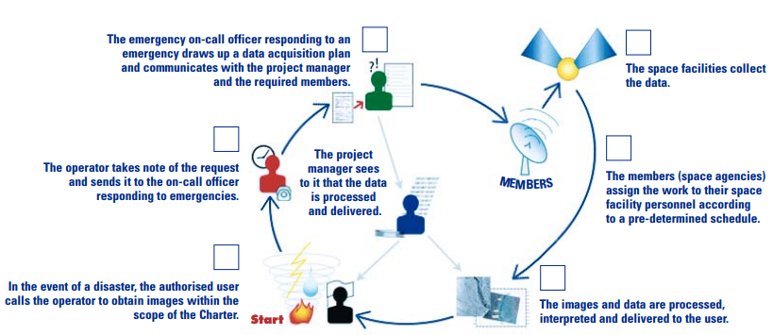
1.Background
Spatial
Resolution
Recursive
Period
Weather
Condition
Receiving
Station
From EO data sharing aspect, the efficiency and effectiveness of spatial technology for disaster reduction now is limited by lack of coordinative mechanism and corresponding operational system.

Slide 4

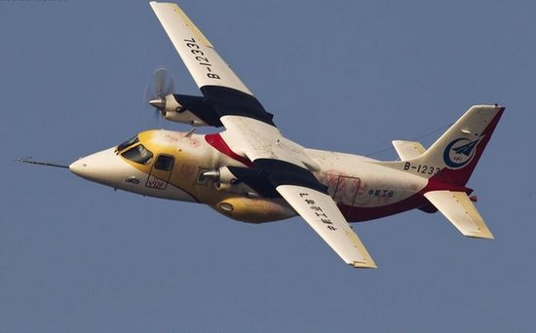
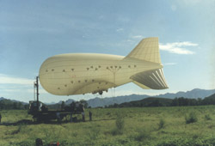
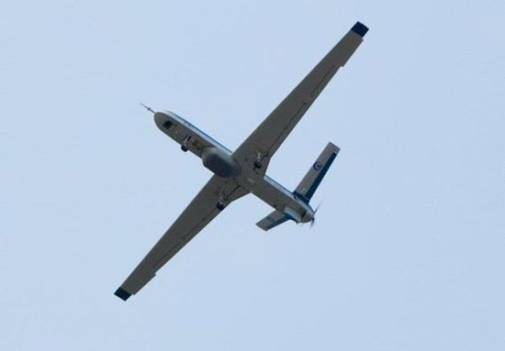
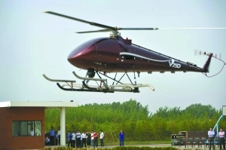
1.Background
It is possible to provide disaster recovery observatory due to the rapid development of spatial technology in China. Many related aerospace agencies and commercial companies are adequately willing to take park in emergency response.
Satellite Constellation
Aerial Remote Sensing System

Slide 5
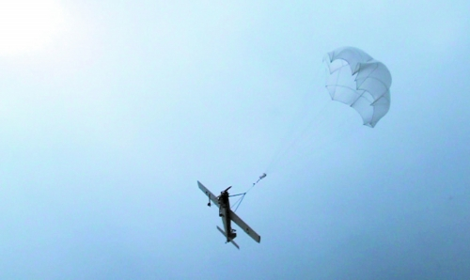
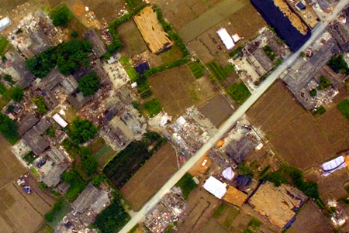
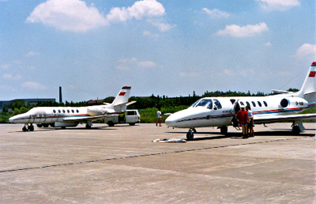
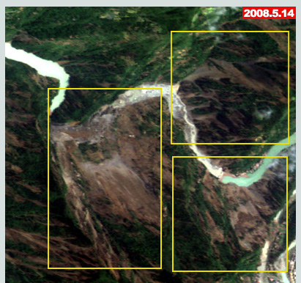
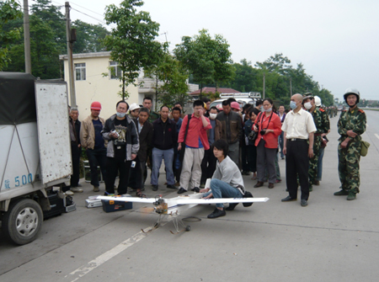
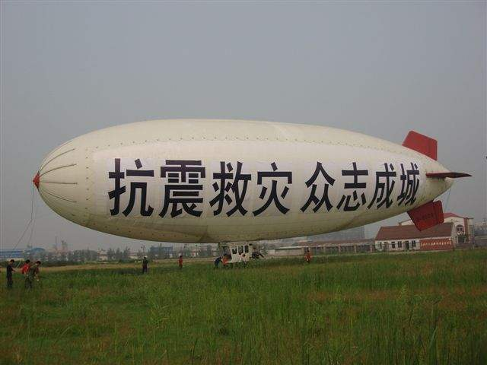
1.Background
However, there are no universal mechanism and system to coordinate the spatial resources to implement disaster reduction, the efficiency and result are not well in previous emergency responses ,which was already evident in WenChuan earthquake.

Slide 6
2.ArcSer
Considering the problem, a new system has been developed, supported by Chinese National Science-Technology Support Plan Project, which is called “Aerospace Application Coordination System for Emergency Response and Data Sharing (ArcSer)”
Coordinate civil aerospace resources to acquire remote sensing data of disaster area
Do aerospace remote sensing data acquisition and collects the data together
Distribute the data to disaster reduction application agencies as soon as possible

Slide 7
2.ArcSer
Characteristics Ⅰ
EO technology for disaster reduction mechanism and unified system workflow are established for Arcser to do emergency response .
Adopt the universal standards for
aerospace data acquisition and exchange, including EO data’s metadata, storage format , product generation order and observation programming order etc.
Space
system
Emergency
Response
Center
Aerial
System
Mechanism for
emergency
response
Unified system
workflow
Universal
standards

Slide 8
2.ArcSer
Characteristics Ⅰ
How ArcSer works?
Emergency Command
Requirement Analysis
Task Planning
Data Analysis
New Task
Data Acquisition Task
Data Acquisition Task
Data
Data
Data
Data

Slide 9
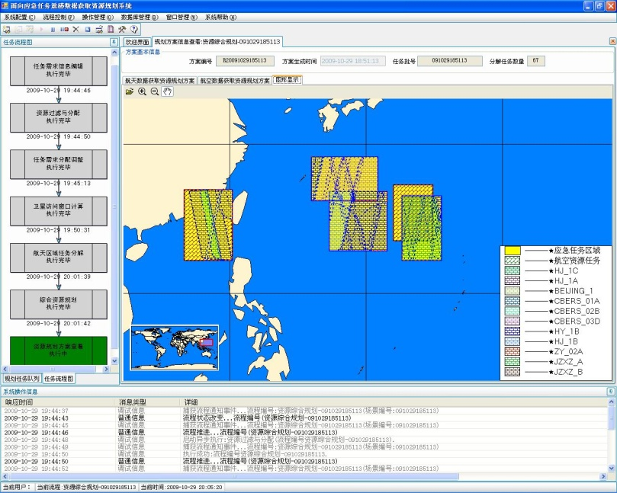
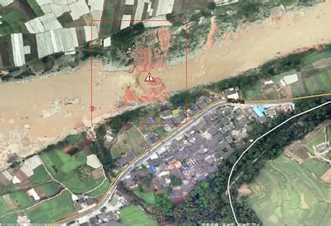
2.ArcSer
Characteristics Ⅱ
Arcser has the capability to coordinate and dispatch all the satellite and aerial resources that attend the system. Moreover, it plans space and aerial tasks uniformly based on EO data requirement of disaster area.
Provide the very latest EO data for disaster area , thus the up-to-minute disaster information extracted from EO data can be transferred to the front for disaster rescue and relief .

Slide 10
2.ArcSer
Characteristics Ⅲ
Arcser is a consultation support system, disaster experts, spatial technology engineers, government officers, end users can consult together on how to acquire EO data.

Slide 11
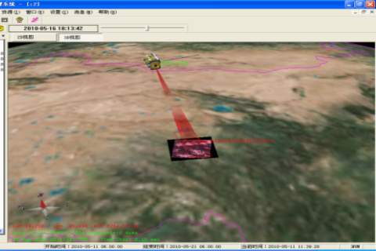
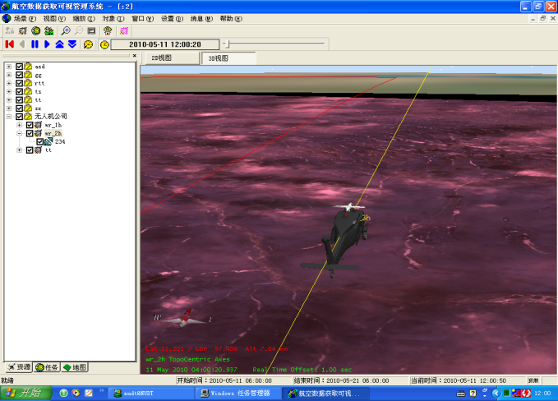
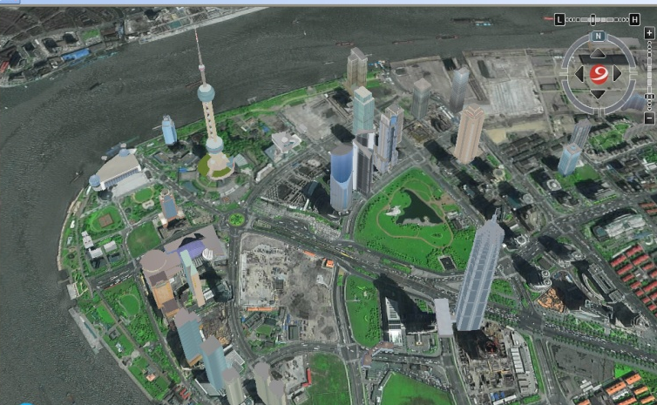
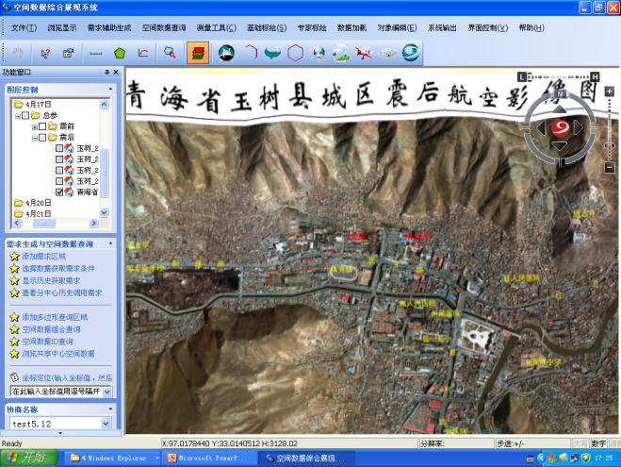
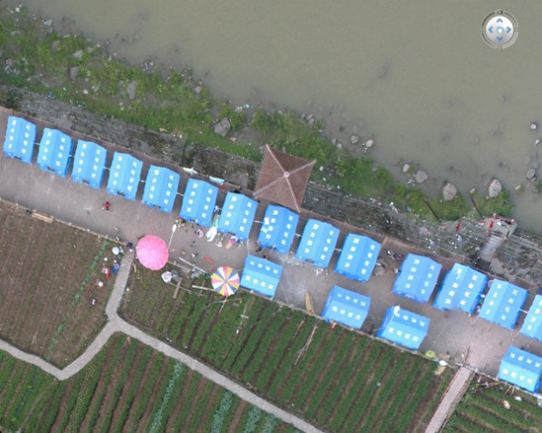
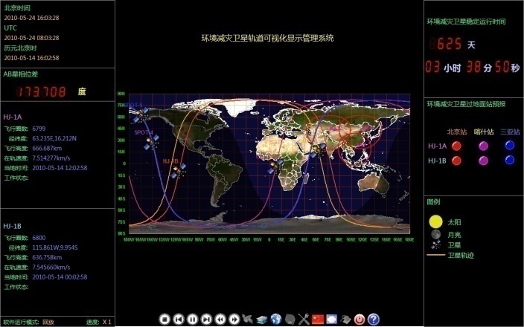
2.ArcSer
Characteristics Ⅳ
Arcser is also an comprehensive information hosting platform , provides intuitive display method for task implementing state, disaster information, and related base data of disaster area .

Slide 12
2.ArcSer
Characteristics Ⅴ
ArcSer is mainly engaged in acquiring, managing EO data and distributing EO data to application agencies for emergency response.
AOE, as EO sharing service center for emergency response, is responsible for Arcser’s operation. She plays a key role in EO technology for disaster reduction in China.

Slide 13
3.Application Case
Three emergency responses have been carried out since the system has been established.
2010.4 YuShu Earthquake in Qinghai Provice
2013.4 Lushan Earthquake in Sichuan Provice
2014.8 Ludian Earthquake in Yunnan Provice

Slide 14
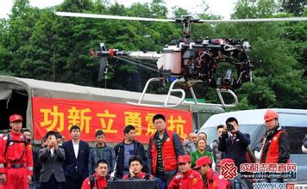
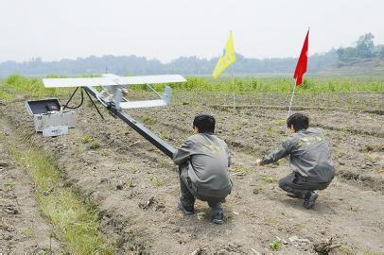
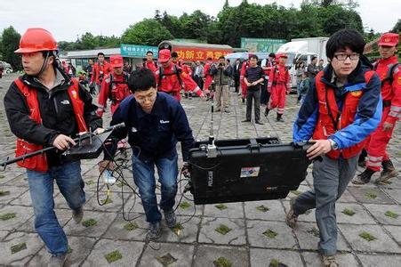
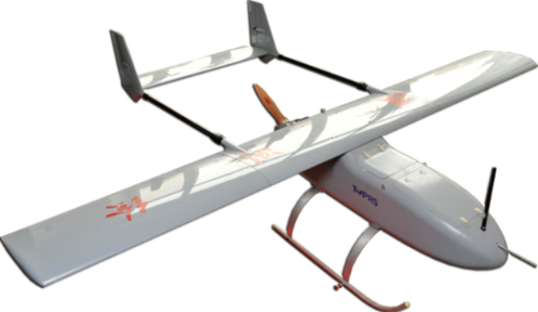
3.Application Case
UAVs were dispatched to acquire EO data once disaster happened, which play more and more important role in emergency responses.
flexible
economic
Easy to operate in disaster area
Easy to acquire high resolution EO data
Notes:
http://chj.jl.gov.cn/article/hyfw/chxh/xsjl/ztbg/201203/20120300099081.shtml

Slide 15
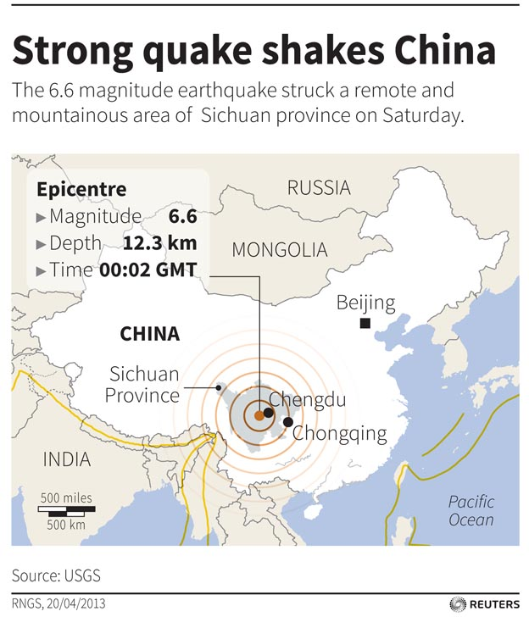
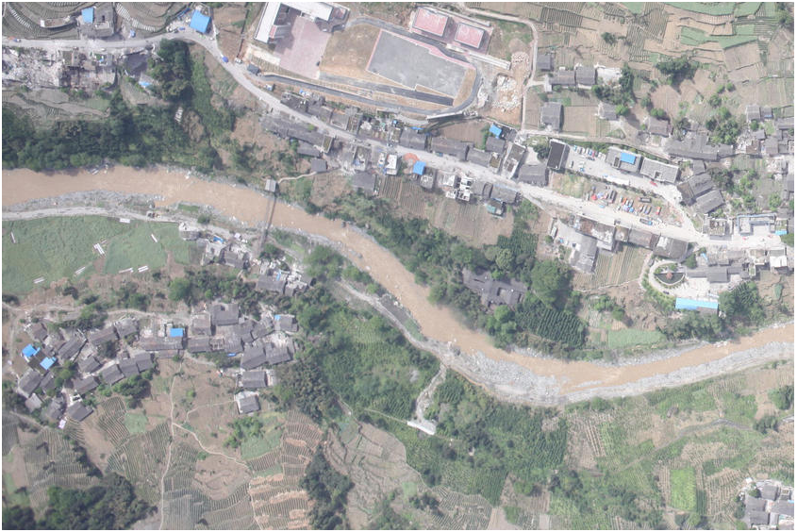
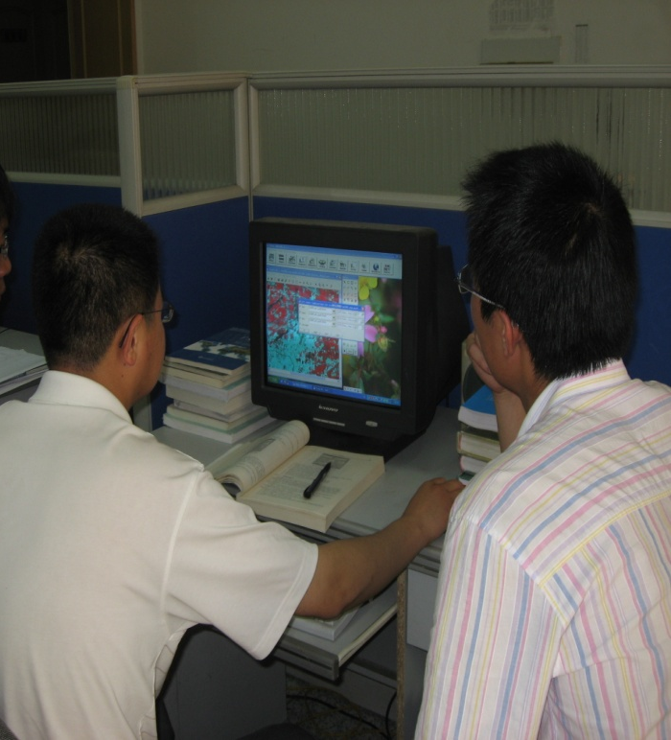
3.Application Case
When great natural catastrophe occurs in China, ArcSer acquires EO data of disaster area and distributes to the end users very quickly.
08:02 Earthquake
15:00 UAV-EO data
21:00 End User

Slide 16
3.Application Case
Time Log of ArcSer for Ludian Earthquake
8:02 The earthquake happened
8:30 Start the emergency coordination and sharing service mechanism
9:00 ArcSer startup
9:10 Send a notification to the Integrated Space Remote Sensing Data Acquisition System
11:00 Spatial Data Sharing Service Center opened

Slide 17
3.Application Case
Time Log of ArcSer for Ludian Earthquake
14:00 The first satellite archive data into ArcSer
15:00 First post-disaster airborne data into ArcSer
20:00 Data sharing info is sent to 19 ministries
21:00 Users get the first data of disaster area

Slide 18
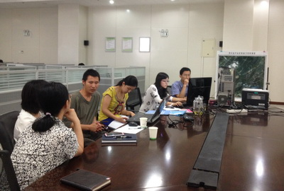
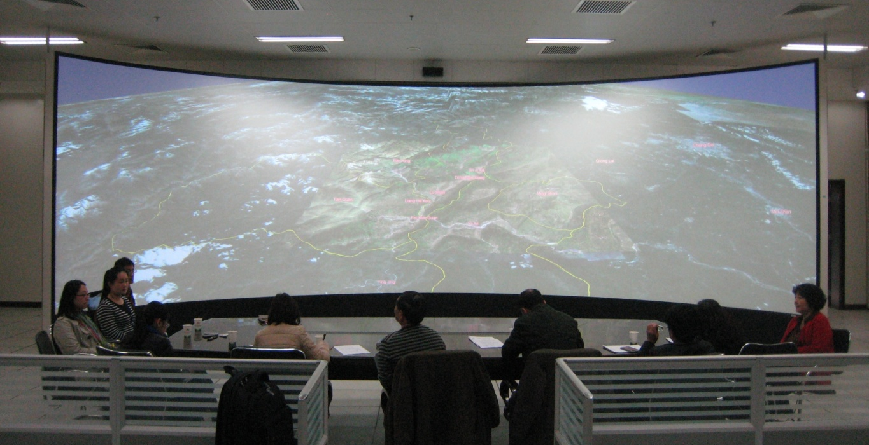
3.Application Case
The forefront rescuers were invited to ArcSer’s consultation center, and took part in EO data acquisition discussion with disaster experts and spatial technical engineers.
Most suitable data acquisition task plans were formulated to meet the urgent need for disaster rescue and relief .

Slide 19
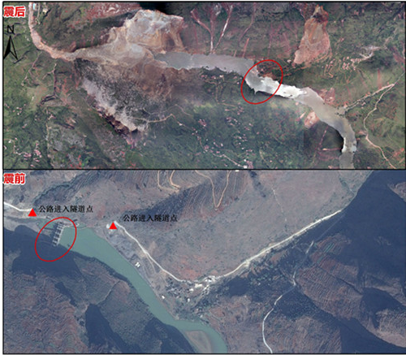
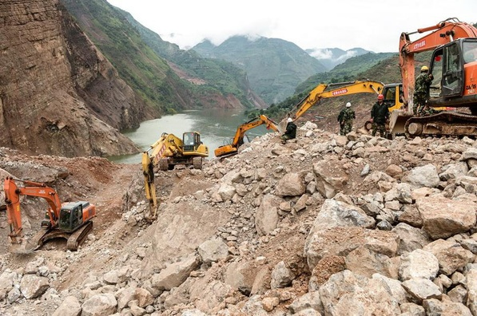
3.Application Case
The information extracted from EO data was sent to the front and used to guide disaster rescue and relief.
Quake lake information
in Ludian Earthquake
In-situ operation based on
decision supported by EO data

Slide 20
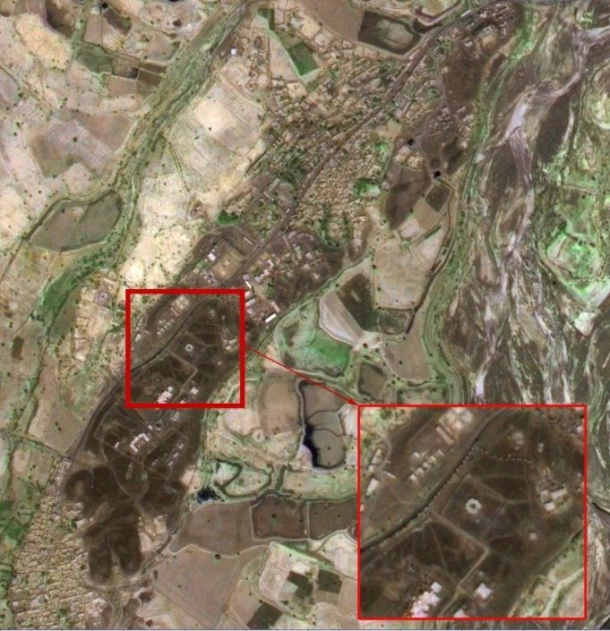
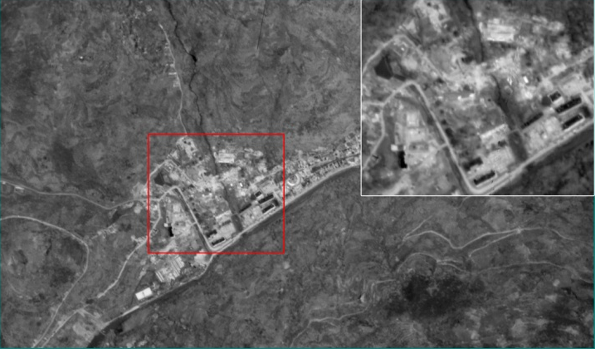
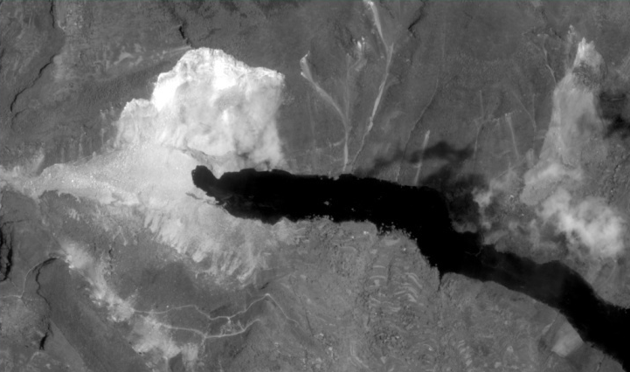
3.Application Case
In the process of emergency disaster relief work, ArcSer can also arrange KZ-1 Satellite to acquire high-time and high-spatial remote sensing image. KZ-1 Satellite has the capability of high-frequent revisiting specially for disaster reduction.
Fusion Image of KZ-1/ZY-02C in Pakistan Earthquake
KZ-1 Image of LuDian Earthquake
in LongTouShan Town
Aug 6th, 2014
KZ-1 image of LuDian Earthquake in HongShiYan Barrier Lake
2014-8-8
Sep 29th, 2013

Slide 21
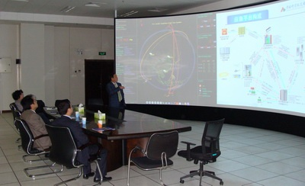
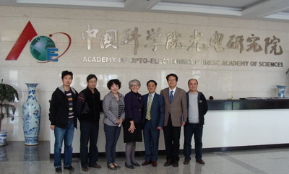
3.Application Case
Barbara J. Ryan, GEO secretariat director, visited AOE and surveyed ArcSer.
Prof. Li Chuanrong introduced ArcSer and its function in Ya’an earthquake to Ms. Barbara J. Ryan.

Slide 22
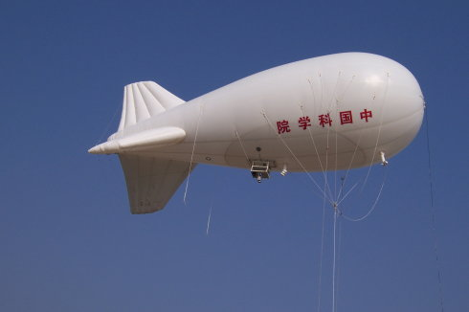

4. Future Development
balloon
Airship
Balloon
Use balloon and airship as remote sensing platform to enhance capalility of persistent monitoring of disaster area.
Use balloon and airship as communication relay platform to enhance capalility of persistent communication for disaster area.

Slide 23
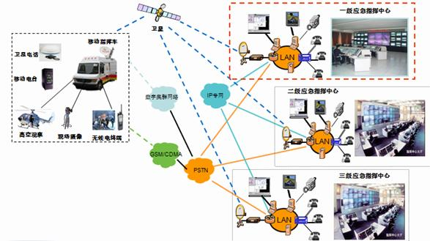

4. Future Development
Integrate various data transfer networks and establish reliable communication between disaster area and command center of emergency response.

Slide 24
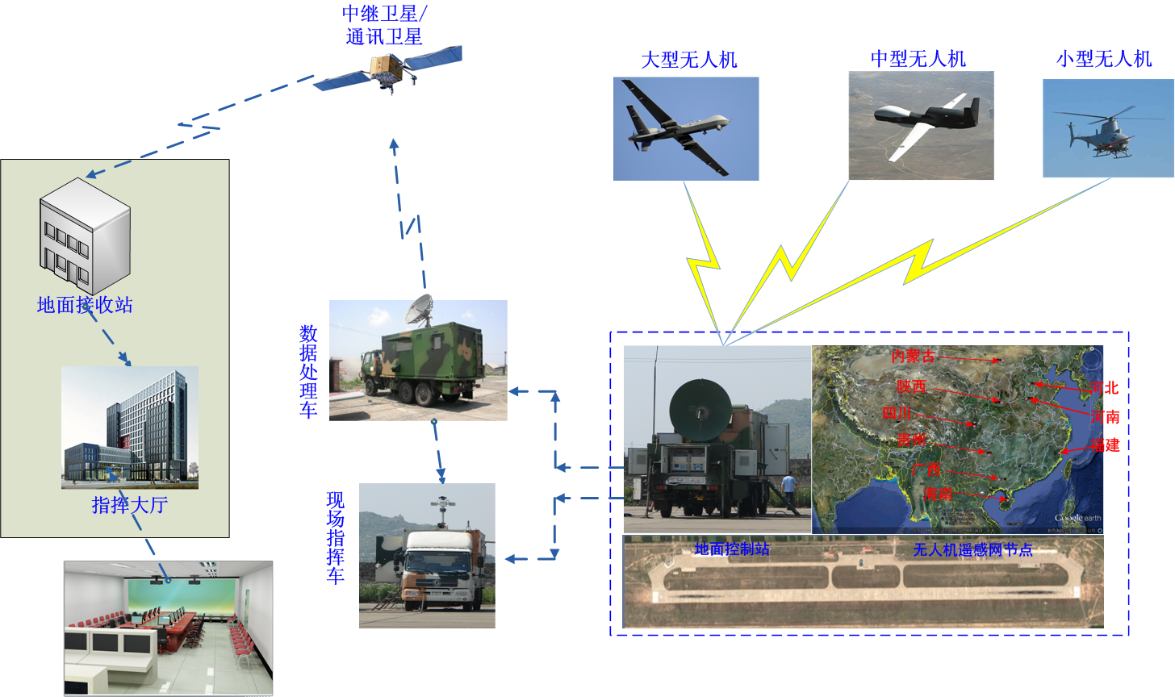
4. Future Development
UAV remote sensing network project led by AOE will provide technology support for optimizing UAV resources to further improve the emergency response capabilities.

Slide 25

Thank you !

