Slide 1
Proposal for a CEOS Pilot on Landslides
Status of development
Philippe Bally , ESA(philippe.bally@esa.int)
Gerald Bawden, NASA (gerald.w.bawden@nasa.gov)
Theodora Papadopoulou (tpapadopoulou@argans.co.uk) c/ESA ESRIN
WG Disasters, Frascati, 8-10 September

Slide 2
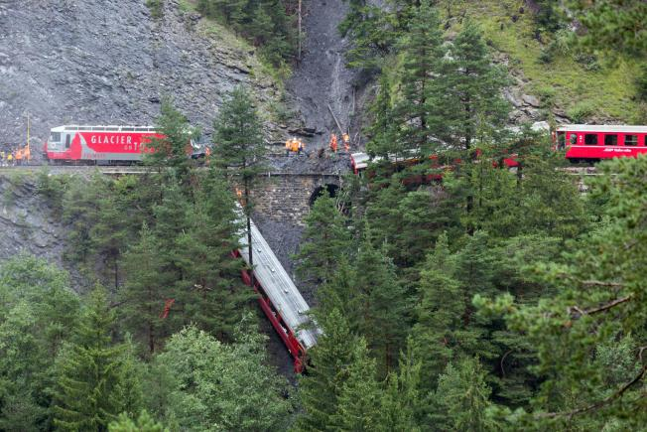
Overview
Objectives of User community
EO based value-added geo-information
Imaging requirements (EO sources relevant to the theme)
Possible contributors?
Discussion
Landslide-induced train derailment in Tiefencastel, Switzerland, 13 August 2014. Credit (AP Photo/Keystone, Arno Balzarini)

Slide 3
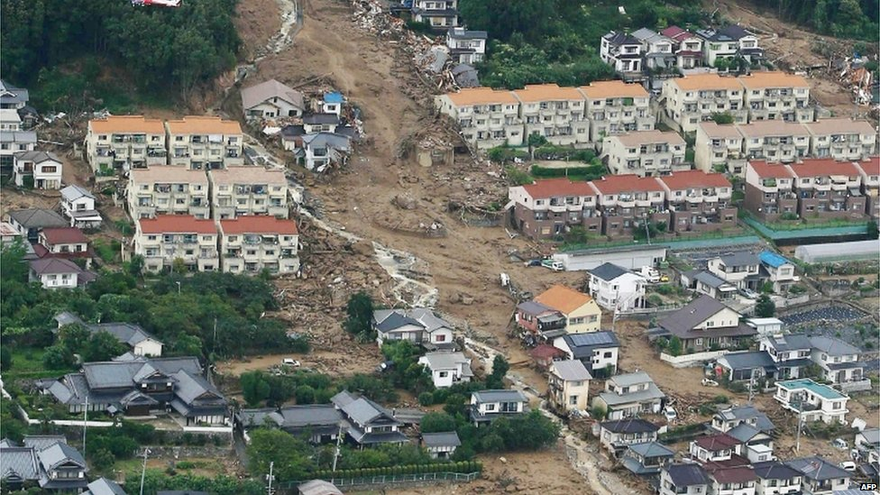
Why landslides?
Global hazard with poor hazard catalogue
Heavy rainfall, topography, tectonics, and human activity cause slope failures
EO offers unique tool to exhaustively catalogue and then monitor landslides
Major landslide near Hiroshima, Japan (72 deaths, 2 missing), August 2014. Credit: AFP

Slide 4


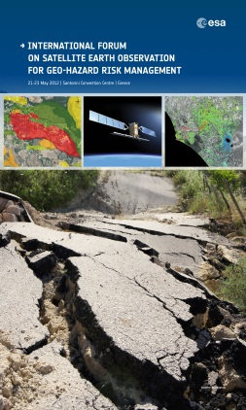
Objectives of the Landslides community
Defined through an open review process (the Santorini Conference):
Objective A:
Develop comprehensive EO-based inventories of known landslide hazard areas currently unmapped or insufficiently mapped to better understand the extent of the hazard (see Global Landslide Hazard Distribution).
Objective B:
Within priority areas above, monitor hotspots using regular satellite EO monitoring on a semestrial to monthly basis, using both optical and radar imagery and derived products.
Objective C:
Develop outreach programs, capacity building and demonstration projects with national authorities to increase use of EO and promote acceptance of EO as a standard.

Slide 5
Landslides Pilot – Identifying the users (1):
Who are the users
Landslides Pilot users can be:
  Scientists
  Civil Protection Authorities
  Organisations with a mandate in DRR
  Policy Makers & Planners
  Citizens
  Other end –users
Areas identified by preliminary contacts (national users, international organisations e.g. UNITAR, UN ESCAP, etc):
  Africa (Uganda, Burundi, Rwanda)
  Latin America (Central America/Caribbean)
  North America (USA, Canada)
  Europe (Italy, Spain, Swizerland, Greece)
  South Asia (Nepal, Bhutan)

Slide 6
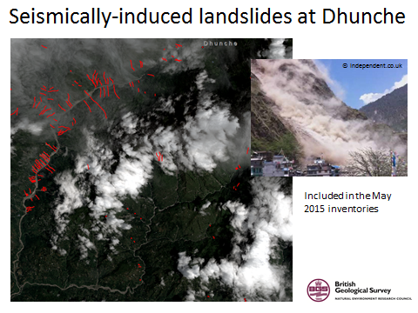
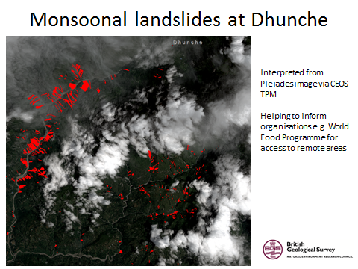
Recent example from the CEOS Seismic Pilot
2015 post-earthquake landslide mapping in Nepal by BGS

Slide 7
User Needs
Deferred time information:
  mapping and inventory of landslides,
  typology and kinematics,
  modeling and prediction,
  vulnerability assessment, and
  Modeling.
Near real time and real time information:
  mapping landslide events and their impact,
  definition of landslide triggers and related thresholds,
  location of safe areas for relocation of elements at risk,
  post-event motion assessment, and
  residual risk zonation.
Benefit: comprehensive monitoring of areas at risk; in many cases, warning of an impending event
Notes:
What practitioners and users need is both deferred time information (mapping and inventory of landslide, typology and kinematics, modeling and prediction, vulnerability assessment and modeling) alongside with near real time and real time information (mapping landslide events and their impact, definition of landslide triggers and related thresholds, location of safe areas for relocation of elements at risk, post-event motion assessment, residual risk zonation). This information allows for comprehensive monitoring of areas at risk and would in many cases offer some warning of an impending event.
CEOS DRM Consensus Report, 2012

Slide 8
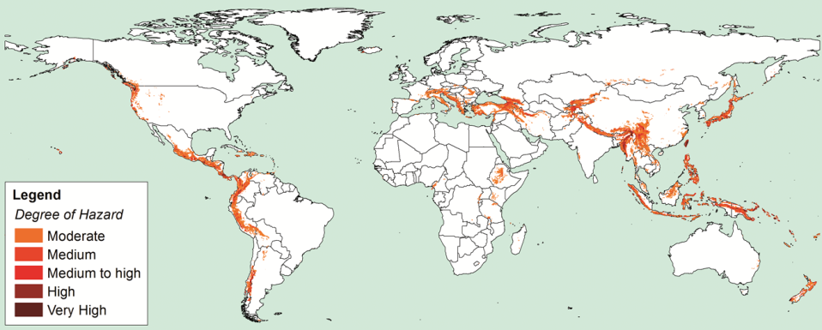
Long-term Landslide Priority Areas
Global Landslide Hazard Distribution, Nadim et al., 2006
Notes:
Map showing actively deforming regions worldwide taken from the GPS Global Strain Rate
Model v2.0 (http://gsrm2.unavco.org/). Deformation rate is defined in terms of the 2nd invariant of the
strain rate tensor, and is based on global GNSS measurements. Regions that are deforming above a
threshold rate of 10 nanostrains (10-8) per year are coloured dark red. A 200 km buffer (orange) is also
required to ensure data continuity and to constrain orbital uncertainties.
Develop comprehensive EO-based inventories of known landslide hazard areas currently unmapped or insufficiently mapped to better understand the extent of the hazard. This corresponds to more than 40% of the GDLND hazard global extent over the next ten years, with a priority focus on Philippines and Japan and in Central and South America along the Pacific Coast, as well as in south-eastern Asia, with medium to very high degree of hazard. For instance, in Europe, this concerns mainly Austria, Bulgaria, Romania, Serbia, Bosnia, Albania and Turkey. This represents an additional 25-30% of the European areas of interest.

Slide 9
Information Needs EO can address
Rapid mapping in response to landslide disasters to support relief actions (already provided through the International Charter).
Landslide inventories providing terrain deformation mapping over large areas e.g. entire watershed basins integrated into a pre-existing landslide inventory created using conventional geo-morphological tools.
Landslide monitoring providing terrain deformation mapping (hot spots) using up to date/continuous satellite observations.
Notes:
Information Needs (Landslide Hazards) and Ability of Satellite EO to address them
Rapid mapping in response to landslide disasters to support relief actions (International Charter).
This is a reactive service primarily based on redundant low earth orbit mission data, primarily optical used in combination to obtain rapid access to imagery to map the impact of a landslide event.
Landslide inventories providing terrain deformation mapping over large areas e.g. entire watershed basins integrated into a pre-existing landslide inventory created using conventional geo-morphological tools.
This is a historical mapping service primarily based on space-borne SAR (HR or VHR) using InSAR. It can be performed with limited in situ data.
Landslide monitoring providing terrain deformation mapping (hot spots) using up to date/continuous satellite observations.
This is a local level monitoring service with a temporal sampling typically in weeks (e.g. revisited cycle) focused on hotspots (e.g. most critical landslides). It also is InSAR based.
Alert/Early warning to support landslide alert.
The contribution of EO is primarily from meteorological missions as well as high resolution multispectral data to infer surface–subsurface water linkages for landslide activation early warning (identification of landslide producing agents or causal/triggering factors).
Asset mapping to support hazard and risk analysis with updated information concerning the elements at risk (infrastructures, population, crops, etc.).
Primarily concerns HR/VHR optical data to support asset mapping/modelling. Includes mapping/ cartography/DEM, land use/land cover monitoring (e.g. urban land use maps).
CEOS DRM Consensus Report, 2012

Slide 10
Imaging requirements 1 SAR
HR SAR:
(i) For landslide inventory and landslide hazard purposes: continuous observations descending and ascending repeat coverage (at least 2 images per month in interferometric mode), the focus is to extend and guarantee observations over mountainous and hilly terrain with priority areas defined in section 2. Narrow orbital tubes are required to get overall short spatial baselines and many pairs with very short spatial baselines. For Sentinel-1 all ascending and all descending orbits should be considered. Single (HH or VV) polarization would be sufficient.
VHR SAR:
For hazard inventory purposes: continuous observations descending and ascending repeat coverage (at least 2 images per month in interferometric mode). The demonstration that this is also possible with VHR SAR is given by the COSMO-SkyMed constellation which achieves over Italy full interferometric coverage with 16-day repeat intervals in both ascending and descending orbits.
For hazard monitoring purposes on hotspots (e.g.. most critical landslides): continuous observations over one selected area in all descending and ascending repeat orbits (e.g. TerraSAR-X every 11 days) means that no data are then available for areas outside of this swath.
Notes:
If possible (e.g. using COSMO-SkyMed constellation of 4 satellites) a full spatial coverage with continuous observations descending and ascending repeat coverage (at least 2 images per month in interferometric mode) is required. If this is not possible (e.g. TerraSAR-X) the requirement is to pre-select for both ascending and descending geometry a set of modes which achieve full spatial coverage over the landslide areas and then to acquire as much interferometric data in these modes as possible.
Typically terrain deformation services to support landslide risk assessment require data processed from archives. For areas where data from archives are not available, campaigns over at least a 6-12 month time window are necessary to assemble HR or VHR SAR data stacks.
Many areas of the world do not have a sufficient archive of data suitable for INSAR (same viewing mode, geometry and polarisation). For instance in Europe is services have been delivered over a portion of the territories of Europe, similarly over North America and in several areas of the rest of the world but overall many areas have not been covered. In Europe there is a need to provide EO-based information in those areas that were not investigated so far (for instance Austria, Bulgaria, Romania, Serbia, Bosnia, Albania and Turkey).

Slide 11
Imaging requirements 2 Optical
HR Optical/VHR Optical:
  For landslide inventory and landslide hazard purposes to provide background reference imagery: archive image (no more than 10-years old), panchromatic or true colour composite.
  For hazard inventory purposes (e.g. historical hazard mapping): VHR optical (no more than 1-year old), better than 5m resolution, panchromatic or true colour composite, stereo pair (max 1 year apart) useful for delineation;
  For hazard monitoring purposes (including early warning and response): repeat observations with HR and VHR optical sensors (panchromatic or multispectral, preferably with a resolution better than 5m).

Slide 12
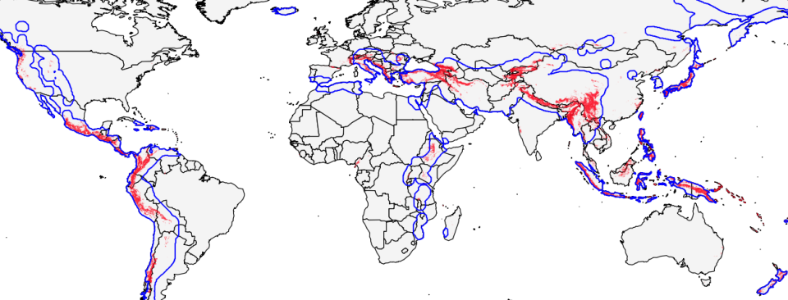
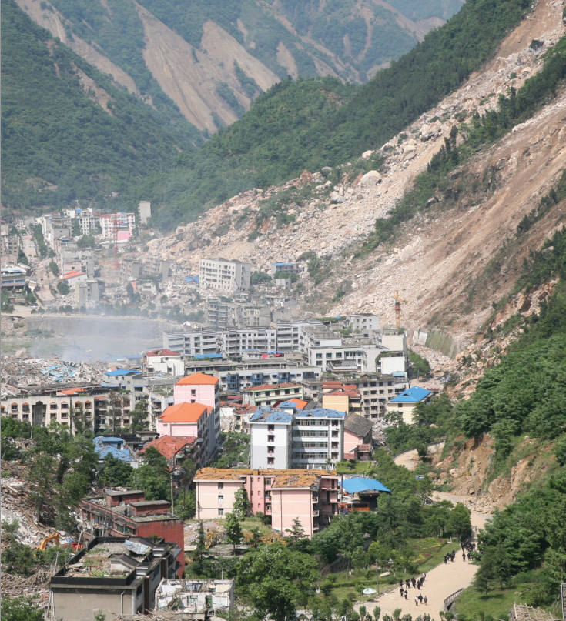
Landslide priorities and Seismic hazards
Priority areas (red): comparison with priority areas of CEOS Pilot on seismic hazards (blue)
Large overlap overall.
Identical observation requirements (e.g. concerning INSAR).
Notes:
Also six volcanoes in South America

Slide 13
Rationale for a CEOS Landslide Pilot
Several CEOS agencies (NASA, USGS, ESA, CSA, ASI) are or have been involved in various research projects (optical, radar and precipitation based methods).
Pooling satellite assets offers broader range of observations to support research.
Take advantage of newly available (e.g. Sentinel-1 and 2, ALOS-2) and planned EO missions (e.g. the NASA-ISRO Synthetic Aperture Radar, NISAR).
Has to take into account the challenges about data access and exploitation, the policy challenges at national, regional or institutional levels.

Slide 14
Possible options:
Integrating all landslide mapping activities under the Seismic Pilot and renaming it: “Geohazards Pilot (seismic hazards/landslides)”
Integrating landslide mapping in existing Pilots according to the type of hydrogeo-hazard causing them:
  under the Seismic Pilot for those landslides triggered by earthquakes, taking landslide mapping in
  under the flood pilot for those landslides triggered by hydro-met events
  what about the other types of landslides?
Creating a new pilot on Landslide mapping, adequately related to the other 3 pilots, given the multi-thematic nature of landslides

Slide 15
Back up slides
(CEOS meeting of Sep 2014)

Slide 16


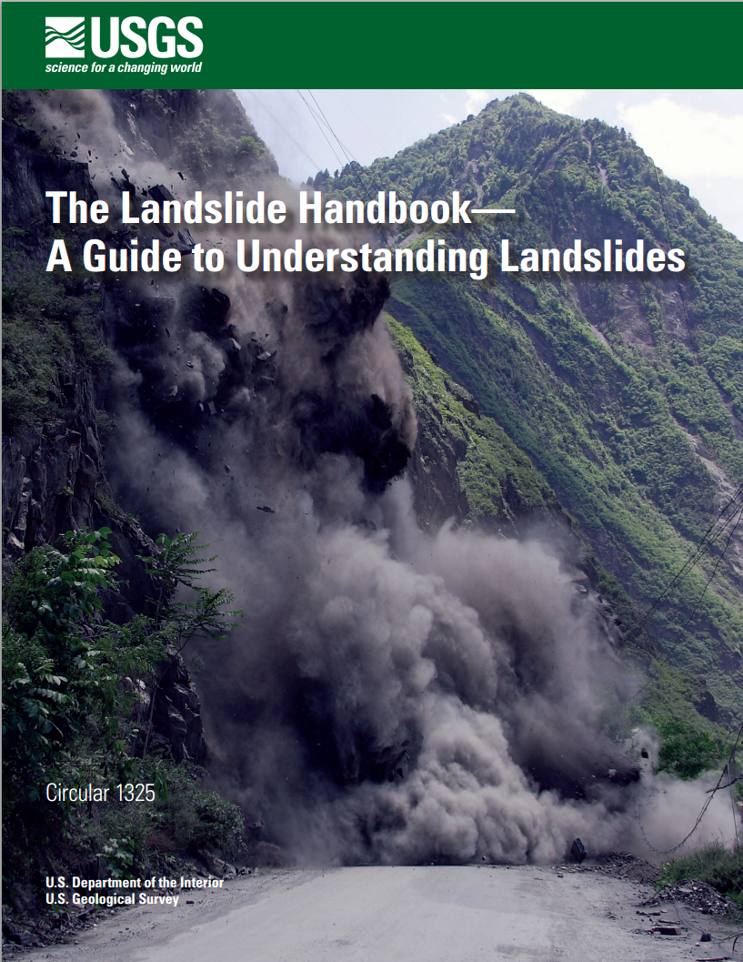
US Projects
USGS Landslides program:
Ambitious & comprehensive
national landslide monitoring
program
Role of EO described in the
Report of the International Forum
on satellite EO & Geohazards
(Santorini, 2012)

Slide 17
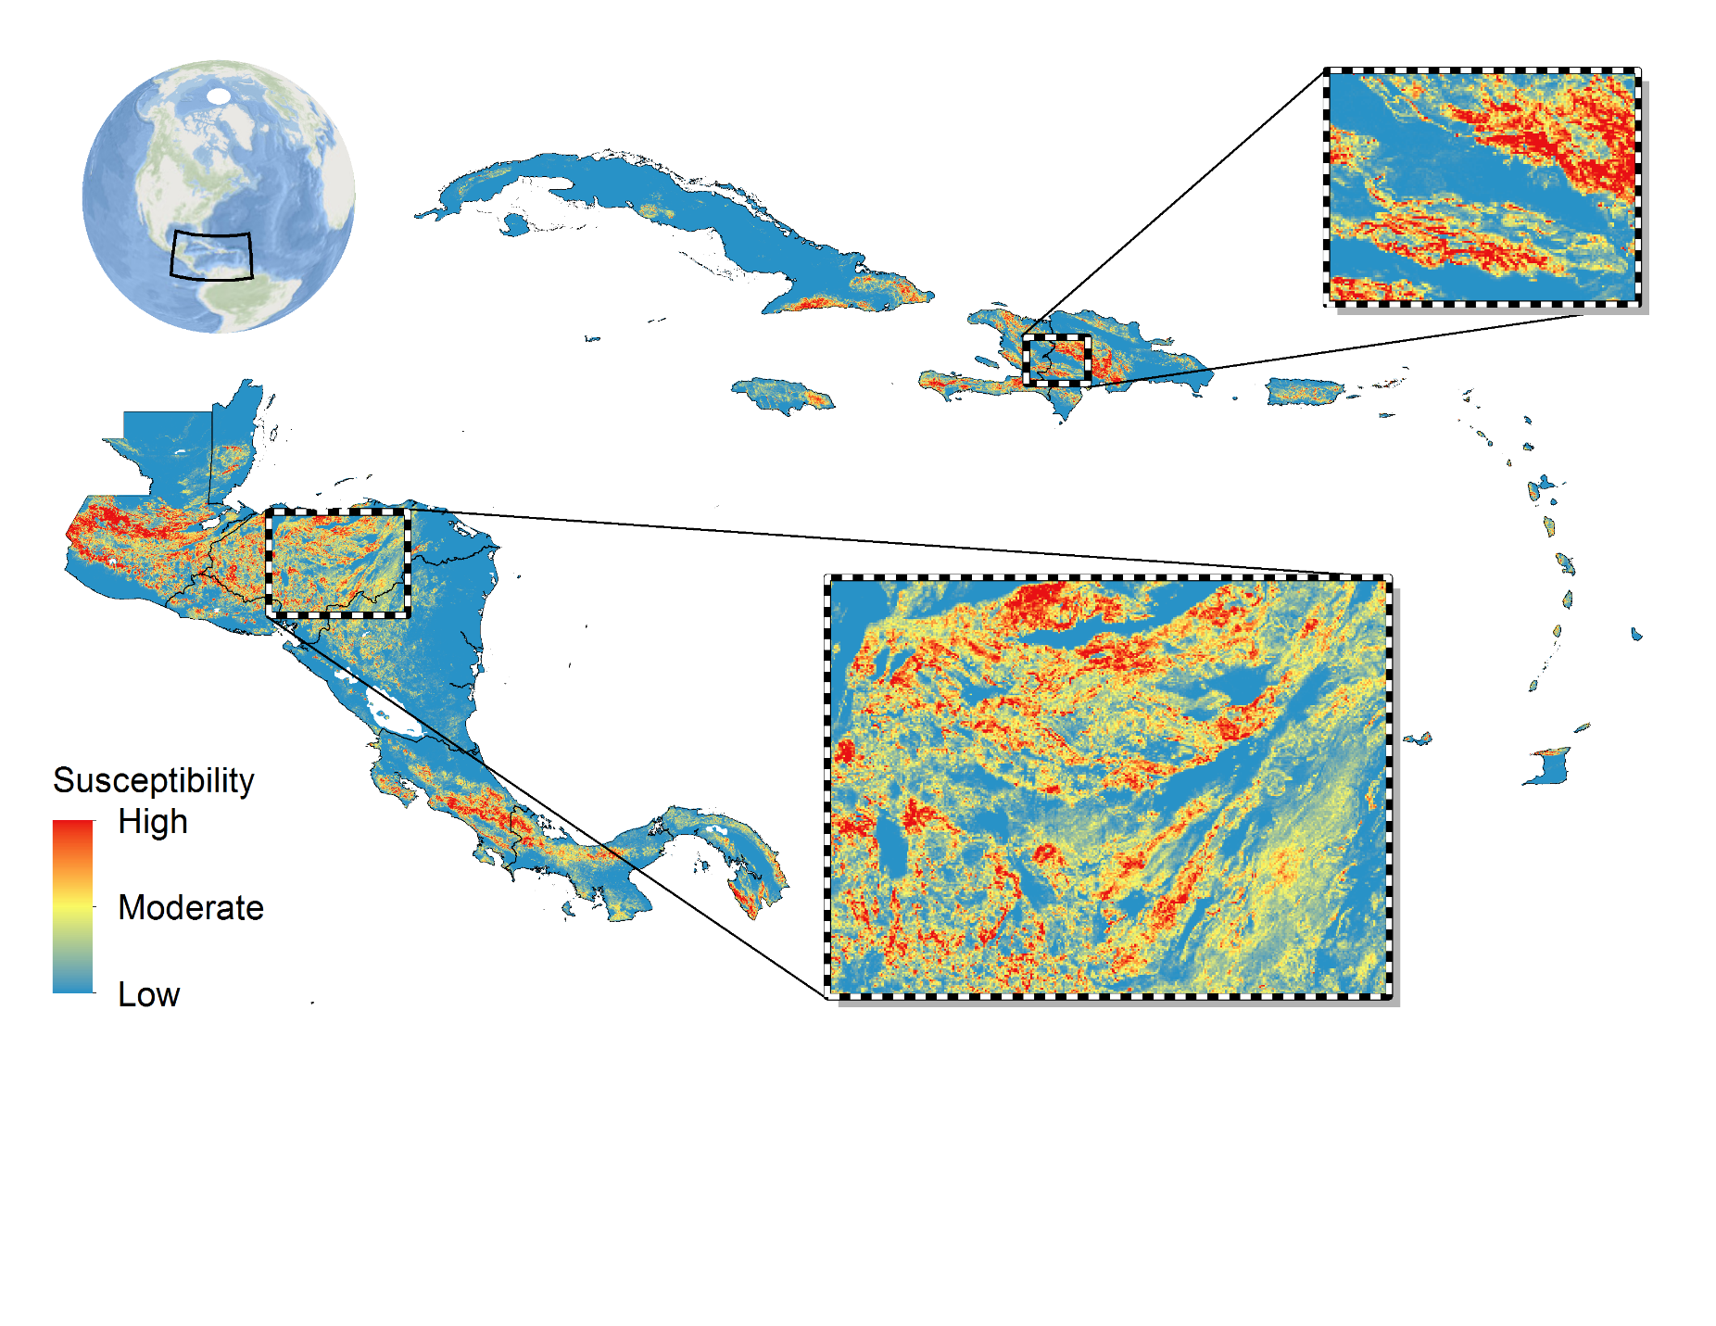
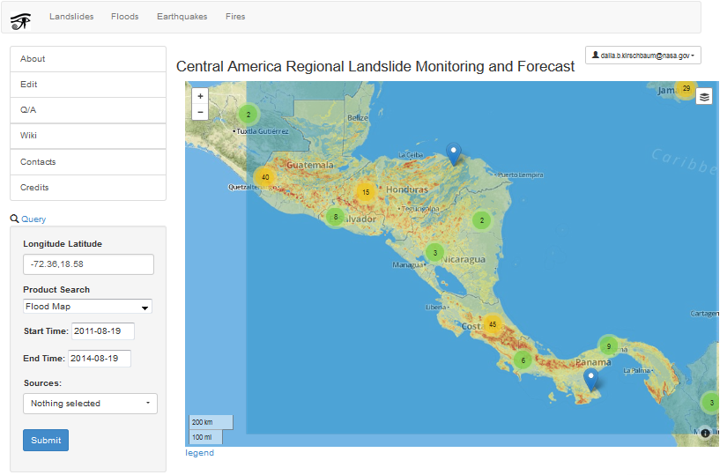
US Projects
SERVIR/NASA Landslide initiative in Central America
Searchable inventory, global landslide catalogue
EO-based landslide susceptibility map to support alerts

Slide 18
Potential Contributions 1
ESA:
ERS SAR and ENVISAT ASAR archive data (multi-year time series).
Sentinel-1 acquisitions: specific collections to gradually be made available ; The main access to S-1A is the circa 3 months rolling archive (https://senthub.esa.int) available to all users.
Access to the processing environment of the Geohazards Platform (as for the Pilot on seismic hazards).
EO based Landslide inventories over test areas in the Caribbean (Grenada, Saint Lucia) and the Himalayas (Bhutan, Nepal).

Slide 19
Potential Contributions 2
NASA:
Access to NASA satellite data
Access to NASA algorithms for decision tree landslide warning approach
Fused products using precipitation, radar and optical approaches
Access to landslide catalogue – to be linked to CEOS “Geohazards Portal”?

Slide 20
Other Possibilities
CNES:
Through the SPOT World Heritage programme, CNES is providing access for the science community to the 25-year SPOT archive. These data can be used for landslide scar mapping, and to determine areas of active landslides
OTHERS?:
Several other CEOS agencies with active landslide interests/projects are members of WG Disasters, including USGS, ASI and CSA

