Slide 1

Status of the GSNL initiative
Stefano Salvi
Chair of the Supersites Advisory Committee
CEOS WG Disasters, ESA-ESRIN, September 2015

Slide 2
Contents
Data status
Scientific product status
End-user issues
New Supersite evaluation procedure
Supersite proposals under preparation
Status and roadmap of the SEANLab
Supersite scope
Side issues

Slide 3
Data Status
Tungurahua and Cotopaxi volcano Supersite, Ecuador, have started to receive COSMO-SkyMed and TerraSAR X imagery
Taupo volcanic zone Supersite, New Zealand, has started to receive TerraSAR X imagery
Normal data flow for the other Permanent Supersites, 100s of images per year provided to PoCs.
EO data infrastructures improvements: after UNAVCO and DLR, now also the GEP is providing data access for COSMO-SkyMed.

Slide 4
Data Status: Nepal Event Supersite
Large data volumes provided to the Supersite (thank you !), mostly new acquisitions:
ASI provides full coverage of the area for several months after the quake, with a quota of 530 COSMO-SkyMed images.
DLR provides up to 50 TerraSAR X images.
CSA provides several Radarsat-2 co-seismic images.
Sentinel-1 data were also widely used by Supersite teams.
JAXA does not provide ALOS-2 data for GSNL, but ALOS-2 data were obtained through JAXA scientific projects and through the Seismic pilot (Obj. C).
Open access in situ data available, but not data from “private” network.

Slide 5
Data issues
For some Supersites the in situ data are still not easily accessible to scientists outside the core team
There are still too few requests to access EO data for scientists outside of Supersite core teams (for some Supersites)
Infrastructures for Supersite data sharing not yet fully in place:
For non freely available EO data only DLR is using a dedicated portal, however automatic remote download is not possible (need an action by DLR to verify with UNAVCO)
For in situ data, only Hawaii is distributing data (GPS and seismic) through web services. Other Supersites have different degrees of implementation (need action by SAC).

Slide 6
Product Status
New GSNL developments: ask scientists to provide their research results (products) in digital form on request. To do this:
We need a data policy
We need a licensing policy
We need a way to share these products (with the scientific community and with the end-users)
New developments still ongoing (see New Supersite evaluation procedures later on) but we experimented with the Nepal Supersite

Slide 7
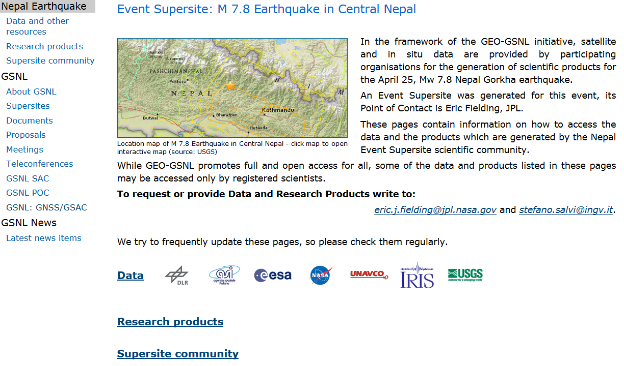
Nepal Supersite website -1
We used the GEO-GSNL website (not the old UNAVCO website) to disseminate research products (and other information)

Slide 8
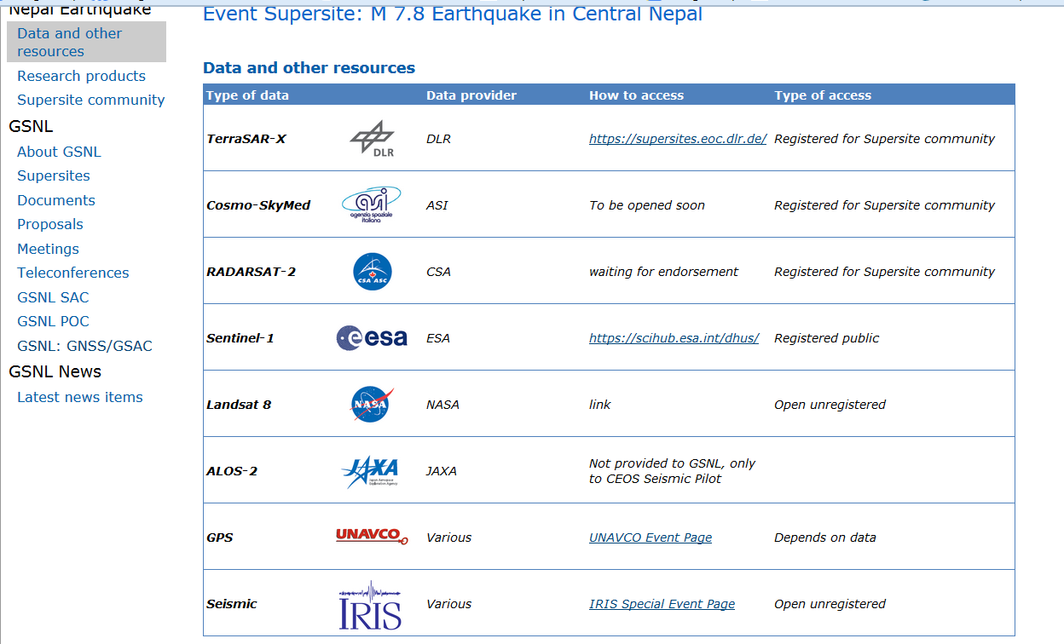
Nepal Supersite website -2
For the data we refer to the downloading platforms:

Slide 9
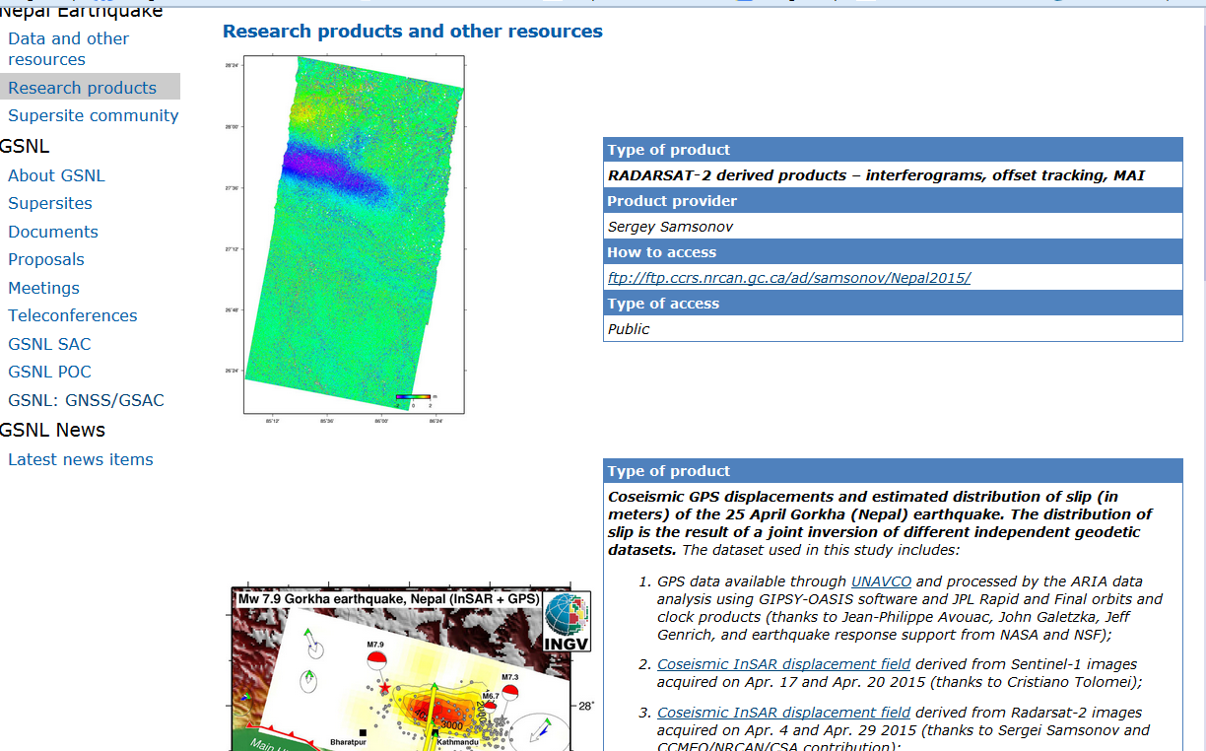
Nepal Supersite website -2
For the research products we provide ftp links or email addresses:

Slide 10
Product issues
As for data dissemination, product dissemination should be provided through existing infrastructures
USGS, UNAVCO, GEP, ARIA, EPOS look as possible solutions, and talks have started . In any case each Permanent/Event Supersite website will be the point of access to the product dissemination platform
Product dissemination should be standardised to have different platforms provide same metadata and formats (complex issue for products)

Slide 11
End-users issues
As requested by GEO, GSNL is moving towards a more direct capacity to provide societal benefits, this requires more direct involvement of local end users
To ensure that the scientific information generated in the Permanent Supersites is effectively used by DRM users for their Prevention activities, we need well organised communications and procedures:
Within the Supersite scientific community (to reach consensus on the information to give and its level of accuracy)
Between the Supersite scientific community and the national scientific agency supporting the Civil Protection (easy if this is part of the Supersite team)

Slide 12
End-users issues, continued
While in Permanent Supersites there is time to develop good communications, and use them for the emergencies in the same areas, for Event Supersites it is more difficult to reach the end users with usable information.
Short term approach (non optimal):
Use any existing relationships within the Supersite team,
Distribute scientific products through the Charter
Publish products on the website (with explanations)
Long term approach:
Identify for each country at risk the national PoC for Civil Defense and the agency(ies) providing scientific support to the CD.
Contact the latter and establish formal relationships before the emergencies.
Best if done within an international framework (GEO for instance)

Slide 13
New Supersite evaluation procedure
A new procedure has been drafted and has been shared with the CEOS DCT.
It should be approved by SAC by the end of September.
The new procedure contains several changes aiming in general to improve participation, data and knowledge dissemination, and uptake of scientific results by end-users (DRM users).

Slide 14
Permanent Supersite evaluation : main changes - 1
The PoC becomes a Coordinator (more responsibilities) and should be proactively promoting the use of the project results by the end user communities.
The Supersite Coordinator institution should support his/her activity to some extent
There should be evidence of existing or planned infrastructures /procedures for accessing a considerable amount of data
The participants should agree on a Supersite data policy for in situ data and products (based on GEO principles): stronger commitment
At the same time exceptions are possible to the open access in case of sensitive information during crises
Data access through web-services should be provided for all data and products

Slide 15
Permanent Supersite evaluation : main changes - 2
Scientists commit to provide science products in digital format with a CC BY NC license or similar
Evidence of long term sustainability of infrastructures for data dissemination should be given.
The team is open to collaborations with other supersites and other international initiatives to support the GSNL initiative.
There should be a good level of involvement of the local scientific and DRM end-user communities, which should appear in the proposal.
The proposal core team commits to support end-users' uptake of the science products (also by addressing their requirements)

Slide 16
Event Supersite evaluation : main changes
The science teams accept to share their research results in numerical format with other science teams and with risk managers and users.
The partners agree to define together a specific Supersite Data Policy respecting the spirit of GEO. Any limitation should be mentioned at the proposal stage.
Optional requirements:
In-situ data available for the event are provided to the scientific teams.
The proposal identifies some End-users interested to the scientific products generated by the teams.

Slide 17
Supersite proposals under preparation
San Andreas fault. Proposal submitted in 2013, to be amended, was never received, now it should follow the new scheme.
South East Asia Natural Laboratory. Discussed later.
Gulf of Corinth fault zone, Greece. Coordinator would be EPPO (scientific branch of Greek Civil Protection). To be submitted possibly at the end of September.
Straits of Messina, Italy. Coordinator would be Catania University or INGV. To be submitted possibly at the end of September.

Slide 18
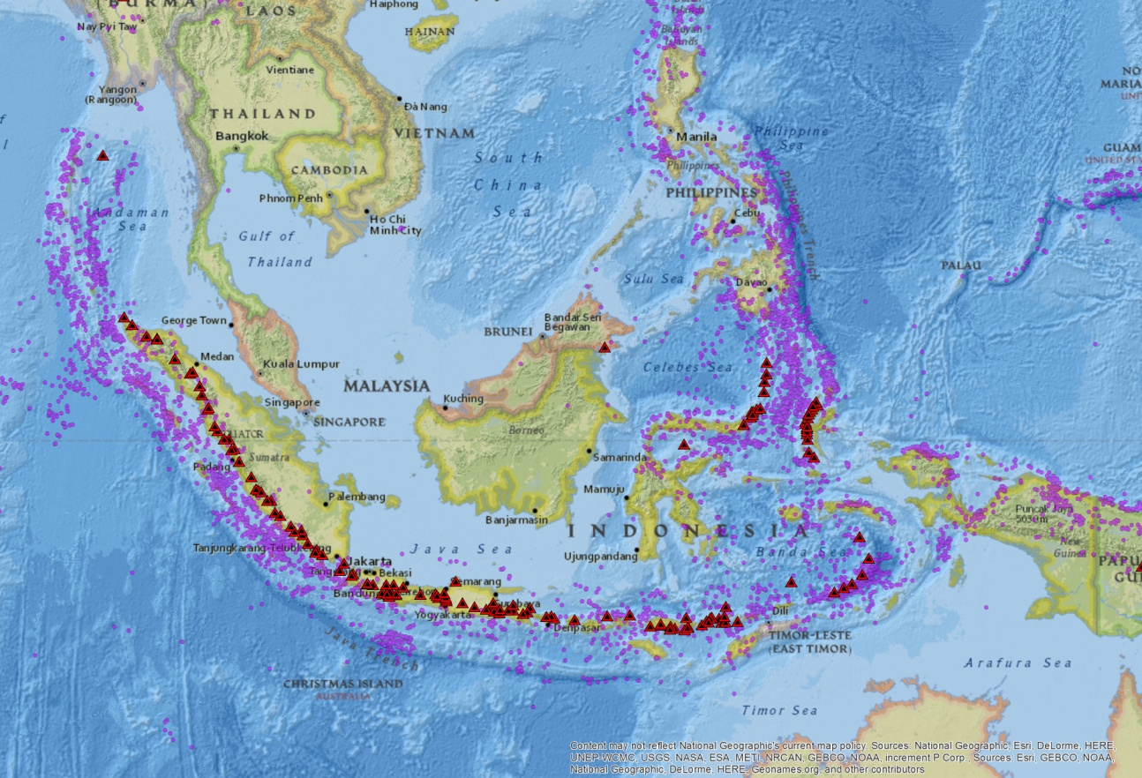
Status of South East Asia Natural Laboratory

Slide 19
SEanLab status and roadmap
The White Paper was revised to match also the outcome of an ad hoc meeting in Sendai.
Agreement obtained on the involvement of the reference local scientific agencies for Indonesia and Philippines: ITB, Badan Geologi, PHIVOLCS.
Phivolcs in particular requested that a data policy be agreed within the Supersite team
An initial proposal was circulated by F. Amelung in 2014. This will need to be revised to match the new criteria and will have to be submitted officially by the Indonesia and Philippine scientific teams to the SAC for approval.
Before proceeding further an initial assessment of the support from each agency would be appreciated.
Notes:
Krakatoa tsunami in 1883 killed 35 to 120k.

Slide 20
SEANLab: Objectives
Volcanic hazard:
Early detection of magma ascent to shallow levels.
Summit monitoring of volcanoes in unrest.
Monitoring of eruptions using SAR backscatter imagery
Assessment of post-eruption lahar hazards
Tectonics/Earthquakes
Imaging of earthquake deformation. Constraints of the source mechanism
Assessment of changes in earthquake hazard using stress change modelling after an earthquake
Estimating rate of strain accumulation along major fault systems

Slide 21
SEANLab EO data requests: SAR
Background acquisitions:
all possible SAR acquisitions of Sentinel-1, ALOS-2.
Targeted acquisitions:
high-spatial resolution SAR imagery (Spotlight mode) to resolve dome growth and summit instabilities of high-risk volcanoes.
Top priority: 11 volcanoes in Indonesia, 5 in the Philippines, 2 in Papua
Medium priority: 8 volcanoes in Indonesia, 5 in Papua
Low priority: 5 volcanoes in Indonesia, 1 in Papua
Active faults to monitor: 3 in Indonesia, 3 in the Philippines
Archived data:
SAR imagery of all previous missions are requested: JERS and ALOS-1, Radarsat-1, ERS1,2 and Envisat.

Slide 22
SEANLab EO data requests: Optical
Pleiades:
Top-priority volcanoes: 2 coverages/year.
Medium-priority volcanoes: 1 coverage/year.
Coverage is also requested after each significant eruption.
NASA Aster: 12 coverages/year to capture a baseline temperature profile through the seasons.
EO-1 Hyperion and ALI: 22 scenes per year should be archived.
Landsat-8 and AVHRR: All acquired scenes should be archived. During eruptions all possible imagery should be acquired.

Slide 23
SEANLab EO data requests: DEM
Tandem-X DEMs are requested for all the 245 volcanoes in the region (each 40*40 km2 centered on the volcano. Used for hazard assessment (forecasting of pyroclastic density currents) and for the InSAR processing.
The DEMs are requested for the mayor fault systems (100 km across) for fault mapping and InSAR processing for a total length of 2500 km, for the Sumatra fault, Palo Kolo fault, Soron Yapan fault, Philippines fault.

Slide 24
SEANLab: summary of EO data requests
Agency | Satellite | Sites | Images
SAR:
ESA | Sentinel-1a,b | All possible acquisitions (asc and desc)
JAXA | ALOS-2 | All possible acquisitions (asc and desc)
ASI | COSMO-SkyMed | 15 targets¹ | 1370 images/yr
DLR | TerraSAR-X | 7 targets² | 230 images/yr
CSA | Radardsat-2 | 19 targets³ | 285 images/yr
Optical:
CNES | Pleiades | 15 top, 20 med priority⁴ | 50 images/yr
NASA | EO-1 | 35 targets⁵ | 770 images/yr
NASA | ASTER | 35 targets⁴ | 420 images/yr
USGS | Landsat-8 | All possible acquisitions
DEMs:
DLR | Tandem-X | 265 volcanoes (each 400 km²), major fault systems (2500*100 km²)
Archived SAR:
ESA | ERS1,2,ENVISAT | Complete archive
JAXA | JERS-1, PALSAR | Complete archive
CSA | Radarsat-1 |  | 500 images
Archived Optical:
JAXA | ALOS-1 PRISM | Complete archive

Slide 25
SEANLab: In situ data available
Data from the 124-station InaCORS GPS network operated by the Indonesia Geospatial Agency (BIG), including stations of the German-Indonesian Tsunami Early Warning System (GITEWS).
The Sumatra GPS array (Sugar) is also open access.
Other geophysical observing systems for tectonics are on the trajectory towards more openness and accessibility.
Streaming of the seismic monitoring data into international data centers such as IRIS poses enormous technical challenges; the scientific value of online access to this data is unclear. Volcano information on the densely populated Java Island is very sensitive.

Slide 26
Supersite scope
Should Permanent Supersites last forever?
To increase societal benefits overall, would not be better to discontinue support when they have reached maturity, so as to be able to identify new areas which are in greater need of support?
Discussion started in the SAC on these fundamental questions
What is the opinion of the CEOS WGD and the DCT ?

Slide 27
Side issues
Request to JAXA to provide at least archived JERS imagery and ALOS-1 imagery at ESA openly accessible to all. To match what has been done for the Alaska SAR Facility ALOS-1 archive, which is now openly available after changes in JAXA data policies.
After the analysis of present status of InSAR coverage over the major urban areas of the world, https://sites.google.com/a/ingv.it/satellite-monitoring-of-geohazard-prone-megacities---satgeomeg/home, how to proceed to ensure these are constantly imaged with optimum coverages.

