Slide 1
Status Report on the Volcano Pilot
Mike Poland (USGS)
Simona Zoffoli (ASI)
WG Disasters #3
Tokyo, Japan
10-12 March, 2015

Slide 2
Overview
Pilot Partners
Overview by Objective
  Products generated
  User benefits
CEOS Data Commitments and Data Usage 2014
Achievements to date (2014)
Milestones 2015-2017
Linkages to other pilots
Issues

Slide 3
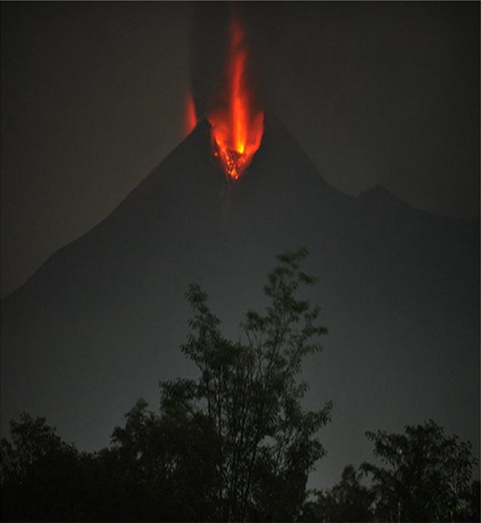
WHY?
Volcano Pilot
Over 300,000 people have been killed by volcanoes since the 1600s.
Hundreds of millions live within 20 km of an active volcano today.
In 2010, the Eyjafjallajökull eruption brought losses of $200m/day, and 100,000 cancelled flights.
Merapi, Indonesia, erupting in 2010. From Pallister and others, 2013

Slide 4
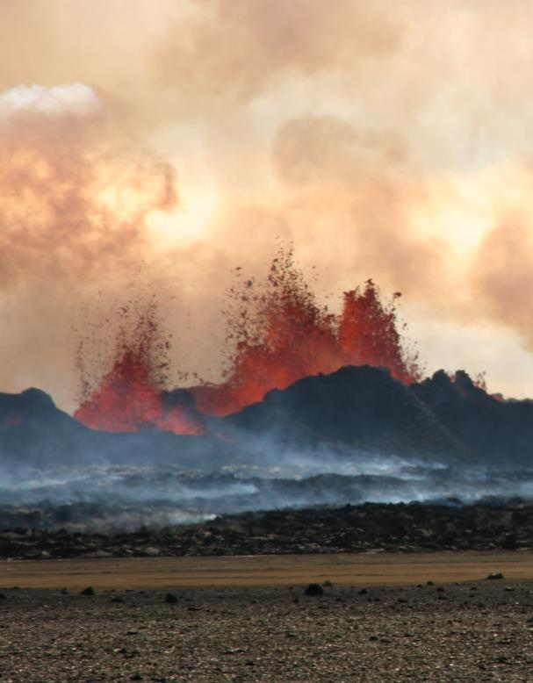
WHAT IS MISSING?
Volcano Pilot
Only ~10% of the ~1500 active volcanoes in the world are being monitored in some way
Current EO data collection is not coordinated for volcano monitoring
Need systematic observations before, during, and after volcanic events
Bardarbunga, Iceland, erupting in 2014.
Photo credit: M Parks

Slide 5
Participants in the Pilot
CEOS partners:
USGS, ASI, CNES, CSA, DLR, ESA, NASA, NOAA, JAXA
Other partners:
University of Bristol (UK), Cornell University (US), University of Iceland, British Geological Survey, Italian National Research Council (IREA –CNR), the Open University (UK), Volcano Observatories (several with confirmed interest in Latin America), VAACs (Buenos Aires and Washington), VDAP, Civil Protection Agencies.
Research Consortia:
IAVCEI, STREVA (University of Bristol), Global Volcano Model (BGS), WOVO, VHUB, COMET+(University of Leeds), ALVO

Slide 6
Objectives of the Pilot
Objective A – Regional Demonstration
Demonstrate the feasibility of global volcano monitoring of Holocene volcanoes by undertaking regional monitoring of volcanic arcs in Latin America, stretching from Mexico to southern Chile, and including the Lesser Antilles, using satellite EO data to track deformation as well as gas, ash, and thermal emissions.
Objective B – Geohazard Supersites and Natural Laboratories
Multi-disciplinary, multi-platform monitoring of a few volcanoes that represent a diverse cross section of eruptive activity and unrest.
Objective C – Significant Global Event
Specific studies in case of a major eruption with significant regional or global impact, providing data for a comprehensive analysis of all aspects of the eruption cycle, including local (e.g., mass flows on the volcanic slopes), regional (e.g., ash emissions that may be hazardous to aircrafts), and global (e.g., volatile and aerosol emissions that may influence climate) impacts.

Slide 7
Pilot Outcomes by Partner
Objective | Outcome | Value Added Partner
A | Identification of volcanoes that are in a state of unrest in Latin America in Central America and Northern Andes | Bristol
A | Identification of volcanoes that are in a state of unrest in Central and Southern Andes | Cornell
A | Identification of volcanoes that are in a state of unrest in the Galapagos | IREA/CNR
A | Validation of EO-based methodology for improved monitoring of surface deformation | All
A | Capacity-building and training activities in countries that do not currently have access to abundant EO data and/or the ability to process and interpret such data | Bristol
A | Collect feedbacks form users | All
ALL | Global observation EO strategy for volcanoes | All

Slide 8
Pilot Outcomes by Partner
Objective | Outcome | Value Added Partner
B | Interferograms and models of earthquake and magmatic deformation on Supersites | USGS/University of Iceland/INGV
C | Thermal monitoring of November-December 2014 eruption of Pico do Fogo, Cape Verde | Open University
C | Response to major eruptive event | All

Slide 9
Data Commitments and Usage in 2014
Obj | Mission | Data Received/Allocated | Products developed
A | RADARSAT-2 | 100/100 SOAR-Geohazard project 5297 Data on : Tungurahua, Cotopaxi, Reventador (Ecuador), and Cordón Caulle (Chile ). A quota extension (100 products) has been asked to CSA for 2015. | Interferograms and models
A | COSMO-SkyMed | 222/600 (up to 3/03/2015) Data on: Masaya (Nicaragua), Cordon Caulle (Chile),Soufriere Hills (Montserrat), Chiles-Cerro Negro (Ecuador/Colombia), Llaima (Chile), Villarica (Chile), Hudson (Chile), Fuego (Guatemala), Turrialba, (Costa Rica) Cerro Blanco (Argentina) | Interferograms and models
A | TSX | 10/400 | Interferograms and models
C | Pleiades | 3/50 Data on Fogo, Cape Verde
C | EO-1 ALI | 5 | Effusion rate estimates
C | Landsat -8 OLI | 2 | Effusion rate estimates
Notes:
Radarsat-2 at 4 volcanoes: Tungurahua, Cotopaxi, Reventador (all in Ecuador), and Cordón
Caulle, Chile . The Radarsat-2 data have been very valuable and revealed new ground
deformation. Preliminary processing has been performed on all the data, and the results shared
with the global CEOS DRM Pilot Project and relevant monitoring agencies: Instituto Geofisico,
Escuela Politechnia Nacional (IG-EPN) in Ecuador and SERNAGEOMIN-OVDAS in Chile.

Slide 10
Achievements 2014
Objective A – Regional Demonstration
Wrote 3 successful (separate) proposals for SAR data access to DLR, ASI, and CSA. Data are now being received from each of these space agencies. These data are being used to achieve the goals of objective A (regional monitoring of volcanic arcs in Latin America).
Processed new and archived SAR data and documented previously unpublished ground deformation at several volcanoes in Latin America, including Llaima (Chile), Cordón Caulle (Chile), Planchón-Peteroa (Argentina/Chile), Tungarahua (Ecuador), and Reventador (Ecuador).
Results were communicated to CEOS, space agencies, volcano observatories in Colombia, Ecuador, Chile and Peru, and at scientific conferences.

Slide 11
User Communities:
Instituto Geofisico, Escuela Politechnia Nacional (IG-EPN), Ecuador
Servicio Geologico Colombiano, Colombia
SERNAGEOMIN-OVDAS (Observatorio Volcanológico de los Andes del Sur), Chile
Observatorio Vulcanologico del Sur, Instituto Geofisico del Perù (OVS-IGP), Perù

Slide 12
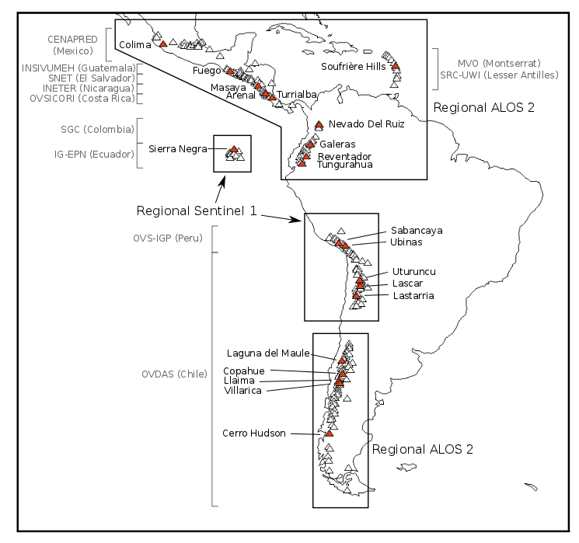
Pilot Region: Latin America
Notes:
Triangles are all volcanoes in Latin America. Red triangles are target volcanoes from the CEOS pilot plan. Black boxes and text show regions for planned quarterly monitoring with C-Band (Sentinel-1) and L-Band (ALOS 2) InSAR. Grey text shows the local end users (monitoring agency).

Slide 13
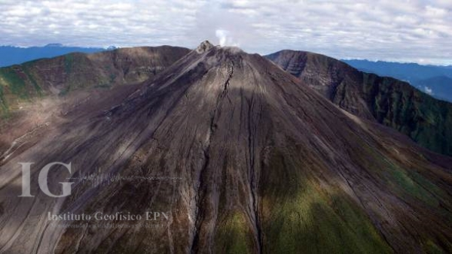
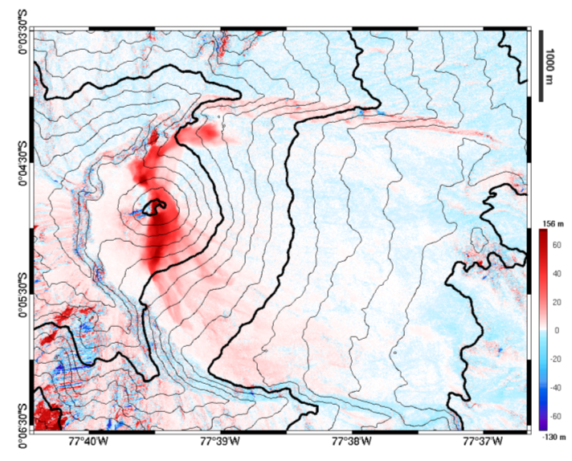
Reventador, Ecuador
Reventador had its largest historical eruption in 2002 and the eruption is still ongoing
CEOS RADARSAT-2 data processed by the University of Bristol has shown the extent and thickness of new lava flows between 2011 and 2014
Work builds on previous collaborative work between Bristol and the Instituto Geofisico (Ecuador) using archive ALOS data
Arnold, Bristol
Topographic change at Reventador Sept. 2011 – June 2014

Slide 14
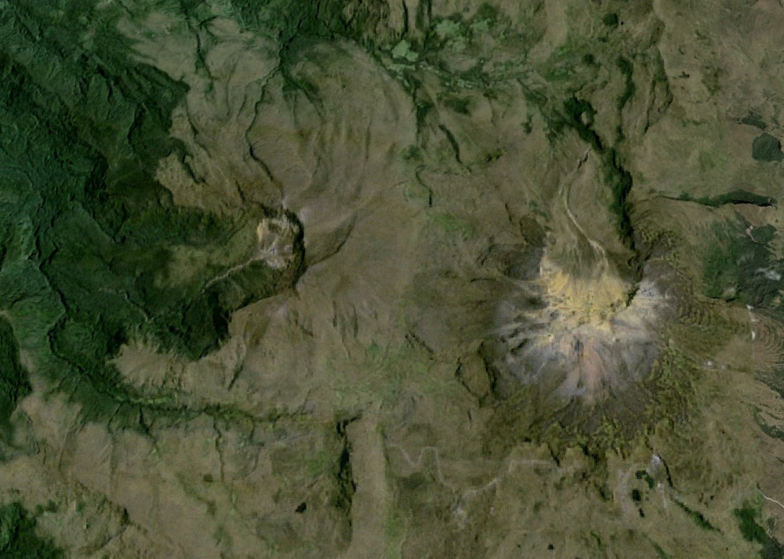
Unrest at Chiles-Cerro Negro de Mayasquer,
Ecuador-Colombian border

Slide 15
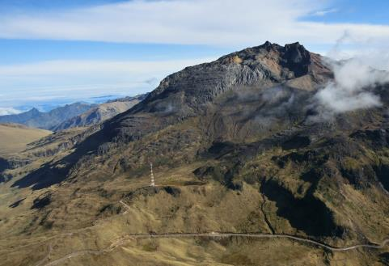
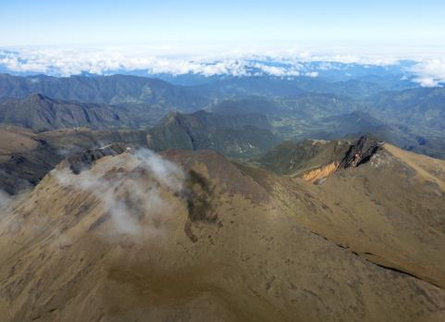
Chiles-Cerro Negro de Mayasquer
Unrest at Chiles-Cerro Negro Volcano
Chiles- Cerro Negro are volcanoes on the Ecuador-Colombian border, with no historical activity
Since September 2014 there have been thousands of small earthquakes every day – but no changes at the surface.
As there have been no historical eruptions, ground based monitoring is limited:
-> satellite data are critical
Chiles
Cerro-Negro
photos: Instituto Geofisico, Ecuador

Slide 16
Chiles-Cerro Negro de Mayasquer
Evolving unrest at Chiles-Cerro Negro:
larger earthquake swarm in Feb 2014
~10,000 small VT type events in March 2014
~1000 similar events per day to May 2014; rapid increase in Oct.
- 5.6 Mw EQ, (thrust) on 20th Oct; 22nd Oct, 7,700 events in 1 day.
Neither Chiles or Cerro Negro have erupted for a long time; USGS believes either could produce a very large eruption
Civil Defense in Colombia ordered the evacuation of 12,000 people.

Slide 17


Chiles-Cerro Negro de Mayasquer
Scientists at the University of Bristol have processed and analysed CosmoSkyMed and TerraSAR imagery provided by the CEOS Volcano DRM Pilot and shared with Volcano Observatories Instituto Geofisico (Ecuador) and Servicio (Colombia)
CEOS
data
Ebmeier, Bristol
Ebmeier, Bristol
TSX, 14th -29th Oct 2014
CSK, 24th May -27th Oct 2014
CEOS data have been used to find fault geometries and constrain location of magmatic intrusion
regular processing of CSK and TSX data since October 2014 to help volcano observatories

Slide 18
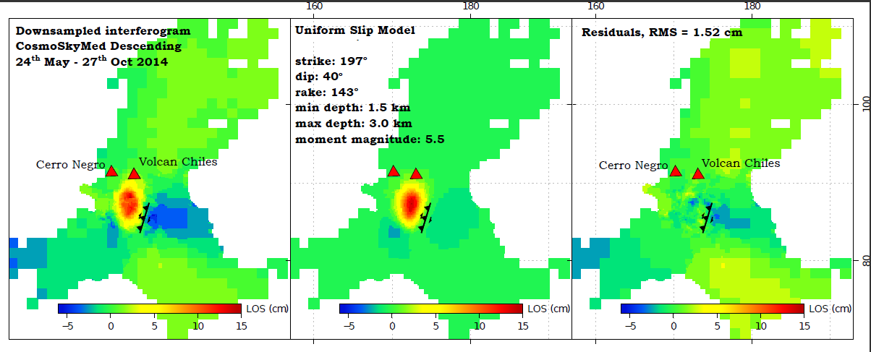
Chiles-Cerro Negro de Mayasquer
Deformation Best-fit fault plane solution Residuals
The deformation detected using InSAR has so far been primarily associated with a larger (M5.6w) earthquake on the 22nd October 2014. This earthquake result in maximum displacements of 15 cm towards the satellite in a region SW of Chiles volcano.
The majority of deformation can be explained by oblique slip on a fault at depths ~1.5-3 km dipping WNW. The orientation of this fault aligns well with faults mapped from regional topographic structures.

Slide 19
Chiles-Cerro Negro de Mayasquer
We have been talking about the Chiles unrest with Patty Mothes (IG-EPN – Ecuador) and Lourdes Medina (SRC-Colombia) since 2013.
At their request, we ordered TerraSAR-X acquisitions in 2013 and May 2014. Acquisitions were restarted in October 2014
All interferograms and model results have been sent to IG-EPN and SRC mailing list as quickly as possible. This includes several members of USGS/VDAP.
SE (Bristol) spent a month in Ecuador last November working with scientists at Instituto Geofisico. CEOS data were presented at their weekly meeting to discuss hazard at Chiles and incorporated into hazard assessments where considered useful.
We are now processing both CSK and TSX imagery in Bristol, acquired through CEOS Volcano Pilot / Supersite

Slide 20
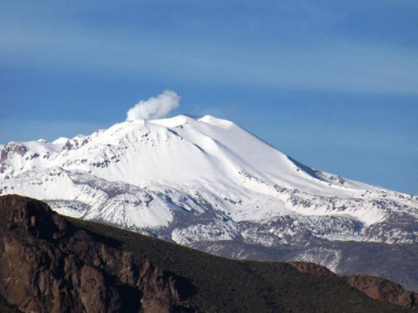
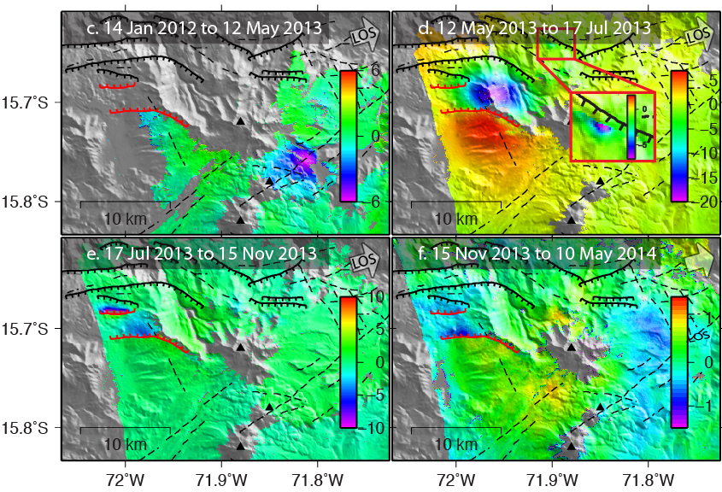

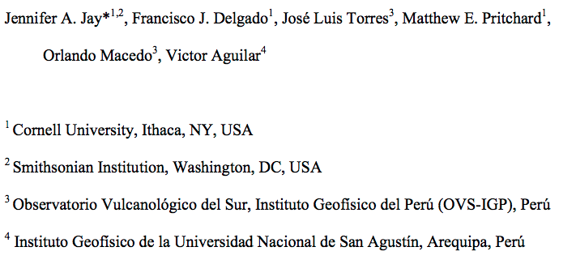
Sabancaya volcano, Perú
Unrest started in Feb. 2013
Complex sequence of mainly tectonic earthquakes
Culminated (so far) in small
August 2014 eruptions.
Remote sensing
(thermal & InSAR) sent to
end users: submitted paper

Slide 21
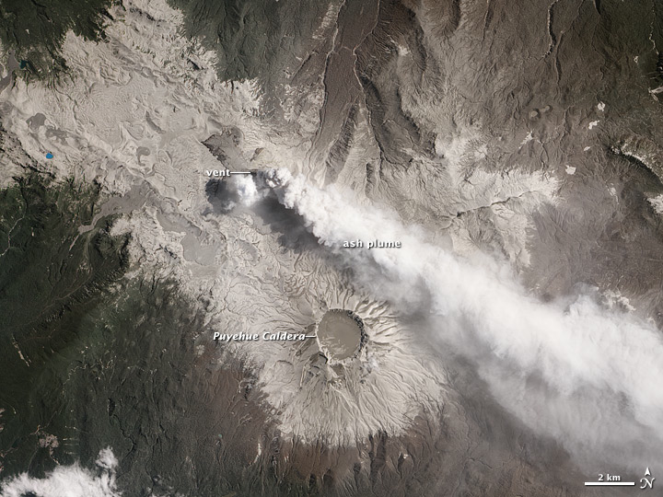
Cordon Caulle volcano, Chile
Volcano with three rhyo-dacite eruptions in the last century (total volume erupted ~2 km³)
Large plinian eruption in 2011-2012 produced widespread damage and disrupted air travel.
Limited in situ monitoring.

Slide 22
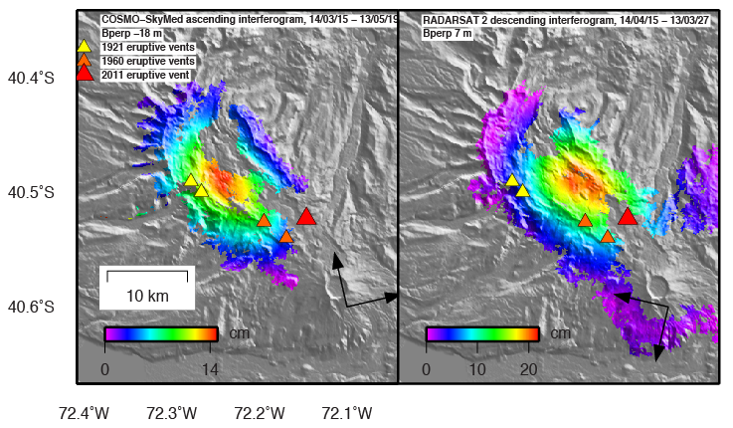
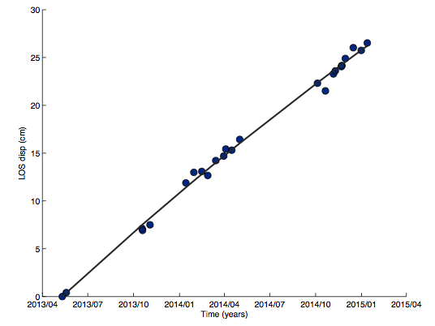
Cordon Caulle volcano, Chile
CEOS RADARSAT-2 and COSMO-SkyMed SAR data processed by Cornell University has discovered widespread volcano inflation (~20 cm/yr) ongoing until mid January 2015.
No increase in seismicity above background.
Met in person with OVDAS (Observatorio Volcanológico de los Andes del Sur, Chile) in Jan. 2015. Results led them to deploy GPS stations during March 2015.

Slide 23
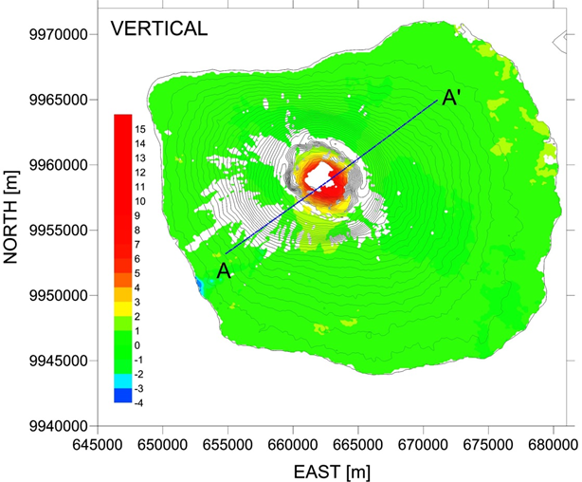
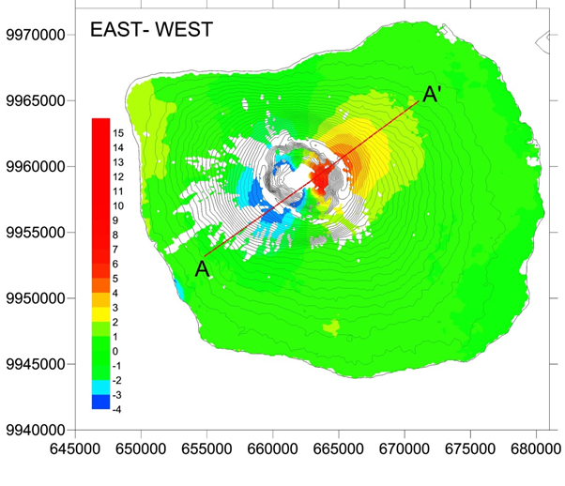
Fernandina, Galapagos
Vertical and East-West Velocity Components at Fernandina Volcano

Slide 24
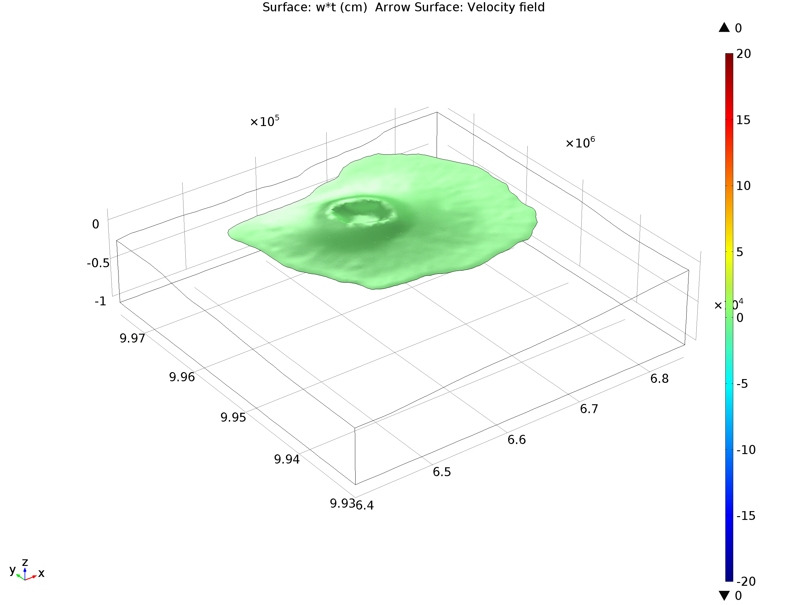
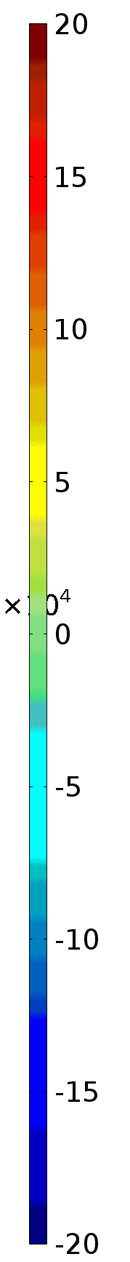
Fernandina, Galapagos
Deformation field model at Fernandina Volcano between
2012-2013
Depth [km]
Displacement [cm]
North [m]
East [m]

Slide 25
Achievements 2014
Objective B – Geohazard Supersites and Natural Laboratories
Produced numerous interferograms in support of research efforts associated with Supersites in Hawaii and Iceland and related models.
Started to provide data to Etna, Campi Flegreii Vesuvio and Marmara Supersites.
Activated new supersites:
  Tungurahua and Cotopaxi in Ecuador (*)
  Taupo Volcanic Zone (New Zealand)

Slide 26

Kilauea, Hawaii
Available Data
Satellite SAR
ENVISAT (756 scenes)
RADARSAT-1 (500)
ALOS-1 (414)
TerraSAR-X (188)
COSMO-SkyMed (426)
RADARSAT-2 (268)
Ground and airborne
GPS
Seismic
Gravity
Gas emissions
Geologic mapping
UAVSAR

Slide 27
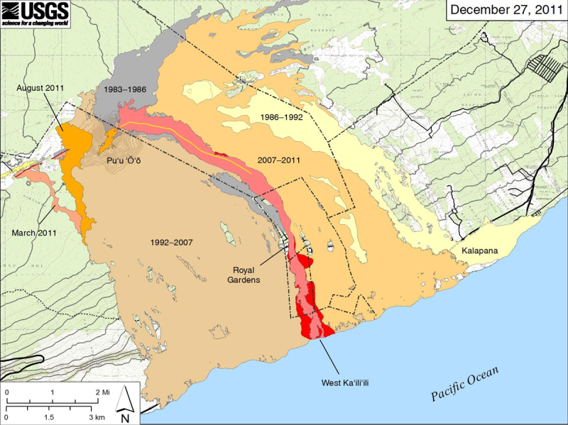
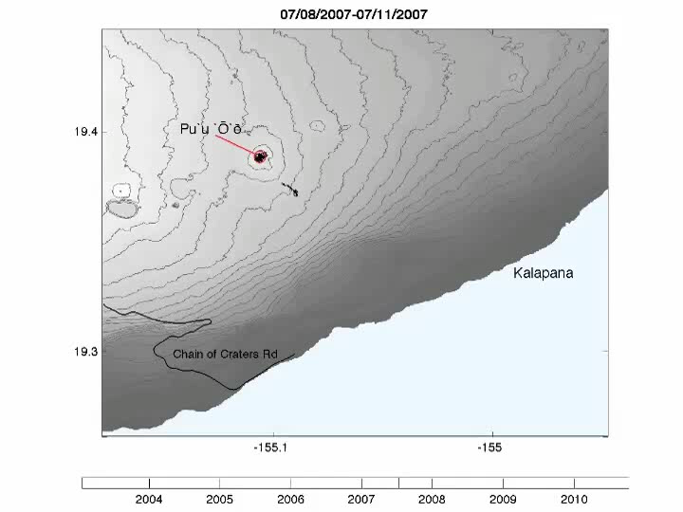

Kilauea, Hawaii
Mapping lava flows
Coherence from multiple satellites and look angles can be combined to develop a temporally dense time series of lava flow activity.
Dietterich et al., 2012

Slide 28
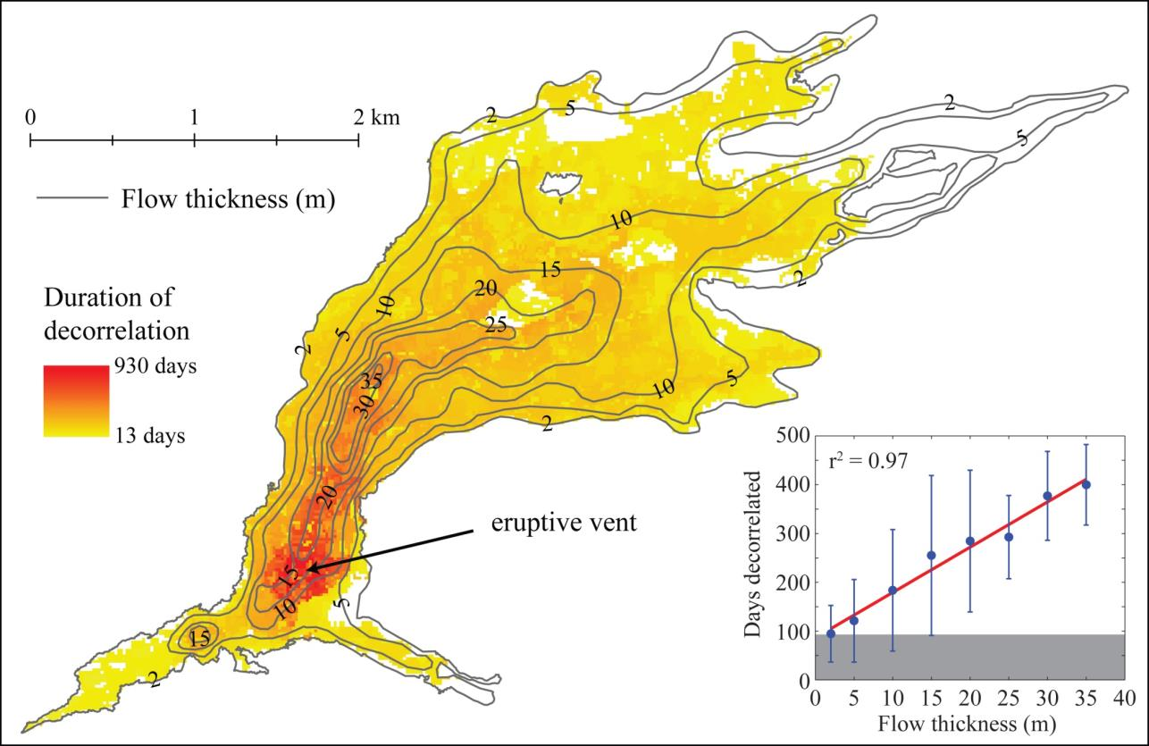
Kilauea, Hawaii
Data from ENVISAT
Lava flow thickness from InSAR coherence
Dietterich et al., 2012

Slide 29
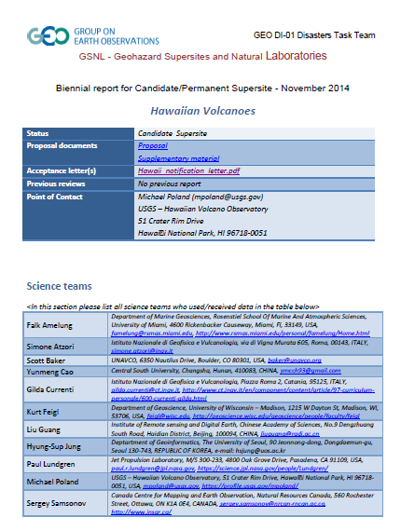
Kilauea, Hawaii
Moro info on

Slide 30
Bárðarbunga, Iceland
Recent unrest and activity at the Bárðarbunga volcano, was initially identified by the onset of an intense earthquake swarm on the 16th August 2014 and displacement on several continuous GPS sites
As part of CEOS Icelandic Supersite Initiative, the Italian Space Agency (ASI) re-tasked CSK satellites in July 2014 at the request of staff at the University of Iceland to commence acquiring both ascending and descending images every 16 days over Bárðarbunga volcano and also over Askja volcano extending south to the tip of the Vatnajökull ice cap
TSX images were also being acquired in the vicinity of Askja volcano and the northern edge of the Vatnajökull glacier and delivered under the German Space Agency (DLR) Icelandic Supersite User Agreement
On the 29th August 2014, a small fissure opened up at Holuhraun. The eruption lasted only a few hours, but was followed on 31st August by the onset of a fissure eruption
New article: Sigmundsson et al., 2014. Segmented lateral dyke growth in a rifting event at Bárðarbunga volcanic system, Iceland, Nature, doi:10.1038/nature14111

Slide 31
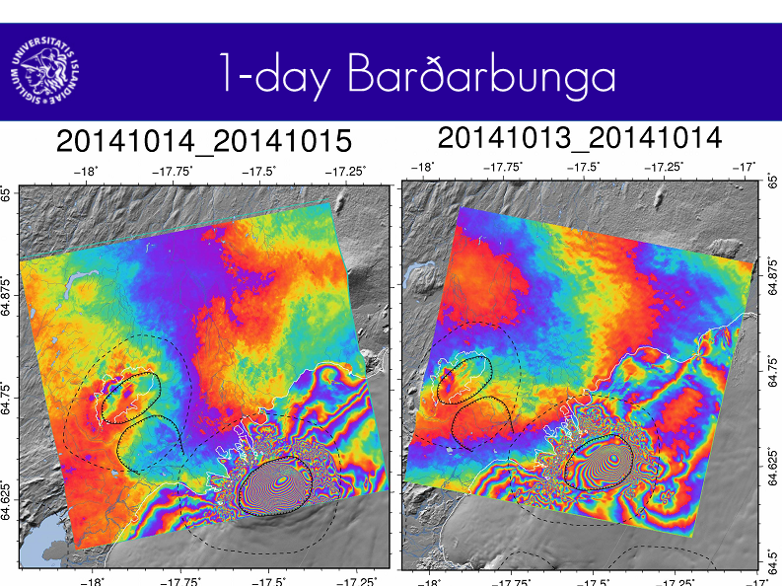
Processing carried out using CSK Products, © ASI (Italian Space Agency) 2014, delivered under an ASI licence to use. COSMO-SkyMed (CSK) data were provided by the Italian Space Agency (ASI) through the Icelandic Volcanoes Supersite project supported by the Committee on Earth Observing Satellites (CEOS) and Geohazard Supersites & Natural Laboratories (GSNL).

Slide 32
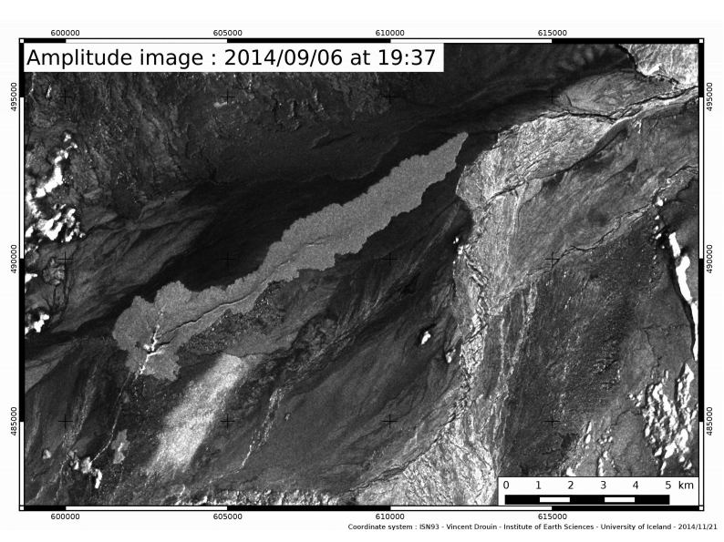

Mapping the extent of the 2014 Holuhraun lava flows
CSK Products, © ASI (Italian Space Agency) 2014, delivered under an ASI licence to use. COSMO-SkyMed (CSK) data were provided by the Italian Space Agency (ASI) through the Icelandic Volcanoes Supersite project supported by the Committee on Earth Observing Satellites (CEOS) and Geohazard Supersites & Natural Laboratories (GSNL).

Slide 33
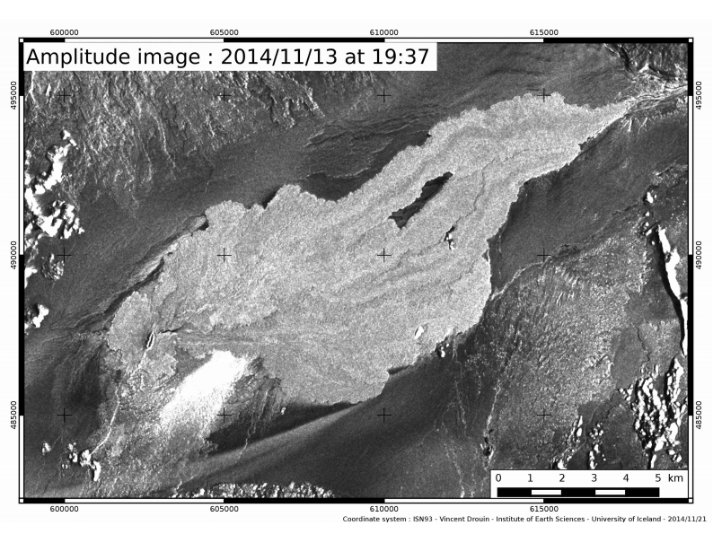
Mapping the extent of the 2014 Holuhraun lava flows
CSK Products, © ASI (Italian Space Agency) 2014, delivered under an ASI licence to use. COSMO-SkyMed (CSK) data were provided by the Italian Space Agency (ASI) through the Icelandic Volcanoes Supersite project supported by the Committee on Earth Observing Satellites (CEOS) and Geohazard Supersites & Natural Laboratories (GSNL).

Slide 34
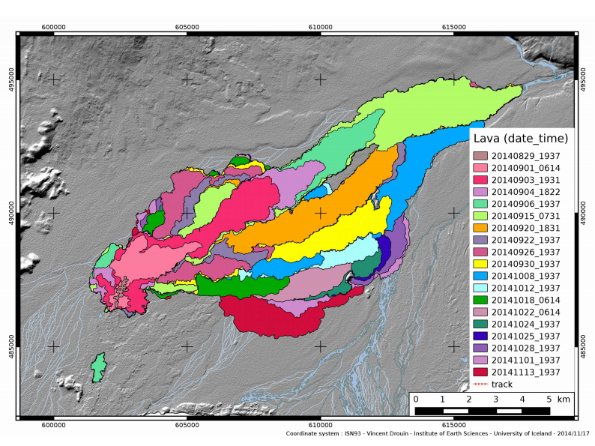
Mapping the extent of the 2014 Holuhraun lava flows
CSK Products, © ASI (Italian Space Agency) 2014, delivered under an ASI licence to use. COSMO-SkyMed (CSK) data were provided by the Italian Space Agency (ASI) through the Icelandic Volcanoes Supersite project supported by the Committee on Earth Observing Satellites (CEOS) and Geohazard Supersites & Natural Laboratories (GSNL).

Slide 35
Achievements 2014
Objective C – Significant Global Event
No eruption meeting our criteria has occurred, so we continue to wait for a suitable event.
However, the potential application of this objective was demonstrated in the remote sensing response to the 2014-2015 eruption of Pico do Fogo, Cape Verde.
  During that eruption, a large quantity of thermal satellite data were analyzed and used to construct a time series of lava effusion rate, one of the most critical volcano monitoring parameters in terms of potential hazard (Open University)
  Thanks to the CEOS Volcano pilot coordination, NASA (S. Frye) arranged 9 EO-1 acquisitions and CNES (S. Hosford) provided 3 Pleiades data acquired in two dates.
  Results were communicated to on-site monitoring agencies for use in hazards assessment and mitigation activities.

Slide 36
Fogo, Cape Verde, 2014
Eruption on the western flank of Pico volcano in the island of Fogo (Cape Verde), started on November 23. It gave rise to a 3-branch lava flow, that destroyed 2 villages and left about 1000 homeless among ca 37000 inhabitants of Fogo.
Upon request of INMG (National Institute of Meteorology and Geophysics), remote sensing and modelling support have been provided (reports provided on November 26, November 28, December 11, December 19, 2014 , and January 4, 2015).
Overall about 2.800 images were processed in 36 days during which:
  instant effusion rate were analyzed in light of the largest possible distance to run, leading us to conclude that flow propagation outside the collapse scar was unlikely after November 30
  the analysis of accumulated erupted volumes allowed forerunning by a few days every following phase of declining effusion rate and lava invasion risk

Slide 37
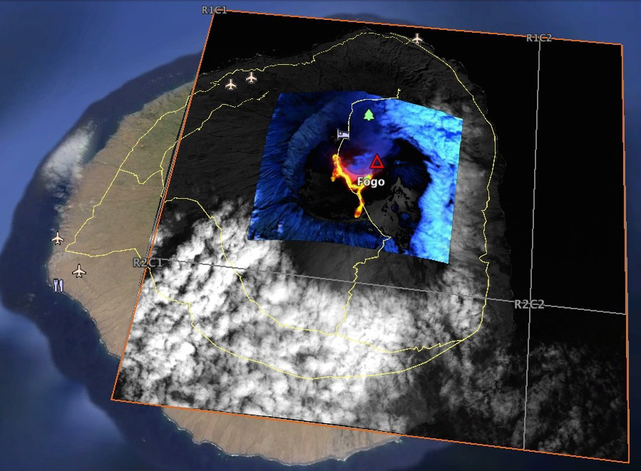
Fogo, Cape Verde, 2014
Footprint of Pleiades‐1A (P1A, large polygon) and resize of the Landsat--‐8 (OLI) and EO--‐1 (ALI) images exploited for detection monitoring and thematic mapping.
The Landsat--‐8 image of November 24 is shown in the inset.

Slide 38
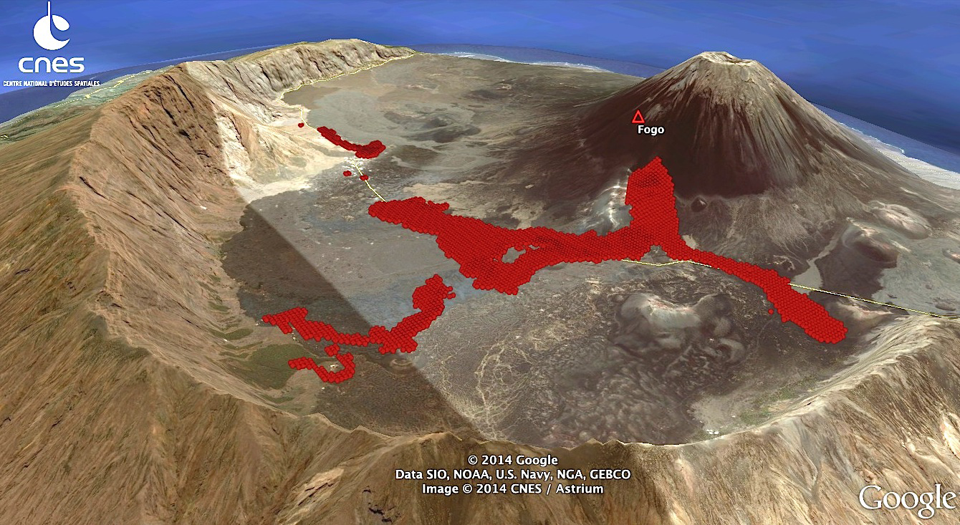
Fogo, Cape Verde, 2014
3D view of the stack of Hot-­‐Spot pixels returning nonzero radiant flux values in the series of multispectral SWIR-­NIR high-­resolution images (1 Landsat-­8 OLI and 5 EO‐1 ALI) acquired between November 24 and December 29,2014.
Notes:
"discontinuitá" nei bracci a Nord e a Ovest significa semplicemente che - a causa di nuvole o di spaziatura temporale delle immagini - quando le colate sono state osservate quei pixels non presentavano temperature che permettessero mobilitá delle lave (diciamo>1000* C) quindi calcolo di un tasso di effusione individuale

Slide 39
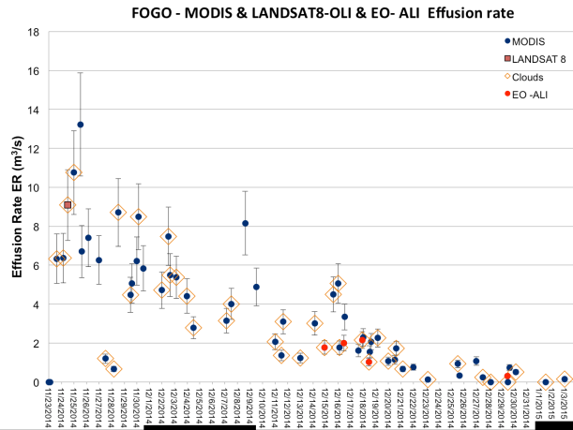
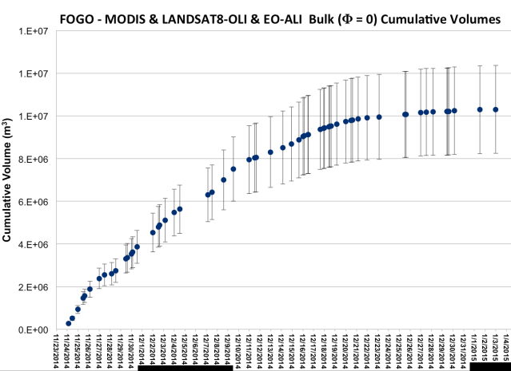
Fogo, Cape Verde, 2014
Effusion rate series from Terra/Aqua MODIS (November 23, 2014 to January 3, 2015), Landsat-­8 OLI and EO-­1 ALI.
Data point to sharp decline of the eruption after Dec. 16, with the last 2014’s ALI image on December 29th returning instant effusion rates as low as <1 m³/s (flow nearly stopped). Negligible change in the overall figure accompanied the ending phase of the eruption (February 8, 2015)
Estimate of lava volumes erupted during the 2014 eruption of Fogo, based on radiant flux‐derived effusion rates computed on 62 Terra/Aqua MODIS, 2 Landsat 8‐OLI and 5 EO1-ALI. Assuming nil porosity, the total volume (dashed line) was ~10.3*106 m3 ±20% on 31/12. As “radiant” volume estimates are exposed to eventual spoiling of Hot Spots by clouds, this figure should be considered an approximated value by default.

Slide 40
User Communities
“The effusion rate inverted from radiance flux satellite data was crucial to us (INMG) to advise the National Civil Protection authorities on what extension of lava flow should be expected. It gave us also a very important information for modelling the lava flow, mainly when the Eastern flank of the Fogo Islands , where there are several villages, was under the threat of lavas”
Bruno Faria (INMG)

Slide 41
Publications / obj A
Utility of regional satellite volcano deformation monitoring in Latin America: The CEOS pilot project. Delgado, Francisco; Pritchard, Matthew E.; Arnold, David; Biggs, Juliet; Fall Meeting of the American Geophysical Union, 2014, abstract V41C-4830.
Volcano Monitoring on a Regional Scale: Results from the CEOS DRM Volcano Pilot. Arnold, David; Biggs, Juliet; Delgado, Francisco; Pritchard, Matthew E.; Ebmeier, Susanna K., FRINGE workshop, Frascati, Italy, March 2015.
Fernandina Volcano (Galápagos) ground deformation modeling via multi-orbits DInSAR data. De Novellis V.; Pepe S., Castaldo R.; De Luca C.; Casu F.; Tizzani P.; Sansosti E., FRINGE workshop, Frascati, Italy, March 2015.
Reducing Vulnerability from Latin American Volcanoes Through Enhanced Monitoring Efforts. Biggs, J.; Delgado, F.; Arnold, D.; Ebmeier, S.; Pritchard, M., International Symposium on the Remote Sensing of the Environment ISRSE36-278, Berlin, May 2015.

Slide 42
Publications / obj B
A large number of publications and conference presentations have utilized GSNL-provided data; a comprehensive list is available in the status reports for individual Supersites. Highlights include:
Pinel, V., Poland, M.P. and Hooper, A., 2014, Volcanology: Lessons learned from synthetic aperture radar imagery. Journal of Volcanology and Geothermal Research, 289, 81-113, doi:10.1016/j.jvolgeores.2014.10.010.
Sigmundsson, F., et al., 2014, Segmented lateral dyke growth in a rifting event at Bardarbunga volcanic system, Iceland. Nature, 517(7533), 191-195, doi:10.1038/nature14111.
Chen, J., Zebker, H.A., Segall, P. and Miklius, A., 2014. The 2010 slow slip event and secular motion at Kilauea, Hawai`I inferred from TerraSAR-X InSAR data. Journal of Geophysical Research, 119(8): 6667–6683, doi:10.1002/2014JB011156.
Lundgren, P., Poland, M., Miklius, A., Orr, T., Yun, S.-H., Fielding, E., Liu, Z., Tanaka, A., Szeliga, W., Hensley, S. and Owen, S., 2013. Evolution of dike opening during the March 2011 Kamoamoa fissure eruption, Kīlauea Volcano, Hawaiʻi. Journal of Geophysical Research, 118(3): 897-914, doi:10.1002/jgrb.50108.

Slide 43



Publications /obj C
Ferrucci, F., Day, S., Hirn, B., Faria, B., and Zoffoli, S., 2015, Multi-payload multi-platform tactical monitoring and evaluation of the 2014 eruption of Fogo, Cabo Verde, European Geosciences Union General Assembly, Vienna, Austria, 12–17 April.
Ferrucci, F., Hirn, B., Faria, B., and Zoffoli, S., 2015, Multi-payload multi-platform simultaneous tactical monitoring of major effusive eruptions in 2014, International Geosciences and Remote Sensing Symposium, Milan, Italy, 26–31 July.

Slide 44
Milestones 2015-2017
Objective A – Regional Demonstration
2014: Begin studies at site-specific volcanoes of opportunity. Begin collection of data over Latin America and development of derived products. Establish ties with users in Latin America and work with them to define procedures for delivering products. (100%)
2015: Provide derived products to appropriate users in Latin America (e.g., VAACs, Observatories) and agencies working on site-specific volcanoes. Collect feedback from users about the data and derived products, and use the feedback to refine monitoring strategies. Provide initial evaluation of pilot results to the World Conference on Disaster Risk Reduction. (20% -- derived products given to end-users in Latin America and some initial feedback received)
2016: Continue to provide products and collect feedbacks form users. Receive reports from Latin American users on derived products and adjust as needed. Evaluate results from site-specific studies. (0%)
2017: Develop broader space-based EO strategy using insights from pilot in a formal report. (0%)

Slide 45
Milestones 2015-2017
Objective B – Geohazard Supersites and Natural Laboratories
2014: Data acquired from multiple platforms over volcanoes in Hawaii and Iceland. Present results at conferences and in peer-reviewed publications. (100%)
2015: Continue to acquire data from multiple platforms over volcanoes in Hawaii, Iceland, Italy, New Zealand and Ecuador. Present results at conferences and in peer-reviewed publications. (10%)
2016: Continue to acquire data from multiple platforms over volcanoes in Hawaii, Iceland, Italy, New Zealand and Ecuador. Present results at conferences and in peer-reviewed publications. (0%)
2017: Continue to acquire data from multiple platforms over volcanoes in Hawaii, Iceland, Italy, New Zealand and Ecuador. Present results at conferences and in peer-reviewed publications. (0%)

Slide 46
Milestones 2015-2017
Objective C – Significant Global Event
submit proposal in advance of any suitable Objective C eruptive event (25%)
identify an eruptive event, hopefully in southeast Asia, that threatens a significant population and in which results from remote sensing data would not otherwise be available to local emergency management officials (0%)
process SAR and thermal/visual data and provide derived products (effusion rates, deformation, deposit maps, etc.) to local scientists and emergency management agencies (20%)

Slide 47
Issues
Current data allocations are not sufficient to monitor all of the volcanoes of interest.
Need to coordinate CEOS efforts with a few researchers who have independent projects monitoring selected volcanoes to avoid redundant studies -- for example, GFZ (Potsdam, Germany) is working at Lascar (Chile) and Colima (Mexico), and JPL is looking at several volcanoes in Latin America.
A stronger tie is needed between the Ecuadorian volcanoes Supersite and the pilot project (thus far, only informal ties are in place).
Limited work force (1 graduate student at Bristol and 1 at Cornell)
Possible addition of a few researchers to the pilot project to focus on areas where we have not had time to investigate in detail: specifically Mexico, Nicaragua, Guatemala, and El Salvador

Slide 48
Issues
Need to share data and results among participant
Proposal by ESA to use the Geohazard Exploitation Platform that can provide:
  EO data discovery
  EO data access over distributed repositories from a pool of contributing agencies
  accounting for EO data consumption allowing to monitor the volumes of
  EO processing
  Access to Value Added products
ASI agrees to use GEP to access CSK data for Geohazard Supersites.

Slide 49
Thank you

