Slide 1
Status Report on the CEOS Seismic Hazards Pilot
Philippe Bally (ESA), Jens Danzeglocke, Jörn Hoffmann (DLR)
WG Disasters #3
Tokyo, Japan
10-12 March, 2015

Slide 2
Overview
Pilot Partners
Overview by Objective
  Products generated
  User benefits
CEOS Data Commitments and Data Usage 2014
Achievements to date (2014)
Milestones 2015-2017
Linkages to other pilots
Issues

Slide 3
Participants in the Pilot
CEOS partners:
ESA, NASA, CNES, ASI, DLR, CSA, JAXA, USGS.
Other partners:
INGV, UNAVCO, COMET+, University of Miami, EU Centre, ISTerre/IPGP

Slide 4
Objectives of the pilot:
Support the generation of globally self-consistent strain rate estimates and the mapping of active faults at the global scale by providing EO InSAR and optical data and processing capacities to existing initiatives, such as the iGSRM
[role of EO: wide extent satellite observations]
Support and continue the GSNL for seismic hazards and volcanoes
[role of EO: multiple observations focused on supersites]
Develop and demonstrate advanced science products for rapid earthquake response.
[role of EO: observation of earthquakes with M>5.8]
Notes:
GSNL Scientific Advisory Committee now chaired by B Salvi of INGV

Slide 5
Pilot Outcomes by Partner
Objective | Outcome | Value Added Partner
A | Regional strain map for Himalayas, Eastern Turkey | COMET+
A | Regional strain map for Andes | ISTerre
A | Calibration and validation zones for global strain map: California, Tokyo, Marmara Sea (Turkey) | Univ of Miami, others?
A | EO based urban footprint to support exposure mapping as supporting information for seismic risk analysis. | EUCentre
B | On-demand processing to support GSNL Supersites (and hosting of ESA and some other GSNL data) | ESA
C | Rapid science products to support earthquake response science – selected events globally | INGV
C | Rapid science products to support earthquake response science – selected events globally | NASA/JPL
ALL | Satellite for Geohazards Exploitation Platform (includes all objectives and volcanoes, possibly landslides) | ESA/TerraDue

Slide 6
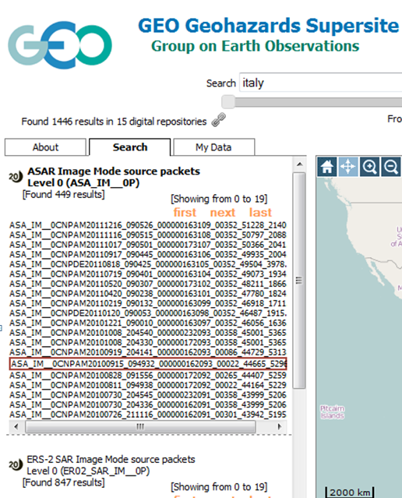
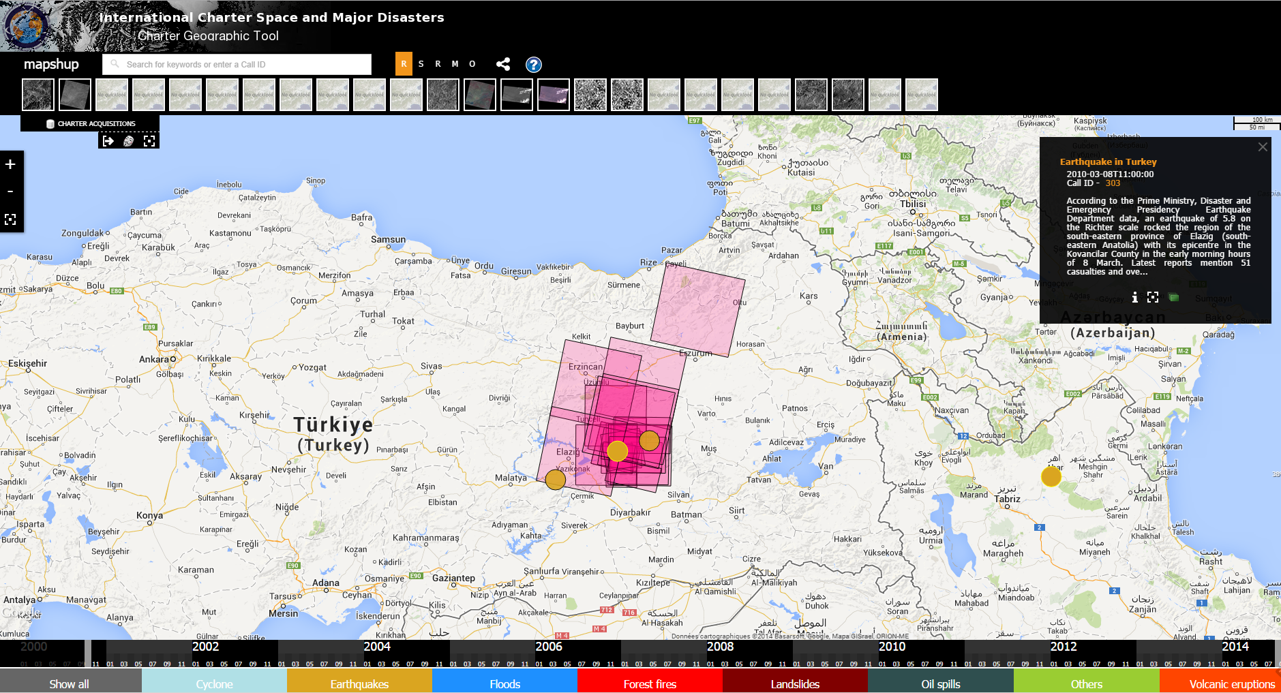
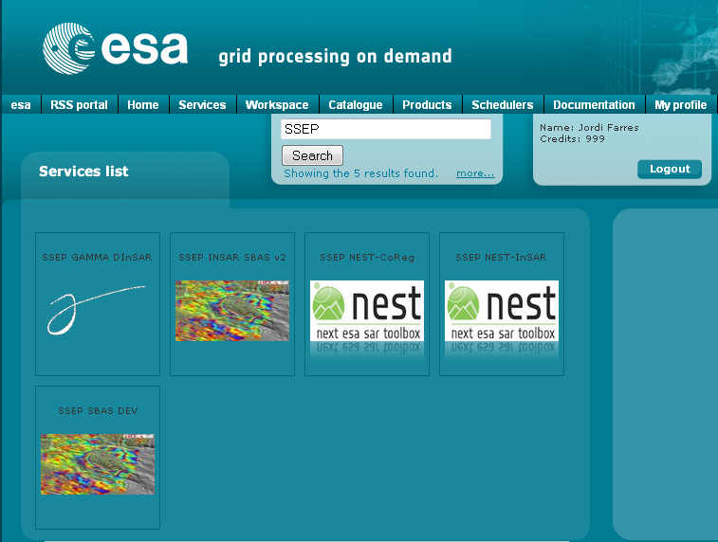
Milestones 2014-2016
Across all Objectives: coordination & development activities.
Q4 2014 Development of the web site portal and platform.
Aim:
Deploy a complete and consistent collaborative platform
to support the CEOS Pilot (Seismic and partly Volcano).
Allow closer links with users to ease access to & exploit data.

Slide 7
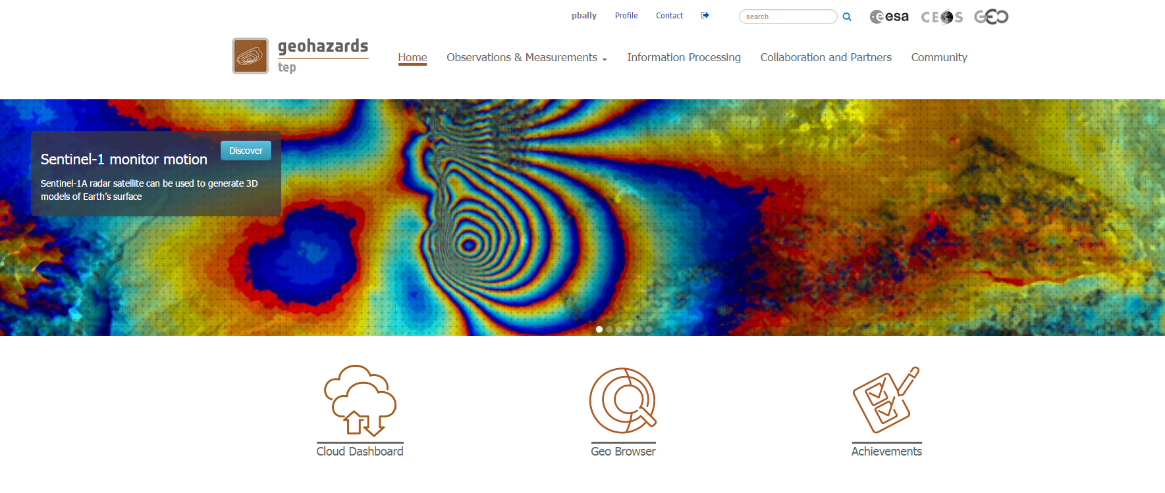
The geohazards exploitation platform to support users
The geohazards platform
A prototype Exploitation Platform that will use new ICT for virtualized data exploitation:
  Data storage/dissemination concerning wide extent tectonic analysis where very large data stacks (typically 1000+ and 5000+ scenes and bigger)
  Access to advanced processing tools
  A collaborative work environment and scientific animation

Slide 8
User Communities:
Short term:
Organisations with a national mandate concerning risk assessment (incl. seismological centres)
Experts from universities worldwide, academia (PIs)
Longer term:
National & regional civil protection agencies and national & local authorities with a risk management mandate (response)
Experts from EO sectors (specialised VA providers)
Specialists of geohazard risks in other sectors (pre-commercial research affecting insurance/re-insurance sector, civil engineering companies, energy, etc.)

Slide 9
Expert contributions
Pilot | Seismic Hazards
CEOS partners | ASI, CSA, CNES, DLR, JAXA, ESA, NASA, USGS
Partners/practitioners | INGV, UNAVCO, University of Miami, EU Centre
Users | Emergency Response/civil protection users, Hazard Science Response users, Operational Science users, Hazard Science Research users (Univ. Leeds, COMET+, ISTerre)

Slide 10
The geohazards exploitation platform to support users
New Users
User organisation
ESA
DLR DFD
Altamira Information
ISTerre / Université Grenoble-Alpes
INGV Roma
INGV Roma
INGV Roma
CNR IRPI Torino
NOA (Greece)
SATIM
Obs. Physique du Globe de Clermont-Ferrand
INGV Catania
Institut de Physique du Globe de Paris
Processors
IPF
S-1 INSAR QL
DIAPASON
NSBAS based on DORIS
SBAS
GAMMA
SBAS
SBAS
ROI_pac, DORIS, Stamps, SBAS
DORIS , ADORE, StaMPS + Matlab, snaphu
DIAPASON
StaMPS, GAMMA, SBAS
Areas
Sentinel-1A Calibration sites
Pilot AOI (wihin European tectonic mask)
Test site
Test site
Alto Tiberina Fault and Fogo Cape Verde
Marmara, East sector of NAFS
Haiti and West Java
Alto Tiberina Fault and Fogo Cape Verde
Geohazard sites in Greece
Silesia & Warsaw (Poland)
Piton de la Fournaise in La Réunion, Cordon del Azufre / Lastarria in Chile–Argentina
Etna & Campi Flegrei / Vesuvius

Slide 11
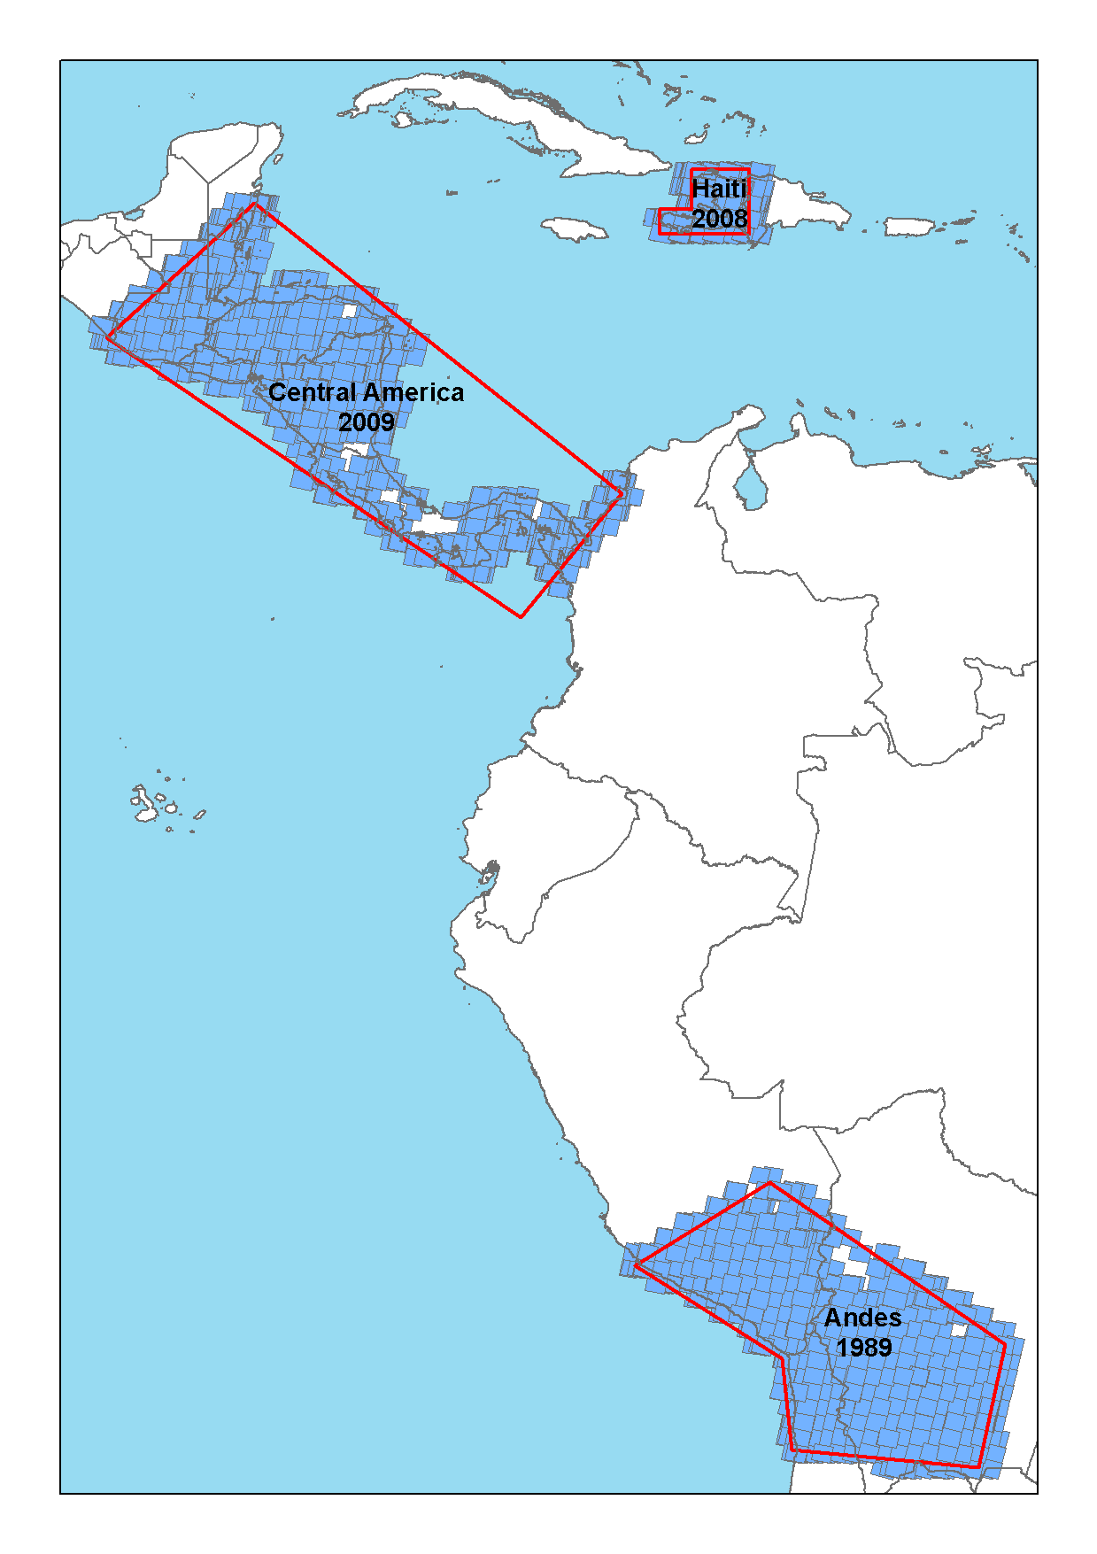
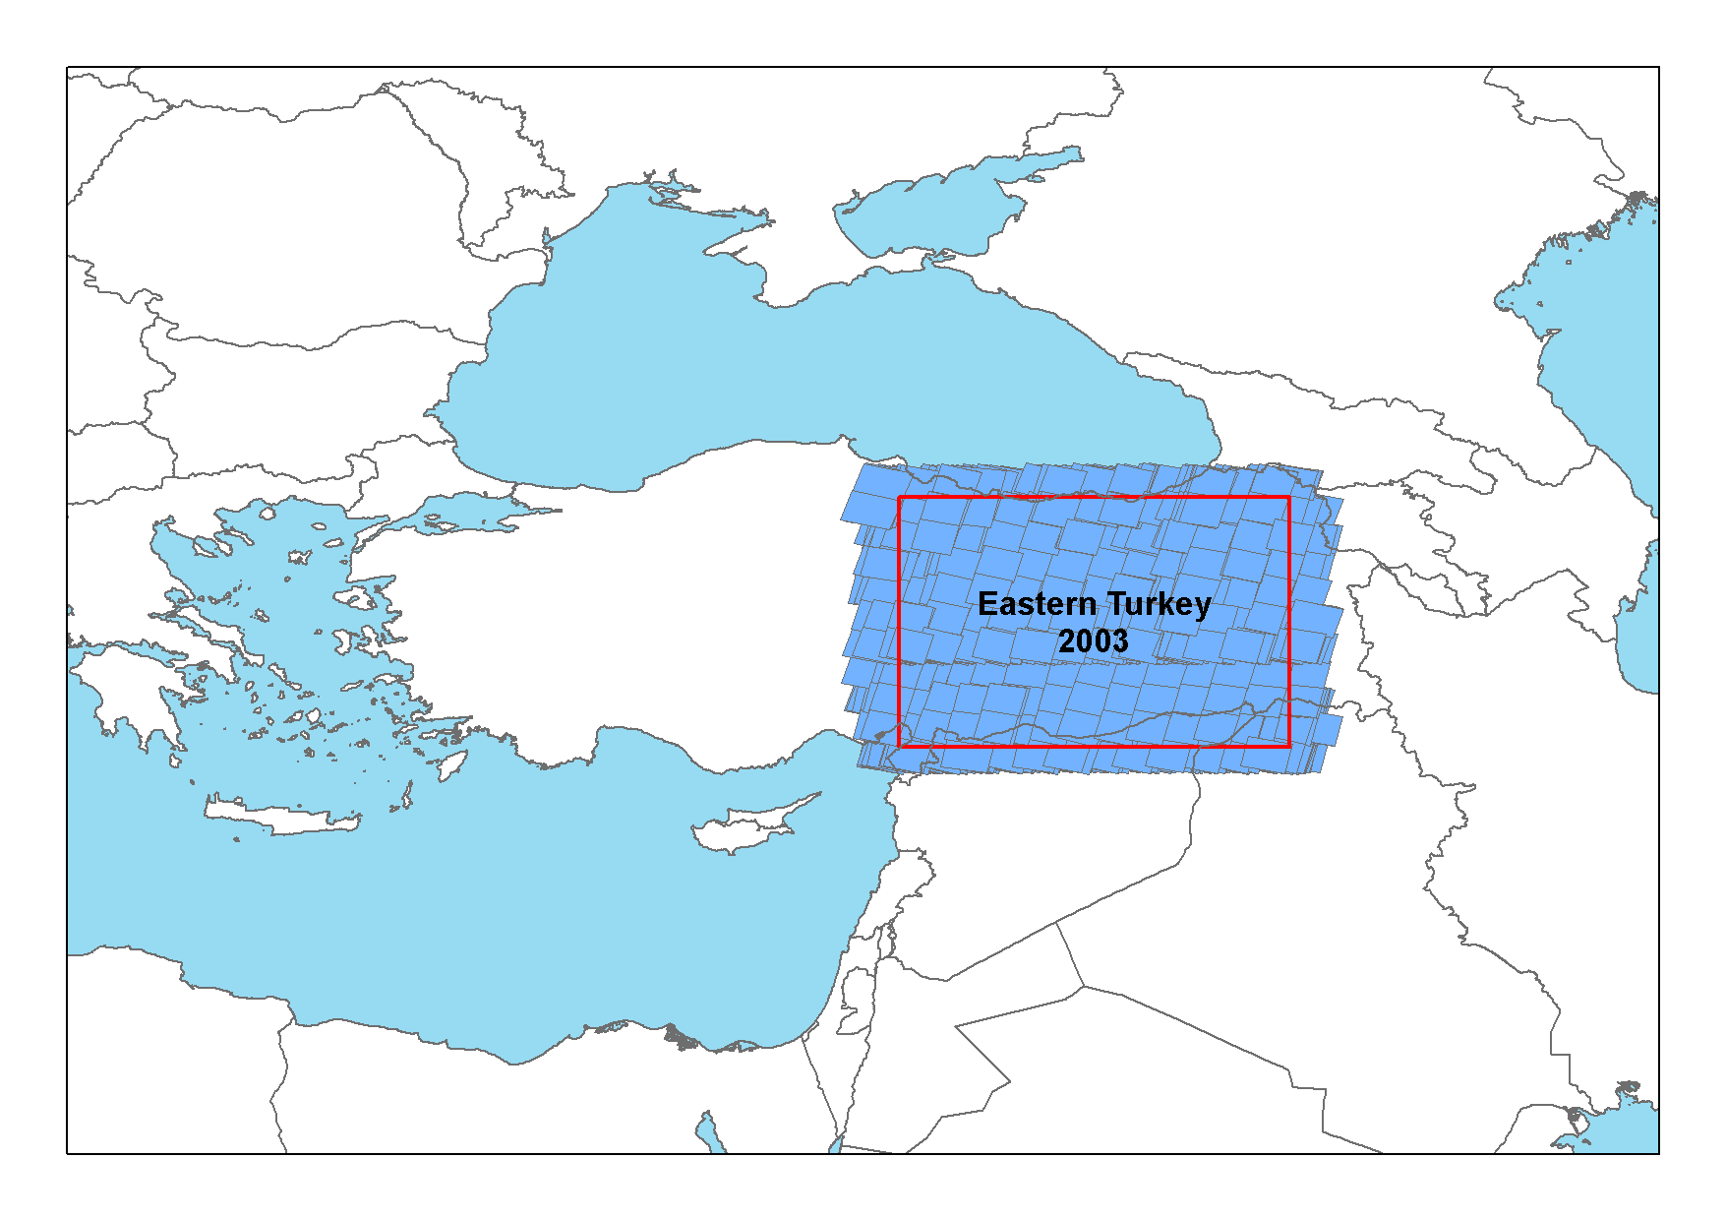
Data Commitments for Seismic Pilot 1/4
CNES: SPOT World Heritage archive made available to pilots (1000s of SPOT archived images) with five-year rolling buffer. The SPOT World Heritage images relevant to the geohazard theme may be accessed through the Geohazard Exploitation Platform.
As a response to Seismic requirements, CNES has selected the 2000 least cloudy scenes between 1986-2009 in each of the Andes and Eastern Turkey AOIs. In addition, 50+ Pleiades images will be provided for seismic pilot over three years.
Sample SPOT coverage over Eastern Turkey Area of Interest:
2003 cloud-free images 1986-2009
Andes: 1989 cloud free images

Slide 12
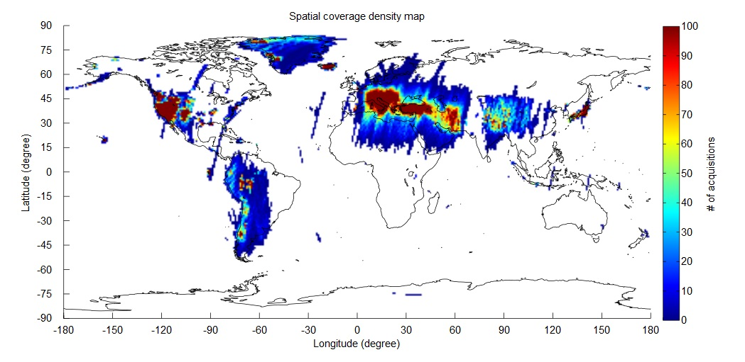
Data Commitments for Seismic Pilot 2/4
ESA: Sentinel-1 gradually made available starting with pilot targets in 2014 and with the goal to cover priority areas of Objective A for 2016 – 100,000+ images; Archive ERS SAR & ENVISAT ASAR
Envisat ASAR IM Level-0 Data : >51500 scenes
ERS SAR IM Level-0 Data : >51300 scenes
Example of coverage of ERS & ASAR data accessible by the geohazard platform:

Slide 13
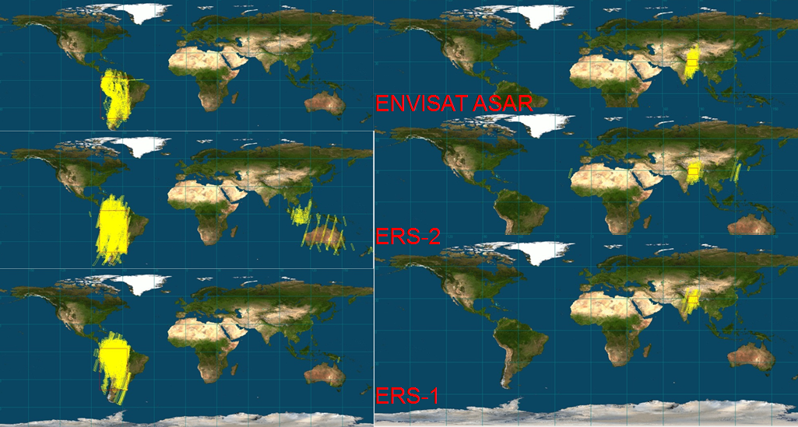
Data Commitments for Seismic Pilot 3/4
Just looking at the last 6 months: 45 TB moved to platform: Himalaya-Tibet, Turkey, Iran, Bolivia, Peru, Central Andes, Serbia, Croatia, Albania, Greece, Italy.
Examples over Latin America and the Himalayas (coverage for other regions not displayed):

Slide 14
Data in 2014
No reporting figures at this stage (in progress)

Slide 15
Achievements 2014
First EO products delivered concerning Objective C) of the pilolt thanks to ASI and INGV.
Platform portal validated after review process with CEOS partners
Successfully concluded the go/no-go step to launch geohazard platform in its first Validation Phase:
Starting Q1 2015
17 user organisation registered as Early Adopters including Seismic Pilot users (e.g. ISTerre, Univ. Leeds)
Platform geobrowser able to visualize collections of EO data from several space agencies (CEOS members)
Collaboration with space agencies to interate accounting for data access to support the CEOS Pilots and the GSNL.

Slide 16
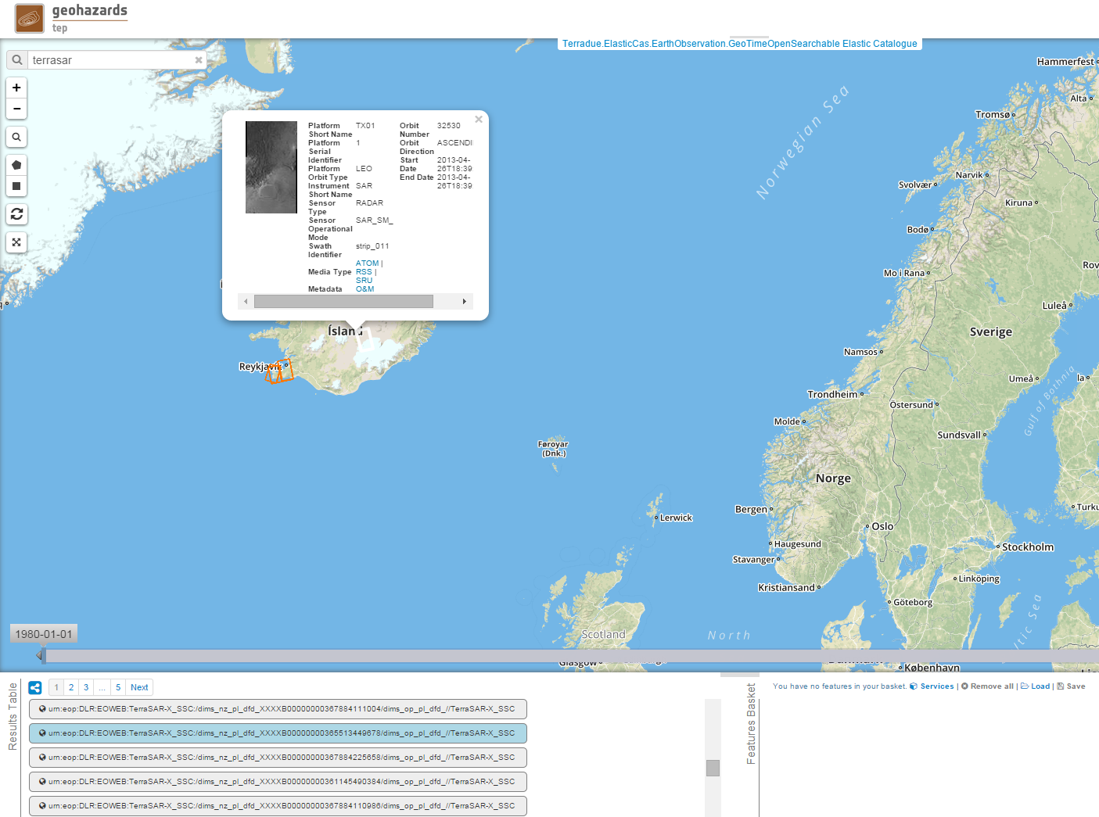
Example with TerraSAR metadata:

Slide 17
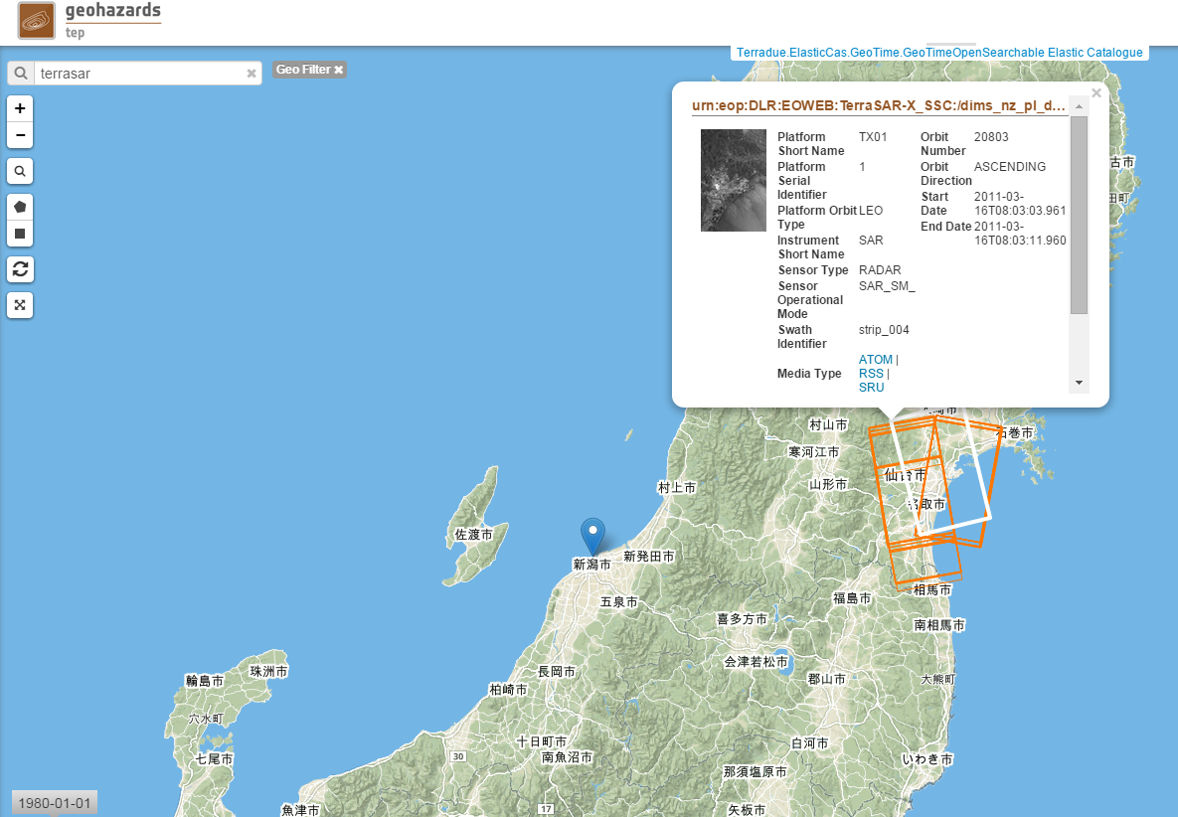
Example over Japan:

Slide 18
Illustrations of EO contributions

Slide 19
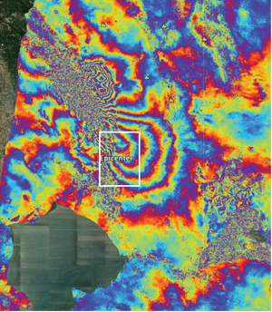
Cosmo based map of South Napa earthquake
The Napa Valley
earthquake
of 24 august 2014
Map of the deformation of the Earth’s surface generated from two COSMO- SkyMed images. One colour cycle indicates 2cm of permanent surface movement and the inset map reveals a discontinuity that identifies a fault rupture cutting through the Napa County Airport.
Image credit: ASI, NASA/JPL-Caltech, Università degli studi della Basilicata, ARIA, Google Earth

Slide 20
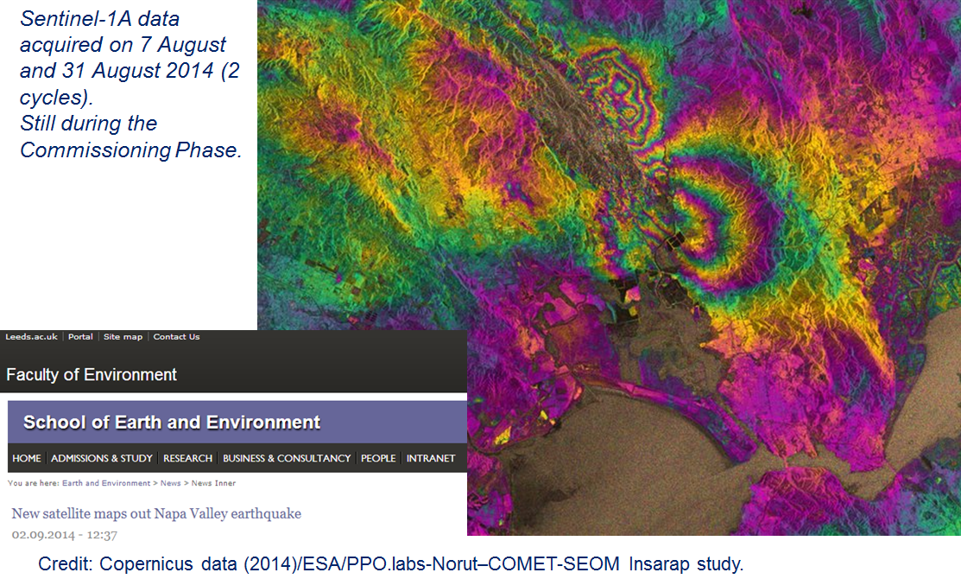
Sentinel-1 based map of South Napa earthquake
The Napa Valley
earthquake
of 24 august 2014

Slide 21
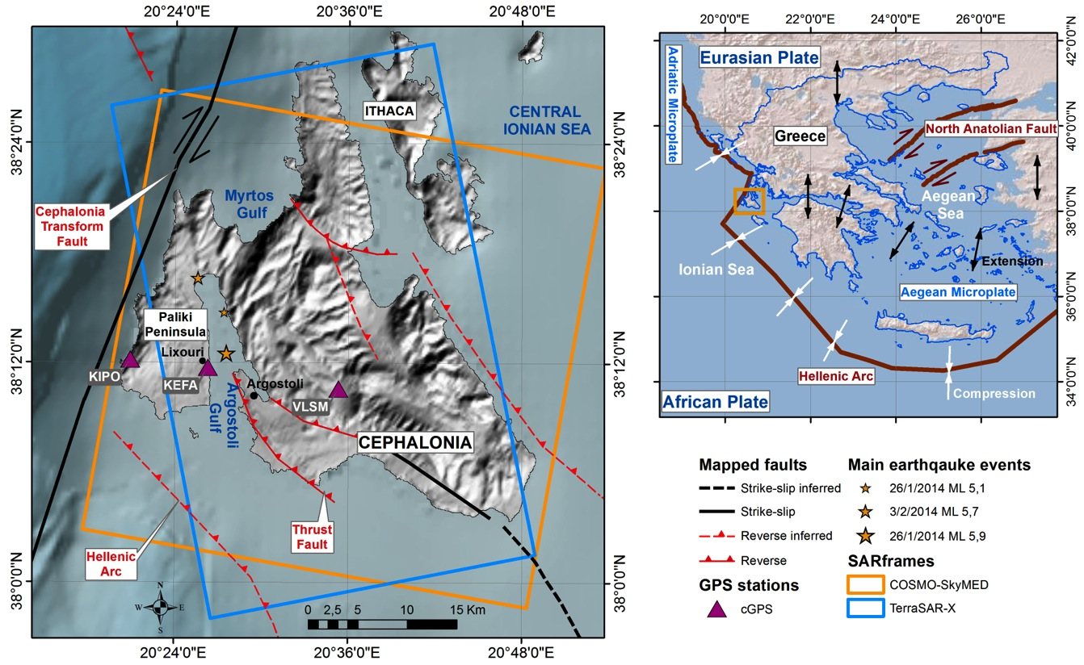
Example of rapid response to earthquakes

Slide 22
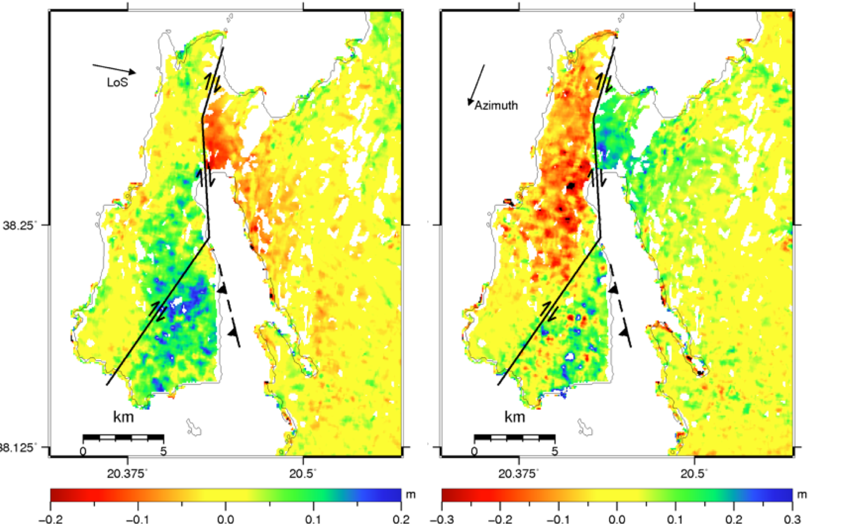
Cosmo based map of Cephalonia earthquake
Descending orbit - COSMO-SkyMed Offset tracking (400 m)

Slide 23
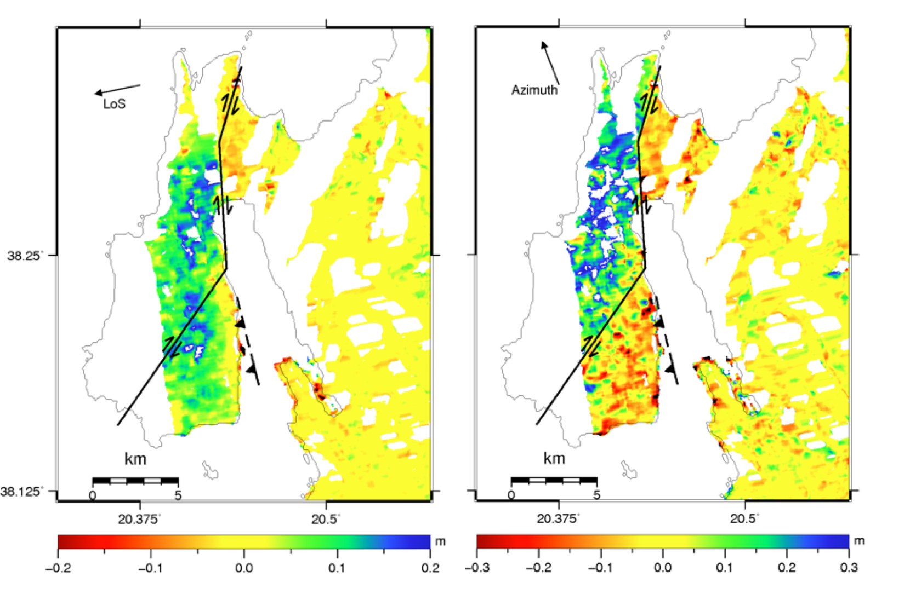
TerraSAR based map of Cephalonia earthquake
Ascending orbit - TanDEM-X Offset tracking (400 m)

Slide 24
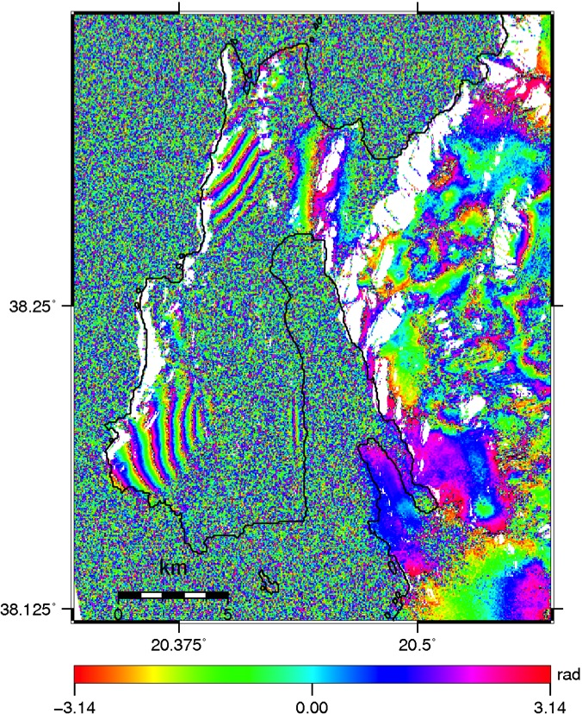
Radarsat-2 ascending orbit
Wrapped RSAT2 DInSAR phase
RADARSAT based map of Cephalonia earthquake
Example of source model for the Feb 3 event

Slide 25
Illustrations of EO contributions concerning global strain rate mapping and the mapping of active faults (Objective A)

Slide 26
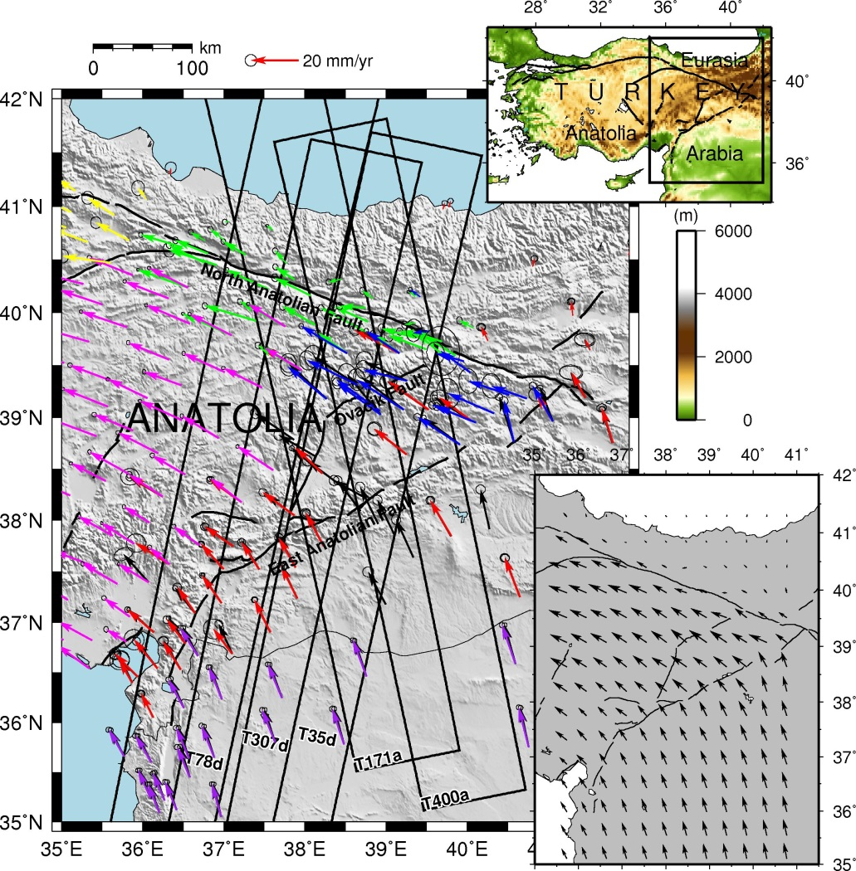
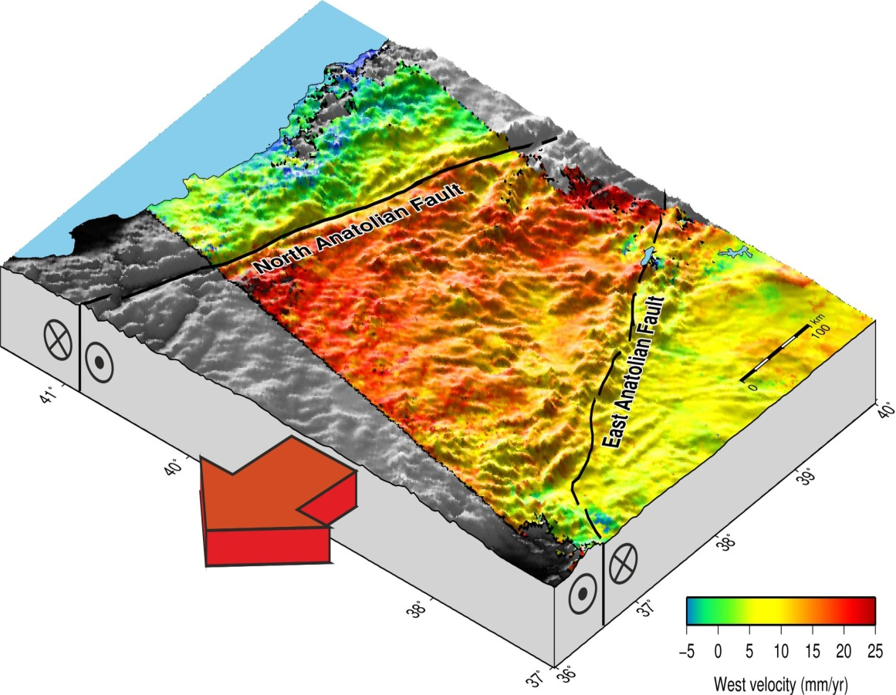


+
GPS
InSAR
~500 km
3D crustal deformation
Walters, Parsons & Wright, JGR, 2014

Slide 27
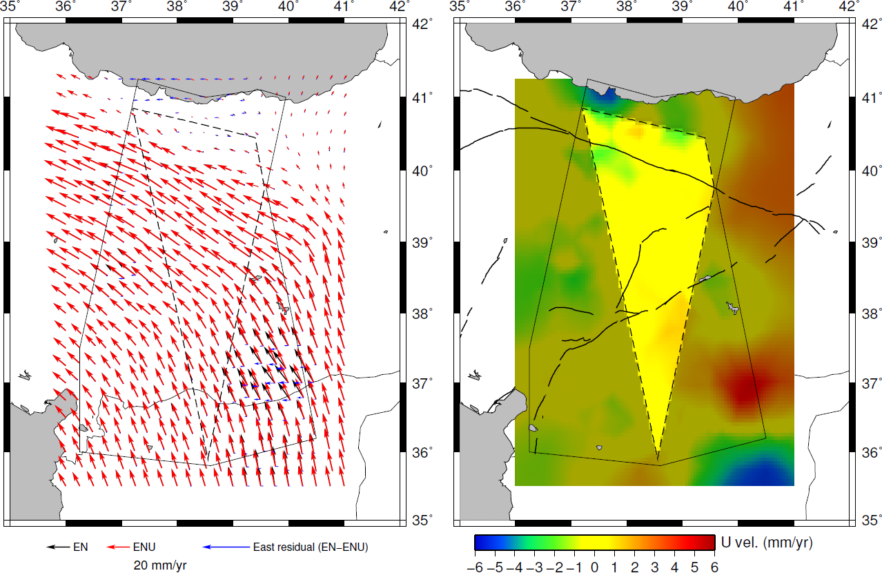
3D crustal deformation
North Anatolian Fault
East Anatolian Fault
Horizontal velocity field
Vertical velocity field
Walters, Parsons & Wright, JGR, 2014

Slide 28
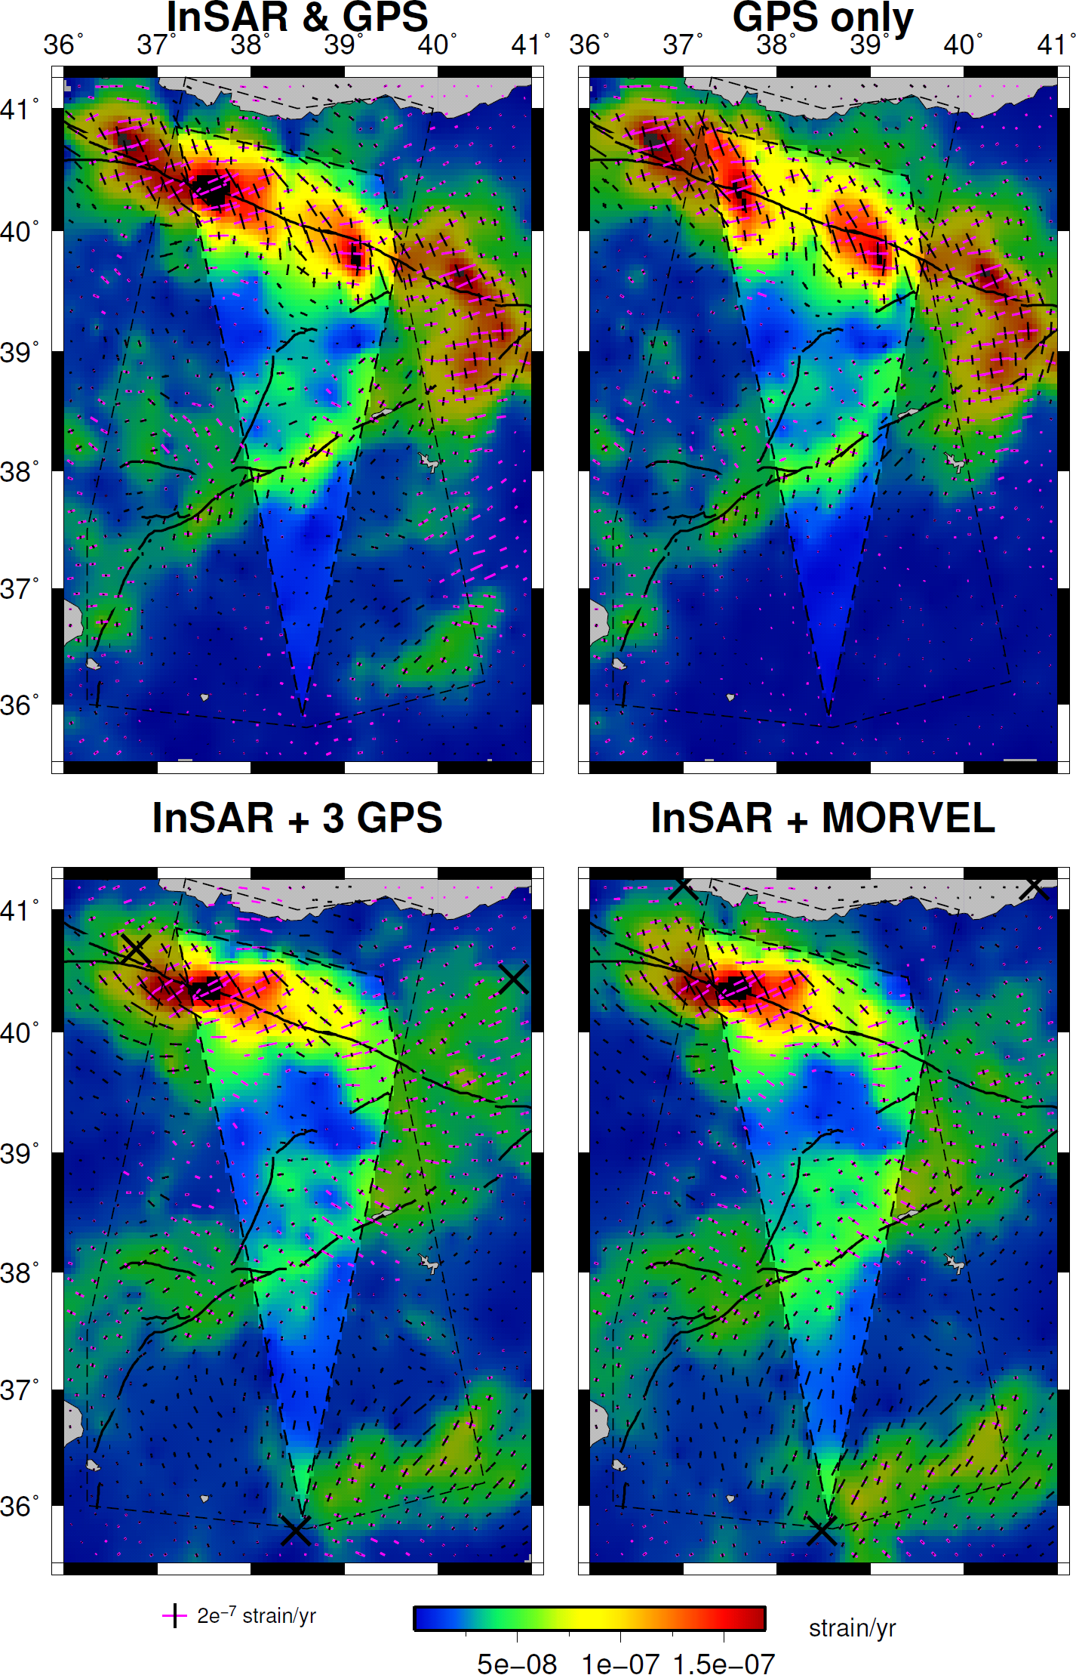

...but even without dense GPS velocities, we can still recover horizontal strain-rate using InSAR data
Within pink region (well constrained by InSAR data) we get the same result with just InSAR data and only 3 GPS velocities (red stars) as from GPS data alone…. Strain is focussed on the two major faults
Can now use this method to measure tectonic strain on the country-wide scale
With dense GPS data - can measure 3D deformation (not just horizontal)
Without dense GPS data - can still map horizontal strain
Now ready to fully exploit Sentinel-1 data for global strain mapping
Walters, Parsons & Wright, JGR, 2014

Slide 29
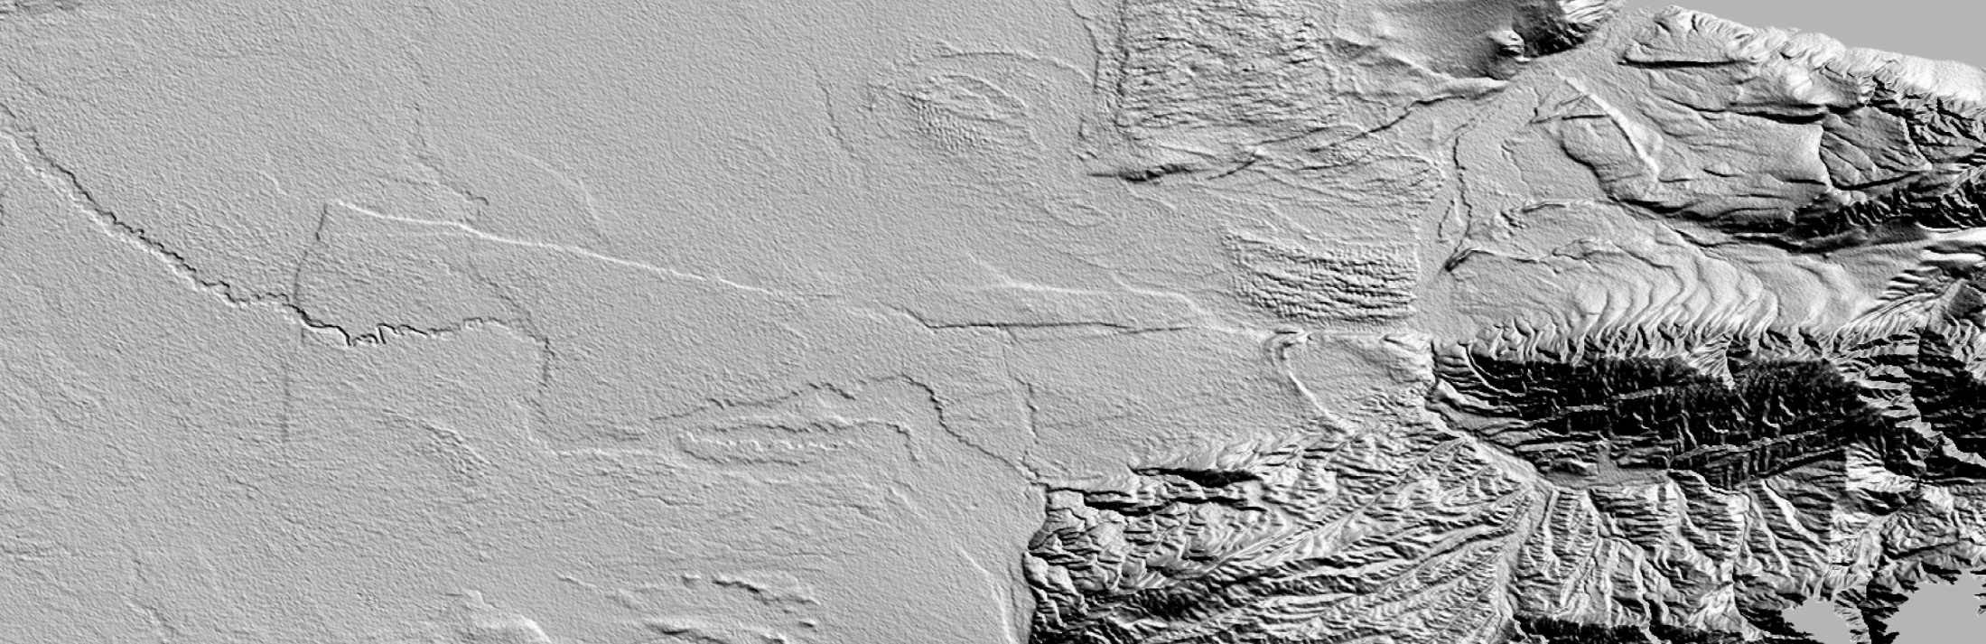
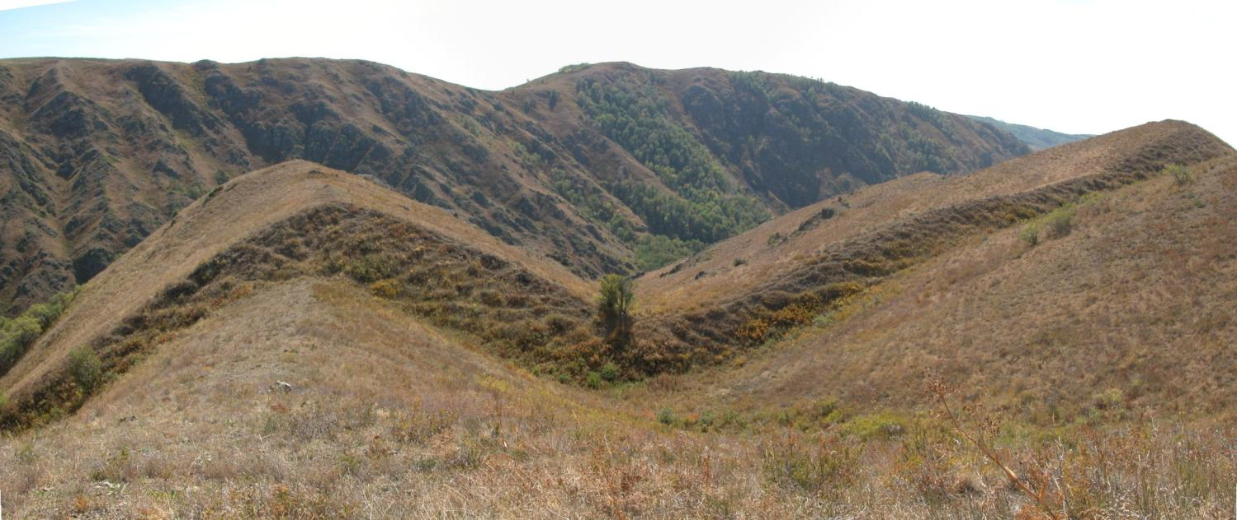
Identifying previously unknown faults with high-resolution imagery and DEMs
Lepsy fault
SRTM Digital elevation data
+
+
N
+
+
+
+
10 km
Lepsy fault, Kazakhstan
(Walker, Jackson et al, in preparation)
Richard Walker, pers comm
10 m
Single event? Length 100 km, slip 10 m .....Magnitude 8.0
17/11/12
Notes:
29
The way you introduced this before was good… one of the reviewers queried whether any faults that remained unknown etc.
I don’t think you need the first slide. Justification is that we recognise hazard associated with faults slipping at < 1mm/yr.
Lepsy fault

Slide 30
Milestones 2014-2016
Objective A):
Q1 2014 - required data and data acquisition plans in place: delayed, awaiting detailed request from users + awaiting data dissemination for Sentinel-1A (key source for Objective A)
Early 2015 - results of test areas using archived data, initial results for main areas; established beta methodology for processing over large areas (see target for end 2016); preliminary results for validation sites on ERS/Envisat, COSMO SkyMed and TerraSAR-X data in Eastern Turkey and California
End 2015 - partial results of validation - Turkey, California, Japan, other selected areas
End 2016 - strain rate measurement results over pilot areas of focus

Slide 31
Milestones 2014-2016
Objective C):
Q3 2014 Examine the gaps in existing acquisition plans over the major cities of the world in areas at high seismic risk (COSMO SkyMed,TerraSAR-X, Radarsat). Delayed
Q3 2014 Implementation of processing algorithms for rapid response products on the platform Delayed
Q3 2014 Demonstration of the generation of different products for 1-2 earthquakes.
Q2 2015 Comparison of results obtained by different groups/algorithms/approaches; consensus report.
Q3 2015 Demonstration of the generation of different products for 1-2 earthquakes.
Q3 2015 Product assessment by the final users
Q3 2016 Demonstration of the generation of different products for 1-2 earthquakes.

Slide 32
Linkages to other pilots
Are there any current or planned linkages to other thematic pilots?
  See outcome of action M2/4
The Geohazards platform is the contribution of ESA to the CEOS Pilot on Seismic Hazards.
Starting in 2015, the Geohazards platform is able to support the CEOS Pilot on Volcanoes for data access and accounting to support the reporting of data consumption of the Pilot activity and including the Supersites (GSNL) activity concerning seismic volcanoes.
Starting in end 2015, the Hydrology TEP is able to support the CEOS Pilot on Floods for data access and accounting to support the reporting of data consumption of the Pilot activity.

Slide 33
Issues
Overeall Pilot users have not really provided detailed requirements for getting EO data (i.e. some agencies haven’t yet had clear input from the CEOS Seismic Pilot)
Some contributing agencies have not implemented the method to provide access to the EO data offered to the Pilot
The schedule of activities of the Seismic Pilot is influenced by major activities such as the release of the GEP platform for data access & processing (we need to take benefit of it so adjusted the planning)

Slide 34
Thank you
philippe.bally@esa.int

