Slide 1
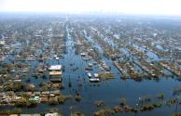
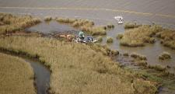
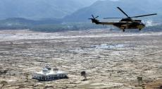
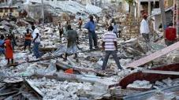
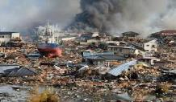
Implementing the Recovery Observatory
Catherine Proy, CNES
Steven Hosford, CNES
WG Disasters #3
Tokyo, Japan
11 March, 2015
Hurricane Katrina
2005
Deepwater Horizon
2009
Indonesian Tsunami
2004
Haiti Earthquake
2010
Tohoku Tsunami
2011

Slide 2
Recovery Observatory Discussion
Overview, status, objectives, roles of partners
Triggering
Review of Needs – products and services (stakeholder perspective), User and stakeholder involvement
IT Architecture – presentation of status and projected evolution (WGISS)
Value-adding Strategies
Sustainability and agency involvement, Next steps (beyond initial triggering)
Promotion and Outreach for the RO

Slide 3
The Idea
Response
(weeks)
Recovery
(years)
Recovery Observatory (≈ 3 yrs)
Organise EO data from response phase and pre-disaster in repository
Plan coordinated acquisitions to support:
Detailed built area damage assessment;
Natural resource and environment assessment;
Reconstruction planning;
Reconstruction monitoring; and
Change monitoring.
Create collaboarative web IT workspace to share data and elaborate and share products
Establish collaborative practices through cooperation on PDNAs
International Charter
Sentinel-Asia
EO data from National Agencies
Commercial providers
Copernicus/EMS
Coordination
Effective Resource Allocation
Clear Institutional Links
VA Product Generation
Ad Hoc Approach
Lack of Coordination and Cooperation
Lack of Institutional Links
Lack of Awareness of Role of EO
No Clear Mechanism to Access VA Products
Notes:
Space agencies already
organise the “response” part of the cycle (International Charter, Sentinel-Asia)
propose an “ad-hoc” approach on scientific requirements for a specific zone or disaster/theme (better understanding of hazard phenomena, modelling, etc.)
After the initial response, space agencies have little or no coordination for the post-crisis part of the disaster management cycle
What is a “Recovery Observatory”?
Infrastructure(s) providing access to EO data of use in the Recovery phase (non profit activities), and to vallue-added products generated by users and partners
Data should include those acquired during the response and regular acquisitions during Recovery planned to address specific prouict needs
Links to local users and to international organisations

Slide 4
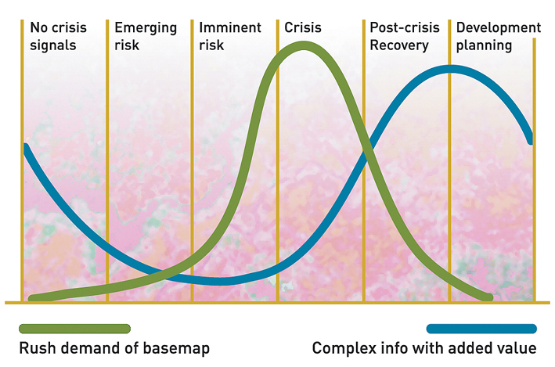
Geo-Information in Response & Recovery
Recovery Observatory added value
Highest current use during crisis – need to develop methodologies and products for recovery planning
Demand for geo-information
Slide adapted from UNOSAT Luca dell’Oro
Notes:
The availability and sharing of timely and relevant information is critical for assisting humanitarian operations.
As shown here in the graph in the immediate aftermath of an event there is a peak in the demand of data and information including maps.

Slide 5
Objectives
Demonstrate in a high-profile context the value of using satellite Earth Observations to support Recovery from a major disaster:
near-term (e.g. PDNA process, rapid assessments); and
long-term (e.g. major recovery planning and implementation, estimated to be about 3 years).
Establish institutional relationships between CEOS and stakeholders from the international recovery community.
Work with the recovery community to define a sustainable vision for increased use of satellite Earth observations in support of recovery.
Foster innovation around high-technology applications to support recovery.

Slide 6
Partners
National end users (government of affected area with mandate for recovery and reconstruction and other government ministries)
International humanitarian GOs and NGOs with interest in reconstruction (e.g. IFRC, OCHA)
International stakeholders with interest in post-disaster needs and recovery/reconstruction financing (e.g. GFDRR, UNDP, EU, UNEP)
Satellite data providers (CEOS agencies, commercial providers)
Value-added product generators (academia, research institutes, companies, specialised organisations (e.g. UNOSAT)

Slide 7
Post Disaster Needs Assessment (PDNA)
Governed by tripartite agreement between UNDP, EU and GFDRR/World Bank
Requested and managed by national government but with support from the three international parties
May begin a few (even 6) weeks after a disaster, and last two to three weeks on average, but sometimes longer
May cover up to 15 sectors (see template) such as transport, agriculture, schools and education, etc, but each PDNA is different
Templates for PDNAs shared with ROOT; agreement with stakeholders to share PDNA planning information with ROOT

Slide 8
A CEOS Initiative
  Recovery Observatory managed by Recovery Observatory Oversight Team under CEOS WG Disasters
  CEOS Plenary and SIT (November 2013; SIT April 2014) approved Recovery Observatory as part of Disaster Risk Management Observation Strategy 2015-2017
  Recovery Observatory ready for triggering since 1 January, 2015
    collaboration on 1 to 3 PDNAs in early 2015 to establish operational linkages;
    triggering of the RO after major event;
    evaluation at RO + 6 months;
    lessons learned and sustainability strategy after evaluation of 1st RO
  Cooperation on Post-Disaster Needs Assessments (PDNAs) to begin as of April or May 2015
Notes:
PDNA will be used to confirm product definition and better evaluate needs of data for the future recovery activation

Slide 9
RO Lifecycle
Prepa
ration
Infrastructure
Institutional relationships
Trig-gering
Charter activation monitoring
Establishment
Product development
Scenario building
Summary Event Report
Decision by ROOT to trigger
Upload of Charter data and baseline products
Opera-tions
Preliminary Data Acquisition Plan
Link to national end user
Development of RO activity grid
Research and training & capacity development
Liaison and development of links with end users
Promotion and Outreach
Reporting
Evaluation (+ 6 months) and lessons learned
Value-adding coordination
Initial reporting
IT maintenance
Legacy planning
PDNA support
Protocols for RO operations
Notes:
Before activation (now)
Development/characterization of product list with UNDP, WB (and others) in coordination with UNOSAT (and others)
Update of existing scenarios including estimates of volume of data to be tasked and processed
Preparation of data processing (ortho-rectification and atmospheric corrections) with involved CEOS agencies
Preparation of value-adding strategy (who? how? in kind contributions? funds?)
License for RO data use (CNES for SPOT and Pleiades, others?)
Pre-triggering RO activities (strategy for PDNAs and for 1st RO; others? which agencies would host and operate)
Link between the RO and the CEOS WEB pages
Development of IT and data ingestion process
Triggering preparation:
Rapid report on situation to support triggering
Interface with stakeholders for product needs, coordination with other initiatives…
Preliminary definition of acquisition plan (V0)
Analyze of possible implementation of IT (deployment, hosting, project management and operations)
After activation (3 to 6 months)
Implementation of the RO when triggered
First operations: upload of Charter data and result, PDNA or for RO, baseline first products for recovery planning and monitoring
Coordination activities:
Interface with stakeholders for precise definition of needs and identification of national entities to involve
Interface with the national institutions for product needs, coordination with other initiatives…
Definition of the acquisition plan (v1) and initial liaison with agencies
Establishment of formal institutional relationship with national entities (definition of role and responsibilities, identification of funding sources if available)
Elaboration of the RO activity grid (applications……)
Reporting to CEOS on development of RO and recommendations on issues to address
Building of research and training activities
On-going operations (1 to 3 years)
Coordination activities:
Liaison and development of institutional relationships, new relationship building
Promotion and outreach (including long term promotion of RO within country)
Development of lessons learned and replication of RO model (in other countries)
Value-adding coordination and new product development; new value added partners
Regular Report of technical results to national institutions
Support to national users (technical and policy), including new service development
Coordination and animation of new research activities around RO concept
Management of the activity (applications) grid in coordination with the project manager
Formal report to CEOS on RO (annual)
Project Management activities
Management of the acquisition plan and tasking with CEOS agencies
Management of RO content (data, product, news, documents)
Management of data processing
Technical reporting
Development of long-term plan for RO after initial set-up (1-3 years)
Maintenance of the RO IT (corrections, evolutions)
VA generation
Preparation of closure
Evaluation
Legacy strategies

Slide 10
Recovery Observatory Discussion
Overview, status, objectives, roles of agencies
Triggering
Review of Needs – products and services (stakeholder perspective), User and stakeholder involvement
IT Architecture – presentation of status and projected evolution (WGISS)
Value-adding Strategies
Sustainability and agency involvement, Next steps (beyond initial triggering)
Promotion and Outreach for the RO

Slide 11

RO Triggering – High-level summary
ROOT monitors Charter activations – evaluates opportunity
ROOT member or associate requests triggering for event
ROOT prepares Summary Event Report and Preliminary Acquisitions Plan
Decision to trigger

Slide 12
Detailed Triggering Process (1/2)
International Charter activation after major disaster – Recovery Observatory Oversight Team (ROOT) monitors Charter activations and each member/associate member considers whether event is a good candidate for the Observatory.
If event is considered to be a candidate event in the subjective judgement of any Team member or associate member, the member or associate member contacts ROOT chair and requests teleconference to discuss triggering.
ROOT secretariat will prepare Summary Event Report in coordination with member or associate member that requested triggering discussion. Summary Event report will present the event, its impact and analyse pros and cons of creating an Observatory for the specific event. In particular, the report: examines predetermined scenarios developed during preparation phase and identifies possible data acquisition requirements; considers advice from DRM stakeholders; identifies commitment in kind or resources for value added support; looks at the scale and scope of the disaster; qualifies expected government support in country; and describes the benefit to be derived from establishment of Observatory.

Slide 13
Detailed Triggering Process (2/2)
At least three Oversight Team members and at least one associate member, with the agreement of the CEOS Executive Officer, in consultation with the CEOS Chair and SIT Chair, the WG Disasters Chair and the ROOT Chair, decide they would like to trigger the creation of the Observatory. The ROOT Chair informs the CEOS SEC of the intention to trigger the Observatory. The CEOS agency ROOT representatives must represent critical mass/varied contributions of data (according to what was deemed to be required in the preparation scenario).
The Observatory is announced within CEOS by the CEOS Chair with a call for broader participation from satellite agencies. In parallel, the Observatory is announced within the DRM community by the ROOT associate members with a call to join.
The Recovery Observatory Oversight Team generates a detailed situation report based on the Summary Event Report and adopts a data acquisition strategy and preliminary list of data products.
The Observatory is announced publicly with DRM partners.

Slide 14
Recovery Observatory Discussion
Overview, status, objectives, roles of agencies
Triggering
Review of Needs – products and services (stakeholder perspective), User and stakeholder involvement
IT Architecture – presentation of status and projected evolution (WGISS)
Value-adding Strategies
Sustainability and agency involvement, Next steps (beyond initial triggering)
Promotion and Outreach for the RO

Slide 15


Utility of Satellite Imagery for Recovery (from GFDRR)
1) Post disaster damages and needs assessments
  Rapid assessments
  PDNAs
  Validation of disaster data (e.g in housing, agriculture)
2) Recovery & reconstruction planning & implementation
  Recovery Planning
  Recovery Implementation
  Reconstruction Monitoring
3) Recovery institutionalization
  Ex-ante Baseline Development
Notes:
1) Post disaster damages and needs assessments
Rapid assessments
PDNAs
Validation of disaster data (e.g in housing, agriculture)
Rapid Assessments
Key source to identify
Extent of Damages (Geographical spread)
Intensity of Damages (completely destroyed, partially damaged, or negligibly damaged)
PDNAs
Pre-disaster baseline development
Validation of Secondary data provided by the Government
Disaster damage estimates where secondary data is not available
2) Recovery & reconstruction planning & implementation
Recovery Planning
Prioritization and sequencing both spatially and sectorally
Recovery Implementation
Land use planning
Hazard mapping
Reconstruction Monitoring
Overall progress
Progress within sectors
3) Recovery institutionalization
Ex-ante Baseline Development
Cost effective source for developing baseline of key sectors
Ex-ante baseline development can significantly improve the speed of post disaster assessments

Slide 16
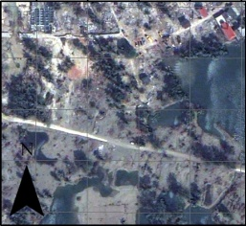
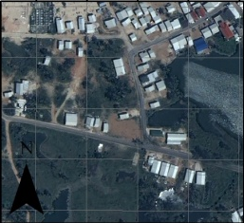
Satellite-derived mapping products
Medium and long-term recovery planning and reconstruction monitoring
Ground verification of preliminary/remote damage analysis
Detailed damage assessment maps categorized by different recovery sectors
GIS data collection, integration and analysis
Establishment of a national/international monitoring mechanism to guarantee transparent, traceable and efficient implementation of recovery plans
Satellite data acquisition for the monitoring of reconstruction and recovery activities
Adapted from slide courtesy of UNOSAT Luca dell’Oro

Slide 17
RO Product Table (1 of 2)
Product | Approx. area | Data required | Frequency | Value-adder | End user | Issues
Baseline before event | Entire area (approx. 150 km x 300 km) | Medium resolution SAR (RSAT-2, Sentinel-1) and optical imagery (Landsat-8, Sentinel-2); in some areas, VHR SAR (ALOS-2, CSK, TSX) and optical (Pleiades) + Charter data | Once; response/ Charter as starting point | TBD | DMA and Ministry of Interior | Scale versus scope
Synoptic impact assessment | Entire area (approx. 150 km x 300 km) | Medium resolution SAR (RSAT-2, Sentinel-1) and optical imagery (Landsat-8, Sentinel-2); in some areas, VHR SAR (ALOS-2, CSK, TSX) and optical (Pleiades) + Charter data | Once; response/ Charter as starting point |  | DMA | Need to trigger quickly if full area to be covered

Slide 18
RO Product Table (2 of 2)
Product | Approx. area | Data required | Frequency | Value-adder | End user | Issues
Detailed disaster impact – sector 1/sector 2/sector 3 (identical products over multiple areas | 15 km x 15 km (x 3?) | VHR SAR and optical (ALOS-2, CSK, TSX, RSAT-2, Pleiades) | Once; response/Charter | TBD | DMA | Linkage to PDNA sectorial analysis
Reconstruction monitoring – built area and transportation .Accessibility .buildings .Camps .Infrastructures | 25 km x 25 km (x 2?) | VHR SAR and optical (ALOS-2, CSK, TSX, RSAT-2, Pleiades) | Monthly for 1 year; annual afterwards | TBD | Ministry of Interior | Scale depends on nature and extent of disaster – difficult to anticipate; could compare open-source methodology (e.g. SENSUM) with higher resolution data results
Environmental impact monitoring | 150 km x 300 km | Medium and VHR SAR and optical (RSAT-2, ALOS-2, Sentinel-1, Landsat-8) | Quarterly for one year; re-assess interval after 1 year. | TBD | NGOs, Ministry of environment | Different impacts may require different resolutions
Agricultural impact – areas cultivated | 150 km x 300 km | Medium res SAR and optical (RSAT-2, Sentinel-1, Landsat-8) | Annual during growing season, compare with baseline ex ante | TBD | Government ministry | Type of data heavily depend on crops

Slide 19
Cambridge Uni Recovery Needs Assessment
 |  | Early Recovery | Monitoring and Evaluation
A | Accessibility | Extraction of damage to road network, which includes primary and secondary roads and bridges Accessibility Proximity analysis Traffic activity analysis | Extraction of recovered primary and secondary roads Extraction of new primary and secondary roads Accessibility Proximity analysis Traffic activity analysis
B | Buildings | Building density of damaged buildings Estimated Population density in damage buildings to inform sheltering and re-housing | Building density at different stages of the recovery/ reconstruction process New estimated population for reconstructed and new building stock
C | Camp | Land-use/open spaces no. of camps no. of tents per camp | New land-use/open spaces
D | Infrastructures | Detailed analysis of utilities and services infrastructure and its operational status ( night-light) | Detailed analysis of utilities and services infrastructure and its operational status ( night-light)
E | Land Use – Environment | Land- use / open spaces | Land- use / open spaces
Notes:
This is a summary of what we found.

Slide 20
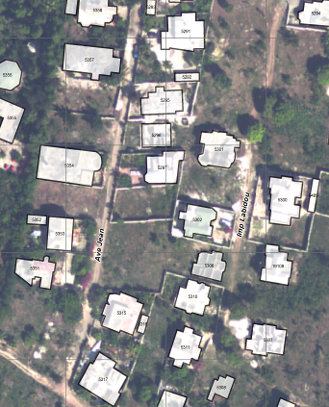
Sample work : municipal infrastructure, Jacmel, Haiti
22,000 buildings identified and described at 3 different dates
Town of Jacmel
Produced by SERTIT using very high resolution satellite imagery

Slide 21
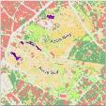
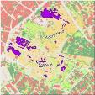

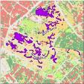
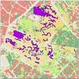
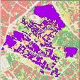
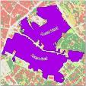
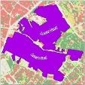
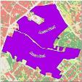
Refugee Camp Monitoring
13 janvier 2010
Map camps and follow planned and spontaneous groupings of people
End-user: French Red Cross
Provided by SERTIT with very high resolution optical imagery
16 janvier 2010
17 janvier 2010
21 janvier 2010
25 janvier 2010
23 février 2010
8 juillet 2010
18 août 2010
9 novembre 2010

Slide 22
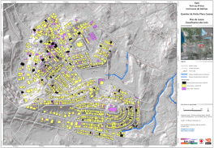
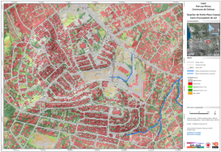
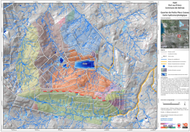
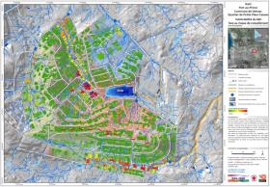
Examples from KAL-Haiti 2010-2015
Objectives :
Provide cartographic support for humanitarian actions
Identify and manage risk
Support logistics operations
Create common visualization
Users : French Red Cross, Town of Jacmel, CIAT….
EO data base including
Aerial imagery (2010), QuickBird (2009), SPOT and Pleiades regular images (2010-2014), radar data…..
Classification des toits
Occupation du sol
hydromorphologie
Vulnérabilité du bâtis
Notes:
BUT:
Recovery in Haiti was supported form a single agency;
Coordination with international stakeholders was lacking;
Challenges in coordinating at a national level with key national stakeholders.

Slide 23
Links to National End User
The core user community for the Recovery Observatory is at the national and local level
In the first weeks following a disaster, the liaison with the National End User will be established by the international DRM stakeholder or stakeholders – they will support the generation of imaging requirements according to a product list established in coordination with the national end user
After the initial response phase is completed, the Observatory will work directly with the national and local end users, ensuring requirements meet expectations and that products respond to needs; the international DRM stakeholders support and facilitate this process
Once the Observatory is established, the Oversight team will work with DRM stakeholders and national and local authorities to develop a legacy strategy, ensuring data and products can be used for long-term recovery and reconstruction efforts, and support resilient reconstruction.

Slide 24
Partner Input
Following materials developed by partners and potential partners as input to meeting

Slide 25
Post Disaster Assessment & Recovery Planning

Slide 26
Areas of Support
Support through financial assistance, technical assistance and knowledge sharing:
Post disaster damage and needs assessments
Recovery & reconstruction planning & implementation
Recovery institutionalization
  How can high risk countries be better ready for disaster recovery and reconstruction

Slide 27
Utility of Satellite Imagery
1) Post disaster damages and needs assessments
  Rapid assessments
  PDNAs
  Validation of disaster data (e.g in housing, agriculture)
Rapid Assessments
Key source to identify
    Extent of Damages (Geographical spread)
    Intensity of Damages (completely destroyed, partially damaged, or negligibly damaged)
PDNAs
  Pre-disaster baseline development
  Validation of Secondary data provided by the Government
  Disaster damage estimates where secondary data is not available

Slide 28
Utility of Satellite Imagery
2) Recovery & reconstruction planning & implementation
Recovery Planning
  Prioritization and sequencing both spatially and sectorally
Recovery Implementation
  Land use planning
  Hazard mapping
Reconstruction Monitoring
  Overall progress
  Progress within sectors

Slide 29
Utility of Satellite Imagery
3) Recovery institutionalization
Ex-ante Baseline Development
  Cost effective source for developing baseline of key sectors
  Ex-ante baseline development can significantly improve the speed of post disaster assessments
  Post Conflict Recovery and Needs Assessments

Slide 30
GFDRR and the RO
As a first step, ‘PDNA specific’ support from CEOS… and buy-in from government clients as well are required.
Thus requires:
  Data
  Resources (value-adding)
  Material to convince internal champions and governments
1. What can we do with freely available data (CEOS support or other arrangements - ad hoc acquisition of some affected areas)
2. What can we do if we had access to much more (i.e. cost benefit of satellite support to recovery)?
Sustainable projects in this area require value-added support, at a cost. The case must be made through the RO (where data and VA services are volunteered) that this is feasible beyond the RO.

Slide 31

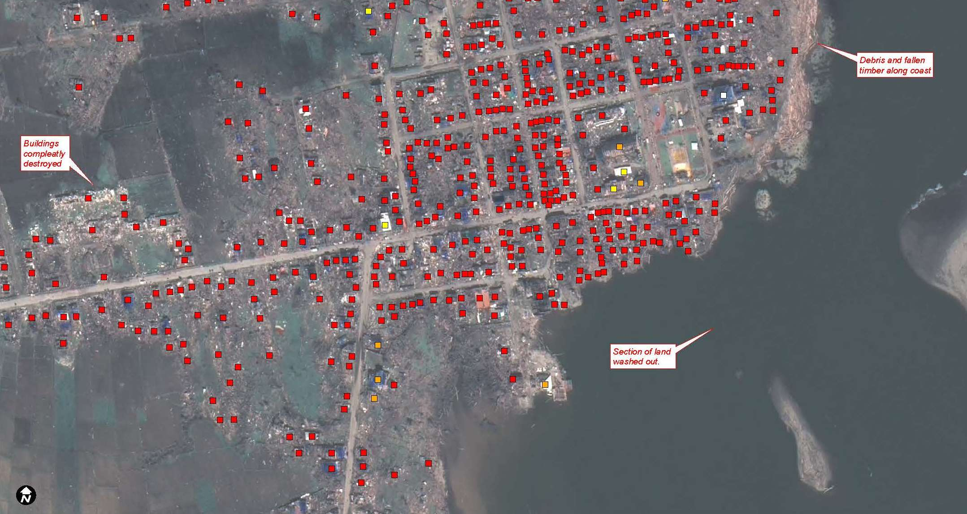
Introduction to UNITAR Operational Satellite Applications Programme (UNOSAT)
Einar Bjorgo, UNOSAT manager (einar.bjorgo@unitar.org)

Slide 32


Introduction to UNOSAT
  An operational programme of the United Nations Institute for Training and Research (UNITAR) serving UN, international organizations and governments
  Fully dedicated to satellite imagery analysis, applications of geospatial information technologies, training and capacity development for full disaster management cycle
  UNOSAT established in 2000 as project by ESA and CNES, then adopted as programme of UNITAR
  30 people
  Presence: Geneva (hosted at CERN), N’Djamena, Nairobi, Bangkok

Slide 33
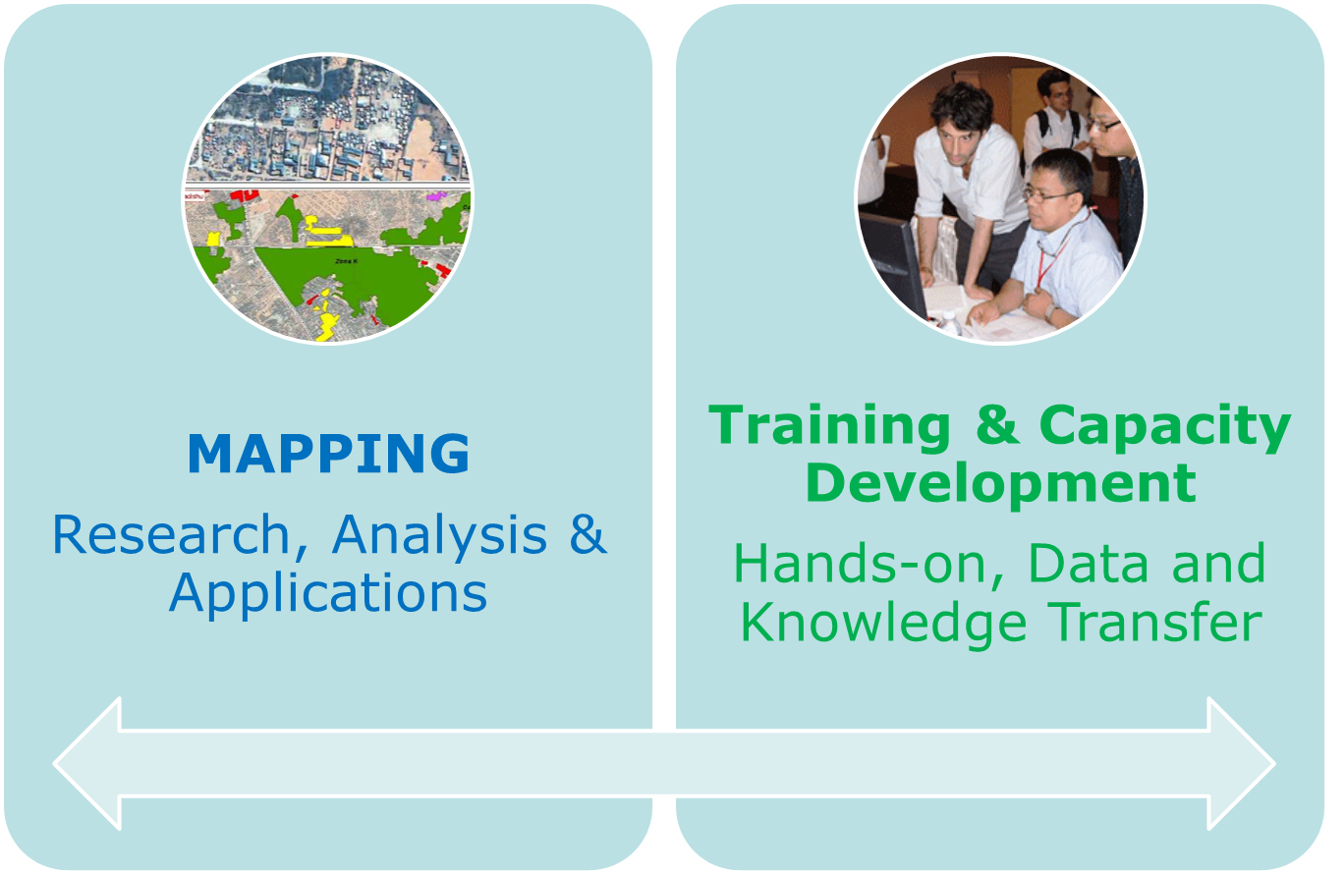
Introduction to UNOSAT
  50%
  50%

Slide 34
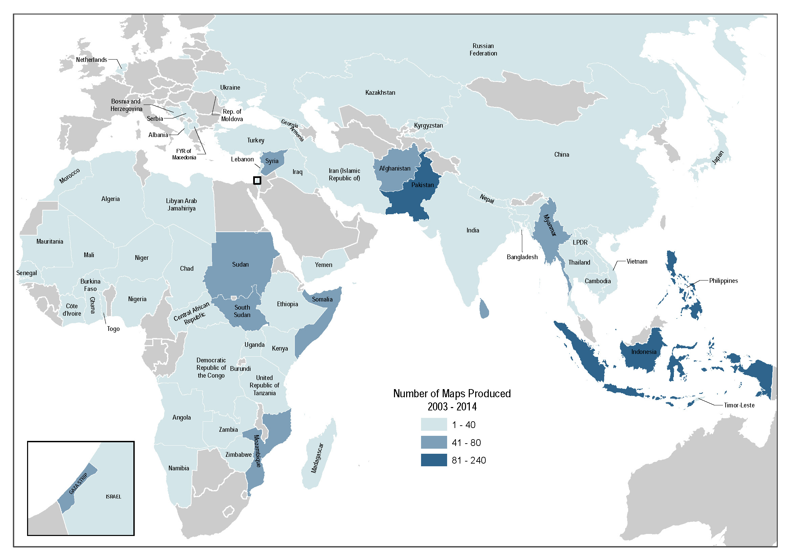

Slide 35
UNOSAT and the RO
Important to mobilize resources for recovery and follow up on QIP (quick impact projects) monitoring, planning and monitoring of reconstruction, definition of potential areas for relocation (vulnerability assessments);
Satellite imagery good complement to UAV and ground photo technologies, to be combined in web-map interface;
Involvement of National Institutions is critical;
UNOSAT is ready to receive the data made available by the RO to produce analysis;
“Build back better” … let’s close the crisis loop!

Slide 36


Cambridge University Centre for Risk in the Built Environment (CURBE)
CURBE has three primary functions:
Research
Dissemination of research findings
Teaching
CURBE focuses on turning ideas into practical projects while creating a skilled team of workers. Research interests of CURBE fall into three broad areas:
Monitoring and observation of the built environment and its hazards
Theory and analysis of risks
Policy and application of risk mitigation strategies

Slide 37

http://www.cam.ac.uk/research/features/ounce-of-prevention-pound-of-cure/

Slide 38
Better information means better ideas,
means better protection.

Slide 39


… in the context of Disaster Recovery and collaboration with the Recovery Observatory
Opportunity to test the application of remotely-sensed data, ground data collection tools and sampling methodologies for planning, monitoring and evaluation of recovery developed in the past 5 years in REBUILDD and SENSUM.
Engage with potential end-users in the development and fine-tuning of methods and tools in post-disaster risk management.
Explore Resolutions to develop the right tools for the job; to provide solutions for different users, at different scales.

Slide 40
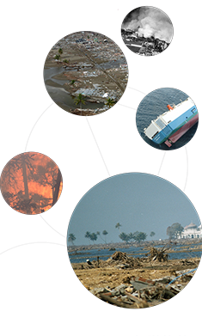
Copenhagen Centre for Disaster research (COPE) and the CEOS RO
Nathan E. Clark
11 March, 2015

Slide 41
PhD Fellow
University of Copenhagen: Faculty of Law
  Centre for International Law and Justice (CILJ)
Copenhagen Center for Disaster Research (COPE)
  Changing Disasters Project
Legal and policy aspects for the use of remote sensing for disaster response
Previous: satellite communications engineering, international relations, development, and disaster management

Slide 42
Standard License Agreement Support
Review of relevant licenses and contracts related to the acquisition, use and dissemination of EO data (raw and processed)
Identify common (and conflicting) terms and conditions
Establish a generic open license appropriate to satellite imagery that recognizes the unique nature of the data provided in support of large-scale disaster recovery

Slide 43
RO Project Assessment
Survey Design
Based on project objectives and user expectations (and my own research interests)
  End-user focused
Validation (dry-run)
Implement after 6 months
Used for later assessments

Slide 44
Recovery Observatory Discussion
Overview, status, objectives, roles of agencies
Triggering
Review of Needs – products and services (stakeholder perspective), User and stakeholder involvement
IT Architecture – presentation of status and projected evolution (WGISS)
Value-adding Strategies
Sustainability and agency involvement, Next steps (beyond initial triggering)
Promotion and Outreach for the RO

Slide 45
Recovery Observatory Development
Version 1 available 1 January, 2015
Shared web-based portal
Geographical and temporal search functions
Display georeferenced images (SPOT and Pléiades are available, CSK, TSX, RSAT-2, ALOS,Sentinel-1, Landsat-8 will be implemented soon)
EO Data available for download (after RO creation):
    high resolution and very high resolution optical imagery;
    high and very high resolution radar imagery (X, C, L-bands).
    airborne data
EO Acquisition Plan management (to be added)

Slide 46
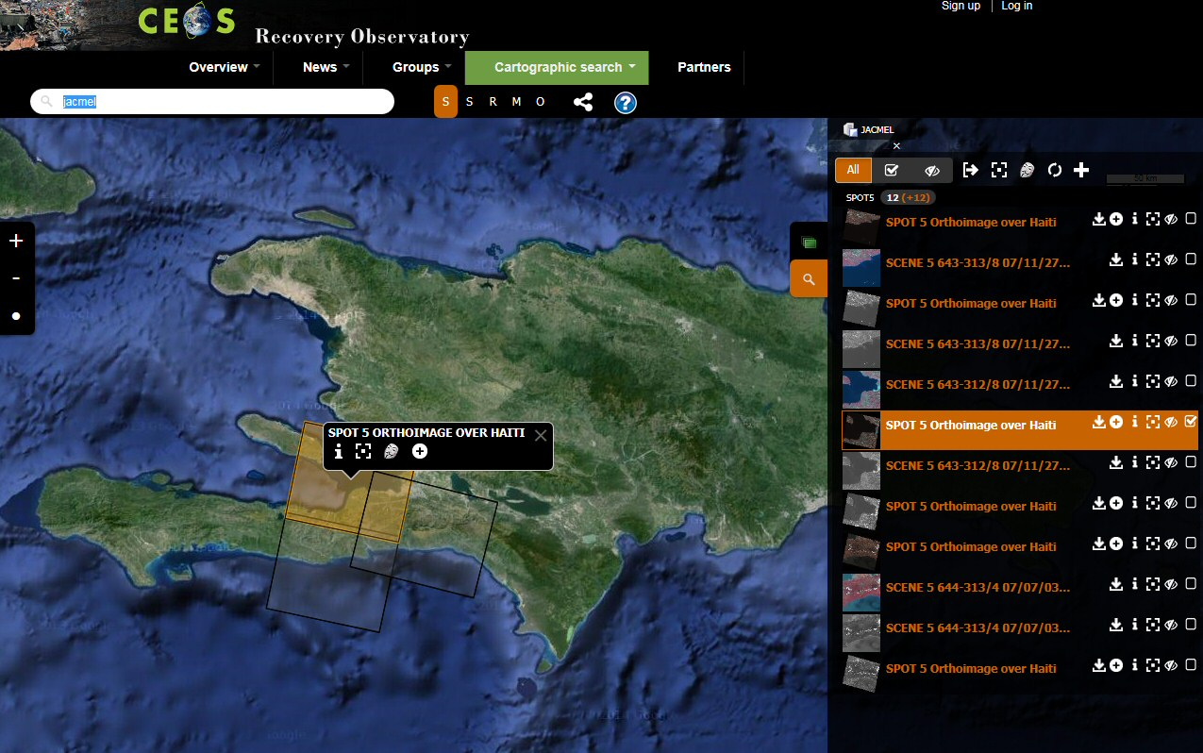
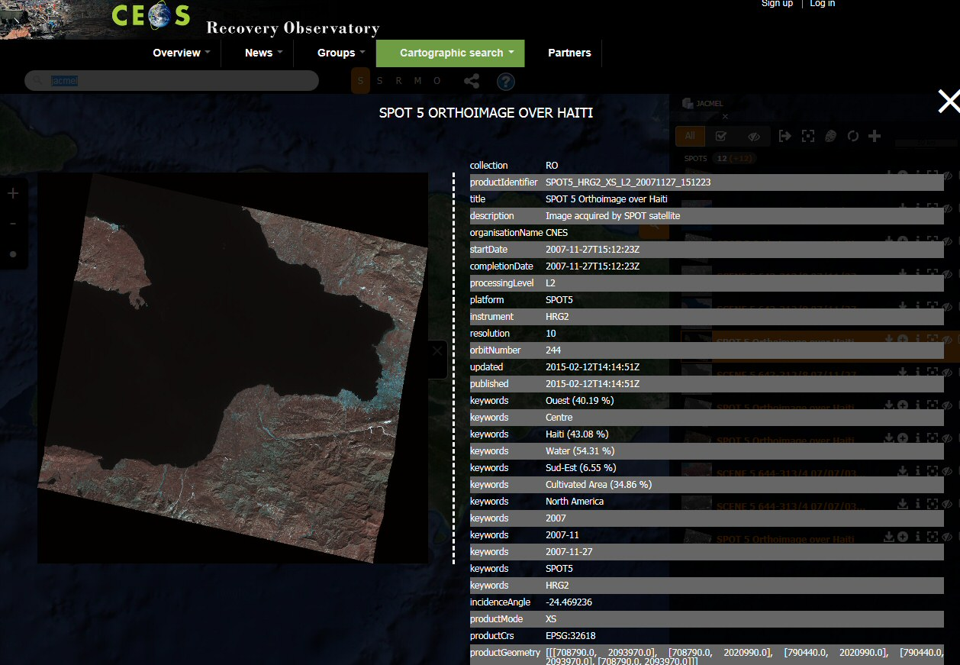
Recovery Observatory Demo
http://dotcloud.akka.eu/drupal/presentation
e

Slide 47
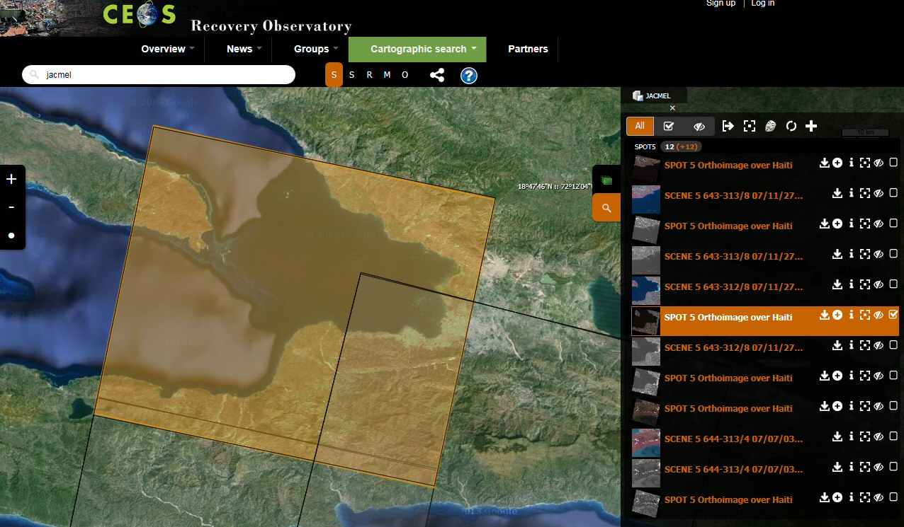
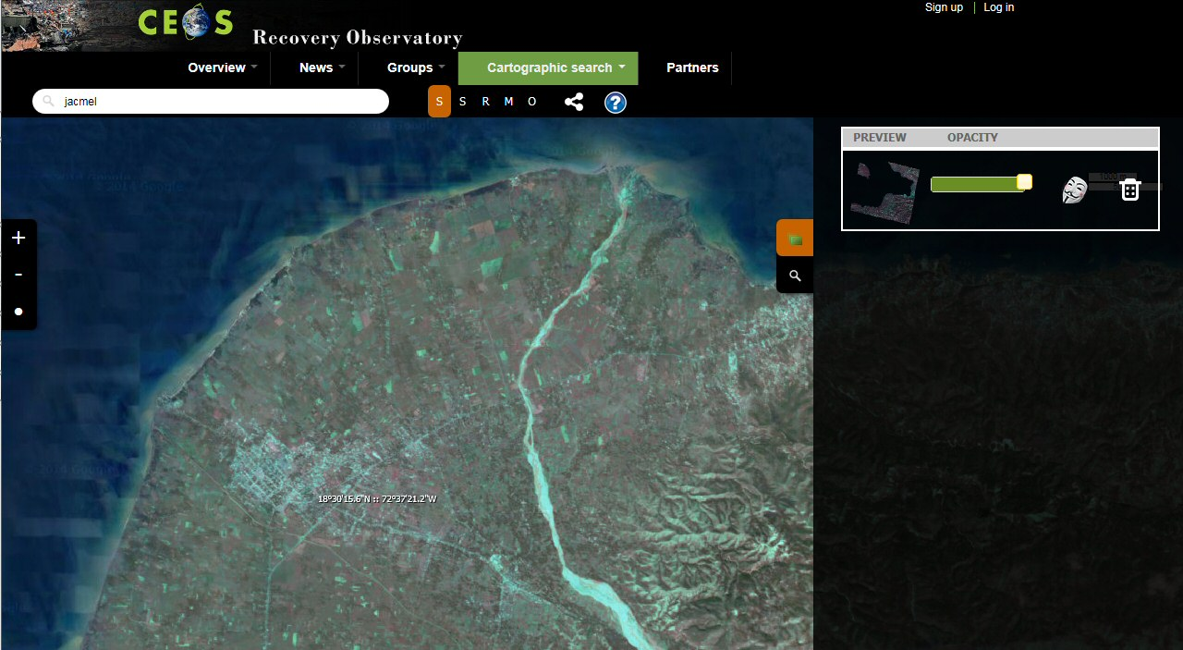
Recovery Observatory Demo

Slide 48
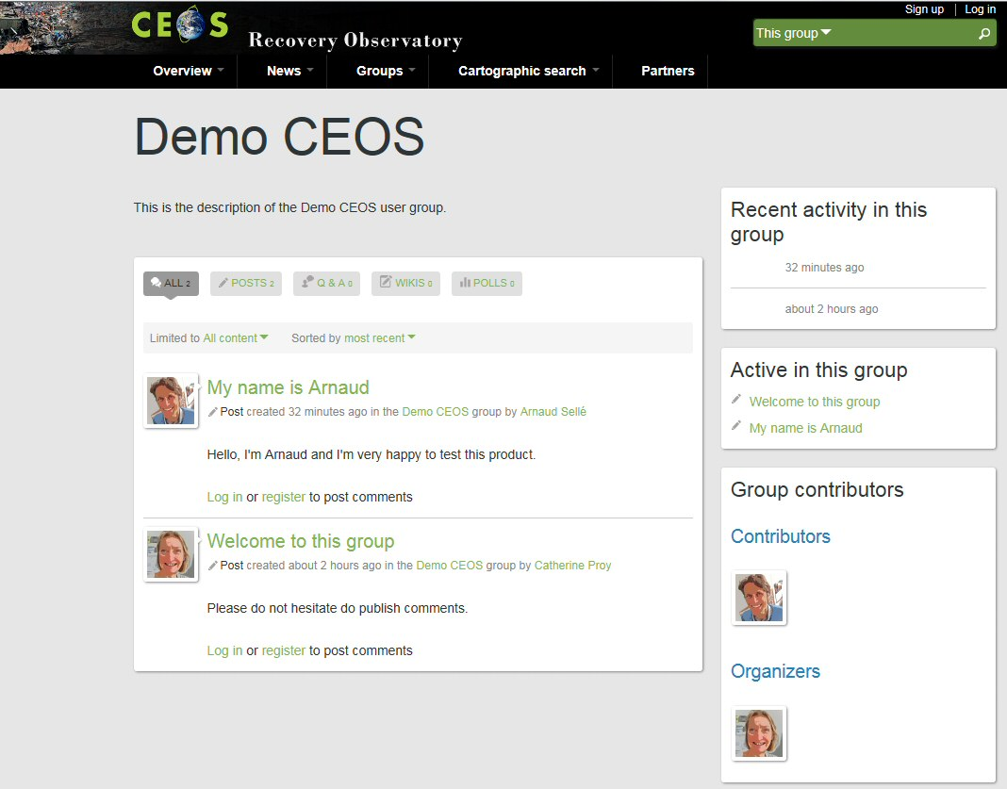
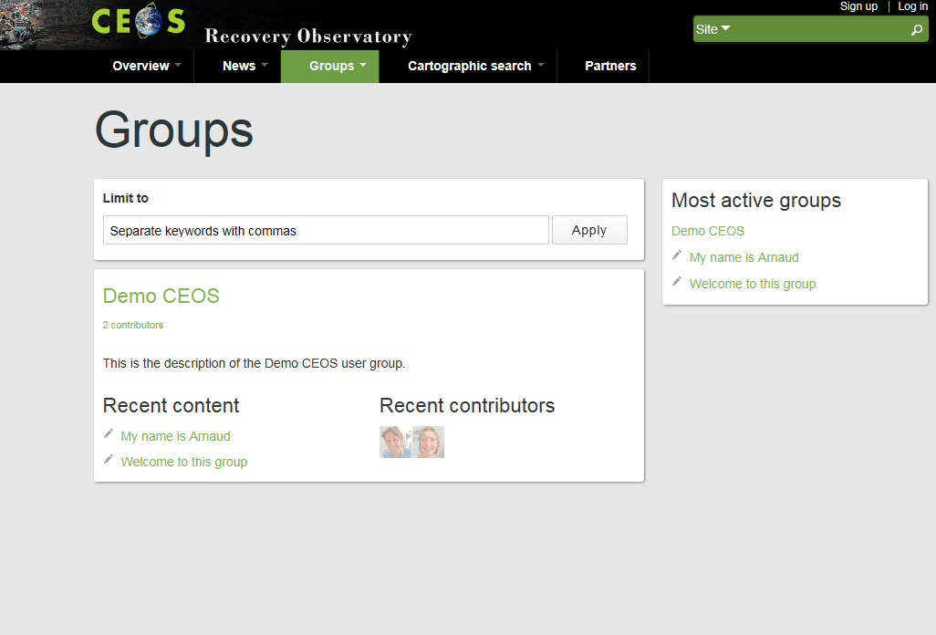
Recovery Observatory Demo

Slide 49
Status of IT infrastructure development
Status of IT infrastructure development
Version 2 available mid 2015 – a collaborative web-based workspace (for groups of users):
To develop networks of users, communities and projects (already integrated in the demo version)
Registration, User profile
Create/join a project community
Resources available for browsing and download
  Ingested EO products for more satellites
  External catalogs : products metadata
  Value Added products, vectors… from Users or RO stakeholders
Community contributed data repository
  In Situ data, ground truth, maps..
  Users contributions : added-value product, reports, publications…

Slide 50
Recovery Observatory Discussion
Overview, status, objectives, roles of agencies
Triggering
Review of Needs – products and services (stakeholder perspective), User and stakeholder involvement
IT Architecture – presentation of status and projected evolution (WGISS)
Value-adding Strategies
Sustainability and agency involvement, Next steps (beyond initial triggering)
Promotion and Outreach for the RO

Slide 51
Value-adding Strategies: multiple approaches
In-kind through partnership
  RO partners with expertise and with secured resources volunteer to join and provide value-added products on a best efforts basis (for PDNAs and RO)
Financed by CEOS agency partners
  CEOS agency places contract with value-adding company (for PDNAs and RO)
Financed through dedicated 3rd party funding
  DRM stakeholders facilitate access to development and/or humanitarian assistance funding for dedicated work on RO (fro RO, after triggering)

Slide 52
Recovery Observatory Discussion
Overview, status, objectives, roles of agencies
Triggering
Review of Needs – products and services (stakeholder perspective), User and stakeholder involvement
IT Architecture – presentation of status and projected evolution (WGISS)
Value-adding Strategies
Sustainability and agency involvement, Next steps (beyond initial triggering)
Promotion and Outreach for the RO

Slide 53
Oversight Team (ROOT) Membership
Space agencies:
CNES – chair (Steven Hosford and Catherine Proy)
ASI (Simona Zoffoli)
DLR (Jens Danzeglocke)
ESA (Ivan Petiteville)
JAXA (Chu Ishida and Nobuyoshi Fujimoto)
NASA (Stuart Frye)
DRM Stakeholders:
UNDP (Chiara Mellucci)
UNOSAT (Luca Dell’Oro and Einar Bjorgo)
World Bank/GFDRR (Keiko Saito)
Secretariat support provided by Athena Global (Andrew Eddy)
Membership is open to all CEOS agencies with an interest in the RO.
Associate Members are invited from donor and DRM stakeholder agencies.
Notes:
Proposal
set-up and agree all organisational aspects (including procedure to decide on the creation of an RO following a major event)
create ONE pilot RO following a major event during the CEOS DRM activities
Example of “Kalhaiti” RO established by CNES following Haiti earthquake, Jan 2010
integration of large quantity of EO data acquired during the Charter activation (approx. 3Tb – 69000 files)
regular acquisitions during Recovery period (<150 images since 2010)
large community of local and international users
HOWEVER:
Kal Haiti is effort driven by one agency (although some data from other agencies has now been contributed)
Kal Haiti was established well after the event
Opportunities to support early recovery not fully exploited
For these reasons, Kal Haiti is not a true showcase of what is possible with satellite EO during major recovery effort

Slide 54
RO Lifecycle
Preparation
Infrastructure
Institutional relationships
Triggering
Charter activation monitoring
Establishment
Product development
Scenario building
Summary Event Report
Decision by ROOT to trigger
Upload of Charter data and baseline products
Operations
Preliminary Data Acquisition Plan
Link to national end user
Development of RO activity grid
Research and training & capacity development
Liaison and development of links with end users
Promotion and Outreach
Reporting
Evaluation (+ 6 months) and lessons learned
Value-adding coordination
Initial reporting
IT maintenance
Legacy planning
PDNA support
Protocols for RO operations
Notes:
Before activation (now)
Development/characterization of product list with UNDP, WB (and others) in coordination with UNOSAT (and others)
Update of existing scenarios including estimates of volume of data to be tasked and processed
Preparation of data processing (ortho-rectification and atmospheric corrections) with involved CEOS agencies
Preparation of value-adding strategy (who? how? in kind contributions? funds?)
License for RO data use (CNES for SPOT and Pleiades, others?)
Pre-triggering RO activities (strategy for PDNAs and for 1st RO; others? which agencies would host and operate)
Link between the RO and the CEOS WEB pages
Development of IT and data ingestion process
Triggering preparation:
Rapid report on situation to support triggering
Interface with stakeholders for product needs, coordination with other initiatives…
Preliminary definition of acquisition plan (V0)
Analyze of possible implementation of IT (deployment, hosting, project management and operations)
After activation (3 to 6 months)
Implementation of the RO when triggered
First operations: upload of Charter data and result, PDNA or for RO, baseline first products for recovery planning and monitoring
Coordination activities:
Interface with stakeholders for precise definition of needs and identification of national entities to involve
Interface with the national institutions for product needs, coordination with other initiatives…
Definition of the acquisition plan (v1) and initial liaison with agencies
Establishment of formal institutional relationship with national entities (definition of role and responsibilities, identification of funding sources if available)
Elaboration of the RO activity grid (applications……)
Reporting to CEOS on development of RO and recommendations on issues to address
Building of research and training activities
On-going operations (1 to 3 years)
Coordination activities:
Liaison and development of institutional relationships, new relationship building
Promotion and outreach (including long term promotion of RO within country)
Development of lessons learned and replication of RO model (in other countries)
Value-adding coordination and new product development; new value added partners
Regular Report of technical results to national institutions
Support to national users (technical and policy), including new service development
Coordination and animation of new research activities around RO concept
Management of the activity (applications) grid in coordination with the project manager
Formal report to CEOS on RO (annual)
Project Management activities
Management of the acquisition plan and tasking with CEOS agencies
Management of RO content (data, product, news, documents)
Management of data processing
Technical reporting
Development of long-term plan for RO after initial set-up (1-3 years)
Maintenance of the RO IT (corrections, evolutions)
VA generation
Preparation of closure
Evaluation
Legacy strategies

Slide 55
Sustainability
Sustainability Issues for Operations:
Liaison and development of institutional relationships, new relationship building
Development of lessons learned and replication of RO model (in other countries)
Value-adding coordination and new product development; new value added partners
Regular Report of technical results to national institutions
Support to national users (technical and policy), including new service development
Coordination and animation of new research activities around RO concept
Management of the activity (applications) grid in coordination with the project manager
Management of the acquisition plan and tasking with CEOS agencies
Management of RO content (data, product, news, documents)
Management of data processing
Technical reporting
Development of long-term plan for RO after initial set-up
Maintenance of the RO IT (corrections, evolutions)

Slide 56
Agency Involvement
Agency Involvement:
Data contributions
Value-added support
IT infrastructure
Project management (technical management, linkages with value-adders and end users)
Project animation (workshops, ateliers, capacity development and training

Slide 57
Licensing
Users of RO Data and Products:
National end users (government of affected area with mandate for recovery and reconstruction and other government ministries)
International humanitarian GOs and NGOs with interest in reconstruction (e.g. IFRC, OCHA)
International stakeholders with interest in post-disaster needs and recovery/reconstruction financing (e.g. GFDRR, UNDP, EU, UNEP)
Value-added product generators (academia, research institutes, companies, specialised organisations (e.g. UNOSAT)
Scientists
Need to check if licences are adapted to this type of distribution.
For CNES data, there is an existing licence enabling all partners of a defined project to access data.
Objective: broaden this to a defined area for a defined period for non-commercial applications of recovery managers.

Slide 58
Recovery Observatory Discussion
Overview, status, objectives, roles of agencies
Triggering
Review of Needs – products and services (stakeholder perspective), User and stakeholder involvement
IT Architecture – presentation of status and projected evolution (WGISS)
Value-adding Strategies
Sustainability and agency involvement, Next steps (beyond initial triggering)
Promotion and Outreach for the RO

Slide 59
Promotion and Outreach
Promotion and Outreach:
Identification of key target users and development of institutional relationships
Identification of ‘secondary’ user communities and promotion within these groups
Organisation of workshops and training sessions
Explanation of process to international DRM community
Participation in critical DRM venues and promotion of RO success
Identification of lessons learned and development of legacy strategies including long-term financial partners for replicated Observatories

Slide 60
Thank you!
for more information:
steven.hosford@cnes.fr
catherine.proy@cnes.fr

