Slide 1

Status and new directions of the GSNL initiative
Stefano Salvi
Chair of the Supersites Advisory Committee
CEOS WG Disasters, Tokyo, March 2015

Slide 2
Status (since Paris meeting) - 1
Two new Supersites formally established:
Tungurahua and Cotopaxi volcanoes, Ecuador: PoC Patricia Mothes, Instituto Geofísico, EPN
Taupo volcanic zone, New Zealand : PoC Nico Fournier & Ian Hamling, GNS Science
Publications:
Napa Event Supersite results have been published, but is unclear if data came through GSNL.
Bardabunga Icelandic volcano eruption covered under the Iceland Permanent Supersite. Excellent results published in Nature: Sigmundsson, Freysteinn, et al. "Segmented lateral dyke growth in a rifting event at Bararbunga volcanic system, Iceland." Nature (2014).
AGU Supersite splinter meeting, UN COPUOS presentation, EGU 2015 session, Fringe 2015 presentations, ISRSE 2015 presentations

Slide 3
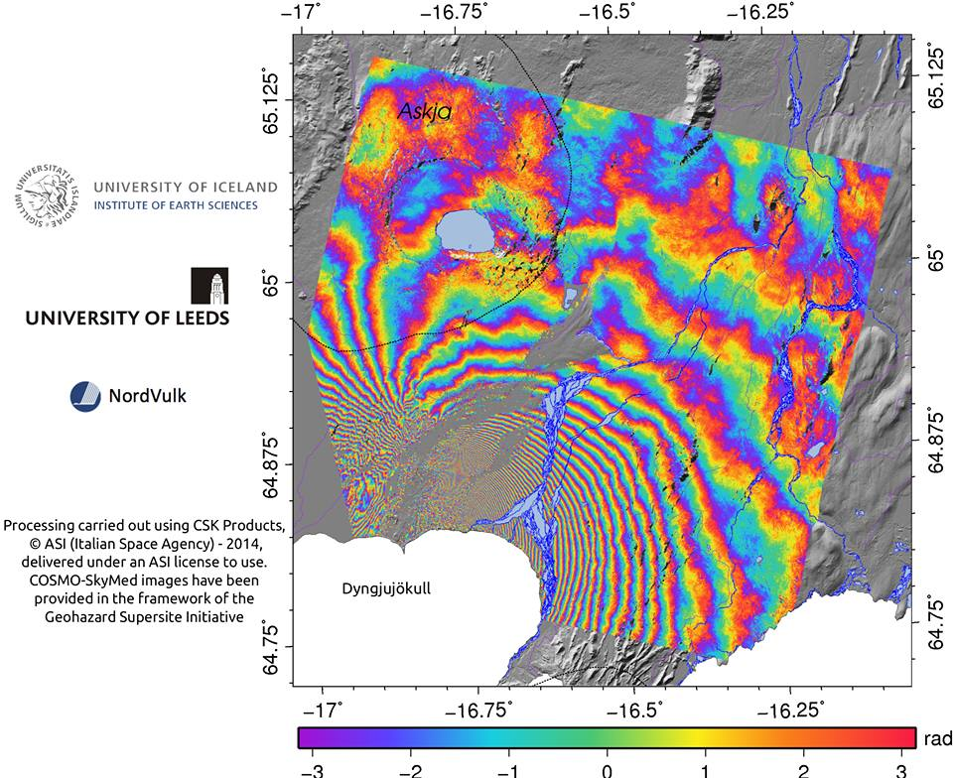
Bardabunga volcano deformation

Slide 4
Status - 2
Coordination with the CEOS WG Disasters and DCT:
Working to cross reference the initiatives on the respective websites, to allow an informed choice for scientists
Talks started on possible delivery of Supersite products to end-users through the Charter (formal steps required)

Slide 5
Status - 3
A new Supersite approval procedure has been drafted (with Brenda). It is still under revision by SAC. New criteria:
evidence of existing or planned infrastructures/procedures for data access
scientist accept the Supersite data policy for in situ data (to be defined)
data access through web-services can be provided
scientists commit to provide science products in digital format with a CC BY NC license
proposal core team is open to collaborate with other Supersites/international initiatives
good level of involvement of the end-user community
proposal core team commits to support end-users' uptake of the science products (also by addressing their requirements)

Slide 6
Status - 4
Supersite reporting:
Preparation of the templates for the annual and biannual reports
First biannual report received from Hawaiian volcano Supersite. According to Mile Poland’s report: “The Hawaiʻi Supersite has been an unparalleled success“. Some issues are discussed later.
Annual reports to be compiled online every 12 months
Preparation of a questionnaire for each Point of Contact to report on the in situ data policies (to be sent in March)

Slide 7
Due dates of next reports
Supersite | Annual 1 | Biennial 1 | Annual 2 | Scientists involved
Hawaii volcanoes |  | 26/10/2014 | 26/10/2015 | 17
Iceland volcanoes |  | 06/11/2015 | 05/11/2016 | 8
Etna volcanoes | 10/04/2015 | 09/04/2016 | 09/04/2017 | 15
Campi Flegrei volcanoes | 10/04/2015 | 09/04/2016 | 09/04/2017 | 11
Marmara fault | 10/04/2015 | 09/04/2016 | 09/04/2017 | 20
Ecuador volcanoes | 30/10/2015 | 29/10/2016 | 29/10/2017 | 12
Taupo volcanoes | 30/10/2015 | 29/10/2016 | 29/10/2017 | 6

Slide 8
Status of Supersite in situ data distribution-1
Hawaii Supersite:
Type of data | Data provider | How to access | Type of access
GPS | USGS – Hawaiian Volcano Obs. | UNAVCO | unregistered public
Seismic | USGS – Hawaiian Volcano Obs. | IRIS | unregistered public
Gas Emissions | USGS – Hawaiian Volcano Obs. | USGS Open-File Reports | unregistered public
Gravity | USGS – Hawaiian Volcano Obs. | Published manuscripts* | unregistered public
Tilt | USGS – Hawaiian Volcano Obs. | Contact HVO scientists** | GSNL scientists
Camera | USGS – Hawaiian Volcano Obs. | Contact HVO scientists** | GSNL scientists
Strain | USGS – Hawaiian Volcano Obs. | Contact HVO scientists** | GSNL scientists

Slide 9
Status of Supersite in situ data distribution-2
All the other Supersites are still using ftp repositories, publications or personal contacts, no Web services yet.

Slide 10
Issues - 1
Hawaii Supersite biannual report highligthed some important issues:
For some data (TerraSAR X) PoCs do not know who is downloading/using the data and cannot properly report
The procedure for accessing Supersite SAR data should be standardized
Need to access High-res DEMs to fully exploit SAR information
Are TanDEM X DLR data available to Supersites?
Could ASI provide higher temporal resolution data (now is 16 days)?
Dissemination is less than optimal:
Need for an Hawaii Supersite website to disseminate info and results, but there are no resources
Sharing of science products could stimulate further research but possible solutions also require funding.

Slide 11
Issues - 2
coordination with the CEOS Pilots
data policy: will the wider scientific community have access to the same data as the pilots, may be after a certain latency period?
Need to have clear rules on the engagement of volcano pilot vs GSNL over large eruptions
ALOS (1-2) data by JAXA should be an important component of Supersites and NL, we need to find a way to make this happen.

Slide 12
Activities Jan.-Feb. 2015
First draft of a proposal for a Southeast Asia Natural Laboratory (SEANLab) prepared and circulated
@WCDRR : Ignite presentation on GSNL concept (Tuesday 17 at 5:45 pm)
@WCDRR : Side meeting to discuss SEANLab with stakeholders at Tohoku Univ. Library Tuesday 17 at 2 pm

Slide 13
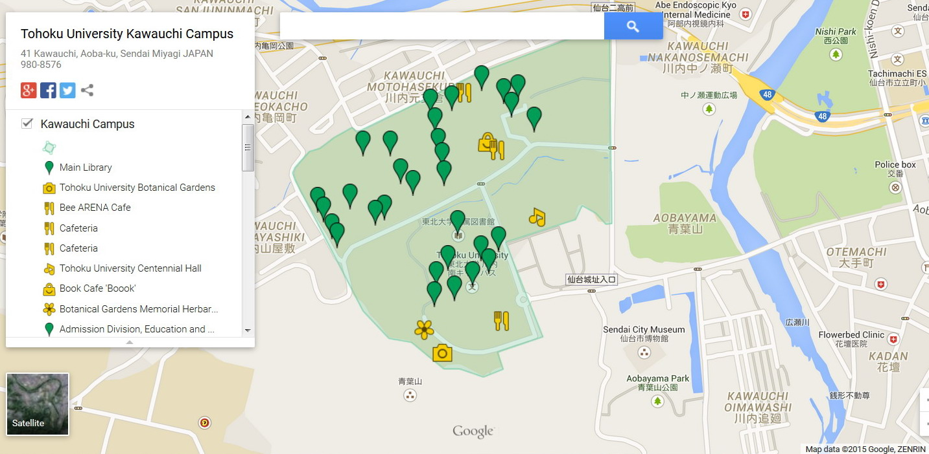
WCDRR SEANLab meeting venue
Tohoku Univ. Library Tuesday 17 at 2 pm
Tohoku Univ. Main Library
Sendai International Center

Slide 14
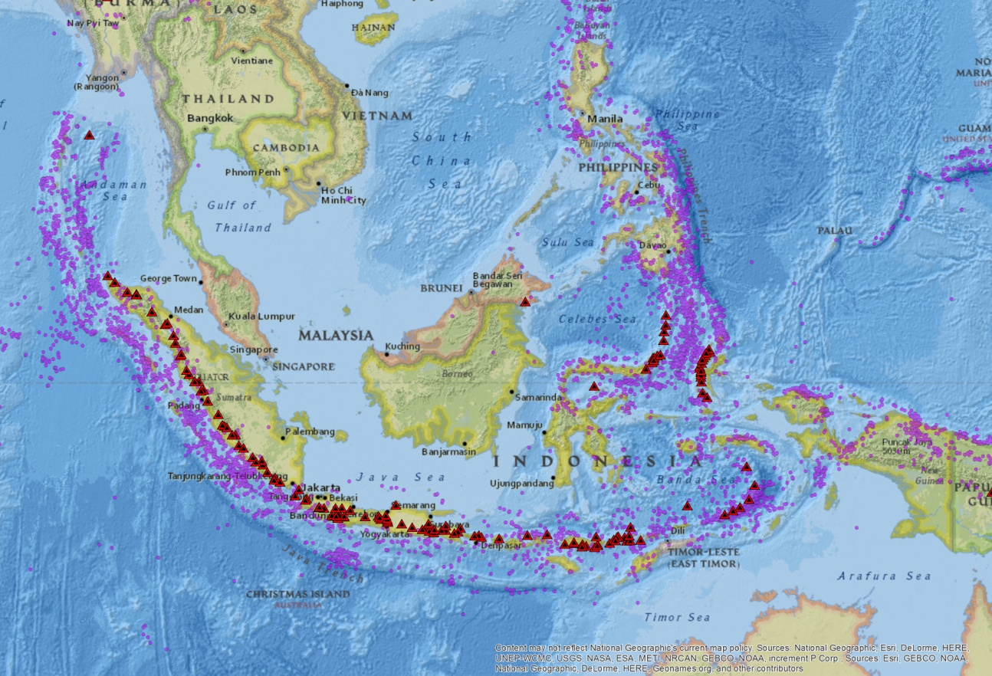
South East Asia:
World’s highest concentration of geohazards

Slide 15
Volcanic risk
The area bears 75% of global volcanic risk. 245 active volcanoes:
4 mega-eruptions in the last millennium, with global effects on climate (e.g. “the year without summer” following the 1815 Tambora eruption). They can also generate strong tsunamis.
1 “normal” eruption per year on average
Strong risk for aviation (about 750 civil flights cross the volcanic belt every day). One encounter per year on average.
Volcanic ash falls are often turned into deadly mudflows due to tropical rainfalls.
In the last 50 years, >6000 casualties and >170,000 evacuees due to eruptions.
Notes:
Krakatoa tsunami in 1883 killed 35 to 120k.

Slide 16
Seismic risk
Large subduction zone thrust faults
Can generate mega-earthquakes (e.g. M9.2, Sumatra-Andaman eq in 2004)
Can generate destructive tsunamis, with extremely large losses.
Increasing exposure levels due to coastal urbanization and touristic developments.
Regional crustal faults, and largely unknown local faults
Moderate to large shallow earthquakes (M6-7)
Poor construction practices and site amplifications strongly enhance earthquake damage.
Fast urban expansion of several metropolitan areas implies growing seismic risk.

Slide 17
Landslide risk
Very high landslide susceptibility, due to rainfall, seismic shaking, favourable lithology.
Landslide hazard is increasing, due to higher frequency of extreme rainfall events.
Hazard is also enhanced by deforestation and expansion of human developments in hilly terrains around large urban centers.
According to UNISDR Indonesia is first out of 162 countries for human exposure to landslides.
More local damage than earthquakes or eruptions, but much higher frequency. Hundreds of victims every year.
Often triggered by seismicity and associated to eruptions (multiple hazard assessment).

Slide 18
Subsidence risk
Very strong subsidence occurs due to anthropogenic causes, more limited subsidence rates can be of natural origin.
Subsidence is affecting all major urban areas in SE Asia, with rates up to tens of cm per year.
Massive groundwater (or fluid) extraction for agricultural, domestic, and industrial use is the main cause.
Natural compaction of recently deposited sediments (as in river deltas) is a way more limited phenomenon.
May cause direct structural damage if strong gradients exist.
Impacts on acquifer production capacity and on sea and river flooding (e.g. strong impacts in Jakarta)

Slide 19
Goals of SEANLab
Create the conditions for obtaining scientific advancements in geohazard and risk assessment.
Create the conditions for a more direct uptake of updated scientific information in DRR, able to benefit the geohazard prevention and disaster response activities.
Help develop better risk assessment and management capacities through an international collaborative environment.

Slide 20
Main pillars of SEANLab
Provision of easier data access (EO and in-situ). Will result in:
Increased number of research teams at work on the area
Promotion of new science results and societal benefits
Provision of digital research products. Will result in:
Direct cross-validation of monitoring products and models.
Development of better science results and societal benefits
Provision of locally coordinated, consensus research products with direct impact on DRR. Will result in:
Easier and faster uptake of research results by DRM end-users.

Slide 21
SEANLab partnership
The partnership includes four main communities:
in-situ data providers (mostly national agencies, but also international projects),
satellite data providers (CEOS space agencies),
the global scientific community (knowledge providers)
the local DRM community (end-users)

Slide 22
In-situ data
How
it works
Science Team #1
Science Team #2
Science Team #3
CEOS Satellite data
Virtual
repository
Science Product A1
Science Product B1
Science Product A2
Science Product A3
Science Product B3
Knowledge processing
(search, compare, validate, model, document, report)
NAA coordination
G-VCP
Consensus product A (geophysical observable, hazard model, predictive scenario, etc.)
E-VCP
Risk products to local DRM
NAA
Integration to generate usable risk product
Other hazard info
Exposure
Vulnerability
Value

Slide 23
Shared principles:
Open exchange of data (GEO principles)
There will be full and open exchange of data, metadata and products, recognizing relevant international instruments and national policies and legislation;
All shared data, metadata and products will be made available with minimum time delay and at minimum cost;
All shared data, metadata and products will be free of charge or no more than cost of reproduction for research and education.
However:
GEO acknowledges that specific legislation may limit the data sharing, e.g. during disaster response, or for commercial reasons.
There will be agreed data sharing policies for in situ and satellite data among the partners.

Slide 24
Shared principles:
Open exchange of research products
Open exchange policy for research products, with license allowing re-use for non-commercial purposes.
Products will be provided in digital form after publication.
During the Disaster Response phase products provided before publication will be exploited for DRM respecting the IPRs.

Slide 25
Shared principles:
Local coordination
Diffusion of research results which are not well validated and reviewed by the community may generate confusion in disaster managers and the public at large.
The SEANLab science product uptake will be coordinate locally by a set of national authoritative agencies (NAA) responsible for the various geohazards and risk factors.
They will coordinate the process for the generation of consensus research products, and disseminate the products to the public agencies in charge of DRM at all scales.

Slide 26
Governance & infrastructure
Given the complexity of the community, a well defined governance is fundamental
Governance model will be discussed within the partnership
SEANLab should be fully integrated with existing regional initiatives on DRR (Sentinel Asia, ADRC, AIFDR, AIFDR, etc.)
Technical infrastructure initially based on best effort, with plans for development
A virtual collaborative platform would be needed for the process of developing the consensus research products.

Slide 27
Resources
Resources for the reseach work will be obtained directly by the community through national and international sources.
Resources for in situ data sharing to be obtained at national scale or through international development funding.
Resources for data sharing: reuse of existing infrastructures
Resources for the virtual collaborative environment to be found at international level.

