Slide 1
CEOS Working Group Disasters – Meeting # 3 (JAXA, Tokyo, 10-12 Mar. 2015)

Slide 2
Meeting Objectives

Slide 3
Meeting Main Objectives
Pilots:
Assess the current and future provision of data
Review the data use and outcomes from Pilots
Assess proposal for new pilot on Landslides
Recovery Observatory:
Review the involvement of external stakeholders
RO triggering procedure to be consolidated wrt CEOS
Test of the infrastructure prior to 1st RO triggering
WCDRR:
Consolidate participation incl. deliverables to Sendai
Prepare the after-Sendai
Web Site: to be conolsidated

Slide 4
Meeting Agenda Overview
TUESDAY 10 | WEDNESDAY 11 | THURSDAY 12
Welcome & Introduction | Floods | Distance Education Course
2015 WCDRR & HFA2 |  | Volcanoes
 | Recovery Observatory | Final preparation of Sendai materials
Pilots Overall Status – Data Access & Data Use | Supersites Initiative CEOS Web Site News from Agencies (JAXA)
Landslide proposal
Seismic Hazards
9 AM
1 PM
LUNCH
…….END !!!
7 PM

Slide 5
WCDRR & HFA 2

Slide 6
Post-2015 framework for DRR (HFA2)
As Observer, CEOS participated in 2 (out of 4) negotiations meetings ; last negotiations on 13th in Sendai (day before WCDRR starts)
Significant progress for space EO with 2 explicit and several implicit references to remote sensing than in 1st draft (August 2014).
Includes about 20 references to climate change.

Slide 7
Working session # 22 - White Paper
Session on ‘Earth Observations and High Technology to Reduce Risks’;
CEOS co-organiser with Japan (MEXT, JAXA), GEO, UNOOSA, UNITAR and other organisations.
White Paper on “Earth observations in support of national strategies for disaster-risk management” prepared with few partners (GEO, UNOSAT/UNITAR, UNOOSA, UNESCAP):
But diverging points of view between current partners on organisation and framework (GEO vs UN)
Might lead to 2 initiatives …..

Slide 8
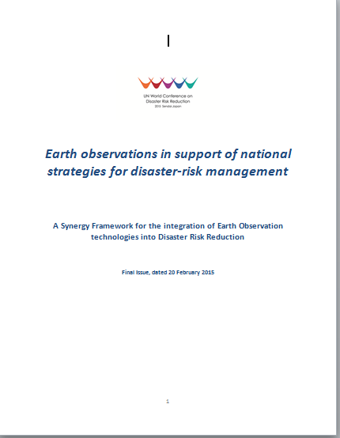
White Paper (1/2)
Purpose: create a synergy framework to better exploit EO technology for the benefits of the DRR community at global and national scale for the implementation of the new post-2015 Framework for DRR.
Partners are experts in EO (satellite in-situ..), practitioners capable to exploit EO data e.g. scientists or value-added companies capable to transform EO data into risk information products, and end-users such as regional and national decision-makers.
Several parallel projects (similar to Pilots) responding to requirements of global DRR community within the resources available

Slide 9
White Paper (2/2)
Priority areas of action to be defined by the partners following WCDRR in consultation with national and international stakeholders
Long term objective:
prepare the ground to:
ensure the future sustained availability of satellite and ground observations and their use in support of DRR & DRM
support countries in the use of EO data and derived information for their national DRR-related activities, taking into account national choices of data and tools.

Slide 10
Working sessions # 30 & 3
Together with GEO, CEOS will participate in a working session (# 30) on:
‘Measuring and Reporting Progress of the post-2015 framework for disaster risk reduction’.
In addition, CEOS will provide a presentation of both the “CEOS DRR activities and of the International Charter” at the Public Forum (Working session # 3 ?)

Slide 11
IGNITE sessions
3 IGNITE sessions (15’ talk) on:
"New knowledge for a more effective DRR through Earth observation“ (GEO SEC)
"New knowledge for a more effective DRR: the GEO GSNL approach“ (Stefano Salvi)
"A Synergy Framework for the integration of Earth Observation into Disaster Risk Reduction“ (Ivan Petiteville)

Slide 12
e-Tutotial by UNITAR
Module on "Technologies for DRR: The Case of Earth Observation" produced by UNITAR
Features 4 video lectures by Simonetta di Pippo (Director UNOOSA), Francesco Gaetani (GEO), Einar Bjorgo (UNITAR-UNOSAT) and Ivan Petiteville (CEOS)
Provides an introduction to the Role of technologies in supporting the DRR efforts of local, national and international actors, with a special focus on Earth Observation technologies

Slide 13
Material for CEOS Booth
CEOS booth hosted in JAXA booth . Thanks to JAXA !
CEOS EO Handbook Special WCDRR
on-line version on EO handbook web site
2000 paper copies to be distributed at the WCDRR venue
300 copies sent by courier worldwide to key persons and organisations involved in DRM - with a cover letter from both CEOS Chair (Mr Yamamoto) and ESA EOP Director (Mr Liebig).
Poster (see next slide) and one 7-minute video

Slide 15
Next steps incl. 2015 WG meetings

Slide 16
Next Steps: Pilots
Pilots:
continue with delivery of data to practitioners and ramp up with new missions e.g. Sentinel-1, ALOS-2,etc
Improve the data request mechanism by distinguishing Pilots and Supersites quotas
Pursue engagement of users as identified in pilots proposals and collect user feedback on data use
Consolidate the Event Supersites selection process
Ask Plenary approval for 2 new Permanent Supersites (Ecuador and NZ)
Consolidate Landslides Pilot proposal (for info at 2015 Spring SIT meeting and approval at 2015 CEOS Plenary (Oct. or Nov.)

Slide 17
Next Steps: RO
Recovery Observatory:
Continue with implementation of IT infrastructure (WGISS lead)
Consolidate engagement of Stakeholders in RO e.g. for RO triggering
WCDRR
Participation in 2nd PrepCom meeting (Nov., Geneva)
Coordinated participation in Open-ended HFA-2 Consultative meetings incl. lobbying via national governments
CEOS EO HB - list of articles to be consolidated – articles written by mid-Nov
CEOS booth – registration and define the booth content.

Slide 18
WG Meetings in 2015
Two suggestions for 2015 – to be discussed
WGDisasters # 3 in Japan (Tokyo, 11-12 March, week before Sendai)
WGDisasters # 4 in Frascati (Italy) (week before SIT Technical workshop - Darmstadt, around mid-September)
In future, participation extended to full WG ?
Longer meeting with 2 or 3 days dedicated to working meetings for each sub-group (pilots, RO, ….) and 2 days for WG-level matters

