Slide 1

ICT and EO for DRR in Southeast Asia
GEO-DARMA Concept Workshop
Tiziana Bonapace, Director, Information and Communications Technology and Disaster Risk Reduction Division, UNESCAP

Slide 2
ESCAP and RESAP
United Nations Economic and Social Commission for Asia and the Pacific (ESCAP)
62 member and associate member States
ESCAP’s Regional Space Applications Programme for Sustainable Development (RESAP) has been operating for around 22 years
Covers 25 member States
Guided by Resolution 69/11
Implementation of the Asia-Pacific Plan of Action for Applications of Space Technology and Geographic Information Systems for Disaster Risk Reduction and Sustainable Development, 2012-2017, though focus is primarily on disasters

Slide 3
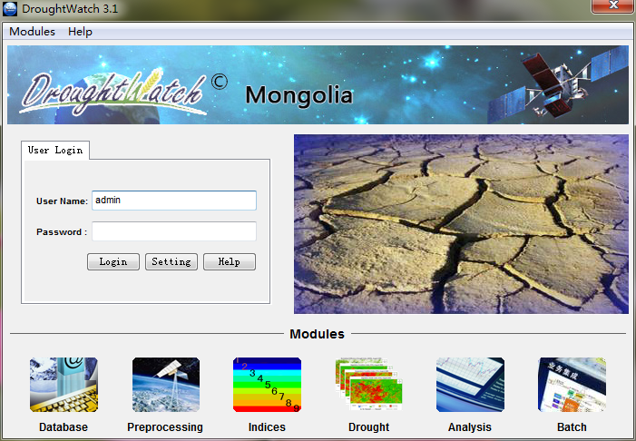
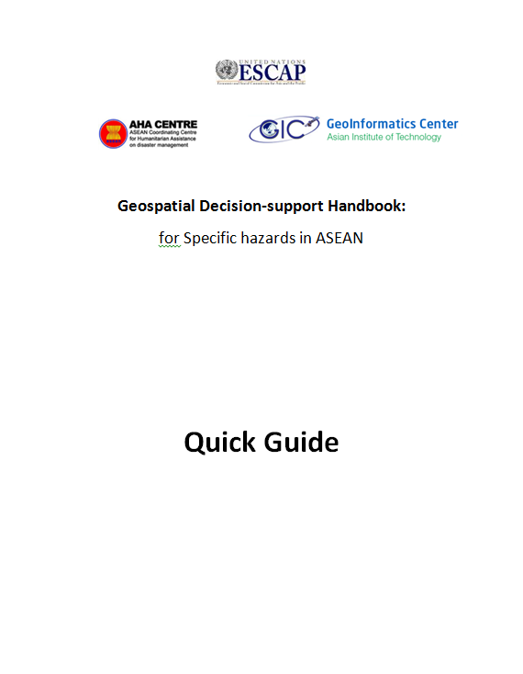
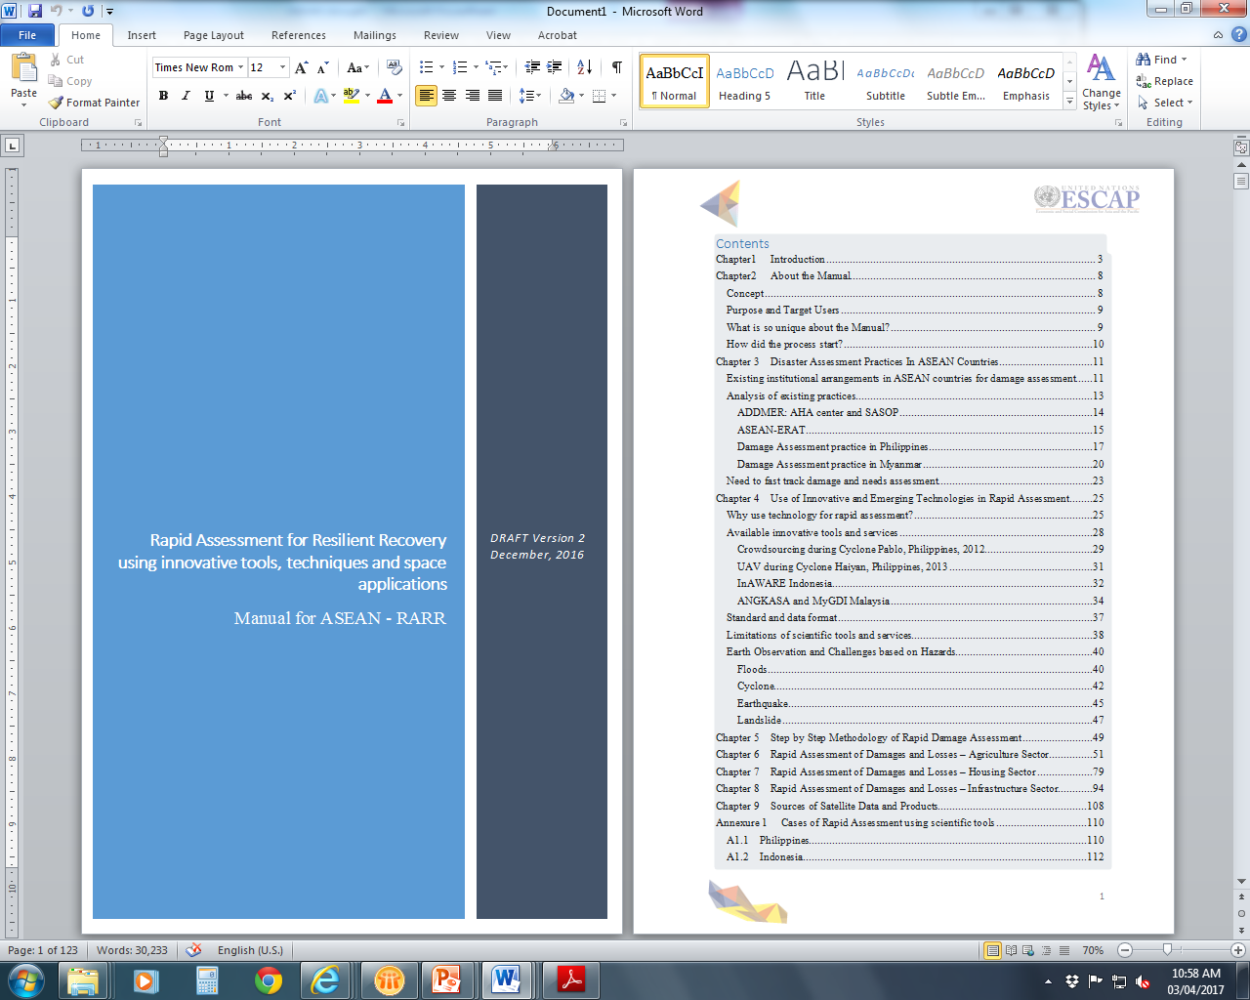
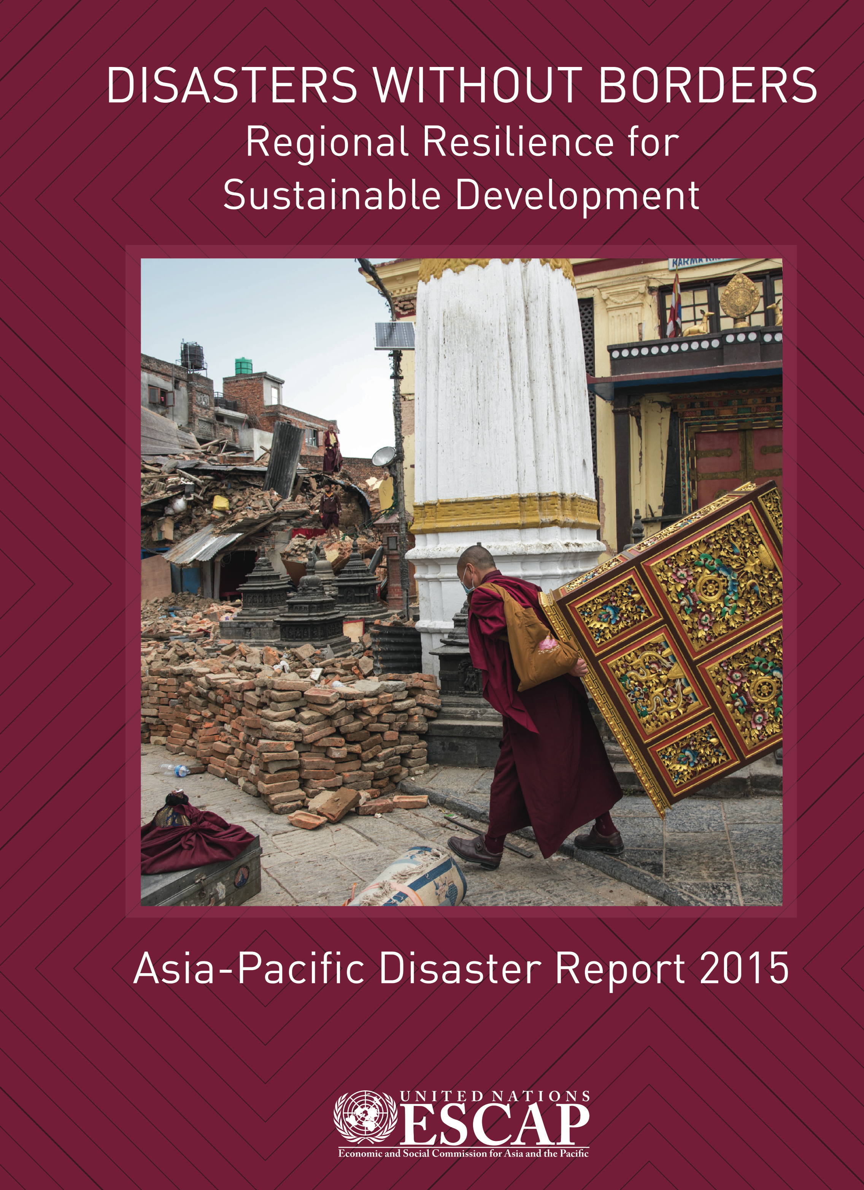
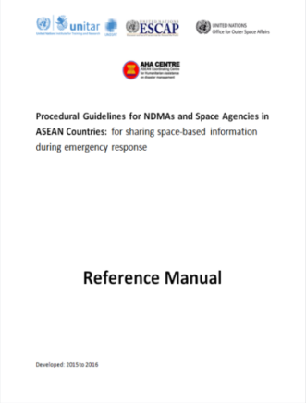
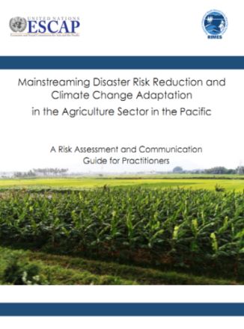
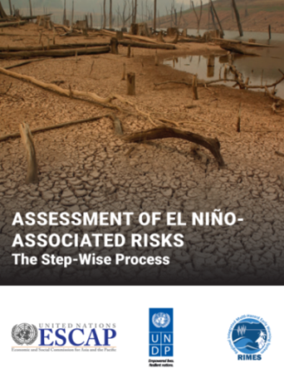
Current activities
Regional Drought Mechanism
  Support for disaster-affected countries
  Capacity building and regional cooperation to enhance access
  ESCAP/ASEAN Study on Drought: Situational assessment and SDG poverty alleviation implications
  Asia Pacific Disaster Report
  Handbooks on risk assessment in ASEAN
  Multi-hazard, Multi-donor Trust Fund: Monsoon
  Forums

Slide 4
Regional Drought Mechanism
Regional cooperative mechanism bringing together experts from countries experienced in using Earth observation, to support build the capacity of developing countries to manage drought
Access to satellite data, products and services
Data from multiple earth observation satellites
Products – Agricultural drought indices
Services – Immediate: seasonal forecasts, in-season crop/vegetation monitoring and early warning; next step: crop forecasting, agricultural land use/land cover changes for sustainable agriculture and efficient water management and water accounting
Customization and validation based on national circumstances
Building the institutional capacity
Specialized capacity development for a multi-disciplinary national team
Networking with Regional Service Providers in China and India, Thailand, Australia as well as with RIMES

Slide 5
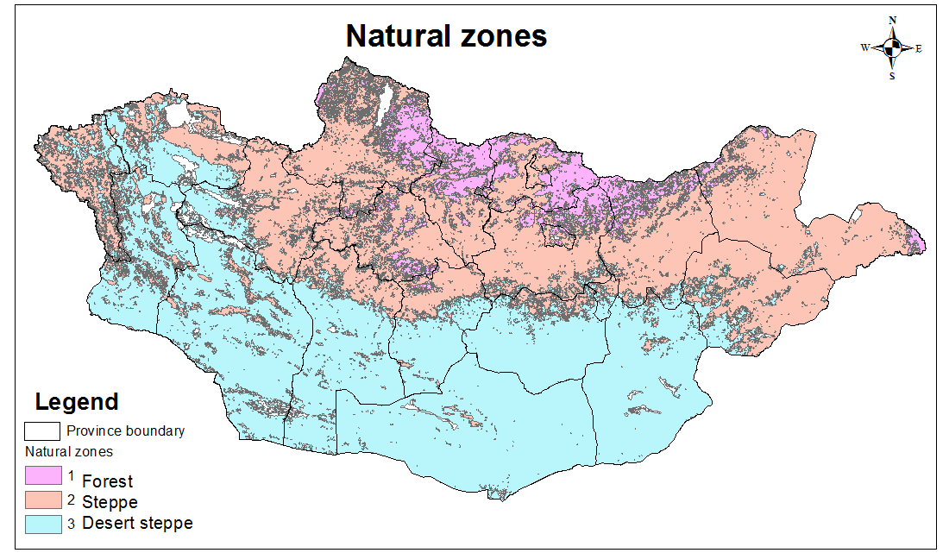
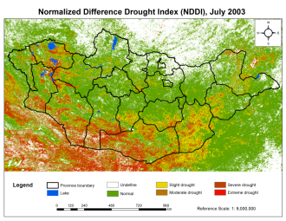
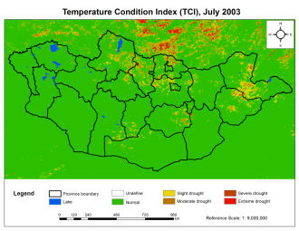
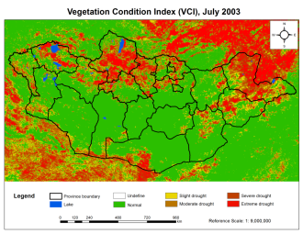
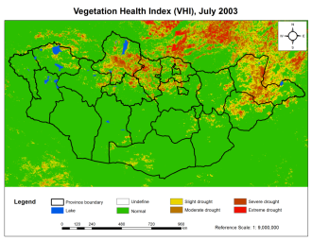
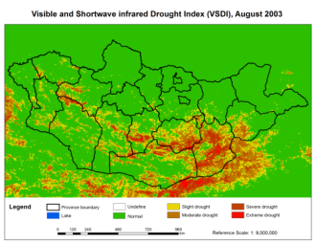
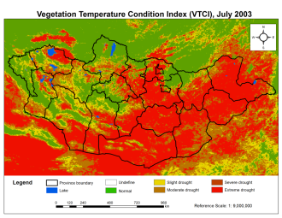
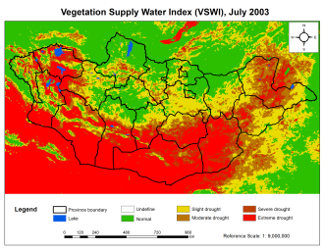
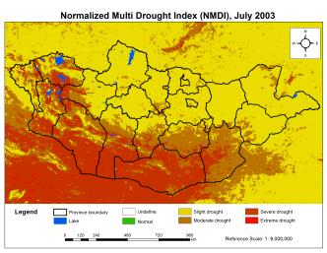
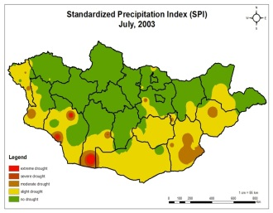
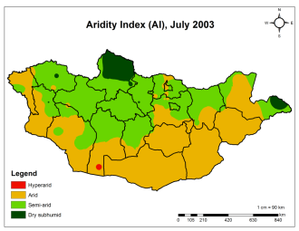
Example in Mongolia
Drought mapping was made by combining 3 agro-ecological regions which has more than 50% correlation including forest, steppe, desert steppe. The correlations between RS index and Drought index calculated by meteorological parameter were different in various natural zones separately.
NDDI
TCI
VCI
VHI
VSDI
A number of indices were tested for each region
VTCI
VSWI
NMDI
SPI
AI

Slide 6
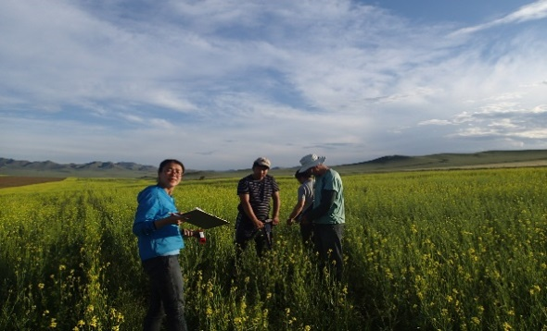
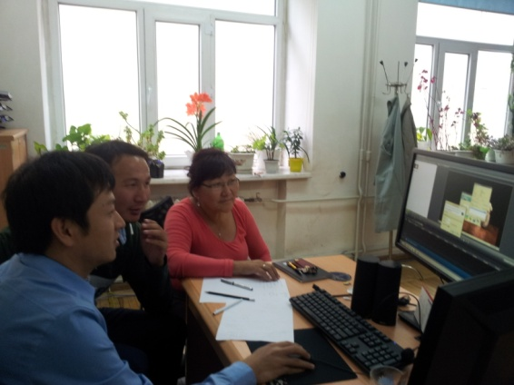
Example in Mongolia
Capacity building:
  Training
  Work with Chinese Academy of Sciences (RADI)
DroughtWatch system built by RADI for Mongolia:
    Data management
    Data preprocessing
    Indices calculation
    Drought monitoring
    Statistics and analysis
    Automation
Field verification of tool
A number of pilot countries: Afghanistan, Bangladesh, Cambodia, Kyrgyzstan, Mongolia, Myanmar, Nepal, Sri Lanka
Supporting Regional Service Nodes: China, India, Thailand (possibly Australia)

Slide 7
Dust and sandstorms
Resolution 72/7, “Regional Cooperation to Combat Sand and Dust Storms in Asia and the Pacific” (19 May 2016)
Linked to drought and land degradation – soil moisture deficits
Value added by ESCAP:
  Partnership framework following NEASPEC,
  Extension of ESCAP’s Regional Drought Mechanism to cover DSS,
  APDIM for managing DSS risk information and decision support tools
  Inter-regional Cooperation network – UNEP, WMO, UNCCD, ECWA and ECA

Slide 8
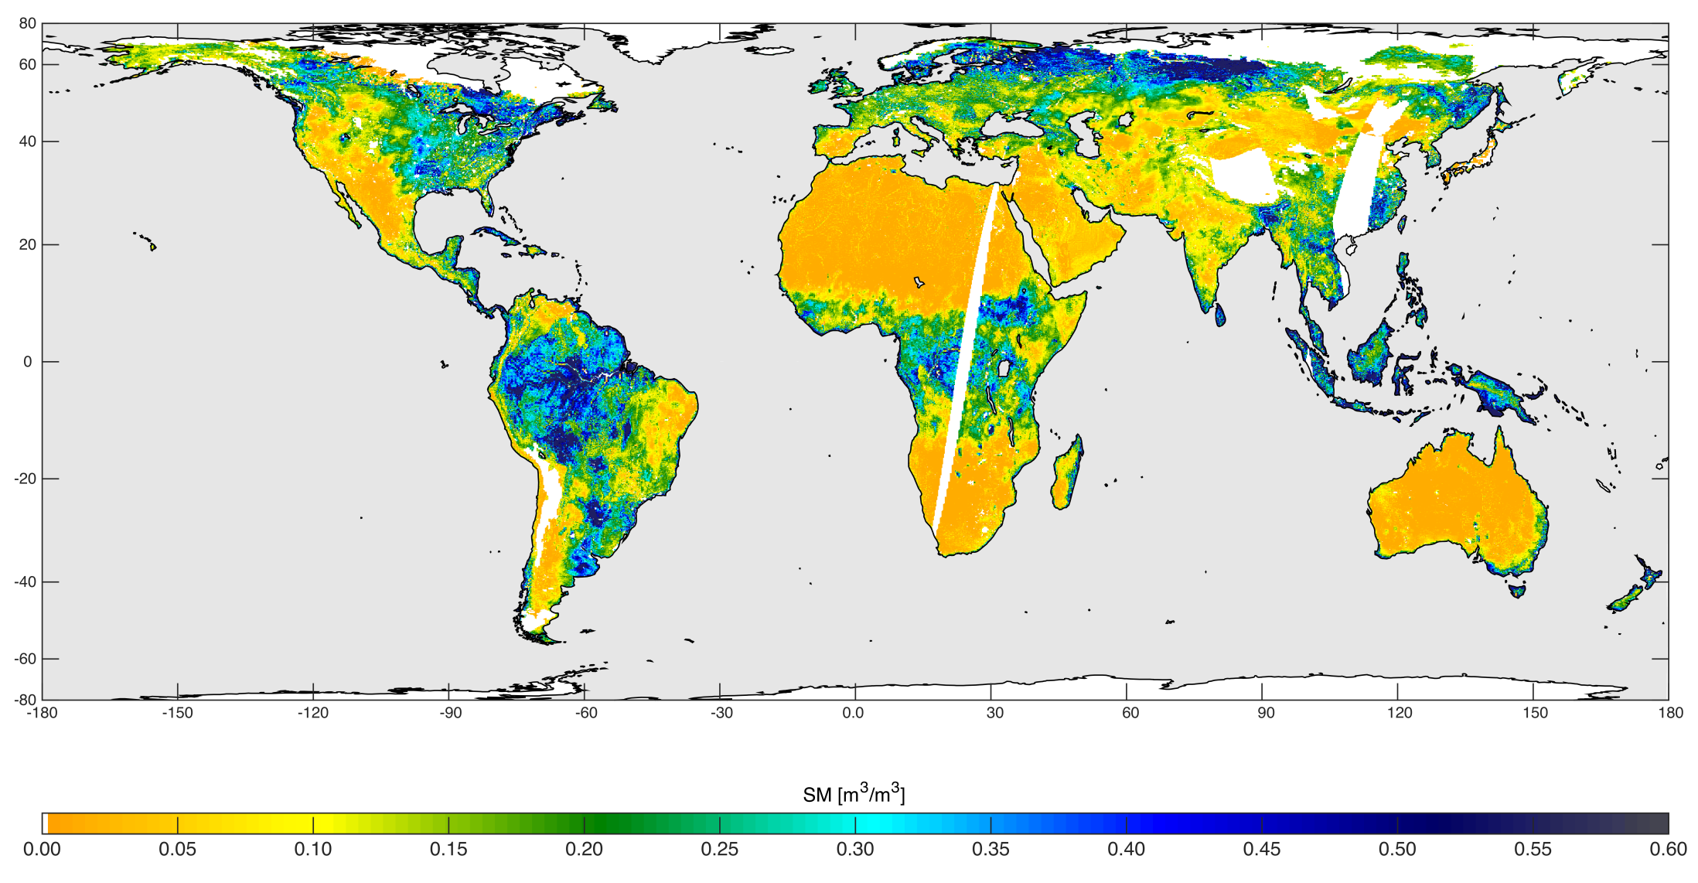
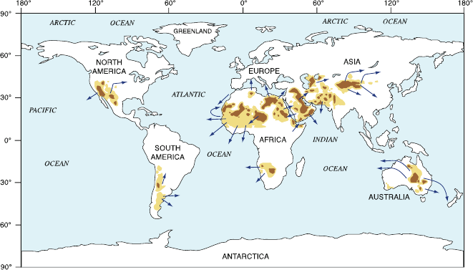
Transboundary Sources and Impacts
High-resolution global soil moisture map based on combined radar and radiometer data, acquired between May 4 and May 11, 2015 Credits: NASA/JPL-Caltech/GSFC

Slide 9
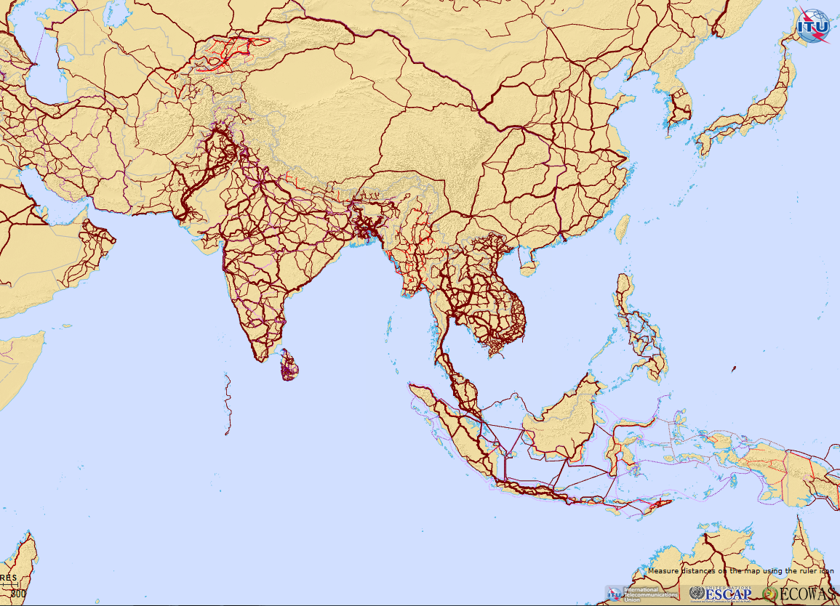
Asia Pacific Information Superhighway
Extending seamless connectivity access for Asia-Pacific for e-resilience

Slide 10
Future activities
Space applications have great potential to support implementation of the SDGs, Sendai Framework, Paris Agreement.
The Asia-Pacific Plan of Action for Applications of Space Technology and Geographic Information Systems for Disaster Risk Reduction and Sustainable Development, 2012-2017 ends this year.
A new Plan of Action is under preparation. Document E/ESCAP/73/20 Space Applications for the 2030 Agenda for Sustainable Development

Slide 11

Thank you!

