Slide 1

Committee on Earth Observation Satellites
GEO-DARMA
Overview, Role of Steering Committee,Cross-cutting Ideas and
Workshop Objectives
Ivan Petiteville, ESA
Andrew Eddy, Athena Global
GEO-DARMA 1st Steering Committee and Concept Workshop
25 May, 2017

Slide 2
Table of Contents
Introduction and GEO-DARMA overview
Concept Workshop Objectives – what can we achieve today?
Steering Committee – role, terms of reference, schedule
Cross-cutting ideas, priorities for GEO-DARMA

Slide 3
GEO-DARMA Overview
Goal:
Enhance use of EO data for better-informed Disaster Risk Reduction and Resilience decision making
How:
Series of end-to-end projects addressing priorities of the “Sendai Framework for Disaster Risk Reduction 2015-2030”.
International Cooperation. Engagement of all stakeholders (end users, data & risk information providers, internat./national agencies, donor institutions,…)
Notes:
DARMA = Data Access for Risk Management.
The Japanese Daruma or Darma, a traditional handmade Japanese wishing doll (referred to as a "GOAL DOLL") that keeps people focused on achieving their goals.
GEO-DARMA Concept still to be consolidated

Slide 4
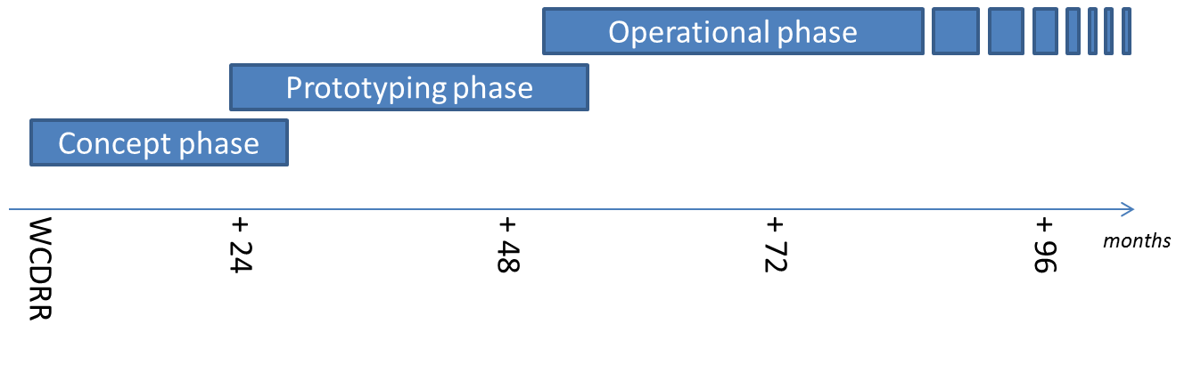
GEO-DARMA Partnership
Intention: build an international partnership with key stakeholders to define a strategy addressing high priorities of Sendai framework with resources available, on a best effort basis, adopting a phased approach
if extra resources and funding
identified
8
24

Slide 5
GEO-DARMA Concept Phase
Data providers not fully aware of DRR priorities & user needs, and users not aware of EO potential.
Dialogue with knowledgeable regional bodies needed for ….
.. independent assessment of DRR priorities for 2015-2030:
At regional level, 2 or 3 independent and authoritative regional institutions or global stakeholders with regional role, such as World Bank, GFDRR, UNISDR, UNDP, UNESCAP, CDEMA, ECOWAS, RCMRD, others, … (start with 3 regions: Africa, Asia-Pacific and Latin American and Caribbean)
Identification of hazards affecting most of the countries in the region (e.g. highest human and economic losses) or of transboundary risks that require regional and multi-country involvement.
Identification of 1st set of national projects within the region that could integrate EO in their objectives and delivery.

Slide 6
GEO-DARMA Prototype Phase
1. Realistic assessment of recommendations from Regional Institutions, given resources from the potential actors (e.g. data providers, value-added information providers, ..)
2. Define and implement possible prototype projects at country level to address recommended priorities;
close iterations with end users;
maximum reuse of existing initiatives / activities incl. operational, research, capacity building, …
3. Progressive extension to neighboring countries where applicable.
4. If “successful” prototype projects and if strong request from end users to continue → Assess transition to operation with identification of donors for future operational phase

Slide 7
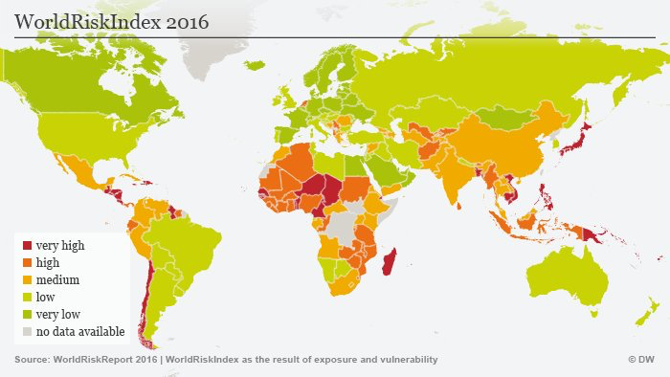

Slide 8
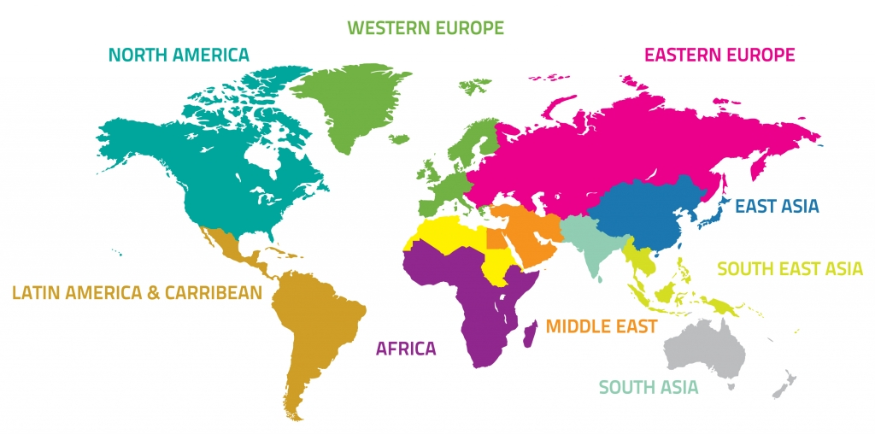

GEO-DARMA Approach
Identification of users needs and DRR priorities per region
For each region:
Types of hazards,
DRR Issues to be solved,
Initial countries

Slide 9
GEO-DARMA Approach (2)
(project dots only an illustration)
Prototype projects – progressive extension to neighbouring countries

Slide 10
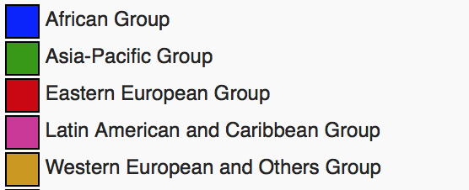
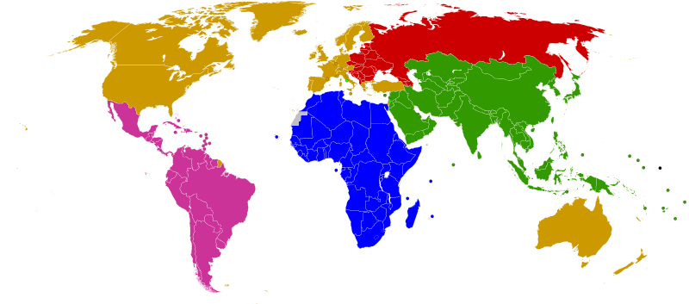
GEO-DARMA Partnership Approach
.
ASEAN
ADPC
ADRC
SDMC (SAARC)
UNESCAP
APEC
Others?
Asia-Pacific
Africa
Latin America
Caribbean
SADC
ECOWAS
IGAD
RCMRD
Others?
CDEMA
CEPRELAC
INDM (OAS)
CAPRADE
ECLAC
Others?
Legend:
Blue (e.g. ASEAN) is prospective Regional Institution partner
Red (e.g. UNESCAP) is identified Regional Institution partner
Regional programmes of global partners (e.g. World Bank, GFDRR, UNDP, UNEP, UNESCO, UNISDR) to be considered across all regions)

Slide 11
KO Workshop March 14th
First planning meeting held in Rome March 14th (18 people) with CEOS WG Disasters, extended to a few interested parties, to discuss next steps and :
Understand Sendai Framework priorities as they apply to EO
Examine Sendai Framework monitoring indicators and relevance for EO
Examine regional organizations of interest
Take stock of relevant regional DRR programs in three regions
Begin planning for 1st SC meeting and Concept workshop in Cancun

Slide 12
Concept Workshop Objectives –
what can we achieve today?
Introduce Steering Committee Members to GEO-DARMA Concept and forge collective approach on way forward
Review role and schedule for SC
Review high-level GEO-DARMA approach and refine schedule and timeline as function of objectives
Discuss Sendai Framework priorities and SDGs, and how EO contributes to their indicators
Initiate discussion on regional priorities
Plan for next SC meeting

Slide 13
GEO-DARMA Steering Committee
Tiziana Bonapace, Director ICT and DRR, UNESCAP
Francis Ghesquiere, Head, GFDRR
Ronald Jackson, Executive Director, Caribbean Disaster and Emergency Management Agency (CDEMA)
Michael Szoenyi, Group Head of Flood Resilience, Zurich Insurance Group
Mohammed Ibrahim, Principal Programme Officer, ECOWAS Commission
Faisal Djalal, Chairperson, Asia-Pacific Alliance for Disaster Management
Hans Guttman, Executive Director, Asian Disaster Preparedness Center (ADPC)
Ivan Petiteville, GEO-DARMA PoC, CEOS / ESA
Two or three more members from Latin America and Sub-saharan Africa expected to join shortly

Slide 14
Role and Schedule for Steering Committee
Steering Committee (SC) composed of high-level advisors to guide and steer GEO-DARMA initiative;
SC to meet once a year face-to-face and once or twice by telcon;
SC membership is voluntary does not imply or require funding commitment from members to GEO-DARMA;
SC provides advice to management team and Technical Committee, which is made up of representatives of all projects partners (some organizations sit on both SC and Technical Committee – e.g. UNESCAP, ADPC, ECOWAS, CDEMA).

Slide 15
Cross-cutting Ideas
EO as a tool to contribute to Sendai and SDG indicators
  Requires data but also applications-oriented funding
EO in support of regional DRR efforts of significance (transboundary issues, case studies, multi-hazard demonstrations, etc)
  May be able to leverage existing funding, but in many cases will require VA support

Slide 16
Suggestions from 1st regional mission – Southeast Asia
Identify specific SGD and Sendai indicators and demonstrate how EO can be used operationally to track progress – suggested area Central Asia or ASEAN countries
Identify existing projects (e.g. SERVIR Mekong) that could benefit from integration of much broader suite of satellite EO resources and demonstrate added benefit
Select a small (four to five) group of coastal mega cities in SE Asia that show rapid growth (e.g. Manila, Jakarta, Bangkok…) and use EO as a tool to monitor key parameters of risk and resilience in a multi-hazard perspective over a five year period
Consider balance of smaller, easier to achieve projects (in Pacific island context for example) and broader more ambitious projects (in transboundary flooding in a major river basin)

Slide 17
Sendai Indicators -
Global Targets
A: Substantially reduce global disaster mortality by 2030, aiming to lower average per 100,000 global mortality between 2020-2030 compared with 2005-2015.
B: Substantially reduce the number of affected people globally by 2030, aiming to lower the average global figure per 100,000 between 2020-2030 compared with 2005-2015.
C: Reduce direct disaster economic loss in relation to global gross domestic product (GDP) by 2030.
D: Substantially reduce disaster damage to critical infrastructure and disruption of basic services, among them health and educational facilities, including through developing their resilience by 2030
E: Substantially increase the number of countries with national and local disaster risk reduction strategies by 2020.
F: Substantially enhance international cooperation to developing countries through adequate and sustainable support to complement their national actions for implementation of this framework by 2030.
G: Substantially increase the availability of and access to multi‑hazard early warning systems and disaster risk information and assessments to the people by 2030.

Slide 18
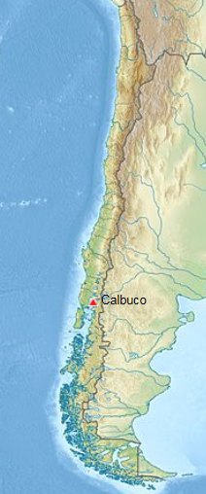
Calbuco, Chile
After 43 years of quiescence, Calbuco began erupting on 22 April 2015, with very little warning.
Large amount of ash, significant impact on air traffic on Chile and Argentina. Ash tracked and was communicated to VAAC Buenos Aires
Several 1000s people were evacuated from villages closest to Calbuco .
Other interferograms constrain the deformation to have started no more than 1.5 days before the eruption, and to have lasted no more than 1 day.
Partner agencies: SERNAGEOMIN (Chile); Buenos Aires Volcano Ash Advisory Center (Argentina); University of Bristol (UK); Cornell University (USA); NOAA (USA)
Notes:
Preliminary model of the deflation indicates that the source is located about 5 km SW of the volcano’s summit at a depth of 9.3 km beneath the surface, with a volume changes of ~0.045 km³. This source geometry and strength is consistent with recordings from a tiltmeter located 4 km W of the volcano.
SAR data used to characterize co-eruption surface deformation, and to constrain the location of the magma body that fed the eruption.

Slide 19
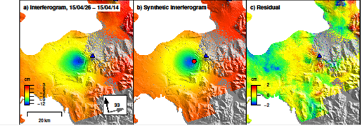
Calbuco, Chile
Observed (left), modeled (center), and residual (right) deformation at Calbuco from a Sentinel-1a interferogram spanning April 14–26, 2015. Deformation can be approximated by a source at ~9 km depth beneath the volcano’s west flank.
Observatorio Volcanológico de Los Andes del Sur (OVDAS) used this source model to validate their tilt meter records

Slide 20
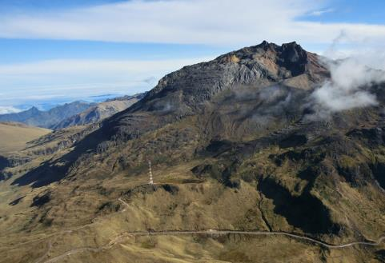
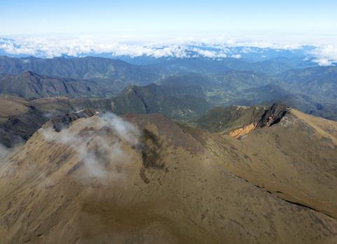
Chiles –
Cerro Negro de Mayasquer
Chiles- Cerro Negro are volcanoes on the Ecuador-Colombian border, with no historical activity
Since September 2014, thousands of small earthquakes every day – but no changes at the surface.
As there have been no historical eruptions, ground based monitoring is limited:
-> satellite data are critical
Chiles
Cerro-Negro
photos: Instituto Geofisico, Ecuador

Slide 21
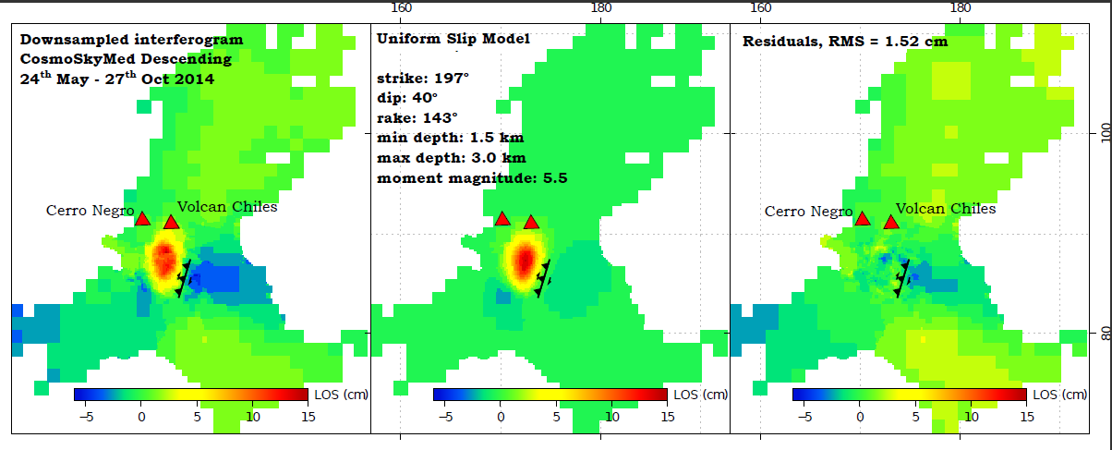
Chiles –
Cerro Negro de Mayasquer
Deformation Best-fit fault plane solution Residuals
The deformation detected using InSAR has so far been primarily associated with a larger (M5.6w) earthquake on the 22nd October 2014. This earthquake result in maximum displacements of 15 cm towards the satellite in a region SW of Chiles volcano.
The majority of deformation can be explained by oblique slip on a fault at depths ~1.5-3 km. Civil Defense in Colombia ordered the evacuation of 12,000 people.
Notes:
The majority of deformation can be explained by oblique slip on a fault at depths ~1.5-3 km dipping WNW. The orientation of this fault aligns well with faults mapped from regional topographic structures.

Slide 22
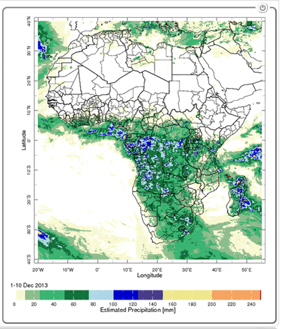
Flood & Climate Information for Management of Mosquito-Borne Diseases
Management of Mosquito-borne Diseases
Malaria and meningococcal meningitis epidemics: recurring problems in Africa
Risk for malaria transmission increases:
Average temperature between 18°C and 32°C
Average precipitation is greater than 80mm
Average relative humidity is greater than 60%
Estimated Precipitation
From SERVIR, NASA’s
Earth Science
PI: Pietro Ceccato,
Columbia UniversityTeam
Combined use of satellite observations and
performing models can provide accurate
predictions to local populations
Notes:
78% of events are infection diseases; 17 % are due to climate events (floods, droughts)

Slide 23
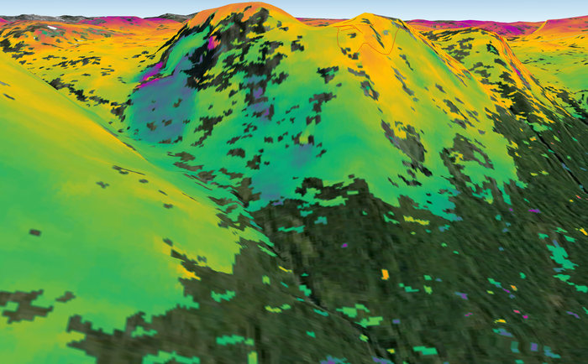
Landslide Risk Monitoring
Landslide Risk Monitoring
‘Interferometric’ image showing surface deformation of a landslide in the municipality of Kåfjord in Troms county, Norway.
  Sentinel-1A radar scans from 23 Sep. and 30 Aug. 2014
In 24 days, the ground moved about 1 cm.

Slide 24
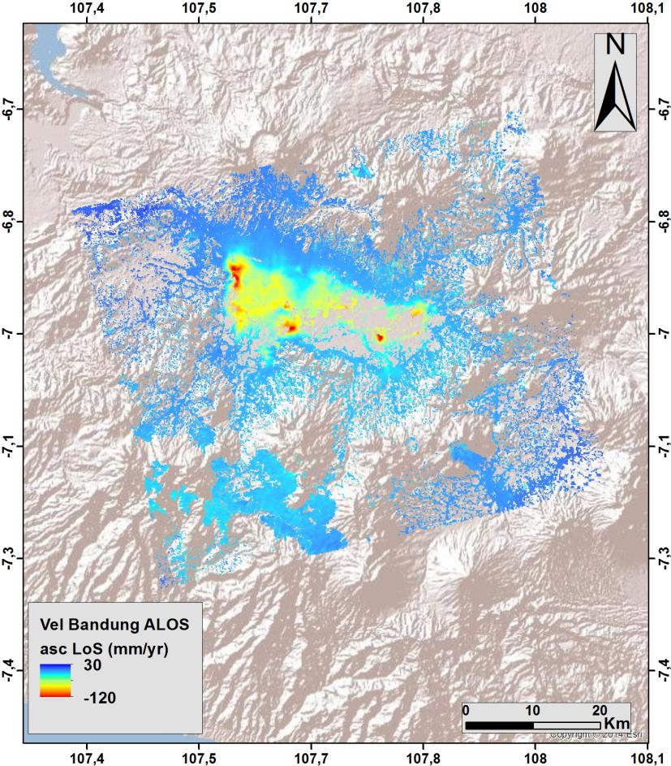
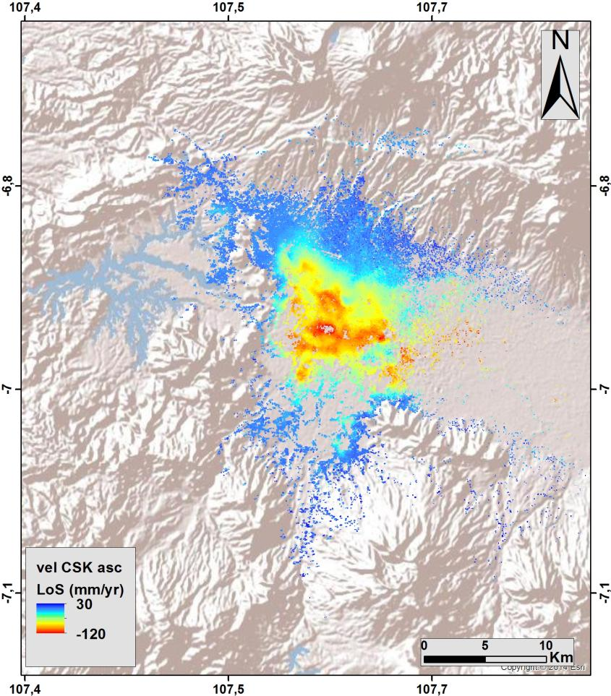
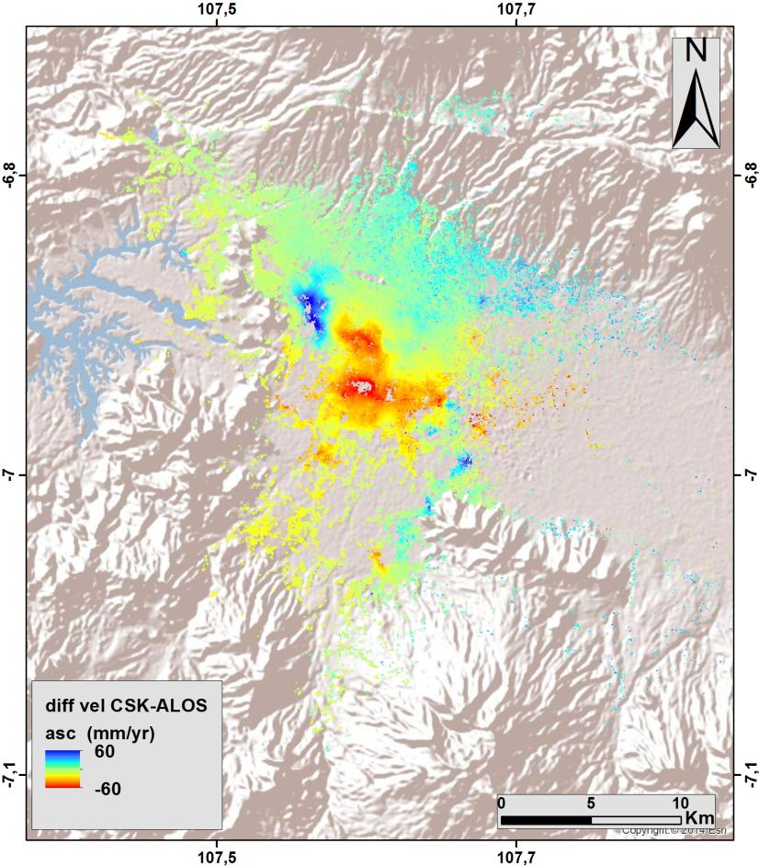
Flood Modelling and subsidence in
South-East Asia
ALOS ascending (2007-2011)
CSK ascending (2013-2015)
Difference (CSK-ALOS)
(red = increased rate of subsidence)
Notes:
Using ALOS and CSK data, INGV calculated the changing rate of subsidence (2007-2015) in an urban flood plain in Bandung, Indonesia, with a view to improving risk assessment for long-term flood projections (RASOR Project).

Slide 25
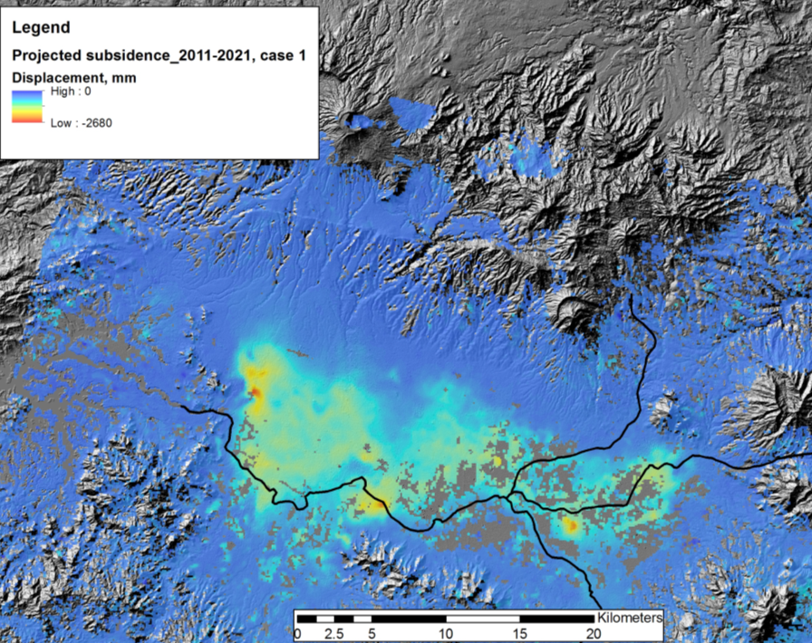
Flood Modelling
- Subsidence Projection
Other Activities:
Consultations on new pilot
products with UN, World Bank, and ICRC
Asian Disaster Preparedness
Center (ADPC, Bangkok
Thailand) to setup instance of
flood modeling and monitoring
processing and distribution
software installed under
cooperation with SERVIR and
USAID Oct-Nov 2015
Projected total subsidence by 2021 of up to 2.2 m along main drainage areas.
© INGV
25
Notes:
RASOR project showing subsidence impact on flood hazard in the Bandung area in West Java, Indonesia.

Slide 26
Thank You!
ivan.petiteville@esa.int
andrew.eddy@athenaglobal.com

Slide 27
Issues for Discussion
Which hazards to address?
Which priorities to pursue? In which order? Using what criteria?
Can we establish 2 or 3 pilots per region, in countries motivated to contribute?
Many small projects vs fewer larger projects?
Can we establish a regional consensus on priorities among leading regional DRR agencies?
Can we identify specific funded projects that would benefit from a new satellite EO component?
What type of information and data is missing for DRR agencies to improve risk reduction efforts?

Slide 28
Background slides

Slide 29
Example:
SOUTH-EAST ASIA

Slide 30
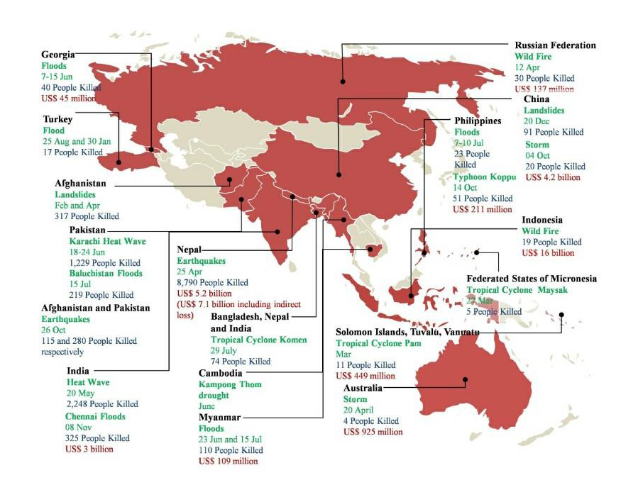
Disasters in Asia in 2015
Notes:
160 disasters recorded in the region
59.3 million people affected by disasters
16,046 death due to natural disasters
US$ 45.1 billion total cost of economic damage
Earthquakes had the highest number of fatalities with 8,790 killed in the Nepal earthquake
Floods were the most frequent disaster, and floods and storms were the costliest in terms of economic damage
South and South-West Asia was the most affected subregion

Slide 31
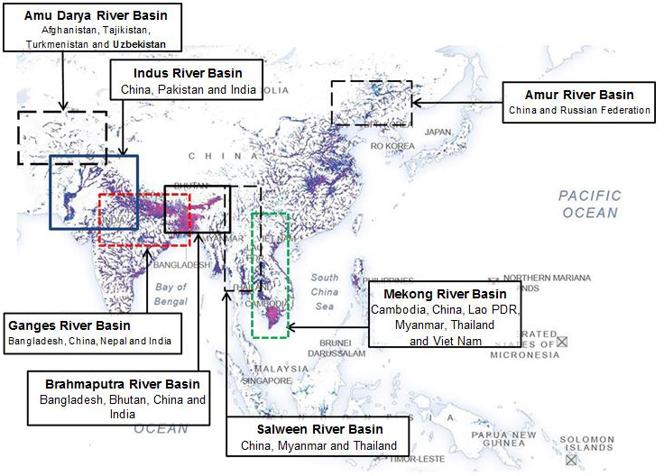
UNESCAP/RIMES toolkit – transboundary flood risk in Asia-Pacific region
Transboundary flood risk in the Asia-Pacific region
(Source: ESCAP 2016a, based on OCHA and ICIMOD data)

Slide 32
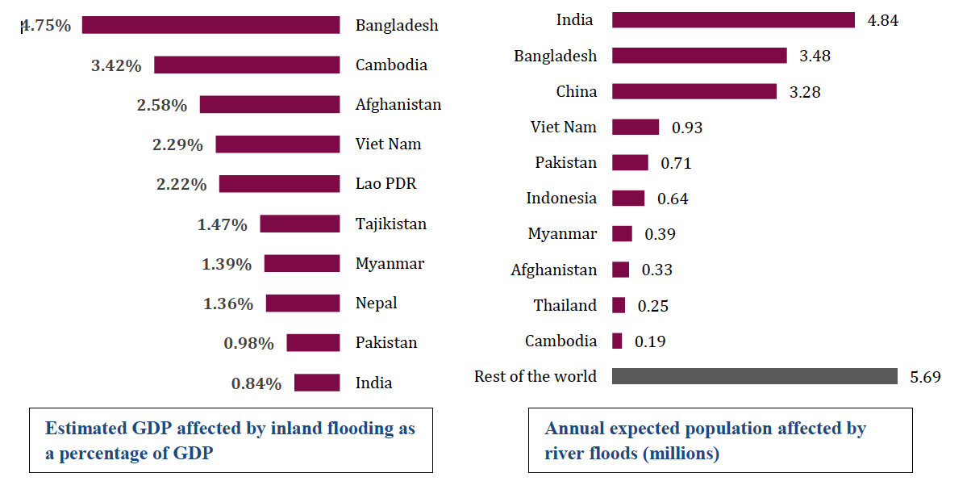
Southeast Asia Flooding –
economic impacts
Economic impacts of (left) and exposure to (right) river floods in the Asia-Pacific region
(Source: ESCAP, 2016b)

Slide 33
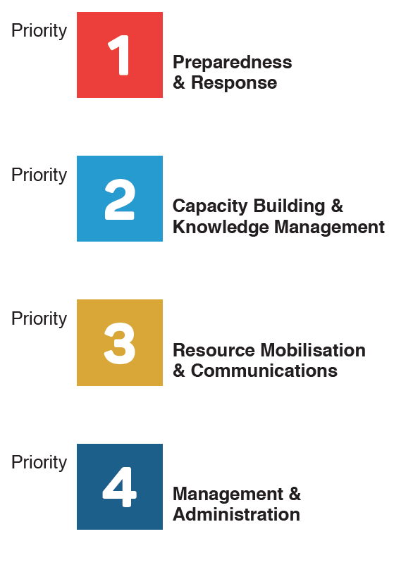
South-East Asia – ASEAN AHA
The ASEAN Coordinating Centre for Humanitarian Assistance on disaster management (AHA Centre) is an inter-governmental organization which aims to facilitate cooperation and coordination among ASEAN Member States and with the United Nations and international organizations for disaster management and emergency response in ASEAN Region.

Slide 34
South-East Asia – ASEAN AHA
Mission: “To facilitate and coordinate ASEAN’s effort in reducing disaster losses and responding to disaster emergencies as one through regional collaboration, national leadership and global partnership in disaster management”.
Vision: “A highly professional and trusted organisation which serves as the coordinating agency in the ASEAN region for disaster management and emergency response that aims to make ASEAN as a global leader on disaster management by 2025”.

