Slide 1

EO as a tool for elaborating Sendai geospatial indicators
GEO-DARMA Concept Workshop
Lauro Rossi, Program Director

Slide 2
EO & Sendai target indicators
1) Monitor and compare (2005-2015 vs 2020-2030):
number of deaths (A)
number of people, dwelling affected (B)
economic losses: agriculture, productive assets,
housing, cultural heritage (C)
critical infrastructure, including health & education service (D)
2) Tools to support DRR:
countries with DRR strategies implemented by 2020 (E)
enhanced international cooperation by 2030 (F)
availability of Multi-Hazard EWS by 2030 (G)

Slide 3
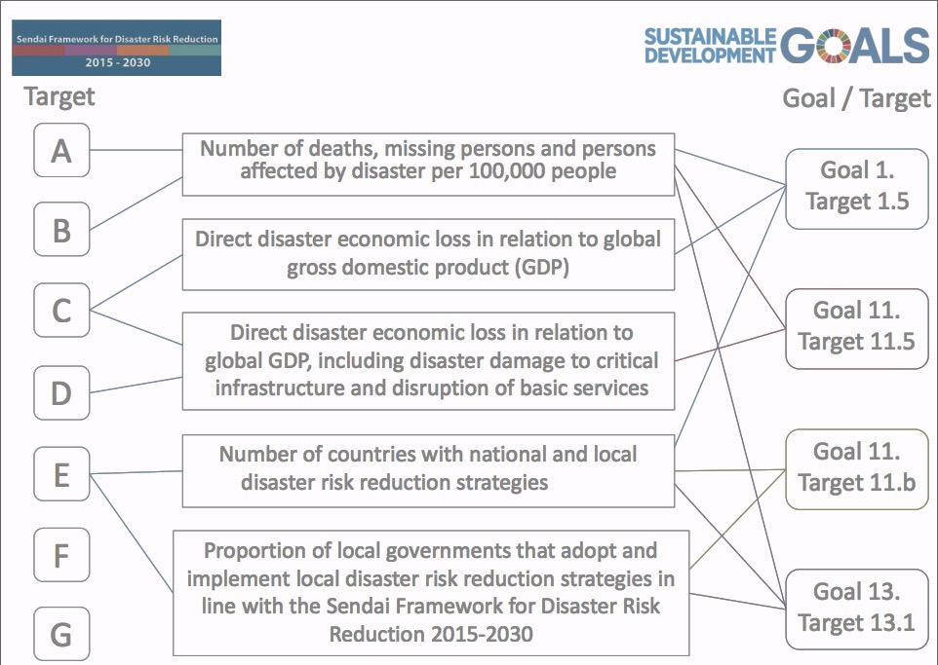
Sendai & SDG indicators
(Andrew Maskrey, 2017)

Slide 4
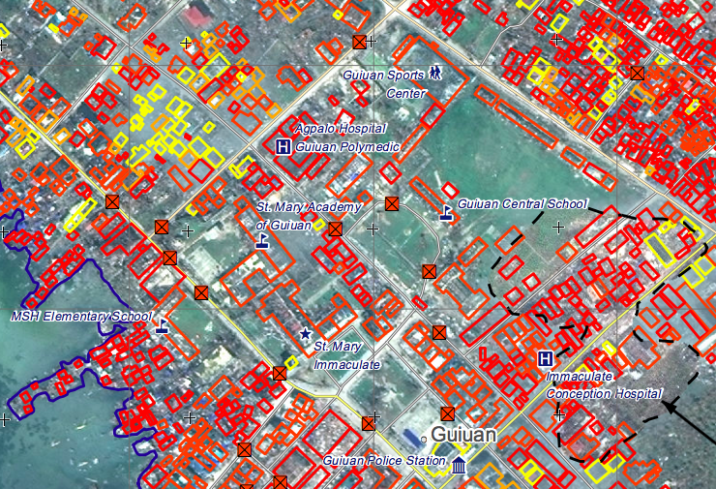
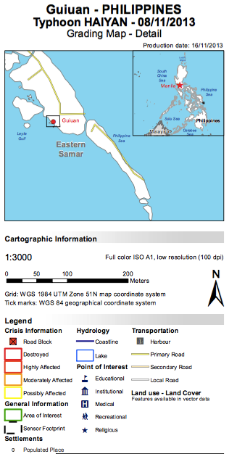
EO contribution (1/3)
Direct physical damage assessment: grading maps
- First assessment
- Prioritize, plan, optimize surveys
Copernicus EMS, Rapid Mapping

Slide 5
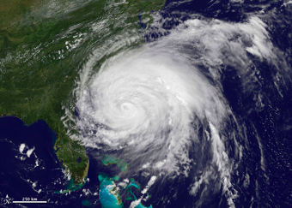

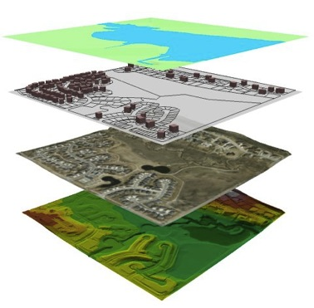
EO contribution (2/3)
How to make the two short periods comparable?
How should outliers be considered?
How can we estimate economic loss?
How can indicators on past event impacts be re-constructed?
MODELLING APPROACH
Impact = f (H,E,V,A)
Hazard
N. of assets affected
Economic losses
Exposure
Vulnerability
Indicators B,D
Indicators C

Slide 6
EO contribution (3/3)
Priority 1. Understanding disaster risk
Disaster risk management should be based on an understanding of disaster risk in all its dimensions of vulnerability, capacity, exposure of persons and assets, hazard characteristics and the environment.
Such knowledge can be used for risk assessment, prevention, mitigation, preparedness and response.

Slide 7
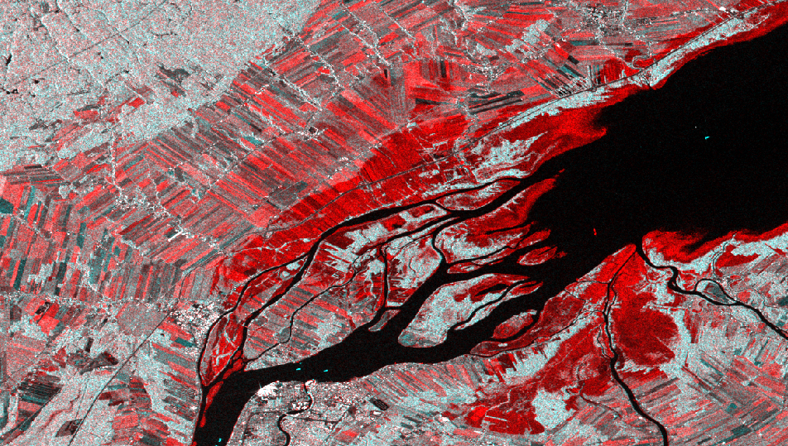
EO & Hazard
Observed hazard: historical records
Dartmouth Flood Observatory
Charter
UNOSAT
Copernicus EMS
Sentinel-Asia
Regional experience
New perspective offered by Sentinel
Exposure
number of people,
dwelling affected (B)
number of critical infrastructures affected (D)
DFO#4468, Central US, April 28, 2017
Notes:
MODIS (LAC, Mekong), Landsat (Australia)

Slide 8
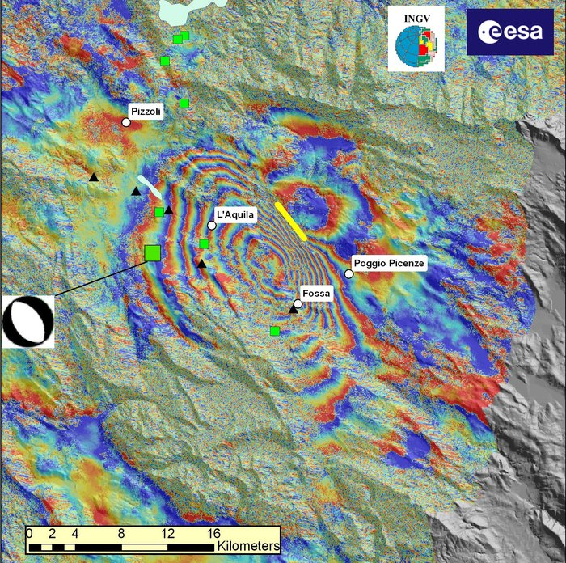
EO & Hazard
Observed hazard, damage assessment
Co-seismic soil deformation
Aquila, Central Italy, 2009 Earthquake, Envisat interferogram by INGV
Notes:
MODIS (LAC, Mekong), Landsat (Australia)

Slide 9
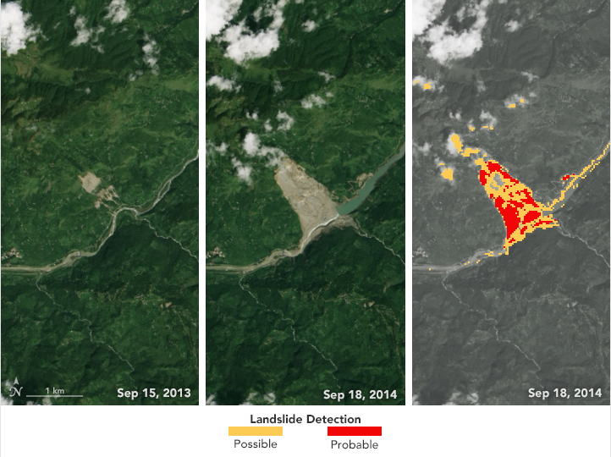
EO & Hazard
Observed hazard, catalogue of past events:
Landslide (change detection)
Recently Mapped Flood: DFO#4468,
Earth Observatory, NASA
Notes:
MODIS (LAC, Mekong), Landsat (Australia)

Slide 10

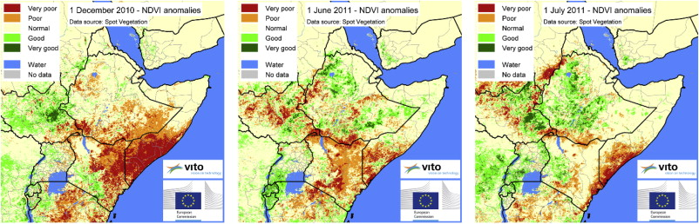
Drought: Vegetation index anomaly
EO & Hazard
(H.Eerend 2014, “Image time series processing for agriculture monitoring”)
→ C-2. Direct agricultural loss attributed to disasters

Slide 11
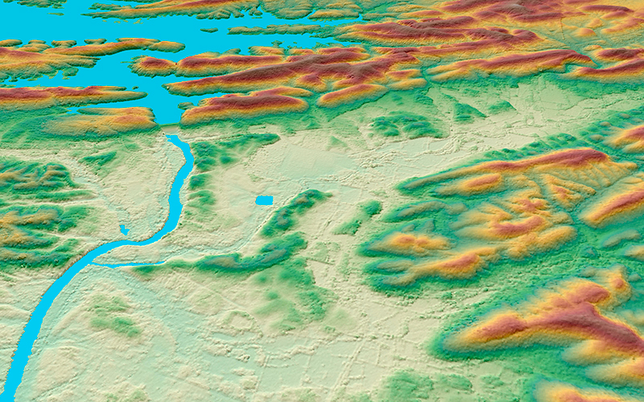
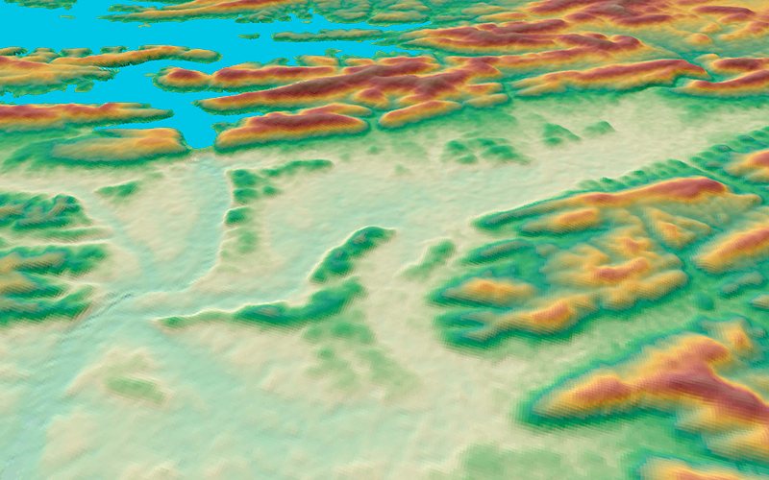
TanDEM-X DTM
TanDEM-X 12m
SRTM 30m

Slide 12
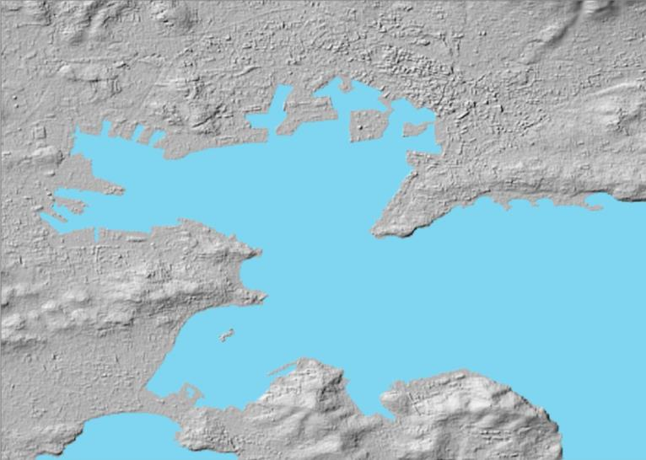
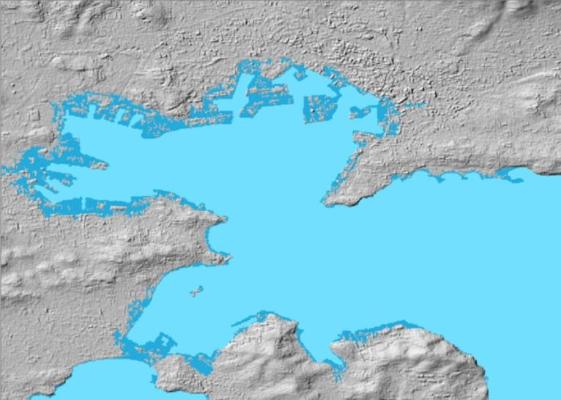
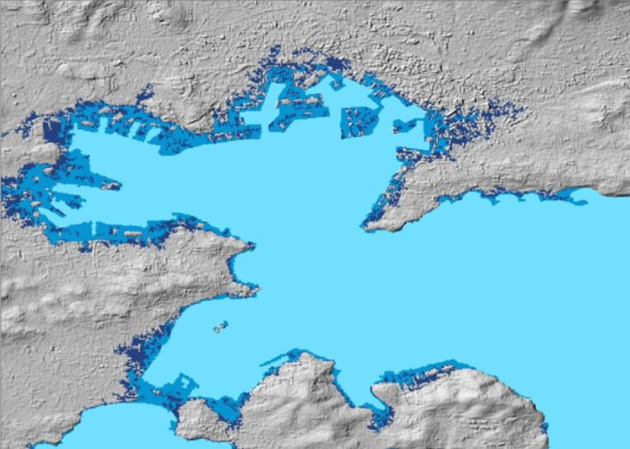
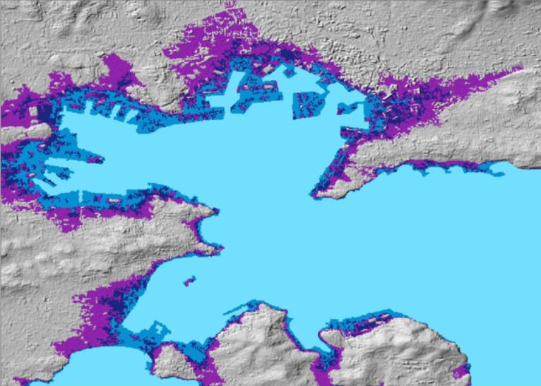
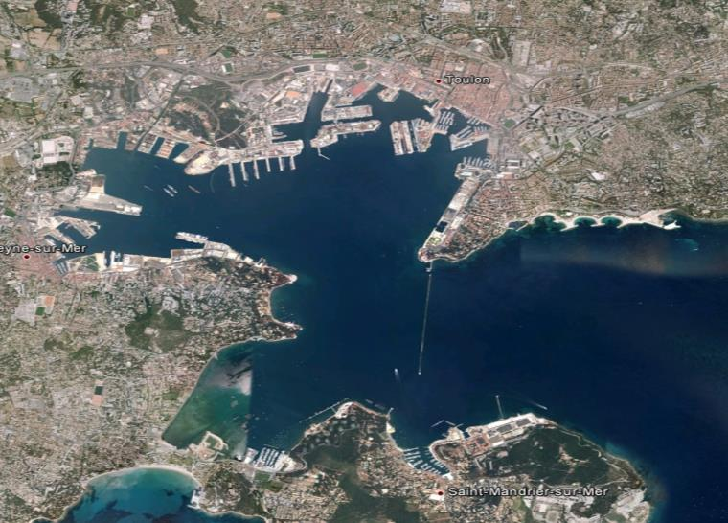
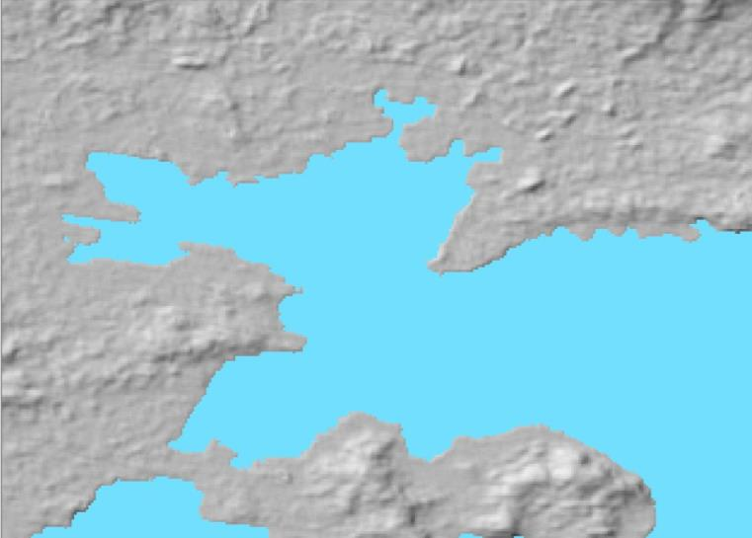
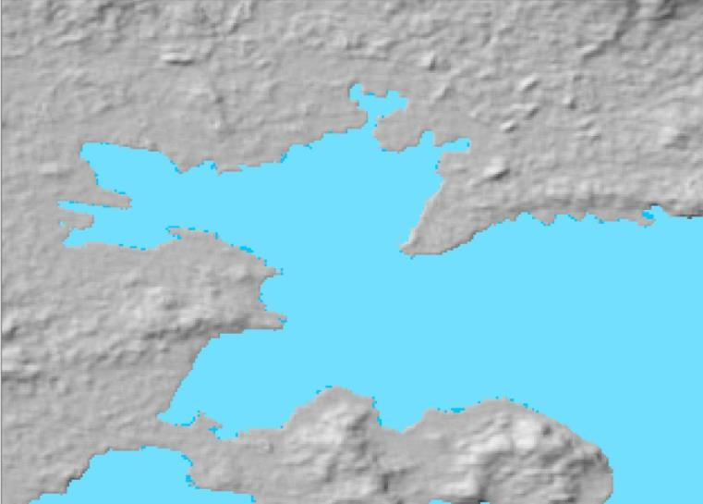
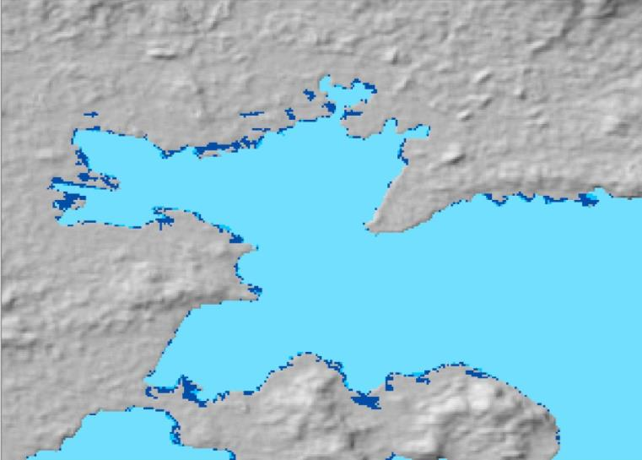
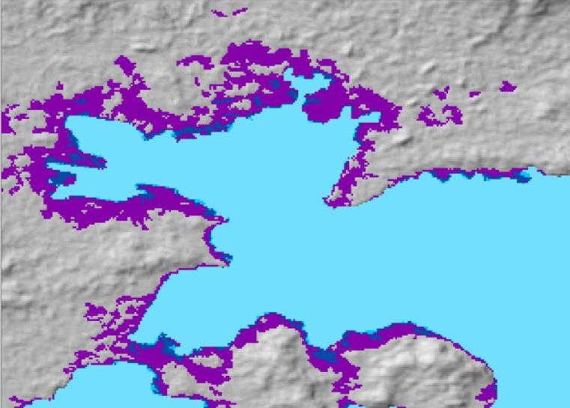
EO & DTM
Case Study: Global Sea Level Rise-up
Geomorphological & hydrological impact in human and natural environment
  Loss of soil to the sea
  Increase of saltwater intrusion (e.g. danger of drinking water reservoirs in coastal areas)
  Increase of storm surges, frequency of cyclones and floodings
IncR^{EO}
Increasing Resilience through Earth Observation
WorldDEMTM
(Pixel spacing 12m)
ASTER GDEM
(Pixel spacing 30m)
ASTER GDEM
(Pixel spacing 30m)
ASTER GDEM
(Pixel spacing 30m)
Sea Level: 0 m
Sea Level: + 5 m
Test site: Toulon, France
Sea Level: + 3 m
Sea Level: + 10 m
Quality of Elevation Reference is decisive in Flood and Sea Level Rise modelling.
Notes:
25 May 2017
12

Slide 13
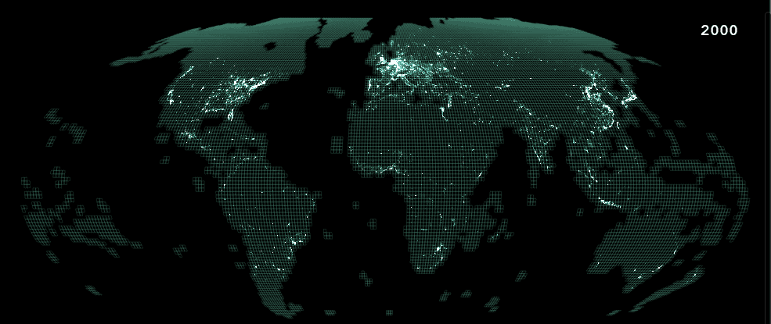



EO & Exposure
Global exposure layers (JRC)
Global Urban Footprint (DLR)
WorldPop (from AfriPop + AsiaPop + AmeriPop)
Global Human Settlement Layer, JRC
Notes:
Globlal Urban Foot print (DLR) ---
World pop - landscan
Layer for africa

Slide 14
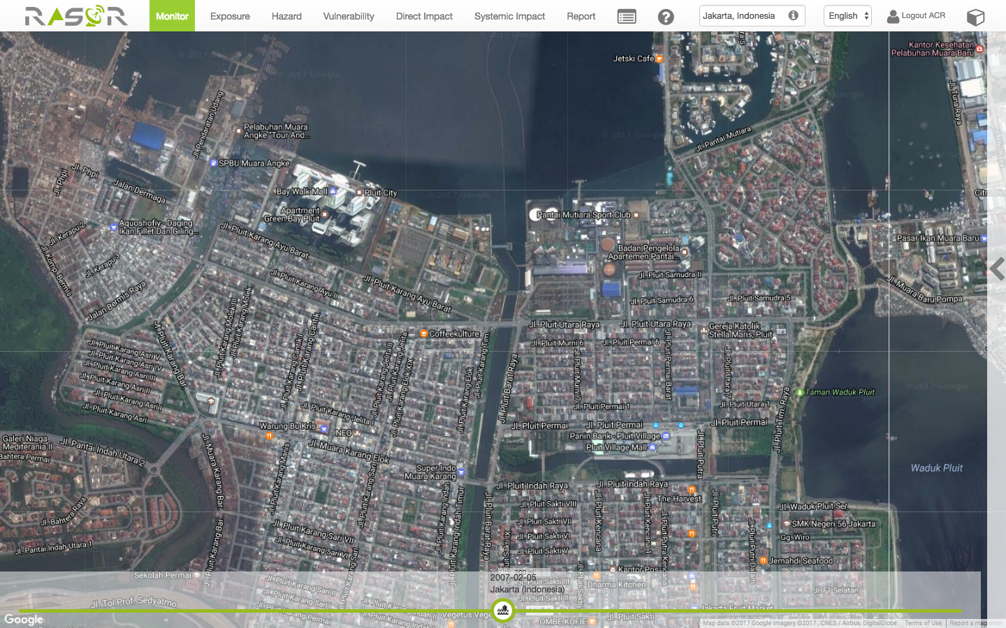
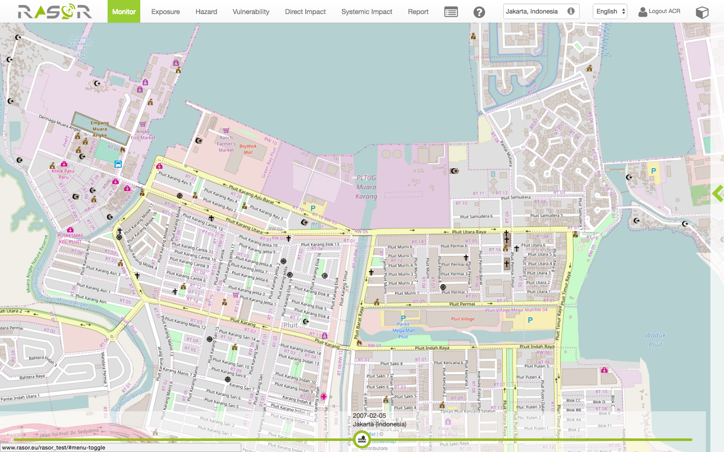
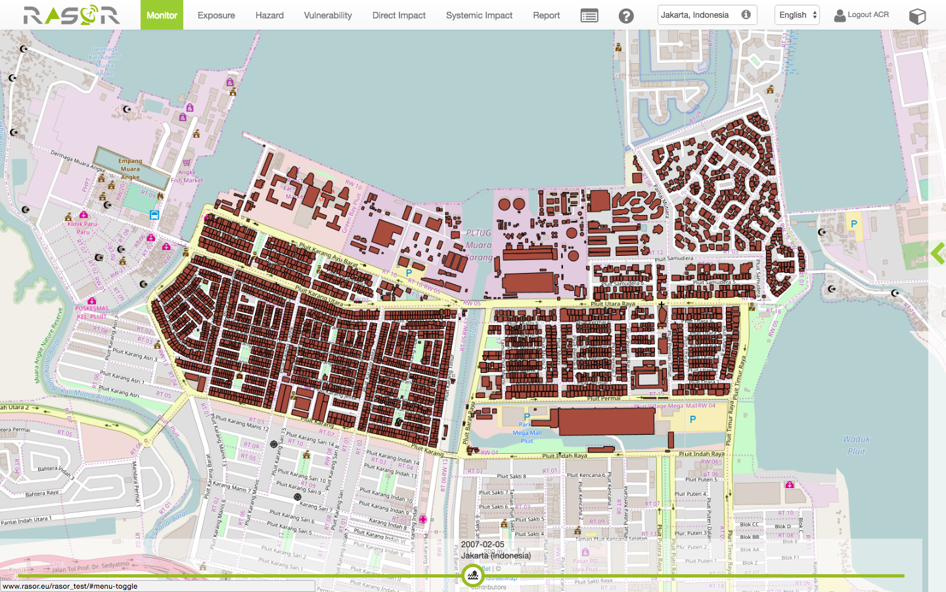
EO & Exposure
Update existing dataset
RASOR Project, Jakarta. Building foot print derived from Pleiades VHR data

Slide 15
EO & exposure characterization
Automated feature extraction
From SENSUM Project EO Proxies for Vulnerability
Medium Resolution | High Resolution
Unsupervised built-up area | Building footprints
Age of built-up area (evolution in time) | Building height
 | Building regularity
 | Building alignment
 | Building density
 | Roof type
BUILDING FOOTPRINTS EXTRACTION, ROOF TYPE, HEIGHT
SENSUM, Earth Observation Tools
Input: VHR imagery, training setOutput: shapefile with polygons (Estimated area accuracy: from 40% to 60%)

Slide 16
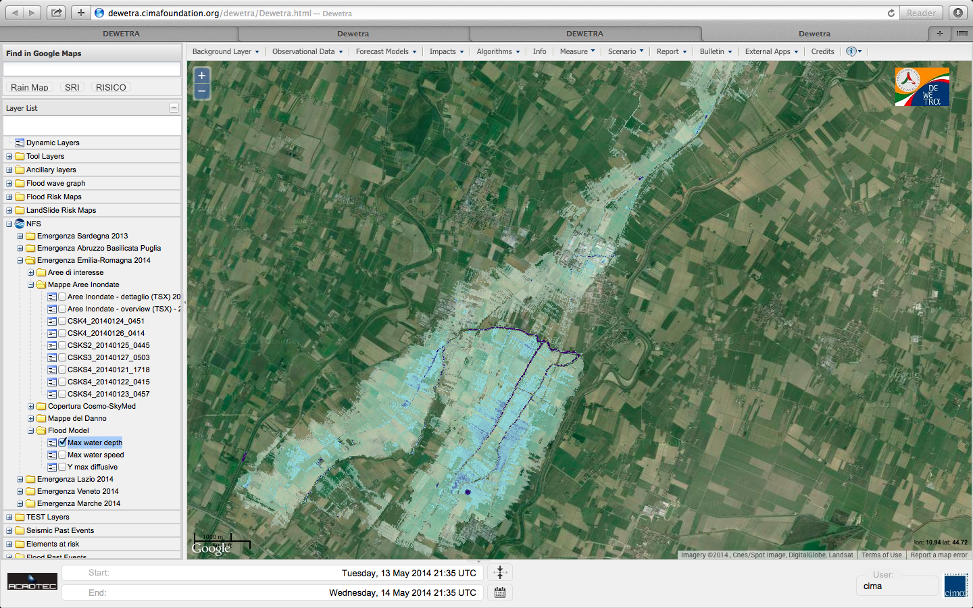
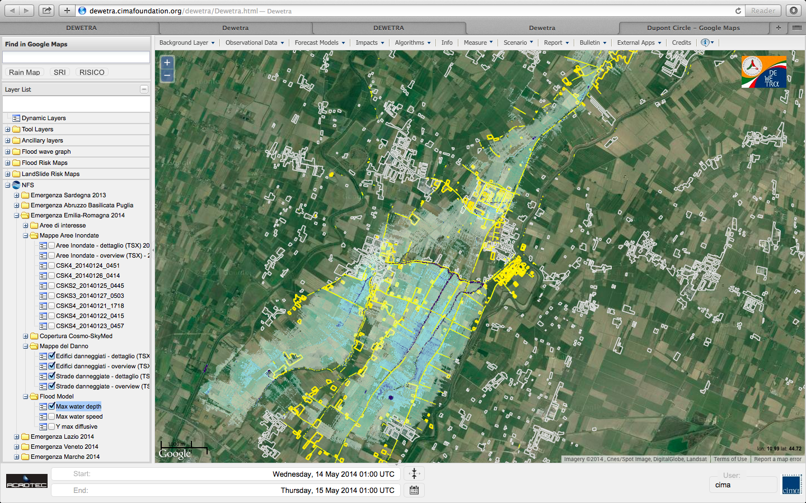
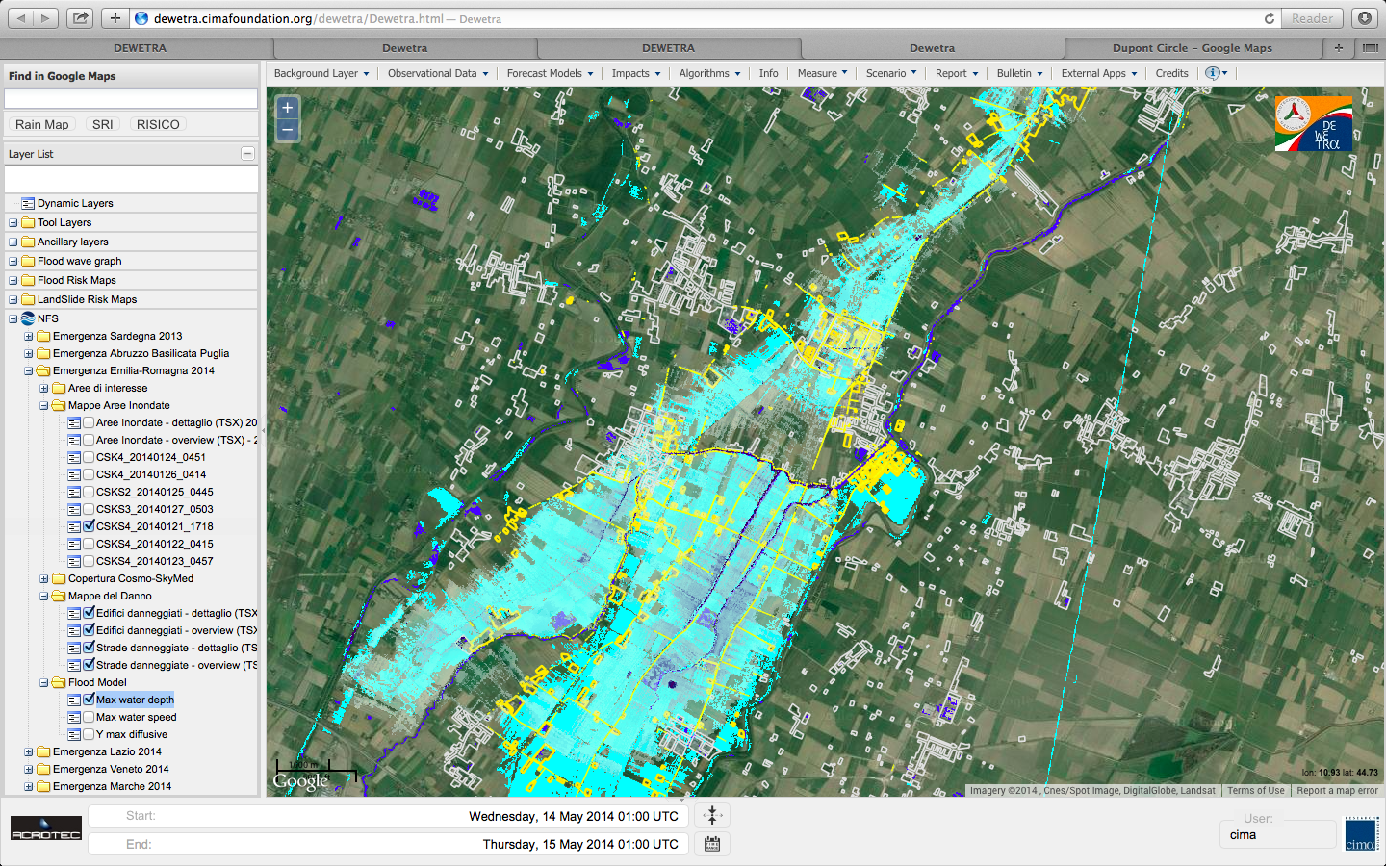
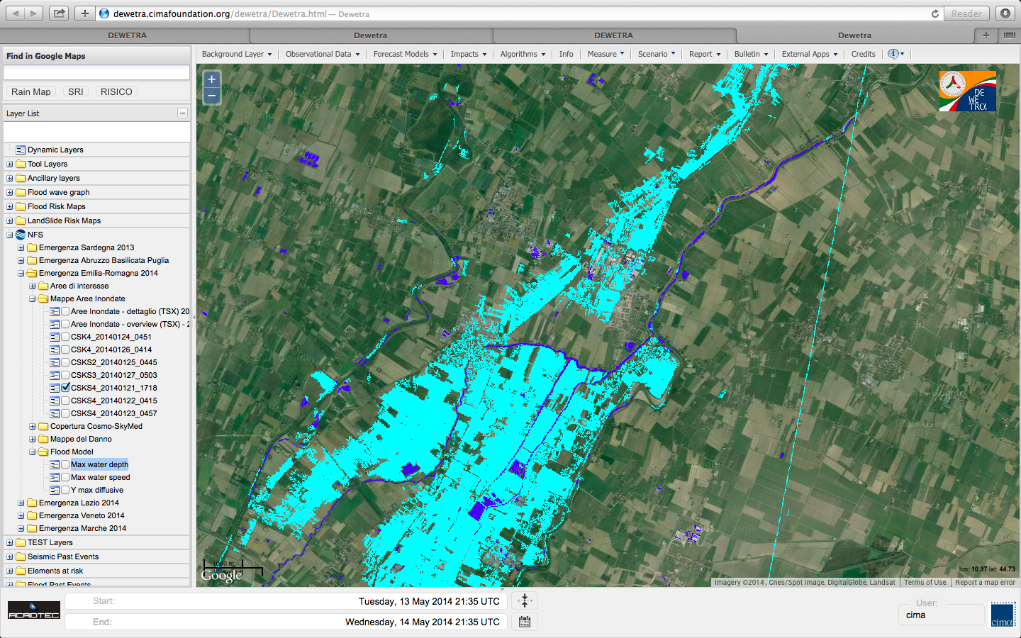
EO & hazard
flood print to calibrate modelled flood water depth
Northern Italy, 2014
Notes:
Extensive and homogeneous data base of automatically generated digital flood vectors connected to modelled flood water depth characterized in terms of return periods, and in some cases time evolution for major events.

Slide 17
EO & vulnerability
From SENSUM Project EO Proxies for Vulnerability (Earthquakes and Landslides)
Medium Resolution | High Resolution
Unsupervised built-up area | Building footprints
Age of built-up area (evolution in time) | Building height
 | Building regularity
 | Building alignment
 | Building density
 | Roof type
BUILDINGS ATTRIBUTES useful for FLOOD DAMAGE CURVES | PROXIES from REMOTE SENSING
1. Use | -Open spaces -Land use -Roof type -Building footprint
1.1 Residential
1.1.1 Upper middle and middle class
1.1.2 Lower middle class
1.1.3 Skilled working class
1.1.4 Working class and lowest level of subsistence
1.2 Commercial
1.2.1 Professional business
1.2.2 Shops/Supermarkets
1.2.3 Industrial
1.3 Public
1.3.1 Hospital/ Health structure
1.3.2 School/ Educational structure
1.3.3 Government facility
1.4 Touristic
1.4.1 Museum
1.4.2 Hotel
1.4.3 Religious building
2. Construction material | -Land use -Roof type -Buiding age
2.1 Wood frame
2.2 Steel Frame
2.3 Masonry
2.4 Concrete bearing wall structures
3. First floor elevation above the ground [meters] | User knowledge required
4. Height of doors and openings above the ground [meters] | User knowledge required
5. Orientation of doors and openings (to be compared to water direction) | User knowledge required An approximative evaluation can be done considering -Street network -Building footprint
5.1 N
5.2 N/W
5.3 W
5.4 S/W
5.5 S
5.6 S/E
5.7 E
5.8 N/E
6. Number of storeys | Building height
7. Presence of a basement [yes/no] | User knowledge required
8. Height of windows/openings on the basement above the ground [“not present”, meters] | User knowledge required
9. Presence of a split level [yes/no] | User knowledge required
10. Height of walls and other retaining structures above the ground [“not present”, meters] | Structure height
11. Foundation type | User knowledge required
11.1 Piers
11.2 Slab
12. Structural type | -Building height -Roof type -Building footprint
12.1 Detached
12.2 Semi-detached
12.3 Terraced
12.4 Flat
12.5 Bungalow
13. Age of buildings | Building age
13.1 pre-1919
13.2 1919-1944
13.3 1945-1964
13.4 1965-1974
13.5 1975-1985
13.6 post 1985

Slide 18
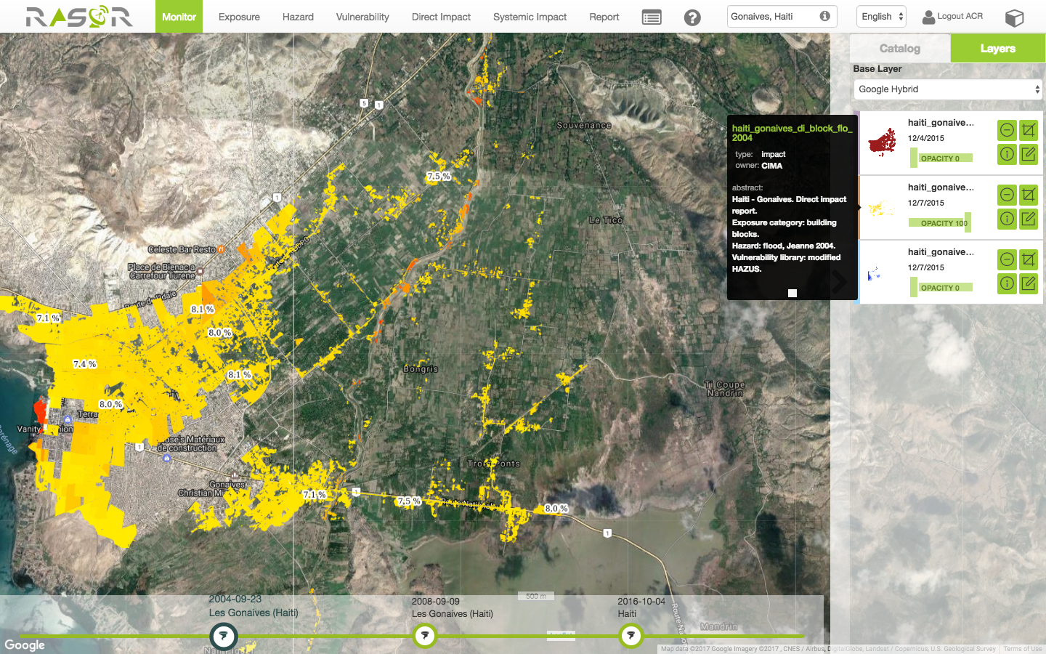
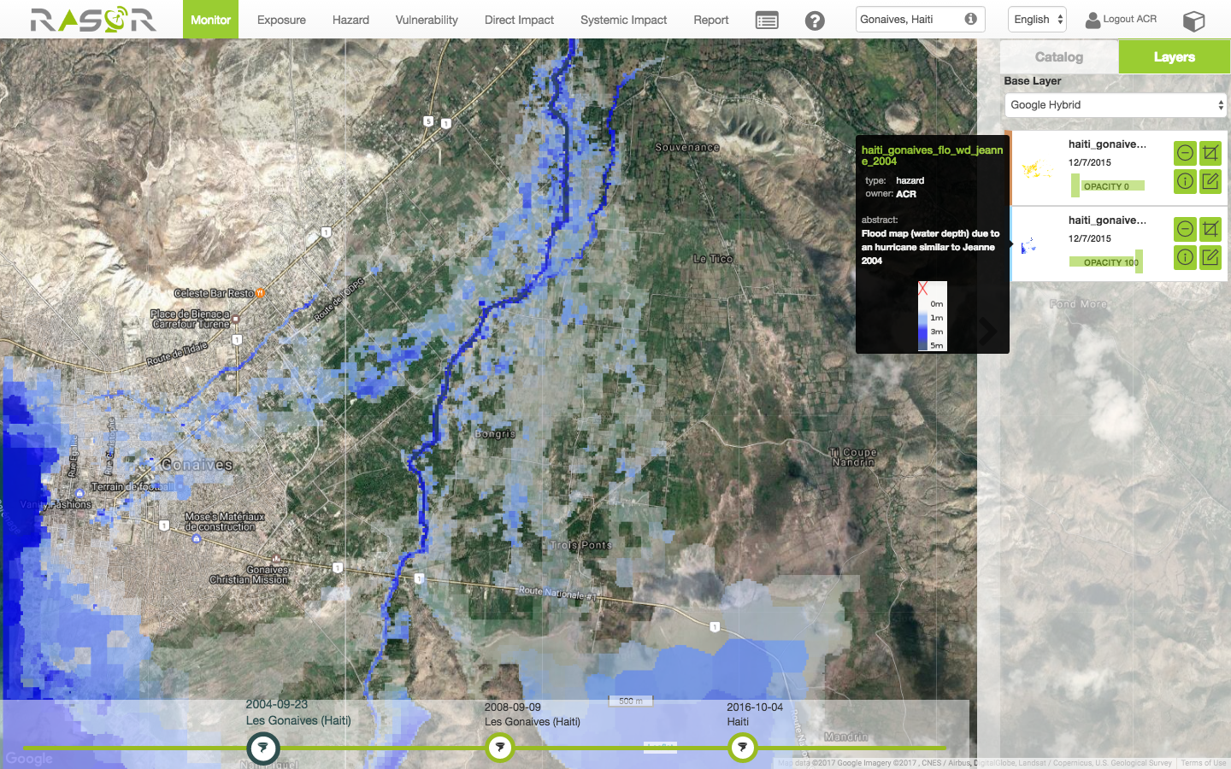
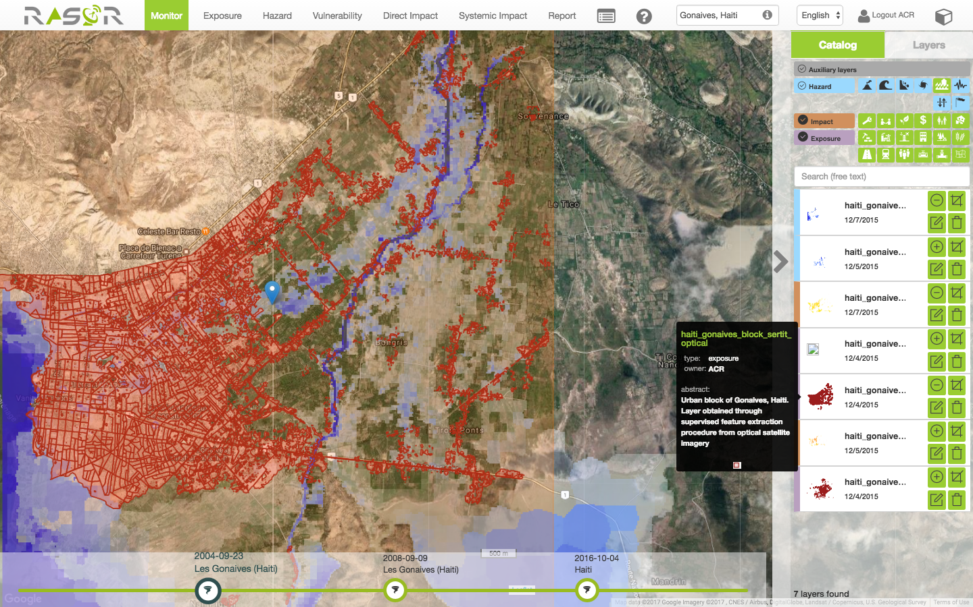
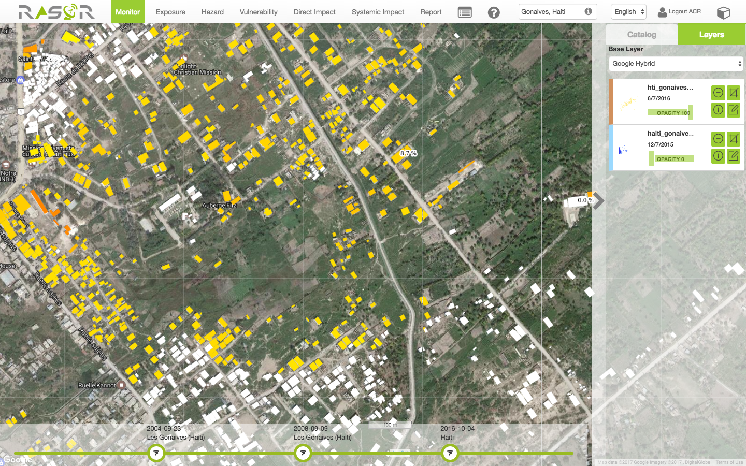
EO & impact
Hazard
Exposure
Hazard
Economic loss, building block
Economic loss, building level

Slide 19
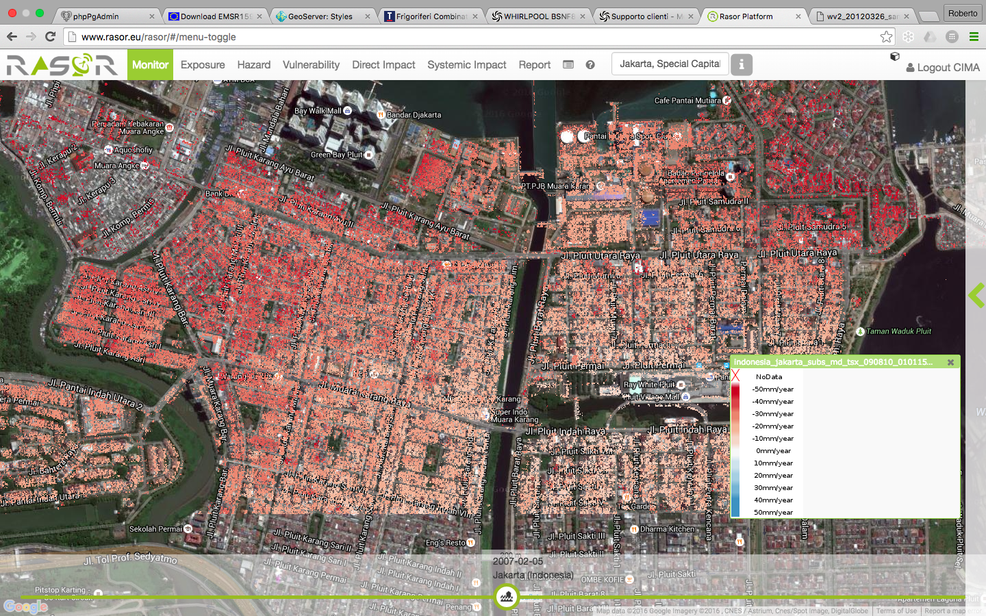
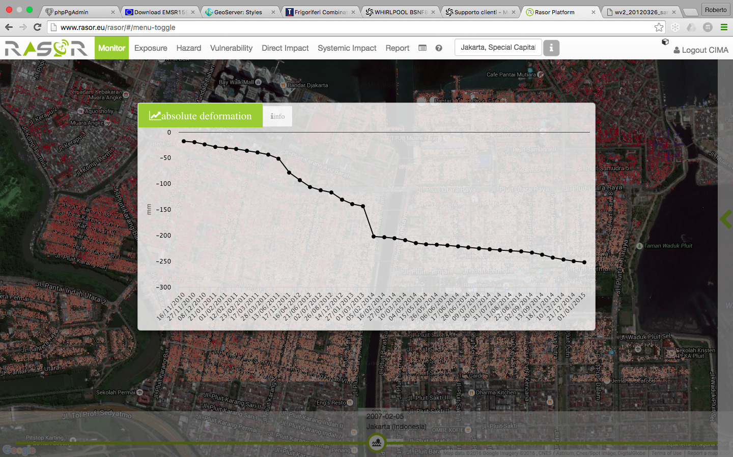
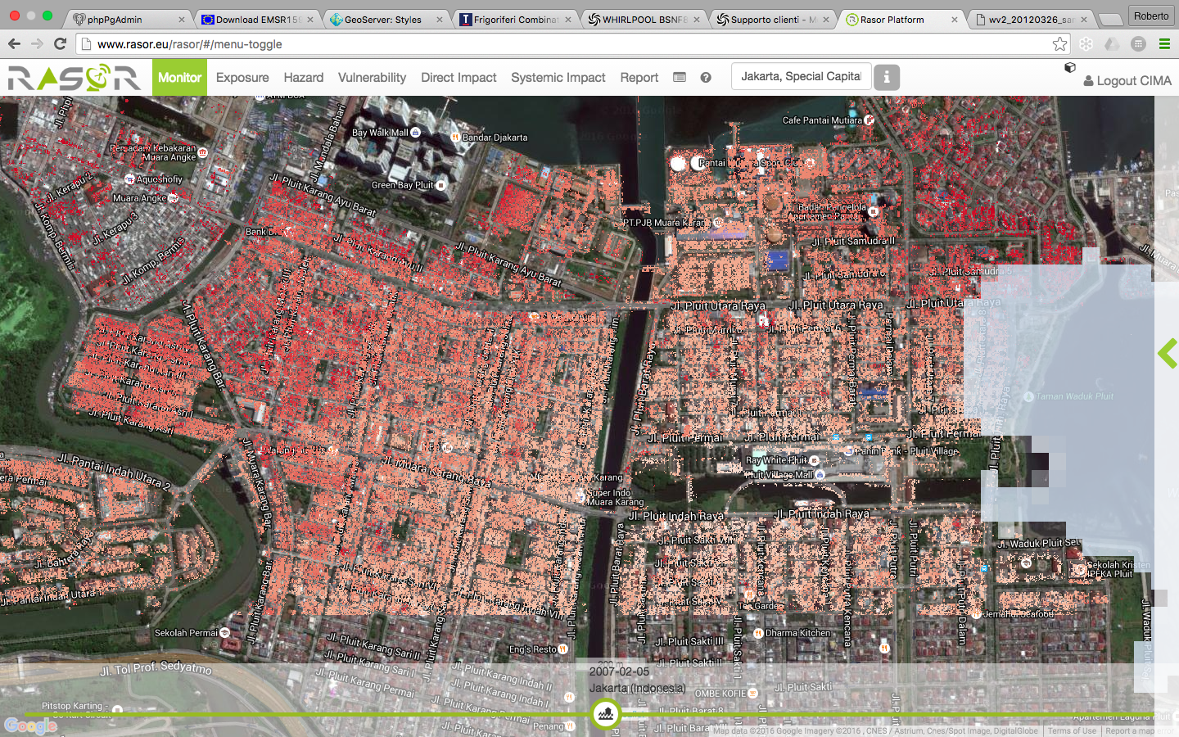
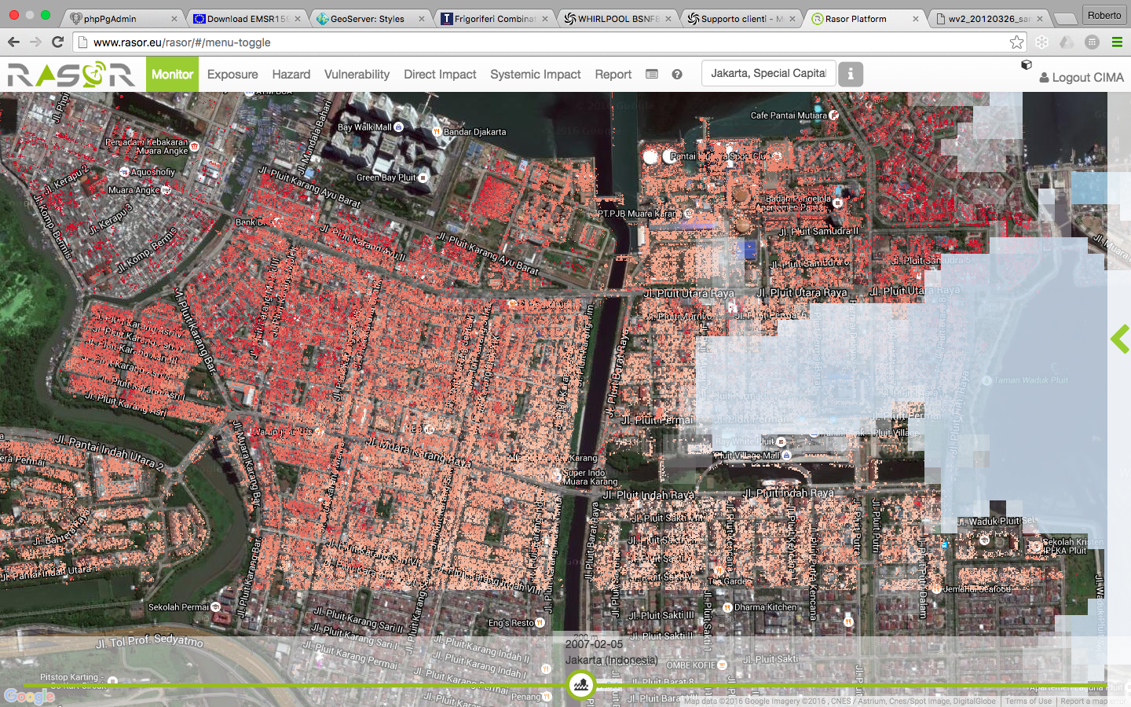
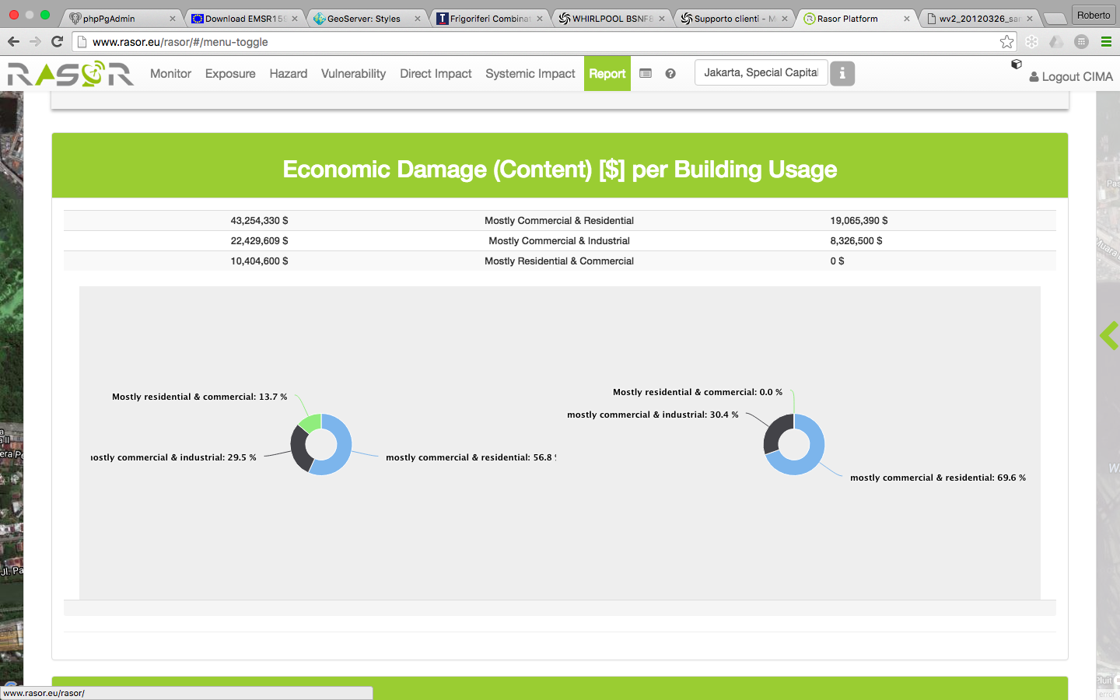
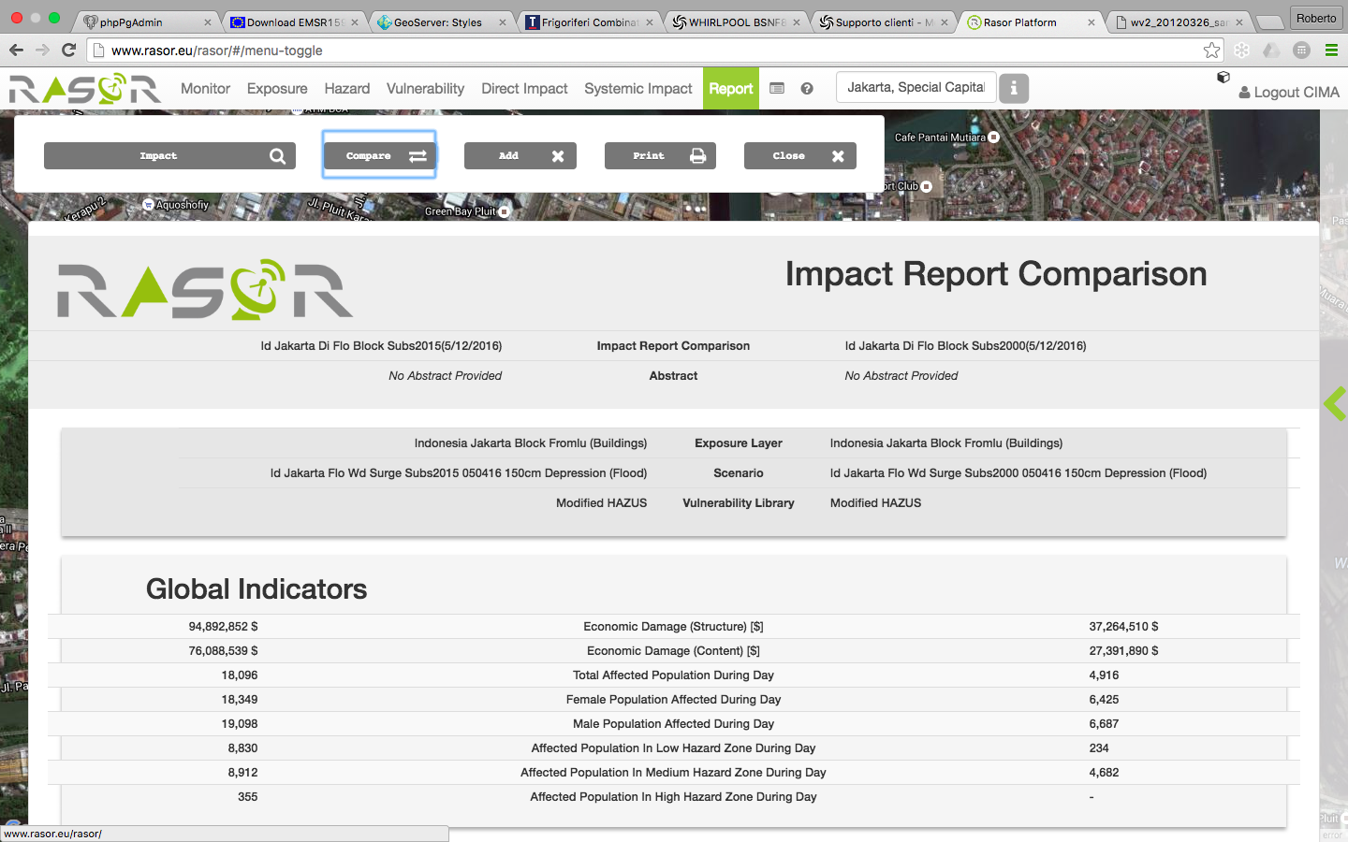
EO & hazards interaction
(subsidence + flood)

Slide 20
Added value to
direct physical impact estimation
Rapid Mapping
Grading Map
Elaboration
Rapid & quantitative Impact Evaluation
(indicator C)
(indicator B,D)

Slide 21
2016 Hurricane Matthew (Haiti)
Standard damage
estimation chain
Maximum wind field
Exposed elements
Damage estimation based on COPERNICUS EMS grading map
Wind vulnerability curves
Economic value of the assets
Physical damage from Copernicus (Grading Map)
Modelled physical damage
Economic damage estimated from grading maps
Economic damage modelled with RASOR
Notes:
4 km resolution from EFS

Slide 22
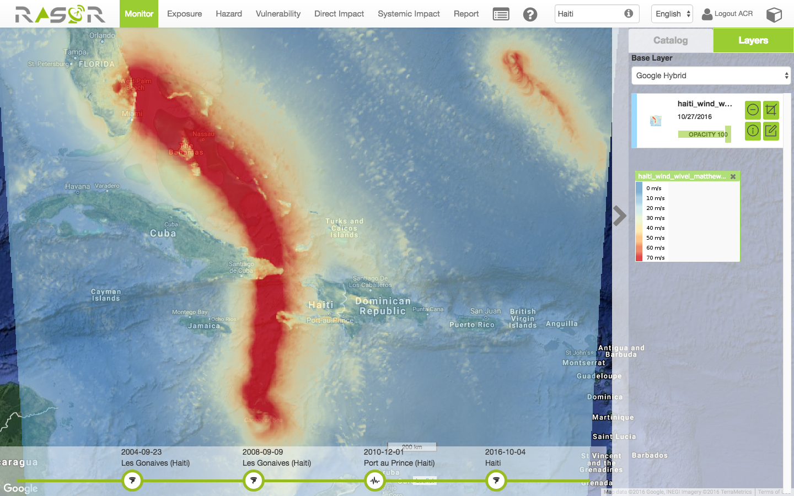
Maximum wind field
RASOR – 2016 Hurricane Matthew (Haiti)

Slide 23
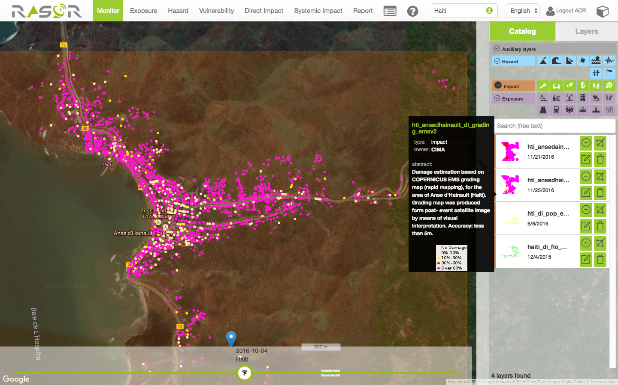
Strong winds impacts on Anse d’Hainault (Haiti)
Economic damage to structure:
estimated from satellite (Copernicus): 36 M$
simulated with RASOR: 29 M$
Notes:
Hurricane Matthew.
Assessment of damage caused by strong winds was computed in two ways:
- Damage estimation based on COPERNICUS EMS grading map (rapid mapping), for the area of Anse d'Hainault (Haiti).
Grading map was produced form post-event satellite image by means of visual interpretation. Accuracy: less than 5m.
Direct economic damage assessment was computed on the basis of percentage damage directly estimated from the grading map, and through asset feature characterization (asset value per m2, No of storeys, etc.)
Matching hazard and exposure through vulnerability curves. Hazard was obtained through numeric weather prediction models, computing max wind field.
The two methodologies led to almost the same economic damage estimation (around 20% difference)

Slide 24
Conclusion
EO for direct damage observation:
    Fast assessment
    Prioritize, plan, optimize surveys
A impact modelling approach is required to:
    make the two (short) periods comparable
    manage outliers
    re-construct past events impacts
EO as tool to estimate hazard, exposure, vulnerability (also PRIORITY 1)

Slide 25
Way forward
Pilot project at national scale comparing several countries would highlight usefulness of EO as a contributor to impact indicators
Where?
How do we structure such a project in the GEO-DARMA framework?

Slide 26
Thank you
Lauro Rossi
EWS Program Director
lauro.rossi@cimafoundation.org

