Slide 1
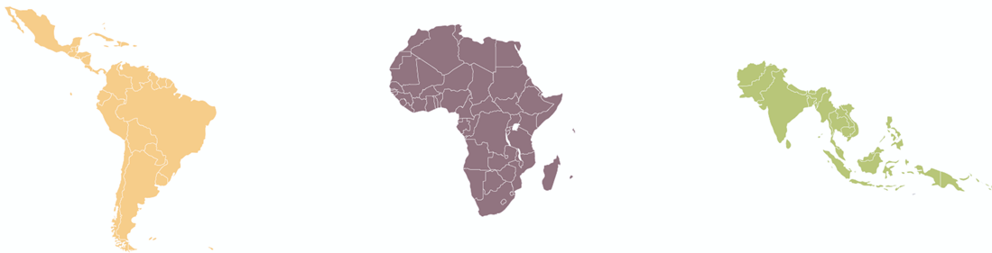

GEO-DARMA
Ivan Petiteville, ESA
GEO-DARMA Workshop
Cancun, 25 May 2017

Slide 2

What is CEOS ?
Committee on Earth Observation Satellites
60 members including all the world’s leading space, satellite and remote sensing agencies.
Operates through best efforts of Members via voluntary contributions.
The ‘space arm’ of GEO (Group on Earth Observations).
Main satellite data supplier for several global initiatives and UN conventions (e.g. UNFCCC (Climate Change) supporting Global Forest Observations Initiative (GFOI), GEOGLAM (Global Agriculture Monitoring – initiated by G20 ).
A Working Group on Disasters: +70 members from both space agencies and other stakeholders such as academia, civil protection, national resources management authorities,..

Slide 3
Expectations After Sendai
Use ALL data sources for better- informed disaster risk reduction decisions and resilience measures.
  in-situ, remote sensing, socio-economic, models,…
ALL relevant Actors have to gather their efforts to implement sustained end-to-end solutions.
  from data / information Providers down to final End Users
Create tangible link to SDGs

Slide 4
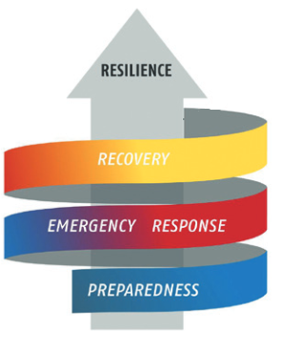
Why GEO-DARMA ?
Satellite data still largely underexploited
Until recently, mostly used in response phase.
Huge volume of free of charge EO data
    e.g. 10 TB/day from European Sentinel-1 and 2
    (optical and radar images;
    more than Facebook !!!!).
GEO-DARMA goal:
Demonstrate that combined use of all sources of EO data improves risk reduction.
  - Implemented through several national / local pilot projects in several regions.

Slide 5

GEO-DARMA Challenges
Data providers not aware of DRR priorities & Users’ needs
Users want ready-to-use information not satellite data !!
Perception of risk can differ between countries.
In each country, national / local issues are the most critical ones in the region …..
  At regional level, identify 2 or 3 independent and authoritative Regional Institutions for independent assessment of DRR priorities for 2015-2030

Slide 6
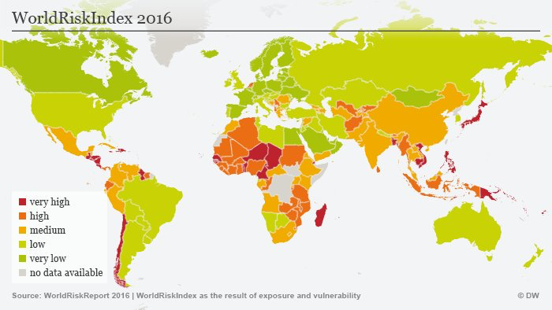
Targeted Regions

Slide 7
GEO-DARMA Overall Status
One of the 22 GEO Initiatives endorsed at last Plenary of the Group on Earth Observations – GEO (Nov. 2016).
Preparatory activities:
  GEO-DARMA Management Support (ESA contract)
  Initial meetings with Asian-based institutions UNESCAP and ADPC, in May 2017.
  Steering Committee being established (1st meeting today):
    High-level actors from disaster community, with different backgrounds and expertise, varied geographical representation.

Slide 8
GEO-DARMA Next Steps
Complete the establishment of the Steering Committee and Technical Committee with ToRs.
Consolidate GEO-DARMA concept and implementation plan with inputs from Steering Committee.
Further meetings with Regional Institutions.
Close and regular interactions with the Regional Institutions during the Concept Phase.

Slide 9
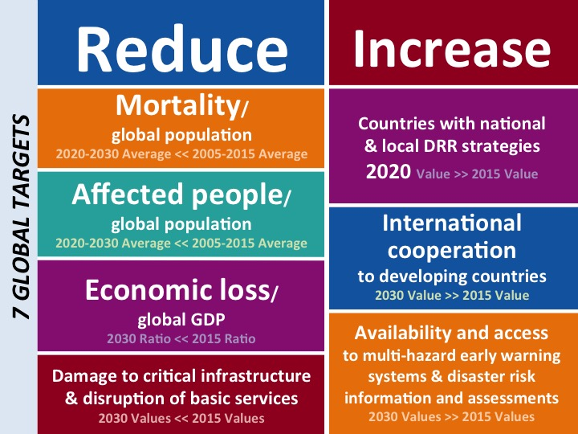

Slide 10
