Slide 1
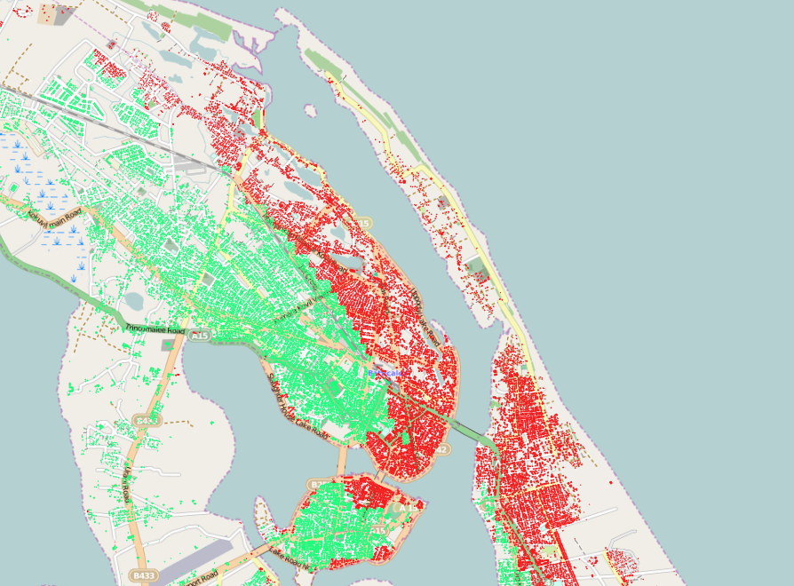


Possible roles for EO and Open Data for Disaster Risk Reduction
Francis Ghesquiere, GFDRR

Slide 2
Risk Information

Slide 3

What do we see on the ground?
  Data not often not available publicly (academic or commercial)
  Metadata is missing – data is not usable
  Many different platforms (and types of platforms)
  Data held in many different formats – GIS compatible, tabulated, PDF
  Hazard parameters are not standards: pga, probability of exceedance, AAL, return periods
  Data quality – which data to use?
  Data ≠ Information ≠ Insight
Notes:
Tools/Products that provide an introduction to information are important, as they can provide a starting point from which a user who is not an expert in disaster risk data can access that data and begin to understand / use it in their projects. These tools provide data and education in combination.
Aqueduct Flood Analyser, JRC’s INFORM index, and GFDRR’s ThinkHazard! are a few of those. ThinkHazard is a new platform, launched earlier this year, to enable project planners in the development sector easily search a country of interest and find out the natural hazards existing.
ThinkHazard takes hazard data that is output from hazard assessments – often gridded data of intensity parameters – e.g., peak ground acceleration, flood depth, wind speed, and translates the data, based on the frequency at which the hazard would be expected to cause damage in a location, into high, medium, low hazard classifications which are delivered to the user for each administrative unit in a more simple format.

Slide 4
This leads to or is the result of…
  Data Fragmentation across Institutions
  Duplication of Effort
  Out-of-Date Datasets
  Incompleteness
  Data management and curation (capacity and cost)
  Weak Usage/Application of Data
  Policy and Legislative Frameworks
  Fear and Power
Notes:
However,

Slide 5
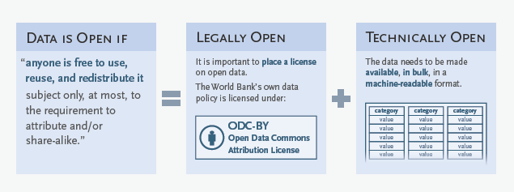
What is Open Data?

Slide 6
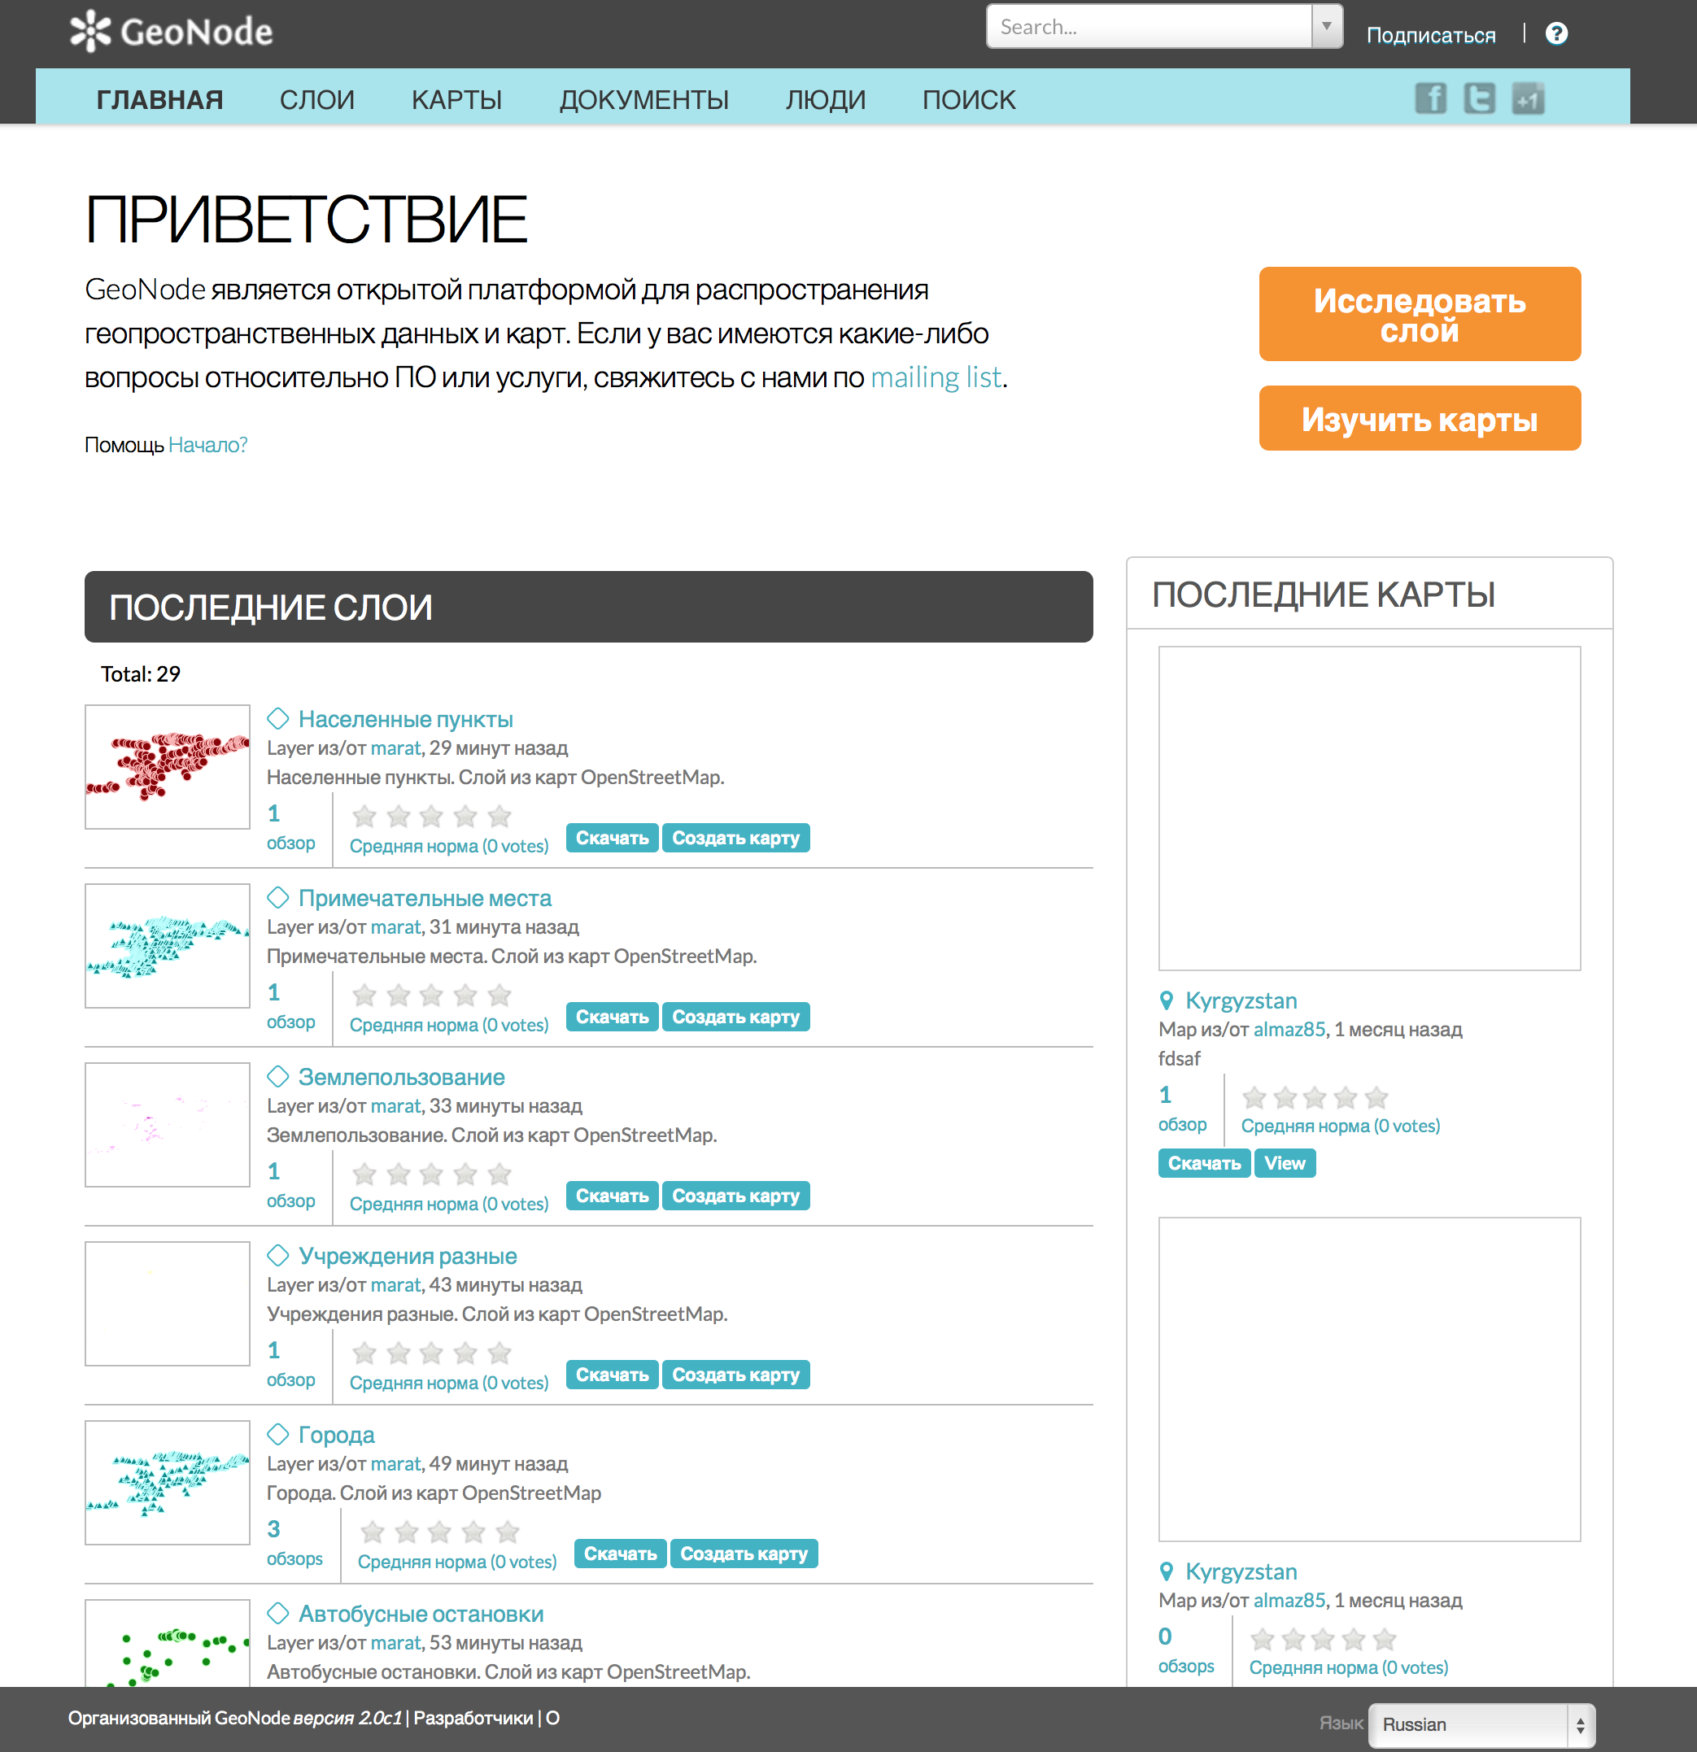
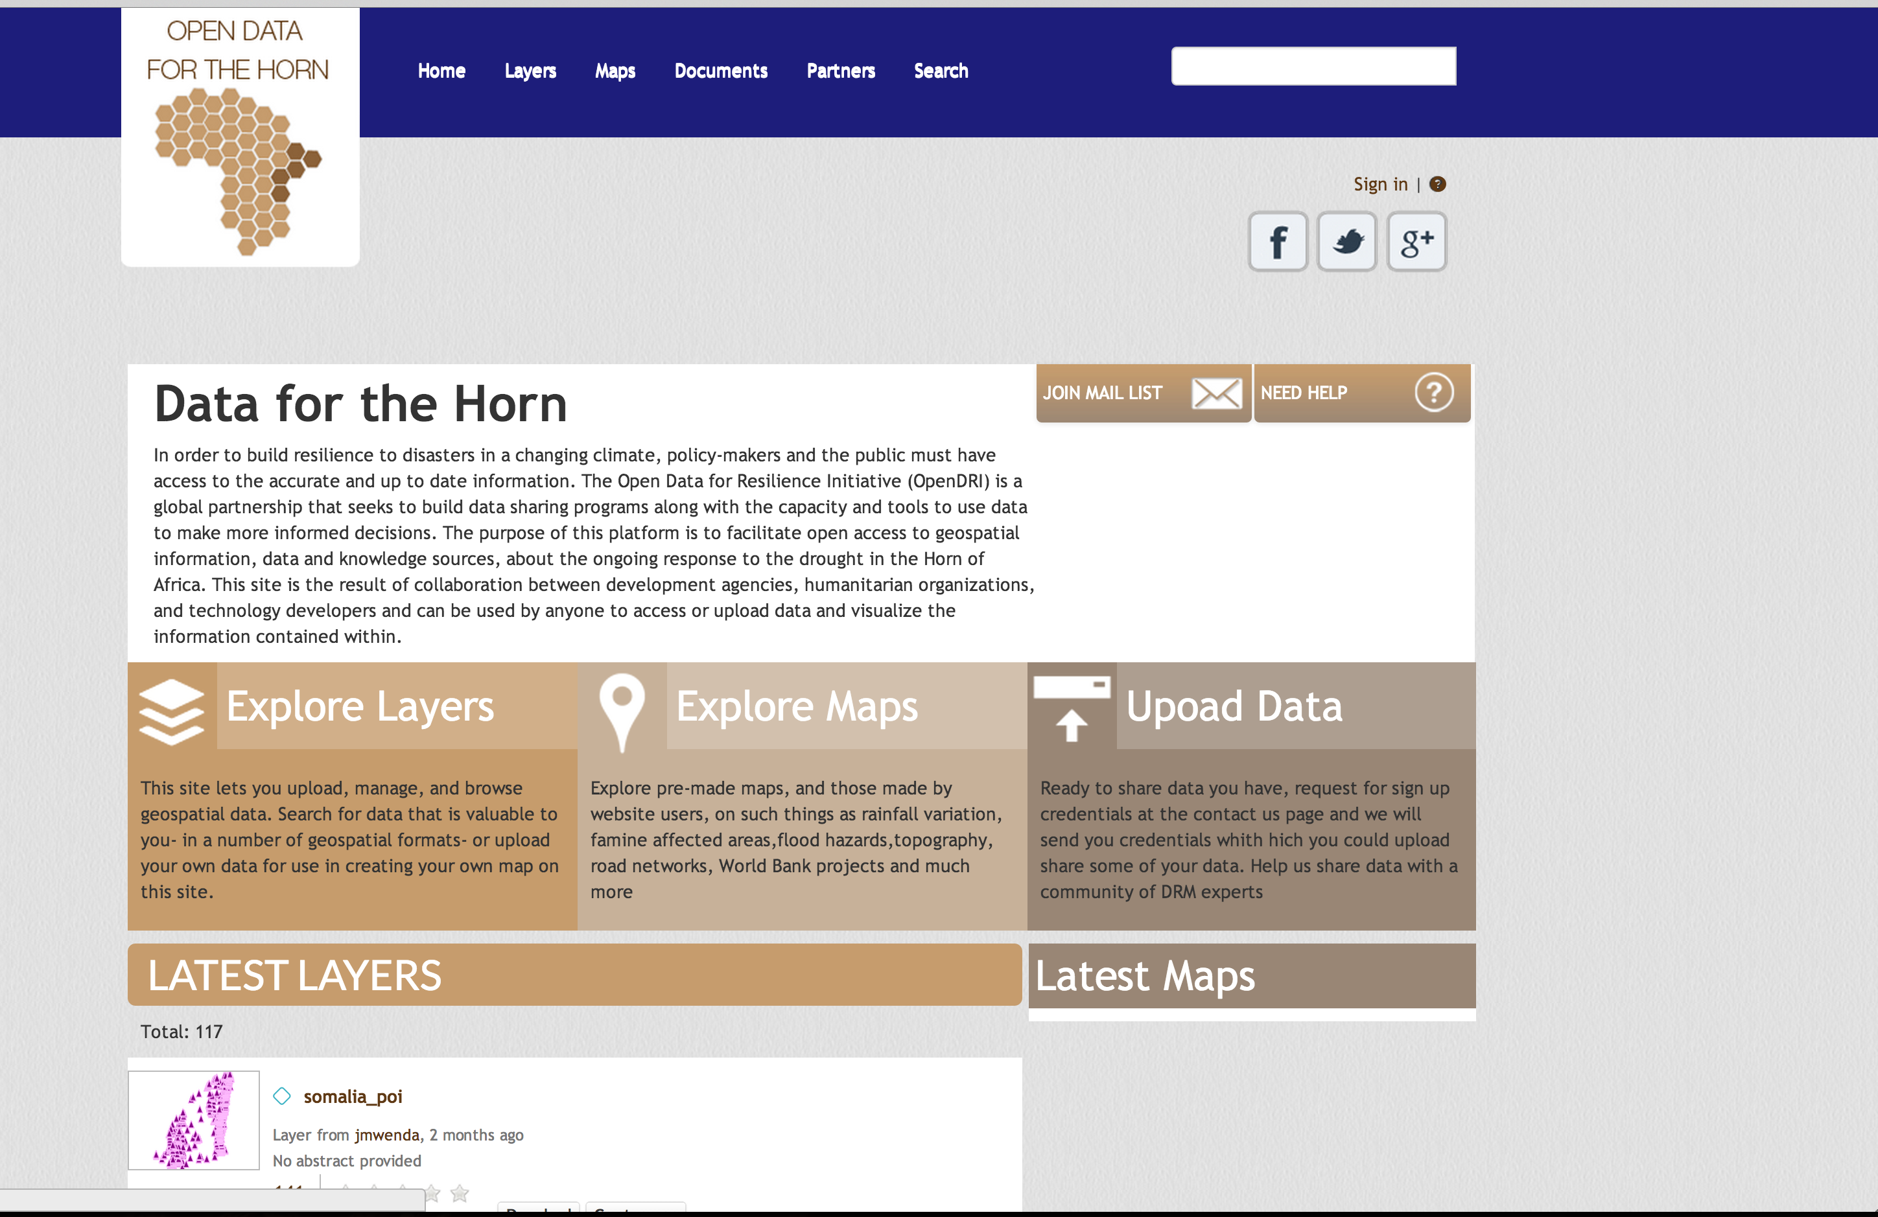
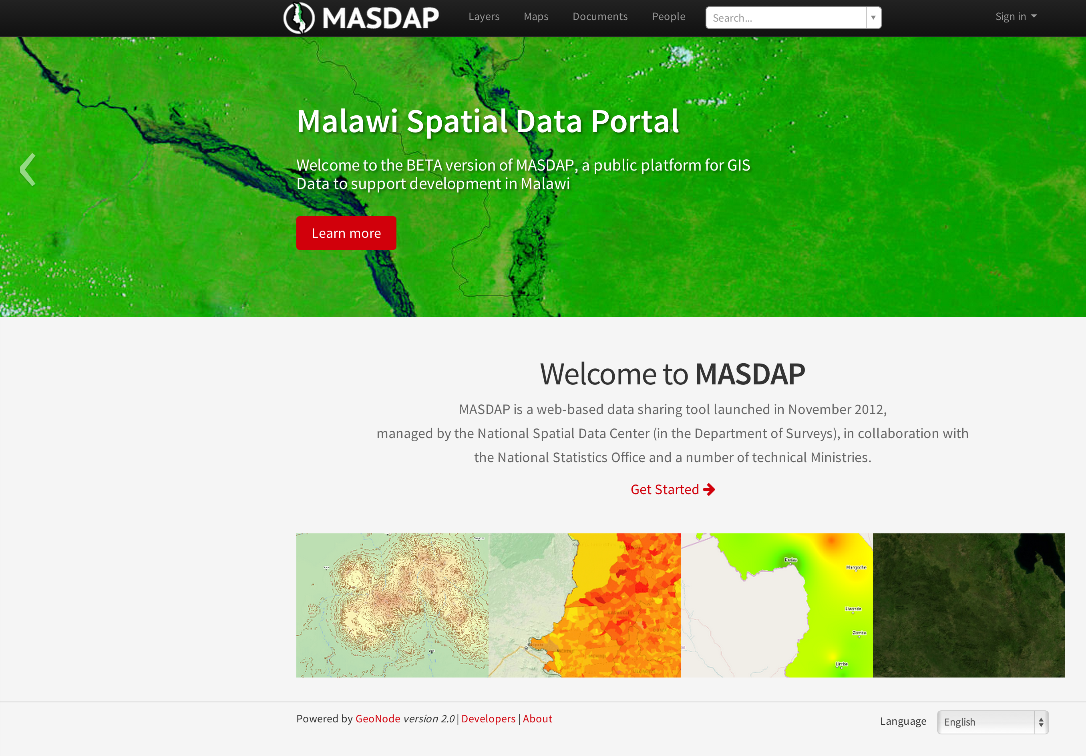
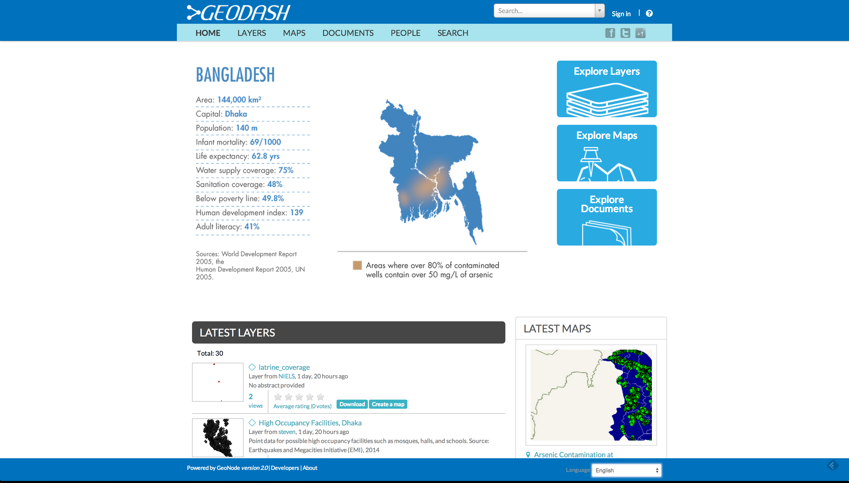
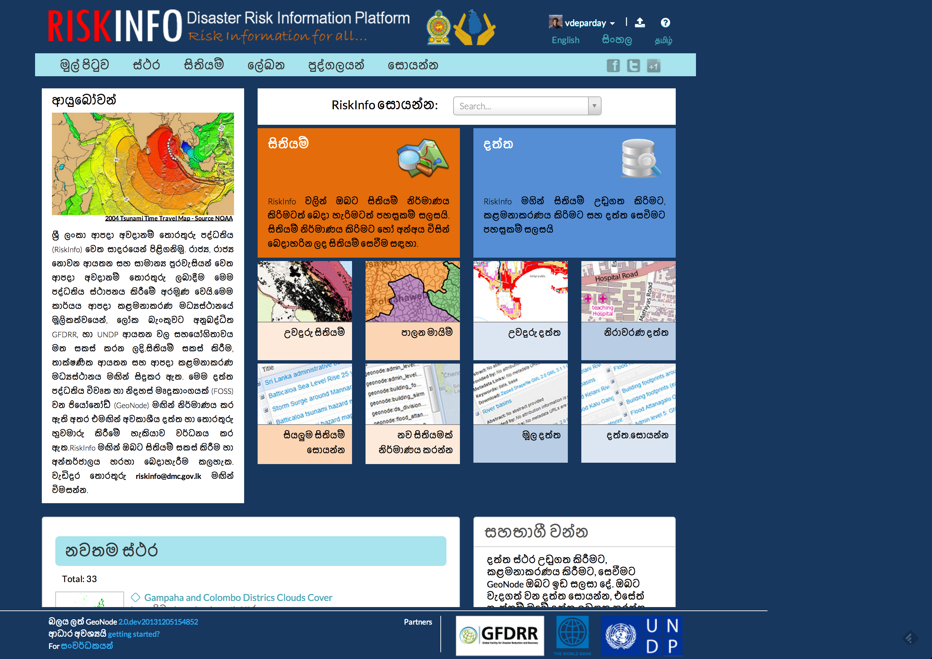
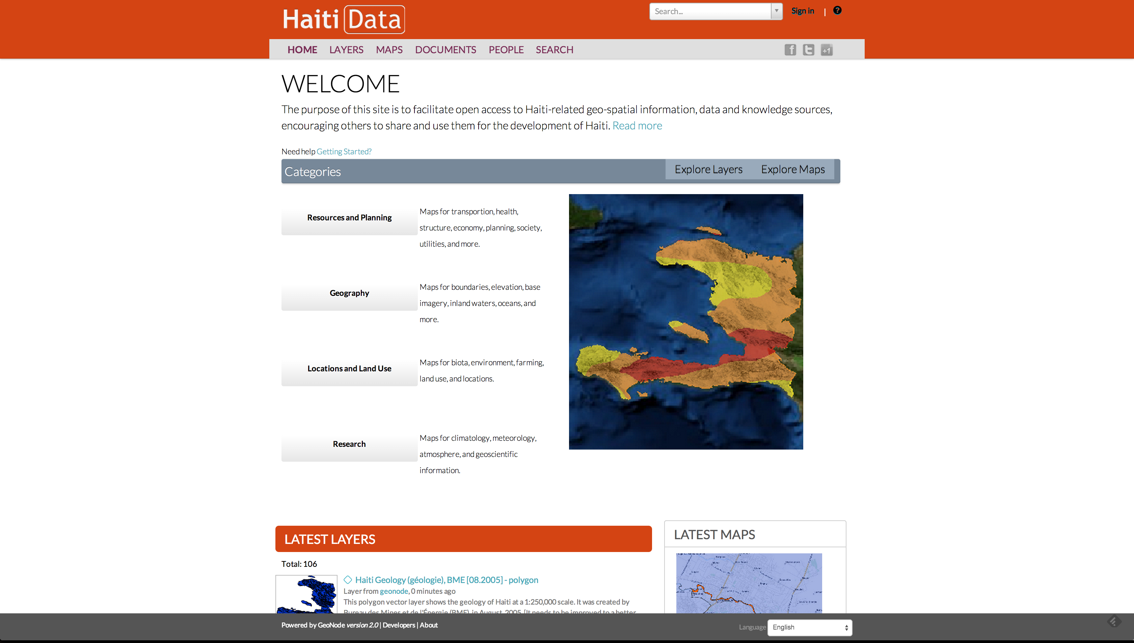
Data Sharing in Practice
Notes:
Establishing the platform is the easy part

Slide 7
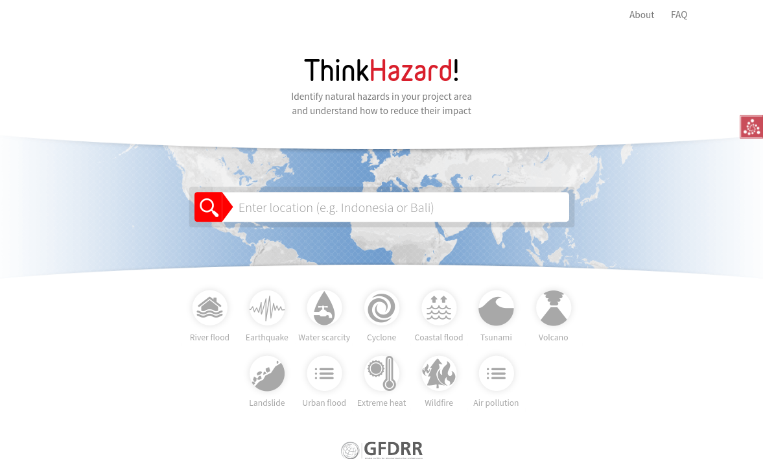
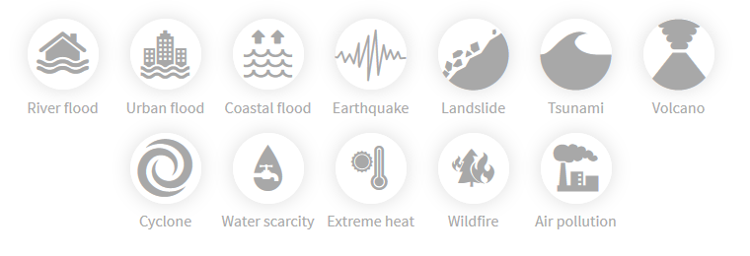
Notes:
The workflow is purposefully simple: A user enters a location of interest (national or subnational) on the homepage

Slide 8
6,500 members in >160 countries
Private, academic, national and sub-national government, intergovernmental representatives from >1,000 institutions
Biennial Global Forum: 2010 (Washington), 2012 (Cape Town), 2014 (London) 2016 (Venice),
  Innovate, inspire and influence
  Networking, partnerships, showcasing best practice, training, etc.
  500-1000 participants across 5 day event.
Regional, National, and City events (e.g. UR+f Africa, UR Brazil, UR Tanzania, UR Vancouver…)
UR
May 2018 (Mexico City)
Notes:
GFDRR Innovation Lab
A group of experts in spatial data, risk analysis, and earth observation data relevant to disaster risk reduction, dealing with all aspects of hazards, exposure information, and vulnerability.
We create and commission risk information, and encourage sharing of models and information with open access in all of our projects.

