Slide 1
Notes:
This is the Holding Slide.
The Holding slide helps you to present a flawless presentation. This means that you can have the presentation running in advance of your introduction to the audience so that they do not see any awkward documents or work before you begin. The holding slide remains in place UNTIL YOU CLICK ON IT TO BEGIN YOUR PRESENTATION.
In a situation when presenting to a large audience the holding slide can be seen on the large screen as you are introduced and make your way to the podium.

Slide 2
Notes:
INTRO - DO NOT TOUCH! OR CLICK ! TO REMOVE INTRO, DELETE FROM THIS SLIDE TO SLIDE 4

Slide 3
Notes:
INTRO - DO NOT TOUCH! OR CLICK ! TO REMOVE INTRO, DELETE FROM THIS SLIDE TO SLIDE 4

Slide 4
Notes:
INTRO - DO NOT TOUCH! OR CLICK ! TO REMOVE INTRO, DELETE FROM THIS SLIDE

Slide 5
Notes:
IDENTIFIER SLIDE, FROM THIS POINT ON CLICK TO ADVANCE SLIDE

Slide 6
Disaster Risk Reduction in the Caribbean
Presenter
Notes:
SECTION HEAD
There are three colour variations for sections. May be used with text or as a divider. Should text flow over, simply pull the text box to enlarge the height.
Please ensure that the width remains the same so as not to impact negatively on the logo.

Slide 7
PRESENTATION OUTLINE
Introduction to CDEMA
CDM and the CDM Strategy
CDM Monitoring and Reporting
Notes:
TEXT PAGE WIDE. Please note the graphic top header which adds visual relief to a page that would be text heavy. Also available with a blue background option.

Slide 8
OVERVIEW OF CDEMA
Notes:
The title screen.
Click to insert Title and Subtitle as required. Should text flow over, simply pull the text box to enlarge the height.
Please ensure that the width remains the same so as not to impact negatively on the logo.

Slide 9



CDEMA
CDEMA transitioned from CDERA on Sept 1, 2009.
CDERA was originally established by an Inter-governmental Agreement signed in Grenada in Sept 1991 at the Conference of the Heads of Government of the Caribbean Community (CARICOM).
Notes:
Text page with two columns. Please note the graphic top header which adds visual relief to a slide that would be text heavy. Also available with a blue background option
9

Slide 10

CDEMA
CDEMA was established on principles of inter-governmental cooperation as the region recognised that there were a number of small states with large vulnerabilities and limited individual capacity which could be collectively harnessed.
Notes:
Text page with two columns. Please note the graphic top header which adds visual relief to a slide that would be text heavy. Also available with a blue background option
10

Slide 11
CDEMA’s MANDATE
CDEMA
Mitigating or eliminating as far as practicable the immediate consequences of disasters in Participating States.
Immediate and coordinated response to disasters in Participating States (PS)
Mobilize and coordinate disaster relief from governmental and non-governmental organizations for affected Participating States
To promote the establishment, enhancement and maintenance of disaster response capabilities among Participating States
Disaster loss reduction and development of a culture of safety
Notes:
Text page with two columns. Please note the graphic top header which adds visual relief to a slide that would be text heavy. Also available with a blue background option
11

Slide 12
CDEMA
CDEMA is a mechanism comprised of 18 Participating States supported by a Coordinating Unit (Secretariat)
CDEMA is the Champion for Comprehensive Disaster Management (CDM) in the Caribbean Region
The CDEMA Coordinating Unit (CU) inter alia coordinates the Regional Response Mechanism (RRM) in the Caribbean
Notes:
Text page with two columns. Please note the graphic top header which adds visual relief to a slide that would be text heavy. Also available with a blue background option
12

Slide 13
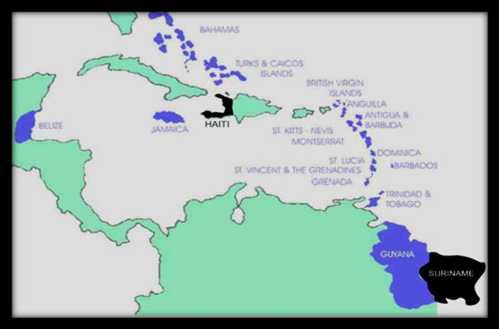


Participating States
CDEMA
Anguilla
Antigua
Bahamas
Barbados
Belize
British Virgin Islands
Dominica
Grenada
Guyana
Jamaica
Montserrat
St Kitts and Nevis
Saint Lucia
St Vincent and the Grenadines
Trinidad & Tobago
Turks & Caicos Islands
Haiti
Suriname
Notes:
Text page with two columns. Please note the graphic top header which adds visual relief to a slide that would be text heavy. Also available with a blue background option
13

Slide 14
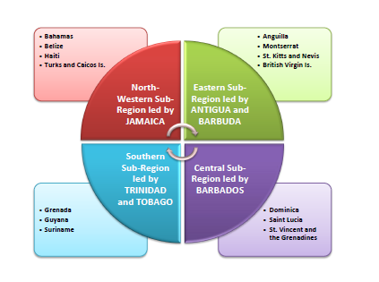
CDEMA
CDEMA’s SUB-REGIONAL ORGANISATION
Notes:
Text page with two columns. Please note the graphic top header which adds visual relief to a slide that would be text heavy. Also available with a blue background option
14

Slide 15
CDM AND THE CDM Strategy
Notes:
SECTION HEAD
There are three colour variations for sections. May be used with text or as a divider. Should text flow over, simply pull the text box to enlarge the height.
Please ensure that the width remains the same so as not to impact negatively on the logo.

Slide 16

THE CARIBBEAN LANDSCAPE
2nd Most Hazard Prone Region in the World
Human Induced
  Fires
  Oil Spills
  Chemical Explosions
  Epidemic
  Water Pollution
  Insurrection
  Theft and robberies
  Accidents
  Bomb Threats
  Kidnappings
Natural Hazards
  Hurricanes
  Floods
  Drought
  Earthquakes
  Volcanoes
  Landslides
  Tsunamis

Slide 17
Comprehensive Disaster
Management (CDM)
Preparedness
Recovery and Rehabilitation
Response
Mitigation and Prevention
CDM is the management of all hazards
through all phases of the disaster management cycle
by all peoples public and private sectors, all segments of civil society and the general population
CDM involves risk reduction & management and
integration of vulnerability assessment into the development planning process
Notes:
Text page with two columns. Please note the graphic top header which adds visual relief to a slide that would be text heavy. Also available with a blue background option
17

Slide 18
CDM – A Paradigm Shift
Comprehensive Disaster
Management (CDM)
FROM
Reactive
Disaster Office
A focus on individual hazards
TO
Anticipatory
Shared Responsibility
Viewing hazard exposure as an ongoing process that aims to reduce vulnerability across all sectors
Notes:
Text page with two columns. Please note the graphic top header which adds visual relief to a slide that would be text heavy. Also available with a blue background option
18

Slide 19
Comprehensive Disaster
Management (CDM)
Benefits of the CDM Approach
  Emphasizes natural hazard risk reduction
  Promotes a “culture of safety”
  Recognizes that strengthening disaster preparedness for better response is critical
  Encourages strategic partner alliances and linkages with global and regional agendas
  Promotes transparency and accountability
  Advocates for empowering of sector partners to (take responsibility) and lead dissemination and advocacy with their constituency
Notes:
Text page with two columns. Please note the graphic top header which adds visual relief to a slide that would be text heavy. Also available with a blue background option
19

Slide 20
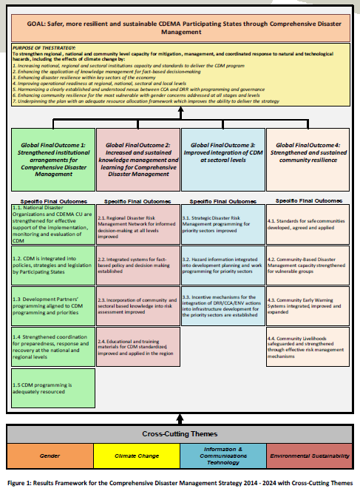
Regional Comprehensive Disaster Management Strategy 2014 - 2024
Results-based
Developed by broad range of regional CDM stakeholders
Establishes goals for improving CDM over the next 10 years in 4 Pillars:
  Institutional Strengthening
  Knowledge Management
  Mainstreaming CDM into Key Sectors
  Building Community Resilience

Slide 21
New Aspects of the CDM Strategy 2014-2024 for Embracing Resilience
Expanded stakeholder base with the inclusion of the merging priority sectors - (i) Physical and Environmental Planning and (ii) Finance and Economic Development.
Strengthened public-private partnerships within all the sector groupings going forward.
Focus on a more strategically aligned and integrated risk management approach, where climate change considerations are integrated into priority sectors allowing for the application of appropriate interventions
Enhanced results-oriented programming and monitoring through the elaboration of an Implementation Plan and an Online Monitoring and Evaluation System

Slide 22
Future Desired State – Resilience Agenda
National, regional and sectoral institutions with adequate/minimum standards of capacity to deliver the CDM program
Knowledge management which is applied for fact-based decision-making
Disaster resilience which is enhanced within key sectors of the economy
Operational readiness at regional, national, sectoral and local levels
Harmonized governance of CCA and DRR programming
Community resilience which has been enhanced for the most vulnerable with gender concerns addressed at all stages and levels
Resource allocation which underpins the ability to deliver the strategy

Slide 23
Long Term Goal for the Caribbean

Slide 24
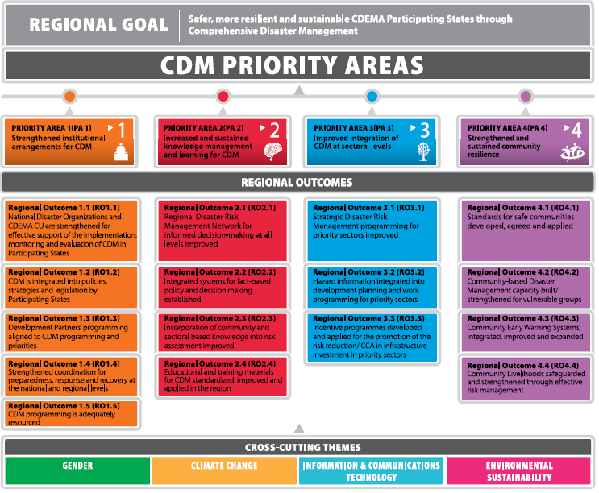

Slide 25
CDM monitoring and reporting

Slide 26
PRIORITY AREA 1: Strengthened Institutional Arrangements for CDM |  |  |  |  | 2024
RO1.1 | National Disaster Organizations and CDEMA CU strengthened for effective support of the implementation, monitoring and evaluation of CDM in Participating States
 |  | Number of CDEMA system stakeholders (NDOs and CDEMA CU) utilizing PMF and MER processes to inform Annual Progress Reports on CDM implementation |  | 19
 |  | Number of CDEMA System stakeholders (CDEMA Participating Countries and CU CDEMA) with a Governance Mechanism functioning |  | 19
RO1.2 | CDM is integrated into policies, strategies and legislation by Participating States
 |  | Number of CDEMA PS countries with a CDM legislation approved |  | 18
RO1.3 | Development Partners’ programming aligned to CDM programming and priorities
 |  | Number of partners that have programmes aligned to support CDM implementation |  | 20
RO1.4 | Strengthened coordination for preparedness, response and recovery at the national and regional levels
 |  | Number CDEMA system stakeholders (CDEMA CU and Participating States) conducting simulation exercises testing multi-hazards |  | 19
 |  | Number of CDEMA system stakeholders (NDOs, CDEMA CU, CIMH, RSS, SRC) with an effective emergency communications system supporting response and recovery |  | 22
RO1.5 | CDM Programming is adequately resourced
 |  |  | % of national budget supporting NDO operations | 2
 |  |  | % of Development Partners contribution to CDM implementation | TBD

Slide 27
PRIORITY AREA 2: Increased and Sustained Knowledge Management and Learning for CDM |  |  |  | 2024
RO2.1 | Regional Disaster Risk Management Network for informed decision-making at all levels improved
 |  | Number of accredited Centres of Excellence (CoE) operating | 6
 |  | Percentage of managers and technical professional from state institutions certified by a CoE | 75%
RO2.2 | Integrated Systems for fact-based policy and decision making established
 |  | Number of stakeholders (Participating States and CDEMA CU) utilizing CRIS for DRM decision making | 11
RO2.3 | Incorporation of community and sectoral based knowledge into risk assessment improved
 |  | Percentage of communities with hazard and vulnerability assessments that have been completed in consultation with community and sector partners | 75%
RO2.4 | Educational and training materials for CDM standardized, improved and applied in the region
 |  | Percentage of beneficiaries satisfied with training provided by trainers using standardized materials | 75%

Slide 28
PRIORITY AREA 3: Strategic Disaster Risk Management programming for priority sectors improved |  |  |  | 2024
RO3.1 | Strategic Disaster Risk Management programming for priority sectors improved
 |  | Number of Participating States with sector specific DRM plans that have been implemented | 18
RO3.2 | Hazard information integrated into development planning and work programming for priority sectors
 |  | Number of Participating States that have integrated normative requirements for risk mitigation | 18
RO3.3 | Incentive programmes developed and applied for the promotion of risk reduction/ CCA in infrastructure investment in priority sectors
 |  | Number of Participating States applying incentive programmes for Disaster Risk Reduction and Climate Change Adaptation | 18

Slide 29
PRIORITY AREA 4:Strengthened and Sustained Community Resilience |  |  |  | 2024
RO4.1 | Standards for safe communities developed, agreed and applied
 |  | Percentage of vulnerable communities in Participating States with a standard community disaster programme in place | 75%
RO4.2 | Community-Based Disaster Management capacity built/strengthened for vulnerable groups
 |  | Percentage of vulnerable communities with a standard multi-hazard community disaster plan which addresses vulnerable groups | 75%
RO4.3 | Community Early Warning Systems, integrated, improved and expanded
 |  | Number of Participating States that completed a multi hazard communication strategy at community level | 18
 |  | Number of Participating States having appropriate multi-hazard EWS | 9
RO4.4 | Community livelihoods safeguarded and strengthened through effective risk management
 |  | Percentage change in the average value (USD) of insurance for communities | Pen-ding

Slide 30
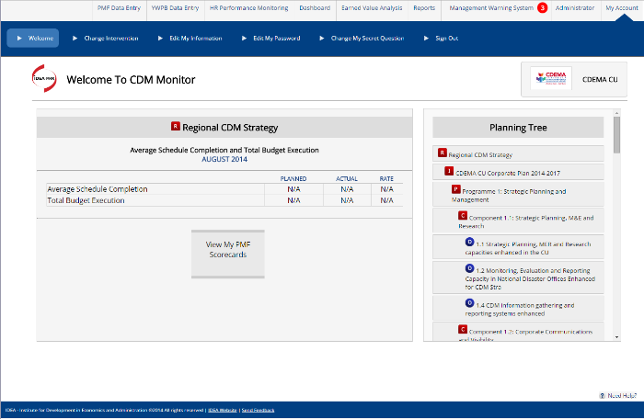
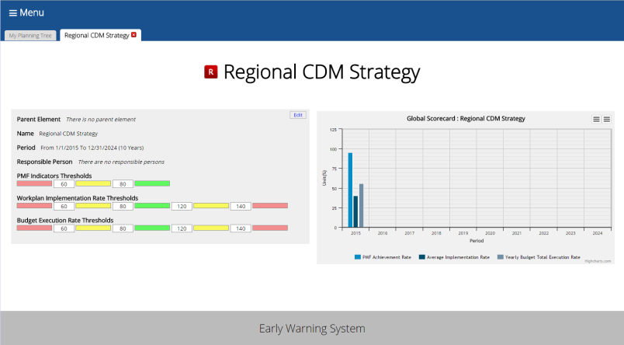
The CDM Monitor – Monitoring, Evaluation and Reporting

Slide 31
CDM Governance Mechanism: Structure
CDM Coordination and Harmonization Council (CHC)
Participating States Representation
Health
Education
Civil Society
Agriculture
Tourism
Finance & Economic Dev.
Physical & Environmental Planning
Development Partner Representation
Gender Working Group
Monitoring and Evaluation Working Group
Climate Change Adaptation, Gender, Environment and ICTs mainstreamed
Notes:
The CHC and its sub-committees are collectively called the CDM Governance Mechanism. The CDM CHC has established sub-committees for priority sectors, as well as CDM Monitoring Evaluation and Reporting, the CDM Database and gender.
Through the CDEMA CU and Executive Director, the organs of CDEMA ( i.e. the Technical Advisory Committee (TAC) and the CDEMA Council of Ministers) are kept apprised of the work of the CDM CHC.
About the Sector Sub-Committees
A Sub-Committee of the CDM CHC has been established for each priority sector. The Sector Lead for that sector chairs the Sector Sub-Committee. The Sector Sub-Committees comprise specialized agency representatives from the respective sectors. The Sector Leads attend meetings of the CDM CHC and, as part of their contribution to the CHC, they report on the progress made by their Sector Sub-Committee.

Slide 32
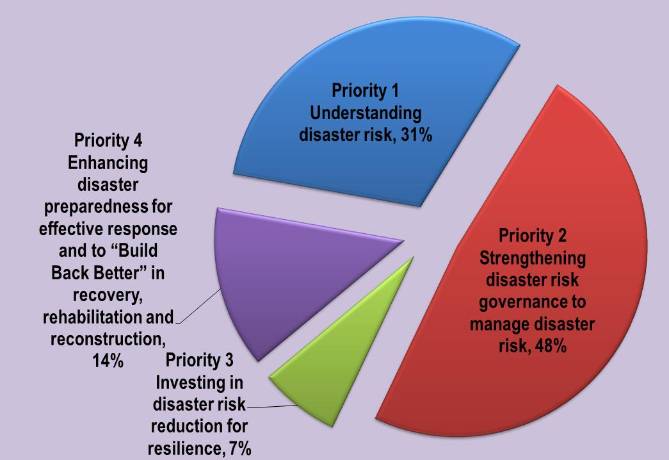
Mapping CDM and Sendai Frameworks

Slide 33
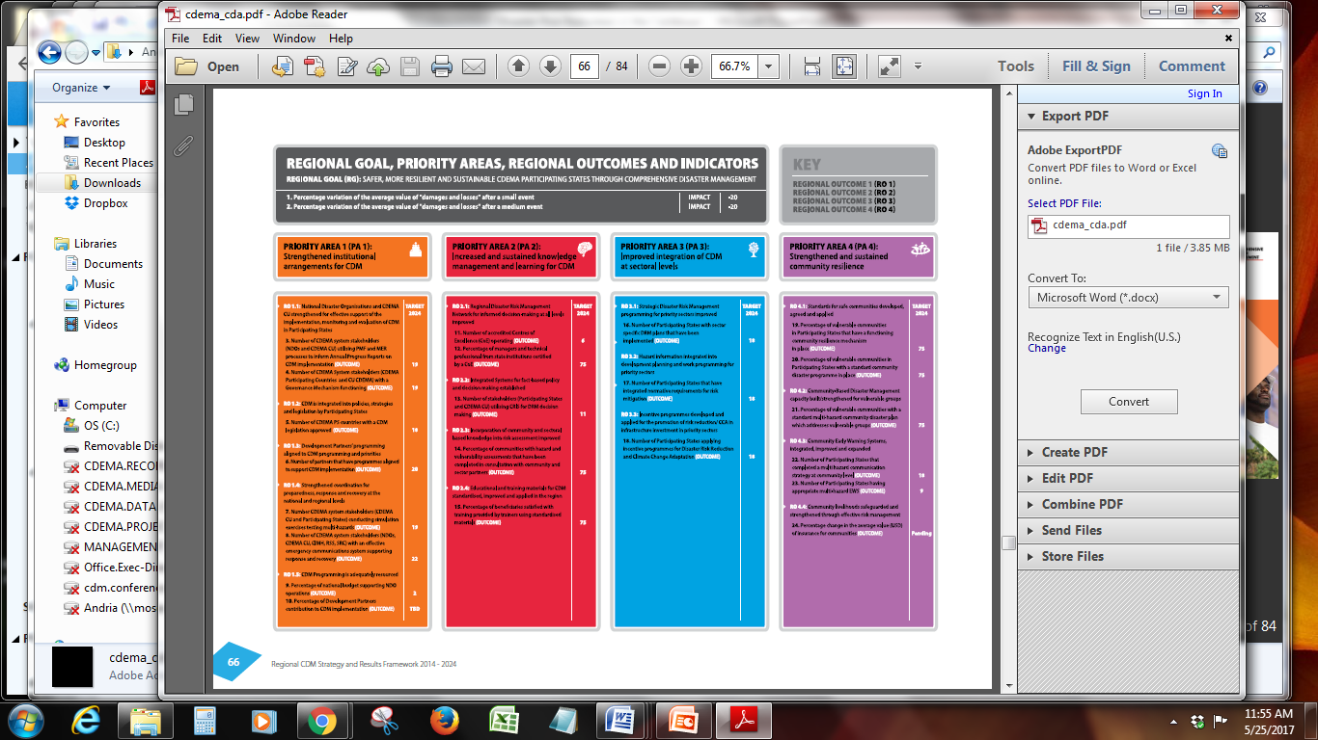
SENDAI INDICATORS AT THE GOAL LEVEL
Number of deaths and missing persons due to small scale events per 100,000
Number of deaths and missing persons due to medium scale events per 100,000
Number of people whose dwellings were damaged due to small scale events
Number of people whose dwellings were damaged due to medium scale events
Number of people whose dwellings were destroyed due to small scale events
Number of people whose dwellings were destroyed due to medium scale events

Slide 34
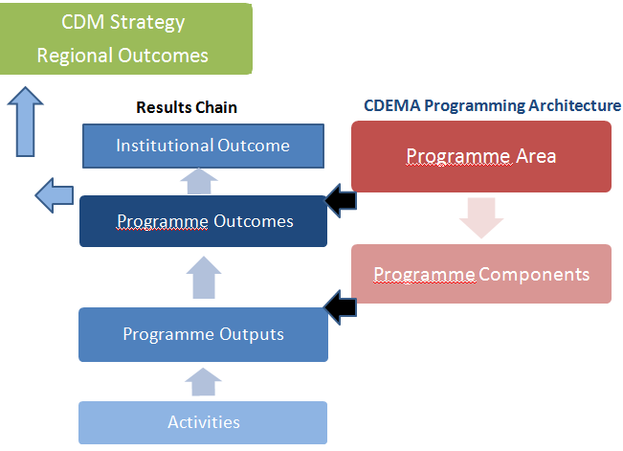
CDEMA CU Programming and Contribution to CDM Strategy
Notes:
Figure 2 shows the relationship between the Programming Architecture and Results Chain within the CDEMA CU and the linkage to the CDM Strategy at the regional level.
The diagram identifies the Programming architecture (Programme Areas and Programme Components) and seeks to chart the “change” and “transformation” utilizing the Results Chain. It recognises inputs through the agency-institutional activities (at operational level), to produce an output (goods and services at the programmatic level), and consequently produce an outcome (change at the programmatic level) which will contribute to an overall change/outcome in the Agency (at the institutional level).
Programme Outcomes contribute to the Regional Outcomes of the CDM Strategy. The CDEMA Corporate Plan shares some of the indicators of the Strategy at the Outcome Level and through its targets will deliver some of the results of the Strategy.

Slide 35
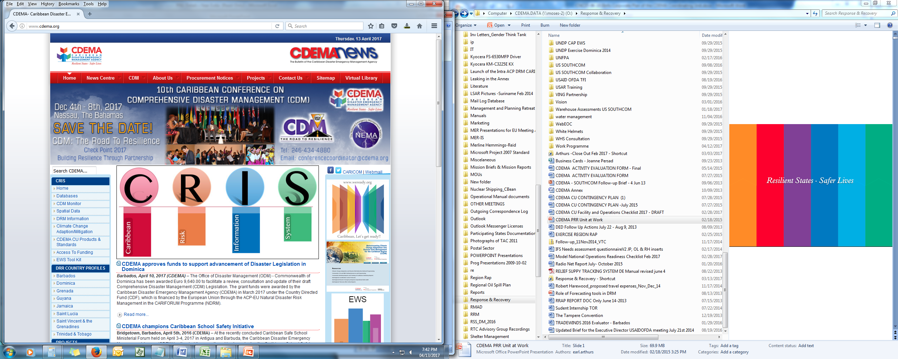
CDM STRATEGY BIENNIAL REPORTING PLATFORM

Slide 36
THANK yOU

