Slide 1
WORLD CLIMATE RESEARCH PROGRAMME
Update on Sponsors’ Review
and Strategy and Implementation Plans
Michel Rixen
WDAC7, 26-27 March 2018
WMO, Geneva, Switzerland

Slide 2
WCRP’s mission
... is to facilitate analysis and prediction of Earth system variability and change for use in an increasing range of practical applications of direct relevance, benefit and value to society.
The two overarching objectives of WCRP are:
to determine the predictability of climate
to determine the effect of human activities on climate

Slide 3
WCRP Structure
Our link to GCOS
Observations are critical across the entire WCRP enterprise, from process studies, to model development, initialization and verification, etc
CLOUDS, CIRCULATION AND CLIMATE SENSITIVITY NEAR-TERM CLIMATE PREDICTION
REGIONAL SEA-LEVEL CHANGE AND COASTAL IMPACTS MELTING ICE AND GLOBAL CONSEQUENCES
CARBON FEEDBACKS IN THE CLIMATE SYSTEM WATER FOR THE FOOD BASKETS OF THE WORLD
UNDERSTANDING AND PREDICTING WEATHER AND CLIMATE EXTREMES

Slide 4
Evolving context and challenges
Last WCRP Strategic Plan: 2005-2015
Last WCRP Review: 2009
Last WCRP Implementation Plan: 2010-2015
Research is pulled into a new and broader
“operational/service/policy” landscape
IPCC Assessment Reports
UNFCCC Paris Agreement and Global Stocktake
Global Framework for Climate Services
Sendai Framework for Disaster Risk Reduction
…

Slide 5
Key recommendations of the Review
Science Strategy and Implementation: key societal needs, international coordination, bedrock science but relevance
Governance and the MoU, sponsors board
JSC Science Strategy leadership
JPS and Operations
WCRP structure to support implementation
Sponsors’ financial support
Science for Services
Partnerships: WWRP, GAW, GCOS, Future Earth, etc

Slide 6
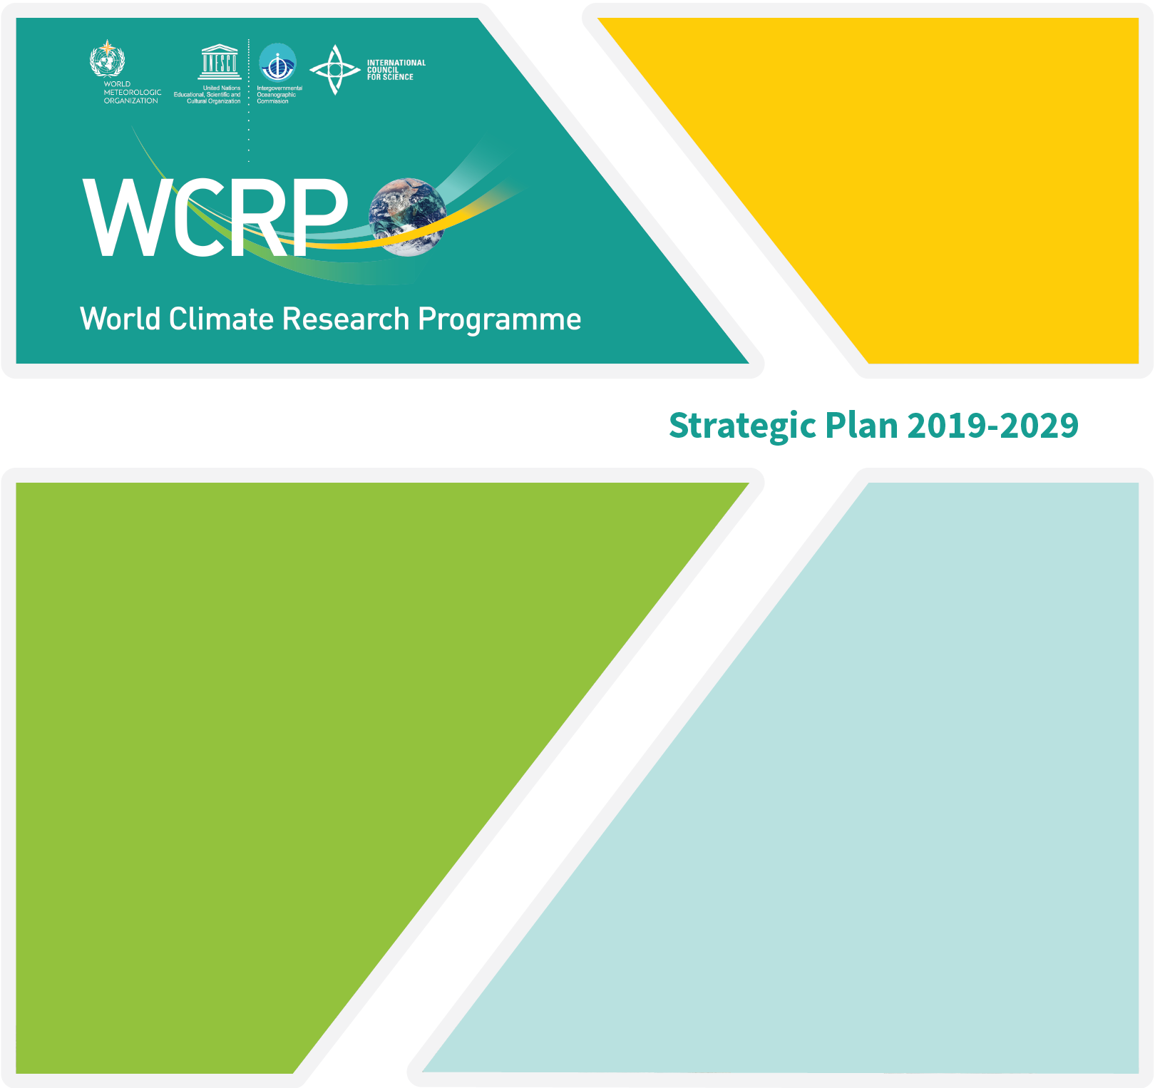
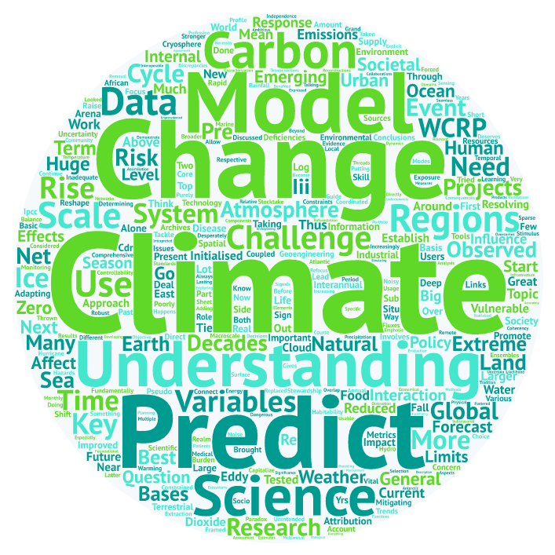
WCRP New Strategy
WCRP is developing a new Strategic Plan, covering a 10-year time horizon (2019-2029)
Takes into account the outcomes of the co-sponsors review (expected final by June ‘18)
SWOT analysis and initial (internal) consultations done
Importance of bedrock science, seamless approach (time, space, ESM, R-O) and links to services and policy emphasised
Extensive consultation with WCRP community Mar 2018 and stakeholders Apr-Jun 2018
5-year Implementation Plan also being developed
Both aimed be finalised end 2018
Notes:
Esm = Earth System Models
R-O : Research to Operations

Slide 7
WCRP New Strategy: draft content
1. The World Climate Research Programme
2. Forty years of successful international climate science
3. The next decade of the World Climate Research Programme
4. Overarching Scientific Objectives of the Programme
O1. Understanding the climate system
O2. Determining predictability on weekly to decadal timescales
O3. Understanding projectability on decadal to centennial timescales
O4. Connecting climate science with policy and decisions
5. Emphases of the Programme
E0. Climate science in support of sustainable development
E1. The ocean in the Earth system
E2. The atmosphere in the Earth system
E3. The land in the Earth system
E4. The cryosphere in the Earth system
E5. The regions in the Earth system
6. Imperatives for the Programme
I1. Hierarchy of Earth and Climate System Models
I2. Observations and data sets in support of climate science
I3. Timely assessments of the state of the climate system
I4. Open access, high-end computing and data infrastructures
I5. Supporting a vibrant climate community around the world
I6. Communication and education
I7. Outreach and societal engagement
I8. Institutional and programmatic partnerships
7. Closure Statement
Notes:
These are the new

Slide 8
WCRP New Strategy: draft overarching objectives
1. Processes / understanding / analyze
Identify and constrain key processes that determine the reservoirs and flows of energy and water - and other essential elements including carbon, aerosols, nutrients, salt - within and between the components of the Earth system.
2. Predictability / seamless prediction / skill
Quantify the uncertainties and predictabilities inherent for weekly to decadal time scales of the climate system.
3. Projectability / projections / sensitivity
Quantity the sensitivities and emergent constraints inherent in the changing climate system.
4. Science for Society / policy and services
Improve the generation and use of decision relevant climate information and knowledge about the evolving Earth system, across space and time scales, due to natural variability and climate change.
Notes:
These are the new

Slide 9
WCRP New Strategy: observations and data
Explicit reference in current draft Strategic Plan to:
Sustained observing systems and innovation
International coordinated field experiments
Open data policies and interoperability
High-end data infrastructures
Climate data records
Reanalyses
Stronger WCRP-GCOS strategic alignment
Implementation Plan: will address WCRP-GCOS governance

Slide 10
Thank You
www.wcrp-climate.org

