Slide 1


Joint CEOS/CGMS Working Group Climate
WGClimate 9th Session
Jörg Schulz, WG Chair
Geneva, Switzerland, 28&29 March 2018

Slide 2
1. Introduction, Agenda, and Status of the Working Group
Jörg Schulz, EUMETSAT

Slide 3
Day 1 Morning
Introduction and Context – Jörg Schulz
09:00 – 09:10 | Welcome
09:10 – 09:20 | Round table introduction
09:20 – 09:30 | Acceptance of Agenda
09:30 – 10:00 | Status of Working Group
2. Gap Analysis Report, Recommendations and Actions – Jörg Schulz
10:00 – 10:15 | Introduction
10:15 – 10:45 | Final review of the Structure of the Document
10:45 – 11:00 | Review of the Introduction
11:00 – 11:30 | Coffee Break
11:30 – 12:00 | Review of ECV Inventory Description and Gap Analysis Approach
12:00 – 13:00 | Review of general GCOS Compliance

Slide 4
Day 1 Afternoon
2- Gap Analysis Report, Recommendations and Actions – Jörg Schulz
13:00 – 14:30 | Lunch
14:30 – 17:00 | Break out groups for review of ECV specific Gap Analysis Atmosphere (Precipitation, CO2 and CH4) Ocean (SST and SSS) Terrestrial (LST, LAI, FAPAR)
15:30 – 16:00 | Coffee Break
17:00 – 18:00 | Review of ECV Gap Analysis all addressed ECVs
18:00 – 18:30 | Conclusions

Slide 5
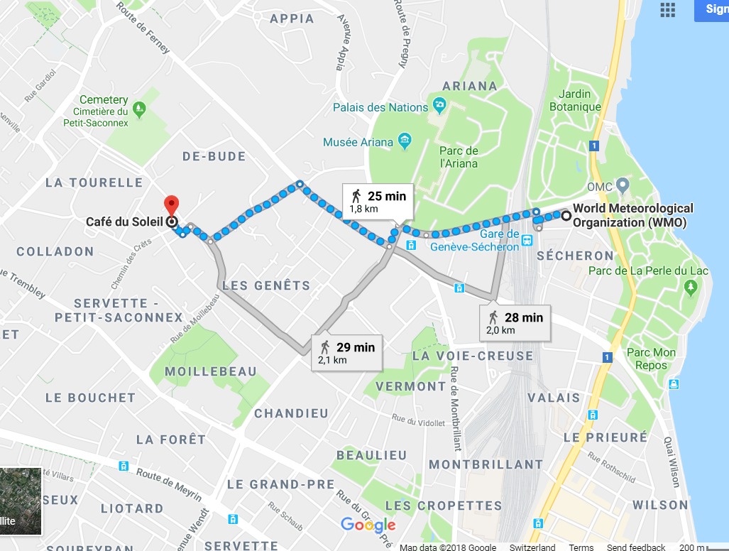
Dinner Evening Day 1
Dinner on 28 March at 19:00
(for 20 participants).
The restaurant is “Café du Soleil” - http://www.cafedusoleil.ch/site/en/
6 Place du Petit-Saconnex
1209 Genève
Suisse
Phone: +41 (0) 22 733 34 17
(Taxi: ca. 7 minutes from WMO)

Slide 6
Day 2 Morning
Technical Supplement for the Response to the GCOS IP (Simon Pinnock)
09:00 – 09:30 | Introduction to the Technical Supplement
09:30 – 10:30 | Review and endorsement of the document
10:30 – 11:00 | Coffee Break
4. New initiatives
11:00 – 11:30 | CNES Space Climate Observatory (Pierre Tabary, CNES)
11:30 – 12:00 | WMO concept for the physical view of the Architecture for Climate Monitoring from Space (Fernando Belda, WMO)
12:00 – 12:10 | SCOPE-CM (Jeff Privette, NOAA)
12:10 – 12:30 | Discussion

Slide 7
Day 2 Afternoon
5. ECV Inventory next steps – Marie Claire Greening
14:00 – 14:30 | Way forward for update of ECV Inventory
14:30 – 15:00 | Discussion
6. Governance, Summary and Actions – Jörg Schulz
15:00 – 16:00 | Review of Minutes and Actions, Concluding Remarks

Slide 8
Status of the Working Group

Slide 9


Chairmanship
November 2017 – November 2019
Chair: Jörg Schulz (EUMETSAT)
Vice Chair: John Dwyer (USGS)
November 2019 – November 2021
Chair: John Dwyer (USGS)
Vice Chair: asking for proposals by Agencies

Slide 10
Achievements since last meeting
Finalised Space Agencies Response to GCOS IP 2016;
Received endorsement from CEOS Plenary for it, CGMS has asked to formally endorse it this year;
Finalised the statement to SBSTA-47 and is was presented by EC at SBSTA-47;
Published the ECV Inventory 2.0 and performed an analysis with respect to compliance to GCOS;
Agreed to address 8 ECVs until CEOS SIT-33 to finalise cycle#2.

Slide 11
Series of Events since last meeting
CEOS Plenary, October 2017, Rapid City, USA
Subsidiary Body for Scientific and Technological Advice (SBSTA)-47, 6–15 November 2017, Bonn, Germany
Conference of the Parties (COP)-23, 6–15 November 2017, Bonn, Germany
Joint meeting with WCRP-DAC, 27 March 2018, Geneva, Switzerland
And one earlier meeting:
WMO SPACE PROGRAMME, Workshop on Operational Space-based Weather and Climate Extremes Monitoring, Geneva, Switzerland, 15-17 February 2017

Slide 12
CEOS Plenary 2017
Perspectives for the next two years
Major Objectives:
  Complete Cycle#2 activities by SIT-33 (finalisation of Gap Analysis);
  Change reference for Inventory and Gap Analysis to the 2016 GCOS-IP (and update the inventory as appropriate);
  Promote case studies and workshops supporting the Architecture and its Inventory;
Changes:
  The Inventory-gap analysis-action plan process shall move to a more incremental update with annual reporting and endorsement (potentially synchronised with UNFCCC/SBSTA reporting);
  Gap analysis addressing Inventory updates and high priority areas, e.g., carbon cycle;
Deliverables:
  First gap analysis report and action plan for endorsement at SIT-33 and CGMS Plenary;
  Update of Inventory baseline to GCOS IP 2016 by 31 Dec 2018;
  Second gap analysis and action plan for endorsement by 2019 CEOS and CGMS Plenaries;
  Continued reporting to UNFCCC SBSTA.

Slide 13
Action from CEOS Plenary
CEOS-31-01 | WGClimate to explore development of a brief, consolidated statement of space agency contributions in support of each Article of the Paris Agreement. | 32nd CEOS Plenary

Slide 14
CO₂ and GHG Monitoring
As CEOS Chair for 2018, EC will prioritize laying the foundation for an international CO₂ and GHG monitoring system, progressed through three initiatives:
Facilitate the completion and follow-on activities of the AC-VC white paper on defining an optimum constellation for CO₂ and GHG monitoring, including the joint competences of CEOS and CGMS, and in the general framework of the continued implementation of the CEOS Carbon Strategy.
Place the space segment in the broader context of a fully sustained system for CO₂ monitoring.
Advance the relationship with CGMS for an operationally implemented and sustained observation capability. Consider establishing a formal working relationship between CEOS and CGMS as with the successful ongoing relationship on Systematic Observations of ECVs in support of UNFCCC.
A workshop to discuss this is planned for June 2018 in Italy.
Notes:
As CEOS Chair for 2018, COM will prioritize laying the foundation for an international CO₂ and GHG monitoring system, progressed through three initiatives:
Facilitate the completion and follow-on activities of the AC-VC white paper on defining an optimum constellation for CO₂ and GHG monitoring, including the joint competences of CEOS and CGMS, and in the general framework of the continued implementation of the CEOS Carbon Strategy.
Place the space segment in the broader context of a fully sustained system for CO₂ monitoring. Individual CEOS Agencies have counterparts in their individual countries/regions who have responsibility for Inventories, the required modelling, in-situ infrastructure and the ground segment elements.
Advance the relationship with CGMS for an operationally implemented and sustained observation capability. Consider establishing a formal working relationship between CEOS and CGMS as with the successful ongoing relationship on Systematic Observations of ECVs in support of UNFCCC.
A workshop is planned for June 2018 in Italy.

Slide 15
CO₂ and GHG Monitoring
CEOS and CGMS to review the modus operandi for cooperation as a priority in this area, and provided some possible paths:
continue ad-hoc collaboration in the context of the CEOS Carbon Strategy Actions, e.g., as in joint efforts on the AC-VC white paper;
establish a sub-group (with dedicated resources) in an existing standing WG, i.e., Joint WG on Climate;
establish a dedicated joint WG specifically on Carbon/GHG observations.

Slide 16

COP-23
November 6th to 17th, 2017 (duration: 12 days)
Bonn, UN Campus
  WG Climate Chair and Ex-Chair participated in several COP-23 side events;
  WGClimate chair introduced to the GHG monitoring event, discussion was highlighting CEOS contribution;
  Climate change monitoring and climate services organised by EC, EUMETSAT and ECMWF where the ECV Inventory was featured as an international coordination tool.

Slide 17
SBSTA - 47
Provided input to SBSTA Chair report on Architecture, GCOS-IP response, ECV Inventory and gap analysis;
Participated in an informal strategy meeting between the SBSTA Chair and the Earth observation community on Friday 10th November;
SBSTA-47 noted with appreciation the statements delivered at its first meeting by representatives of the European Union on behalf of the Committee on Earth Observation Satellites (CEOS) and the Coordination Group for Meteorological Satellites (CGMS), the Global Climate Observing System (GCOS);
In particular:
  4. (e) The comprehensive space agency response to the GCOS IP, and its executive summary, by the Joint CEOS/CGMS Working Group on Climate.
  9. The SBSTA recognized the progress made by the satellite community (see para. 4(e) above), in close collaboration with GCOS, in the development of the essential climate variable inventory (with explicit link). It noted the usefulness of the essential climate variable inventory for climate services. It invited CEOS and CGMS to report on progress at future sessions of the SBSTA, as appropriate.

Slide 18
Operational Space-based Weather and Climate Extremes Monitoring
Workshop to stimulate the utilization of space-based observation data and products for monitoring selected weather and climate extremes (heavy rainfall and drought in particular) on a routine basis (“in operations”), in response to current and future user requirements;
Opened dialogue amongst satellite operators, WMO Regional Climate Centres (RCCs) hosted by National Meteorological and Hydrological Services (NMHSs), and the science community;
In this context EUMETSAT CM SAF presented a definition of an ICDR (Interim Climate Data Record) and stated that an international agreement of definition of ICDRs is needed;
Definition (as used in GCOS-IP response): An Interim Climate Data Record (ICDR) is a Fundamental or Thematic Climate Data Record regularly updated with an algorithm / system having maximum consistency to the FCDR or TCDR generation algorithm / system. The update cycle depends on the user needs for climate extremes and might range from pentad to monthly.
Notes:
How useful are NWP reanalysis and satellite derived ICDRs? - NWP reanalysis will be extremely useful for developing baselines for common meteorological variables like temperature and humidity. However, the current generation reanalysis will not be useful for precipitation because of model inadequacies and poor spatial resolution. It was noted by data providers that the reanalysis data will be useful for improving satellite products; some precipitation products today use NWP temperature fields as part of their retrieval. The ICDRs will be good for continued monitoring; having a lower latency than a CDR should outweigh the slight loss in accuracy (it was noted that today’s era of satellites are much better calibrated from inception so current ICDRs should be relatively well calibrated). However, it was also pointed out that we need to see through actual practice by the RCCs and national forecast centers what error tolerance is acceptable.

Slide 19
Operational Space-based Weather and Climate Extremes Monitoring
RECOMMENDATION 9: The CEOS/CGMS Working Group on Climate to adopt the above proposed definition of an ICDR as part of the Climate Architecture.
RECOMMENDATION 10: The CEOS/CGMS Working Group on Climate to confirm as best practice that the producer of the climatology (FCDR and TCDR) is best positioned to be responsible for an ICDR, in order to enable and maximize consistency.
RECOMMENDATION 11: Data providers to provide at least two kinds of datasets for different applications, one being consistent with the longest available CDR, and the other one taking into account the latest developments/capabilities of instruments.
Notes:
RECOMMENDATION 1: To CGMS (and CEOS) – There is a continuing need for improved satellite payloads. We recommend that agencies continue to strive for improved sensors as baseline missions that consider the following attributes: improved spatial resolutions for all sensors; expanded baseline payloads as new research technologies are proven (e.g., space based radars for precipitation; high resolution SAR/scatterometer for surface information, etc.)
RECOMMENDATION 2: To CGMS (and CEOS) – Support the R&D needed to exploit emerging technologies (e.g., lightning, multi-sensor and in-situ data fusion, etc.) in order to improve precipitation retrieval in deficient precipitation regimes, including orographic/”warm top” precipitation and flash floods/short duration events that rely on geostationary orbiting measurements (through use of lightning observations); improve the representation of heavy precipitation, reducing regional biases, in particular, those associated with tropical systems; exploitation of reanalysis data sets.

Slide 20
CEOS 2018-2020 Workplan
Climate Monitoring, Research, and Services Objectives/Deliverables: 2018-2020
Objective/Deliverable | Projected Completion Date | Background Information | Responsible CEOS Entity
Information dissemination and communication
CMRS-13: Development and Promotion of Case Studies | Q3 2019 | Previous work, supervised by the EC JRC and WMO, has already produced WMO 1192 Case Studies for Establishing an Architecture for Climate Monitoring from Space. WGClimate #6 decided that an updated version containing additional case studies is targeted for the WMO congress in 2019. The output of previous and potential future work is to be supported by the dedicated Joint CEOS/CGMS WGClimate website. | WGClimate
Delivery of a second iteration of the Essential Climate Variable Inventory
CMRS-15: Gap analysis | Q2 2018 | Several teams will perform the cycle 2 gap analysis in parallel, with the work organized by thematic area. To ensure consistency of approach across the full inventory, the gap analysis work of the individual teams will be overseen/coordinated by the WGClimate Chair team. | WGClimate
CMRS-16: Action plan | Q2 2018 | The action plan will identify agreed actions that CEOS and CGMS Members and Associates intend to take to address priority gaps. The action plan will be endorsed and released to the CEOS community at the 33rd CEOS SIT Meeting. | WGClimate

Slide 21
CEOS 2018 – 2020 Workplan
Annual delivery of the Essential Climate Variable inventory
CMRS-17: Collection, incorporation, and quality control of new & updated information from data providers | Q4 every year from 2019 onwards | Based on a stable questionnaire, with potential updates of the inventory structure, to accommodate for example requirements stemming from C3S and WCRP; and experiences from applicable projects. | WGClimate
CMRS-20: Gap analysis | Q4 every year from 2019 onwards | WG chairs will initiate gap analysis work that always provides incremental updates to the year before in terms of improvements on the compliance to GCOS requirements and a report in focus areas addressing needs of CEOS and CGMS. The gap analysis is coordinated by the WG Chair team and support by several expert teams that will perform the gap analysis in parallel. | WGClimate
CMRS-21: Action plan | Q4 every year from 2019 onwards | The action plan identifying agreed actions that CEOS and CGMS Members and Associates intend to take to address priority gaps will be updated once a year. The actual action plan will be endorsed and released to the CEOS community at a suitable meeting. | WGClimate
Engagement with GCOS
CMRS-19: Joint CEOS/CGMS response to the new GCOS IP | Q2 2018 | Complement the response to the GCOS IP 2016 with the technical supplement addressing individual ECVs. Reflecting the partnership, this document will be developed jointly by CEOS and CGMS. | WGClimate

Slide 22
Goals for this meeting
Finish the specific ECV analysis to the degree we can and agree a set of recommendations and actions;
Agree on how we finish the remaining task on the GCOS-IP response;
Establish a view on the Space Climate Observatory proposed by CNES;
Discuss proposals for future structures implementing ECV climate data record production by WMO and SCOPE-CM;
Discuss the way forward for the ECV Inventory update and evolution.

Slide 23
2. Gap Analysis Report, Recommendations and Actions
Jörg Schulz, EUMETSAT

Slide 24
ECV Inventory and Gap Analysis
Action Plan & Creation of conditions to deliver CDRs
ECV Inventory
Gap Analysis & Recommendations
ECV Inventory 2.0 published;
Fully describes current and planned implementation arrangements (ECV-by-ECV) within the Architecture;
More than 4 times more data records 913 versus ~210 compared to first version 2015;
Content for the first time fully verified;
Gap analysis capacity demonstrated:
  All ECV Products without CDRs identified
  Compliance of CDRs to GCOS requirements analysed
  Capability to analyse missing measurements established (Inventory/MIM/OSCAR harmonisation realised);
Financial support of the EC for the Inventory gratefully acknowledged.
✓
✓
http://climatemonitoring.info/ecvinventory
http://climatemonitoring.info/ecvinventory
http://climatemonitoring.info/ecvinventory

Slide 25
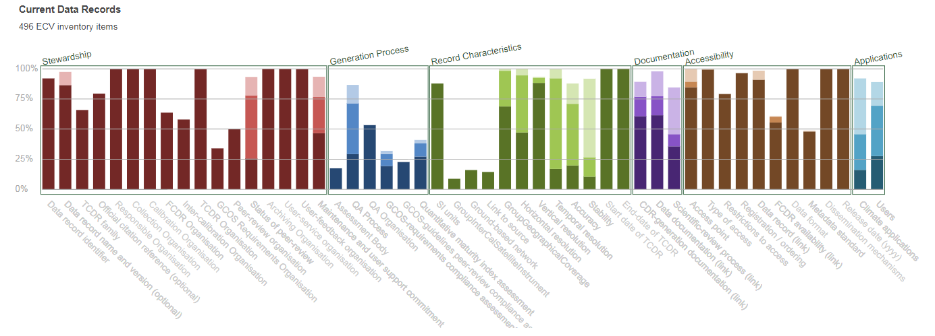
Addressing shortfalls wrt. GCOS
This analysis can be done down to the single data record.

Slide 26
Lessons learnt
The EC Funding of the inventory activities made a big difference;
Engagement with agency focal points and data set experts (>100) was key to success;
Verification process absolute critical to ensure that the inventory is a reliable source of information (for both users and the gap analysis process);
Population and verification was a huge effort - need to keep the community involvement in the future and avoid drastic changes;
Commitment level for future component of the inventory needs to be reconsidered to get a more complete picture from agencies;
Global data record development is more dynamic than we thought. Biennial update of inventory should be replaced by incremental (annual) updates;
Volume of data records does not allow full analysis of Inventory every year => need to carefully track changes during inventory update process and perform limited gap analysis in affected areas;
General low use of FCDRs to derive ECV climate data records implies extra Inventory for the base data records.

Slide 27
Completion of gap analysis to baseline ECV Inventory 2.0
We agreed that the residual activities to be performed include a gap analysis on a limited number of ECV products (CO2, CH4, Precip, SSS, SST, LST, LAI, and Biomass) including measurement availability and suitability (with the selection of these ECV products based on the relevance of the variable to current discussions and/or known issues with past and future missions);
The finalisation of the Gap Analysis (and its documentation - including the coordinated action plan) is planned to be completed in time for SIT-33 in April 2018;
To enable the analysis we integrated information from CEOS MIM and WMO OSCAR into the inventory and mapped the ECV products to the measurement of physical quantities – very hard work hampered by erroneous information in the two satellite data bases;
Are now able to identify missed opportunities and missing measurements in the future;
This and non availability of people has delayed the analysis of the 8 ECVs proposed.

Slide 28
Gap Analysis on ECVs
The analysis for each ECV shall consist of:
Analyse if the ECV inventory misses a known existing or planned climate data record;
An ECV specific analysis of the compliance to GCOS requirements based on the gap analysis done in summer 2017;
An analysis of the missed opportunities for creating a climate data record from existing past and planned future measurements from space;
An analysis of missing measurements in the future that are needed to continue existing data records or to establish new ones with enhanced quality.
The result of the analysis shall be documented in Chapter 5 of the gap analysis report.

Slide 29
Tool for missed opportunities and missing measurements
Technology | Instrument | Mission | Launch | EOL | WMO relevance for SST | CEOS relevance for SST | No. current CDRs in ECV Inventory | No. future CDRs in ECV Inventory | Comments
Cross-nadir infrared sounder | IMG | ADOES | 17/08/1996 | 30/06/1997 | Primary | N | - | -
 | AIRS | Aqua | 04/05/2002 | 2018 | Primary | Y | 9 | 8 | No gaps in the use of AIRS.
 | TES-nadir | Aura | 15/07/2004 | 2018 | Primary | N | - | -
 | IASI | Metop-A Metop-B | 19/10/2006 17/09/2012 | 2018 2018 | Primary | Y | - - | - - | EUMETSAT plans to release reprocessed SST in 2019
Moderate-resolution optical imager | ATSR | ERS-1 | 17/05/1991 | 10/03/2000 | Primary | N | 2 | 2 | Not in MIM. No gaps in use of ATSR.
 | ATSR-2 | ERS-2 | 21/04/1995 | 06/07/2011 | Primary | N | 2 | 2 | Not in MIM. No gaps in use of ATSR-2.
 | AATSR | Envisat | 01/03/2002 | 08/04/2012 | Primary | N | 2 | 2 | Not in MIM. No gaps in use of AATSR.
 | SLSTR | Sentinel-3A | 16/02/2016 | 2023 | Primary | Y | - | -
 | AVHRR/2 | NOAA-7 NOAA-9 NOAA-11 NOAA-12 NOAA-14 | 23/06/1981 12/12/1984 24/09/1988 14/05/1991 30/12/1994 | 07/06/1986 13/02/1998 16/06/2004 10/08/2007 23/05/2007 | Very High | N | 3 3 3 2 5 | 4 4 4 2 4 | NOAA-7 not in MIM. No gaps in the use of AVHRR/2.

Slide 30
Recommendations and Actions
Recommendations and actions can be directed towards space agencies, coordination and implementation bodies, such as CGMS and CEOS Working Groups, CEOS-VCs and SCOPE-CM;
Actions are combined with the need to report to WGClimate on outcome;
Overall success with respect to climate data records shall become measurable by analysis of annually updated ECV CDR Inventory.

Slide 31
Missing Recommendations
Subsections for individual ECVs have been worked out but need review;
There are currently no explicit requirements for CO2, CH4, LAI, and SST. However the text has recommendations that need to be made explicit;
Because of this I could not formulate actions yet;
That’s why we will have breakout groups in the afternoon.

Slide 32
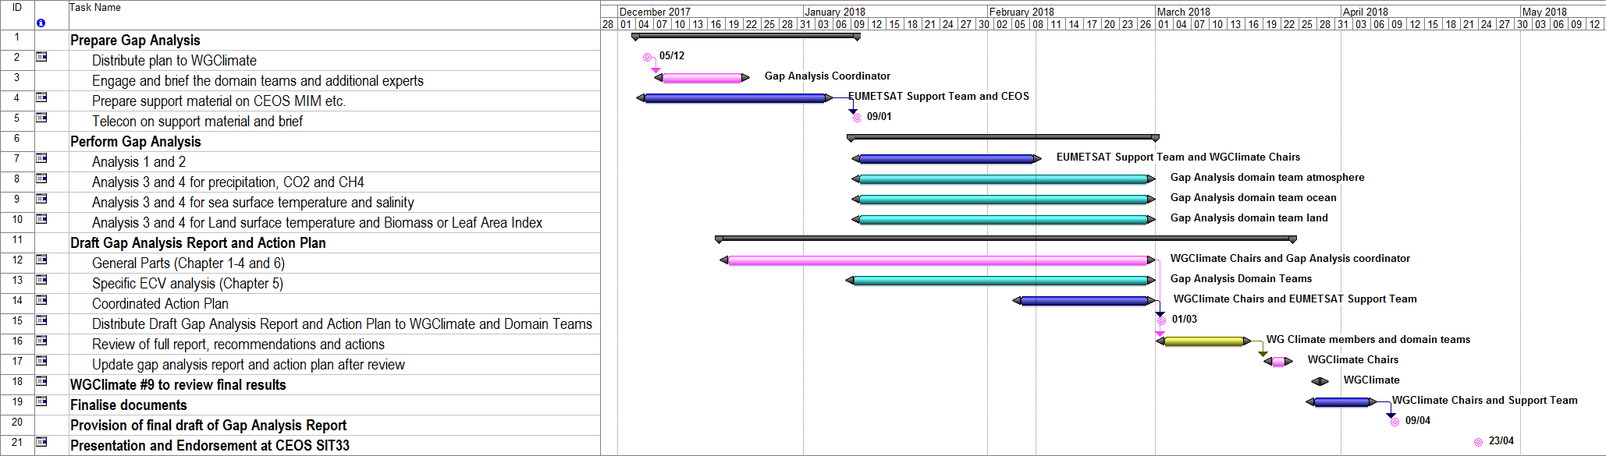
Planning for completion of gap analysis to baseline ECV Inventory 2.0
Schedule has slipped by one month, due to issues with the usage of WMO OSCAR and CEOS MIM for developing to interpret ECV Inventory content versus space data base.

Slide 33
Recommendations from gap analysis
Recommendation #1: WGClimate shall create an additional part of the inventory that shall contain Interim Climate Data Records.
Recommendation #2: Space agencies should implement the nomenclature for climate data records as defined in GCOS Satellite Supplement (2011) and should educate their personnel to use it.

Slide 34
Recommendations from gap analysis
Recommendation #3: GCOS to work towards application driven user requirements for the ECV products.
Recommendation #4: WGClimate to include a commitment level into the future part of the ECV Inventory to allow capturing of more contributions using future sensors.
Recommendation #7 (mislabeled in document, should be #5): WGClimate to develop a white paper on what is needed for the validation of climate data records including addressing the stability aspect.

Slide 35
Recommendations from gap analysis
Recommendation #7: WGClimate to establish a specific inventory for FCDRs to signal their importance and to promote their usage for the production of ECV climate data records.
Recommendation #8: CEOS and CGMS agencies to add the delivery of FCDRs for each mission to their mission requirements.
Recommendation #9: CEOS and CGMS agencies to require the application of metadata standards with the production of climate data records.

Slide 36
Recommendation from Precipitation
Recommendation #6: WGClimate to study in detail the situation on precipitation, and may task SCOPE-CM with exploring a way forward to organise a project that utilises multi-mission data to produce a precipitation climatology.

Slide 37
Recommendations from Biomass
Recommendation #1: Space agencies are encouraged to ensure that all C-band and L-band SAR measurements are made available for the construction of CDRs for Above-ground Biomass. The combination of L-band and C-band measurements will help extend the sensitivity of existing estimates.
Recommendation #2: Space agencies are encouraged to establish and populate a database of airborne LIDAR observations on forest structure to aid the estimation of biomass using satellite observations

Slide 38
Recommendations from Biomass
Recommendation #3: Space agencies to coordinate C-band and L-band measurement provision and availability to allow existing research estimates of biomass to be continued.
Recommendation #4: Space agencies to plan for continuity of research missions of nominally short duration (BIOMASS, GEDI).
Recommendation #5: Space Agencies to plan for high-resolution data provision in support of REDD+ type applications leading to the Global Stocktake process.

Slide 39
Recommendations from Salinity
Recommendation #1: Space agencies are encouraged to launch a second and third analysis activity to produce best possible SSS CDRs from the available L-Band and potentially C-Band measurements. The result shall contain a judgement on the usefulness of C-band measurements.
Recommendation #2: NASA should give priority to sea surface salinity in the selection of Earth Venture missions and report back to WGClimate on the development.
Recommendation #3: Space agencies should consider including L-band instrumentation on future missions, in particular if it is not realised by NASA.

Slide 40
Recommendation for SST
Recommendation #1: GHRSST and VC-SST to explore the reason for the non-utilisation of C-band data for climate data records.

Slide 41
3. Technical Supplement for the Response to the GCOS IP
Simon Pinnock, ESA

Slide 42
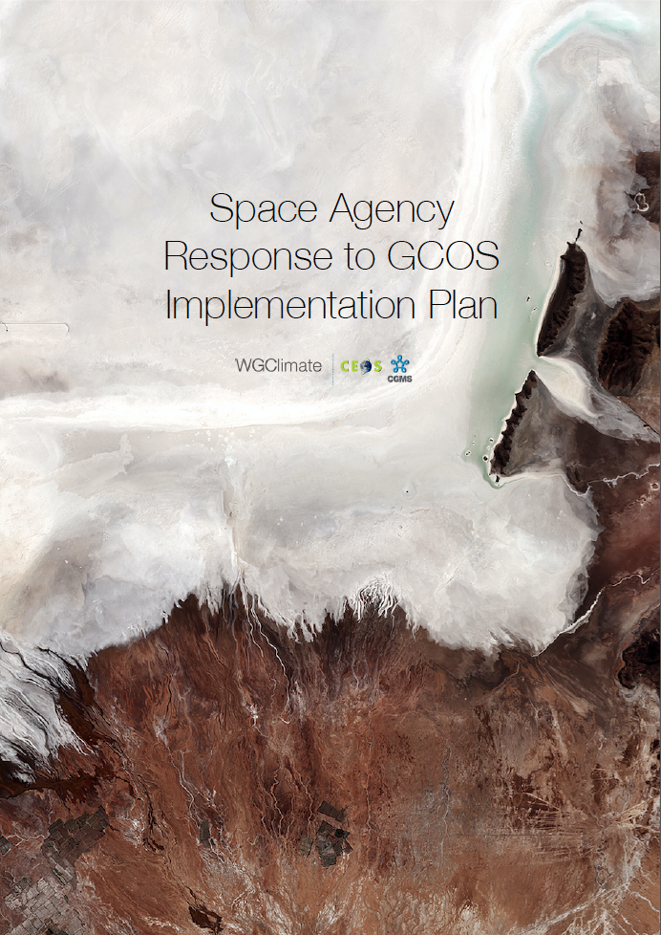
Response of Space Agencies: CGMS and CEOS
http://ceos.org/document_management/Meetings/Plenary/31/Presentations/2.1-Space%20Agency%20Response%20to%20GCOS%20IP%20v2.0.pdf

Slide 43
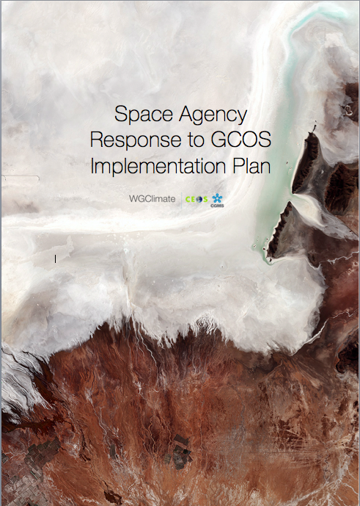
Space Agency Response to the GCOS IP
Addresses GCOS Actions with space relevance;
In total 11 (32) general, 19 (40) atmospheric, 17 (57) oceanic and 48 (72) terrestrial actions;
Structure of response is similar to the plan itself;
A technical supplement has been drafted including more detailed responses to the GCOS IP.

Slide 44
4. New initiatives
Pierre Tabarry, CNES
Fernando Belda, WMO
Jeff Privette, NOAA

Slide 45
5. ECV Inventory next steps
Marie-Claire Greening, EUMETSAT

Slide 46
Tasks
Establish Inventory 1.0 for FCDR;
Establish Inventory 1.0 for ICDR;
Update information in CDR Inventory and release 3.0;
Keep split between current and planned for all;
Baseline all Inventories to 2016 GCOS IP;
Cut-off date for all 31/12/2018;
Will contact focal points for Inventory contents after the CEOS-SIT 33;
Think and decide about further gap analysis activities;
Renew Inventory support at EUMETSAT until mid 2021.

Slide 47
FCDR
Purpose is to promote usage of FCDR for climate data records;
Inventory shall only contain specific elaborated data records;
Content needs to be elaborated but assumed to be less demanding than current CDR Inventory;
Will search agency by agency and also include known projects;

Slide 48
ICDR
Observed existence of ICDRs during population of current CDR Inventory;
Artificially split on 31/12/2016 into current and future;
Need to identify those data records in CDR Inventory 2.0 and resort into new category;
Then enter update activity.

Slide 49
Update of information for CDR Inventory 3.0
Each contributor to v2.0 will be contacted to request updates;
Identify and follow up on those who did not respond to the v2.0 call as these could be creating “artificial gaps”;
Keep a track of all updates made from v2.0 to v3.0 to make verification checks easier and less time-consuming;
Investigate inconsistencies discovered during the gap analysis and update in v3.0.

Slide 50
6. Governance, Summary and Actions
Jörg Schulz, EUMETSAT

Slide 51
Endorsement of ICDR Definition
RECOMMENDATION 9: The CEOS/CGMS Working Group on Climate to adopt the above proposed definition of an ICDR as part of the Climate Architecture.
Definition: An Interim Climate Data Record (ICDR) is a Fundamental or Thematic Climate Data Record regularly updated with an algorithm / system having maximum consistency to the FCDR or TCDR generation algorithm / system10. The update cycle depends on the user needs for climate extremes and might range from pentad to monthly.
RECOMMENDATION 10: The CEOS/CGMS Working Group on Climate to confirm as best practice that the producer of the climatology (FCDR and TCDR) is best positioned to be responsible for an ICDR, in order to enable and maximize consistency;
Propose to send letter to WMO Space Programme to indicate endorsement of the definition.

Slide 52
Upcoming Meetings
CEOS SIT-33 : 23-26 April, 2018, Boulder, Colorado, USA
SBSTA-48: 30 April to 10 May 2018, Bonn, Germany,
CGMS-46: 4-8 June 2018, Bengaluru, India
GEO Symposium and Climate Workshop, 11-13 June 2018, Geneva, Switzerland
CEOS 2018 SIT Technical Workshop : Darmstadt, Germany | September, 2018
32nd CEOS Plenary : Brussels, Belgium | October, 2018

Slide 53
CLIMATE MONITORING [75’]
 |  | GCOS [35']
GCOS status report and next steps |  |  | CGMS-46-GUEST-WP- | 27/02/2018
CGMS response to the GCOS IP (J. Schulz) |  |  | CGMS-46-CGMS-WP- | 16/03/2018
 |  | CEOS/CGMS Joint Working Group on Climate - Progress and next steps [30’]
Status and plans of the CEOS-CGMS joint WG on climate (J. Schulz) |  |  | CGMS-46-JWGCLIM-WP- | 22/11/2017
Endorsement of the gap analysis report and the coordinated action plan (J. Schulz) |  |  | CGMS-46-JWGCLIM-WP- | 25/10/2017
 |  | Lunch break [60']
 |  | GREENHOUSE GAS MONITORING [90']
 |  | Greenhouse gas monitoring, contributions and plans
Status of CEOS AC-VC CO2 white paper and next steps [20'] |  |  | CGMS-46-CEOS-WP- | 27/02/2018
Common roadmap for greenhouse gas monitoring from space [15'] (European Commission) |  |  | CGMS-46-EC-WP- | 27/02/2018
 |  | Greenhouse gas monitoring, contributions and plans (continued)
Contributions from other space agencies (China, Japan, US, ...) [45'] |  |  | CGMS-46-CGMS-WP- | 27/02/2018
 |  | Discussion on CGMS contribution to greenhouse gas monitoring from space [10']

Slide 54
WGClimate Meetings
2018
2019
2020
2021
CGMS Plenaries
CEOS Plenaries
#9
#10
#11
#12
#13
#14
Keep 3 WGClimate meetings over 24 months
Every 8 months
  March, November-Feb, and July-September the following year

Slide 55
Next WGClimate Meetings
WGClimate #10
  We are looking for a possible venue in Asia
WGClimate #11
  We are looking for a possible venue in the USA

Slide 56
WGClimate Chairmanship
2018
2019
2020
2021
CGMS Plenaries
CEOS Plenaries
#9
#10
#11
#12
#13
#14
CGMS Chairmanship
CEOS Chairmanship
CEOS Vice chair
CGMS Vice chair
Election of the new Vice Chair
Request for proposal will be send after WGClimate #9;
Nominations of candidates shall be received by WGClimate #10;
Nomination will be presented to CGMS-47 (2019) and CEOS (2019) for endorsement.

Slide 57
Timeline

