Slide 1
WGClimate Meeting #8
Pascal Lecomte – WGClimate Chair
September 11th 2017

Slide 2
1. Introduction & Context
Pascal Lecomte

Slide 3
Day 1 - Morning
1. Introduction and Context – Pascal Lecomte
09:00 – 09:10 | Welcome
09:10 – 09:20 | Round table introduction
09:20 – 09:30 | Acceptance of Agenda and Review of Actions
2. Space Agency Response to GCOS IP – Pascal Lecomte
09:30 – 10:00 | Introduction
10:00 – 10:30 | Final Review of the Structure of the Document
10:30 – 11:00 | Review of the Introduction
11:00 – 11:30 | Coffee Break
11:30 – 12:00 | Review of the Broad Context
12:00 – 13:00 | Review of the Overarching and Cross-Cutting Actions
13:00 – 14:30 | Lunch

Slide 4
Day 1 - Afternoon
2. Space Agency Response to GCOS IP – Pascal Lecomte (Continued)
14:30 – 15:30 | Review Atmospheric Climate Observing System
15:30 – 16:00 | Coffee Break
16:00 – 17:00 | Review Oceanic Climate Observing System
17:00 – 18:00 | Review Terrestrial Climate Observing System
18:00 – 18:30 | Conclusions
20:00 onwards – No Host Group Dinner – Belvedere 1833.

Slide 5
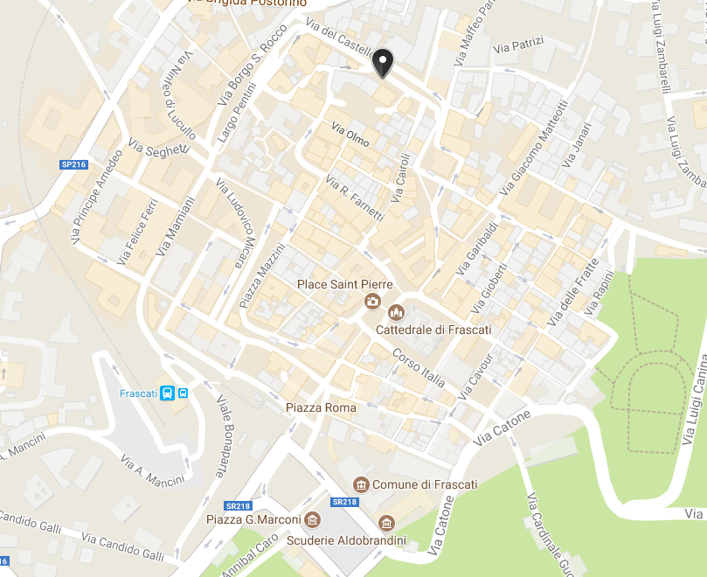
Restaurant Belvedere 1833
20:00 onwards – No Host Group Dinner
Restaurant Belvedere 1833.
Via Regina Margherita, Frascati
(+39) 06 9419004

Slide 6
Day 2 - Morning
3. Excursion to the VC/WG Day – Climate/Carbon
09:00 – 10:30 | VC/WG Day (Magellan) Session 1 – Climate Carbon Moderators: M. Dowell, P. Lecomte and D. Crisp
10:30 – 11:00 | Coffee
4. Preparation for SBSTA-47 and COP-23 - Pascal Lecomte
11:00 – 11:30 | Report on preparation for SBSTA-47 and COP-23
5. ECV Inventory – Jörg Schulz
11:30 – 12:30 | Review of Status and Progress
12:30 – 14:00 | Lunch

Slide 7
Day 2 - Afternoon
5. ECV Inventory – Jörg Schulz (Continued)
14:00 – 16:00 | Review of Gap Analysis
16:00 – 16:30 | Coffee Break
16:30 – 17:45 | Review of Action Plan
6. WMO ECV Inventory Workshop – Stephan Bojinski
17:45 – 18:00 | Workshop Concept - Discussion
6. 7. Governance, Summary and Actions – Pascal Lecomte
18:00 – 18:30 | Review of Minutes and Actions, Concluding Remarks

Slide 8
2. Space Agency Response to GCOS IP
Pascal Lecomte

Slide 9
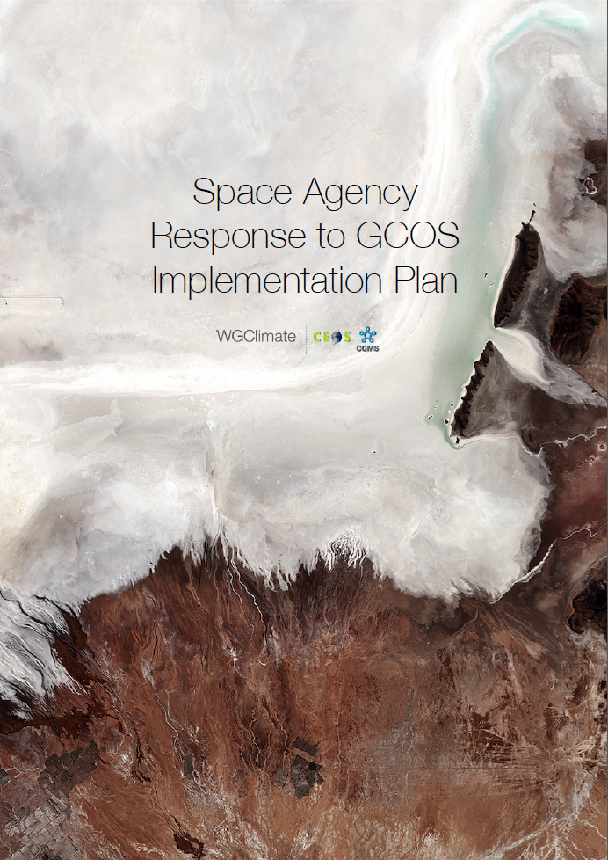
1. SARGIP -
Introduction
What is expected by GCOS
Why is the response crucial to WGClimate
When should our response be ready
Where are we now
Inputs received.
Consolidated into SARGIP Version 0.111
Gaps & anomalies to resolve.

Slide 10
1. SARGIP -
Introduction
(Writing Team – WGC#7)
Broad Context – Pascal Lecomte (ESA)
ESA Pascal Lecomte
EUMETSAT Jörg Schulz
EUMETSAT Robert Husband
EC Mark Dowell
Atmospheric Chapter – Stephan Bojinski (WMO)
CNES Carole Deniel
NOAA Steven Goodman
DLR Albrecht von Bargen
INPE Daniel Vila
Rainer Hollmann
NOAA Jeff Privette
EUMETSAT Kenneth Holmlund
NOAA Mitch Goldberg
METEO FRANCE Pierre Tabary
NASA Wenying Su
JAXA Misako Kachi
Oceanic Chapter – Chris Merchant (UKSA)
ESA Craig Donlon
EUMETSAT Hans Bonekamp
JAXA Hiroshi Murakami
NASA Paula Bontempi
NOAA Paul DiGiacomo
NOAA Eric Leuliette
INPE Milton Kampel
Terrestrial Chapter – John Dwyer (USGS)
ESA Simon Pinnock <simon.pinnock@esa.int>
ESA Stephen Plummer <stephen.plummer@esa.int>

Slide 11
1. SARGIP -
Introduction
(Schedule – WGC#7)
• 07/02/2017 1st Face to Face meeting (São Jose dos Campos - Brazil)
• 01/03/2017 Verify feasibility of a high level report
• 22/03/2017 Report to WCRP Council (Frascati – Italy)
• 25/04/2017 CEOS SIT (Paris – France)
• 08/06/2017 SBSTA-46 – Status report (Bonn – Germany)
• 12/06/2017 CGMS plenary (Seoul – Korea)
• 01/08/2017 Gap Analysis report ready
• 11/09/2017 2nd Face to Face meeting (Frascati – Italy)
• 12/09/2017 WGClimate #8 (Frascati - Italy)
• 13/09/2017 CEOS SIT Workshop (Frascati – Italy)
• 01/10/2017 Coordinated Action Plan ready
• 06/10/2017 Draft response sent to SBSTA-47
• 18/10/2017 CEOS plenary (Rapid City – USA)
• 06/11/2017 SBSTA-47 and COP-23 (Bonn – Germany)

Slide 12
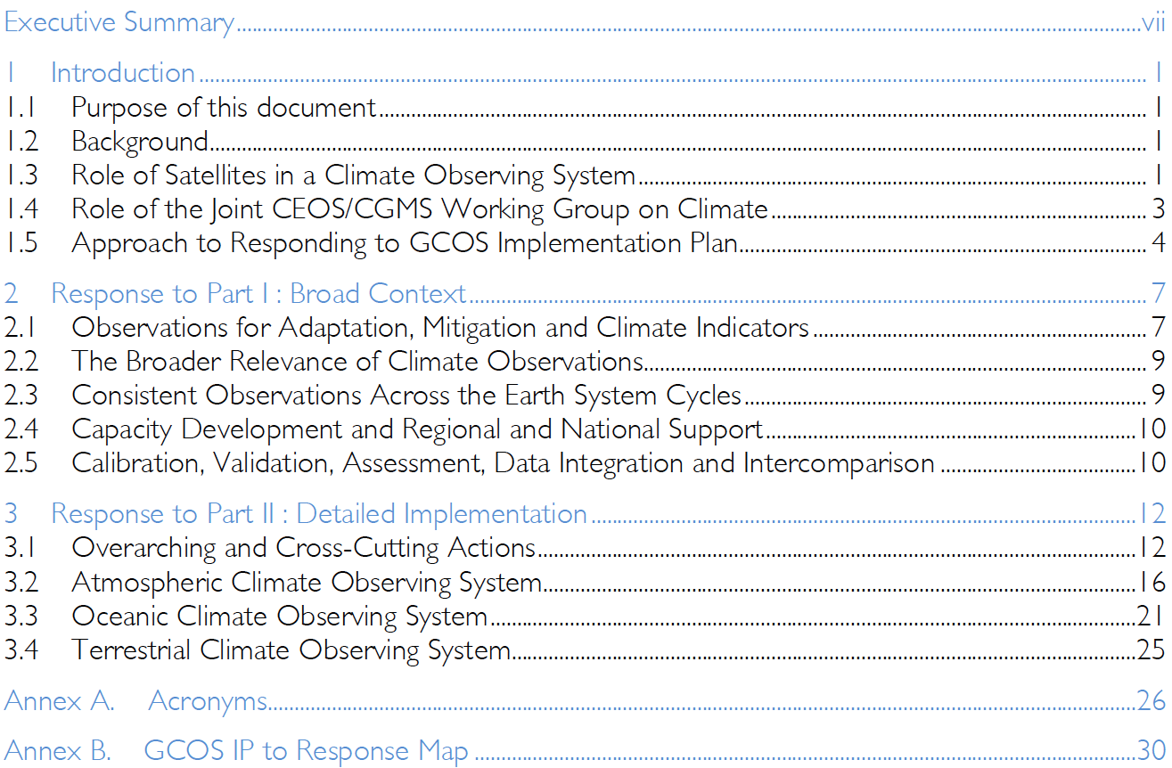
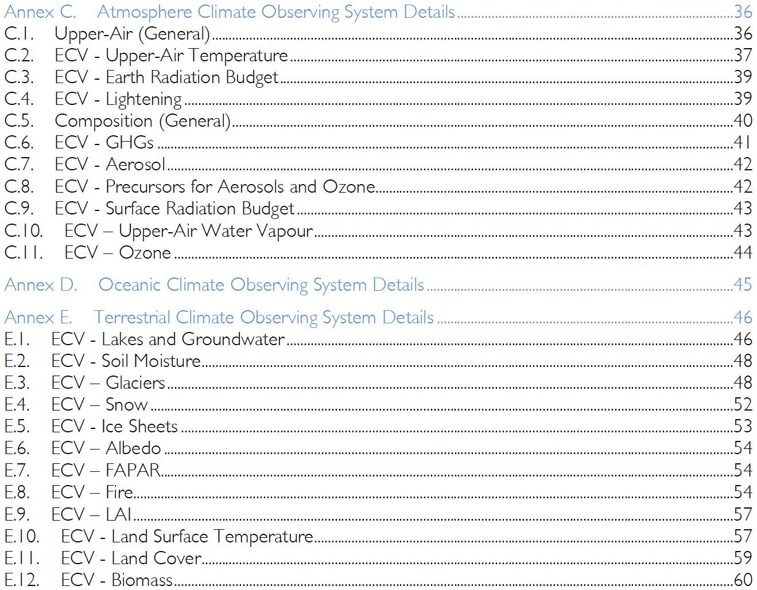
1. SARGIP -
Final Review of Structure #1
(Table of Contents)

Slide 13
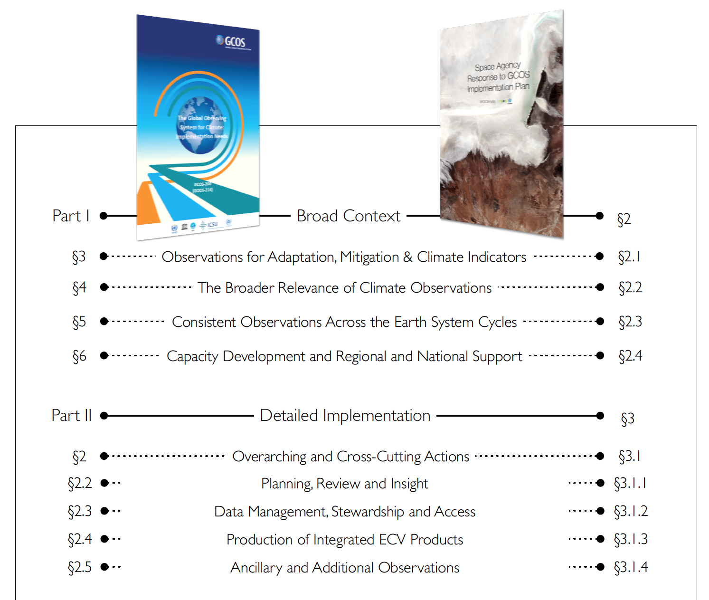
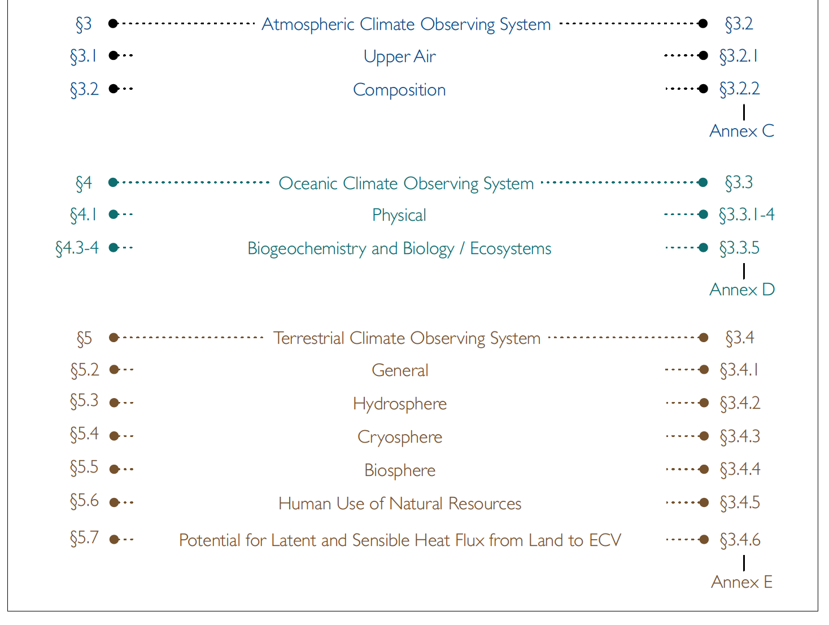
1. SARGIP -
Final Review of Structure #1
(Mapping to GCOS IP)

Slide 14
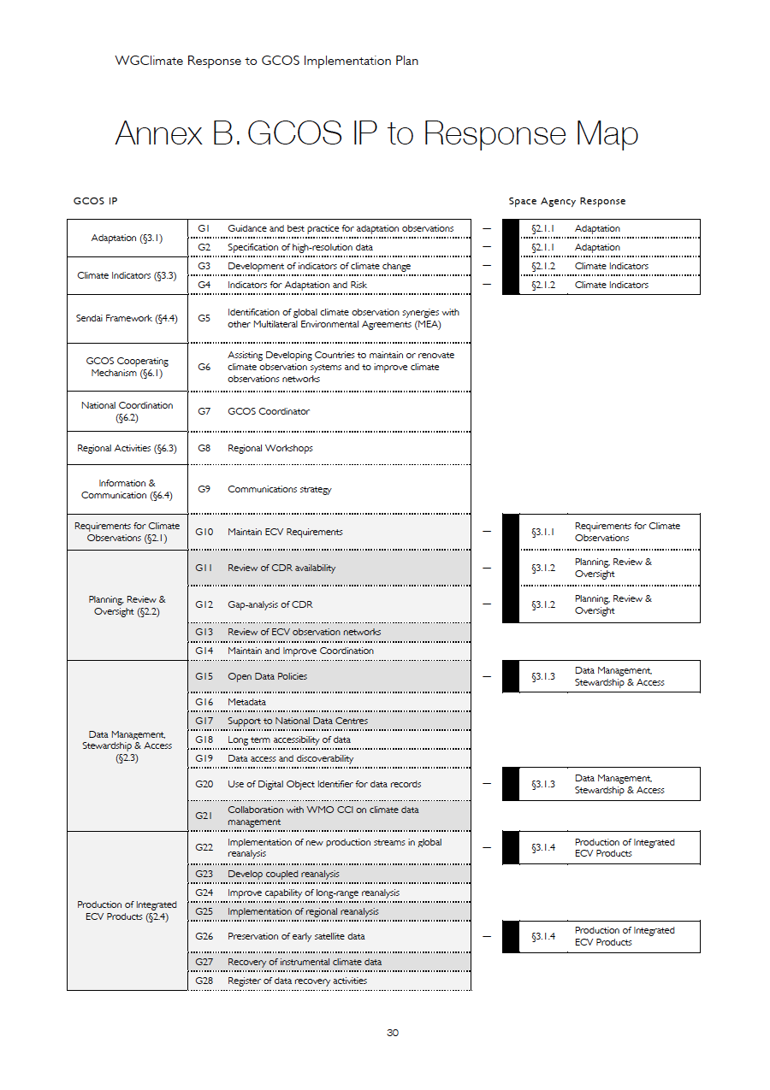
1. SARGIP -
Anomalies in GCOS IP to SARGIP Mapping (Annex B)
Content in Main Body & Annexes but non ‘Space’ action.
Content (detailed) in Annexes but no content in Main Body
Content (detailed) in Annexes but no content in Main Body & not ‘Space’.
Content in Main Body but content (detailed) not yet in Annexes
Content in Main Body but content (detailed) not yet in Annexes & not ‘Space’.
‘Space’ action but no content exists ; not yet received.
‘Space’ action but no content exists ; has been removed from earlier version.

Slide 15
1. SARGIP -
Anomalies
(General)
Missing Content ; marked “[#]”
Other mapping anomalies.
SARGIP Document-Input Comments – to be discussed.
Document structure inconsistencies across domains.
Domain author proposal(s) for non-GCOS actions or responses.
Language & notation conventions e.g. American English / British English.
Miscellaneous anomalies.

Slide 16
1. SARGIP -
Review of the Introduction

Slide 17
1. SARGIP -
Review of the Broad Context

Slide 18
1. SARGIP -
Review of Overarching & Cross-Cutting Actions.

Slide 19
1. SARGIP -
Review of the Atmospheric Climate Observing System.

Slide 20
1. SARGIP -
Review of the Oceanic Climate Observing System.

Slide 21
1. SARGIP -
Review of the Terrestrial Climate Observing System.

Slide 22
1. SARGIP -
Next Steps.
Next SARGIP draft version distribution to WGClimate : 25 Sept 2017
Any further inputs should be submitted through SARGIP v0.x
Any final refinement contributions to WGClimate : 2 Oct 2017
Draft SARGIP sent to SBSTA-47 : 6 Oct 2017
Final Response to CEOS @ CEOS Plenary : 18 Oct 2017
Final Response to SBSTA @ SBSTA-47 : 6 Nov 2017

Slide 23
3. Excursion to the VC/WG Day
Climate / Carbon

Slide 24
4. Preparation for SBSTA-47 & COP-23
Pascal Lecomte

Slide 25
5. ECV Inventory
Jörg Schulz

Slide 26
ECV Inventory – Relevance for Planning
Action Plan & Creation of conditions to deliver CDRs
ECV Inventory
Gap Analysis & Recommendations
ECV Inventory provides visibility on Climate Data Records available/planned from CEOS & CGMS satellite missions or their combination on an GCOS ECV product basis that allows response to GCOS IP;
The ECV Inventory establishes traceability with respect to GCOS principles, guidelines and requirements for ECVs;
The WG identifies gaps and shortfalls, provides recommendations and formulates a coordinated action plan to address recommendations;
This shall optimise the planning of future missions and constellations to expand Climate Data Records and close gaps with respect to GCOS requirements.
ECV Inventory is updated in 2 year cycles.
http://climatemonitoring.info/

Slide 27
ECV Inventory #2 Cycle: timeline (1)
Jul
…
Jun
…
Nov
Mar
Dec
…
Jul
Aug
Sep
Oct
…
Jan
Feb
Preparation
Collection
Verification
Gap Analysis
Identification of “Focal Points’ and ‘Responders’
Interaction with ‘Responders’: access and assistance
Pre-check of entries → 1-to-1 interactions with ‘Responders’ → “Verified” (+ Comments)
Response to web-based questionnaire by ‘Responders’ → Submission of entries (by ‘Responders’)
Cycle #1 Heritage, Questionnaire, web-interface
Focal points were WGClimate members organising ~100 responders
WGC #6
Opening of data input window
WGC #7
Closing of data input window
ECV Inventory #1 (table)
Beginning of Cycle #2

Slide 28
ECV Inventory #2 Cycle: timeline (2)
Feb
Jun
Mar
May
Apr
Jul
Aug
Sep
Oct
Nov
…
…
Preparation
Gap Analysis
GA Report
Pre-check of entries → 1-to-1 interactions with ‘Responders’ → “Verified” (+ Comments)
Preparation of Gap Analysis: Experts teams (by Domain), definition of schedule and procedures, web interface and tools
Gap Analysis by the Domain Teams: assessment of individual TCDRs
Analysis of outcomes of assessment by Domain Teams, statistical overview, higher-level gaps, …
1st Gap Analysis Report
Experts teams ~20 people performing gap analysis
WGC #8
SBSTA-47 and COP-23
Draft response to SBSTA-47
WGC #7
Kick-off of GA by Domain Teams
Deadline for completion of GA by Domain Teams
End of Cycle #2

Slide 29
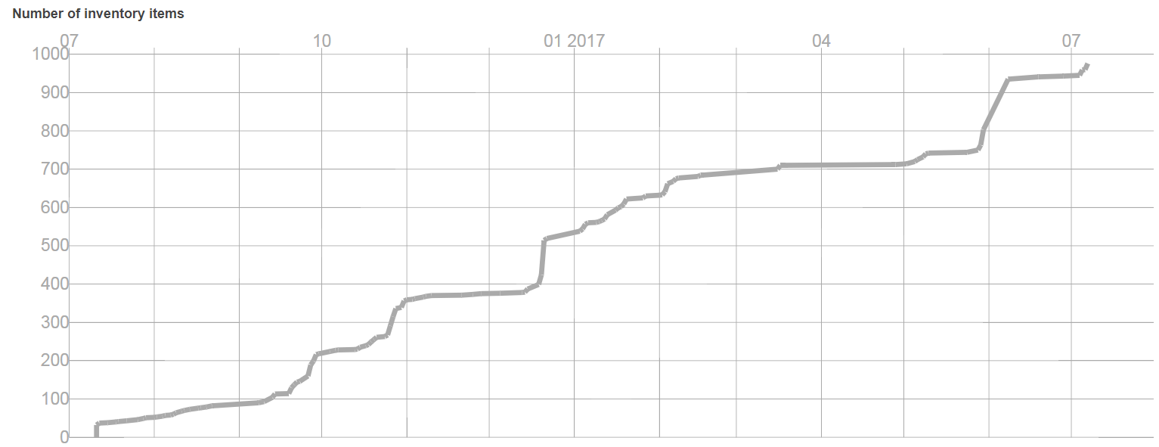
ECV Inventory Population

Slide 30
Organisation of Gap Analysis
Gap analysis coordinator (EUMETSAT) – reports to the WG Chairs
Oversees the whole gap analysis process, ensures consistency of approach and outcome across domain teams
Domain specific gap analysis teams – report to the Gap Analysis Coordinator
Implement the gap analysis following the gap analysis guide;
Report per ECV data record following the structure provided by the online tool.
EUMETSAT SupportTeam – report to Gap Analysis Coordinator;
Supports gap analysis teams with rapid developments of graphical representations
helps clarifying ECV Inventory content with responders if needed
WGClimate Chairs – report to WGClimate and to bodies
Support the gap analysis coordinator during report structuring and drafting;
Report to all bodies (CEOS SIT, CGMS Plenary, CEOS Plenary, SBSTA) as outlined in overall schedule
Take final decisions on inclusions or exclusions of ECV Inventory content for gap analysis
WGClimate Members
Endorse gap analysis report and coordinated action plan
EUMETSAT Support Team
Atmosphere Team
Ocean Team
Gap Analysis Coordinator
WGClimate Chairs
Terrestrial Team
WGClimate

Slide 31
Gap Analysis Report Structure
Chapter 1: | Introduction describes the context of the gap analysis, provides document overview and document references;
Chapter 2: | Describes the ECV Inventory addressing its structure, the population and verification process and provides information on the agencies contributions;
Chapter 3: | Provides information on gap definition, describes the gap analysis approach and its implementation and discusses limitations of the approach;
Chapter 4: | Provides a Generic gap analysis with information on the covered and uncovered ECVs and ECV products and analysis compliance to GCOS in total and domain wise. In addition it shows correspondence to Cycle #1 information;
Chapter 5: | Provides information on individual gaps for ECV products including a trace to potentially missing missions;
Chapter 6: | Describes potential improvements to the cyclic process of the ECV Inventory
Annex A: | Provides the questionnaire for the current component of the ECV Inventory;
Annex B: | Provides the questionnaire for the future component of the ECV;
Annex C: | Provides per question the grading used to assess compliance to GCOS;
Annex D: | Provides detailed gap analysis results per ECV product;
Annex E: | Provides recommendations for coordinated actions;
Annex F: | Glossary of acronyms.

Slide 32
Critical Issues
Chapter 6 is not ready but will be in essence what I already described;
Degree of detail for gap analysis is low due to time constraints;
Analysis of missing ECV products in particular link to missions is feasible but very work intensive for various reasons;
Content of the report has not been reviewed yet.

Slide 33
ECV Inventory Completeness
 | Known | Unknown
Known | Verified content of the ECV Inventory. | Known climate data records that did not became part of the ECV Inventory.
Unknown | Partly or not verified content of the ECV Inventory. | Climate Data Records that may exist but are not known by the WGClimate.

Slide 34
ECV Inventory Current Status
Population and verification of web-based Inventory of Climate Data Records (CDRs) of ECVs observable from space completed. Note: Completed verification means > 95% “verified” for Gap Analysis Process [because of non responsiveness to the verification process the final count will never reach 100%).
Entries from 11 CEOS/CGMS Agencies (100 experts involved as responders
Number of entries higher than expected
913 entries
539 for existing CDRs, 437 for planned CDRs
27/29 (GCOS-154, 2011) and 30/35 (GCOS-200, 2016) ECVs covered
The ECV Inventory published in September 2017.

Slide 35
ECV Inventory Content
Domain | Total | Current | Future | Total (Cycle #1)
All | 913 | 496 | 417 | ~200
Atmosphere | 658 | 376 | 282 | N/A
Land | 135 | 56 | 79 | N/A
Ocean | 120 | 64 | 56 | N/A

Slide 36
Atmospheric ECV Products

Slide 37
Land ECV Products

Slide 38
Ocean ECV Products

Slide 39
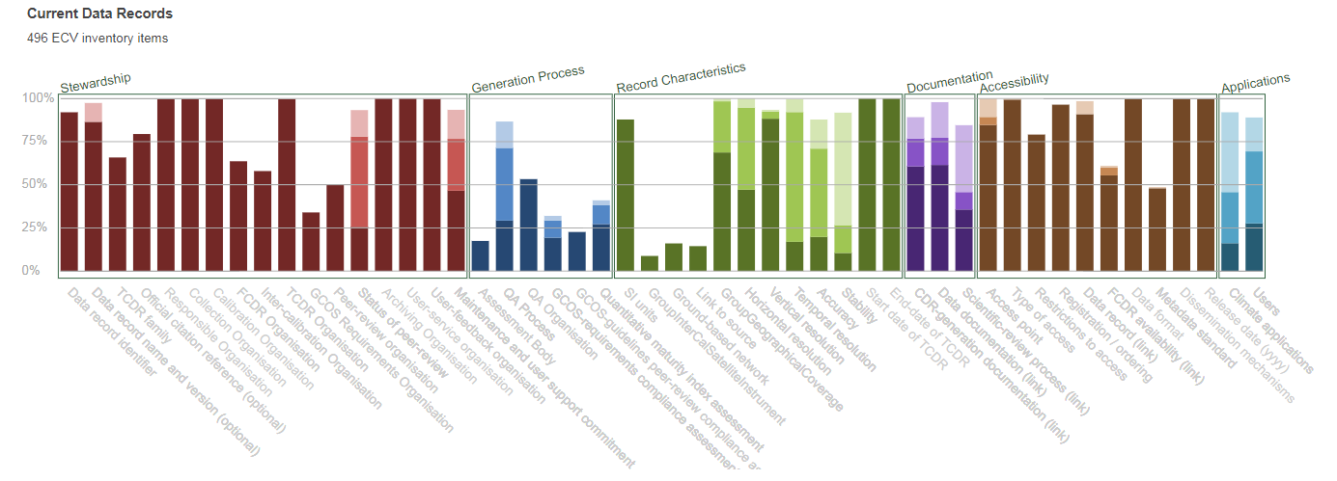
Level of Responses and Compliance to GCOS

Slide 40
ECV Products missing in “Current”
Atmosphere |  | Land |  | Ocean
ECV | ECV Product | ECV | ECV Product | ECV | ECV Product
Ozone | Tropospheric Ozone Profile | Fire disturbance | Fire Radiative Power | Sea State | Wave Height
CO2, CH4 and other GHG | NO2 Tropospheric Column | Ice Sheets | Elevation Data | Sea surface salinity | Sea surface salinity
CO2, CH4 and other GHG | SO2 and HCHO Tropospheric Columns | Ice Sheets | Mass Change
 |  | Lakes | Areas of GTN-L Lakes
 |  | Biomass | Above-ground Biomass

Slide 41
Screen Space Mission

Slide 42
6. WMO ECV Inventory Workshop
Stephan Bojinski

Slide 43
7. Governance, Summary and Actions
Pascal Lecomte

Slide 44
Thank You
Pascal Lecomte – WGClimate Chair
September 12th 2017

