Slide 1


Cycle #2 ECV Inventory:
Inventory implementation
WGClimate
The Joint CEOS/CGMS
Working Group on Climate
Peter Albert
(EUMETSAT)

Slide 2
Outline
Background
Technical baseline for new implementation
Database tables and relationships
Integration with WGClimate Website
Data security

Slide 3
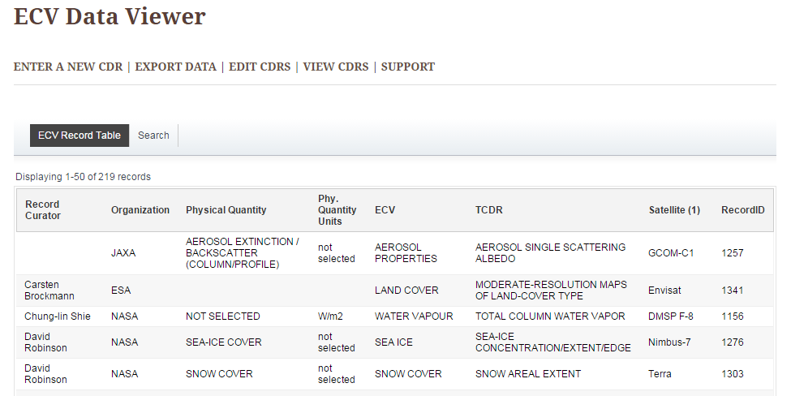
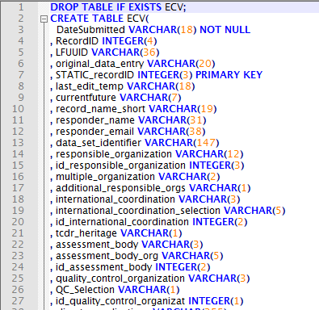
Background
Current inventory hosted by NASA delivered to EUMETSAT in July 2015
Content (SQL)
Pulldown menus (Excel)

Slide 4
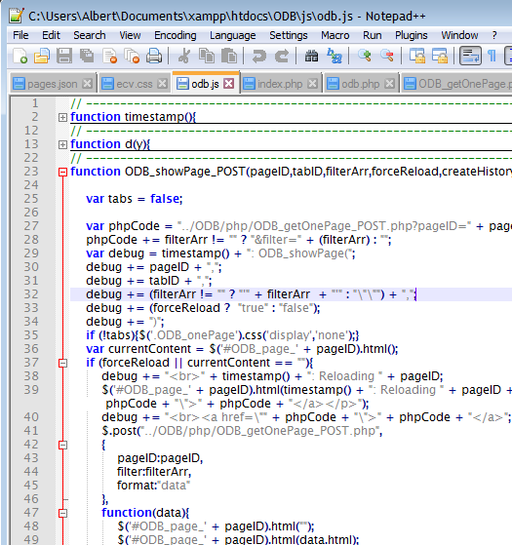

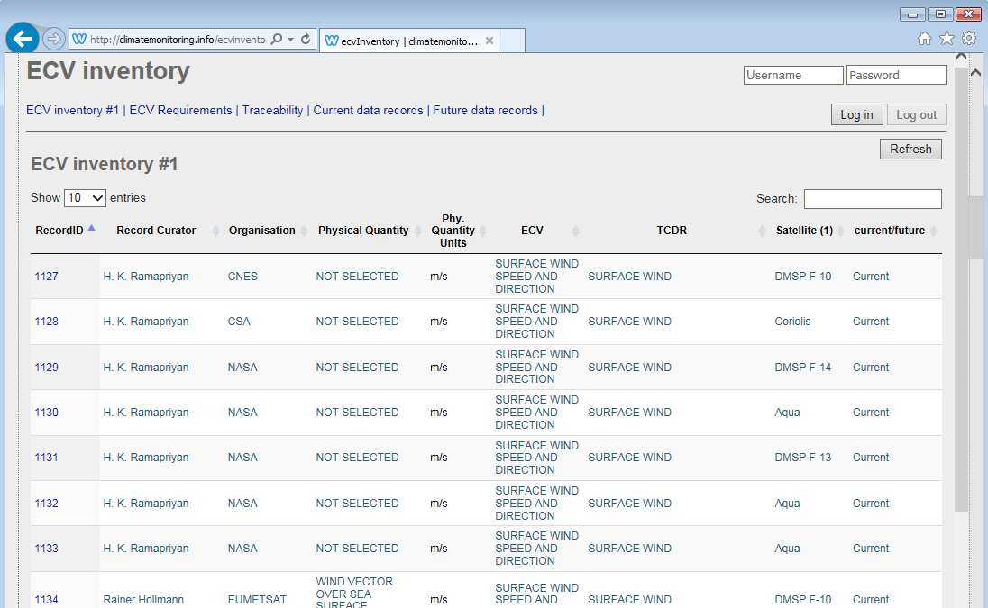
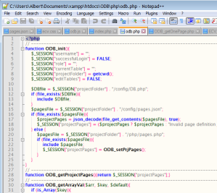
Technical baseline for new implementation
Webserver, Database, User Interaction
Apache, MySQL, PHP (server), JavaScript (Client)

Slide 5

Database tables
Table | Content | Access restrictions
ECV | ECV Inventory Cycle #1 | Read-only, publicly avilable
ECV_2 | ECV Inventory Cycle #2 | Editable, during verification only available to dataset providers and WGClimate
ECV_requirements | GCOS ECV Requirements | Read-only, publicly available
Satellites_instruments | List of satellites and instruments | Available through drop-down lists
Items_sat_data | Relationship table ECV_2 ← → ECV_requirements | Available through edit form
ECV_list | List of ECVs, ECV produc ts and Physical quantities | No access, internally used for dropdown lists
History | Log-table for history registration | No access
Users | User management for log-in and dataset edit rights management | No access

Slide 6
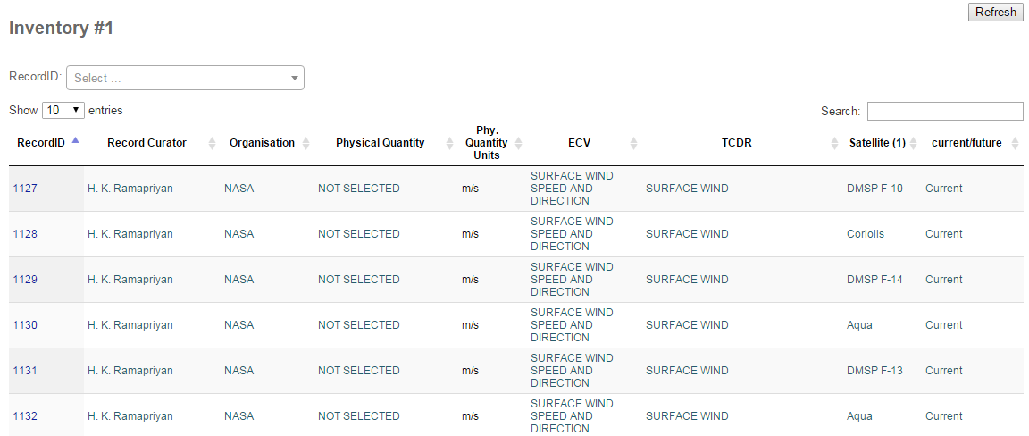
Database tables – ECV Inventory #1
Record selection
Search and filter all fields
Search and filter for selected values
Show record details

Slide 7
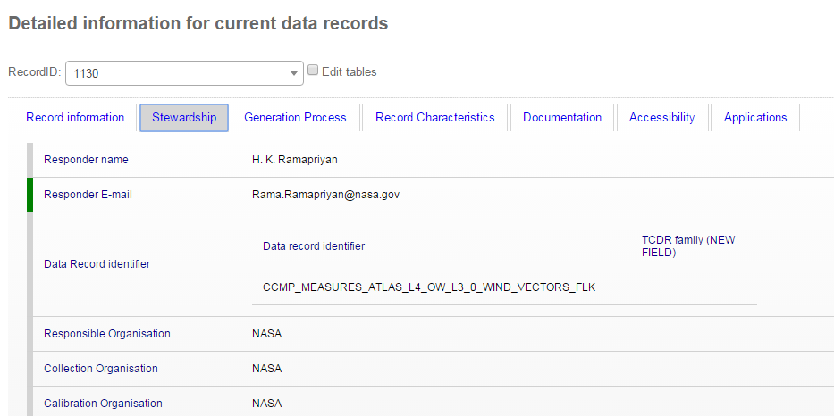
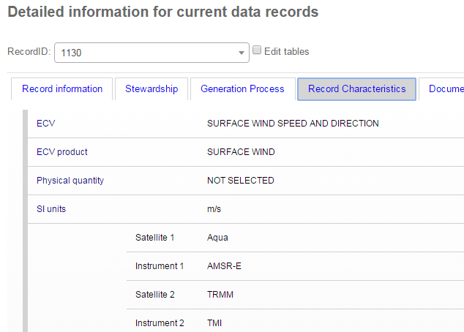
Database tables – ECV Inventory #1

Slide 8
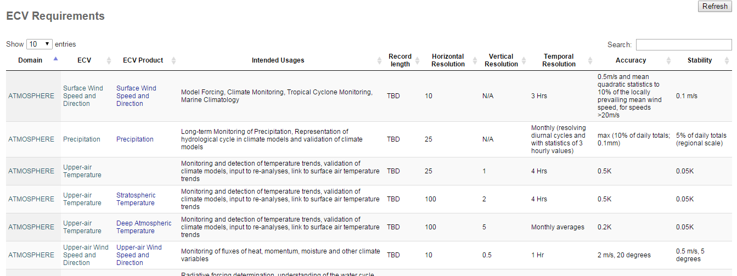
Database tables – GCOS ECV Requirements
Show traceability between requirements and inventory items

Slide 9
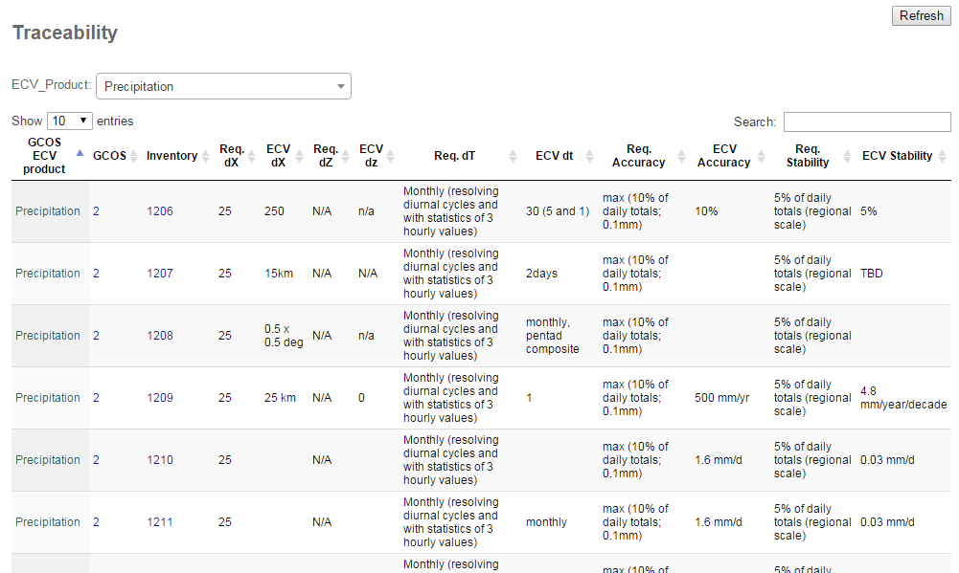
Database tables - Traceability

Slide 10
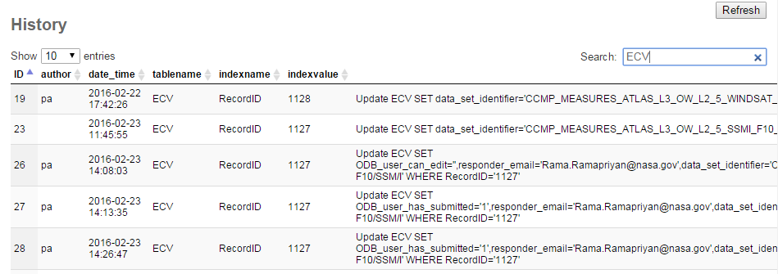
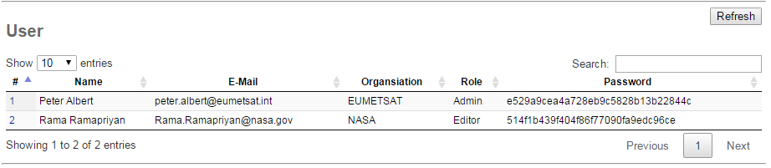
Database tables – History and Users

Slide 11

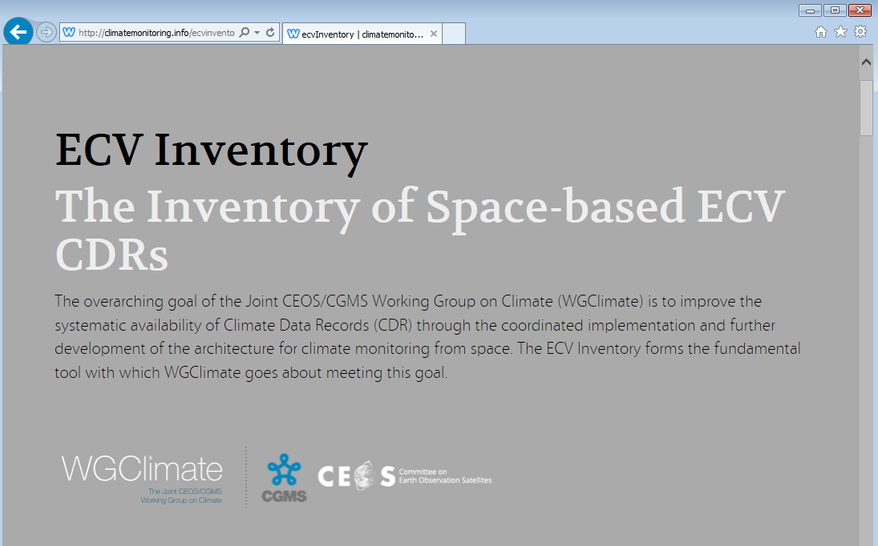
Integration with WGClimate Website
ECV inventory is displayed as integral part of the WGClimate website
Integration via <iframe> allows independent development and maintenance

Slide 12
Data security
Database modifications by registered users only
Appropriate means against SQL injection and cross-site scripting
Daily backups of Database content and ECV inventory server

