Slide 1
ECV Inventory: Status after Cycle#1, planned update for Cycle#2, review of questionnaire
WGClimate
The Joint CEOS/CGMS
Working Group on Climate
Jörg Schulz, Alexandra Nunes

Slide 2
Content
What is the ECV Inventory and why is it important
Analysis of Cycle #1 Inventory Status
Structure of Cycle #2 Inventory
Example of questionnaire entry
ECVs, ECV Products and Physical Quantity
Discussion and Endorsement

Slide 3
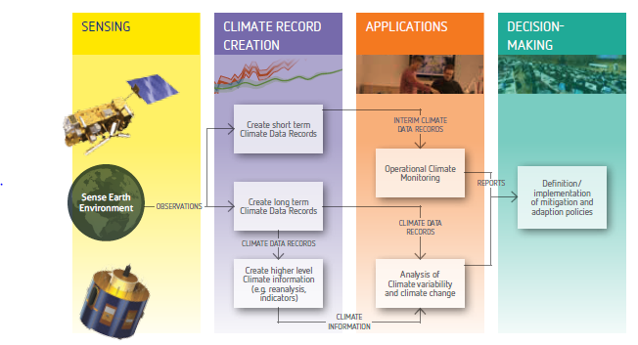
The Architecture for Climate Monitoring from Space
Implementation coordinated by
Joint CEOS – CGMS Working Group on Climate (JWG Climate)

Slide 4
Importance of the ECV Inventory
Based on a questionnaire it describes the current and planned monitoring capability on an ECV basis;
Provides specific information per data record (some being not part of meta data);
Establishes traceability with respect to GCOS principles, requirements and guidelines;
Directly supports gap analysis by its structure.
ECV Inventory
Reference Assessment Process
Gap Analysis & Recommendation
Action Plan
Creation of conditions to deliver CDRs

Slide 5
Usage of the ECV Inventory by WG Climate
Description of current and future monitoring capability on an ECV basis allows easier response to e.g. GCOS IP (may suffer from mismatch after update but discussion on ECV list in GCOS not finished);
Combined perspective of the logical and physical views of the architecture should enable the definition of an optimum “macroscale” space system configuration and its components;
Used at the ECV/product level to identify gaps and shortfalls as well as to provide recommendations for action;
Formulation of a coordinated action plan to address recommendations;
Trigger for the medium‐term activities that need to be undertaken to sustain the long‐term implementation of the architecture.

Slide 6
Potential Usages of the ECV Inventory beyond the WGClimate
Can inform data record users with a public repository of verified information on what is available and how to access the data;
Can inform climate services on what to use;
Can inform data providers on competitive situations;
Can inform developers with whom to collaborate;
Can inform reviewers of proposals for new CDRs if it is worth investing ...

Slide 7
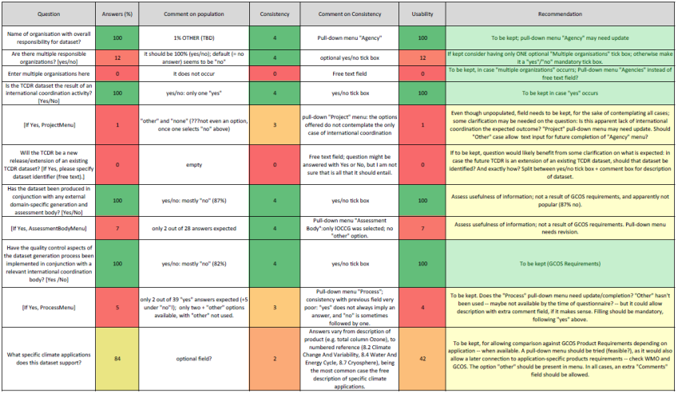
ECV Inventory Cycle#1 - Analysis

Slide 8
Rationale
Lessons learnt from Cycle #1
Proposed approach for Cycle #2
Unpopulated / poorly populated fields
Inconsistent / insufficient input of information
Potentially missing data records
Difficult assessment for future improvements of questionnaire
Clear distinction between current and future partly lost in implementation
Revision of questionnaire
Guide to the Questionnaire
Direct engagement of POCs per data record
Finding right POCs via WGClimate members engagement
1-to-1 interactions between ‘questioner’ and ‘responders’
Clear split into two questionnaires

Slide 9
Questionnaire Structure I
Current
Future
Notes:
Stewardship of the record - with questions aimed at exposing both the administrative and technical arrangements
for the stewardship of the record;
b) Generation Process of the record - with questions aimed at exposing the degree to which this generation
process complies with the provisions described in [RD-1];
c) Record Characteristics - with questions aimed at ensuring (inter alia) that there is sufficient information to
establish whether the record satisfies the technical requirements defined in [RD-2];
d) Documentation of the record - with questions aimed at ensuring that the minimum documentation needs
defined in [RD-1] are met;
e) Accessibility of the record - with questions aimed at ensuring that appropriate access to the data set is available,
as defined in [RD-1];
f) Applications of the record - with questions aimed at exposing the envisaged usage of the record.

Slide 10
Questionnaire Structure II
6 Categories feeding gap analysis
Stewardship
15 Questions
Generation Process
5 Questions
Current
Record Characteristics
14 Questions
Documentation
3 Questions
Accessibility
7 Questions
Applications
1 Question

Slide 11
Questionnaire Structure III
6 Categories feeding gap analysis
X
Stewardship
13 Questions
Generation Process
5 Questions
Future
X
Record Characteristics
12 Questions
Documentation
3 Questions
Same questionnaire structure but less questions and different tense.
Accessibility
3 Questions
Applications
1 Question

Slide 12
Example for Questionnaire Entry
Question #6 (Calibration organisation)
Question:
Which organisational entity is responsible for calibrating the satellite observations?
Description:
The answer to this question is in most cases the name of the space agency operating the satellite and/or instrument that provides for instance pre-launch or on‐board calibration during the during the lifetime of the instrument(s). However, in case that a specific re-calibration of the instrument data leading to a FCDR has been performed, another agency may take the responsibility of providing an updated calibration of the individual instruments. If several entities are involved they should all be mentioned in the answer by stating full name(s) and acronym(s).
This question is associated with GCOS-143 [RD-4] guidance #2 which reads that the GCOS Steering Committee recommends that data producers pay attention to the “Application of appropriate calibration/validation activities”. It is also associated with the GCOS-143 [RD-20] GCMP #15 which reads that “On-board calibration adequate for climate system observations should be ensured and associated instrument characteristics monitored.”
This question should not be confused with question #8 (section 3.1.8), which focuses exclusively on the inter-calibration of different instruments.
Stage:
Stewardship – Generation – Process – Record – Characteristics -Documentation – Accessibility - Applications
Explanation of the question
Link to GCOS principles, requirement and guidelines
Indication of area for gap analysis process

Slide 13
ECVs, ECV Products and Physical Quantities
Satellite Supplement to the GCOS IP defines ECVs and ECV Products for which quantitative requirements are given;
Unfortunately, these definitions are not consistent throughout the Satellite Supplement, but we need to be pragmatic;
We constructed a list of ECV, ECV Product and Physical Quantity to overcome it.
ECV
ECV Product
Variable/ Parameter
Top of atmosphere ERB longwave
Top of atmosphere ERB shortwave (reflected)
Surface ERB longwave
Surface ERB shortwave
A7.1
Earth radiation budget (top-of-atmosphere and surface)
Earth Radiation Budget
A7.2
Total and spectrally resolved solar irradiance
Total solar irradiance
Solar spectral irradiance

Slide 14
Our change ...
ECV
ECV Product
Physical Quantity
A7.1 Top of atmosphere ERB longwave
A7.2 Top of atmosphere ERB shortwave (reflected)
A7.3 Surface ERB longwave
A7.4 Surface ERB shortwave
Upward Longwave Radiation at TOA
Upward Shortwave Radiation at TOA
Surface ERB Longwave
Downward Longwave Radiation at Surface
Upward Longwave Radiation at Surface
Surface ERB Shortwave
Downward Shortwave Radiation at Surface
Upward Shortwave Radiation at Surface
Earth Radiation Budget
A7.5Total solar irradiance
A7.6Solar spectral irradiance
Total solar irradiance
Solar spectral irradiance
This allows to include individual ERB component data records even if specific flux components do not exist today.

Slide 15
Discussion and Endorsement

