Slide 1
JAXA Agency Report
Misako Kachi
Earth Observation Research Center (EORC)
Japan Aerospace Exploration Agency (JAXA)
Climate WG
March 7, 2016

Slide 2
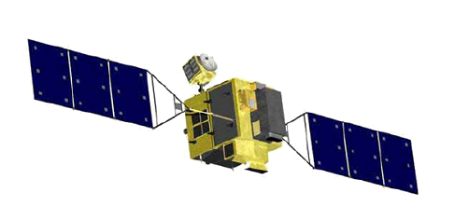
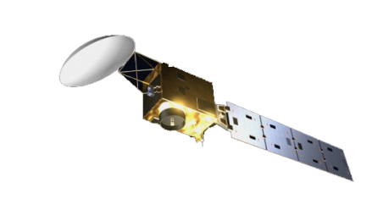
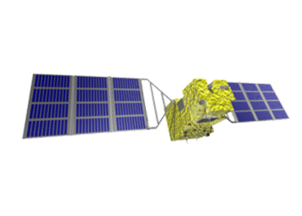
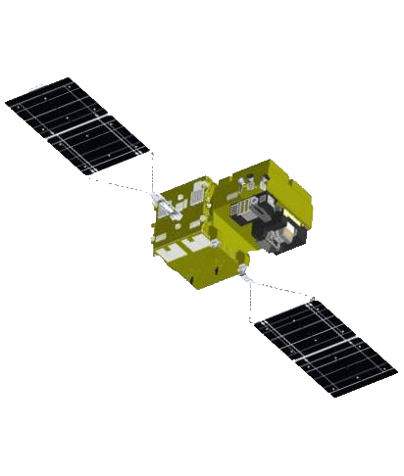


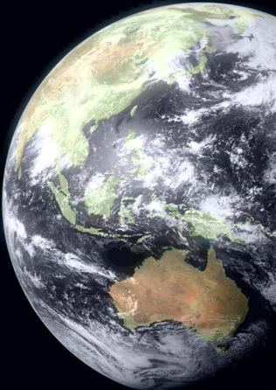
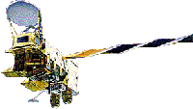
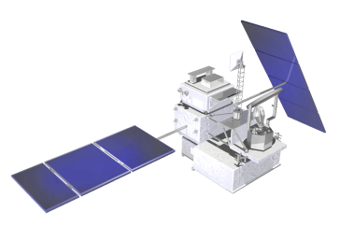
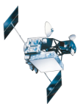
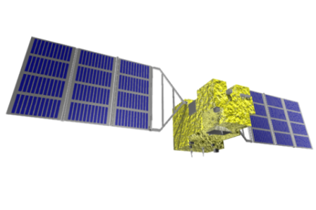
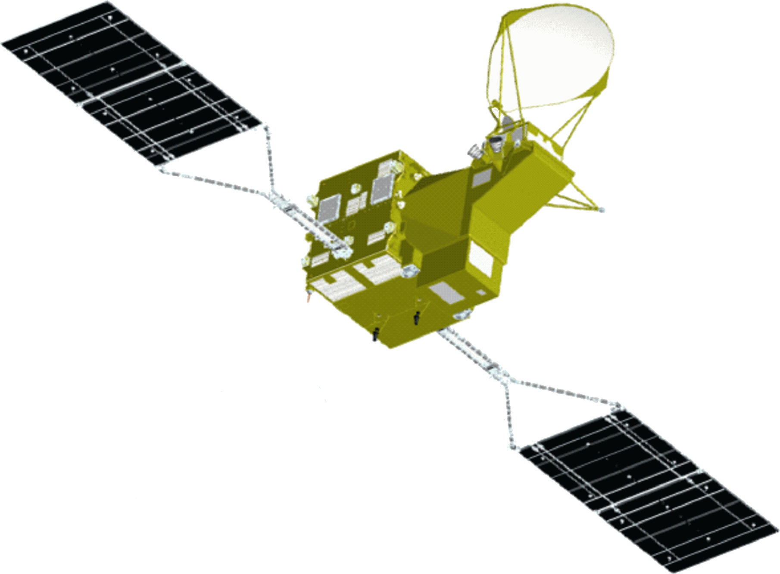
JAXA’s Current and Future Satellite/Sensor Activities
High Resolution Wide Swath (Optical)
GOSAT-2
Earth CARE/CPR
(JFY2018)
(JFY2019 (TBD))
(JFY2017)
GCOM-C
(JFY2016)
ALOS-2
(2014)
DAICHI (ALOS)
(JFY2005)
GPM/DPR
(2014)
Aqua/AMSR-E
(JFY2002)
ADEOS-Ⅱ
(JFY2002)
TRMM/PR
SHIZUKU
(GCOM-W)
JERS-1
(JFY1997)
(JFY1991)
MOS
(2012)
IBUKI (GOSAT)
(JFY1986)
(2009)
Notes:
This is overview of JAXA’s past (orange color), current (green color) and future (blue color) Earth Observation missions.
At present, JAXA operates four missions, CO2 monitoring satellite GOSAT, water cycle mission GCOM-W carrying passive microwave imager AMSR2, NASA-JAXA mission GPM Core Observatory carrying Dual-frequency Precipitation Radar (DPR), and Land Observing satellite ALOS-2 carrying L-band SAR.
In Japanese Fiscal Year 2016 (from April 2016 to March 2017), we will launch climate observation mission GCOM-C carrying SGLI, which has similar specification to MODIS.

Slide 3
Agency update
Recent launches, commissioning status
    GPM: Launched in 2014. Data release in September, and version up is scheduled on March 3, 2016
    GCOM-W: Launched in 2012. Latest version 2 was released in March 2015
    GOSAT: Launched in 2009. Latest version 201.201 was released in 2015.
    ALOS-2: Launched in 2014. Data release in November, 2014
  Forthcoming launches
    GCOM-C (JFY 2016)
    GOSAT-2 (JFY 2017)
    EarthCARE (JFY 2018)
  Major satellite events
    End of TRMM science operation (April 2015, NASA and JAXA)
    End of AMSR-E operation (December 2015)
Other major events
  JMA and JAXA are collaborating in exchanging information, calibration, and geophysical products generation, by taking advantage of GEO/LEO complementarity especially in Himawari-8.
  JAXA Himawari Monitor to distribute images and data of Himawari-8 (L1 & L2) has been operated since August 2015.

Slide 4
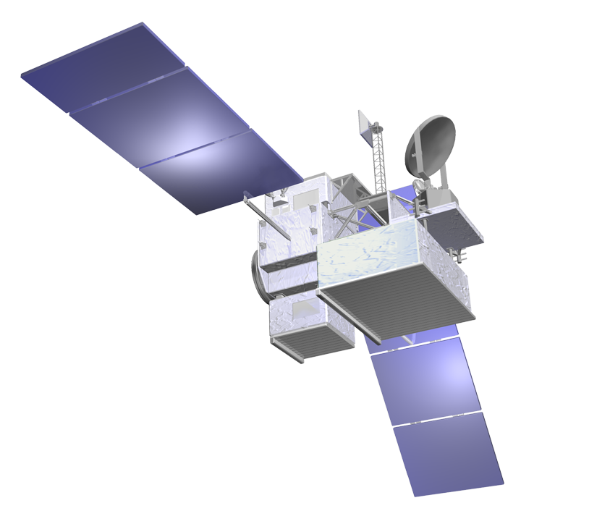
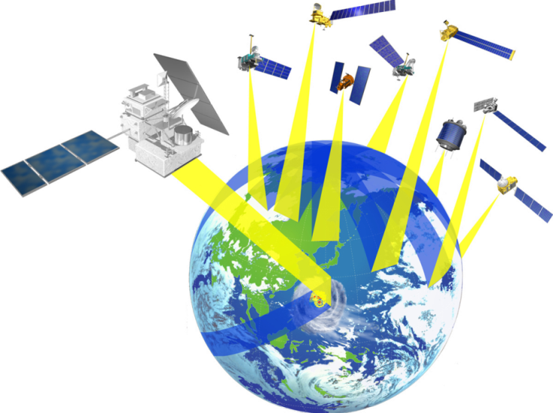
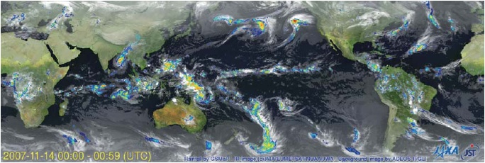
Global Precipitation Measurement (GPM)
GPM Core Observatory
GPM is an international mission consisting of the GPM Core Observatory and Constellation Satellites for high accurate and frequent global precipitation observation.
GPM Core: launched on 28 Feb. 2014 (JST).
All GPM standard products (V03) were released on September 2014.
  Research product: GMI SST, GMI & DPR sea ice concentration, GSMaP Realtime version
New version (V04) was released on March 3, 2016.
  Major changes in GMI L1 & small changes in DPR L1.
  New latent heating products for TRMM area.
  Release of GMI L2 & global rainfall map will be later.
V05 will be TRMM/GPM consistent products.
GMI (Microwave Imager)
KuPR: 13.6GHz radar (phased array)
KaPR: 35.5GHz radar (phased array)
Constellation
Satellites by international partners
Core
Observatory
by NASA-JAXA
Notes:
GPM is an international mission consisting of the GPM Core Observatory and Constellation Satellites for high accurate and frequent global rainfall observation.
- Core Observatory: developed under NASA and JAXA equal partnership.
- Constellation satellites: provided by international partners (includes GCOM-W1)
Dual-frequency Precipitation Radar (DPR)
- developed by JAXA and NICT
- the most sophisticated precipitation radar
- 3D structure of rainfall
- simultaneous dual-frequency observation to detect even weak rainfall and snowfall.
GPM Core Observatory will be launched in early 2014, and the first public data release is in Sep. 2014.
New version (V04) products was just released in March 3, 2016.
JAXA and NASA is planning to release TRMM/GPMM consistent products in future V05 products.

Slide 5
JAXA Global Rainfall Watch
Rapidly changing precipitation phenomena need frequent observations
  JAXA GPM project provides hourly rainfall product (GSMaP) in 0.1x0.1deg lat/lon grid in global (60N-60S) by merging multi-satellites’ microwave radiometers and geostationary infrared cloud moving vector information
  Processed and distributed in near real time basis (about 4-hour after observations)
  Reprocessing of past period (Mar. 2000 -) data is underway.
http://sharaku.eorc.jaxa.jp/GSMaP
Champi
Olaf
Patricia
Notes:
Global Rainfall Map product is one of main targets of the GPM mission, and JAXA and NASA developed their own national product, GSMaP by JAXA and IMERG by NASA.
GSMaP, Global Satellite Mapping of Precipitation, is a hourly 0.1-degree grid rainfall map by merging multi satellites’ passive microwave imagers and sounders and using geostationary infrared cloud moving vector information to fill the gap between passive microwave observations. NRT data is distributed 4-hour after observations, and reprocessing past period data from Mar. 2000 to present.

Slide 6
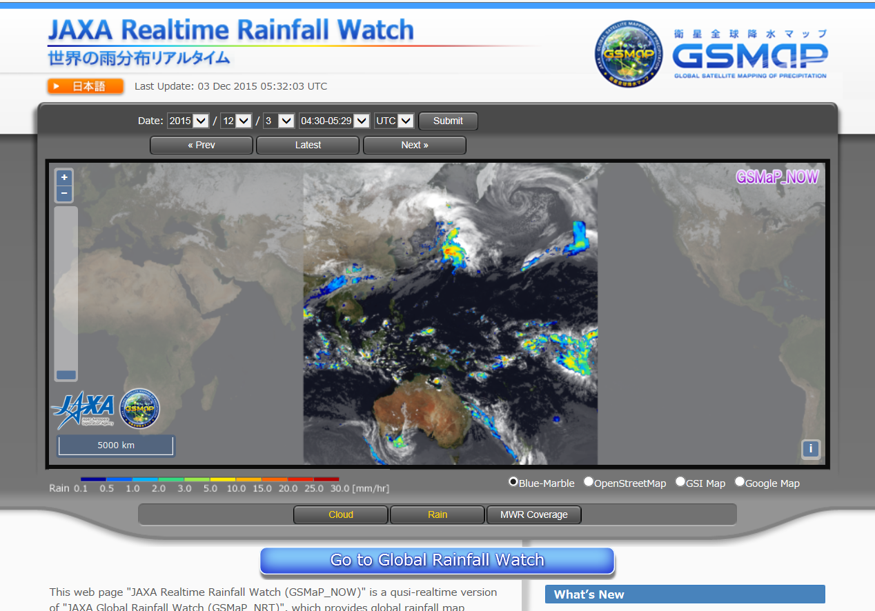
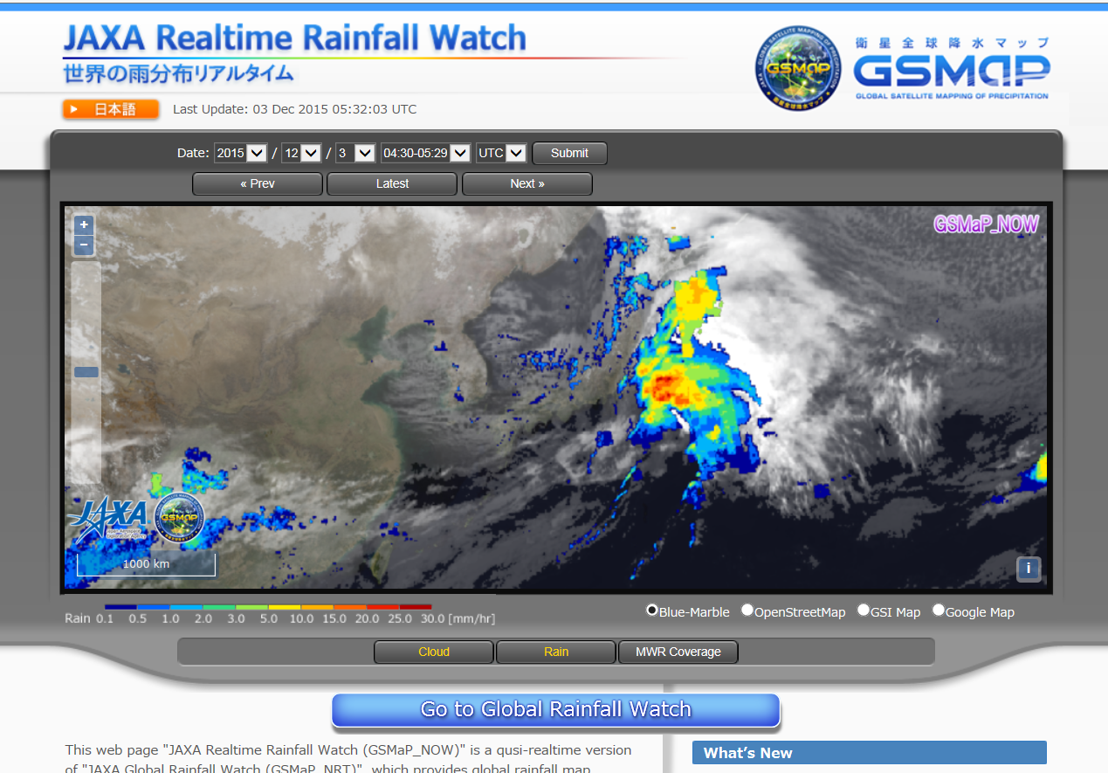
GSMaP: From 4-hour Delay to Realtime
To reduce latency of GSMaP to respond users
  Using data that is available within 0.5-hour (GMI, AMSR2 direct receiving data, AMSU direct receiving data and MTSAT) to produce GSMaP at 0.5-hr before.
  Applying 0.5-hour forward extrapolation (future direction) by cloud moving vector to produce GSMaP at current hour (GSMaP_NOW).
Area: Geostationary satellite Himawari area
Grid size: 0.1-degree
Average: Hourly
Update: every 30-min
Data is freely available
after simple registration
http://sharaku.eorc.jaxa.jp/GSMaP_NOW
Notes:
In Nov. 2015, JAXA has released GSMaP realtime version (GSMaP_NOW) to respond user requests to reduce data latency. To produce this, we use data that is available within 0.5-hr after observation, and apply 0.5-hr forward extrapolation by cloud mobbing vector to produce GSMaP at current hour. At present, we released data over the geostationary satellite Himawari observation area only because of data latency. Accuracy of GSMaP_NOW is almost same or slightly worse than GSMaP near-real-time version (4-hr data latency).

Slide 7
AMSR-E operation completed on Dec.4, 2015
After 9.5 year observation, the AMSR-E on the EOS-Aqua satellite had been operated in slow rotation mode (2 rotations per minute) since December 4, 2012 for cross-calibration in order to produce and provide a consistent and long-term dataset between the AMSR-E and AMSR2 on the GCOM-W satellite by correcting their differences in sensor properties.
The AMSR-E automatically halted its observation and rotation at around 2:30 p.m. on December 4, 2015 (JST). As December marks just three years of simultaneous AMSR-E and AMSR2 operation, and because we obtained sufficient data necessary for cross-calibration, JAXA decided to complete operation of the AMSR-E at this time.
AMSR-E products applying AMSR2 algorithms and formats will be produced in JFY2016.

Slide 8
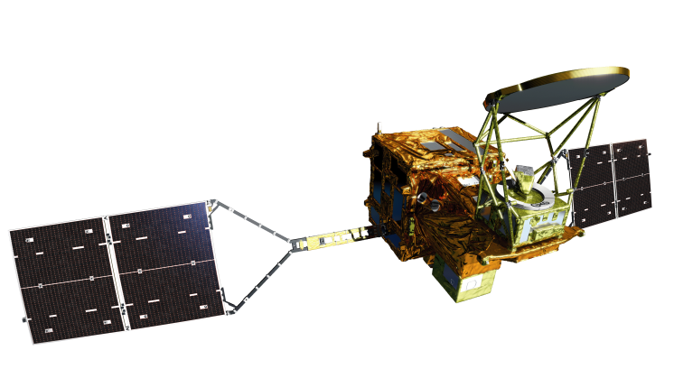
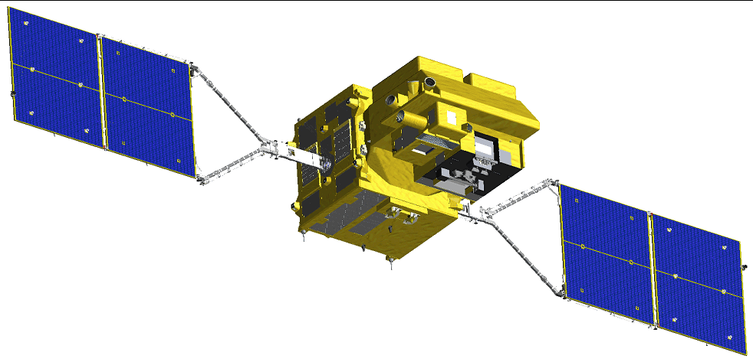
GCOM 1st Generation Satellites
“SHIZUKU”
May 18, 2002 –
(in operation)
late JFY 2016
(to be launched)
GCOM-W (Water)
GCOM-C (Climate)
Instrument | Advanced Microwave Scanning Radiometer-2
Orbit | Sun Synchronous orbit Altitude：699.6km (on Equator) Inclination: 98.2 degrees Local sun time: 13:30+/-15 min
Size | 5.1m (X) * 17.5m (Y) * 3.4m (Z) (on-orbit)
Mass | 1991kg
Power gen. | More than 3880W (EOL)
Launch | May 18, 2012
Design Life | 5-years
Instrument | Second-generation Global Imager
Orbit | Sun Synchronous orbit Altitude：798km (on Equator) Inclination: 98.6 deg. Local sun time: 10:30+/- 15min
Size | 4.6m (X) * 16.3m (Y) * 2.8m (Z) (on orbit)
Mass | 2093kg
Power gen. | More than 4000W (EOL)
Launch | JFY 2016
Design Life | 5-years
8
Notes:
Global Change Observation Mission (GCOM) consists of two medium size satellites that provide complementary information of climate and Earth environment. GCOM-W or “SHIZUKU” was launched in May 2012, and carrying AMSR2, successor of AMSR-E. The other one is GCOM-C which will be launched in Japanese Fiscal Year of 2016, and carrying SGLI.

Slide 9
AMSR2 Standard Products
Ver.2 has been released in March 2015
Product |  | Release Accuracy | Standard Accuracy | Target Accuracy | Version 1 Accuracy | Version 2 Accuracy
GEO | Total Precipitable Water | ±3.5 kg/m² | ±3.5 kg/m² | ±2.0 kg/m² | ROB:2.7 kg/m² GPS:1.5 kg/m² | ROB:2.5 kg/m² GPS:1.5 kg/m²
 | Cloud Liquid Water | ±0.10 kg/m² | ±0.05 kg/m² | ±0.02 kg/m² | 0.04 kg/m² | 0.04 kg/m²
 | Precipitation | Ocean ±50 % Land ±120 % | Ocean ±50 % Land ±120 % | Ocean ±20 % Land ±80 % | Ocean 49% Land 86% | Ocean 48% Land 84%
 | Sea Surface Temperature | ±0.8 ºC | ±0.5 ºC | ±0.2 ºC (zonal mean) | 0.59 ºC | 0.58 ºC
 | Sea Surface Wind Speed | ±1.5 m/s | ±1.0 m/s | ±1.0 m/s | 1.8 m/s | 1.1 m/s
 | Sea Ice Concentration | ±10 % | ±10 % | ±5% | 9 % | 8 %
 | Snow Depth | ±20 cm | ±20 cm | ±10 cm | 16 cm | 16 cm
 | Soil Moisture | ±10 % | ±10 % | ±5 % | 4 % | 4 %
ECV
ECV
ECV
ECV
ECV
ECV
ECV
Achieved Release Accuracy
Achieved Standard Accuracy
Achieved Target Accuracy
Notes:
This is a list of GCOM-W/AMSR2 standard products and its accuracy. The latest Version 2 products were released to public in March 2015. All products are achieved required release accuracy and some already achieved target accuracy that is defined as an extra success of the mission.

Slide 10
AMSR2 Research Products defined in March 2015
Products | Area | Resolution | Target accuracy | Range
All-weather sea surface wind speed | Ocean | 60 km | ± 7 m/s (at 15-40m/s range) | 0 - 70 m/s
10-GHz sea surface temperature | Ocean | 30 km | ± 0.8 °C | 9 – 35 °C
Soil moisture and vegetation water content based on the land data assimilation | Africa, Australia | 25 km | soil moisture: ± 8% vegetation water: ± 1 kg/m² | 0 – 100 % 0 - 2 kg/m²
Land surface temperature | Land | 15 km | forest area: ± 3 °C nondense vegetation: ± 4 °C | 0-50 °C
Vegetation water content | Land | 10 km | ± 1 kg/m² | 0 – 4 kg/m²
High resolution sea ice concentration | Ocean in high latitude | 5 km | ± 1 % | 0 – 100 %
Thin ice detection | Okhotsk sea | 15 km | ± 80 % | N/A
Sea ice moving vector | Ocean in high latitude | 50 km | 2 components: 3 cm/s | 0 - 40 cm/s
ECV
ECV
ECV
ECV
Development by PI
Evaluation at EORC
Released
Notes:
We also defined AMSR2 research products in March 2015, and two of eight products were already released to public.

Slide 11
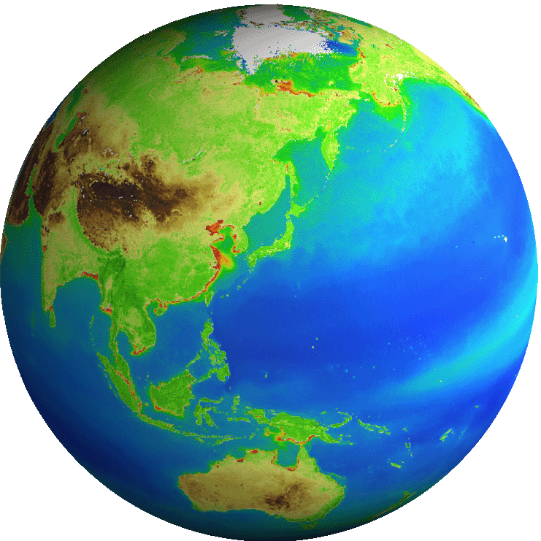
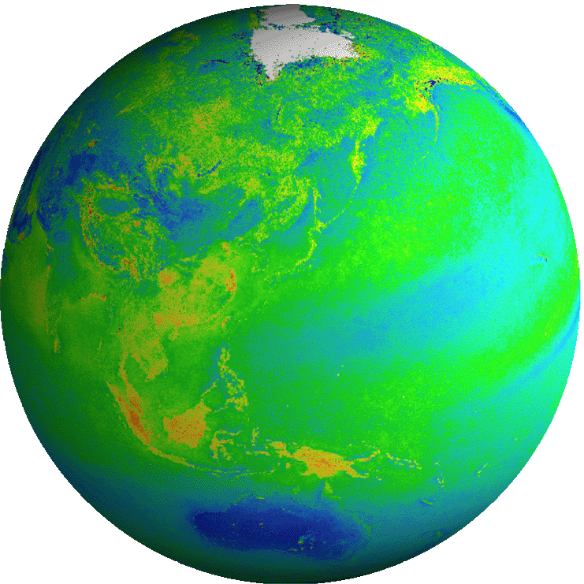
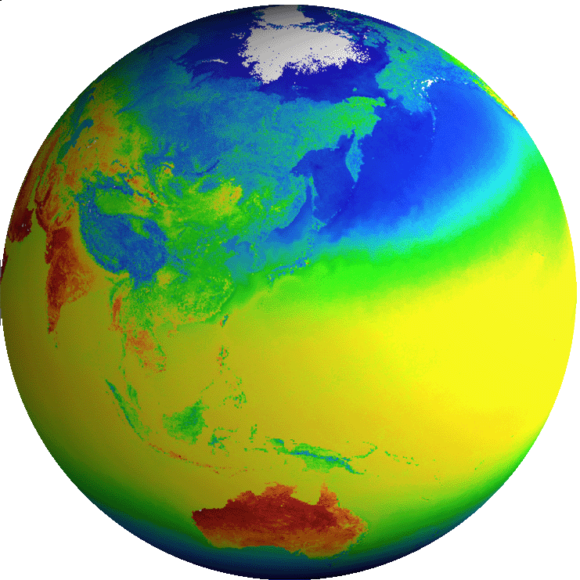

GCOM-C Observation Products
Common
Radiance | TOA radiance (including system geometric correction)
Radiation budget and Carbon cycle
Long-term observation
Land
Surface reflectance | Precise geometric correction
 | Atmospheric corrected reflectance
Vegetation and carbon cycle | Vegetation index
 | Above-ground biomass
 | Vegetation roughness index
 | Shadow index
 | Fraction of Absorbed Photosynthetically available radiation
 | Leaf area index
Temp. | Surface temperature
Application | Land net primary production
 | Water stress trend
 | Fire detection index
 | Land cover type
 | Land surface albedo
Atmosphere
Cloud | Cloud flag/Classification
 | Classified cloud fraction
 | Cloud top temp/height
 | Water cloud optical thickness /effective radius
 | Ice cloud optical thickness
 | Water cloud geometrical thickness
Aerosol | Aerosol over the ocean
 | Land aerosol by near ultra violet
 | Aerosol by Polarization
Radiation budget | Long-wave radiation flux
 | Short-wave radiation flux
Ocean
Ocean color | Normalized water leaving radiance
 | Atmospheric correction parameter
 | Photosynthetically available radiation
 | Euphotic zone depth
In-water | Chlorophyll-a conc.
 | Suspended solid conc.
 | Colored dissolved organic matter
In-water | Inherent optical properties
Temp. | Sea surface temp.
Application | Ocean net primary productivity
 | Phytoplankton functional type
 | Redtide
 | multi sensor merged ocean color
 | multi sensor merged SST
Cryosphere
Area/ distribution | Snow and Ice covered area
 | Okhotsk sea-ice distribution
 | Snow and ice classification
 | Snow covered area in forest and mountain
Surface properties | Snow and ice surface Temperature
 | Snow grain size of shallow layer
 | Snow grain size of subsurface layer
 | Snow grain size of top layer
 | Snow and ice albedo
 | Snow impurity
 | Ice sheet surface roughness
Boundary | Ice sheet boundary monitoring
ECV
ECV
ECV
ECV
ECV
ECV
ECV
ECV
ECV
ECV
ECV
Blue: standard products
Red: research products
ECV
ECV
ECV
11
Notes:
This is a summary of GCOM-C standard & research products. GCOM-C provides various parameters, including ECV of Land, Atmosphere, Ocean and Cryosphere. Information of GCOM-C and GCOM-W is complementary for climate observation.

Slide 12
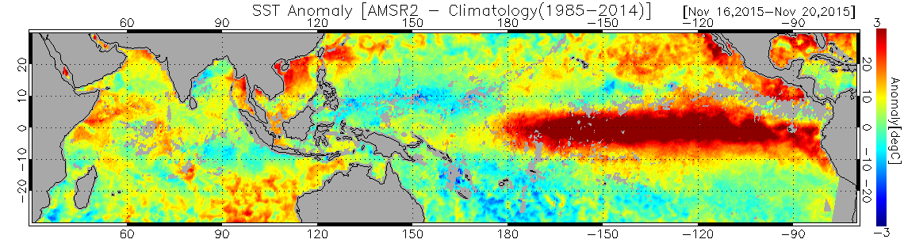
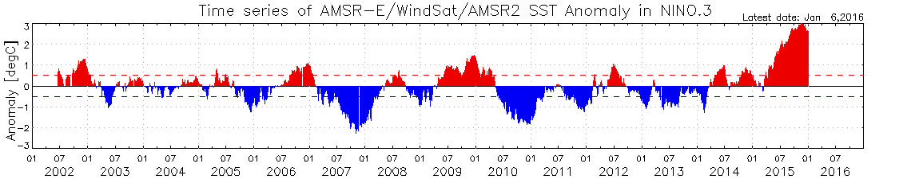
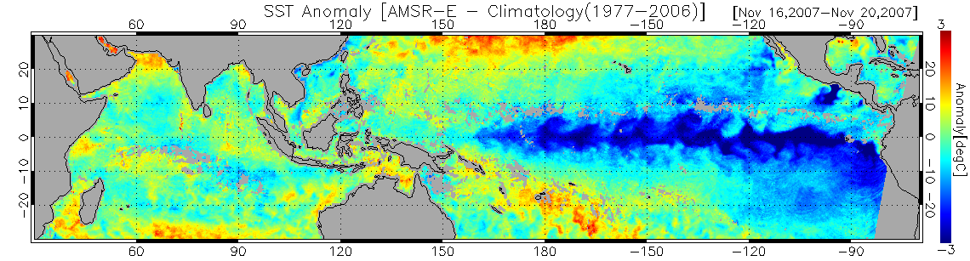
All Weather Sea Surface Temperature
Long-term SST data is provided by AMSR-E, Windsat, and AMSR2
with all-weather observation capability
El Nino:
SST anomaly Nov. 16-20, 2015 by GCOM-W /AMSR2
SST anomaly of NINO.3
(white rectangle)
La Nina：
SST anomaly Nob. 16-20, 2007 by Aqua/
AMSR-E
Notes:
SST from passive microwave imagers will provide all-weather SST information. Its major advantage is that passive microwave observes SST through the clouds, and can cover global area in shorter time period compared to IR SST. SST observations

Slide 13
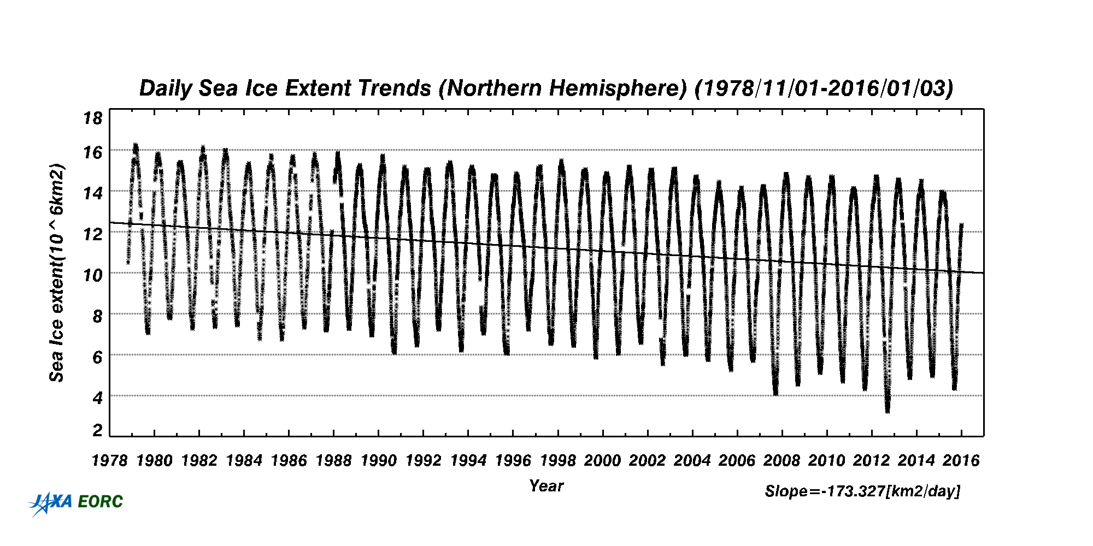
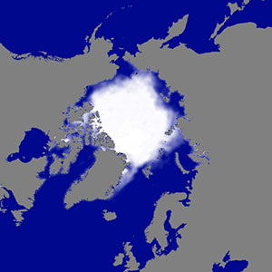
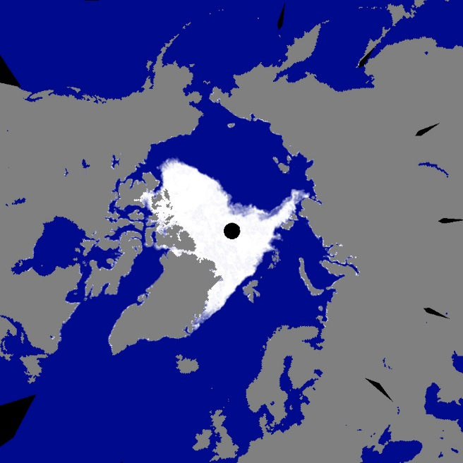
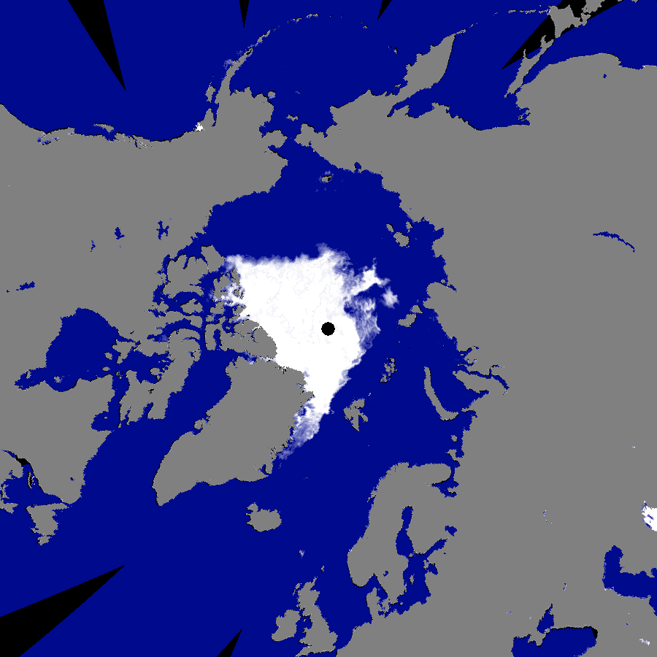
Long-term monitoring of Arctic Sea Ice
Daily sea ice concentration dataset by SMMR, SSM/I, AMSR-E, Windsat and AMSR2.
Daily Arctic Sea Ice Extent Variation (1978/11～2016/1)
AMSR2
AMSR2 captured the smallest sea ice extent in the record in 2012, and AMSR-E captured the 2nd smallest in 2007.
Average distribution of Sep. in 1980s by DMSP/SSM/I
Sep. 24, 2007 by Aqua/AMSR-E
Sep. 16, 2012 by
GCOM-W/AMSR2
Notes:
JAXA also develops daily sea ice concentration & sea ice extent datasets from 1978 to present using available passive microwave imagers, SMMR, SSM/I, AMSR-E, Windsat and AMSR2. The datasets are distributed through the web site.

Slide 14
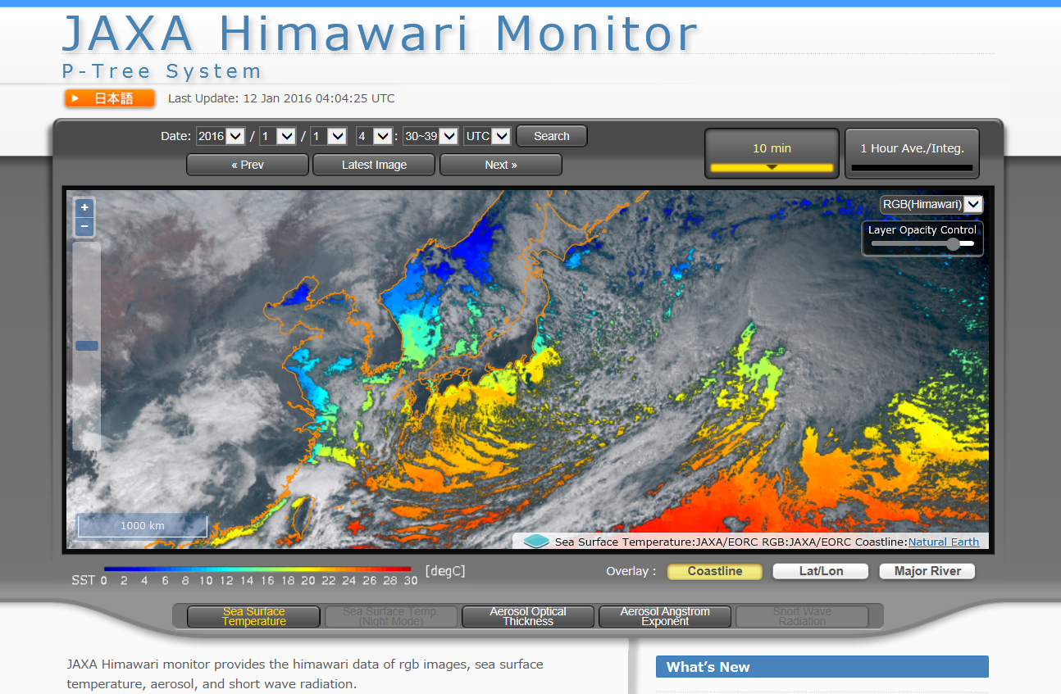
JAXA Himawari Monitor
Producing Himawari-8 L2 products, which are consistent with the JAXA’s Earth observing missions’ products, and distributing them through the JAXA Himawari Monitor (http://www.eorc.jaxa.jp/ptree)
JAXA Himawari Monitor
Available Data
L1 (JMA):
HSD format
L2 (JAXA):
NetCDF format
- Aerosols Properties
- SST
To be released in 2016
- Solar Radiation
- PAR
- Chla
- Cloud Properties
- Wild Fire
Notes:
In 2014, Japan Meteorological Agency (JMA) launched new geostationary meteorological satellite Himawari-8. JAXA collaborates with JMA closely in calibration, algorithm development and validation. JAXA also distributes Himawari-8 L1 data through JAXA Himawari Monitor along with JAXA produced geophysical parameters that are developed consistently with JAXA’s future Earth observation missions, such as GCOM-C, EarthCARE, and GOSAT-2. Currently, aerosol properties and SST products are released through the Himawari Monitor. We plan to add other parameters, such as solar radiation, PAR, Chlorophyll a, cloud properties and wild fire detection in 2016.

