Slide 1
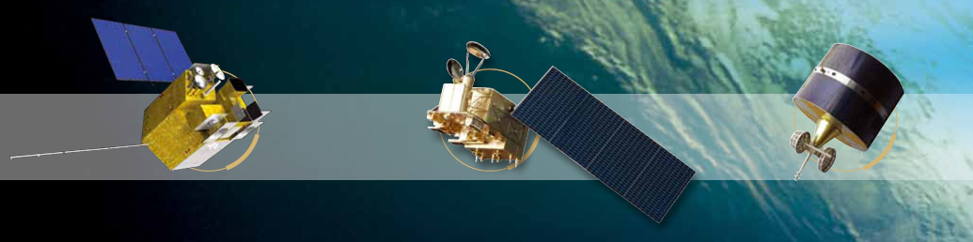

SPACE BASED ECVs
Current & Future Plans
Raj Kumar
Space Applications Centre, (ISRO)
Ahmedabad- 380015
rksharma@sac.isro.gov.in
CEOS/CGMS Working Group on Climate Meeting
CNES HQ, Paris, France, March 7-9, 2016

Slide 2

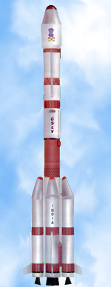

Indian EO Programme: Dimensions
Space Infrastructure
Launch vehicles (PSLV, GSLV)
Spacecrafts (LEO, GEO and beyond)
Sensors (optical/microwave)
Ground Segment
Data Acquisition and Processing
International Ground stations
Cal-Val Programme
TTC Network
Applications
Large number of applications towards national development
Advanced R&D for land-atmosphere-ocean interactions
Synergy between EO, Satellite Communication & Navigation
Institutionalization
National Natural Resources Management System (NNRMS)
Involvement of stake-holders from the planning level
State Remote Sensing Centres
International Cooperation
Bilateral and multilateral cooperation with various countries and international Organisations (CEOS, GEO, …..)
Capacity Building
Formal education through CSSTE-AP, IIRS, IITs….
On-the job training

Slide 3
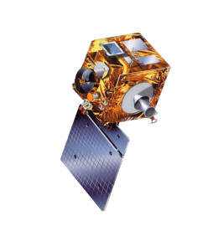
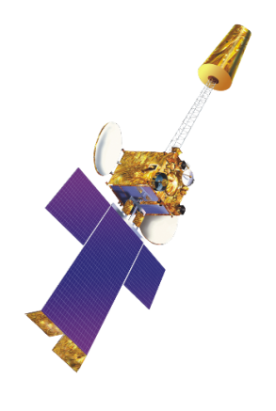
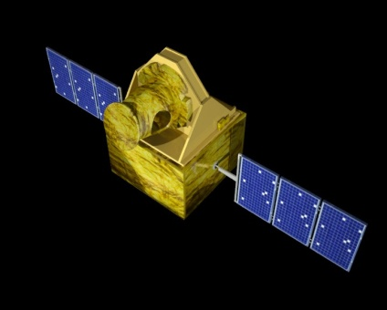
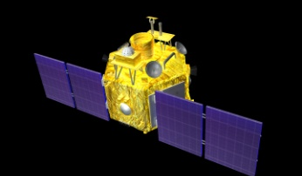
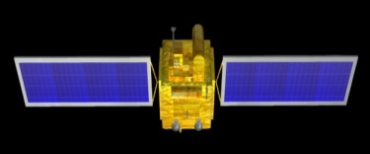
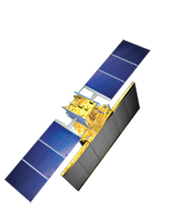
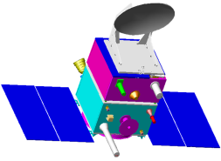
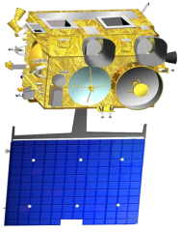
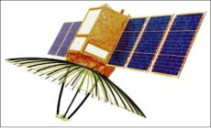
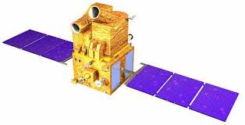
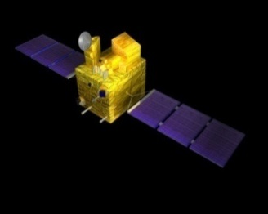
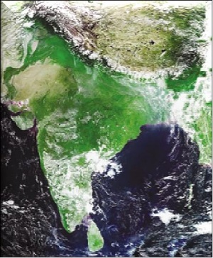
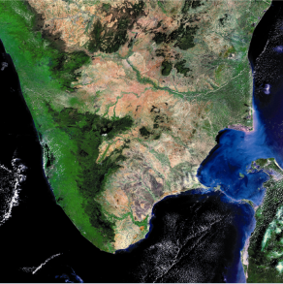
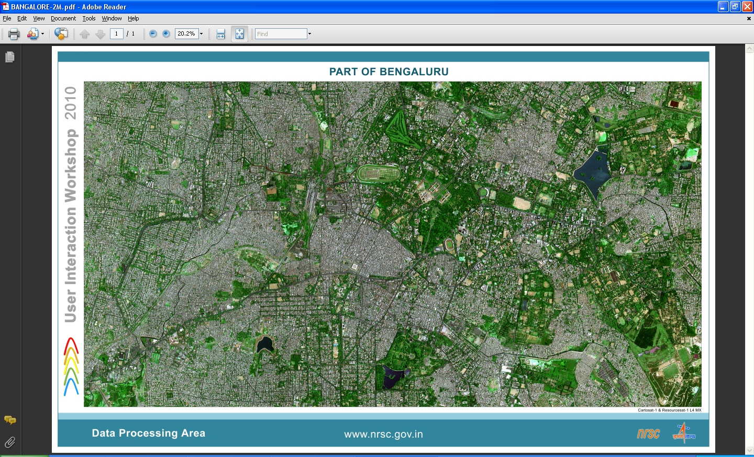
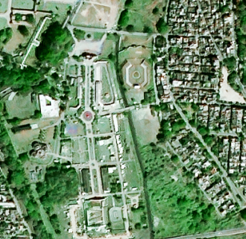
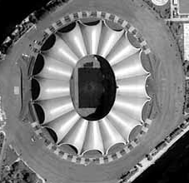
EARTH OBSERVATION SATELLITES
LAND & WATER
HIGH RESOLUTION
OCEAN
WEATHER; CLIMATE
RESOURCESAT-2
CARTOSAT-2; 2A; 2B
OCEANSAT-2
INSAT-3A
(2003)
(2011)
(2009)
KALPANA
(2007)
(2002)
RISAT-1
(2008)
(2010)
MEGHA-
TROPIQUES
SARAL
RISAT-2
CARTOSAT-1
(2013)
(2012)
(2009)
(2011)
INSAT-3D
(2005)
(2013)
1 KM
IMAGING CAPABILITY
0.8 M
Resourcesat-2A, SCATSAT-1, Cartosat 2C/2D/2E, Cartosat-3, Oceansat-3, INSAT-3DR, GISAT being added during 2015-17 for continuity of services and new capability.

Slide 4
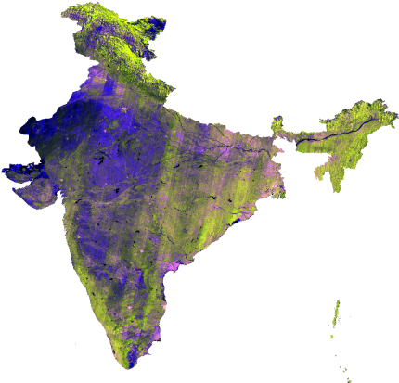
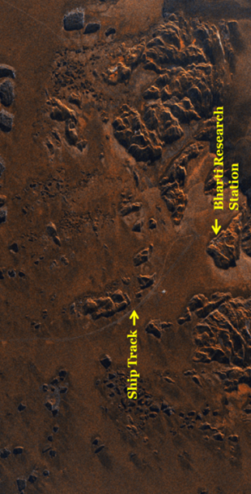
Indian Satellite Systems for Observing Climate Variables
Terrestrial
Satellites | Major Variables
IRS Series (IRS-1A/1B/P2/1C/P3/1D) Resourcesat-1/2, IMS-1 | Vegetation, Land Use, Coastal Zone, Glacier
Cartosat Series (Cartosat-1/2/2A/2B) | Urban Land Use, Urbanization
INSAT 2E/3A (CCD) | Vegetation
Oceansat-1/2 (MSMR, Scatt., OCM) | Ice/Snow, Vegetation
RISAT-1 | Soil Moisture, Vegetation
Resourcesat-2A | Vegetation, Land Use, Coastal Zone, Glacier
Cartosat Series 2C/2D/2E/3 | Land Use, Urbanization
GISAT-1/2 | Vegetation, Land Use, Coastal Zone, Glacier
NISAR | Snow Glacier, Vegetation

Slide 5
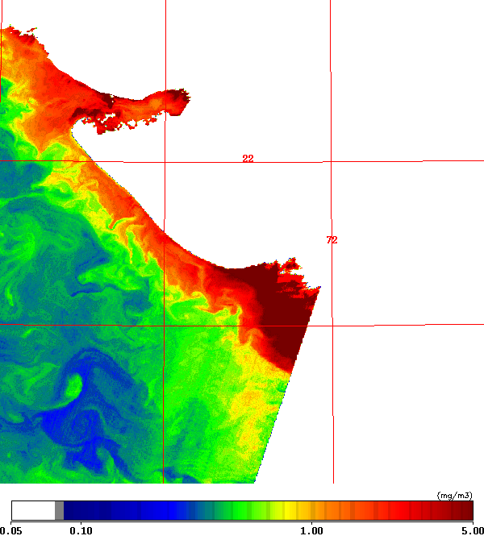
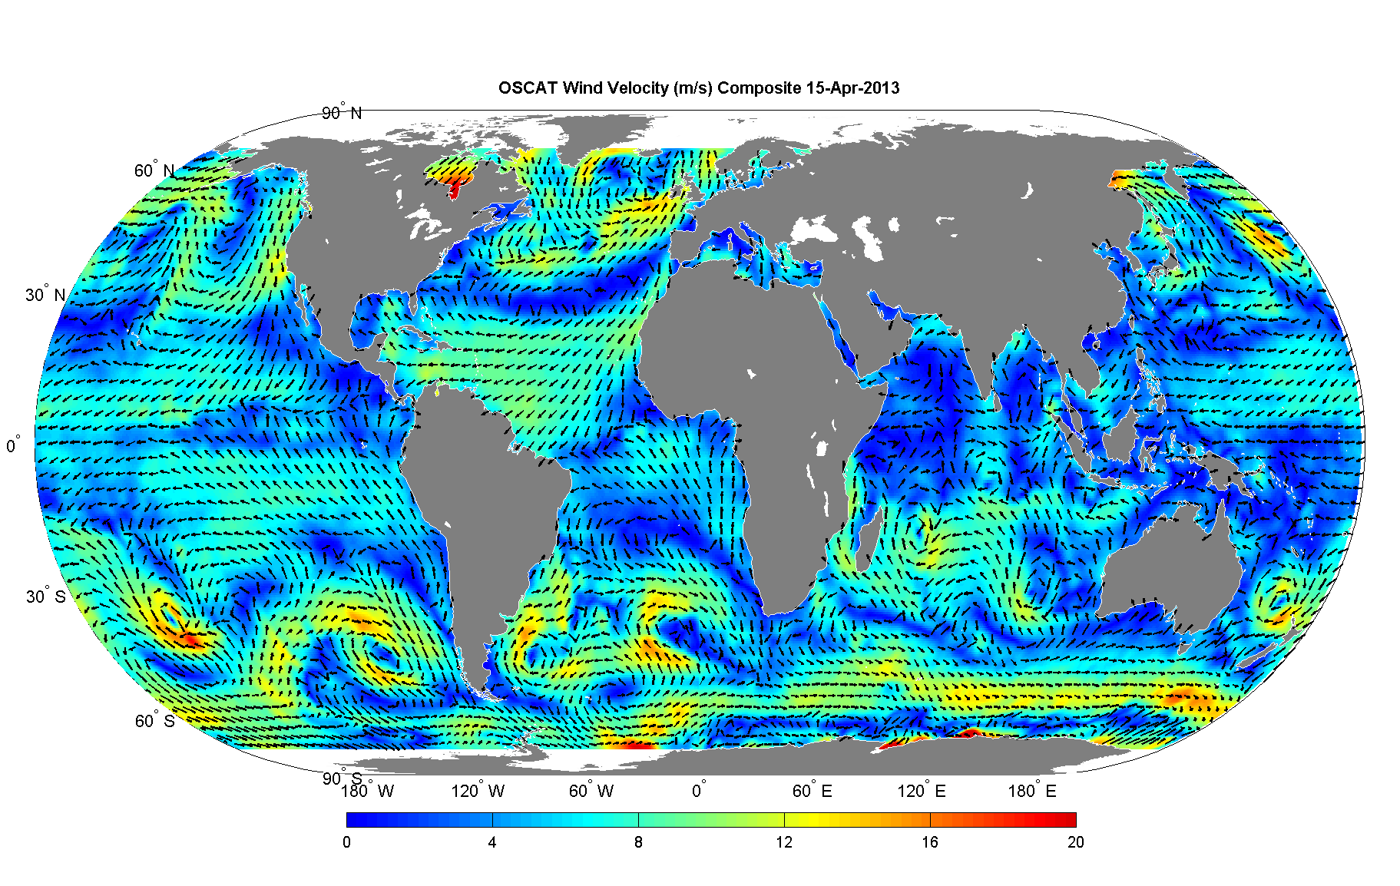
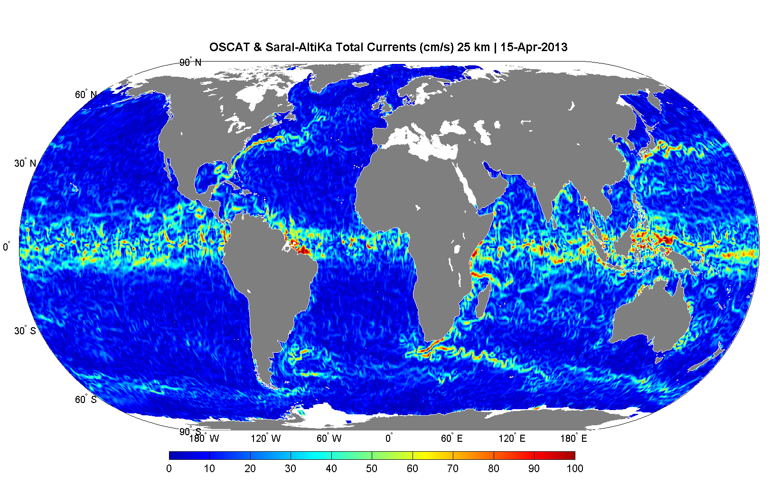
Indian Satellite System for Observing Climate Variables
Ocean
OCM - Chlorophyll-a
Satellite | Major Variables
IRS-P3 Oceansat-1 | Chlorophyll, Ocean Sediments (OCM), SST, Surface Winds (MSMR)
Oceansat-2 | Chlorophyll, Ocean Sediments (OCM-II), Surface wind (Scatterometer)
SARAL | Sea Surface Height
Megha-Tropiques | Sea Surface Wind, SST
INSAT-3D | Sea Surface Temperature
OCEANSAT-3 | Chlorophyll, Sea Surface Temperature Sea Surface Winds
SCATSAT-1 | Sea Surface Winds
INSAT-3DR/ DS | Sea Surface Temperature
Global Wind field -OSCAT
Global Current (OSCAT+Altika)

Slide 6
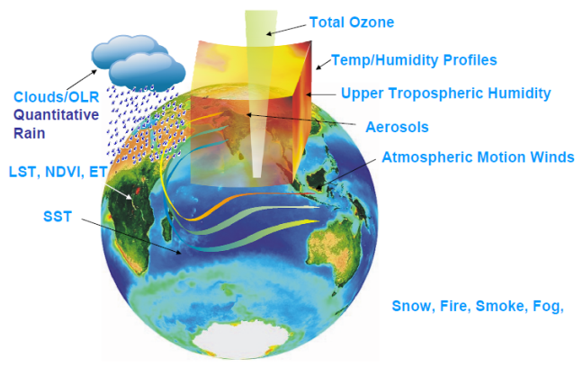
Indian Satellite System for Observing Climate Variables
Atmosphere
Satellite | Major Variables
Oceansat-1/ MSMR | Rain rate, Column Integrated Water Vapour, Cloud Liquid Water Content
INSAT Series | Cloud, Radiation
Oceansat-2 | Aerosols
KALPANA-1 | Cloud, Radiation, Upper Tropospheric Humidity
Megha-Tropiques | Radiation Budget, Water Vapor Profile, Integrated Water Content, Radio Occultation for Temperature and Humidity Profiles
INSAT-3D INSAT-3DR/ 3DS | Temperature & Humidity Profiles, Ozone, Clouds
INSAT-3D Sounder Product | Resolution
Temperature profile | 50 km x 50 km ( 5 x 5 pixels) 40-vertical pressure levels
Water vapour profile | 50 km x 50 km ( 5 x 5 pixels) 21-vertical pressure levels up to 100 hPa
Ozone profile | 50 km x 50 km ( 5 x 5 pixels) 40-vertical pressure levels
Total Column Ozone | 50 km x 50 km ( 5 x 5 pixels)
Surface skin temp. | 50 km x 50 km ( 5 x 5 pixels)
INSAT-3D Geophysical Products
Outgoing long wave radiation (OLR), Quantitative Precipitation Est. (QPE), Sea Surface Temperature (SST), Snow cover, Snow depth, Fire, Smoke, Aerosol, Cloud Motion Vector, Upper Tropospheric Humidity (UTH), Temperature & Humidity profiles, Total Ozone, Value added products from Sounder payload…

Slide 7
ISRO Current satellites for Earth Observations
YEAR...
00
01
02
03
04
05
06
07
08
09
10
11
12
13
14
15
16
17
18
19
20
21
22
23
24
25
26
27
28
29
30
GEO
KALPANA-1 (VHRR)
INSAT-3A (VHRR, CCD)
INSAT-3D (IMAGER & SOUNDER)
INSAT-3DR (IMAGER & SOUNDER)
INSAT-3DS (IMAGER & SOUNDER)
GISAT (MX-VNIR, HyS-VNIR, HyS-SWIR, MX-LWIR)
Atmosphere & Ocean
Oceansat-2 (OCM, SCAT, ROSA)
LEO
CNES-ISRO
MT (MADRAS, SAPHIR, ScaRaB, ROSA)
CNES-ISRO
SARAL (ALTIKA, ARGOS)
NEMO-AM (MADPI)
SCATSAT-1 (Scatterometer)
Oceansat-3 (OCM, LWIR, SCAT)
NASA-ISRO
NISAR
Land & Water
Resourcesat-2 (LISS-3/4, AWiFS)
RISAT-1 (C-SAR)
Resourcesat-2A (LISS-3/4, AWiFS)
Cartographic
CARTOSAT-1 (Stereo PAN)
CARTOSAT-2 (PAN)
CARTOSAT-2E (PAN)
CARTOSAT-3 (PAN)
YEAR...
00
01
02
03
04
05
06
07
08
09
10
11
12
13
14
15
16
17
18
19
20
21
22
23
24
25
26
27
28
29
30

Slide 8
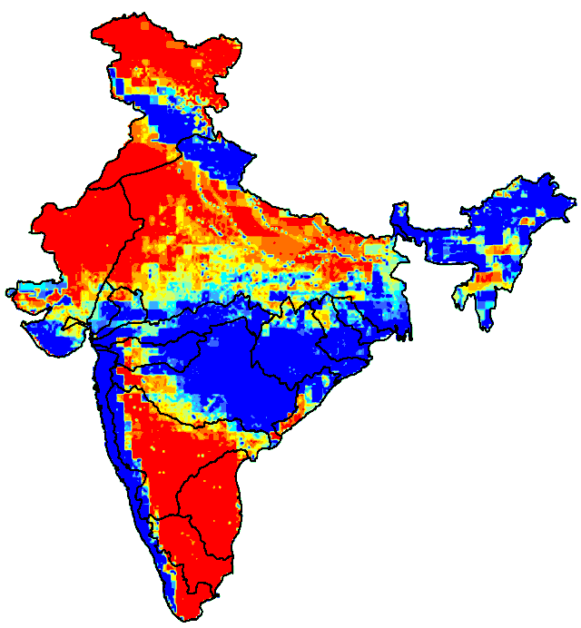
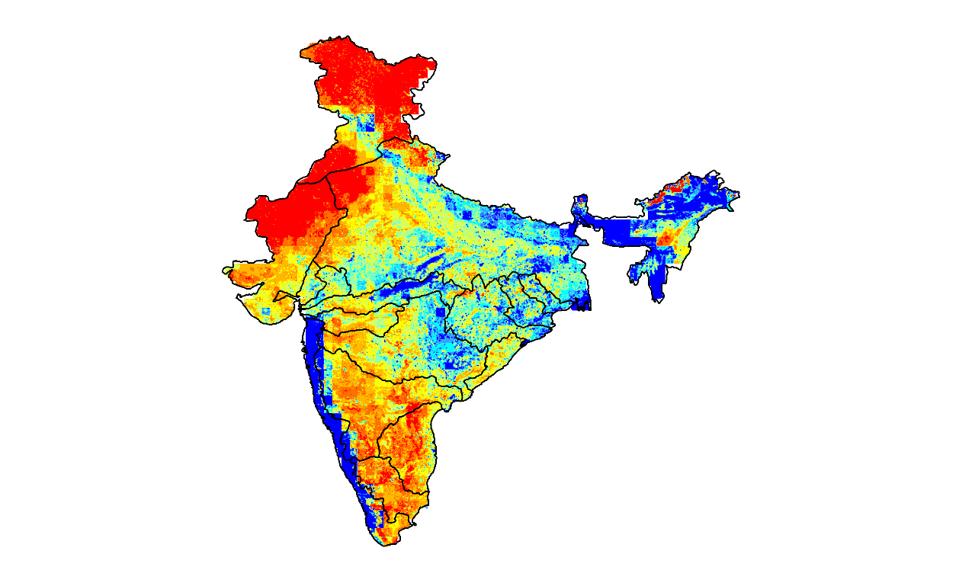
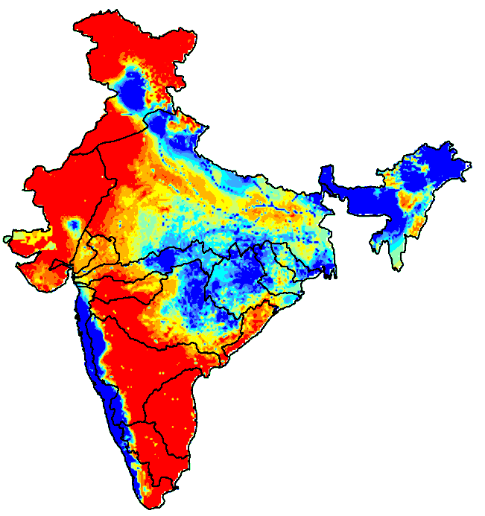
Runoff Modeling and Trend Analysis over Main Land of India
SATELLITE DERIVED INPUTS:
1. Land Use/ Cover (AWiFS)
2. Rainfall (IMD, IITM)
3. Topography (Cartosat-1)
4. NDVI (SPOT-VGT)
MODELING SCHEME:
Modified curve number model
Runoff, mm
Indus
River basin boundary
< 100
Mean = 471.9
Std. dev = 594.2
OTHER INPUTS:
Soil textures
Soil properties
101 - 175
176 - 250
Ganga
PROJECTED RUNOFF
(2071-2100: A2)
251 - 325
326 - 400
401 - 475
Godavari
476 - 550
551 - 625
Krishna
Reduction in rainfall based runoff water availability (14.3%) during 1951-1980 period to 1971-2005 whereas significant increase (18.4%) observed for future projections over India.
Western and south-eastern region runoff show increasing trend for future scenario.
Most of the river basins except Ganga and Cauvery show increase in runoff for future predictions.
626 - 700
Mean = 341.6
Std. dev = 469.5
> 700
Cauvery
RECENT PAST RUNOFF
(1971-2005)
Mean = 398.4
Std. dev = 545.8
ANALYSIS PERIOD:
May to October
NORMAL RUNOFF
(1951-1980)

Slide 9
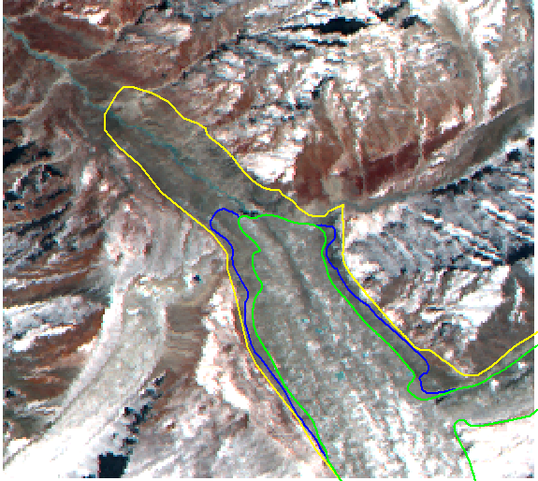
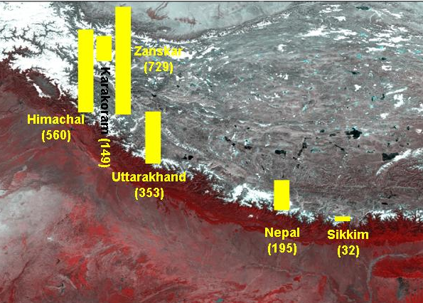
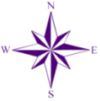
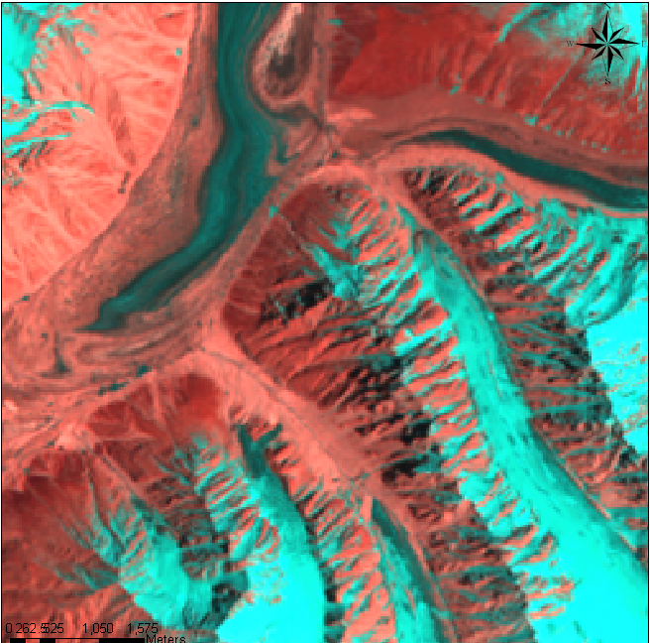
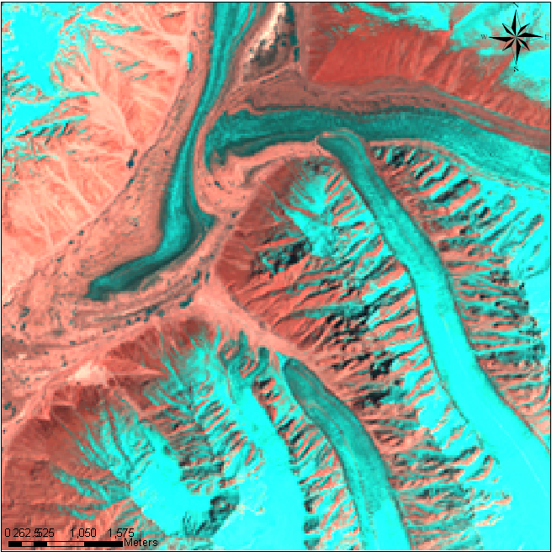
Monitoring of Himalayan Glaciers (2000 – 2011)
Gongotri Glacier
1962 BOUNDARY
BHAGIRATI RIVER
1999
BOUNDARY
SNOUT (GAUMUKH)
2006 BOUNDARY
IRS LISS-III SEP 2006
Advancing Glacier (Panamah Glacier, Karakoram Range)
Total 2018 glaciers
1752 shows no change,
248 Retreat & 18 Advance
87 % Stable, 12 % retreating 1% advance
2000
2011

Slide 10
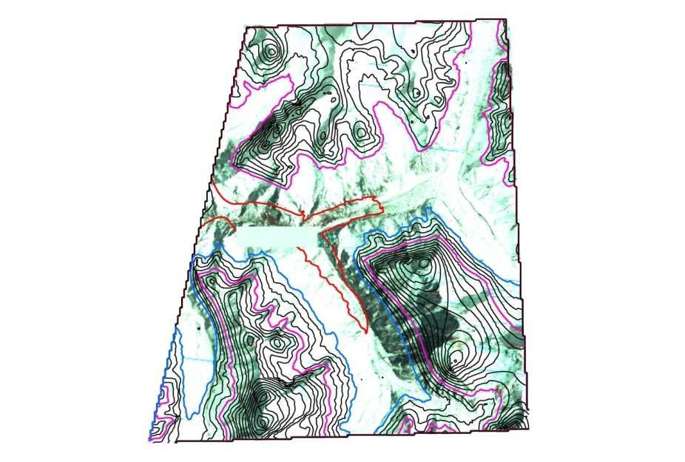
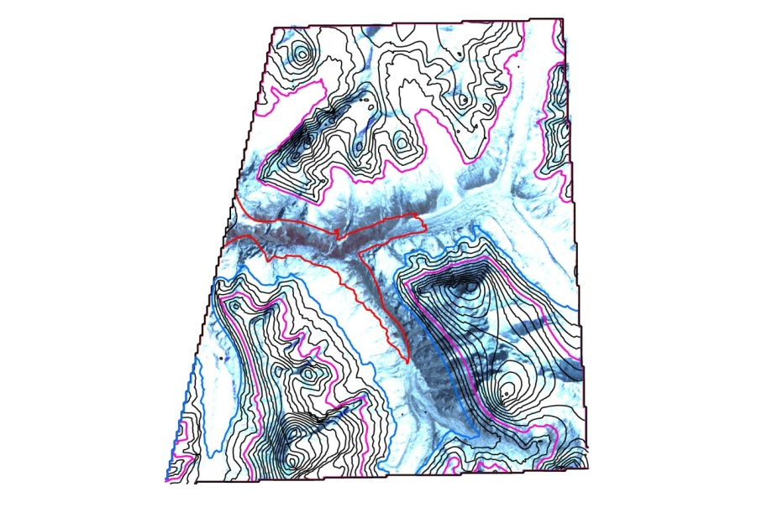
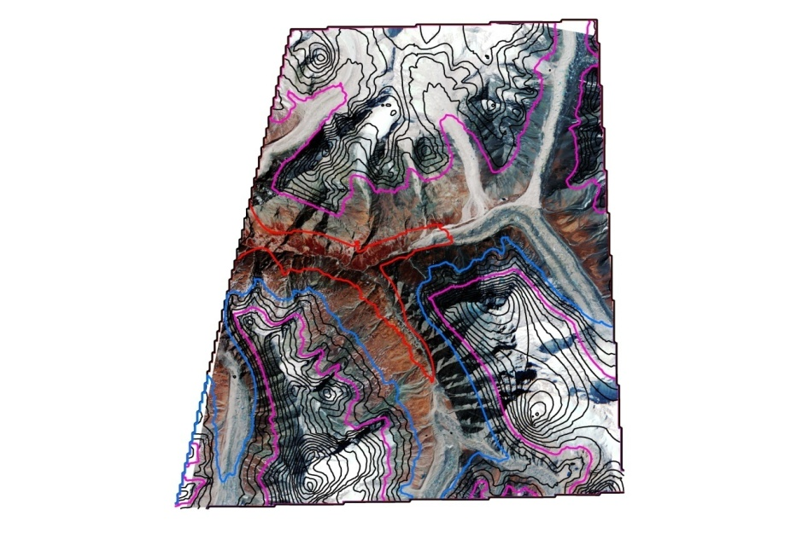
Vegetation Ingression in High Altitude Himalayan Ranges
LANDSAT TM
MARCH, 1986
IRS LISS III
MARCH, 1999
IRS LISSIV
MARCH, 2004
Tree line upward shift of 388 ± 80m in Uttarakhand has been reported during year 1970s–2006 in study conducted for Indian Himalaya using satellite remote sensing.
HIMADRI : HIMalayan Alpine Dynamics Research Initiative sites (20 summits & >1000 quadrates)

Slide 11
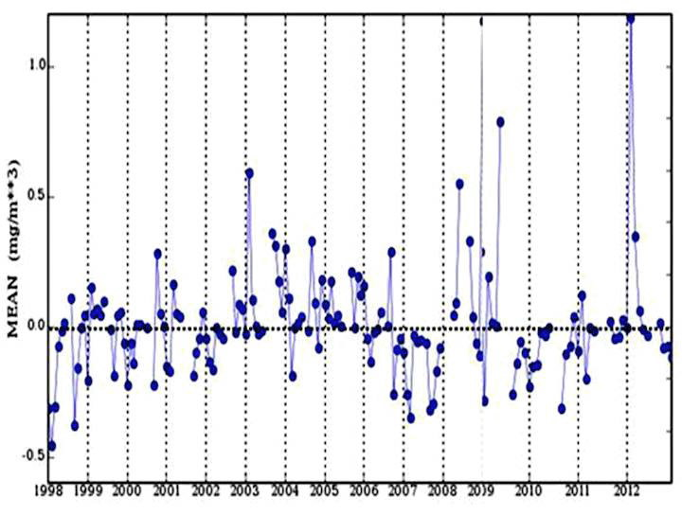
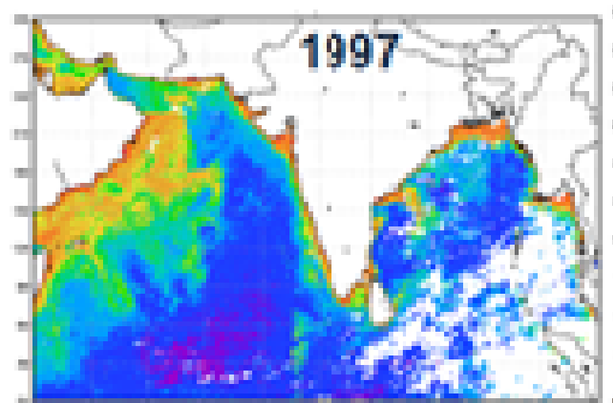
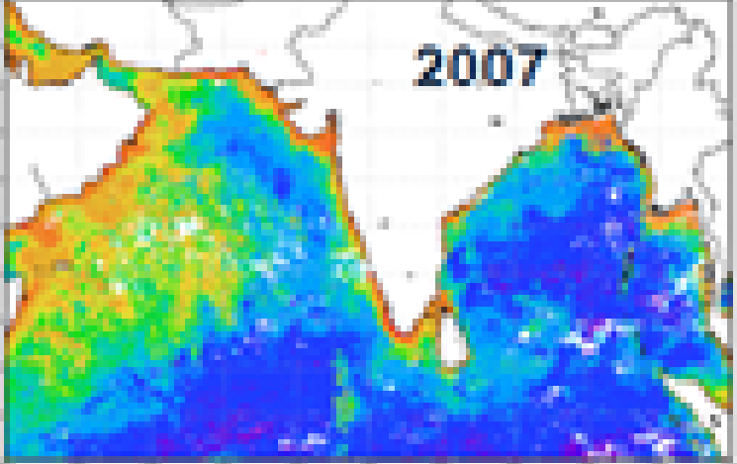
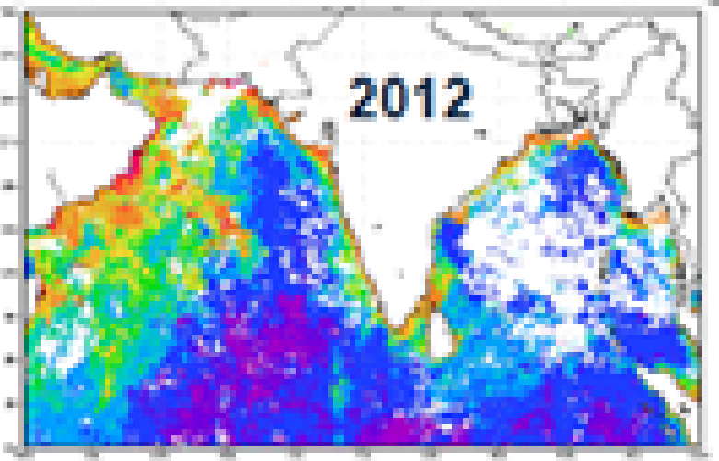

Chlorophyll-a variability in the Indian Ocean during 1997-2012
Chlorophyll: Increasing trend in west Arabian sea
Major Science Issues
How the ecosystem of Arabian Sea & Bay of Bengal is responding to increasing SST
How the fisheries will be affected due to changing ecosystems
OCEANSAT OCM & other international ocean colour data

Slide 12
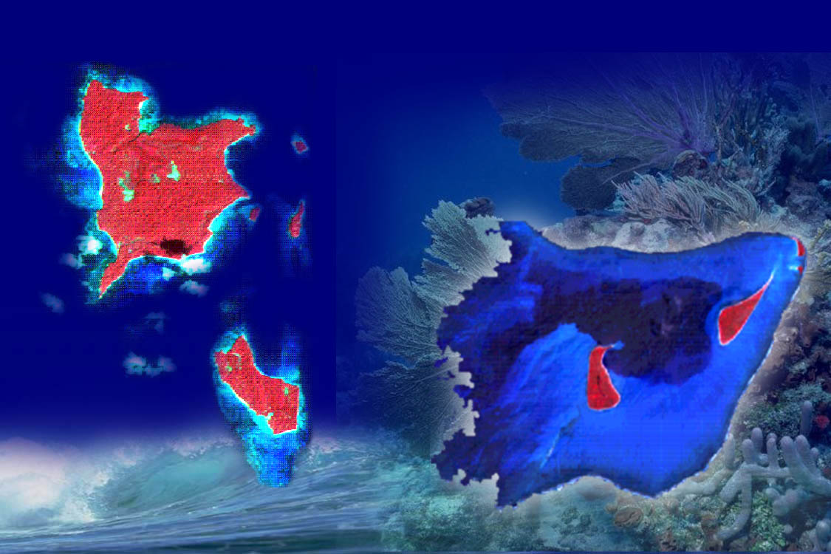
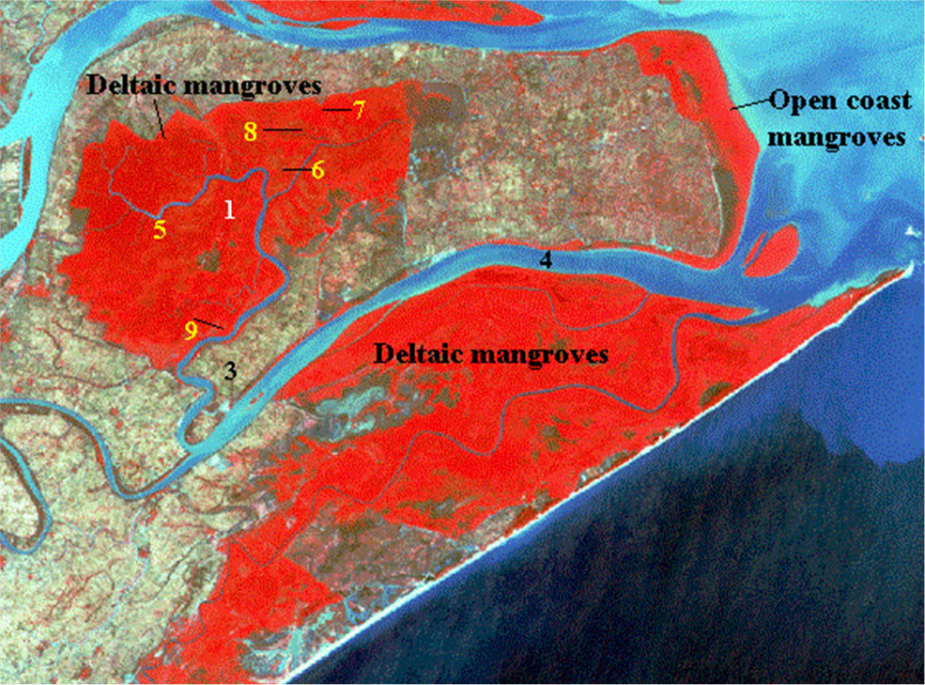
Coral Reef and Mangroves
Submerged
Live corals
Rocks
WANDOOR
A & N Islands
Mangrove area (km²) in different states
Lagoon
Coral Reef areas of the Indian coast have been mapped on 1:25, 000 scale using satellite data during 2004-07.
Notes:
Coral Reefs support more species per unit area than any other marine ecosystem. Coral reefs rival and surpass tropical rainforests in their biological diversity and complexity. This biodiversity may be a source of natural products derived from reef dwelling organisms. Many drugs are now under development from coral reef animals and plants. Coral reef ecosystems are considered to be a key source of natural compounds for new medicines for the 21st century.
Satellite data have been found to be very useful for mapping the extent and their ecological condition. Using high resolution satellite data, it was possible to map various component of the coral reef such as windward reef front, reef crest, reef flat, live corals zone, coral knolls, coral heads, reef patch, sanded habitat, sand cays, algae/sea grass, lagoon, etc. Small reefs and live coral zones as small as 100 and 5 ha have been mapped, respectively. Massive corals of only 50 sq m area along were identified and mapped on this small reef. The ecosystem diversity and species diversity inter-linkages in coral reefs are as follows:
Windward Reef front: Rich coral diversity zone
Outer Reef crest: Richest coral diversity and density zone. Massive corals forming large colonies occur in this zone.
Algal Ridge: Site of high Algal diversity
Moat: Rich in corals, algae and sea grass diversity
Aligned and Non-Aligned coral zone: Sites of soft and massive corals in shallow pools and seaward side.
Inner region has more of algae. Can have sand or mud depositions with dense algal and sea grass growth.
Lagoon: Highly diverse patch reefs and coral knolls
Sanded and muddy reef flat: Fleshy algae
Knolls: High species diversity and density. 70-80% live coral cover.

Slide 13
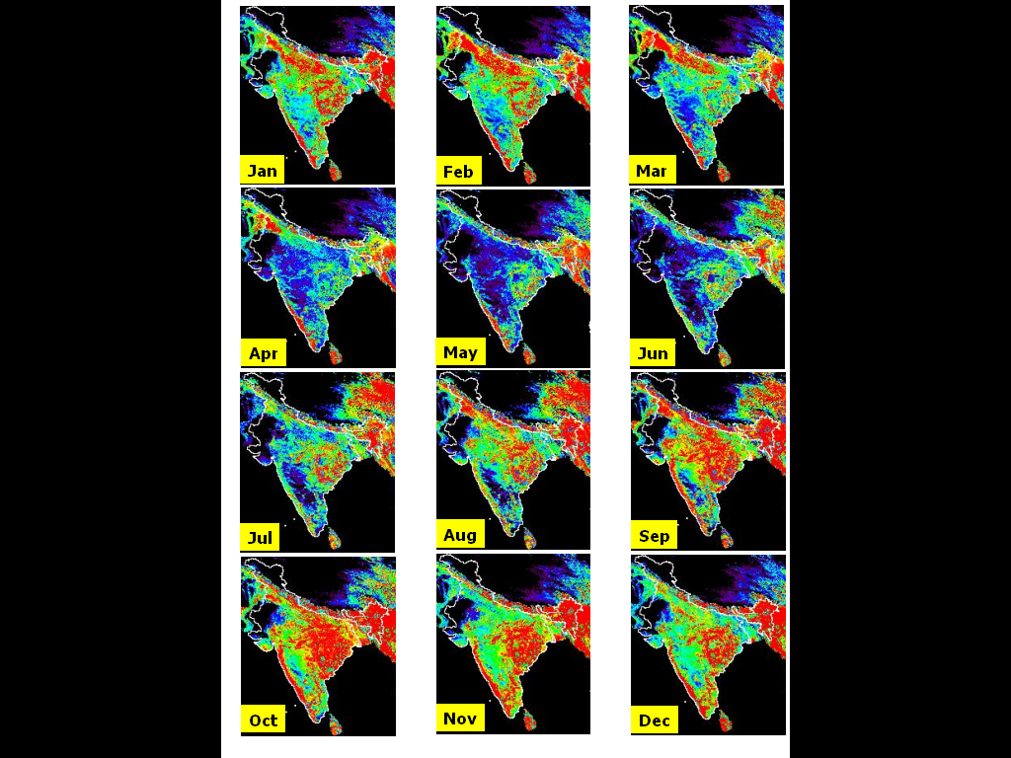
Long term changes in fAPAR using NOAA-AVHRR Data

Slide 14
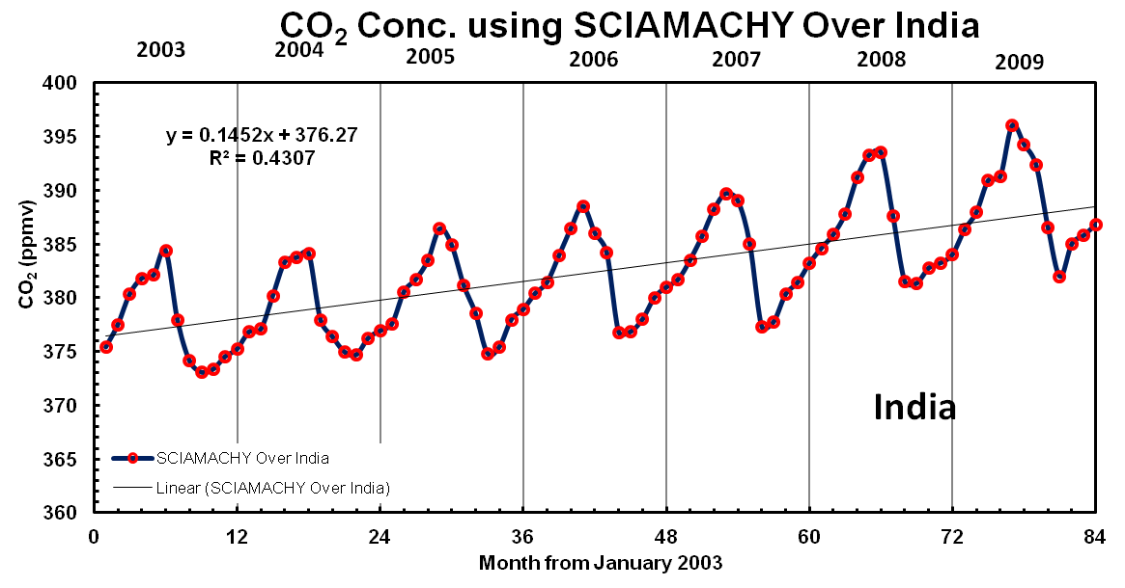
Increasing Trends in CO₂ Concentration
1.74 ppm/year
AIRS Data
SCIAMACHY
2.01 ppm/year
MOPITT Data
AIRS
( Prasad et al., 2014)

Slide 15
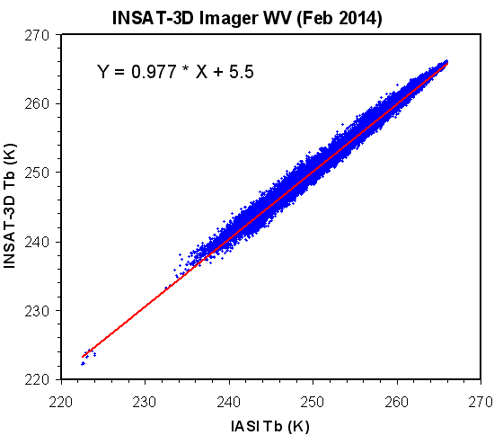
Global Space-based Inter-Calibration System (GSICS)
GSICS is an international collaborative effort initiated in 2005 by WMO & the Coordination Group for Meteorological Satellites (CGMS)
GSICS delivers calibration corrections needed for accurately integrating data from multiple observing systems
Ensures consistent observations for long-term monitoring, weather forecasting, and environmental applications.
GSICS-ISRO
  Inter-calibration of IR sensors onboard Indian geostationary satellites, Kalpana, INSAT-3A and INSAT-3D Imager/ Sounder using state-of-the-art hyperspectral sounding measurements from Metop-IASI, NPP-CrIS and Aqua-AIRS
GSICS members: CMA, CNES, EUMETSAT, ISRO, IMD, JAXA, JMA, KMA, NASA, NIST, NOAA, ROSHYDROMET, USGS, WMO

Slide 16
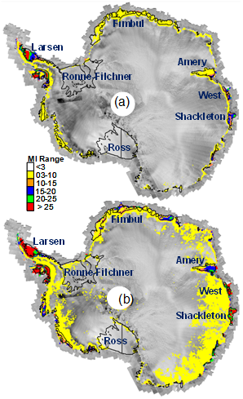
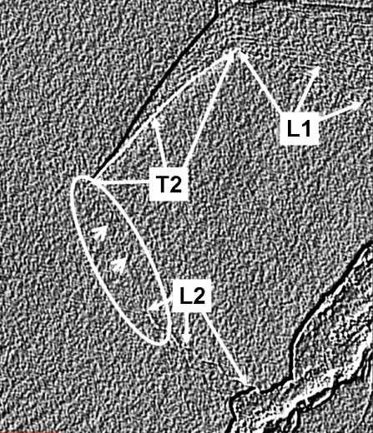
Impact of Atmospheric Warming
Induced Surface Melting on Rift Propagation
Decadal (1999-2010) Average MI
Impact of surface melting on rift propagation (Amery ice shelf)
Loose tooth (possible calving of large tabular iceberg)
2013
Interannual variations in melting index (SCAT based) and rate of rift propagation (from MODIS).
Consistent melting is observed over Larsen ice shelf (West Antarctica), Shackletone & West ice shelves (East Antarctica) – i.e. East Antarctica is also not immune from warming!
Amery- Higher maximum and lower average indicates episodic melting events
Loose tooth on Amery ice front is likely to get detached in near future when tips of L2 and T2 rifts intersects with each other (visible on processed RADARSAT data of 2013)
Study indicates the impact of surface melting on rift propagation for rifts with narrow widths
Decadal Maximum MI
Year-wise MI
QuikSCAT
OSCAT
Oza S. R., 2015. Spatial-temporal patterns of surface melting observed over Antarctic ice shelves using scatterometer data. Antarctic Science Antarctic Science, doi:10.1017/S0954102014000832

Slide 17
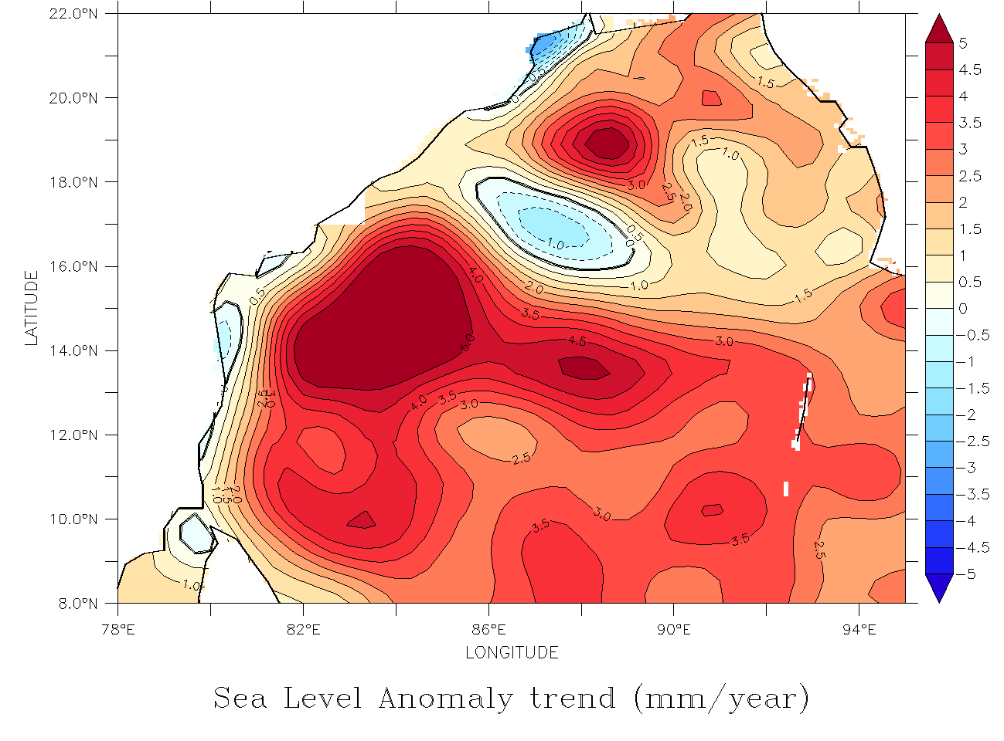
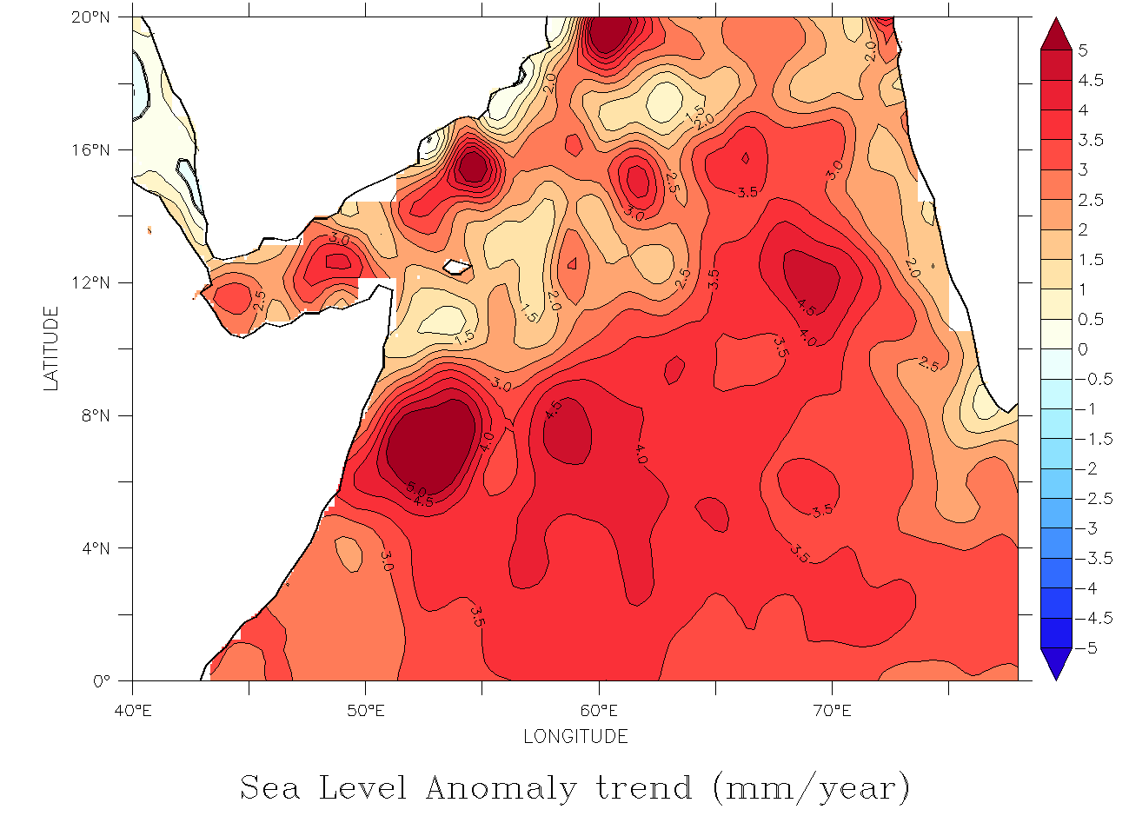
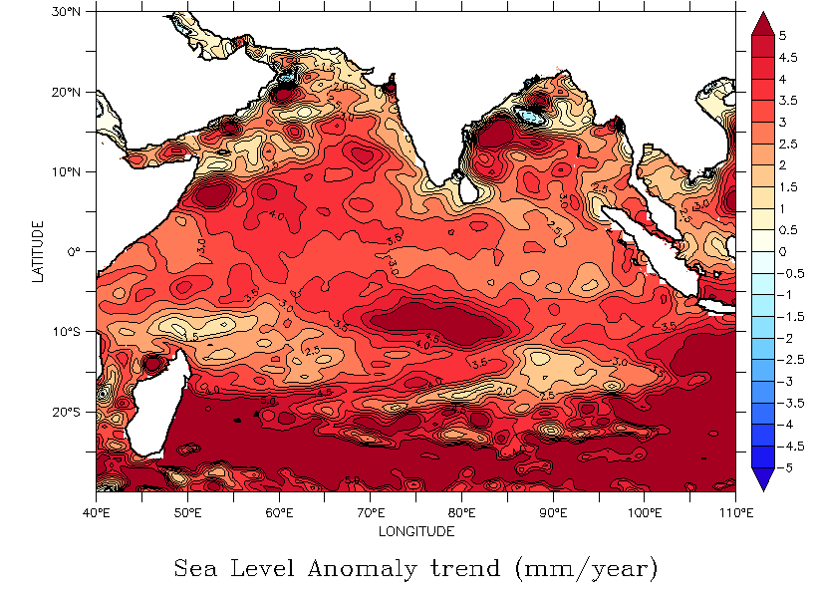
Sea Level Trends (mm/ year) from Altimeter during 1992-2012
Bay of Bengal
Arabian Sea
Indian Ocean
Overall trends in Bay of Bengal and AS are positive indicating rising sea level .
Coastal data not reliable due to contamination in altimeter measurements.
The average Indian Ocean SL trend is ~ 3 mm per year

Slide 18
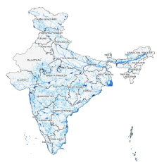




Derived products for Modeling & Applied research (NICES)
Products | Res. /Gridsize | Availability | Frequency
Atmospheric and Climate Sciences
Derived Tropospheric Ozone | 1° x 1° | 2010 – 2013 | Daily
Ocean Sciences
Daily Ocean Heat Content | 0.25° | 2002 - 2015 | Daily
Daily Tropical Cyclone Heat Potential | 0.25° | 1998 – 2015 | Daily
Model Derived Depth of 26°C Isotherm | 0.5° x 0.5° | 2013 - 2015 | Daily (15 days lag)
Model Derived TCHP | 0.5° x 0.5° | 2013 - 2015 | Daily (15 days lag)
Ocean Wind Curl | 0.5° x 0.5° | 2012 – 2014 (Feb) | Daily
Ocean Wind Stress | 0.5° x 0.5° | 2012 – 2014 (Feb) | Daily
Ocean Wind Velocity | 0.5° x 0.5° | 2012 – 2014 (Feb) | Daily
Terrestrial Sciences
AWiFS: Snow Cover Fraction | 3' X 3' Grid | 2014-2015 | 15 Days
AWiFS: Water Bodies Fraction | 3' X 3' Grid | 2004 – 2013, 2014-2015 | Monthly, 15 Days
Mesoscale compatible inputs for: MM5 | 30 sec, 2, 5 mins | 2004-05 to 12-13 (9 Cycles) | Yearly
Mesoscale compatible inputs for: WRF | 30 sec, 2, 5 mins | 2004-05 to 12-13 (9 Cycles) | Yearly
OCM2: Albedo | 1 Km | 2013 – 2014 | 15 Days
OCM2: NDVI - Global Coverage | 8 Km | 2013 | Monthly
OCM2: NDVI - Local Coverage | 1 Km | 2011, 2012-2014 | Monthly, 15 Days
OCM2: Vegetation Fraction | 1 Km | 2011, 2012-2014 | Monthly, 15 Days
Snow Melt and Freeze | 2.225 Km | 2009 – 2013 | 2 Day
Surface Soil Moisture | 0.25° x 0.25° | 2012 – 2014 | Daily
Surface Soil Moisture - 2 Day | 0.25° x 0.25° | 2012 – 2014 | 2 Day

Slide 19


Slide 20


Slide 21







The Way Forward
Continuity and improvement of operational constellations
Sustained observation of ALL Essential Climate Variables (ECVs) observable from space
Calibration/validation sites and global cooperation for inter comparison of satellite observations

