Slide 1
6th Meeting of Joint CEOS/CGMS Working Group on Climate (WGClimate) (Mar 7, 2016)
KMA Implementation Plan
For Climate products
Jinho Shin, Na-Yeon Park, Sang Jin Lyu
National Meteorological Satellite Center
Korea Meteorological Administration
jshin0@korea.kr

Slide 2
Outline
Introduction : Current & Future KMA GEO Satellite
1.1 Current satellite products
1.2 Product validation & Quality monitoring
1.3 Future GEO-KOMPSAT-2A
Implementation plan of KMA
Evaluation of effect of GSICS Correction
3.1 GSICS correction results
3.2 SST, INS improvements
Summary and Plan

Slide 3
1. Introduction : Current GEO Satellite(COMS)

Slide 4
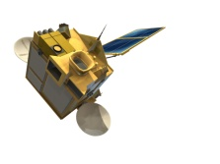
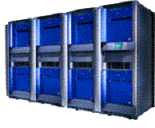
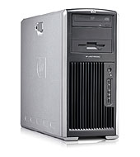
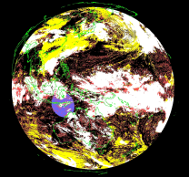
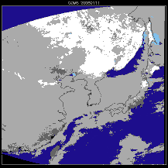
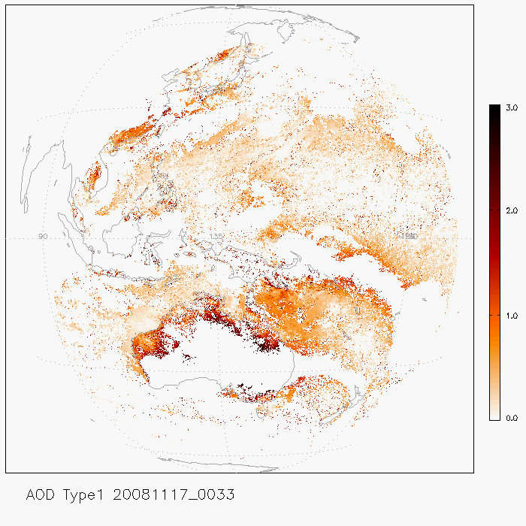
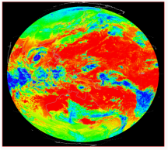
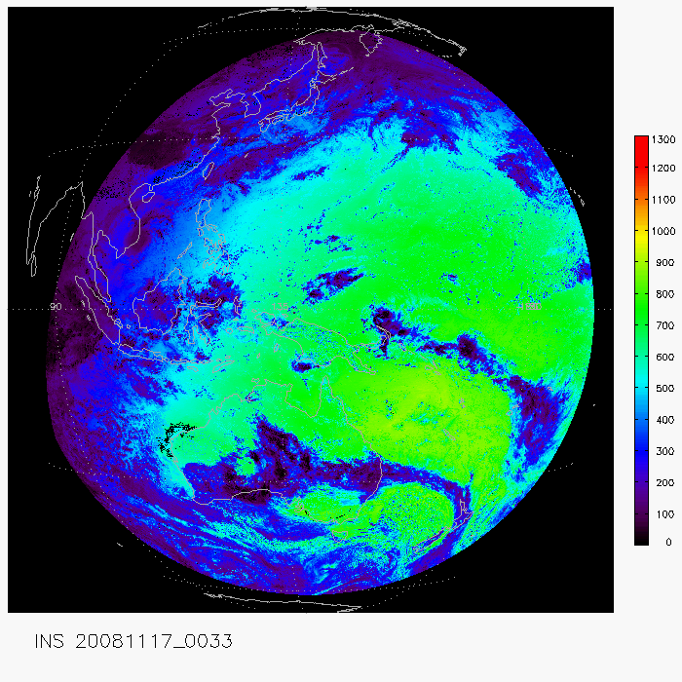
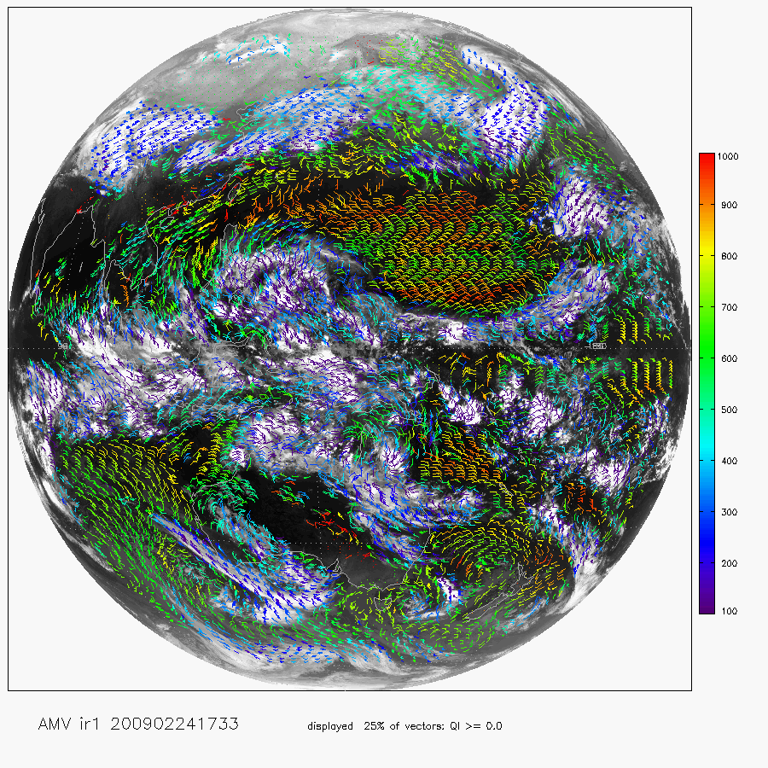
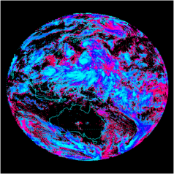
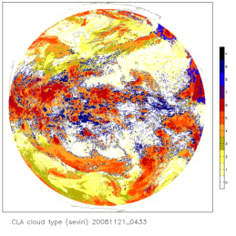
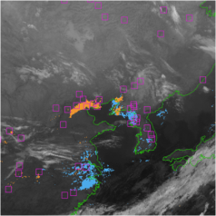
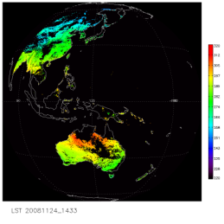
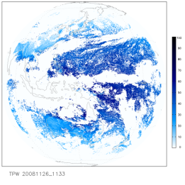
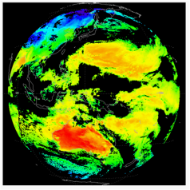
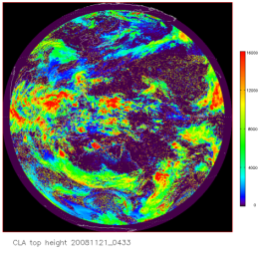
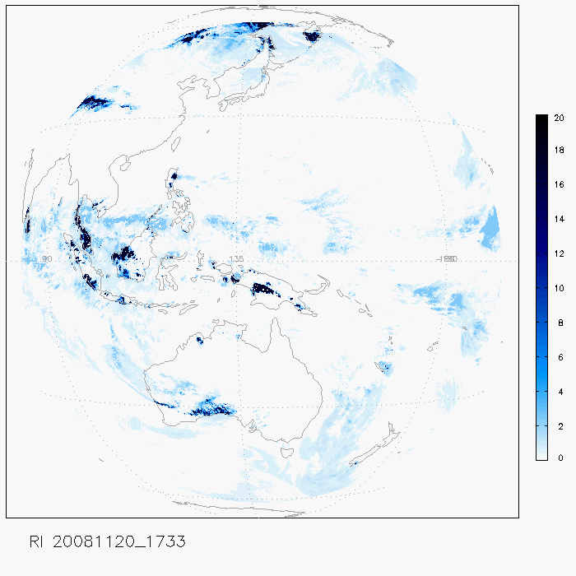
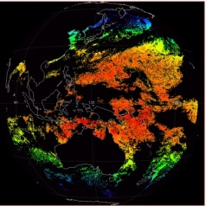
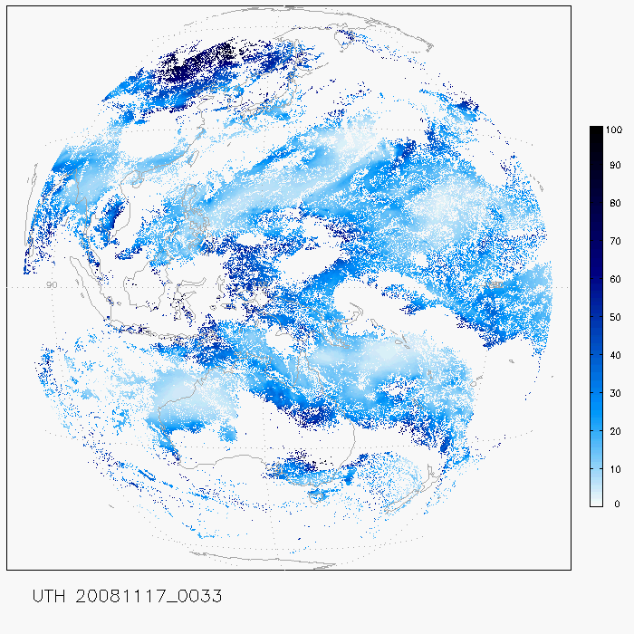
1.1 Introduction : COMS Products
Ancillary data
NMSC/KMA
Level 1B
Image Processing
Archiving &
Distribution
Validation
Preprocessing System
CMDPS
CMDPS(16)
□ confidently cloudy
■ cloudy
■ probably cloudy
■ probably clear
■ confident clear
CLD
SSI
AI/AOD
OLR
INS
Cloudy sky
Clear sky
AMV
CLA
Fog
LST
TPW
CSR
CTTP
RI
SST
UTH

Slide 5
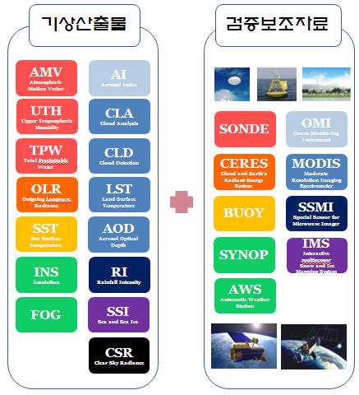
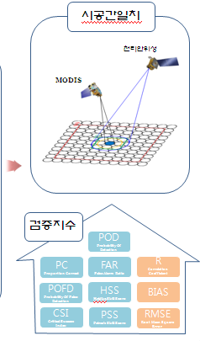
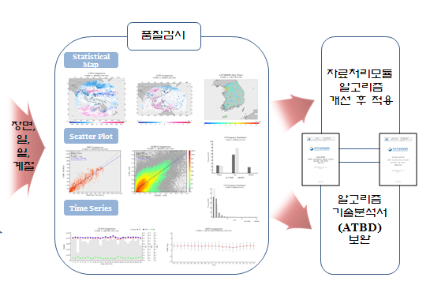
1.2 Product Validation & Quality Monitoring -
Product
Observation data
Collocation
COMS
Quality monitoring
MODIS
Algorithm Improvement
Daily Monthly
Seasonal
Statistical index
Algorithm Theoretical Basis Document

Slide 6
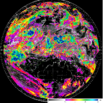
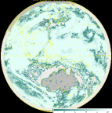
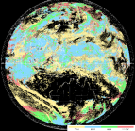
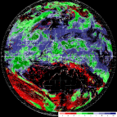
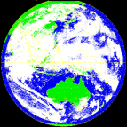
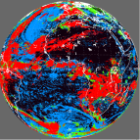
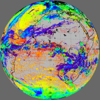
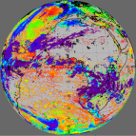
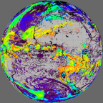
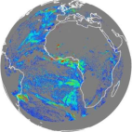
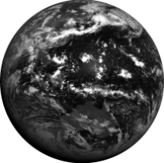
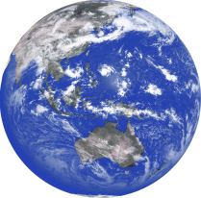
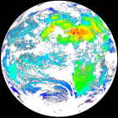
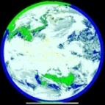
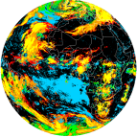
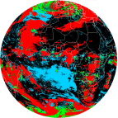
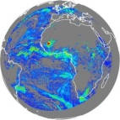
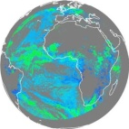
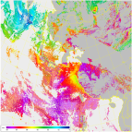
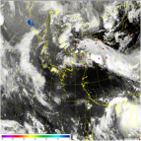
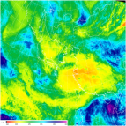
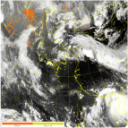
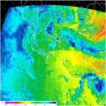
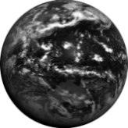
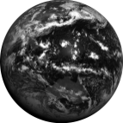
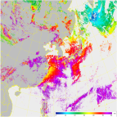
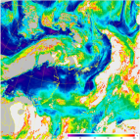
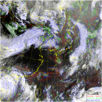
COMS MI vs. GEO-KOMPSAT-2A (AMI)
4 times spatial resolution
3 times number of channels
3.5 times number of products
COMS
Geo-KOMPSAT-2A
COMS
Geo-KOMPSAT-2A
COMS
VI 1km
IR 4km
Geo-KOMPSAT-2A
VI 0.5~1km
IR 2km
1 channel
(achromatic)
4 channels
(color)
Cloud/Precipitation (5→19)
VI
4 times tempral resolution
Radiation/aerosol (5→16)
1 Hr
2 channels
SWIR
O
1 FD
4 FD
Atmospheric Motion/Conditions(3→6)
4 channels
10 channels
2 NH
10 NH
Surface information(3→11)
IR
…....
4 Korea
Every 2 min Korea
5 channels
16 channels
16 products
52 products

Slide 7
2. Implementation Plan of KMA
PESK
Algorithms: In operation
Similar algorithms with other
GEO satellites
Similar input data with other
GEO satellites
To participate immediately for SCOPE-CM
· Sea Surface Temperatrue
· Outgoing Longwave Radiation
· Insolation
SESK
Algorithm:
In development (Albedo)
Improvement needed
(Precipitation, Cloud fraction)
Different algorithms and inputs
with other GEO satellites
To participate prospectively for SCOPE-CM after GK-2a launch
· Albedo
· Precipitation
· Cloud fraction

Slide 8
PESK Implementation Plan, KMA
Primary ECVs for SCOPE-CM of KMA(PESK)
Parameters | Sea Surface Temperature Outgoing Longwave Radiation Insolation
Step-1 ( ~2017) Action Items | Step 1-1 (3 years) | GSICS→FCDRs→TCDRs continuous generating Evaluation of effect of GSICS correction QC./QA, algorithm improvement
 | Step 1-2 (3 years) | Inter-satellite comparison of products EUMETSAT-KMA operating collaboration Preparation for GeoKompsat-2a / Future Korean LEO satellite
Step-2 (2018~ ) Action Items | Obtaining consistency and continuity between COMS and GeoKompsat-2a TCDRs Continuous improvement of TCDRs Continuous collaboration with SCOPE-CM working group
Parameters | SST |  | OLR | INS
Accuracy (objective) | 0.5 –0.8 ℃ |  | 10 W/m² | 70-100 W/m²
Spatial Resolution | 1-5 km² |  | 15 km² | 15 km²
Temporal Resolution | 2 daily |  | daily | daily

Slide 9
SESK Implementation Plan, KMA
Secondary ECVs for SCOPE-CM of KMA(SESK)
Parameters | Albedo Precipitation Cloud Fraction
Step-1 ( ~2017) Action Items | Preparation for GeoKompsat-2a / Future Korean LEO satellite Algorithm development
Step-2 (2018~ ) Action Items | GSICS→FCDRs continuous generating FCDRs→TCDRs generating Evaluation of effect of GSICS correction QC./QA, algorithm improvement Inter-satellite comparison of products Obtaining consistency and continuity between COMS and GeoKompsat-2a TCDRs Continuous collaboration with SCOPE-CM working group
Parameters | Albedo | Precipitation | Cloud fraction
Accuracy (objective) | Albedo>0.15 : 10~20% Albedo<0.15 : 0.015~0.15 | 40-80% (> 10mm/h) | 10~20%
Spatial Resolution | 15 km² | 8 km² | 4 km²
Temporal Resolution | daily | daily | daily

Slide 10
3. GSICS Processing Results – (IR channels)
IR1 channel
IR2 channel
SWIR channel
WV channel
2012
2012
2012
2012
2013
2013
2013
2013

Slide 11
3. GSICS Processing Results – (VIS channels)

Slide 12
Improvement of SST after GSICS Correction
Data: 01/04/2011~31/03/2012
COMS SST: using COMS L1b
Spring
Summer
Autumn
Winter
NEW SST: after GSICS correction

Slide 13
Improvement of SST after GSICS Correction
2011, April, July
2011.04 (after)
2011.04 (before)
2011.07 (before)
2011.07 (after)

Slide 14
Improvement of SST after GSICS Correction
Monthly GSICS Daytime SST
Monthly GSICS Nighttime SST
2011.4~2012.3
2011.4~2012.3
2011.04~2012.03 |  | Daytime | Nighttime
Before | RMSE (W/m²) | 0.8928 | 0.8182
 | Bias (W/m²) | 0.5377 | 0.0928
After | RMSE (W/m²) | 0.6851 | 0.8075
 | Bias (W/m²) | 0.0627 | 0.0208
Before Correction
Before Correction
Target Area: 0-45°N, 105-160°E
Data: COMS/MI IR data,
GTS buoy SST data
After Correction
After Correction

Slide 15
Improvement of Insolation after GSICS Correction
Data: 01/04/2012~31/03/2013
COMS
INS
RMSE : 95.5762
Bias : 6.4493
ALL Sky
RMSE : 90.8045
Bias : 16.2023
Cloudy Sky
Partially Cld.
2011.04~2012.03 |  | All | Cloudy | Partially
Original | RMSE (W/m²) | 95.576 | 90.806 | 103.952
 | Bias (W/m²) | 6.449 | 16.202 | -3.527
After GSICS Correction | RMSE (W/m²) | 95.772 | 89.677 | 106.137
 | Bias (W/m²) | 2.523 | 2.102 | -1.016
after
GSICS
Correction
RMSE : 95.772
Bias : 2.523
RMSE : 89.677
Bias : 2.102
RMSE : 106.137
Bias : -1.016

Slide 16
4. Summary
1
1
SST accuracy was improved after GCIS correction
2
2
Insolation estimation bias was improved after GSICS correction without new cloud factor generation
3
3
Resulted positive effect of GSICS-based FCDRs toward TCDRs
4
4
These positive effect of GSICS should be continuously monitored.

Slide 17
Thank you

Slide 18
1.3 GEO-KOMPSAT-2A
Development of GEO-KOMSAT-2A : - launch in 2018 - 16 channels : 4 visible, 2 near-infrared and 10 infrared channels - 52 meteorological products : Cloud, Precipitation, AMV, Aerosol, Land surface
- Continuous monitoring of meteorological phenomena through the succession of COMS mission
- Development of Advanced MI(AMI) and Space Weather Sensor
Mission
- Continuing the COMS Meteorological Mission
- Improving the Severe Weather Monitoring
- Improving the support of the NWP model
- Intensifying the environment & climate monitoring
· Various surface information retrieval
· Establishing long-term observation data

Slide 19
2. Implementation Plan of KMA
Timeframe | …. | 2012 | 2013 | 2014 | 2015 | 2016 | 2017 | 2018 | 2019 | 2020 | ….
Plan of SCOPE-CM | Phase Ⅰ | Phase Ⅱ |  |  | Phase Ⅲ
Satellite
KMA Step
 |  | : COMS Generation -Selected ECVs generating (GSICS-based) - Preparation for GeoKompsat-2a |  |  |  |  |  | : GeoKompsat-2a Generation - Selected ECVs generating - Continuous management - Selection and generating of supplementary ECVs
COMS
GeoKompsat-2A
Step-1
Step-2
Primary ECVs for SCOPE-CM of KMA (PESK)
KMA’s ECVs to participate immediately for SCOPE-CM
Secondary ECVs for SCOPE-CM of KMA (SESK)
KMA’s ECVs to participate prospectively for SCOPE-CM after GK-2a launch

Slide 20
Validation data
Buoy SST data
Pyranometer data
Area : 0-45°N, 105-160°E
Period : 2011.4.1.~2013.3.31.
Area : 30-40°N, 120-130°E, 37 stations
Period : 2011.4.1.~2013.3.31.

Slide 21
GEO-KOMPSAT-2A payload
 | MI(COMS) |  | AMI(GEO-KOMPSAT-2A)
Channels | 5 |  | 16
Spatial resolution(km) | 1/4(VIS/IR) |  | 0.5,1/2(VIS/IR)
True color image | X |  | O
Temporal resolution(min) | 25(Full Disk) |  | 10(Full Disk)
Products | 16 |  | 52
Data rates(Mbps) | 2.6 |  | ~70
Design life(year) | 7 |  | 10
Utilization | Weather forecasting |  | + NWP + Climate model
Loaded satellites | U.S.A. | GOES-8~15 | GOES-R(ABI) | 2015
 | Japan | MTSAT-2 | Himawari-8/9(AHI) | 2014/2016

Slide 22
GEO-KOMPSAT-2A payload
16 channels
FPM | Band name | AMI(Geo-KOMPSAT-2A) |  | ABI(GOES-R) |  | AHI(Himawari-8/9) |  | MI (COMS)
 |  | Center Wavelength (µm) | Resolution (km) | Center Wavelength (µm) | Resolution (km) | Center Wavelength (µm) | Resolution (km) | Center Wavelength (µm) | Resolution (km)
VNIR | VIS0.4 | 0.47 | 1 | 0.47 | 1 | 0.46 | 1
 | VIS0.5 | 0.51 | 1 |  |  | 0.51 | 1
 | VIS0.6 | 0.64 | 0.5 | 0.64 | 0.5 | 0.64 | 0.5 | 0.675 | 2
 | VIS0.8 | 0.856 | 1 | 0.865 | 1 | 0.86 | 1
 | NIR1.3 | 1.378 | 2 | 1.378 | 2
 | NIR1.6 | 1.61 | 2 | 1.61 | 1 | 1.6 | 2
 | NIR2.2 |  |  | 2.25 | 2 | 2.3 | 2
MWIR | IR3.8 | 3.9 | 2 | 3.9 | 2 | 3.9 | 2 | 3.75 | 4
 | IR6.3 | 6.185 | 2 | 6.185 | 2 | 6.2 | 2
 | IR6.9 | 6.95 | 2 | 6.95 | 2 | 7.0 | 2 | 6.75 | 4
 | IR7.3 | 7.34 | 2 | 7.34 | 2 | 7.3 | 2
 | IR8.7 | 8.5 | 2 | 8.5 | 2 | 8.6 | 2
LWIR | IR9.6 | 9.61 | 2 | 9.61 | 2 | 9.6 | 2
 | IR10.5 | 10.35 | 2 | 10.35 | 2 | 10.4 | 2 | 10.8 | 4
 | IR11.2 | 11.2 | 2 | 11.2 | 2 | 11.2 | 2
 | IR12.3 | 12.3 | 2 | 12.3 | 2 | 12.3 | 2 | 12.0 | 4
 | IR13.3 | 13.3 | 2 | 13.3 | 2 | 13.3 | 2

Slide 23
 | No. | Products |  | No. | Products
cloud/ rainfall | 1 | Cloud detection | radiation/ Aerosol | 27 | Visibility
 | 2 | Cloud Top Temperature |  | 28 | O3 total
 | 3 | Cloud Top Pressure |  | 29 | Radiances
 | 4 | Cloud Top Height |  | 30 | Upward Shortwave Radiation(TOA)
 | 5 | Cloud type |  | 31 | Downward Shortwave Radiation(Surface)
 | 6 | Cloud phase |  | 32 | Absorbed Shortwave Radiation(Surface)
 | 7 | Cloud Amount |  | 33 | Downward Longwave Radiation(Surface)
 | 8 | Cloud Optical Depth |  | 34 | Upward Longwave Radiation(Surface)
 | 9 | Cloud Particle Size Distribution |  | 35 | Upward Longwave Radiation(TOA)
 | 10 | Cloud Liquid Water | ATM motion/ condition | 36 | Atmospheric Motion Vector
 | 11 | Cloud Ice Water Path |  | 37 | Vertical Temp. Profile
 | 12 | Cloud Layers/Heights |  | 38 | Vertical Moisture Profile
 | 13 | Fog |  | 39 | Derived Stability Indices
 | 14 | In-flight icing |  |  | Total Precipitable Water
 |  |  |  | 40 | Atmospheric Motion Vector
 | 15 | Convection initiation |  | 41 | Tropopause folding turbulent flow
 | 16 | overshooting top/enhanced thermal couplet detection | surface | 42 | Sea Surface Temperature
 | 17 | Rainfall Intensity |  | 43 | Land Surface Temperature
 | 18 | probability of rainfall |  | 44 | Fire/Hot Spot Characteristic
 | 19 | rainfall potential |  | 45 | Vegetation Index
radiation/ aerosol | 20 | Aerosol detection |  | 46 | Vegetation Fraction: Green
 | 21 | Asian dust detection |  | 47 | Surface Emissivity
 | 22 | Volcanic Ash: Detection and Height |  | 48 | Surface Albedo
 | 23 | SO2 Detection |  | 49 | Snow Cover
 | 24 | Aerosol Optical Depth |  | 50 | Snow Depth
 | 25 | Asian dust Optical Depth |  | 51 | Ice Cover
 | 26 | Aerosol Particle Size |  | 52 | Current
Development & utilization
of GK-2A data
Schedule of meteorological data processing system

Slide 24
Climate monitoring using LEO satellites
Sea ice
Concentration, Small-scale roughness and refractive index of sea ice surfaces (June. 2011) using AQUA/AMSR-E data
Hong and Shin, 2010 (J. Climate)
Hong, 2010 (Rem. Sens. Environ.)

Slide 25
Climate monitoring using LEO satellites
Soil moisture
Volumetric soil water content (g/cm3) using Hong’s algorithm
AMSR-E level 3 products.
Hong and Shin, 2011 (J. Hydrol.)

