Slide 1
EUMETSAT Report
Jörg Schulz

Slide 2
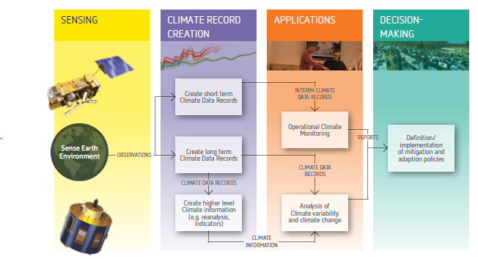


The Architecture for Climate Monitoring from Space
EUMETSAT
Implementation coordinated by
Joint CEOS – CGMS Working Group on Climate (JWG Climate)

Slide 3
EUMETSAT support to WG Climate
Host the WG Climate ECV Inventory and will lead the population for Cycles #2 and #3;
Provide dedicated personnel (Alexandra Nunes) to support WG Climate for the next 4 years;

Slide 4
EUMETSAT’s Role in Climate Monitoring
Operates one of the longest satellite time series (Meteosat);
Operates benchmark quality instruments, e.g., IASI, GRAS;
We have the capability to enhance the value of past observations through inter-satellite calibration and reprocessing;
We generate 16 instrument Fundamental Climate Data Records (FCDR) in VIS, IR and MW spectral range;
We generate Thematic Climate Data Records (TCDR) contributing to 20 GCOS ECVs;
Address GCOS needs and requirements and follow GCOS Climate Monitoring Principles and Guidelines as best as feasible.

Slide 5
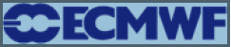









Coordination for CDR Generation
EUMETSAT
Climate Monitoring Implementation Plan
EUMETSAT Secretariat
EUMETSAT Working Group on Data Set Generation through Reprocessing
Coordinates SAF Network and EUMETSAT Secretariat commitments
Agrees on standards (meta data, formats, data publication (doi))
Resolves implementation dependencies
Performs maturity assessment

Slide 6
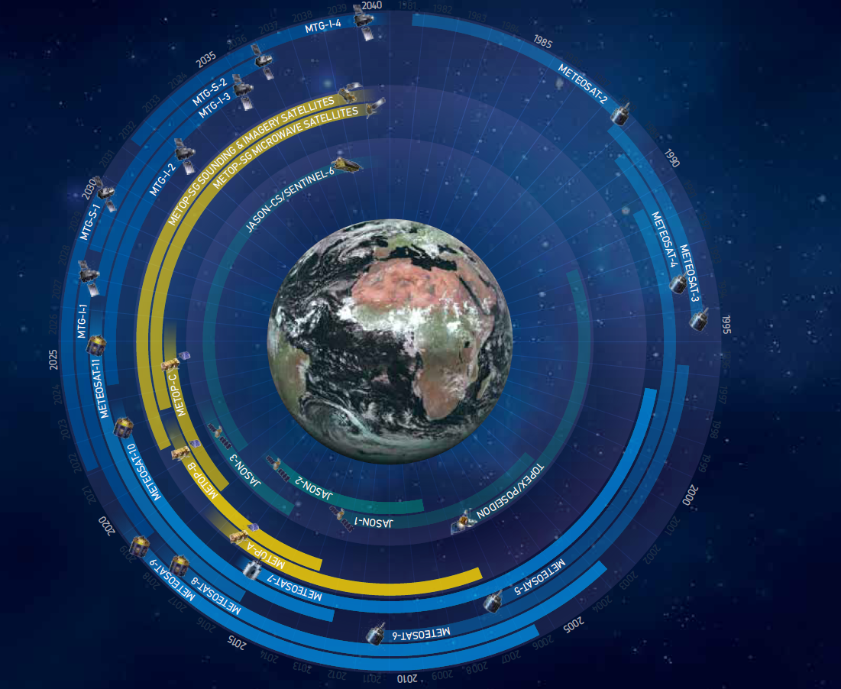


EUMETSAT Satellites – Past, Present and Future
Three launches:
MSG-4
    – 15 July 2015
Jason-3
    17 January 2016
Sentinel 3
    16 February 2016
Notes:
Long term monitoring requires a long term commitment into a sustainable space segment – here we see EUMETSAT programmes reaching out to ~2040 at which time we will reach about 60 years of Meteosat data.
There is an increase in number of instruments – orientation to cycles (energy, water, carbon) will enforce more combinations making careful consideration of individual input data even more important

Slide 7
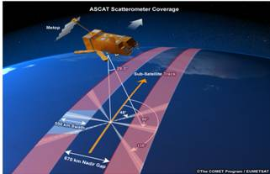
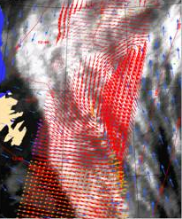
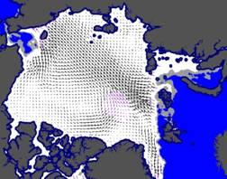
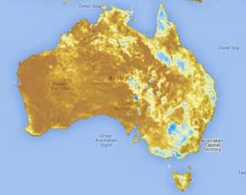
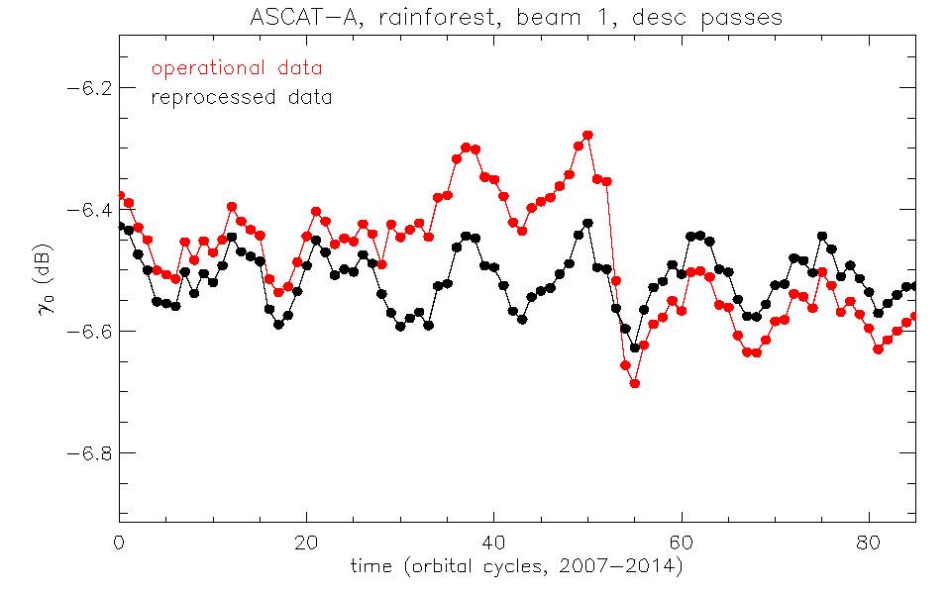
Metop-A ASCAT Data Record
ASCAT Ocean winds Sea ice drift Soil moisture
Radar backscatter signature of tropical rainforest;
Recalibration eliminates drifts and jumps in the time series;
Reflects only natural variations of backscatter of the forest canopy;
EUMETSAT provides the basis for improved ECV data records.
2007 2008 2009 2010 2011 2012 2013

Slide 8
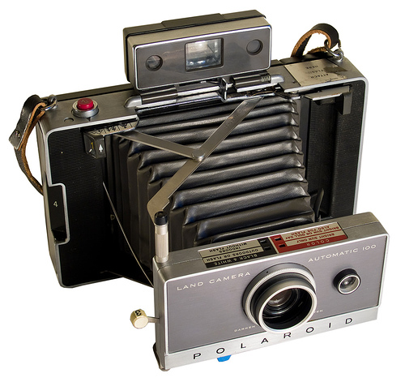
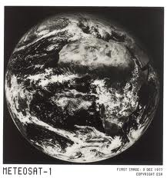
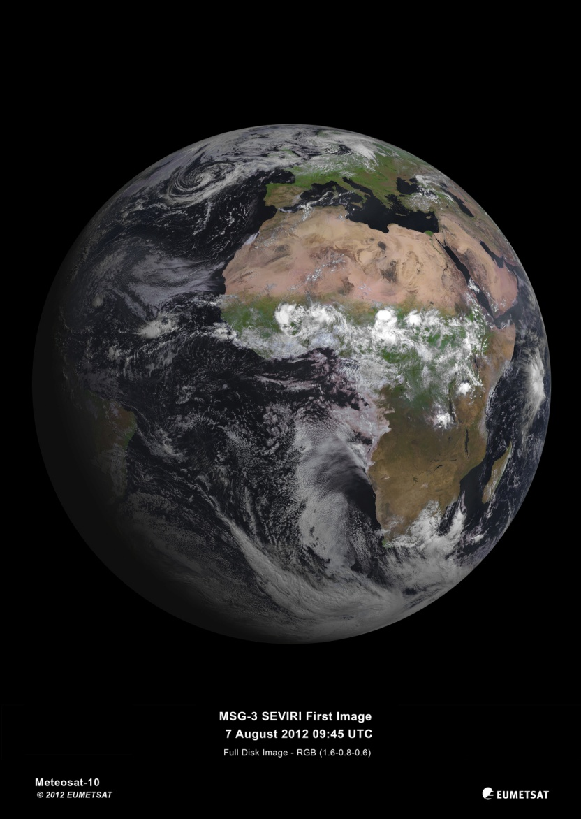
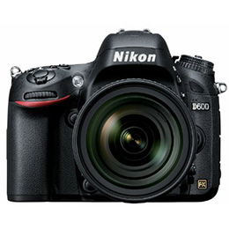
... but others were mainly built for monitoring weather
No Name

Slide 9
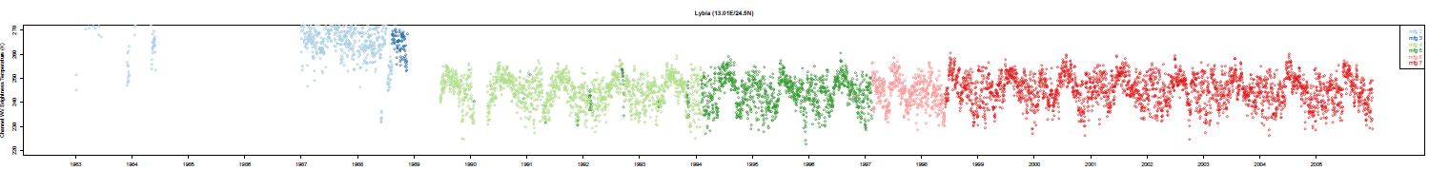

Inter-calibrated Meteosat Brightness Temperature
Every image IR 10.8 μm (top) and WV 6.2 μm (bottom) brightness temperature [K] at Libya site.
MFG 4
MFG 5
MFG 6
MFG 7
MSG 1
MSG 2
MSG 3
240 260 280 300 320
1990 1991 1992 1993 1994 1995 1996 1997 1998 1999 2000 2001 2002 2003 2004 2005 2006 2007 2008 2009 2010 2011 2012 2013 2014 2015 2016
MFG 2
MFG 3
MFG 4
MFG 5
MFG 6
MFG 7
220 230 240 250 260 270
1983 1984 1985 1986 1987 1988 1989 1990 1991 1992 1993 1994 1995 1996 1997 1998 1999 2000 2001 2002 2003 2004 2005
Figure courtesy of Reto Stoeckli, Meteo Swiss - “I really like the (visual, not statistical) cleanness of the IR BT’s over time. It’s a marvel to look at it.”

Slide 10
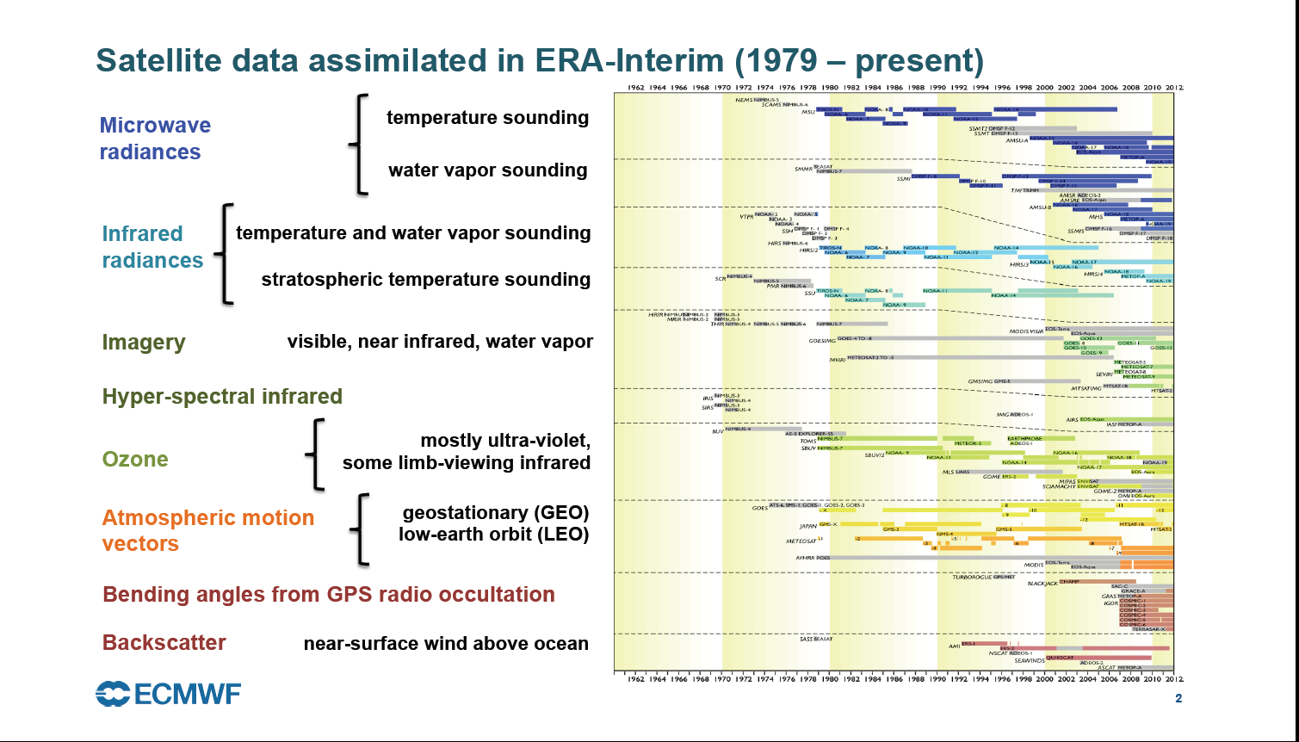
Inputs to Global Reanalysis

Slide 11
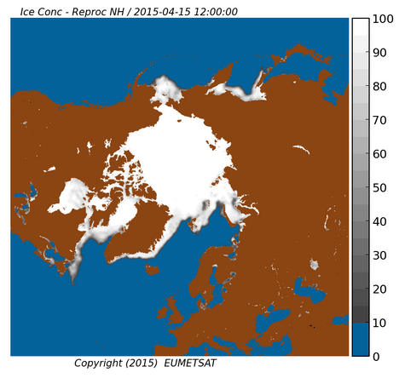
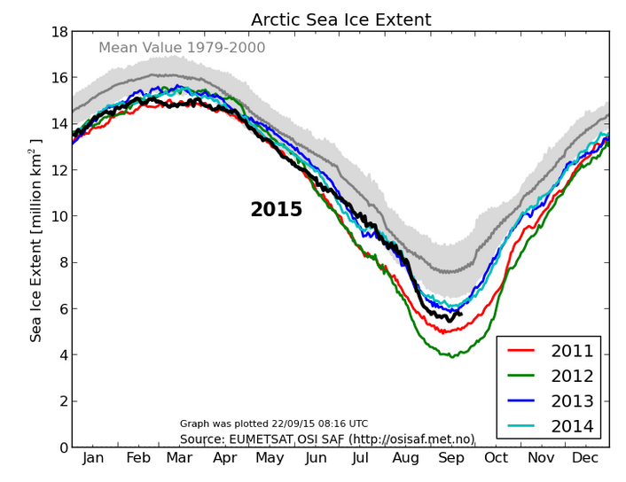
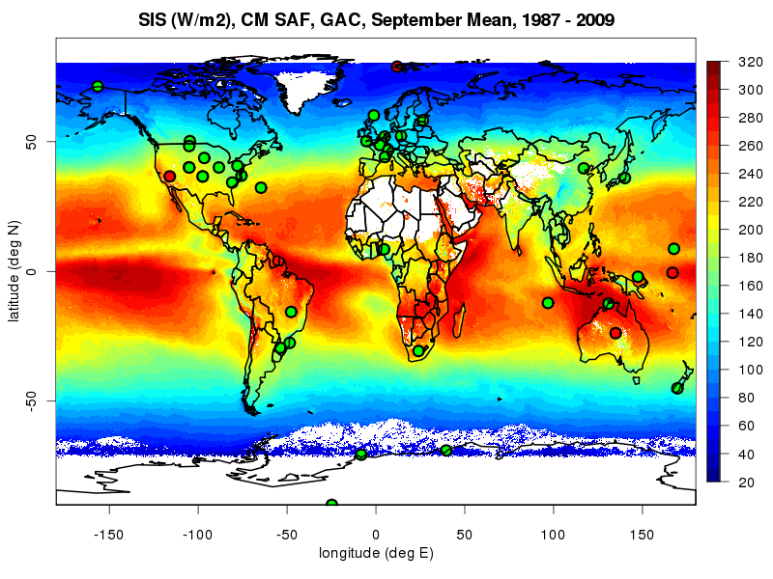
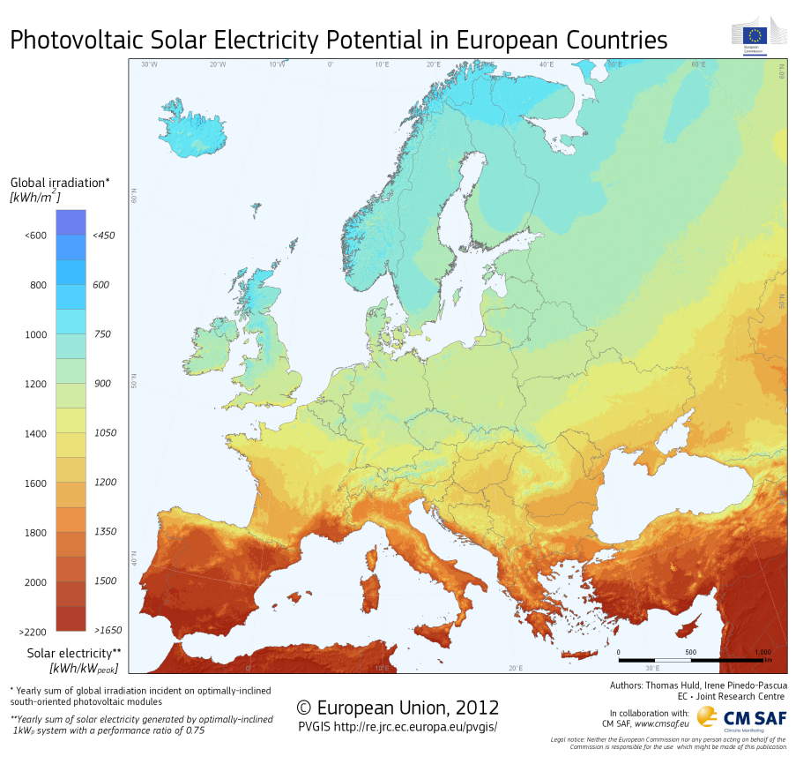
Thematic Climate Data Records of ECVs

Slide 12









Innovation: EUMETSAT involvement in EU Research
Support to Reanalysis
Support to Quality Assurance
Quantitative Uncertainty Characterisation

Slide 13


You are welcome to celebrate 30 Years EUMETSAT

