Slide 1
Climate Change Initiative
Pascal Lecomte
Head of the ESA Climate Office
GCOS Science Conference
Amsterdam – March 2nd, 2016

Slide 2
Current Status of the CCI Programme

Slide 3
CCI Master Schedule
2009
2010
2011
2012
2013
2014
2015
2016
2017
1 2 3 4
5 6 7 8
9 10 11 12
13 14 15 16
17 18 19 20
21 22 23 24
25 26 27 28
29 30 31 32
33 34 35 36
Inception
Phase 1
Phase 2
Scientific User Consultation
Scientific User Consultation
p p p
Algorithm Specification Delivery
Major System Development
p p p
ECV Delivery
Assimilation / Assessment
p Prioritise ECV
p PB-EO Implementation
p Mid Term Review
Collocation Meetings
p #1
p #2
p #3
p LPS
p #4
p #5
p #6
p #7
CMUG Meetings
p #1
p #2
p #3
p #4
p #5
p #6

Slide 4
CCI Programme (2010-2017)
CCI ECV Projects
Cloud
Aerosol
Greenhouse Gases
Ozone
SST
Sea Level
Sea Ice
Ocean Colour
Glaciers
Ice Sheets
Land Cover
Fire
Soil Moisture
Cross-ECV
& Exploitation
Climate Modeller User Group
Research Fellowships
Ice Sheet Mass Balance
Intercomparison Exercise
Cross-ECV Workpackages
Horizontal Supporting
Activities
System Engineering WG
Data Standards WG
Colocation Meetings
Integration Meetings
Communication
and User Support
CCI Visualisation Tool
CCI Open Data Portal
CCI Toolbox

Slide 5
CCI Products Time Coverage
Cloud
Ozone
Aerosol
GHG
Sea Ice
Sea Level
SST
Ocean Colour
Glaciers
Ice Sheet
Land Cover
Fire
Soil Moisture
 |  | 1980s | 1990s | 2000s | 2010s
8
3
3
2
2
OSISAF
2
1
2
2-3 measurements per glacier over the period
4
2
1
1

Slide 6
CCI Achievements
The CCI has enabled more than 300 European scientists from over 100 research institutions and companies to work together in an integrated programme on ECV algorithm development, inter-comparison, validation, and large-scale EO data processing for 13 GCOS ECVs
All CCI ECV data products have been fully error characterised, are provided with quantitative uncertainty estimates, and have been evaluated by leading members of the climate research community
Prototype processing systems for each ECV have been developed and validated in phase 1, and are being furthered developed during phase 2 to become operationally sustainable. This is a major step in making them suitable for transfer into the Copernicus Climate Change Service (C3S).
ECV products are being made available under an open and free data policy for uptake by the wider climate science community through the CCI Open Data Portal and via community initiatives such as ESGF and CMIP/obs4MIPs.

Slide 7
CCI Achievements
Substantial community building has taken place to strengthen the relationship between satellite data product developers and climate scientists, and as a result of the multidisciplinary approach of the programme, strong links have also been forged spanning the land, ocean, atmosphere and cryosphere science communities.
The CCI programme is contributing to a rapidly expanding body of scientific knowledge demonstrating new insights in climate research by maximising the scientific benefits that satellite observations can provide. This was shown through the important contributions CCI made to the IPCC's 5th Assessment Report (WG1, 2013)
In all, 27 CCI scientists were involved as leaders, contributing-authors or editors in seven of the 14 chapters of the IPCC AR5 WG1 report, and CCI results were cited 59 times.
The CCI scientific community have published 233 scientific articles in peer-reviewed journals (as of Aug 2015).

Slide 8
Proposal for a CCI Extension – CCI +

Slide 9
CCI+ Objectives & Scope
CCI+ Objectives:
research, development, qualification and delivery to users of pre-operational ECV products
definition, sizing and demonstration of ECV processing systems
transfer of ECV production to operational entities outside ESA
Driven by climate user requirements defined by GCOS, under authoritative advice from CSAB, and strong coordination with the international Space Agencies response to GCOS via the
Joint CEOS/CGMS Working Group on Climate (WGClimate).
CCI+ Scope:
Development of new ECVs (i.e. ECVs that were not started in CCI so far)
New R&D on ECVs that were started in CCI
Cross-ECV scientific exploitation
Outreach and Communication
NB: CCI+ will not build operational processing systems
Notes:
- Aim to perform the R&D necessary to deliver develop pre-operational satellite-based ECVs responding to the climate user requirements expressed by GCOS, and deliver system specifications which facilitate the transfer to sustained production by operational entities outside ESA.
- Continue the successful CCI achievements on the research, development and qualification of ECV products and pre-operational processing systems with the aim to transfer to operational production externally.
- Driven by GCOS as the primary source of requirements, under authoritative advice of the CSAB
- Strong international coordination with, and contribution to, the international response of Space Agencies to GCOS via WGClimate, which is now a joint working group of CEOS and CGMS.
- Scope of CCI+ is:
(i) development of new ECVs (i.e. ECVs that could not be done in CCI)
(ii) new R&D on ECVs that were already started in CCI
(iii) cross-ECV scientific exploitation
(iv) outreach and communications
- CCI+ will not build operational processing systems

Slide 10
(i) New ECVs in CCI+
Selection will be based on criteria already defined by Member States [ESA/PB-EO(2009)32, rev. 1]:
Response to GCOS requirements (to be revised in 2016)
Availability, quality, uniqueness and importance of the satellite data
Maturity of retrieval algorithms
Ability to capitalise on European scientific expertise
Prospects for transition to an external operational context
Taking into account:
Overall level of Member States contributions
Need for complementarity with other ECV activities in Europe (C3S, CDOP-3, H2020, etc.)
List of new ECVs will be selected in early 2017, after CMIN-16.
CSAB meeting in early 2017 to support Executive in formulating...
GMECV Evolution Implementation Plan to be presented to PB-EO in 2017 Q1
Notes:
- show coloured table
- explain how ECV selection will be performed (see p13 of PB-EO rev.1 paper)

Slide 11
Preliminary analysis of new ECVs in CCI+

Slide 12
Preliminary analysis of new ECVs in CCI+
Notes:
UPDATE "Proposed in CCI+ Extension" to "Proposed in CCI+ Evolution"

Slide 13
(ii) New R&D on ECVs already started in CCI
ESA/PB-EO(2015)24 Annex 2 lists many CCI ECV products expected to be sufficiently mature for pre-operational production by the end of CCI (2017-2018).
Further R&D on ECVs is needed in CCI+ to:
Improve quality of ECV products closer to meeting GCOS goals (e.g. accuracy, spatial resolution, long term stability), and improve cross-ECV consistency.
Develop algorithms for "difficult" ECV variables required by GCOS,
e.g. regional sea-level, coastal ocean colour, aerosol absorption, sea-ice drift.
Extend ECV length by developing methods to bring older less well-calibrated satellite instruments into the time series (e.g. AVHRR), and develop corrections for future instrument degradation.
Fully exploit the new capabilities of Sentinel and Earth Explorer instruments,
e.g. new types of measurement, new spectral bands, wider swaths, higher resolution.
Develop climate-quality methods to join-up multi-mission time series, especially where there are gaps, e.g. Envisat to Sentinel-1/3.
Increase maturity of ECV product uncertainty estimates.
Develop better merged ECV products.
Perform algorithm round-robins to assess promising new ECV retrieval techniques.

Slide 14
(iii) Cross-ECV Activitie
Cross-ECV activities are a key strength of CCI and CCI+
CCI has succeeded to build an active multi-disciplinary community fostering dialogue and cooperation between the EO and climate science – as recommended by both CSAB and ESAC.
1. CMUG-type activity providing
an integrated climate user perspective across all ECVs
demonstration exploitation of the CCI+ ECV products
feedback to the CCI+ teams on ECV quality and consistency
outreach to the wider climate user community
2. Cross-ECV targeted scientific studies
Demonstrate the value of the CCI and CCI+ ECVs and to strengthen uptake by the wider climate community
E.g. Assembly and analysis of multiple ECVs for sea-level budget closure, permafrost, air-sea mass and energy fluxes, etc.
3. Young Scientist Research Fellowship Scheme
To stimulate exploitation by the next generation of climate scientists.

Slide 15
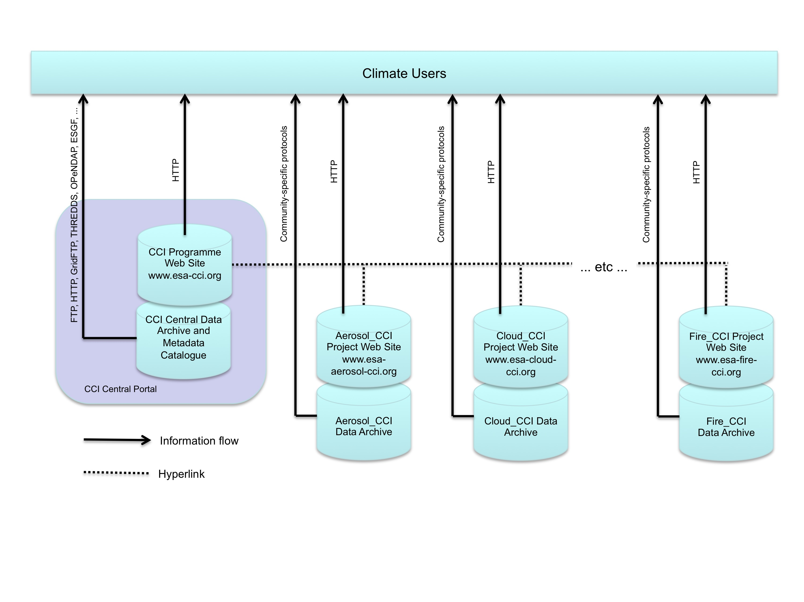
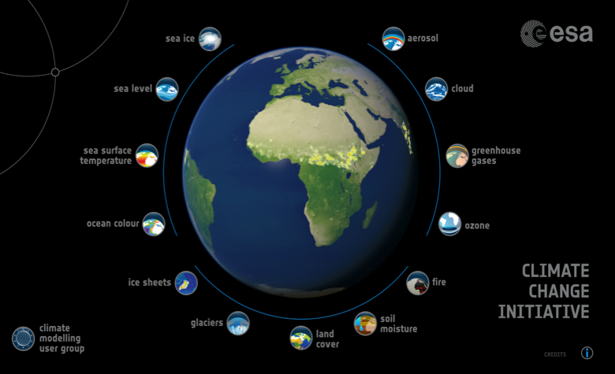
(iv) Outreach and Communications
Continue the CCI activities on:
Open Data Portal
... to provide open, free, and easy access to the
CCI+ ECVs via multiple standard climate community
interfaces.
Visualisation Tool
... to provide interactive visualisations of the ECVs to
help communicate the types of climate information
satellites can provide.
Software Toolbox
... to equip users at all levels with the tools they require
to visualise, analyse and manipulate the ECV data.

Slide 16
Related European Activities on ECVs
H2020
R&D exploiting ECVs
Some complementary work on developing ECVs
Copernicus Climate Change Service
Operational production of ECVs, but no R&D
First call for 9 ECVs announced on 13 Jan 2016 (sea ice, sea level, sea surface temperature, ozone, aerosol, CO₂ and CH₄, soil moisture, glaciers and ice caps, albedo-LAI-FAPAR)
Expect further C3S calls for ~20 more ECVs by end 2017
EUMETSAT Satellite Application Facilities
New SAF CDOP-3 programme starts 2017 (approval in mid-2016)
ESA is working closely with EUMETSAT to ensure full complementarity on the development of ECVs, on a case-by-case basis.

Slide 17
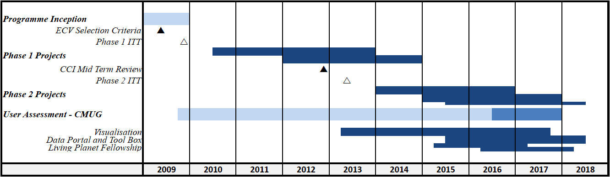
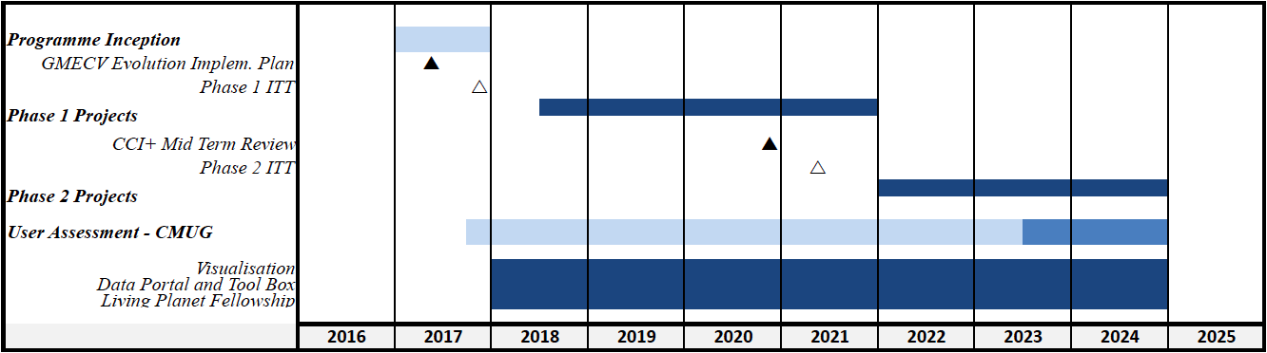
CCI+ Schedule
CCI
CCI+

Slide 18
CCI+ Summary
CCI+ is a proposal for the evolution of CCI over the period 2017-2024 to develop new ECV data products required by climate science and for use in climate services.
As for CCI, the objective is to transfer the R&D results into an operational context outside ESA once the ECV algorithms and pre-operational processing systems are sufficiently mature.
CCI+ will enhance the contribution of European EO science to future IPCC assessments, as part of the international coordinated action on climate observations through CEOS and GCOS.
Both new ECVs as well as new R&D on ECVs already started in CCI are included, complemented by supporting activities providing an integrated climate user perspective, on cross-ECV exploitation, communications and outreach.
The proposed CCI+ activities are complementary to other activities on ECVs in Europe
(e.g. C3S, H2020, EUMETSAT SAFs) , and will be closely linked with international climate science programmes.

Slide 19
Thank you for your attention

