Slide 1
WDAC Paris, March 7, 2016

Slide 2
WCRP Data Advisory Council
(WDAC)
Mission
act as a single entry point for all WCRP data, information, and observation activities with its sister programmes,
coordinate their high-level aspects across the WCRP,
ensure cooperation with main WCRP partners such as GCOS, CEOS, CGMS and other observing programmes
WDAC works with the WCRP Modeling Advisory Council to promote effective use of observations with models and to address issues related to the coordinated development of data assimilation, reanalysis, Observing System Sampling Experiments, fluxes and paleoclimatic data and their assessments (metrics, etc.).

Slide 3
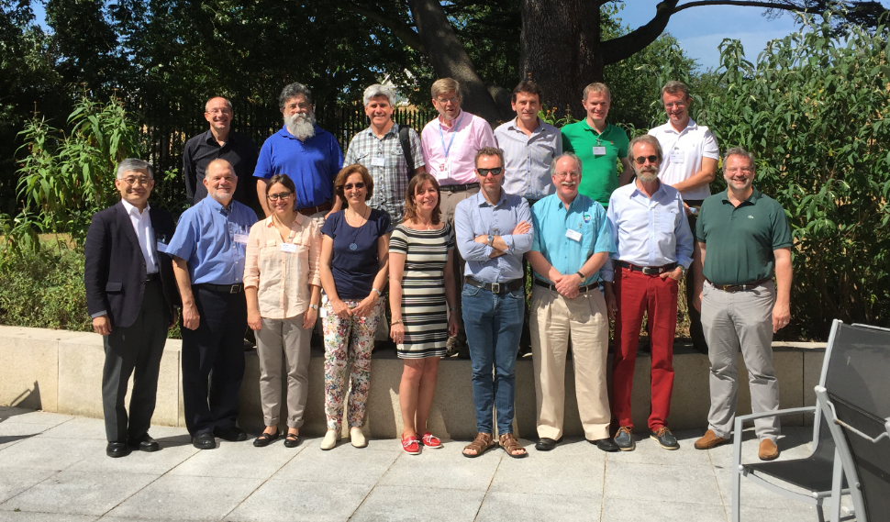
WDAC4@ECMWF Reading, 2-3 July 2015

Slide 4
WDAC-2 Recs/Actions
WDAC4 Reading, 2-3 July 2015
Topic | Outcome
Open Data Policy | Discussed the need for WCRP wide open data policy to further support quality science through open data publication and DOIs. A recommendation from WDAC is needed in order to adopt such approach across the Programme. May start with CLIVAR data policy.
Surface Fluxes: | Establishment of a Surface Flux Task Team to address: Flux ECV cross walk Gaps in observing system Tracking of community activities Single point of contact for WCRP fluxes Discussed ToR and candidate membership recommendation Endorsement planned at WDAC-5
Dataset Quality Assessment | Endorsed and published report to WCRP addressing best practices for quality assessment
Obs4mips | Established obs4mips task team continued to prepare CMIP 6 data record baseline via open data call
Reanalysis/Fluxes | WDAC Task Team for Intercomparison of ReAnalyses (TIRA). Should represent a central body to coordinate reanalyses information and understanding within WCRP and its partners. International Conference on Reanalysis currently planned for 2017
Development of data prize | Data prize suggested by WCRP JSC-36
WDAC-5 | Asheville, USA, April 7-8, 2016
Notes:
CORE-CLIMAX == Coordinating Earth Observation data validation for Reanalysis for CLIMAte ServiceS
S-RIP == SPARC Reanalysis/analysis Intercomparison Project

Slide 5
A Proposal for Structured Data Set Quality Assessments
Endorsed by WCRP

Slide 6
Data Set Assessments
Data set diversity can be confusing for users, and without the proper background information and understanding of the limitations of available data, there is a danger that these data may be incorrectly applied or misinterpreted;
Users need to realise that it is often difficult to define a single best climate data source. Data sets are instead most often complementary in nature with varying strengths and weaknesses;
Essential elements that define the usefulness of a data set are certainly its accuracy and error characterization, but data products can be evaluated too favourably by the developers themselves in order to encourage data usage;
Assessments have benefits for both science and applications as well as product providers.

Slide 7
High Level Best Practises
A general procedure, e.g., to ensure at least a certain degree of independency to avoid that data products be evaluated too favourably by the developers themselves in order to encourage data usage;
A general structure of an individual assessment including the definition of a certain set of mandatory sections in the assessment report but not preventing the publication of additional results. For instance, essential elements that define the usefulness of a data record are certainly its accuracy and uncertainty characterization;
A lexicon of best practises to create climate data records also including practises on data comparisons and nomenclature used for characterising uncertainties;
Metrics to assess how far best practises have been followed.

Slide 8
Obs4MIPs
Objective: To make observational data more accessible for evaluation of CMIP class simulations
WDAC obs4MIPs Task Team

Slide 9
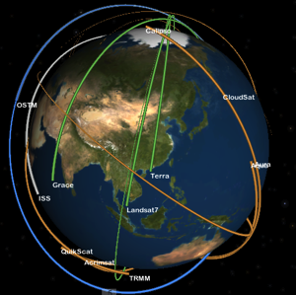
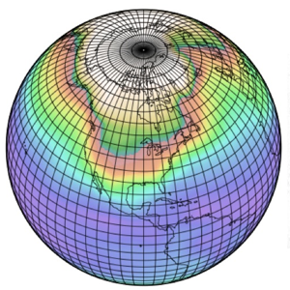
Obs4MIPs
obs4MIPs: The 4 Commandments
Target Quantities
Began as a NASA pilot project, now expanding as a WCRP project with WDAC oversight
Model Output
Variables
Satellite Retrieval
Variables
Use the CMIP Standard Model Output as guideline for selecting observations.
Observations to be structured the same as CMIP Model output (e.g. NetCDF, CF Convention).
Hosted on the ESGF side by side with CMIP model output.
Include a Technical Note for each variable describing observation and use for model evaluation (at graduate student level).
Modelers
Observation
Experts
Analysis
Community
Initial Target
Community

Slide 10
obs4MIPs: Current Set of Satellite Observations
Air Temperature
Ambient Aerosol Optical Thickness at 550 nm
CALIPSO 3D Clear fraction
CALIPSO 3D Undefined fraction
CALIPSO Clear Cloud Fraction
CALIPSO Cloud Fraction
CALIPSO High Level Cloud Fraction
CALIPSO Low Level Cloud Fraction
CALIPSO Mid Level Cloud Fraction
CALIPSO Scattering Ratio
CALIPSO Total Cloud Fraction
Cloud Fraction retrieved by MISR
CloudSat 94GHz radar Total Cloud Fraction
CloudSat Radar Reflectivity CFAD
Fraction of Absorbed Photosynthetically Active Radiation
ISCCP Cloud Area Fraction (Joint histogram of opt thickness and CTP)
ISCCP Mean Cloud Albedo (Cloud-fraction weighted & daytime)
ISCCP Mean Cloud Top Pressure (Cloud-fraction weighted & daytime)
ISCCP Mean Cloud Top Temperature (Cloud-fraction weighted & daytime)
ISCCP Total Cloud Fraction (daytime only)
Leaf Area Index
Mole Fraction of O3
Near-Surface Wind Speed
PARASOL Reflectance
Precipitation
Sea Surface Height Above Geoid
Sea Surface Temperature
Specific Humidity
Surface Downwelling Clear-Sky LW
Surface Downwelling Clear-Sky SW
Surface Downwelling LW
Surface Downwelling SW
Surface Upwelling Clear-Sky SW
Surface Upwelling LW
Surface Upwelling SW
TOA Incident SW
TOA Outgoing Clear-Sky LW
TOA Outgoing Clear-Sky SW
TOA Outgoing LW
TOA Outgoing SW
Total Cloud Fraction
Water Vapor Path
Sorted by CF Variable Long Name
Datasets Currently Hosted at obs4MIPs
(Variable Long Name)
Air Temperature
Ambient Aerosol Optical Thickness at 550 nm
CALIPSO 3D Clear fraction
CALIPSO 3D Undefined fraction
CALIPSO Clear Cloud Fraction
CALIPSO Cloud Fraction
CALIPSO High Level Cloud Fraction
CALIPSO Low Level Cloud Fraction
CALIPSO Mid Level Cloud Fraction
CALIPSO Scattering Ratio
CALIPSO Total Cloud Fraction
Cloud Fraction retrieved by MISR
CloudSat 94GHz radar Total Cloud Fraction
CloudSat Radar Reflectivity CFAD
Eastward Near-Surface Wind
Eastward Wind
Fraction of Absorbed Photosynthetically Active Radiation
ISCCP Cloud Area Fraction (Joint histogram of optical thickness and cloud top pressure)
ISCCP Mean Cloud Albedo (Cloud-fraction weighted & daytime only)
ISCCP Mean Cloud Top Pressure (Cloud-fraction weighted & daytime only)
ISCCP Mean Cloud Top Temperature (Cloud-fraction weighted & daytime only)
ISCCP Total Cloud Fraction (daytime only)
Leaf Area Index
Mole Fraction of O3
Near-Surface Wind Speed
Northward Near-Surface Wind
Northward Wind
PARASOL Reflectance
Precipitation
Sea Surface Height Above Geoid
Sea Surface Temperature
Specific Humidity
Surface Downwelling Clear-Sky Longwave Radiation
Surface Downwelling Clear-Sky Shortwave Radiation
Surface Downwelling Longwave Radiation
Surface Downwelling Shortwave Radiation
Surface Upwelling Clear-Sky Shortwave Radiation
Surface Upwelling Longwave Radiation
Surface Upwelling Shortwave Radiation
TOA Incident Shortwave Radiation
TOA Outgoing Clear-Sky Longwave Radiation
TOA Outgoing Clear-Sky Shortwave Radiation
TOA Outgoing Longwave Radiation
TOA Outgoing Shortwave Radiation
Total Cloud Fraction
Water Vapor Path

Slide 11
WDAC Observations for Model Evaluation Task Team
Terms of Reference 1. Establish data/metadata standards for observational and reanalysis data sets that are consistent with standards used in major climate model intercomparison efforts (e.g., CMIP)
2. Encourage the application of these standards to well-established observational datasets that have demonstrated utility for model evaluation.
3. Provide guidance and oversight to obs4MIPs, including the organization of data hosted on ESGF. Establish criteria and a process by which contributed datasets are accepted for inclusion.
5. Seek community input and feedback on the value of products conforming to the standards, and refine and extend the standards, as necessary, to meet any additional or evolving needs. 6. Coordinate above activities with major climate model intercomparison efforts (e.g., CMIP) and liaise with other related WCRP bodies

Slide 12
WDAC Observations for Model Evaluation
Task Team Membership
Peter Gleckler, co-chair, PCMDI Duane Waliser, co-chair, JPL/NASA Sandrine Bony, IPSL Mike Bosilovich, GSFC/NASA
Helene Chepfer, IPSL Veronika Erying, DLR Robert Ferraro, JPL/NASA Pierre-Phillipe Mathieu, ESA Roger Saunders, UKMO Jörg Schulz, EUMETSAT Karl Taylor, PCMDI Jean-Noël Thépaut, ECMWF

Slide 13
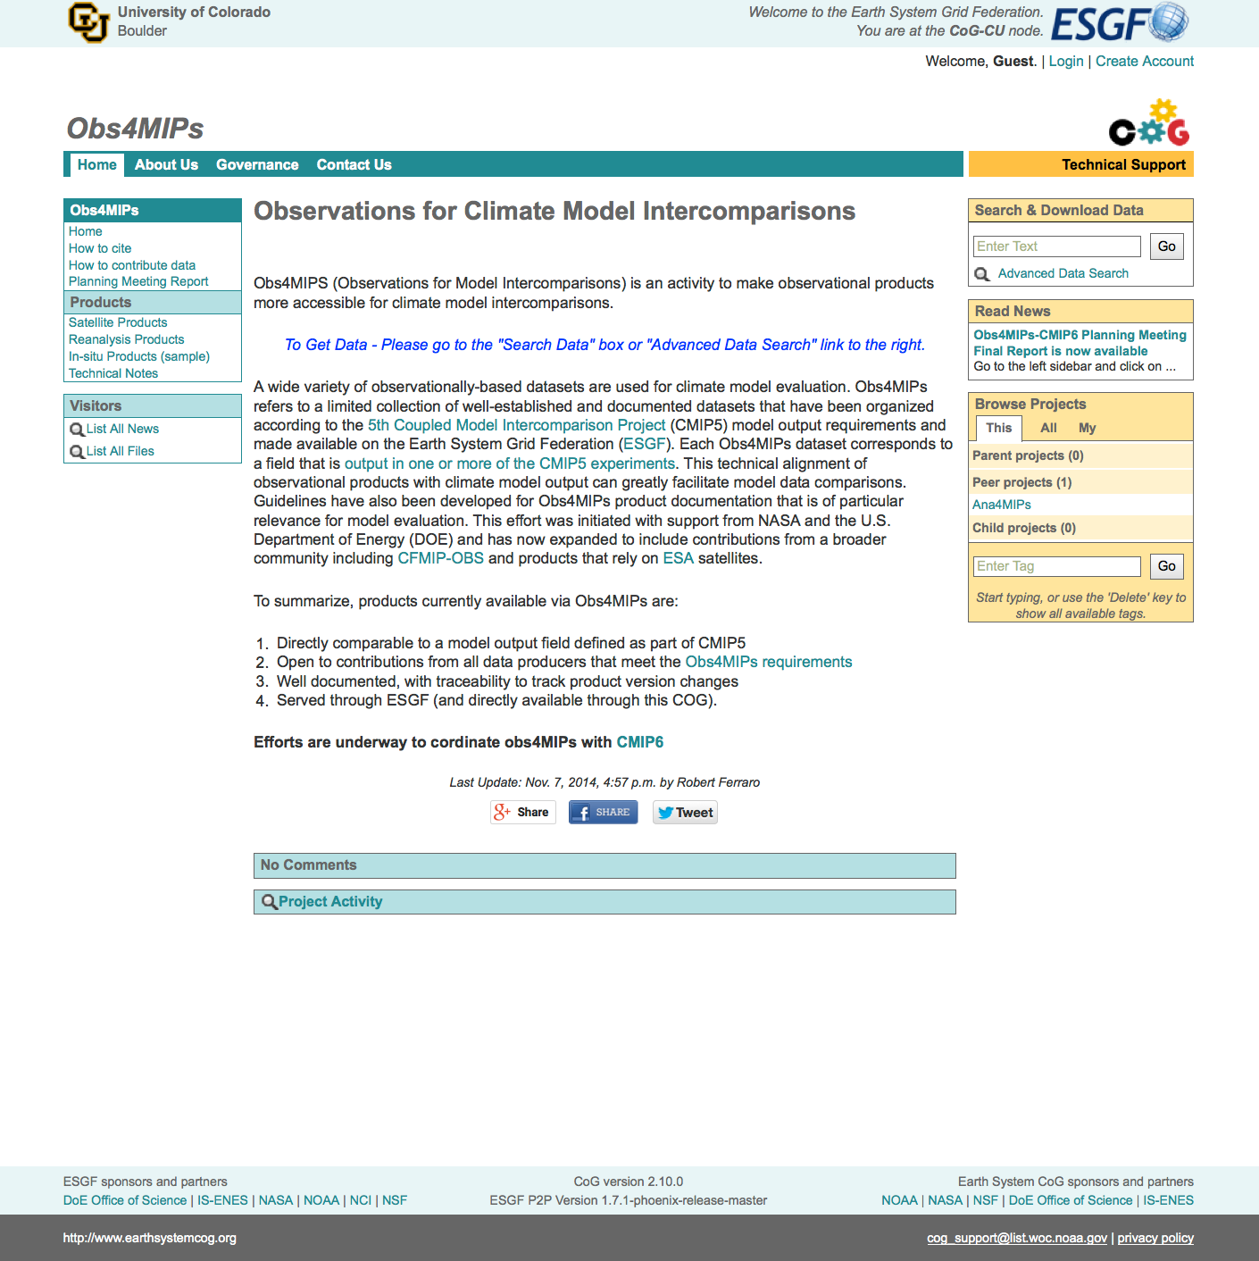
Data access and project connectedness
obs4MIPs data are available through the CoG
The CoG is directly connected to ESGF
CMIP6 is expected to be hosted on the CoG along with many related projects (e.g., ana4MIPs and CREATE-IP)
https://www.earthsystemcog.org/projects/obs4mips/

Slide 14
obs4MIPs-CMIP6 Planning Meeting (NASA HQ, May 2014)
Consensus recommendations:
Expand the inventory of included datasets.
Include higher frequency datasets, and higher frequency model output.
Reliable and defendable error characterization/estimation of observations
Include datasets in support of off-line simulators.
Include collocated observations, including sparser in-situ datasets
Precise definitions of data products (what’s actually being reported), including biases, and precise definitions of the model output variables are required.
Ferraro, R., D. Waliser, P. Gleckler, K. Taylor, and V. Eyring, 2015: Evolving obs4MIPs to Support the Sixth Coupled Model Intercomparison Project (CMIP6). Bull. Amer. Meteor. Soc. In Press, http://dx.doi.org/10.1175/BAMS-D-14-00216.1
Facilitating the CF/CMOR/ESGF preparation of obs data
CMOR3 is currently developing at PCMDI for use in CMIP6. It is being generalized to be useful for preparing observational data. It will include:
A version of CMOR that is accessible via python
Templates for defining global attributes
Numerous examples (including data) to facilitate ease of use
Task team with the help of others is developing a proposal for describing observational data (via the CF convention) in coordination with CMIP
Related efforts for reanalyses
Ana4MIPS: A CoG “peer project” with obs4MIPs, providing a collection of fields from selected major reanalysis well suited for comparison with CMIP simulations (mostly dynamical fields).
CREATE-IP: A resource for reanalysis data in a centralized location on NASA’s NCCS Advanced Data Analytics Platform (ADAPT), standardizing data formats, providing analytic and visualization capabilities, and overall improved access to many fields from reanalysis datasets.

Slide 15
Call For Observation Datasets
For Inclusion In Obs4mips
November 30, 2015
The WCRP Data Advisory Council’s (WDAC’s) Observations for Model Evaluation Task Team seeks recommendations for data sets to be considered for inclusion in obs4MIPs.
At present, obs4MIPs is limited to regularly gridded datasets, with a focus on global or near-global satellite data products. Past contributions have mostly consisted of monthly, global data products. Consideration and emphasis on higher frequency, as well as basin- to global-scale gridded in-situ data sets is increasing. Of central importance is the continued obs4MIPs requirement for demonstrated (e.g. peer-reviewed publications) model evaluation uses of the proposed data set(s). Of particular interest for this call is data products that are of direct relevance to CMIP6 endorsed model intercomparison projects (http://www.wcrp-climate.org/modelling-wgcm-mip-catalogue/modelling-wgcm-cmip6-endorsed-mips). The WDAC Task Team encourages recommendations for new obs4MIPs datasets to be made between December 1 2015 and March 31 2016, and is committed to responding no later than June 1 2016. For instructions on the procedures for recommending a dataset for obs4MIPs, please refer to:
https://www.earthsystemcog.org/projects/obs4mips/
Ferraro et al., BAMS in press

Slide 16
Reanalysis Activities
The Collaborative REAnalysis Technical Environment – Intercomparison Procject (CREATE-IP):
collection of data on ESGF from selected major reanalyses (NASA/GMAO, ECMWF, NOAA, JMA)
Each dataset is reformatted similarly to facilitate comparison with each other (including innovations and observations).
WCRP Task Team for Intercomparison of Reanalyses (TIRA) – White Paper (Michael Bosilovich et al.) – Draft endorsed by WDAC members
Proposed involvement of WDAC, WMAC, WGNE, GEWEX and CLIVAR
To foster understanding and estimation of uncertainties in reanalysis data
To communicate new developments and best practices among the reanalysis centers
To enhance the understanding of data and assimilation issues and their impact on uncertainties, leading to improved reanalyses for climate assessment
To communicate the strengths and weaknesses of reanalyses, their fitness for purpose, and best practices in the use of reanalysis datasets by the scientific community

Slide 17
Reanalysis Activities
Earth System Reanalysis initiative:
a major outcome of WCRP-IPCC Bern meeting, Sept 2014
March 2015 meeting in Paris to define scope of activity
TIRA could host this activity
Discussions at WDAC-4: A number of scientific challenges (eg ocean atmosphere coupling) to be addressed ahead of addressing full earth system models
coupled reanalyses are currently being developed at reanalysis centres
5th International Reanalysis Conference planned for 2017
(Jean-Noël Thépaut, Michael Bosilovich and Michel Rixen)
Co-sponsored by the Copernicus Climate Change Service

Slide 18
Thank you

