Slide 1
WGClimate Governance
Pascal Lecomte - WGClimate Chair
March 7th, 2016

Slide 2
Schedule
2016
2017
2018
2019
CEOS Plenaries
CGMS Plenaries
CEOS Plenaries each year, in Autumn
CGMS Plenaries each year, end of Spring

Slide 3
WGClimate Meetings
2016
2017
2018
2019
CEOS Plenaries
CGMS Plenaries
#6
#7
#8
#9
#10
#11
3 WGClimate meeting over 24 months
Every 8 months
March, November and July the following year

Slide 4
WGClimate Meetings
2016
2017
2018
2019
CEOS Plenaries
CGMS Plenaries
#6
#7
#8
#9
#10
#11
WGClimate #7 to be delayed until early 2017 to better match WGClimate Work Plan.

Slide 5
WGClimate Chairmanship
2016
2017
2018
2019
CEOS Plenaries
CGMS Plenaries
#6
#7
#8
#9
#10
#11
CEOS Chairmanship
CGMS Chairmanship
CGMS Vice chair
CEOS Vice chair

Slide 6
Vice Chair Election
2016
2017
2018
2019
CEOS Plenaries
CGMS Plenaries
#6
#7
#8
#9
#10
#11
CEOS Chairmanship
CGMS Chairmanship
CGMS Vice chair
CEOS Vice chair
Election of the new Vice Chair

Slide 7
Next WGClimate Meetings
WGClimate #7
Long lasting invitation (already for WGClimate #4)
INPE - São José dos Campos Brazil

Slide 8
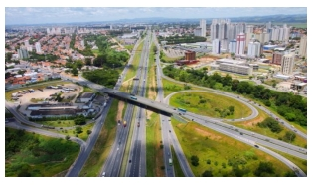
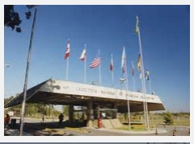
7th Meeting of the Joint CEOS/CGMS Working Group on Climate (WGClimate #7)
February 2017 – São José dos Campos - Brazil
About the city
About INPE
São José dos Campos is located 90km North East from São Paulo. It is the largest and most important city of the industrial region known as Vale do Paraíba.
São José dos Campos is also known for its academic strength. Major research institutes, such us the National Institute for Space Research INPE, as well as private and state universities are located here.
Fostering science and technology in earth and space context and be able to offer products and regular services in benefit of the country, the National Institute for Space Research has become a national and international reference in both space and earth environment.

Slide 9
Next WGClimate Meetings
WGClimate #7
Long lasting invitation (already for WGClimate #4)
INPE - São José dos Campos Brazil
WGClimate #8
We are looking for a possible venue for that meeting

