Slide 1
WGClimate meeting #6
Pascal Lecomte - WGClimate Chair
March 7th, 2016

Slide 2
Day 1 - Morning
1 Introductions and Context – Pascal Lecomte
09:00 – 09:20 Welcome Pascale Ultré-Guérard - CNES
09:20 – 09:40 Round table introductions All
09:40 – 10:00 Acceptance of Agenda P. Lecomte
10:00 – 10:30 Review of WGClimate activities and work plan P. Lecomte
10:30 – 11:00 Coffee Break
2 Report and discussion on COP-21/SBSTA-43 results – Pascal Lecomte
11:00 – 11:20 Report on SBSTA #43 J. Bates
11:20 – 11:40 Presentation on COP-21 P. Lecomte
11:40 – 12:00 Discussion All
12:00 – 13:30 Lunch in restaurants around CNES

Slide 3
Day 1 - Afternoon
3 International Coordination – Pascal Lecomte
13:30 – 13:50 WMO W. Zhang
13:50 – 14:10 GEO A. Obregon
14:10 – 14:30 WCRP M. Rixen
14:30 – 14:50 WCRP DAC J. Schulz
14:50 – 15:10 GCOS C. Richter
15:10 – 15:30 Future Earth M. Hernandez
15:30 – 16:00 Coffee
4 Agency reports – Pascal Lecomte
16:00 – 16:20 Copernicus Climate Change Service J.N. Thépaut
16:20 – 16:30 ESA - Climate Change Initiative Programme P. Lecomte
16:30 – 16:40 EUMETSAT J. Schulz
16:40 – 16:50 NASA W. Su
16:50 – 17:00 NOAA J. Bates
17:00 – 17:10 CNES C. Deniel
17:10 – 17:20 KMA Jinho Shin

Slide 4
Day 2 - Morning
5 Status of the ECV Inventory – Jörg Schulz
09:00 – 09:10 Introduction to the Implementation of the Architecture P. Lecomte
09:10 – 09:30 Status of ECV Inventory after Cycle #1, planned update J. Schulz
for Cycle #2 and review of the questionnaire and endorsement
09:30 – 10:00 ECV Inventory Implementation P. Albert
10:00 – 10:30 Coffee Break
10:30 – 10:45 Cycle #2 update process of the ECV Inventory A. Nunes
10:45 – 11:15 Schedule for Cycle #2 J. Schulz
11:15 – 11:30 Perspectives for Cycle #3 J. Schulz
11:30 – 12:00 Discussion J. Schulz
12:00 – 13:30 Lunch in restaurants around CNES

Slide 5
Day 2 - Afternoon
6 Gap Analysis – John Dwyer
13:30 – 14:15 Review of the Gap Analysis Guidelines R. Husband
and endorsement
14:15 – 14:45 Gap Analysis in Action J. Dwyer
14:45 – 15:00 Schedule for Cycle #2 R. Husband
15:00 – 15:30 Gap Analysis implementation roles. J. Dwyer
15:30 – 16:00 Coffee
7 Case Studies – Stephan Bojinski
16:00 – 16:20 Summary and Key Results S. Bojinski
16:20 – 17:00 Discussion on Possible Follow-on S. Bojinski
19:00 No-host Group Dinner

Slide 6
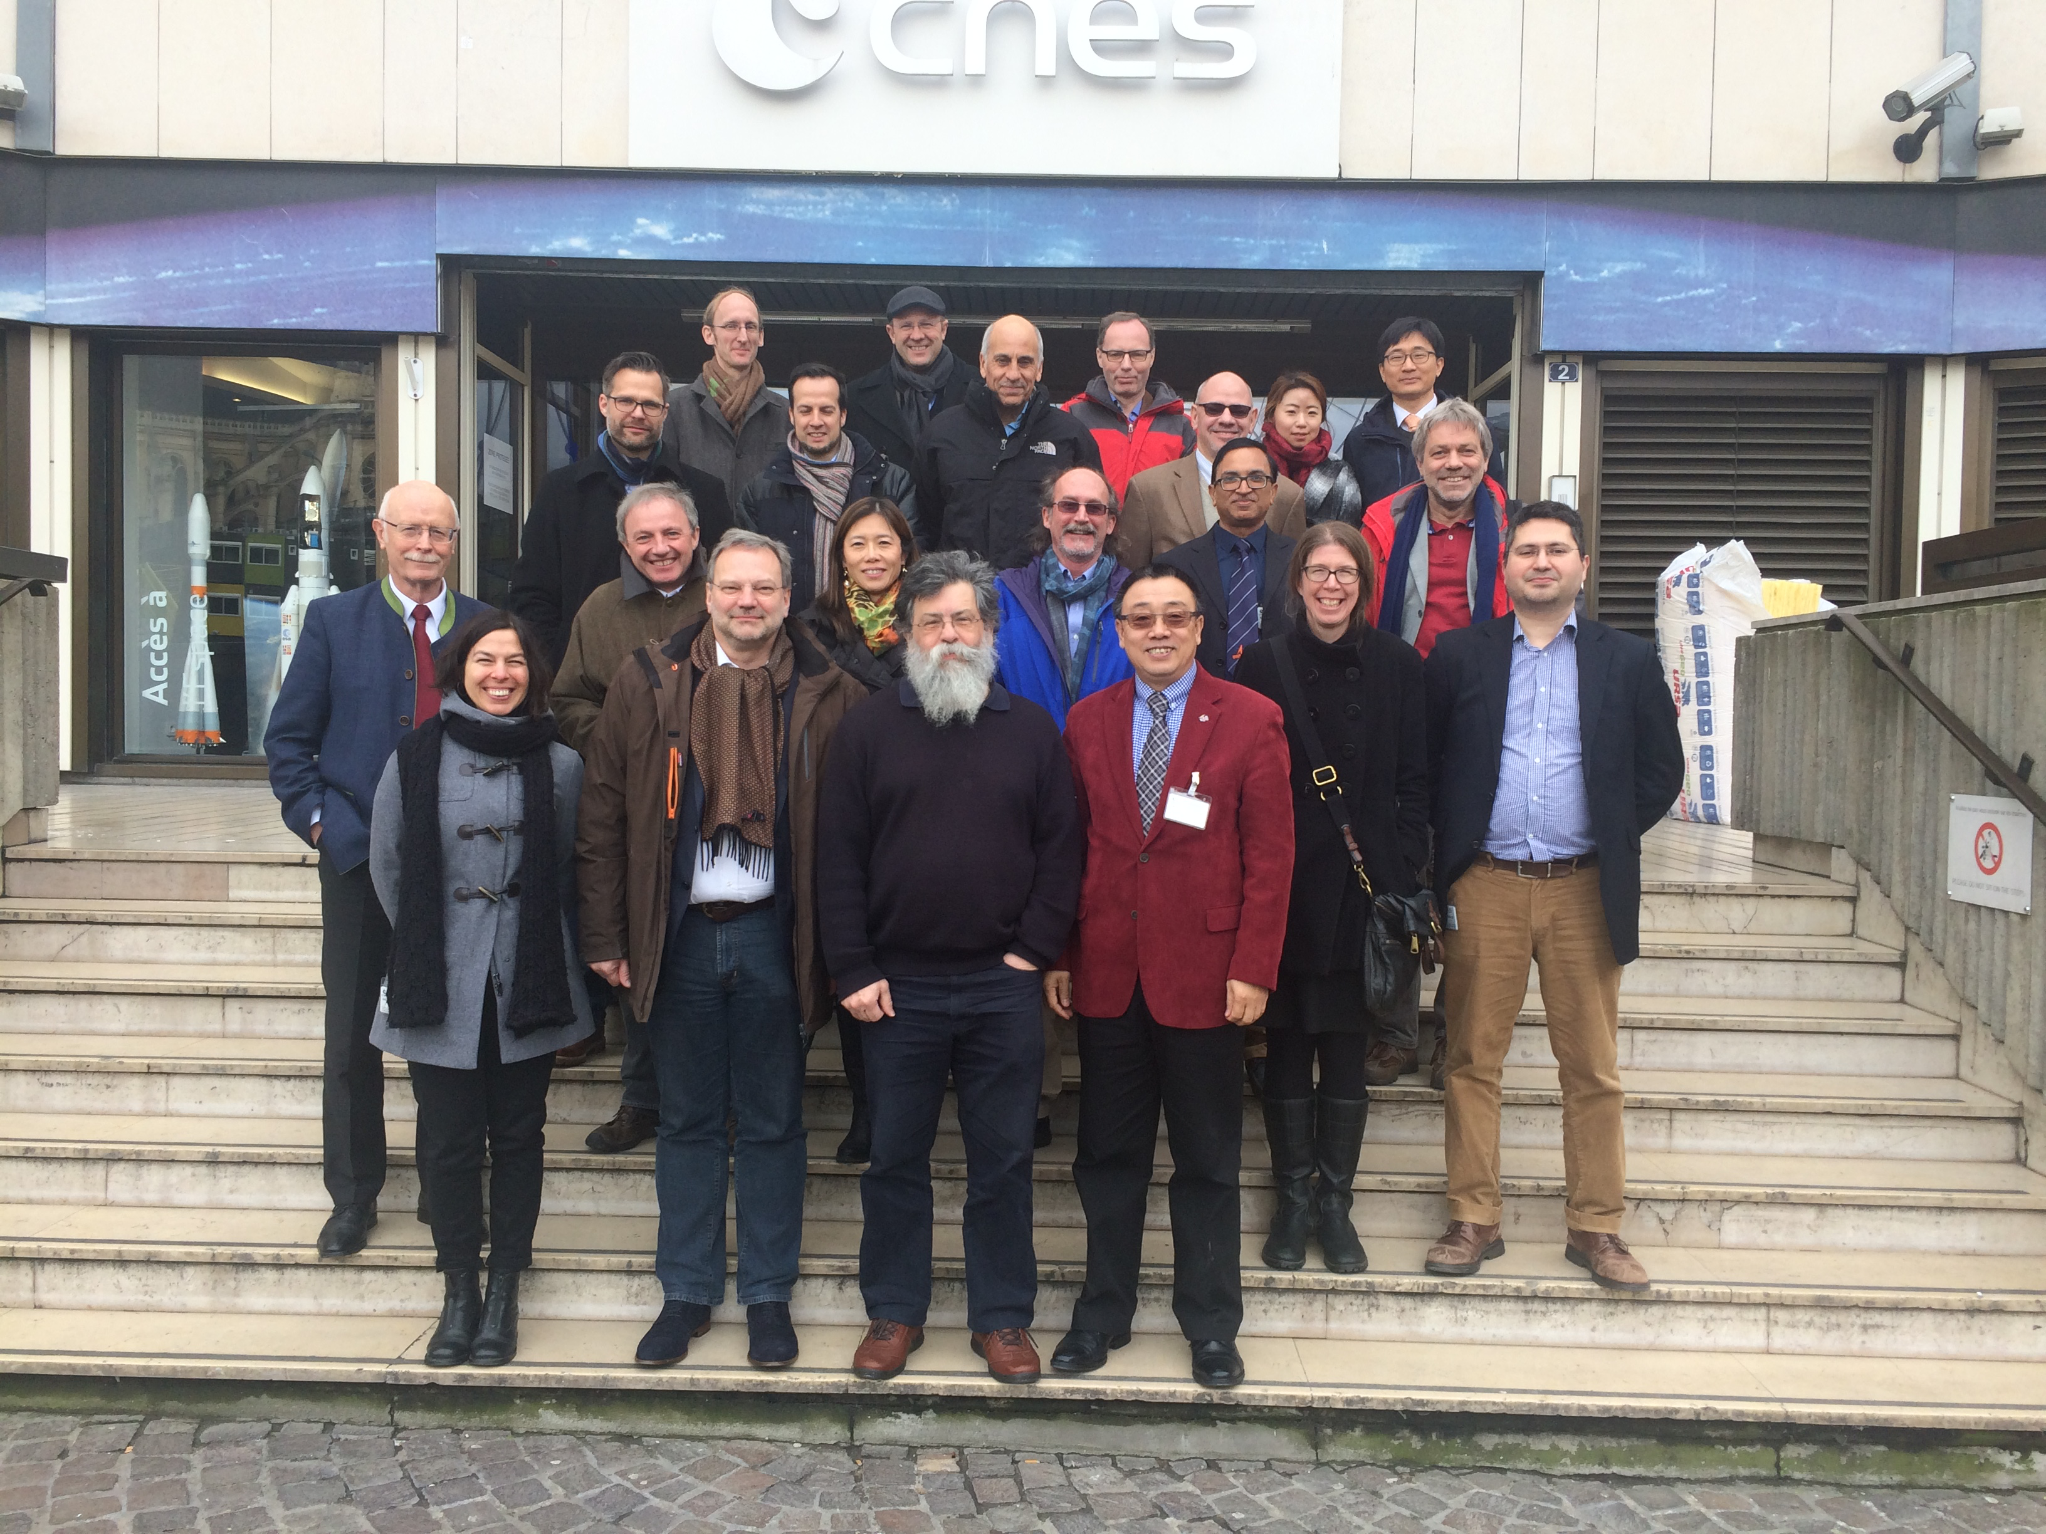
WGClimate #6

Slide 7
Day 3 - Morning
8 Supporting CEOS Strategy for Carbon Observations – Mark Dowell
09:00 – 09:20 Report from the Carbon from Space Workshop M. Dowell
09:20 – 00:40 Review of the CEOS Strategy for Carbon Observations WGClimate Actions M. Dowell
09:40 – 10:00 Reporting to CEOS SIT Workshop M. Dowell
10:00 – 10:30 Coffee Break
9 Coordination with Other CEOS-CGMS Bodies – John Bates
10:30 – 10:45 WGCV A. von Bargen
10:45 – 11:00 Scope-CM J. Bates
11:00 – 11:15 IROWG U. Foelsche
11:15 – 11:30 Preparation of the CEOS/CGMS response to GCOS IP P. Lecomte
10 Governance, Summary and Actions – Pascal Lecomte
11:30 – 12:00 WGClimate Web Site E. Pechorro
12:00 – 12:20 WGClimate Governance P. Lecomte
12:20 – 12:40 Review of the Actions
12:40 – 13:00 Concluding remarks
13:00 Meeting end

Slide 8
CEOS SIT meeting 18-20 April 2016

