Slide 1

GEO Update and Feedback
Espen Volden
GEO Secretariat
CEOS-CGMS WG Climate
Darmstadt, 5-7 March 2014

Slide 2
GEO Vision
To realize a future wherein decisions and actions for the benefit of humankind are informed by coordinated, comprehensive and sustained Earth observations and information.
CEOS Mission:
Ensure international coordination of civil space-based Earth observation programs
and promote exchange of data to optimize societal benefit and inform decision making for
securing a prosperous and sustainable future for humankind.

Slide 3
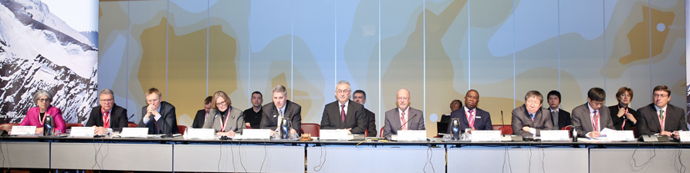
GEO X Plenary & Ministerial
Geneva 13 -17 January 2014
We, the Ministers and Participants assembled at the GEO Ministerial Summit in Geneva, Switzerland, on 17 January 2014:
…
1. Note that GEO has proven its capability to respond positively to calls for action from the international community of States and to address the challenges for which it was established;
…
3. Resolve to continue the critical work … to expand further the availability of consistent and complete datasets with full and open access … to consolidate observing networks … to further develop GEO global initiatives and to continue to foster the engagement of GEO users, data providers and citizens
Notes:
1. Opening of GEO Geneva Ministerial Summit 17 January
L-R: B. Ryan, Director, GEO Secretariat; GEO Co-Chair R. Strohmeier, European Commission; J. Potočnik, European Commissioner for the Environment; GEO Co-Chair K. Sullivan, US; P. Gallagher, Acting Deputy Secretary of Commerce, US; B. Oberle, State Secretary, FOEN, Switzerland; D. Hanekom, Minister of Science and Technology, South Africa; GEO Co-Chair P. Mjwara, South Africa; J. Cao, Vice Minister of Science and Technology, China; L. Chen, China; A. Steiner, Executive Director, UNEP

Slide 4
GEO Geneva Declaration
Integrating Observations to Sustain our Planet
4. Renew the mandate of GEO through 2025 … and agree to develop the work of GEO through 2025 in line with the recommendations put forward by the GEO-X Plenary as the foundation for shaping GEO through 2025.
…
7. … highlight the unique contributions of Participating Organizations, and welcome additional participants, in particular UN Organizations and Programmes …;
…

Slide 5
Ministerial Guidance on the
Evolution of GEOSS
Key areas of activity 2016-2025
Advocate for the value of Earth observations and the need to continue improving Earth observation worldwide
Urge the adoption and implementation of data sharing principles globally
Advance the development of the GEOSS information system for the benefit of users
Develop a comprehensive interdisciplinary knowledge base defining and documenting observations needed for all disciplines and facilitate availability and accessibility of these observations to user communities
Cultivate global initiatives tailored to meet specific user needs

Slide 6
GEO Implementation Plan
Working Group and Writing Team being established
A draft will be reviewed by GEO-XI Plenary
Endorsement at the next GEO Ministerial Summit
POs role & POs not equal (type, role in GEOSS impl.)
Private Sector
New Data Sharing Principles
Data Management Principles

Slide 7
GEO Climate Target 2015
Achieve effective and sustained operation of the global climate observing system and reliable delivery of climate information of a quality needed for predicting, mitigating and adapting to climate variability and change, including for better understanding of the global carbon cycle.
CL
CL-a
CL-b
CL-c
CL-d
SB-01
SB-02
SB-03
SB-04
CL-01
CL-02
Progress assessment
GEO Members and Participating Organisations should contribute national/international activities related to climate and carbon information production, use, and access; align data policies with the GEOSS Data Sharing Principles; and make the data accessible through the GEOSS Portal.

Slide 8



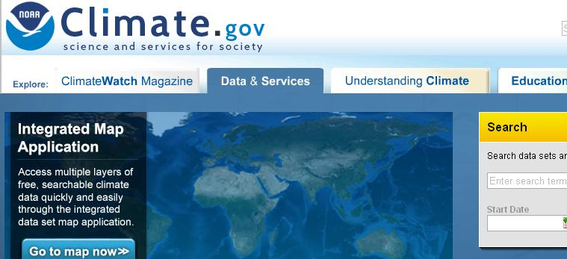
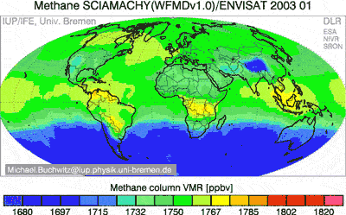
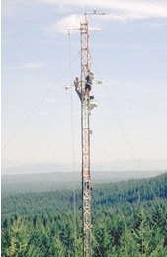
GEO CLIMATE OUTCOMES
Task CL-01
Climate Information for Adaptation
Improved scientific understanding, modelling and prediction of climate
Availability of ECVs needed by WCRP, IPCC, UNFCCC
Accessibility of all the observational data needed for climate monitoring and services in support of adaptation to climate variability and change
Global carbon observing and analysis system
Task CL-02
Global Carbon Observation & Analysis
Notes:
Sub-targets progress all evaluated yellow
Main Tasks contributing (but not the only ones)

Slide 9
Task Progress
Notes:
Main Climate Task progress also evaluated yellow

Slide 10
CL-01: Challenges and issues
CL-01 Task Team a functioning team
Clarify WMO-GEO collaboration on GFCS
Requirements for ECVs need to be revised in order to better address mitigation & adaptation needs at national & local scales
Requirements for in-situ climate data records to be better specified
More national climate adaptation activities to be contributed
Key climate datasets more visible and accessible
Cross-SBA activities, e.g. Water, Health, Agriculture, Disasters, Energy, Blue Planet, Cold Regions, GEO-GNOME

Slide 11
Climate Tasks
Task CL-01
Climate Information for Adaptation
Extension & Improvement of the Climate Record
Accelerated Implementation of the Global Climate Observing System
4 Components
Weather, Climate and Earth-System Prediction Systems
Easy Access to, and Use of, Climate Information

Slide 12
GFCS
From GFCS Implementation Plan:
“There are obvious parallels between the Framework and
the Global Earth Observation System of Systems (GEOSS).
Moreover, GEOSS provides a framework for preparing services such as those that the Global Framework for Climate Services is targeting. As the four identified priority areas of the Framework are already Societal Benefits Areas for GEOSS (i.e. agriculture and food security, water, health and disaster risk reduction), there is an opportunity for the Framework to collaborate with these ongoing efforts.
Furthermore, for each of these areas GEOSS has fostered the growth of Communities of Practice that could contribute significantly to the User Interface Platform.
GEOSS has also developed applications and services in collaboration with these user communities that could be shared more fully to advance the Framework implementation.
Additionally, GEOSS comprises components that could advance the Framework’s goals (i.e. improved discovery of, and access to, climate information; promotion of Data Sharing Principles; involvement of end-users; and capacity building coordination).”
Exemplars ++
White paper
PAC

Slide 13
CL-01: Need for CEOS support
Develop physical architecture for Climate Monitoring from Space via ECV inventory population, integrating in-situ data records, case studies, gaps analysis and agreed actions
Facilitate access to climate data and derived products (incl. ECV data records)
Contribute to GCOS Assessment of the adequacy of the Global Observing System for Climate (Architecture for Climate Monitoring from Space)
Implement CEOS response to GCOS IP
More climate adaptation activities to be contributed from agencies

Slide 14
GEO Priorities for CEOS Support (2014)
Coordinated data acquisitions, data access and R&D support for:
- GFOI
- GEOGLAM
- Disasters & Supersites
Coordinate/support updating and consolidation of observation requirements across SBAs
Help increase developing countries benefits from GEOSS, in line with AfriGEOSS
Easier access to satellite data and derived products (incl. ECV data records)
Develop physical architecture for Climate Monitoring from Space
Implement CEOS Strategy for Carbon Observations from Space
Support implementation of GEO Water Strategy (once released)

Slide 15
GEO Priorities for CEOS Support (cont.)
Support Blue Planet, GEO BON . . .
Respond to new observation requirements for polar and mountain areas (2015)
(Cold Regions and Mountain Ecosystems)
Supporting efforts for:
  WP management (TCs & PoCs)
  Implementation Boards
  Data Sharing Working Group
  The processes for developing the new GEOSS Implementation Plan and the new Work Plan
  GEO Secretariat with secondments

Slide 16
Radio-frequencies protection
Notes:
GEO-X Plenary: EC – Sentinel-1
Know it was decided some years ago not to work on this issue in CEOS …
Describe very shortly pb and what we try to do
Sentinel-1, Sentinel-3, Jason

Slide 17
GEOSS Portal

Slide 18
User Requirements Registry (URR)
Workshop 20-21 March in Geneva:
Addressing key area of activity 4
Conceptual consideration for a knowledge base for user needs and EO requirements
Using the knowledge base to improve availability and accessibility of information
Using a user-related knowledge base to improve searches, discovery and usability of EOs and derived products
URR-1.0: Status, issues, experiences, community requests and
immediate plans
Populating the knowledge base: a top-down approach based on MDGs
and SDGs, sustainability metrics, essential variables
Populating the knowledge base: a bottom-up approach based on users
of GEOSS and beyond, what they do, what they need
Use of the knowledge base in gap analyses

Slide 19
GEO Work Plan Symposium
28-30 April in Geneva
INFORMATION FOR SOCIETY – GEO GLOBAL INITIATIVES
GEOSS PORTAL – DATA, TOOLS AND SERVICES
MANAGING AND SHARING DATA
FUTURE REQUIREMENTS FOR OBSERVATIONS AND INFORMATION
LOOKING INTO THE FUTURE OF GEO AND GEOSS

Slide 20

http://www.earthobservations.org
evolden@geosec.org

Slide 21
GEO Data Management Principles
Capture and address user needs (including mechanisms to collect “data” requirements and mapping between “data” requirements and available resources) ???
Facilitate access and use of information made available through GEOSS (incl. data documentation, quality control and quality assessment)
Ensure data are properly managed, archived and long term preserved (when appropriate)
Ensure data could be properly referred (data citation)
Promote a progressive harmonization of GEOSS data resources in order to facilitate their re-use at global or regional scales
Monitor the availability of “ready-for-use” data made available in accordance with the GEOSS Data Sharing Principles

Slide 22
CL-01: Recommended actions
CL1. Implement the recommended actions of the GCOS Implementation Plan (2010, GCOS-138)
=> Implement CEOS Response (Sept 2012)
CL2. GCOS to revise Essential Climate Variable requirements to better address needs at the national and local levels
CL4. Contribute national/international activities related to climate information production, use, and access – to ensure the delivery of adaptation information through the GEOSS Portal
CL5. For Members and Organizations that own climate and carbon-related data: Align data policies with the GEOSS Data Sharing Principles; make the data accessible through the GEOSS Portal; and provide information on data records to the Essential Climate Variable inventory

Slide 23
Climate Tasks
CL-01 Climate Information for Adaptation (GCOS)
Produce high-quality temporally-homogeneous estimates of past and current climate to better detect climate variability and change
Accelerate the implementation of the Global Climate Observing System (GCOS) – the climate-observing component of GEOSS
Accelerate advances in Earth-system prediction with a focus on coupling and interaction of the various Earth domains
Strengthen the ability worldwide to deliver new and improved climate, weather, water and environmental services
Support the integration of climate products and services into adaptation processes
Encourage the use of this information by policy and decision makers at all levels

Slide 24
GEO CL-01: Main 2014 activities
Reanalysis projects (ERA-CLIM)
2000-year regional climate reconstruction (IGBP PAGES)
GCOS Assessment of the Adequacy of the Global Observing System for Climate
Develop physical architecture for Climate Monitoring from Space via ECV inventory population (incl. in-situ data records), gaps analysis and agreed actions & maturity matrix, ESA CCI, WMO SCOPE-CM
Subseasonal to Seasonal Prediction (S2S) (improved forecasts, quantified uncertainties, societal applications) & Polar Prediction & YOTC
GFCS & Copernicus Climate Service
Easier access to, and use of, climate data records and derived information products
Eumetsat/WCRP Symposium

