Slide 1
CEOS Strategy for Carbon Observations from Space
Carbon Task Force Co-Chairs: Masakatsu Nakajima (JAXA) and Diane E. Wickland (NASA)
CEOS-CGMS WG Climate
March 6, 2014

Slide 2

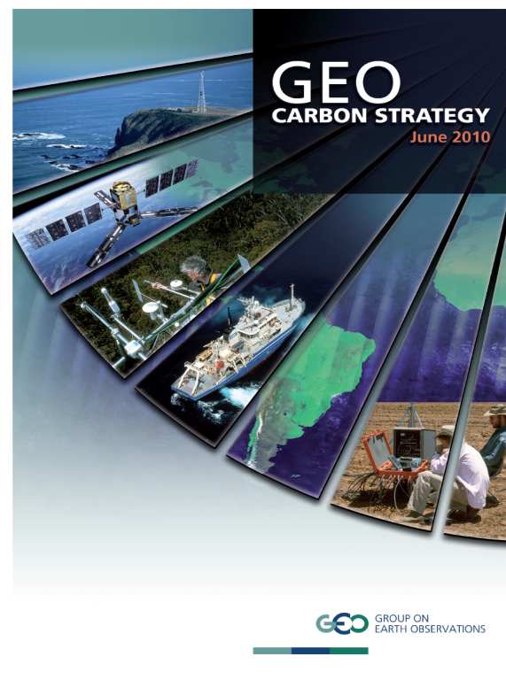
CEOS Response to the GEO Carbon Strategy
CEOS established a Carbon Task Force (CTF) to coordinate the response from the space agencies to the GEO Carbon Strategy.
  Take into account information requirements of both the UNFCCC and IPCC and consider how future satellite missions will support them
  Also take account of, and be consistent with, the GCOS and GEO Implementation Plans.
  Help definition of next generation missions for individual agencies (provide a long-term outlook, 2013-2028).
  Provide a basis for systematic observation and reporting of progress towards satisfying society’s carbon information needs
CEOS Strategy for Carbon Observations from Space

Slide 3
Current Status of Report
CEOS Strategy for Carbon Observations from Space is in ready to submit to CEOS SIT for consideration (review and approval)
  Open review period October - early December 2013
  Response to reviewers comments completed; major revision of actions/recommendations essentially complete
    CEOS Actions
    Challenges that CEOS can acknowledge
Report is on agenda for consideration at SIT-29; CTF has been requested to circulate final draft by end of February 2014 (we are now late by a few days!)

Slide 4
Report Structure and Chapter Leads
CEOS Strategy for Carbon Observations from Space
Executive Summary (Wickland, Nakajima, Plummer)
Chapter 1: Introduction (Nakajima, Wickland, Plummer, and Ward)
Chapter 2: Land Domain (Dubayah and Schmullius)
Chapter 3: Oceans and Inland Waters Domain (Sathyendranath)
Chapter 4: Atmosphere Domain (Moore)
Chapter 5: Integration (Plummer)
Chapter 6: The Way Forward (Wickland, Nakajima, Plummer)
References
Appendices

Slide 5
Summary of Actions: Continuity Missions
The report calls for CEOS agencies to assign high priority to continuing the following types of measurements for carbon:
Moderate-resolution land remote sensing data (e.g., MODIS, MERIS)
Medium-resolution land remote sensing data (e.g., SPOT, Landsat)
Ocean colour, sea surface temperature, and microwave sensor observations that are adequately calibrated and have sustained calibration/validation operations.
Ocean colour measurements with resolution and frequency of coverage adequate for coastal waters
Measurements with sufficient spatial resolution and sensitivity for inland water bodies (e.g., Landsat 8 and Sentinel-2 type measurements)
Atmospheric column measurements of X_{CO2} and X_{CH4} (e.g., GOSAT)

Slide 6
Summary of Actions: New Missions
The report calls for the CEOS member agencies to deploy new missions to acquire high priority, new observations of carbon. These high priority missions are:
A mission(s) to more accurately measure forest canopy height and estimate aboveground biomass (e.g., lidar, single-pass InSAR)
A mission(s) for observations of ocean colour with the higher temporal, spatial, and/or spectral resolution needed for coastal waters (likely geostationary)
A mission(s) to measure ocean salinity with higher spatial resolution than current missions
A constellation of passive and active LEO satellites measuring X_{CO2} and X_{CH4}
A constellation of passive GEO satellites measuring X_{CO2} and X_{CH4}

Slide 7
Summary of Actions: Data Products
The report indentifies actions to improve and enhance the utility of many remote sensing data products. In some cases, individual space agencies may be able to take the action, but most will require the international coordination, cooperation, and agreement. Of particular note are:
Development of protocols for the generation of products and enforcement of requirements for clarity and traceability in product generation
Development of guidelines for the specification of errors and uncertainties
Intercomparison of similar products from existing and new missions to ensure globally consistent products and enable integrated products
Efforts to make remote sensing data products consistent within domains, across domains, and with the requirements of intended uses
Efforts to ensure long-term continuity, consistency and archiving of their data and facilitate joint agency activities, where appropriate

Slide 8
Summary of Actions: New Data Products
The report also called for CEOS to encourage the development of new data products from existing missions. These include:
Maps of wetlands, inundated areas and small water bodies
Ocean colour-type products for inland water bodies
Ocean carbon pool products
River discharge and sediments
Merged time series products (same variable from differing sensors and platforms), using a product-based approach
Estimates of anthropogenic emissions

Slide 9
Summary of Actions: Calibration/Validation
The report calls for CEOS actions to ensure satellite data are well calibrated and data products are validated. Specific actions called for include:
Encourage national agencies to provide ground reference data for calibration and validation; CEOS should support efforts to establish, coordinate, and maintain observational networks (land, ocean and atmosphere) for this purpose
Assess the quality of validation and coverage for data products in each domain and develop a strategy for improvement
CEOS WGCV to establish a subgroup for validation of ocean carbon products analogous to the land product validation group
CEOS WGCV to expand the number of land variables being addressed by the land validation subgroup
CEOS should coordinate the cross calibration of all current and future satellites to measure atmospheric CO₂ and CH₄

Slide 10
Summary of Actions: Institutional Linkages
The report contains several recommendations for CEOS and its member agencies to engage with other groups and the carbon science community in order to improve communications and optimally address actions. These include:
Interactions with the GEO Carbon Community of Practice and the GEO Blue Planet initiative to advance work on new products and data product intercomparisons
Interactions with the carbon and climate modeling communities and CEOS Working Group on Climate in support of data-model intercomparisons
Interactions with the GEO carbon community of practice to understand science needs and priorities for missing measurements that satellites could provide beyond 2020

Slide 11
Major Action Regarding Implementation
Action-38: CEOS will establish a group to be responsible for carbon activities within CEOS and for advancing the findings and recommendations of this report. This group will take responsibility for overseeing, coordinating, and reporting on the actions identified in this report. It is recommended that CEOS establish a Carbon Subgroup within the CEOS WG on Climate as a most efficient way of implementing this action (this recommended group will hereafter be referred to as the "Carbon Subgroup"). The Carbon Subgroup will report to (and through) the WG Climate. It will establish strong working relationships with all relevant VCs and CEOS WGs, especially the WGCV.
Action-41: The CEOS Carbon Subgroup (recommended in Action-38) will report to the CEOS WG Climate. It will track and report upon progress in responding to the actions in the CEOS Strategy for Carbon Observations from Space in a manner similar to that for the CEOS Response to the GCOS Implementation Plan, which includes at a minimum annual reporting by the Carbon Subgroup through the WG Climate to the CEOS SIT and Plenary.

Slide 12
Actions Recommended for Carbon Subgroup
Product-Related:
Action-21: The CEOS Carbon Subgroup will coordinate with other relevant CEOS WGs and VCs to ensure that the carbon observations and data products that transcend traditional scientific domains (e.g. black carbon, nutrient fertilization) are accorded appropriate priority in CEOS activities and future plans and that key satellite products to permit scientific studies of these phenomena are produced and made available.
Action-24: The CEOS Carbon Subgroup will work to encourage the production and availability of high-quality, consistent long time series data products based on multiple sensors and missions for carbon and climate science and for model-data and data-data intercomparison exercises.
Action-25: The CEOS Carbon Subgroup and relevant VCs will provide periodic technical information to the research and operational space agencies regarding readiness for and issues regarding transitions from research to operations for long-time series carbon observations.
Action-26: The CEOS Carbon Subgroup, in consultation with the CEOS WGCV, will develop effective protocols for the generation of products from individual satellites and platforms and encourage their implementation by CEOS Agencies to ensure long-term consistent datasets relevant to carbon cycle community needs.

Slide 13
Actions Recommended for Carbon Subgroup
Action-29: The CEOS Carbon Subgroup will develop guidelines for the specification of uncertainty for carbon products from signal counts through the various CEOS Processing Levels.
Calibration/Validation-Related:
Action-9: CEOS WGCV and its relevant subgroups, in consultation with the CEOS Carbon Subgroup, will organize and coordinate carbon data product intercomparison activities as they are identified as priorities for CEOS action and in coordination with the wider carbon cycle science community.
Action-35: The CEOS Carbon Subgroup will develop guidelines for appropriate data use of satellite data and data products. This will require improved interactions between the carbon cycle community and the satellite community; comprehensive review of the current use of data products, including current data limitations; and reconciliation of methodological differences and spatial compatibility. Such interactions may include co-sponsorship of joint workshops targeting specific data needs and investment in community product assessments, especially for key intercomparison exercises.

Slide 14
Actions Recommended for Carbon Subgroup
Interactions / Linkages / Communications-Related:
Action-37: The CEOS Carbon Subgroup will serve as a point-of-contact for appropriate satellite products for major model-data intercomparison exercises related to the carbon cycle.
CEOS Mechanisms and Future Planning-Related:
Action-40: The CEOS Carbon Subgroup will lead in the planning for activities to 1) develop more specific measurement requirements for continuing and new carbon observations from space that will fulfill science and policy needs and 2) encourage further prioritization of these measurements. It will work, in consultation with the relevant VCs, to coordinate the incorporation of the refined requirements and priorities into multi-agency planning and preparation for future satellites.
Action-41: The CEOS Carbon Subgroup will report to the CEOS WG Climate. It will track and report upon progress in responding to the actions in the Strategy for Carbon Observations from Space in a manner similar to that for the CEOS Response to the GCOS Implementation Plan (IP), which includes at a minimum annual reporting by the Carbon Subgroup through the WG Climate to the CEOS SIT and Plenary.

Slide 15
WG Climate has a Strong Supporting Role in Other Actions
Many of these actions involve responsibilities the WG Climate already has, they are just customized for carbon in this report.
There are several important actions related to coordinating the improvement of data products and making them consistent (across sensors, platforms, domains)
Support of model and model-data intercomparison studies – and CEOS serving as a source of reliable information on the quality and utility of satellite data and data products for use in intercomparison studies – is the subject of several such actions
The report calls for recognition and acceptance of the priorities for missions to provide continuity data products and new data products for carbon science and policy

Slide 16
Backup Materials

Slide 17
Domain Chapter Authors
Atmosphere:
Berrien Moore (University of Oklahoma)
John Burrows (Universität Bremen)
David Crisp (NASA Jet Propulsion Laboratory)
Michio Kawamiya (Japan Agency for Marine-earth Science and Technology)
Martin Heimann (Max Plank Institute for Biogeochemistry, Jena)
Ray Nasser (Environment Canada)
Peter Rayner (Laboratoire des Sciences du Climat et de L'Environnement)
Ocean
Shubha Sathyendranath (Plymouth Marine Lab)
Prakash Chauhan (Indian Space Research Organization)
Watson Gregg (NASA Goddard Space Flight Center)
Nicolas Hoepffner (Joint Research Centre)
Joji Ishizaka (Nagoya University)
Johnny Johannessen (Nansen Environmental and Remote Sensing Centre)
Milton Kampel (Instituto Nacional de Pesquisas Espaciais)
Tiit Kutser (University of Tartu)
Trevor Platt (Bedford Institute of Oceanography)
J-H Ryu (Korea Ocean Satellite Center)

Slide 18
Domain Chapter Authors
Land
Chris Schmullius (Friedrich-Schiller University Jena)
Ralph Dubayah (University of Maryland)
Warren Cohen (USDA Forest Service)
Eric Kasischke (University of Maryland)
Kyle McDonald (City College of New York)
Shaun Quegan (The University of Sheffield)
Jean Ometto (Instituto Nacional de Pesquisas Espaciais)
Stephen Plummer (European Space Agency)
Steven Running (University of Montana)
Sassan Saatchi (NASA Jet Propulsion Laboratory)
Masanobu Shimada (Japan Aerospace Exploration Agency)

