Slide 1
Architecture case study activity
Mark Dowell
European Commission – JRC mark.dowell@jrc.ec.europa.eu based on discussions with S. Bojinski, W. Zhang & R. Husband

Slide 2
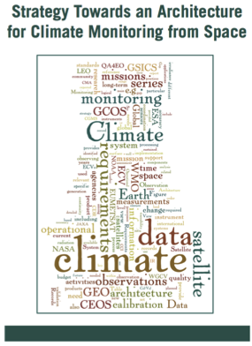
From the Strategy Report – Roadmap for the Way Forward
“In the short-term it is also necessary to verify that the proposed logical view adequately supports, in a top-down context, the depiction of the required information flows, from the decision-making process back to the sensing capacity/requirements. This capability is fundamental in ensuring that the policy makers are able to appreciate the demand for an integrated climate monitoring capability that meets their policy needs.”

Slide 3
Proposed Activity
Define, Validate and Obtain Consensus on Overall Approach (including logical representation)
Undertake a series of Case Studies making use of the logical architecture and providing walkthroughs
Demonstrating the Architectures validity from defined policy/decision making requirements back through specific applications to the necessary thematic climate data records and ultimately the required observing system.
Short-term
(2 years)
Describe Current and Planned Implementation Arrangements (ECV-by-ECV) within an Inventory
Mid-term
(2-4 years)
Use the Inventory to Develop a Coordinated Action Plan to Address Identified Gaps/Shortfalls

Slide 4
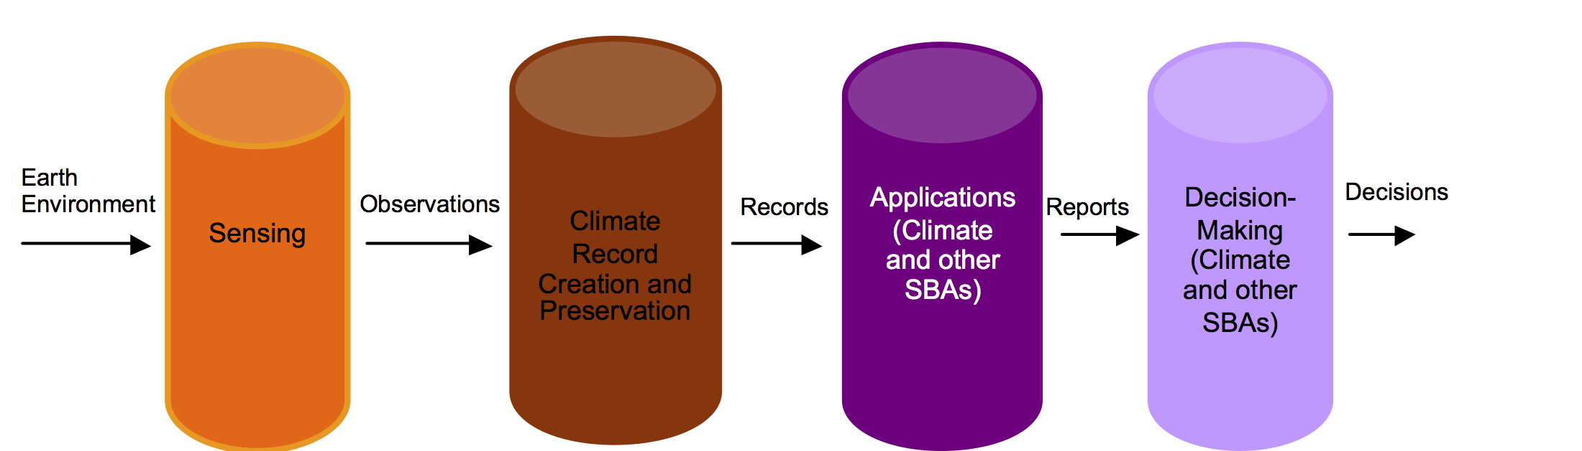
Emphasis on the right-had side of the Architecture
More focused on the right-hand side of the Architecture i.e. the application and decision/policy pillars, than the original Strategy report, and in fact we may end up providing feedback to the Logical Architecture helping to refine/expand those right-hand components.

Slide 5
Dual Purpose
“Internal” validation of the Architecture
Demonstrate it's value to external communities
NB: This analysis could also be used to demonstrate the resourcing requirements for the observation system components to the funding agencies, an therefore should be prepared in a way that is "amenable" to that audience.

Slide 6
Scope of Activity
Won't be exhaustive but we should be able to identify different case studies which are appealing to different communities.
Suggest that we use the GFCS global-regional-national/local subdivision and identify several case studies within each.
For the regional I bring in some European examples and link to the Copernicus Services.
For the national we have had some passed interest e.g. Canada and S. Africa – need to find others
Try to have crosscutting thematic coverage, maybe using the GFCS Priority Areas, but also consider some politically prominent
Should be addressing three broad categories: climate risk/extreme events, adaptation and mitigation.

Slide 7

Sources of Case Studies
Climate Exchange Sections: Agriculture, Water, Health, DRR, Energy, Transport, Ecosystems, Urban Issues.
Policy in context of International Frameworks e.g. REDD+
Existing Climate Services (national & regional e.g. Copernicus Climate Change Service)
National & regional policy on Climate Adaptation (e.g. EU Climate Adaptation Strategy)
Communities – e.g. Small Island States
Should include examples based on in-situ data requirements

Slide 8
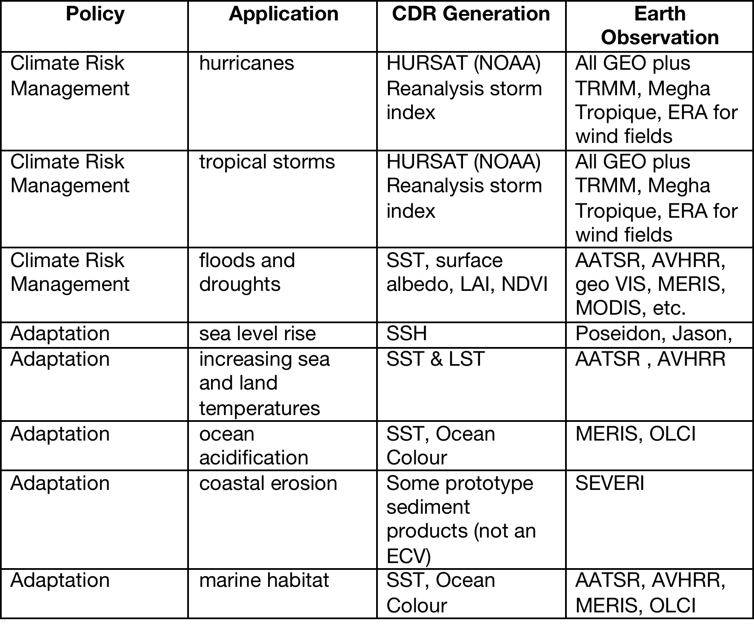
SIS Priorities mapped onto Architecture Pillars

Slide 9
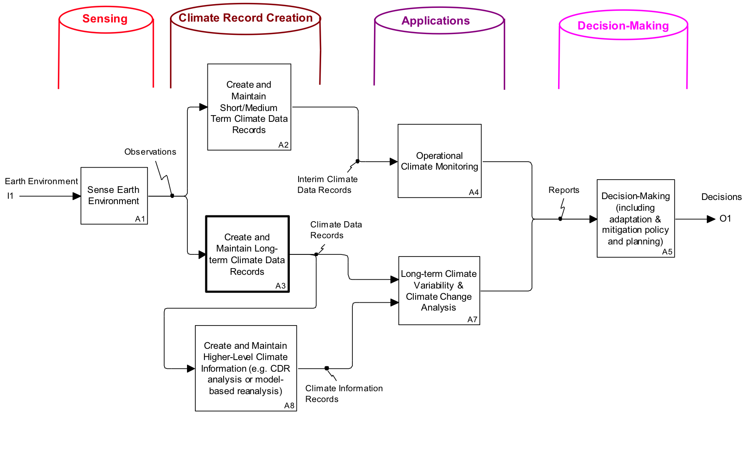
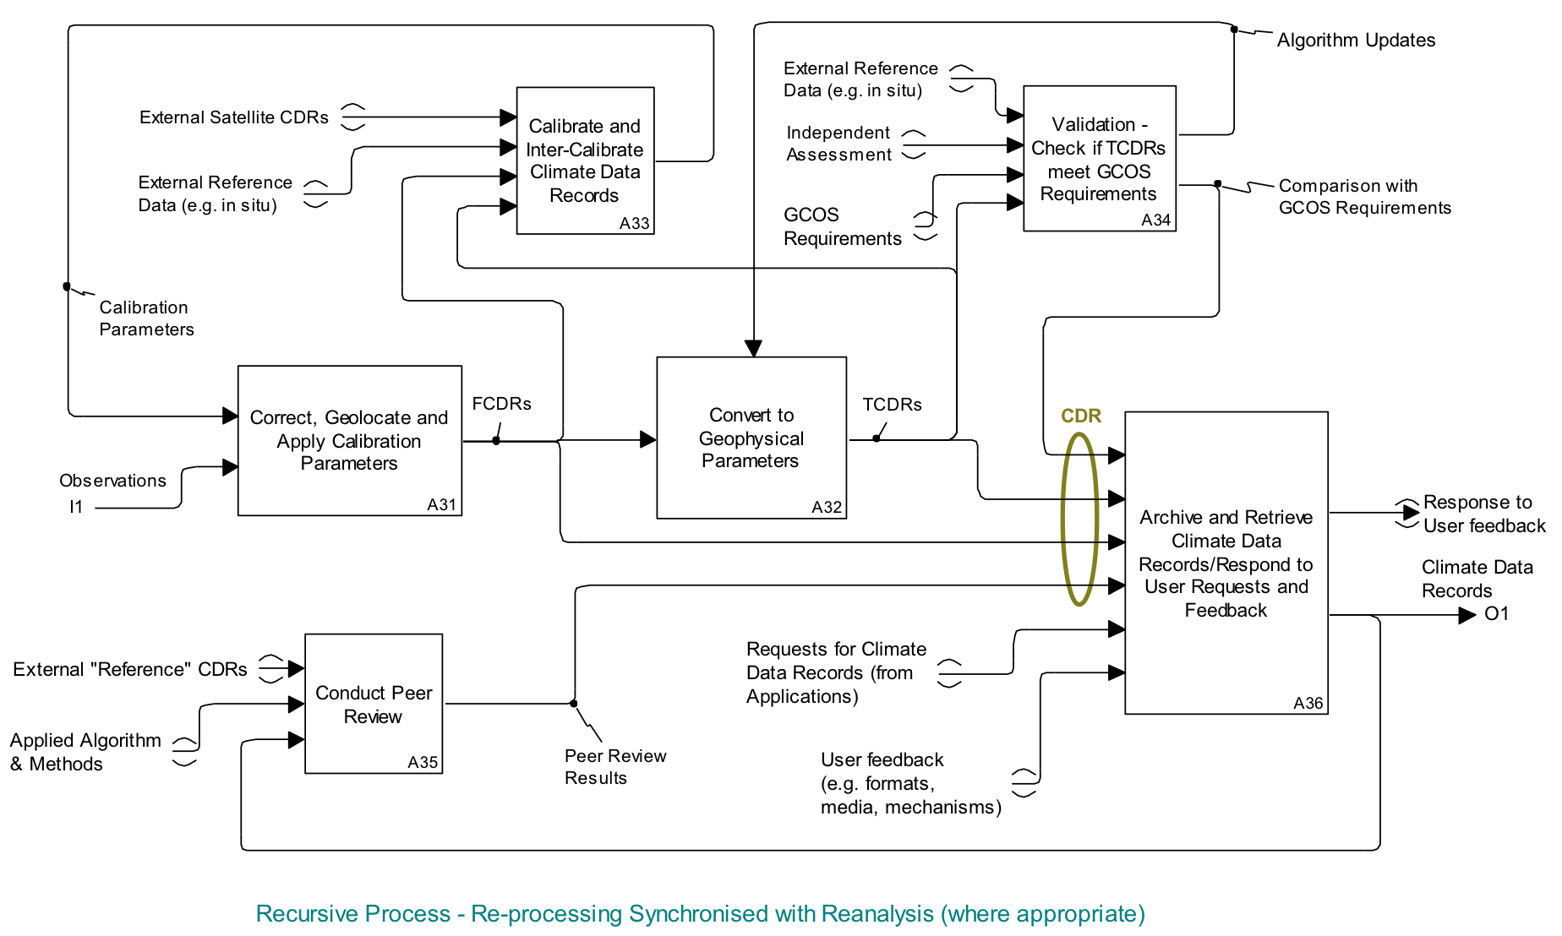
Logical representation
Traceable to GCOS Guidelines and GCOS Climate Monitoring Principles
Traceable from ECV Inventory and physical representation of Climate Monitoring Architecture

Slide 10
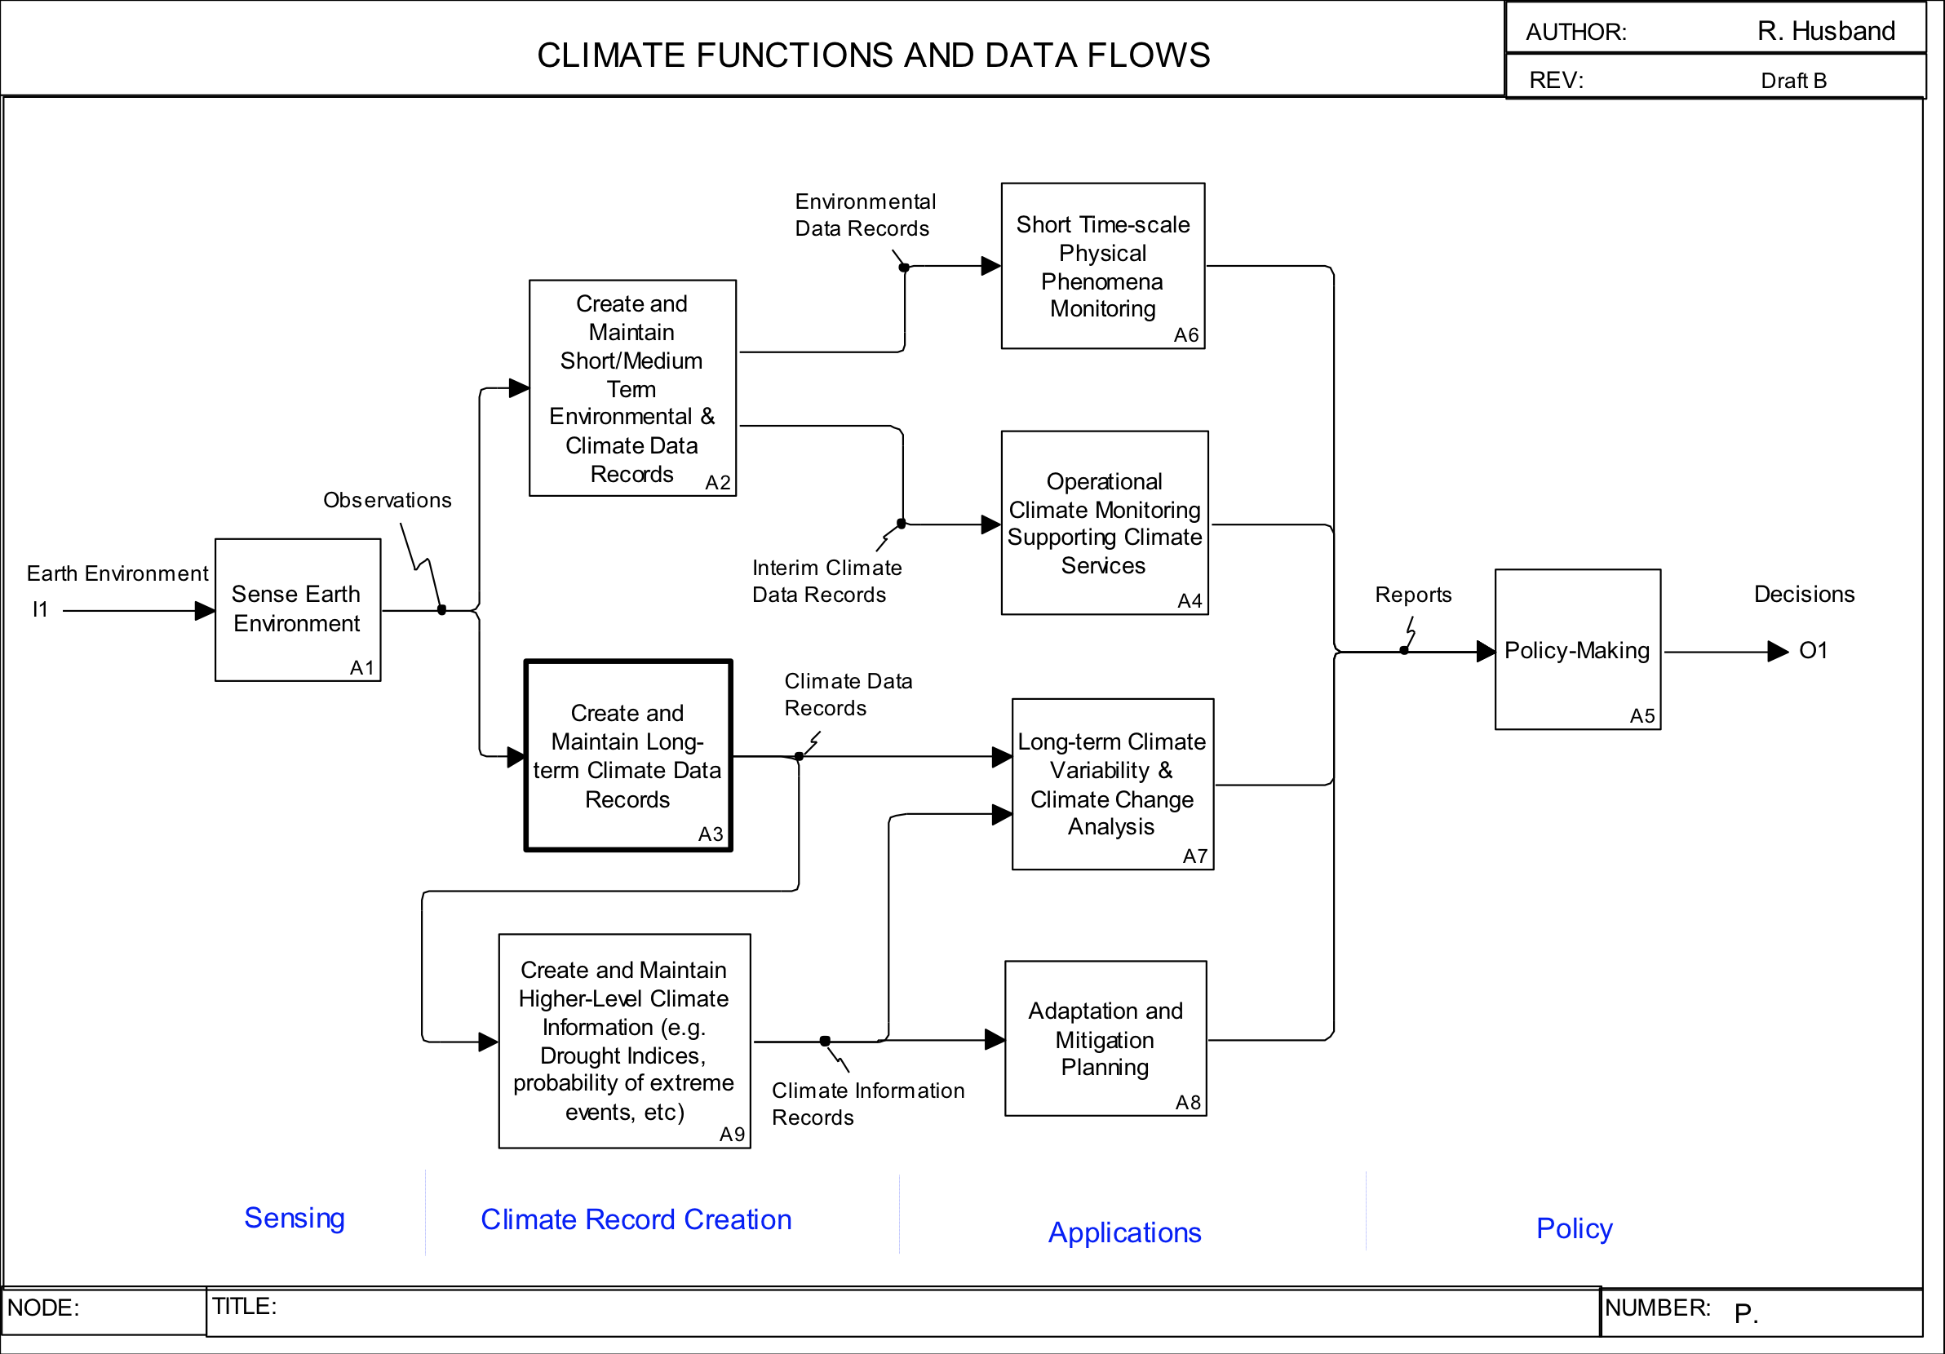
Case Studies
NB: Continuity in change obligation is on reducing rate
FCDR Current/Future:
LDCM
Sentinel-2
CBERS
…
Anomalies
FAPAR
Fires
Event -based
NB: Timescale requirements may not be as strict as for other applications
Landcover
Nat/Reg
summary tables
National blocks
REDD
Change
FCDR Current/Future:
High Res optical/spectral TOA L
Microwave
National Reports
FCDR Past:
MSS, Landsat
Spot
CBERS
ASTER
DMC
…
Landcover baseline 1990 (?)
X
Ancillary data
Fires
Albedo
Clouds
FAPAR
REDD
Unlikely to be needed
Maybe Landuse

Slide 11
Final Product
Ultimately we would produce a companion to the strategy report, presenting the Case Studies using a consistent format.
With the necessary background information/context and clearly mapping the application datasets, observing system requirement onto the logical Architecture.
We may also think of some kind of web/dynamic version of the report.
The report could have a title like "Establishing an Architecture for Climate Monitoring through Case Studies for Climate Services".
Keep this activity in the context of the general Architecture activities and reporting to the new Joint WGClimate, I see no reason why they couldn't actually be published, maybe as a joint WMO-EC/JRC report - Up for discussion
Notes:
establish |ɪˈstablɪʃ, ɛ-|
verb [ with obj. ]
1 set up on a firm or permanent basis: the scheme was established in 1975.
• initiate or bring about (contact or communication): the two countries established diplomatic relations in 1992.
2 achieve permanent acceptance or recognition for: the principle of the supremacy of national parliaments needs to be firmly established | he had established himself as a film star.
• introduce (a character, set, or location) into a film or play and allow its identification: establish the location with a wide shot.
3 show (something) to be true or certain by determining the facts: [ with clause ] : the police established that the two passports were forgeries.
4 Bridge ensure that one's remaining cards in (a suit) will be winners (if not trumped) by playing off the high cards in that suit. the right plan would be to establish dummy's diamonds.

Slide 12
Next Steps
Identify interested parties: EC-JRC, WMO, EUMETSAT, CSA?, NSC?, South Africa?, opportunity for “smaller” Agencies
Identify existing initiatives that may be interested/complementary i.e. ET-SUP, GCOS scoping Activity, GFCS Pilots
Discuss feasible number of Case Studies ~ 10 - 20
Identify case studies Global-Regional-Local, thematic and community representation, satellite and in-situ “driven”
Define template(s) for individual cases studies
Organise a dedicated workshop to ensure consistency in completing Case studies
Compile report including Background, Case Studies, Commonalities, Lesson Learned & Feedback to Architecture
Possible timeline IBCS-2 November 2014, may be too “aggressive”

Slide 13
CALL FOR EXPRESSIONS OF INTEREST EXPERTS FOR THE "Copernicus Expert Group”
“The European Commission has decided to establish a Copernicus Expert Group to provide independent advice concerning the status and evolution of the Copernicus Earth Observation programme and delivered results. Individuals from the Copernicus Expert Group will be called upon to form specific Topical Panels to examine issues arising from the initial operations and longer-term development of the Copernicus services…“ http://copernicus-expert-group.jrc.ec.europa.eu

