Slide 1
WGClimate Work Plan for 2014-2016
John Bates, Chair WGClimate

Slide 2
Outline
Work plan outlines what activities WGClimate will undertake in the next few years to accomplish its goals
The architecture strategy forms the basis for moving forward to achieve the goals of WGClimate
The architecture allows for participation of agencies across a broad range of time scales and societal applications
I invite WGClimate members to help work in areas that benefit both their agencies and the broader climate community

Slide 3
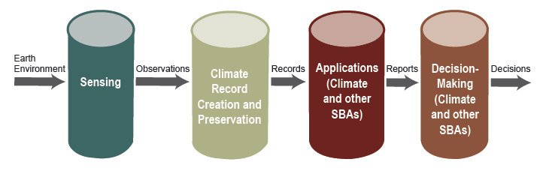
Architecture 4 Pillars

Slide 4
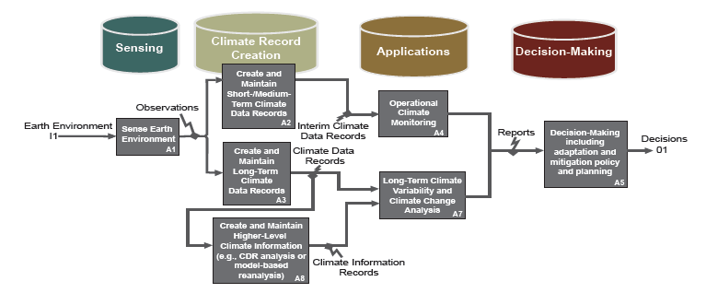
Architecture – Data Flow

Slide 5
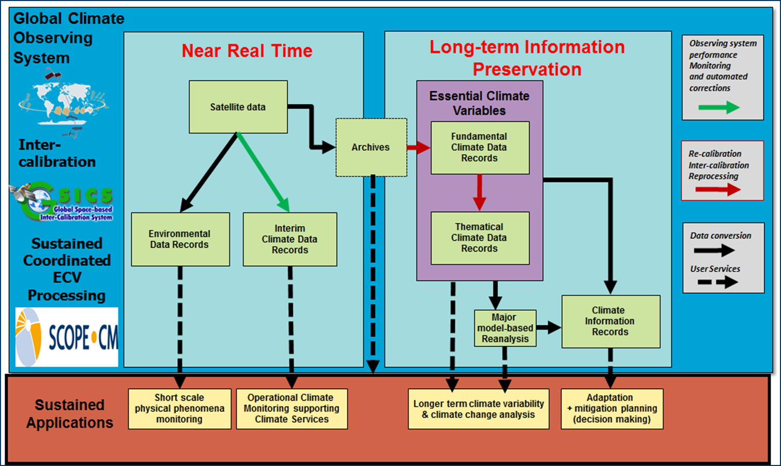
Architecture – Latency/Application View

Slide 6
WGClimate Work Plan –
Climate Monitoring, Research, and Services
CMRS-1: ECV inventory (first version) Q2 2014
  The ECV inventory provides the foundation for the fulfillment of the three main objectives assigned to the Joint Working Group. At the 1st meeting of the Joint Working Group in March 2014, the current status of the inventory will be reviewed in the three domains (land, ocean and atmosphere) and the actions needed to achieve "Version 1" status of the inventory will be identified.
In Agenda Item 4, we will get familiar with the inventory and provide feedback to the developers so they can provide analysis tools

Slide 7
WGClimate Work Plan –
Climate Monitoring, Research, and Services
CMRS-2: Gap analysis (first version) Q4 2014
  Also, at the 1st meeting of the Joint Working Group, the reference process will be defined for the gap analysis (including guidelines for ECV assessments), together with the necessary tools to support the implementation of this process. The gap analysis activities will commence once: a) Version 1 of the ECV inventory is available, and b) the reference process for the gap analysis and supporting tools are available.
In agenda Item 4 discussion sections, we will devise a approach for how we would conduct a gap analysis. An analysis will be performed for a select set of ECVs by the end of the year

Slide 8
WGClimate Work Plan –
Climate Monitoring, Research, and Services
CMRS-3: Action plan (first version) Q1 2015
  Once the gap analysis has been completed, a coordinated action plan will be developed to:
    Create the conditions for delivering further climate data records from existing observational data by targeting processing gaps/shortfalls/opportunities (e.g., cross-calibration, reprocessing)
    Optimize the planning of future satellite missions and constellations to expand existing and planned climate data records, in terms of both coverage and record length, and to address gaps with respect to GCOS requirements
This is the logical continuation of CMRS-2. Each case study will identify appropriate follow on actions

Slide 9
WGClimate Work Plan –
Climate Monitoring, Research, and Services
CMRS-4: Case studies linking CDRs to societal applications and informed policy decisions Q1 2015
  In order to provide a connection between the availability of climate data records and the socio-economic benefits that could accrue, particularly from a policy-making perspective, case studies will be performed to characterize the link between the capability to make informed policy decisions and the availability of climate data record information. These case studies will make use of the climate monitoring architecture and are expected to involve drilling down within the Applications and Decision-making pillars of the architecture. One of the case studies will be in an application area of the Global Framework for Climate Services (GFCS)—see CMRS-5.
In Agenda Item 3, we will discuss how ECVs/CDRs can be used to address societal applications and decision making. We would like to identify several case studies, including one from the GFCS priority areas

Slide 10
WGClimate Work Plan –
Climate Monitoring, Research, and Services
CMRS-5: Contributions to the Global Framework for Climate Services (GFCS) Q4 2014
  The Joint Working Group will examine the most effective means of contributing to the GFCS from the viewpoints of: a) ensuring adequate representation of the capabilities and plans of CEOS and CGMS agencies, as represented by the ECV inventory, gap analyses and action plan, and b) formalization of the relationship between the GFCS and the Joint Working Group, including possible GFCS representation in working group meetings.
In Agenda Item 3, we will have an overview of GFCS and follow up by identifying what ECVs/CDRs might be used to apply to a GFCS priority area

Slide 11
WGClimate Work Plan –
Climate Monitoring, Research, and Services
CMRS-6: Report to UNFCCC Subsidiary Body for Scientific and Technological Advice-Research and Systematic Observation (SBSTA-RSO) Q4 2014
  This report will address CEOS and CGMS support to the GCOS implementation plan, as well as CEOS contributions to GFOI and Carbon Strategy. In addition, relevant CGMS-specific activities may also be included.
Understand how to incorporate GCOS plans with this reporting function. Also include updates on other items of interest such as forest (GFOI) and carbon (CTF)

Slide 12
WGClimate Work Plan –
Climate Monitoring, Research, and Services
CMRS-7: Incorporation of in situ data holdings within the ECV inventory Q4 2015
  In order to extend the benefits of the infrastructure of the ECV inventory to climate-relevant in situ data holdings, in January 2013 it was agreed to assess the feasibility of incorporating such information within the scope of the ECV inventory. At the 1st meeting of the Joint Working Group progress on this objective will be assessed.
Led by GOSIC and in coordination with WCRP Data Advisory Council and GCOS, in situ ECV providers will enter data into ECV questionnaire tool

Slide 13
WGClimate Work Plan –
Climate Monitoring, Research, and Services
CMRS-8: Update of ECV inventory, gap analysis and action plan (version 2) Q2 2015 to Q4 2016
  Once the first full cycle has been completed (see CMRS-1 to CMRS-3), resulting in Version 1 of the ECV inventory, gap analysis and action plan, a new cycle will be triggered by the availability of an updated ECV inventory, leading to Version 2 of these deliverables.
Our experience with this first cycle will lead to iterative improvements and an ability to provide continuous feedback to achieve the WGClimate goals

Slide 14
CGMS Climate Actions
Plen G.1.1 – 41.12 - CGMS Plenary proposes that the CGMS/CEOS joint climate WG establish an inventory of FCDRs including for each one: Information on
  contributing missions and instruments
  calibration and cross-calibration
  contributing agencies
  and reference to ECV/TCDRs which could be extracted.
  To be done in addition to and in full consistency with the existing ECV-driven inventory of TCDRs.
This will be discussed in further detail in Agenda items 3 and 4. Need to better understand intended users and use cases.

Slide 15
CGMS Climate Actions
Plenary G.1.1 – 41.13 - The CEOS/CGMS joint climate working group to report to each CGMS plenary session
  Approval pending by NOAA to have Bates attend

Slide 16
CGMS Climate Actions
Plenary G.1.2 R 41.01
  Space-based climate architecture: To extend the ECV product inventory to FCDRs
Duplicate with Plenary G.1.1 – 41.12

Slide 17
CGMS Climate Actions
Plenary G.1.2 R 41.02
  Space-based climate architecture: the design phase of new sensors should include an analysis of compatibility with heritage instruments.
Recommend inclusion into next WGClimate architecture report

Slide 18
CGMS Climate Actions
WG IV 39.51
  Action 39.51: All CGMS Members to propose using interoperability standards for providing and sharing of climate data records and report on their efforts at the next meeting of CGMS Deadline: CGMS-40
Recommend to close or modify for inclusion into future architecture work by WGClimate

Slide 19
Action Requests from VCs & WGs
Action request from SST VC
  Consider adopting curation standards as proposed in “Curation of sensor information, for climate data records from space”
  Scan instrument documentation?
Identify with MIM and ECV inventory what is captured and what would need to be added
Identify CGMS action to Agencies to scan

