Slide 1
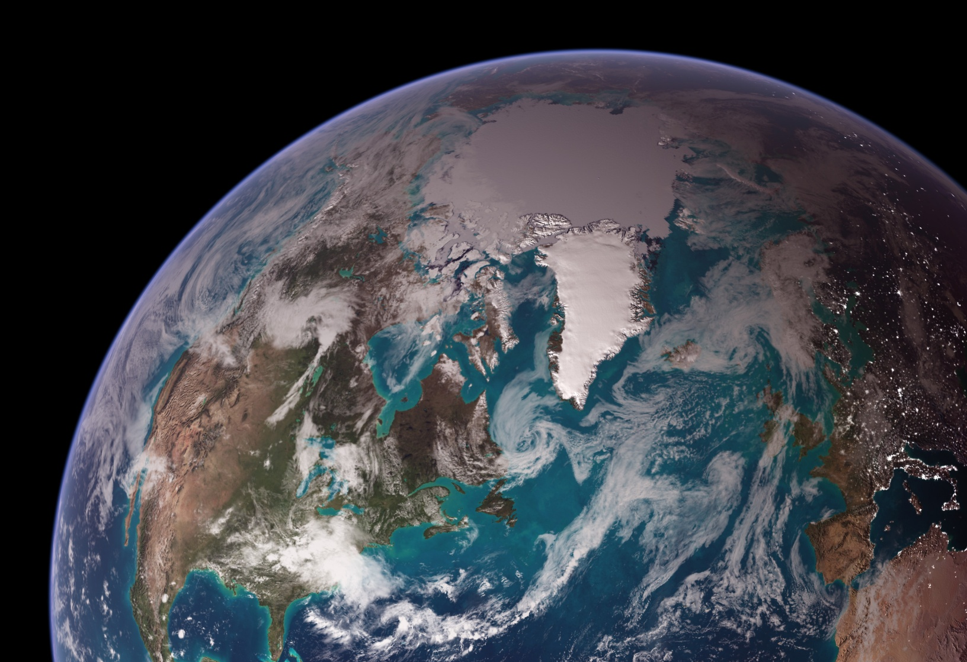
NOAA’s Climate Data Records (CDRs)
Walter Glance
(CDR Program Manger)
&
Tom Zhao
(CDR Program Scientist)
Notes:
Note composite image contains “city lights at night” in east, terminator, and RGB in west.
Define Operational: sustained and reliable (greater redundancy, including on-orbit and “callable” backups).

Slide 2
What Are Climate Data Records and Why Are They Important?
Climate Data Records (CDRs) are time series of measurements of
sufficient length, consistency, and continuity to determine climate
variability and change (National Research Council, 2004)
NOAA’s CDRs comprise the longest record of global operational
satellite measurements in the world. By applying knowledge gathered over time about instruments’ performance and sensor characteristics, the data are reprocessed to create consistent long-term records with climate quality.
The information revealed in the NOAA CDRs are critical for improving science understanding of climate changes and the Nation’s resilience to climate changes and variability.

Slide 3
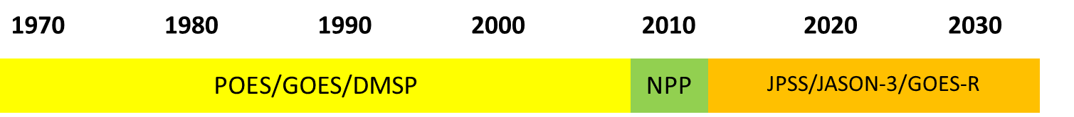
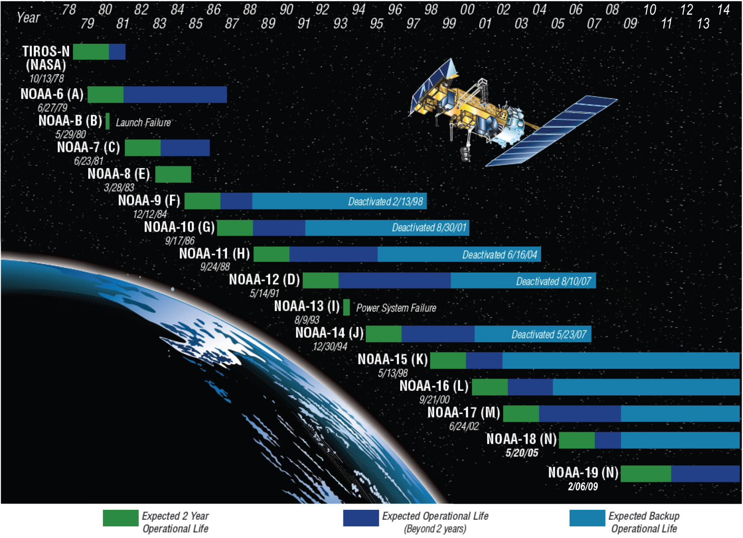
NOAA CDRs Cover Three Major Satellite Epochs

Slide 4
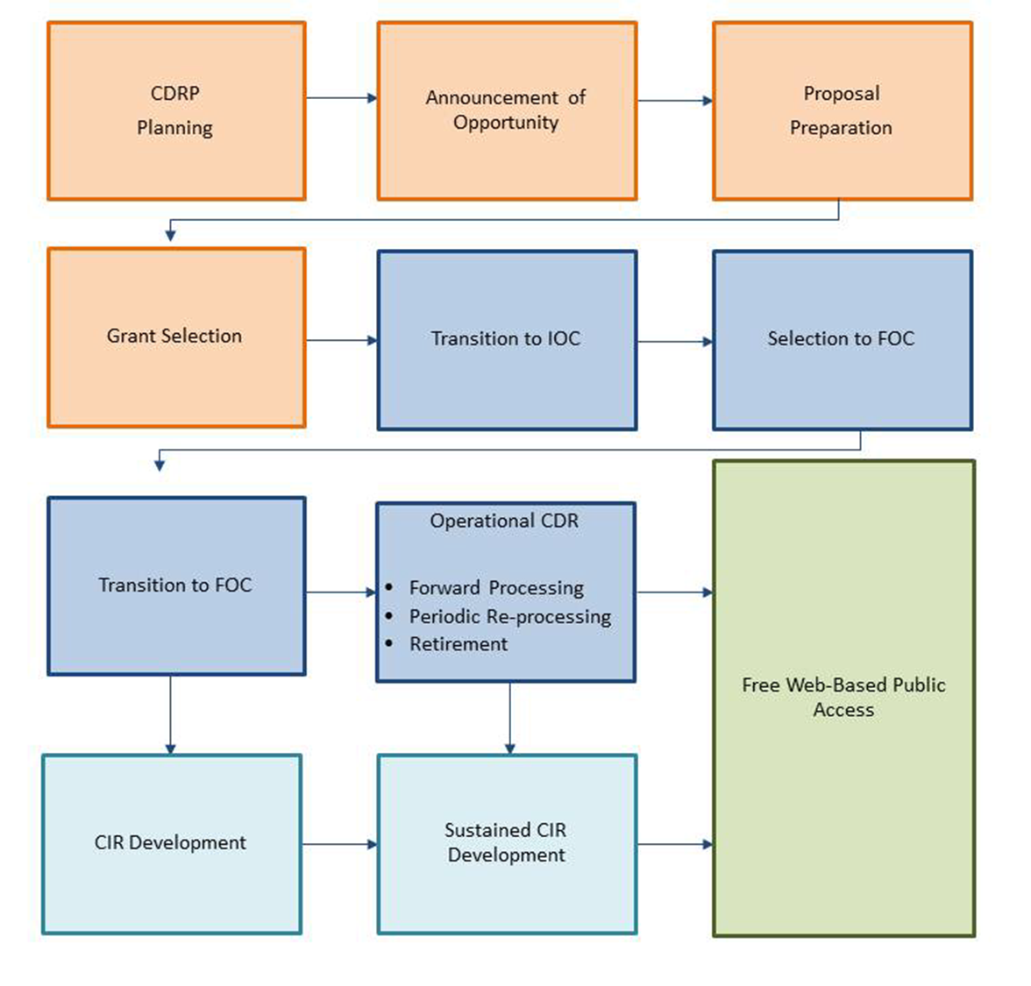
Production of NOAA CDRs
Notes: CDRP: CDR Program; IOC: Initial Operation Capability; FOC: Final Operation Capability; CIR: Climate information Record (derived from CDR)

Slide 5
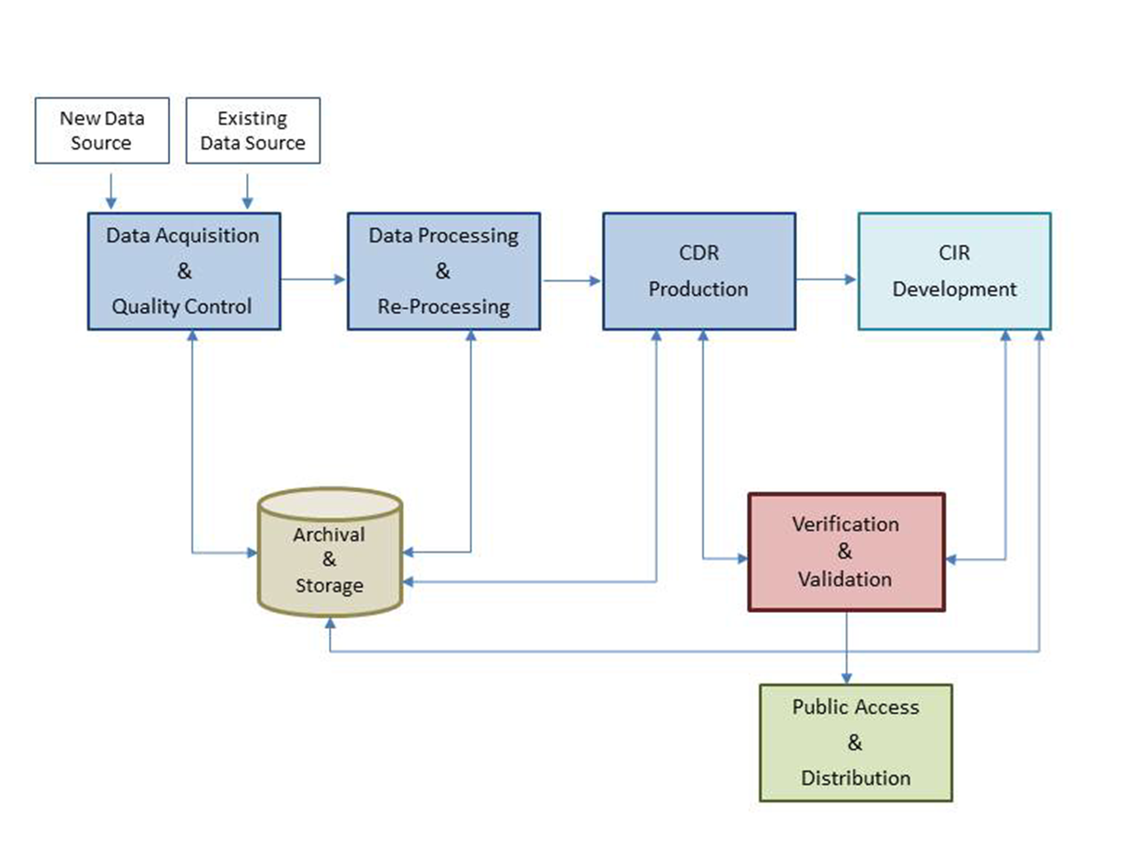
CDR Data Processing Flow Diagram

Slide 6
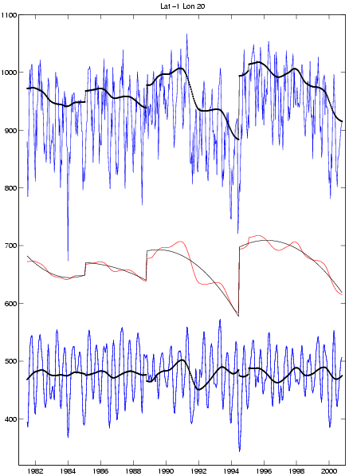
Why Recommend CDRs to Customers?
Homogenization reduces artifacts imparted by observing systems,
facilitating meaningful comparisons in space and time
Operational weather and hazard products
are produced rapidly to potentially save life and property
New satellite launched
Vegetation Greenness Index
Climate Data Records (CDRs)
provide long term product consistency through rigorous reprocessing with advanced algorithms, ancillary data and evolved instrument understanding.
Time (year)

Slide 7
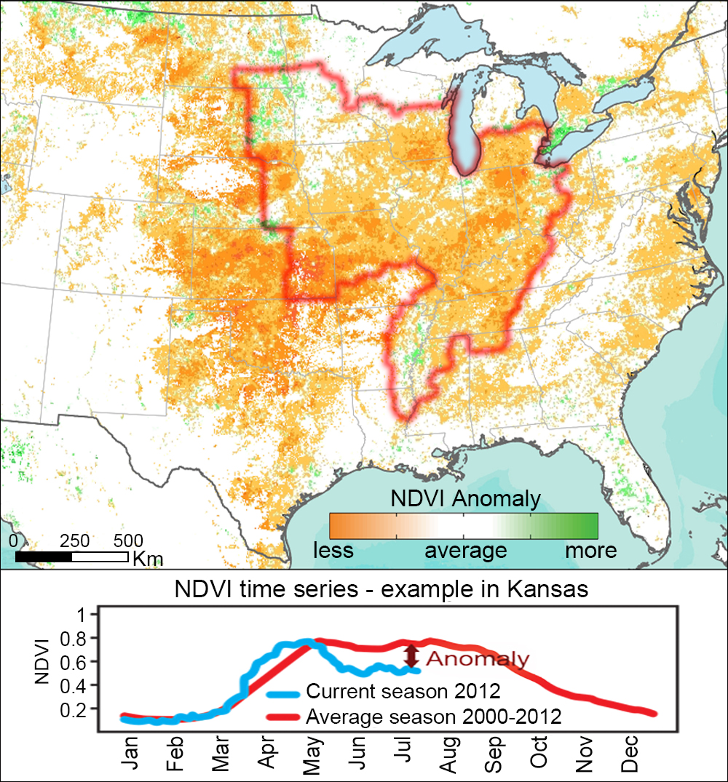
2012 drought depicted by Vegetation Index CDR (July 17)
CDRs Supporting Farming and Agribusiness
Example: historical context
5 km resolution,
“wall-to-wall” (globally)
Historical record from 1981- to current
Collatoral products
  Surface Reflectance
  Leaf Area Index (LAI)
  FPAR (photosynthetically active radiation)
Primary U.S. corn and soybean region

Slide 8
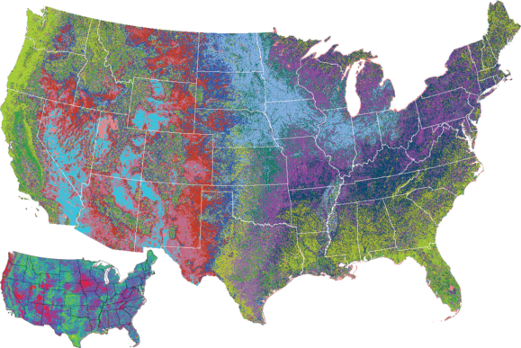
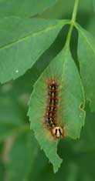
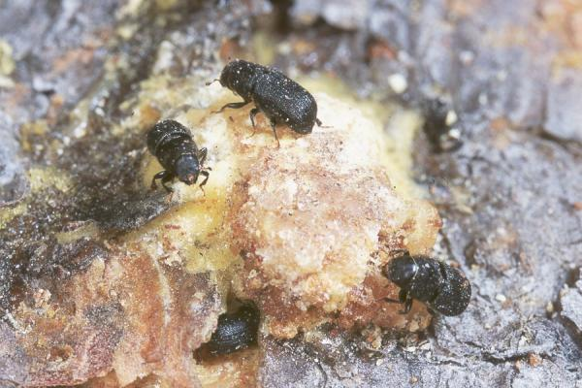
CDRs Supporting Resource Management
Example: Forest Change Detection
Project Goals
USDA and NASA are developing a capability to assess forest health using a satellite-derived Vegetation Index
Opportunity
The CDR Program will leverage NASA and USDA research and transition to operations.
Expanding ranges of forest scavengers linked to climate trends
Output and Impact
CDR Program produces a 30 year times series of Vegetation Index suitable for identifying forest health trends, leading to better forest and resource management.
Partners
USDA Southern Research Station, NASA and NOAA
Gypsy moth larvae
Pine Beetles

Slide 9
Temporal Scale of Agricultural Stakeholder Interests
Days
Months
Years
<1 10 20 1 3 6 9 1 3 5 10 50 100<
Farmer
Consumer
Crop Breeder
Reservoir Construction
Aid Agency
Emissions Policymaker
Regulatory Agency
Commodities Trader
Biofuel or Processing Plant Construction
Elected Official
(Re-)Insurance Companies
Disaster Relief
Development Aid

Slide 10
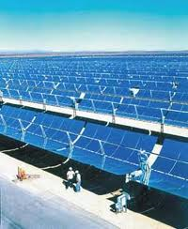
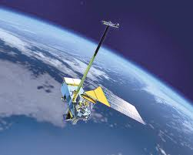
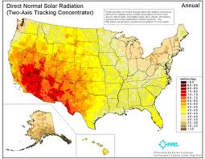
CDRs Supporting Energy Sector
Example: Solar farm siting
A collaboration between NOAA, NASA, Academia, Private Sector and NREL
Raw Observations
Fundamental CDRs
(Calibrate Data)
Thematic CDRs
(Geophysical Data)
Climate Information
(Derived Goods & Services)
NOAA & NASA
raw satellite data
Merged and corrected
NOAA & NASA
data provide trustworthy
multi-decadal time series
Standards of the renewable
energy community applied
Siting information for major solar energy farms
NREL= National Renewable Energy Laboratory

Slide 11
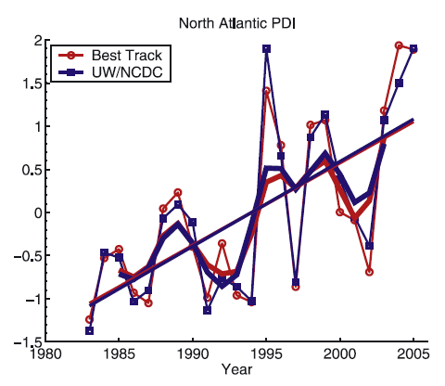
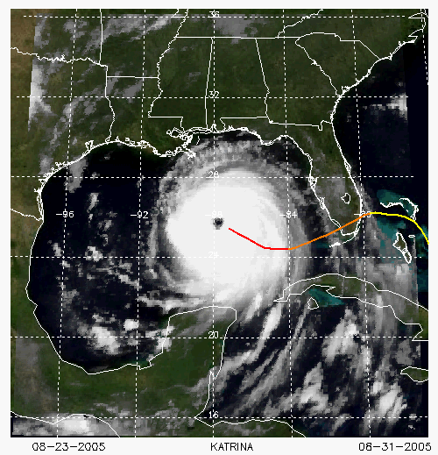
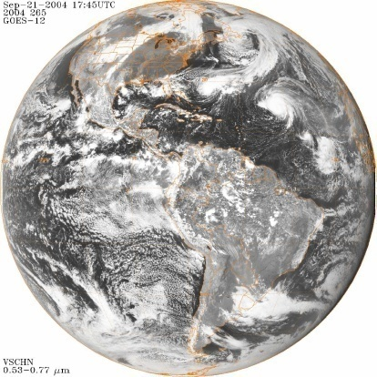
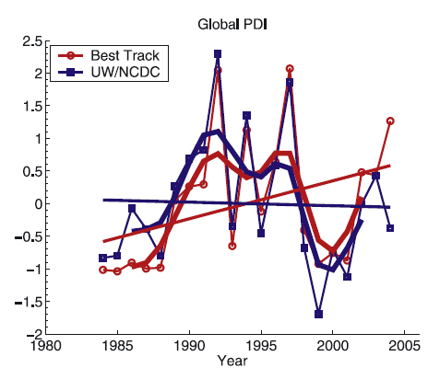
CDRs Supporting Insurance/Reinsurance
Example: Hurricane Trends
Government provision
of data
Transition from
government to industry
Decision support information
Hurricane intensity trends
(Kossin et al. 2007)

Slide 12
Current NOAA CDR Products
Notes: FCDR: Fundamental CDR; OLR: Outgoing Long-wave Radiation
AOT: Aerosol Optical Thickness; SST: Sea Surface Temperature
NDVI: Normalized Difference Vegetation Index; LAI: Leaf Area Index

