Slide 1
German National Report
CGMS / CEOS Working Group Climate
Albrecht von Bargen
German Aerospace Center, Space Administration

Slide 2






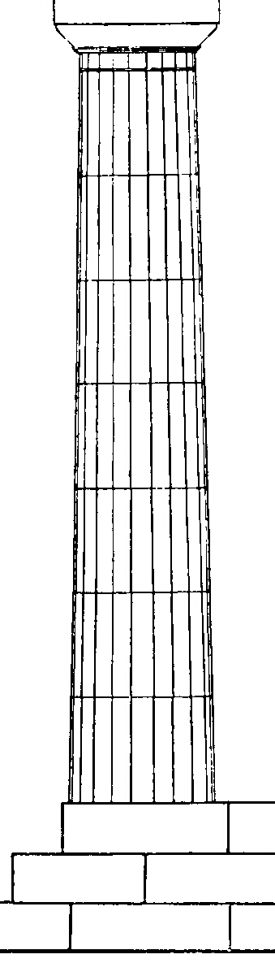





German Earth Observation Programme
International Co-operation
bi-/multilateral
CEOS
GEO
Int. Charter
„Space and Major Disasters“
Operational
European
Programmes
National Programme
BMWi
(Federal Ministry of Economics and Technology)
Programme

Slide 3
Earth Observation Missions (I)
Atmosphere
SCIAMACHY (ENVISAT) (2002 – 2012)
(AO contribution by DLR/NSO/BelSpo)
  Data access:
  ESA / EO-Portal
  https://earth.esa.int/web/guest/data-access
  https://earth.esa.int/web/guest/pi-community
  http://www.eoportal.org/
  EUMETSAT
  http://www.eumetsat.int/Home/Main/DataAccess/EOPortal/index.htm?l=en
  World Data Center for Remote Sensing of the Atmosphere
  http://wdc.dlr.de/
Gravity
CHAMP
GRACE / GRACE-FO (GFZ/DLR) in cooperation with NASA
  Radio occultation products (humidity / temperature profile)
  Data access: http://isdc.gfz-potsdam.de/index.php

Slide 4
Earth Observation Missions (II)
TerraSAR-X / TanDEM-X
  First & second global (& first Antarctica) acquisition completed,
  third & fourth coverage in progress
  Data acquisition for the global DEM to finish by the end of 2014
  Delivery of Global DEM commenced in January 2014
  http://sss.terrasar-x.dlr.de/
  IGOR => http://isdc.gfz-potsdam.de/index.php
Future Missions
  Hyper-spectral imaging mission: EnMAP
  In-kind contribution to MetOp 2nd Generation: MetImage
  French / German CH₄ Lidar: MERLIN

Slide 5
Climate related activities
Direct National contributions
  German Weather Service (DWD)
  R&D initiative by different National Ministries:
  see for example: World Data Center for Climate (http://www.dkrz.de/daten/wdcc/)
  DLR internal R&D
  Universities and Research Institutes
EUMETSAT SAF (includes additional national co-funding)
  Climate Monitoring SAF (CM-SAF) led by DWD
  Ozone Monitoring SAR (O3-SAF)
ESA CCI programme line
  Lead in Aerosols and Cloud ECV projects
  Strong contributors from Germany in most of the ECV projects

Slide 6
Example from R&D
Provided by Markus Rapp, DLR, Institute of Atmospheric Physics

Slide 7
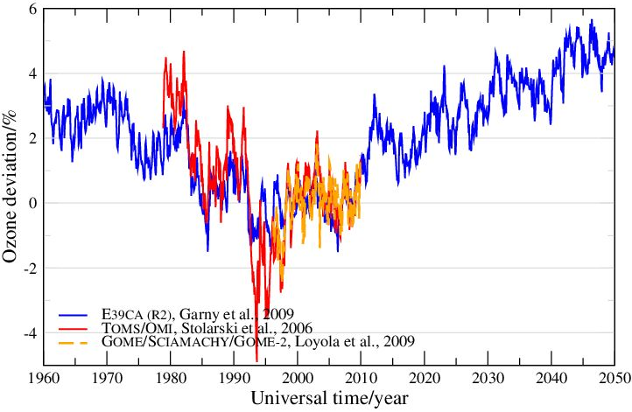
The evolution of stratospheric ozone
Numerical model simulations:
Reproduction of observations – evaluation studies
Understanding of changes and trends
Investigation of climate-ozone connections
Prediction of future ozone layer
Dameris (DLR-IPA)
Loyola (DLR-IMF)
Strong relation to the ESA-CCI ozone project

Slide 8
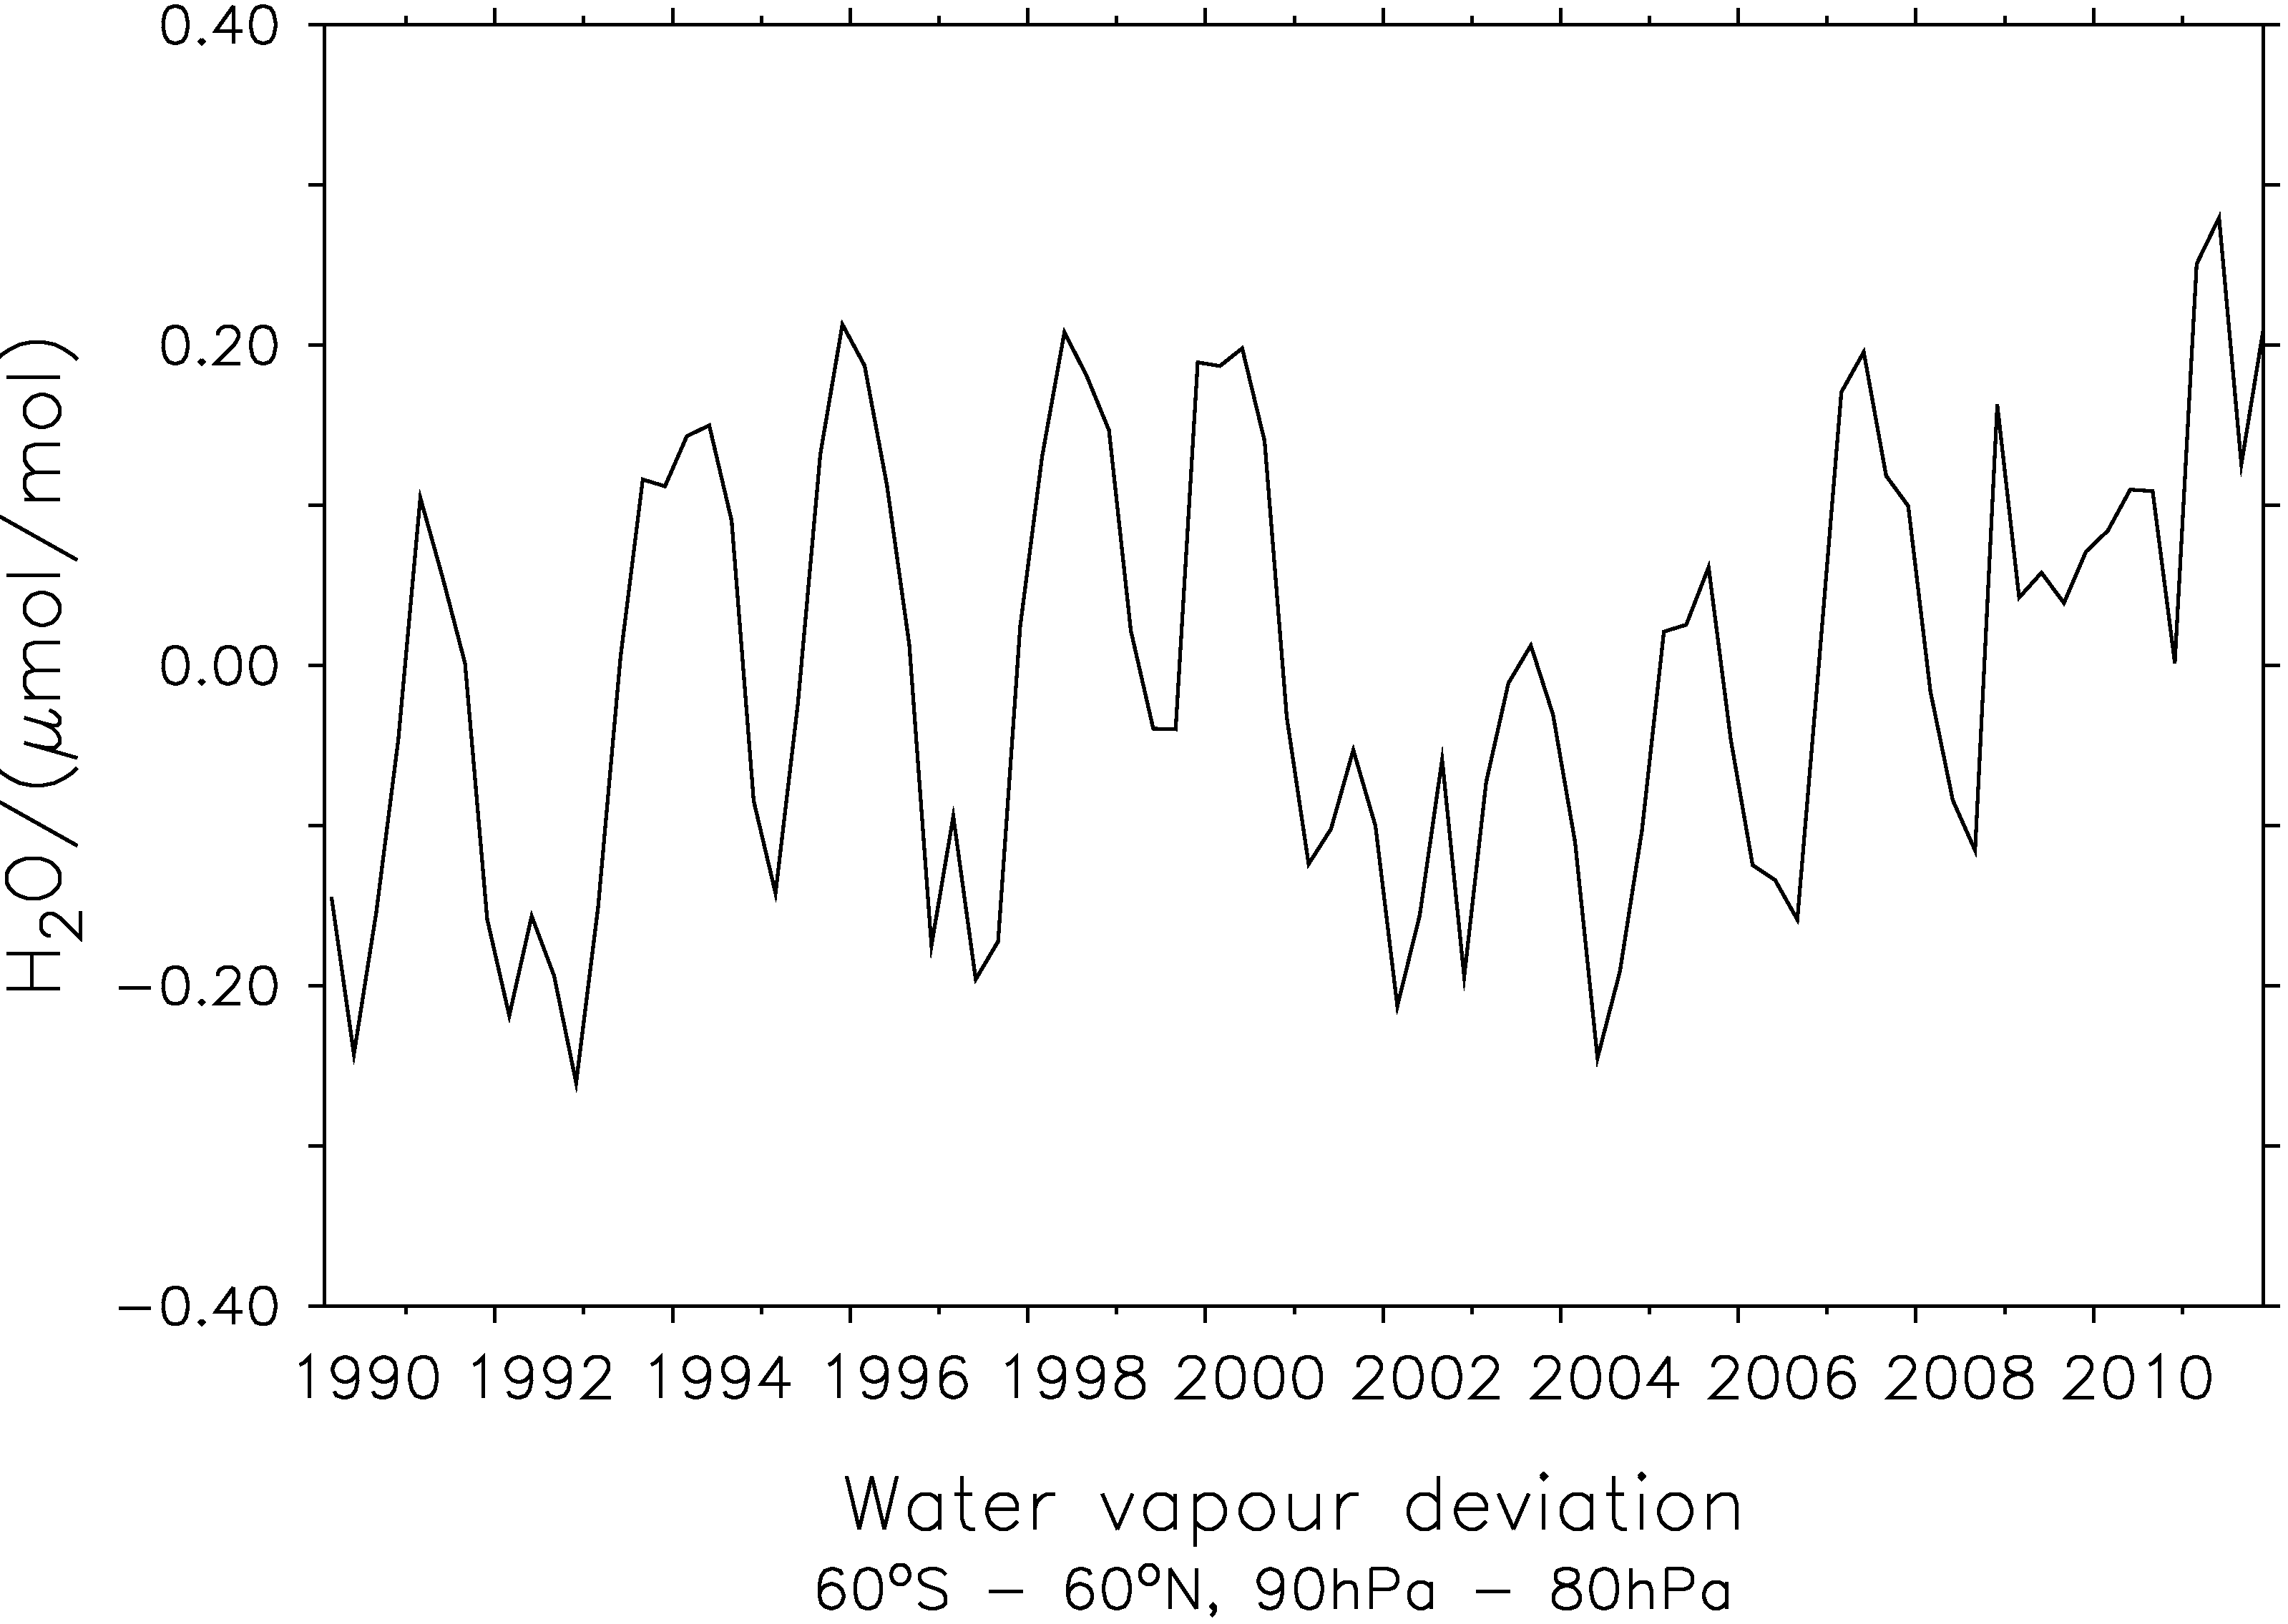
The role of stratospheric water vapour
Numerical model simulations:
Reproduction of observations – evaluation studies
Understanding of changes
Investigation of stratospheric water vapour on climate changes
Assessment of future evolution
“The millennium drop”
Eichinger, Jöckel, Brinkop, Dameris (DLR-IPA)
near global mean, lower stratosphere
Notes:
Die erste (!) Simulation, die den beobachteten millennium drop reproduziert hat. Offenbarer Auslöser war ein starkes Temperatursignal in der tropischen bodennahen Schicht.

Slide 9
Trends in upper tropospheric humidity from
30 years of HIRS data
Several versions of the High-Resolution Infrared Radiation Sounder have flown on NOAA satellites since 1979. The most recent HIRS flies on METOP-A.
Data have been intercalibrated in recent years, such that about 30 years of a nearly homogeneous data time series can be analysed.
Using channels 12 and 6 we have produced a 30 yr dataset of upper tropospheric humidity with respect to ice (UTHi), sofar only for the latitude range 30°-60°N.
A first analysis shows that UTHi increased in many regions significantly from the 1980s to the 2000s.

Slide 10
Statistical significance and causes of trends
The brightness temperatures in both channels, T₆ and T₁₂, have changed as well, but less significantly. (top panel)
It turns out that the significance of the change (mainly increase) in UTHi is caused by an increase mainly in the variance of T₁₂. (middle panel)
Because of the nonlinear relation between T₁₂ and UTHi (Soden and Bretherton, 1993; Jackson and Bates, 2001) a change of T₁₂-variance changes the mean of UTHi even when the mean T₁₂ would stay constant. (bottom panel)
Further analyses of UTHi and supersaturation trens will follow.
(Gierens, Eleftheratos, Lei, submitted)

Slide 11
Climate Data Contributions by the DWD
Provided by Rainer Hollmann, DWD

Slide 12

Available Climate data records from CM SAF
(www.cmsaf.eu, funded jointly from EUMETSAT, Germany, S, CH, NL, B, FI, UK)
Ocean Atmosphere Parameters and Fluxes from Satellite Data (http://dx.doi.org/10.5676/EUM_SAF_CM/HOAPS/V001)
Vertically Integrated Water Vapour from SSM/I (1987-2005) (http://dx.doi.org/10.5676/EUM_SAF_CM/HTW_SSMI/V001)
Geost. Surface Radiation (1982-2005) (http://dx.doi.org/10.5676/EUM_SAF_CM/RAD_MVIRI/V001)
Clouds, Albedo and Radiation dataset from global AVHRR (1982-2009) http://dx.doi.org/10.5676/EUM_SAF_CM/CLARA_AVHRR/V001
Geost. TOA Radiation (2004-2010) (http://dx.doi.org/10.5676/EUM_SAF_CM/TOA_GERB/V001)
FCDR of SSM/I Brightness Temperatures (1987-2008) (http://dx.doi.org/10.5676/EUM_SAF_CM/FCDR_SSMI/V001)
Free Tropospheric Humidity from METEOSAT (1983-2009)
http://dx.doi.org/10.5676/EUM_SAF_CM/FTH_METEOSAT/V001
Vertically integrated water vapour, humidity and temperature from ATOVS (1999-2011)
http://dx.doi.org/10.5676/EUM_SAF_CM/WVT_ATOVS/V001
CLoud property and surface albedo (2004-2011) http://dx.doi.org/10.5676/EUM_SAF_CM/CLAAS/V001
Surface Radiation Daylight Data Set (1982-2011)
http://dx.doi.org/10.5676/EUM_SAF_CM/DAL_MVIRI_SEVIRI/V001

Slide 13
Available Climate data records from DWD
Precipation (GPCC, gpcc.dwd.de):
Global Monthly Land Surface Precipitation
  Centennial data set 1901-2010, resolutions 0.5, 1.0 and 2.5 degrees
  Qualitative error information through station density field
Global Monthly Land Surface Precipitation Watch Product
  Multi-decadal product from 1986 until present, updated monthly
  Qualitative error information and systematic error (under-catch) on same grid
Global Daily Land Surface Precipitation (to be released by end of 2014)
  Bi-Decadal global data set 1988-2008, resolutions, 0.5, 1.0
  Sub-Section data set for Europe on CORDEX grid topology at 0.22 degrees
  Krigging error, standard deviation and station density on same grids
Individual CDRs based on surface (station) observations
Gridded products for Germany (Climate Data Centre, www.dwd.de/cdc)
(1881 – 2013 and other periods); All ECV’s

Slide 14
Thank you for your attention

