Slide 1
WGClimate-22 & GHG-TT-4
WMO Integrated Global Observing Systems (WIGOS) 2050 Vision
S.-A. Boukabara, NASA
Heikki Pohjola, WMO
Agenda Item 8.5

Slide 2
Agenda
Goal of the WIGOS 2050 Vision
Factors Driving the global observing system of the Future
Community Engagement
WIGOS 2050 Vision: Plans & Timeline

Slide 3
Bottom Line Up Front BLUF
- An effort has been kick started (January 23, 2025) to update the WMO Integrated Global Observing System (WIGOS) vision for the 2050 timeframe.
- A representative (but small-enough to be agile) core team was put together by WMO to this end, with the purpose of finalizing the product in 2026.
- The scope will include space- and surface-based components and will envision a global system to measure the Earth, and address WMO-relevant applications
- Many driving factors are expected to influence this vision including technology evolution, applications/users needs, the future landscape of observing systems providers including non-traditional systems and commercial providers, etc.
- This effort is expected to provide the community with a vision that will help coalesce efforts toward a cohesive, complementary global observing system.
- The vision, should be as well-informed and technically accurate as possible, and should inspire the community to design, evolve and deploy a complementary global observing system that addresses the needs of the future, and leverages the emerging opportunities
- To this end, the purpose of this presentation is to inform the community of this effort, and to seek inputs, thoughts, ideas, and other contributions

Slide 4
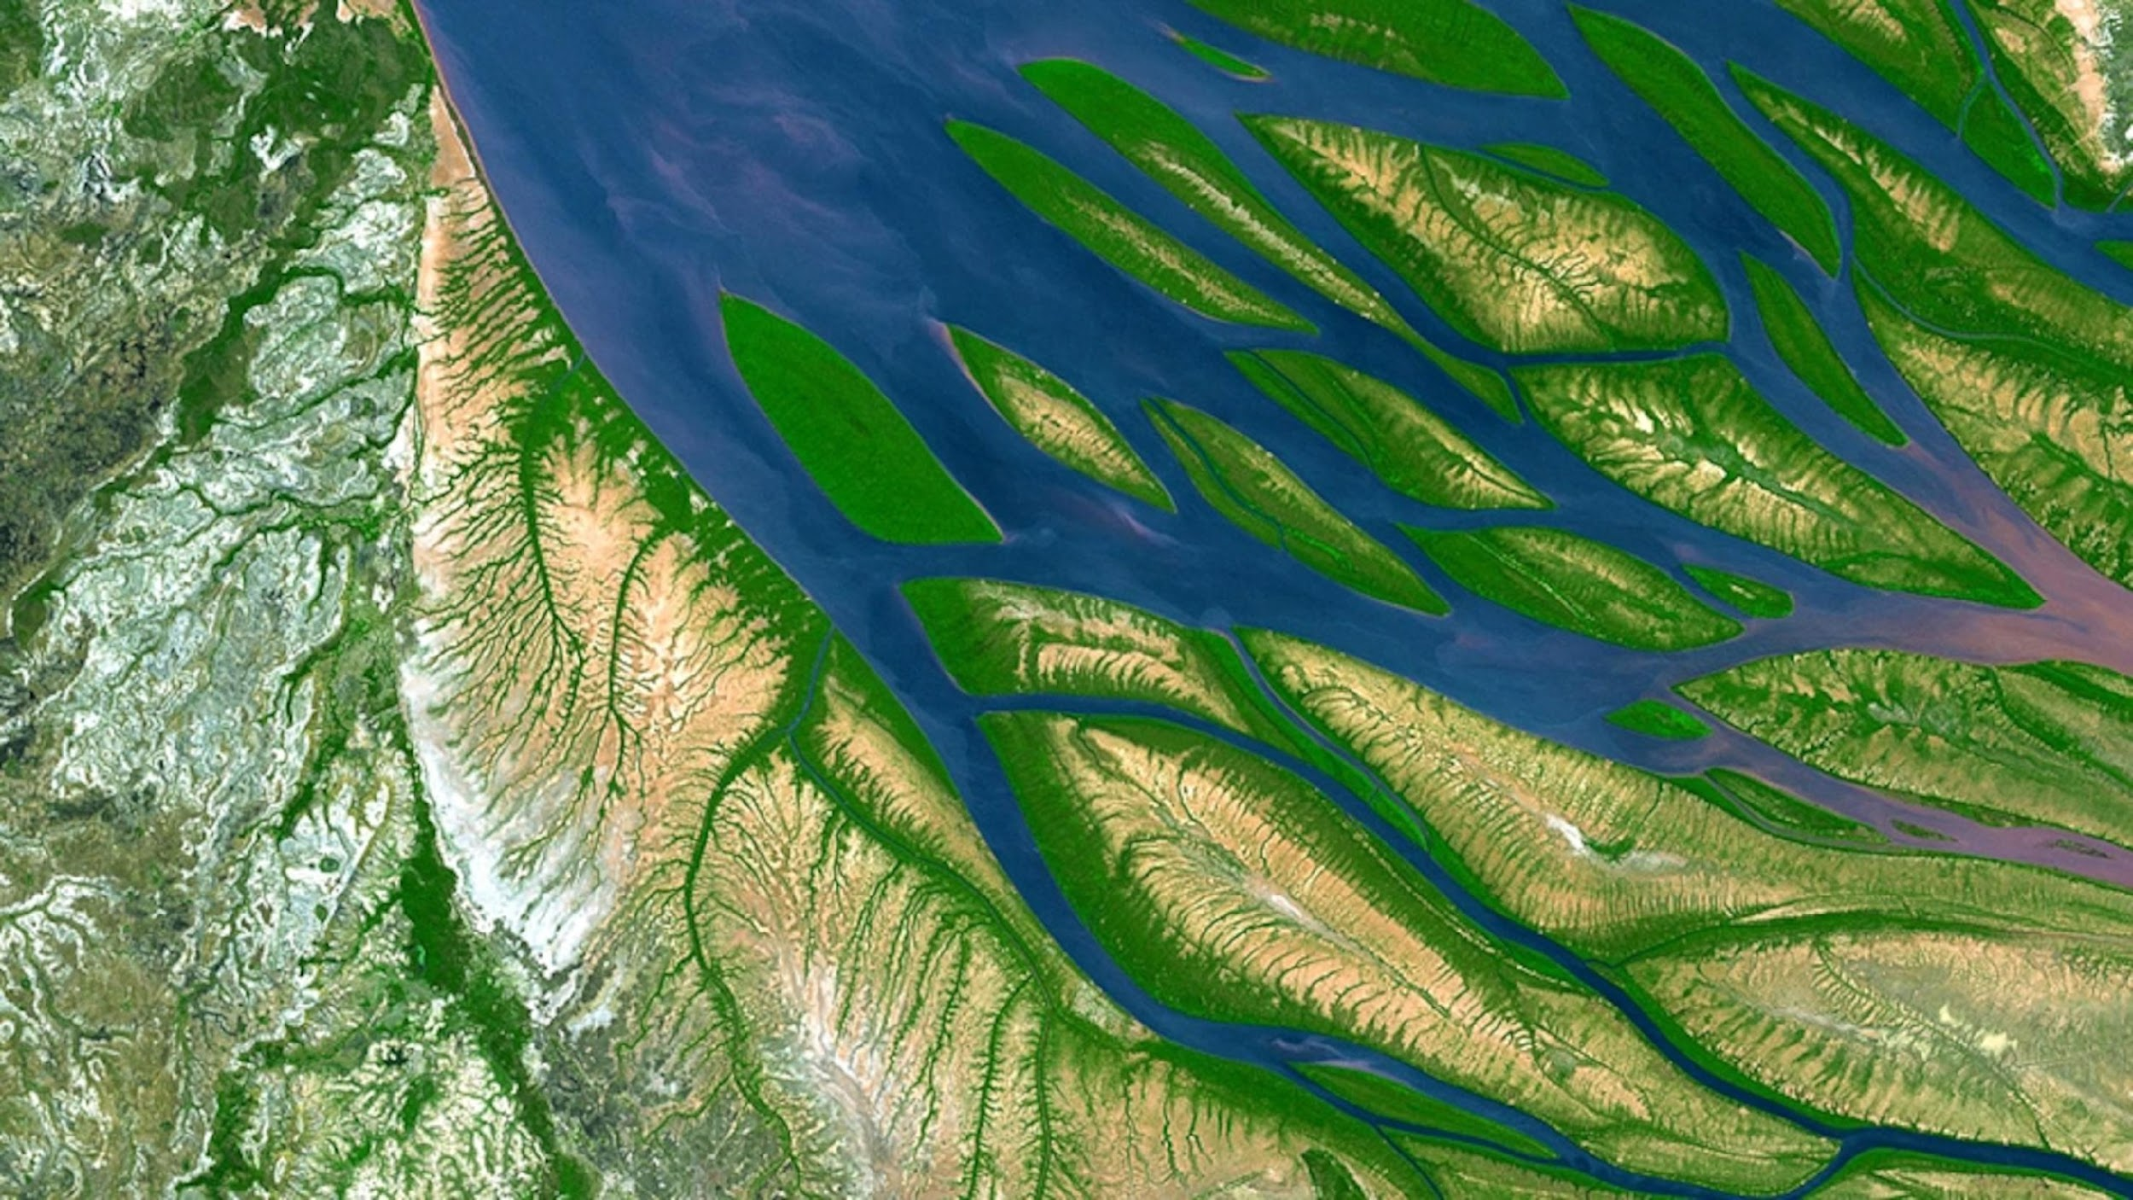
General Goal of the Vision
“The Vision for WIGOS in 2050 presents a likely scenario of how user requirements for observational data may evolve over the next 25 years, and an ambitious, but technically and economically feasible vision for an integrated observing system that will meet them. It provides high-level targets to guide the evolution of the WIGOS in the coming decades. It anticipates a fully developed and implemented WIGOS framework that supports all activities of WMO and its Members within the general areas of weather, climate and water.”
‹#›

Slide 5
How WIGOS 2040 Vision Was Used in the Past
- Helped Connecting Users of Observations (and requirements) with Observing systems owners (space and surface)
- Influenced Space agencies plans (space agencies or through CGMS). Examples: NOAA, EUMETSAT, JAXA, CMA, etc
- Influenced surface observing systems owners in their plans when designing/deploying programs
- Helped applications areas owners (especially GNWP) get gradually ready for future Global observing systems
- Served as a focal topic to facilitate international, regional coordination of observing systems owners (gap analysis)
- Helped trigger innovative observing systems solutions
- 99 publications (Google Scholar) included ‘WIGOS 2040’: variety of applications and obs

Slide 6
Expected Benefits of WIGOS 2050 Vision
- Provide inspiration, motivation to influence design, evolution of the global observing systems in a harmonious way, both space and surface components
- Facilitate discussions between operators and owners of applications to work in an integrated fashion (space-surface, across Earth system domains, …)
- Provide visibility to and trigger potential adoption of new technologies (hardware, data processing, new capabilities, cost-effective solutions, non-traditional observing systems, etc)
- Provide high-level recommendations to the international community on how to perhaps enhance interactions, collaborations, to facilitate the vision.

Slide 7
Drivers for WIGOS Vision update
The major drivers should include, but not exclusively:
  Applications Requirements evolution,
  Technology Evolution and Innovation (H/W, Data, AI, etc)
  Observing systems plans and capabilities (surface and Space)
  Expected evolution of public/private sectors in this field
  Other drivers as deemed relevant by the team
  Evolution of the Importance of Earth Observations to societies

Slide 8
Importance of a Wide Community Engagement and Participation
Three components and purposes to the Engagement:
  Collect technical feedbacks, gaining insight and knowledge to enrich the vision drafting (scientists, users, etc)
  Allow technical review to gain institutional and strategic guidance during drafting
  Conduct formal review by major stakeholders,
This extensive engagement will maximize the chance of:
  The vision being well structured and comprehensive
  The vision being well received by WMO Infrastructure Commission
  The vision being accepted (and being influential) when released to the community

Slide 9
Community Engagement
Inclusive and Balanced Representation:
- Space/Surface balance
- Geographic representation
- Gender balance
- Applications representation
- Institutions representations
Team members are also reps of or familiar with:
CGMS, CEOS, GOOS, WMO, ET-EOSDE, RRR, NWP, NASA, SC-ON, EUMETSAT, SAEON, GBON, JAXA, ET-SSU, BOM, ECMWF, Academia, private sector and non-traditional EO sector
They are also from:
US, Canada, Japan, South Africa, Argentina, Europe, Australia, China, etc
First Circle: Technical Feedbacks
Engage with potential users of the vision (agencies, networks owners, etc) to better understand how this vision could help them in defining, designing, evolving and deciding
WMO-organized WIGOS 2050 Vision workshop
Technical conferences where major users of Observations are represented (ITSC for NWP, IPWG, IROWG, IWWG, AMS (possibly Town Hall, or a presentation), EMS, AGU, AOGS, ESA Living Planet,
CGMS and CEOS working group, strategic implementation team, and plenary sessions.
WMO High-level Consultative Meeting on Satellite Matters.
Technical Conferences where observing systems evolution is discussed (IGARSS, PIERS, ISRSE, NASA Technology Forum, etc.)
WMO Entities (GCOS – GCOS Steering Committee mid 2025 , GAW , G3W – observation workshop , GCW – Space weather -
GOOS event-
Hydrology event-
WMO Core Vision Drafting Team:
Members are expected to reach back to their institutions, communities to collect feedbacks, thoughts and bring it back to the vision drafting
Second Circle: Inclusive and Balanced Review
ET-EOSDE
CGMS
CEOS
GEO
UNESCO/IOC/GOOS
GCOS
GCW
GAW
G3W
WMO Hydrological community
(WMO) Space Weather communities
WMO GBON/RBON/RRR/HLG expert teams and PoCs
UNOOSA
HMEI
Etc

Slide 10
WIGOS Vision 2050 Team
Experts Team:
  Sid Boukabara (WMO/ET-EOSDE/RRR, NWP, NASA, US)
  Shannon Kaya (WMO/SC-ON, Canada)
  Sean Burns (CGMS, EUMETSAT, Europe)
  Mary-Jane Bopape (SAEON, GBON, South Africa)
  Jianxia Guo (GSRN, CMA, China)
  Fiona Smith (WMO ET-SSU chair, Australia)
  Lihang Zhou (WMO ET-SSU co-chair, US)
  Elian Wolfram (Ground Based Network, Argentina)
  Mike Seablom (Office of Technology, NASA, US)
  Tony McNally from ECMWF (NWP, ESP, Europe)
  Osamu Ochiai (CEOS, JAXA, Japan)
  Junhong Wang (WMO SC-MINT, MesoNet, US)
In addition to WMO secretariat:
  Jitsuko Hasegawa
  Albert Fischer
  Natalia Donoho
  Heikki Pohjola
  Mikael Rattenborg

Slide 11
High-Level Timeline for WIGOS Vision update
Scoping: On-going
Drafting/Technical Reviewing
WMO Approval Process
2024
2025
2026
2027
  Scoping by core group
  Stakeholder WS
  Consultations with all stakeholders
  Drafting the update
  Review, finalization, recommendation by INFCOM-4
  Approval by Cg-20
Slide Courtesy WMO

Slide 12
Your Thoughts, Ideas, Feedbacks, stemming from your own perspective, is sought, and is expected to enhance the final product. Your feedback and contribution will be appreciated by WMO and by the WIGOS 2050 Vision Drafting Team. Please reach out.

