Slide 1
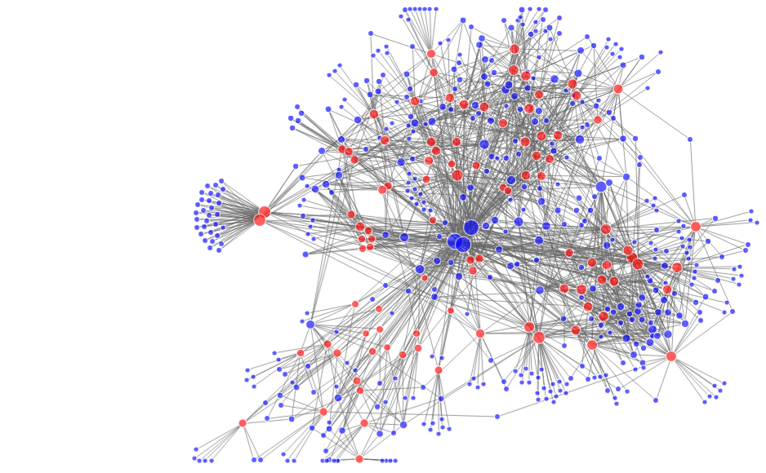
Capacity Development: EOTEC DevNet Climate Change Communities of Practice
Image: Altay Özaygen
Earth Observation Training, Education, and Capacity Development Network
Martyna A. Stelmaszczuk-Górska, EOTEC DevNet Secretariat
February 2025

Slide 2
Objective of today’s presentation:
Show how EOTEC DevNet is strengthening EO capacity building worldwide
Discuss how EOTEC can best support CEOS WGClimate priorities
Invite CEOS members to engage & collaborate
Presentation Overview
What is EOTEC DevNet?
How EOTEC CoPs Work – Example: Floods & Droughts
Discussion – Shaping the Climate Adaptation Working Group
Individual participation (blue dots) in EOTEC regional and thematic meetings (red dots). (Source: Network analysis conducted by Altay Özaygen, Metis Analytica)

Slide 3
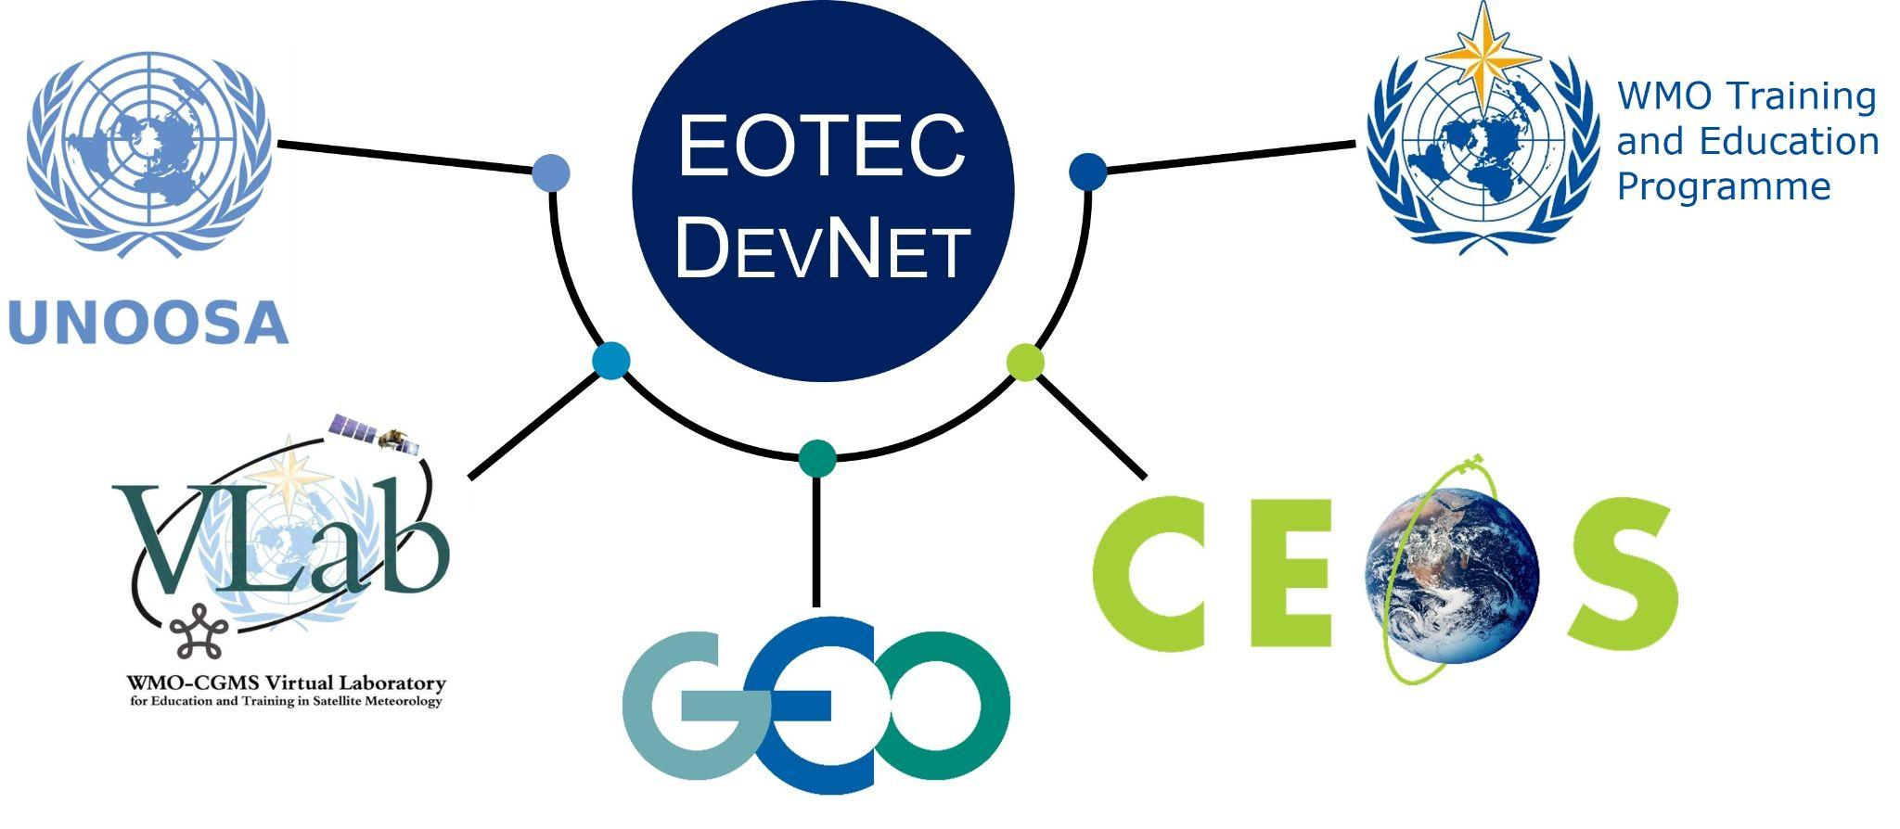
EOTEC DevNet in brief
Promoting collaboration among EO capacity providers
AIMS
Improve collaboration among EO-capacity building providers
Foster exchange of capacity building resources
Reduce duplication
THEMATIC FOCUS
Disaster risk reduction
Climate adaptation and mitigation
eotecdev.net @EOTEC DevNet @EOTECDevNet

Slide 4
EOTEC DevNet in brief
How the network operates
1420 engaged people

Slide 5
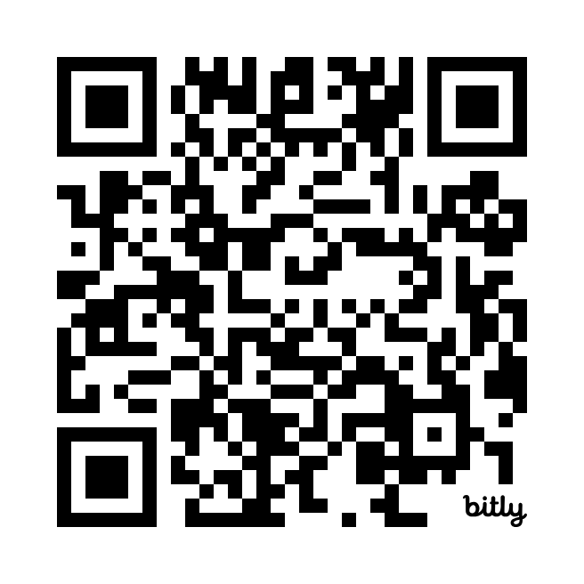
EOTEC DevNet in brief
Engagement in-between meetings: Ways to interact online
Volunteer for an ad hoc team, e.g., to help plan a webinar
secretariat@eotecdev.net
Share an image of the week
https://forms.gle/vBfSfN46wP7ND3936
Connect with global colleagues on our member platform
https://eotecdev.net/connect/
Join our
WhatsApp group
Engage with us on social media
@EOTEC DevNet @EOTECDevNet

Slide 6
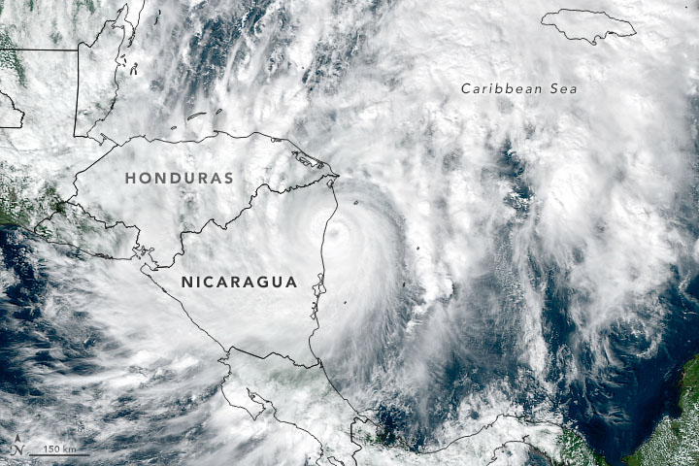
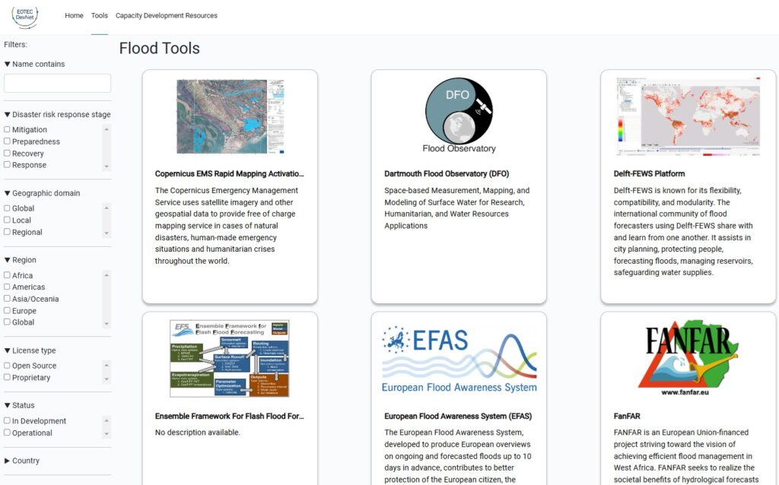
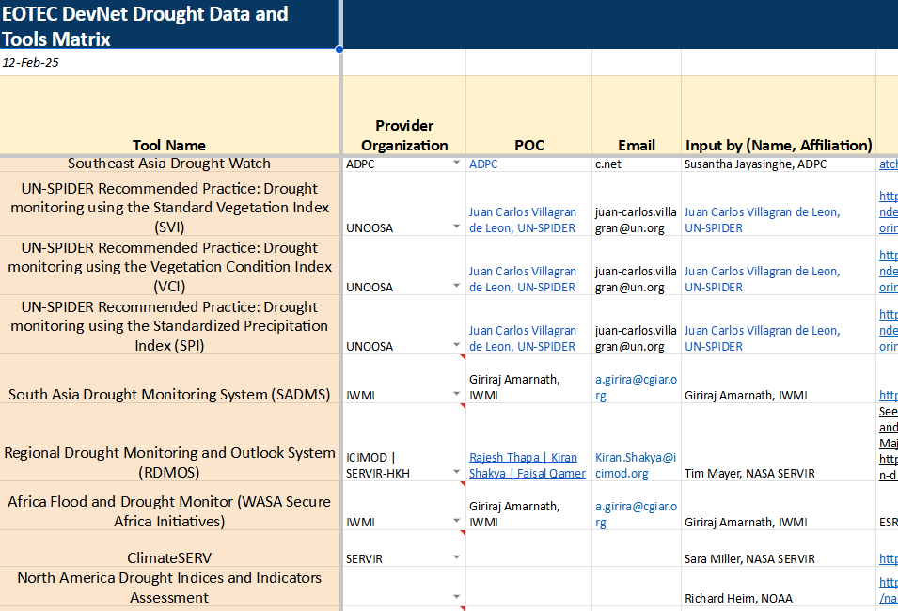
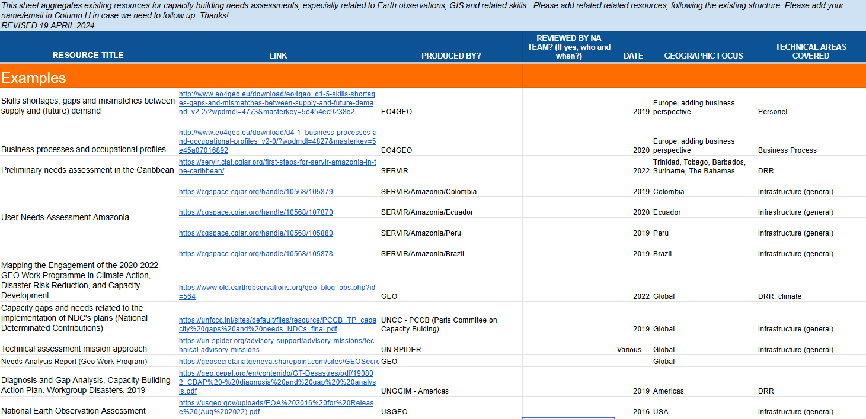
Regional communities of practice drive our work
CoP volunteers collaborate on guidance/tools to make Earth information more accessible
Global case on flood extent tools
Flood tools tracker: https://eotec-dev.ceos.org
Drought Tools Tracker in development
EO Needs Assessment Guidance

Slide 7
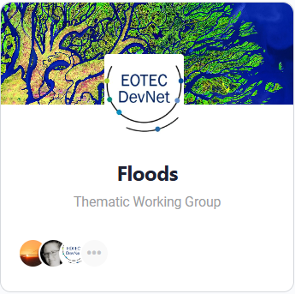
Flood Thematic Working Groups in detail
Identify gaps and set priorities for regional capacity building
Target Group: Flood and Capacity Development Subject Matter Experts
Identify Needs & Engage at Regional Levels: Regional groups led by local experts
Facilitate Collaboration: 46 regional meetings and 1 thematic webinar took place since April 2022, 60+ colleagues actively involved
Collect & Share Resources: Collaborate on the Flood Tools Tracker (35+ flood tools) and regional use cases (6)

Slide 8
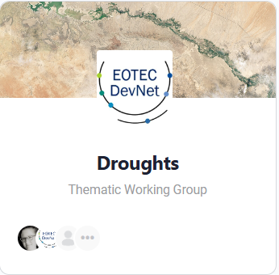
Creating Drought Working Groups Consultation + collaboration to build partnerships and find our niche
Dec 2022/
April 2023
Sep 2023
2024
April/
Oct 2025
2 EOTEC community meetings
Inaugural global meeting
Active partnership
Biannual EOTEC drought WG mtgs
CONSULTATION on capacity building on DROUGHTS
25 participants at two meetings
PARTNERED with UNCCD, IMDP, others
Engaged experts on the DROUGHT TOOLS TRACKER
EOTEC - IDMP Partner
2 JOINT WEBINARS and SIDE EVENT at WMO Drought Resilience +10 event, more work on tracker
EXPERTS come together by region based on priorities set by each task team

Slide 9
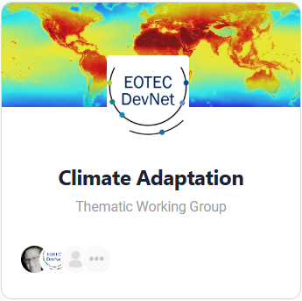
Creating New Working Groups Expanding for the Climate Adaptation and Mitigation Working Groups
How It Could Work:
Connect global & regional climate experts.
Centralize climate adaptation and mitigation resources & training materials.
Facilitate expert discussions & information exchange.

Slide 10
Discussion Shaping the Climate Adaptation and Mitigation Working Group
Discussion Questions:
Key Initiatives & Stakeholders – Who are the critical partners & projects we should engage with?
Pressing Needs – What are the biggest capacity-building gaps in climate adaptation and mitigation?
Defining the Scope – What thematic priorities would provide the most value to stakeholders?

Slide 11
Who are the critical partners & projects we should engage with?
ⓘ Start presenting to display the poll results on this slide.

Slide 12
What are the biggest capacity-building gaps in climate adaptation and mitigation?
ⓘ Start presenting to display the poll results on this slide.

Slide 13
What thematic priorities would provide the most value to stakeholders?
ⓘ Start presenting to display the poll results on this slide.

Slide 14
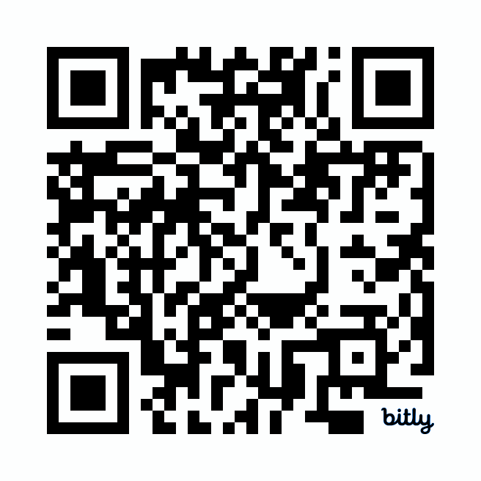
Next Steps & How to Stay Involved
What comes next?
Strengthening collaboration with CEOS WGClimate & key stakeholders.
Gathering insights to shape the climate adaptation and mitigation working groups – Q4 2025 First Global Consultation.
Finalizing the Working Group’s structure & priorities.
Launching the Climate Adaptation and Mitigation Working Groups.
JOIN US!
Visit
www.eotecdev.net
Connect with experts in our online communities

Slide 15
Thank you for your attention!
Earth Observation Training, Education, and Capacity Development Network
eotecdev.net @EOTEC DevNet @EOTECDevNet secretariat@eotecdev.net

